Slide 1
The Gospel of John

Slide 2
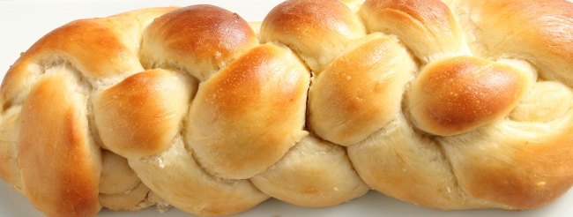
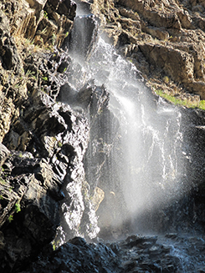
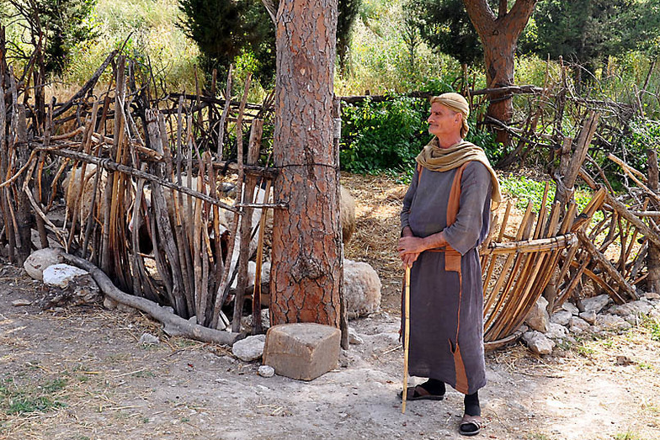
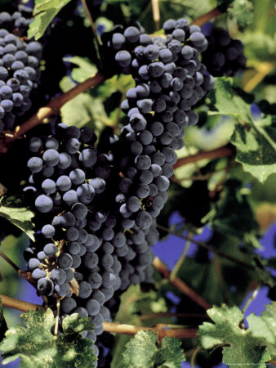
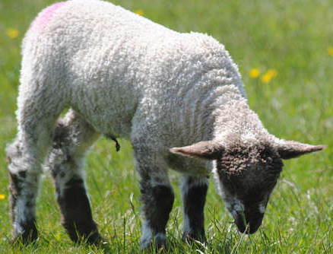

Slide 4
John 20:26-31 After eight days his disciples were again in a house and Thomas was with them. Even though the doors were locked, Jesus entered and stood among them. He said, “Peace be with you.” Then he said to Thomas, “Put your finger here. Look at my hands. Put your hand into my side. No more disbelief. Believe!”

Slide 5
Thomas responded to Jesus, “My Lord and my God!”
Jesus replied, “Do you believe because you see me? Happy are those who don’t see and yet believe.”

Slide 6
Then Jesus did many other miraculous signs in his disciples’ presence, signs that aren’t recorded in this scroll. But these things are written so that you will believe that Jesus is the Christ, God’s Son, and that believing, you will have life in his name. John 20:26-31

Slide 8
“They set out in a boat, but throughout the night they caught nothing.” John 21:3

Slide 9
Jesus called to them, “Children, have you caught anything to eat?” John 21:5-14

Slide 10
John 21:5-14 Jesus called to them, “Children, have you caught anything to eat?” They answered him, “No.”
He said, “Cast your net on the right side of the boat and you will find some.”
So they did, and there were so many fish that they couldn’t haul in the net. Then the disciple whom Jesus loved said to Peter, “It’s the Lord!” When Simon Peter heard it was the Lord, he wrapped his coat around himself (for he was naked) and jumped into the water. The other disciples followed in the boat, dragging the net full of fish, for they weren’t far from shore, only about one hundred yards.

Slide 11
When they landed, they saw a fire there, with fish on it, and some bread. Jesus said to them, “Bring some of the fish that you’ve just caught.” Simon Peter got up and pulled the net to shore. It was full of large fish, one hundred fifty-three of them. Yet the net hadn’t torn, even with so many fish. Jesus said to them, “Come and have breakfast.” None of the disciples could bring themselves to ask him, “Who are you?” They knew it was the Lord. Jesus came, took the bread, and gave it to them. He did the same with the fish. This was now the third time Jesus appeared to his disciples after he was raised from the dead.

Slide 12
When they finished eating, Jesus asked Simon Peter, “Simon son of John, do you love me more than these?”
….
Jesus asked a second time, “Simon son of John, do you love me?”
….
He asked a third time, “Simon son of John, do you love me?” …. John 21:15-17

Slide 13
Simon replied, “Yes, Lord, you know I love you.”
….
Simon replied, “Yes, Lord, you know I love you.”
….
Peter was sad that Jesus asked him a third time, “Do you love me?” He replied, “Lord, you know everything; you know I love you.” John 21:15-17

Slide 14
Jesus said to him, “Feed my lambs.”
Jesus said to him, “Take care of my sheep.”
Jesus said to him, “Feed my sheep.
John 21:15-17

Slide 15
^{John 21:22} Jesus replied, “If I want him to remain until I come, what difference does that make to you? You must follow me.”

Slide 16
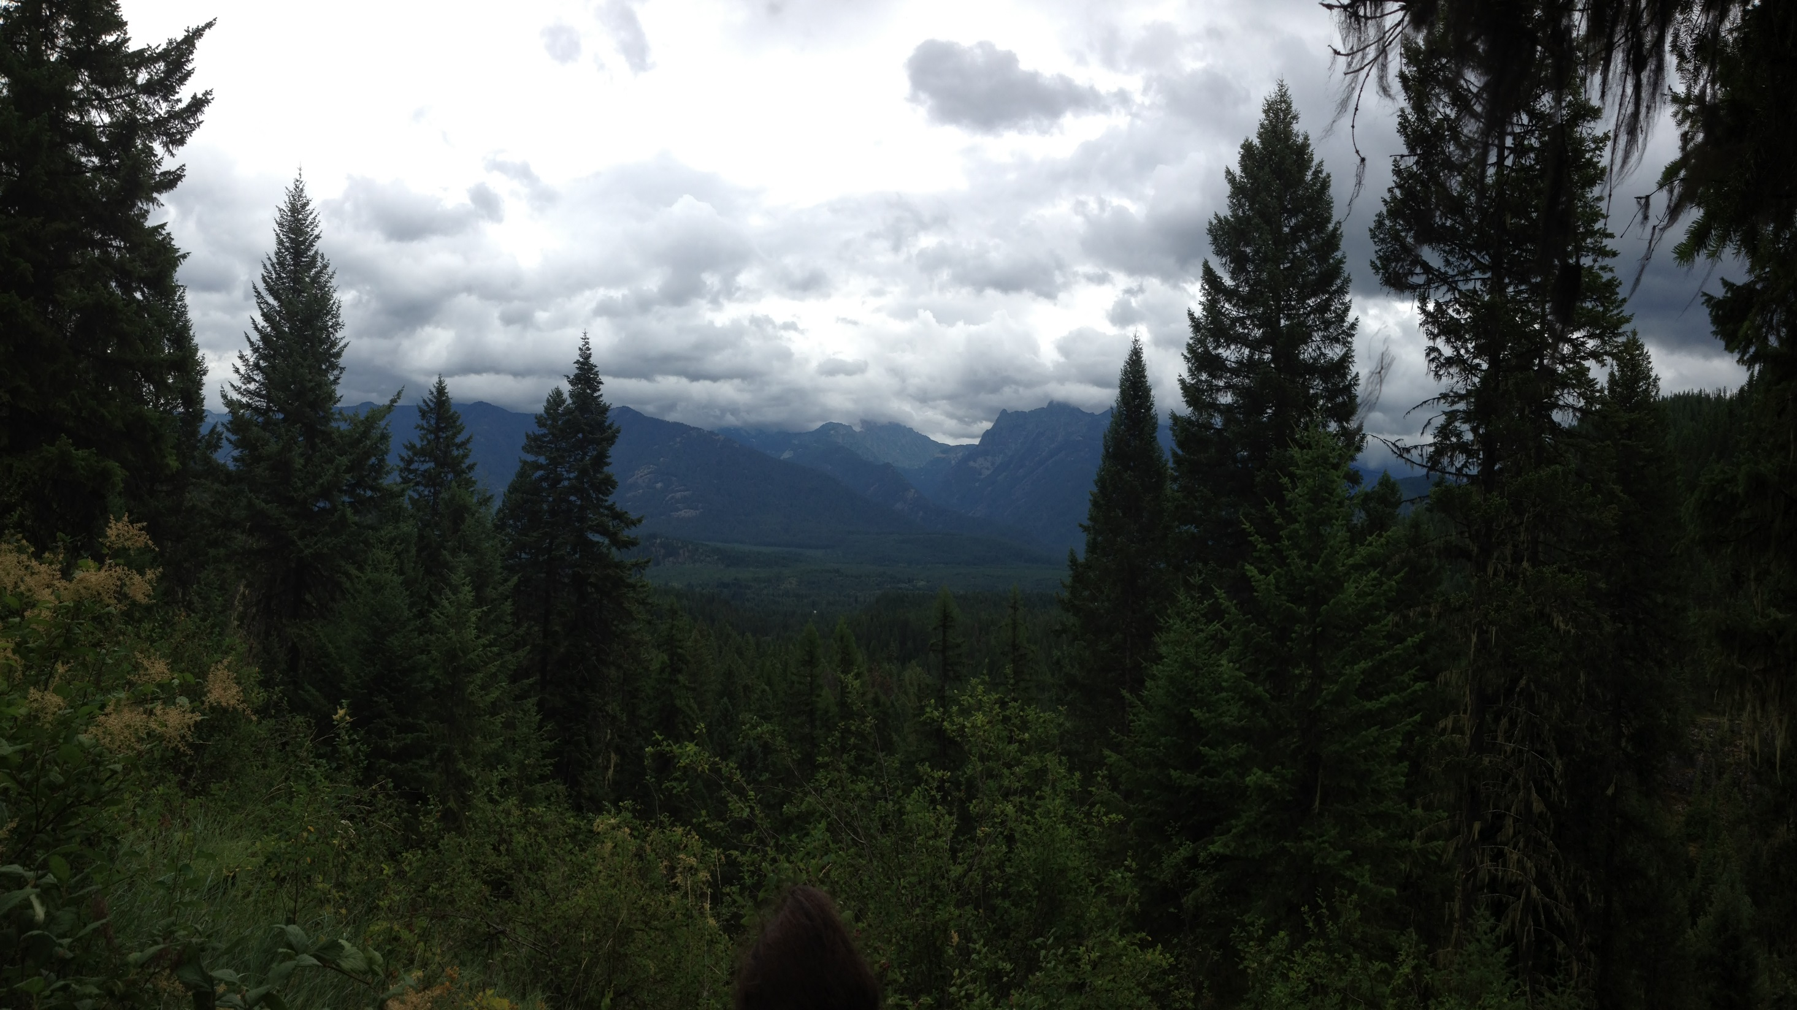
You Have Walked with Me

