Slide 1
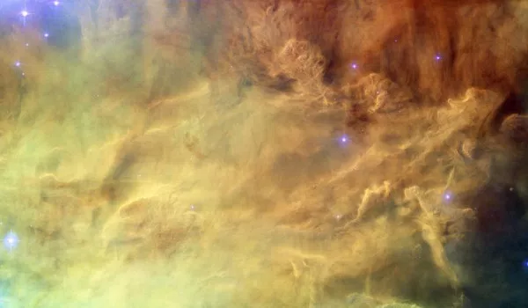
Easter 2017

Slide 2
For you are dust,
And to dust you shall return.
Genesis 3:19
)

Slide 3
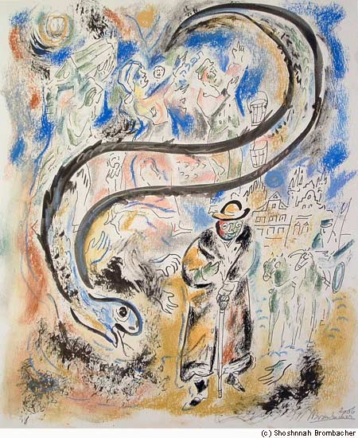

Slide 4
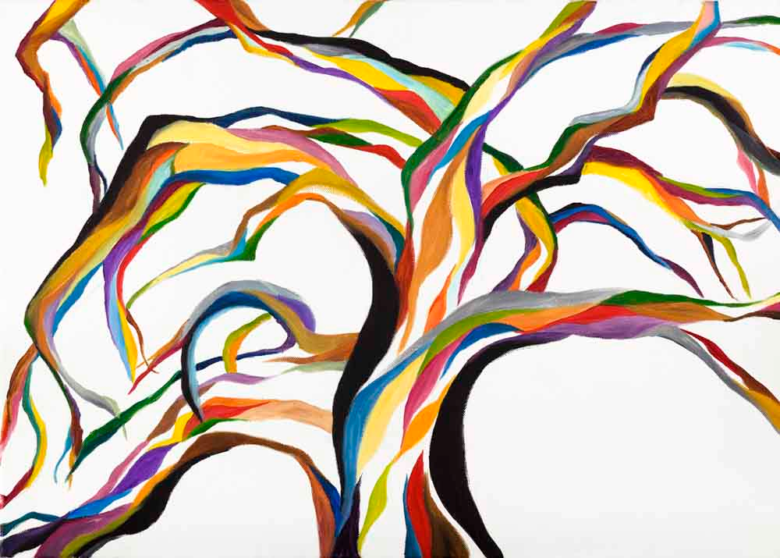

Slide 5
A legal expert stood up to test Jesus. “Teacher,” he said, “what must I do to gain eternal life?”
Jesus replied, “What is written in the Law? How do you interpret it?”
He responded, “You must love the Lord your God with all your heart, with all your being, with all your strength, and with all your mind, and love your neighbor as yourself.”

Slide 6
Jesus said to him, “You have answered correctly. Do this and you will live.”
But the legal expert wanted to prove that he was right, so he said to Jesus, “And who is my neighbor?”
Luke 10:25-29

Slide 7
As Jesus continued down the road, a man ran up, knelt before him, and asked, “Good Teacher, what must I do to obtain eternal life?”
Jesus replied, “Why do you call me good? No one is good except the one God. You know the commandments: Don’t commit murder. Don’t commit adultery. Don’t steal. Don’t give false testimony. Don’t cheat. Honor your father and mother.”
“Teacher,” he responded, “I’ve kept all of these things since I was a boy.”
Jesus looked at him carefully and loved him.

Slide 8
He said, “You are lacking one thing. Go, sell what you own, and give the money to the poor. Then you will have treasure in heaven. And come, follow me.” But the man was dismayed at this statement and went away saddened, because he had many possessions.
Mark 10:17-22

Slide 9
When Jesus finished saying these things, he looked up to heaven and said, “Father, the time has come. Glorify your Son, so that the Son can glorify you. You gave him authority over everyone so that he could give eternal life to everyone you gave him. This is eternal life: to know you, the only true God, and Jesus the Messiah whom you sent. I have glorified you on earth by finishing the work you gave me to do. Now, Father, glorify me in your presence with the glory I shared with you before the world was created. John 17:1-4

Slide 10
After eight days his disciples were again in a house and Thomas was with them. Even though the doors were locked, Jesus entered and stood among them. He said, “Peace be with you.” Then he said to Thomas, “Put your finger here. Look at my hands. Put your hand into my side. No more disbelief. Believe!”
Thomas responded to Jesus, “My Lord and my God!”

Slide 11
Jesus replied, “Do you believe because you see me? Happy are those who don’t see and yet believe.”
Then Jesus did many other miraculous signs in his disciples’ presence, signs that aren’t recorded in this scroll. But these things are written so that you will believe that Jesus is the Messiah, God’s Son, and that believing, you will have life in his name. John 20:26-31

