Slide 1
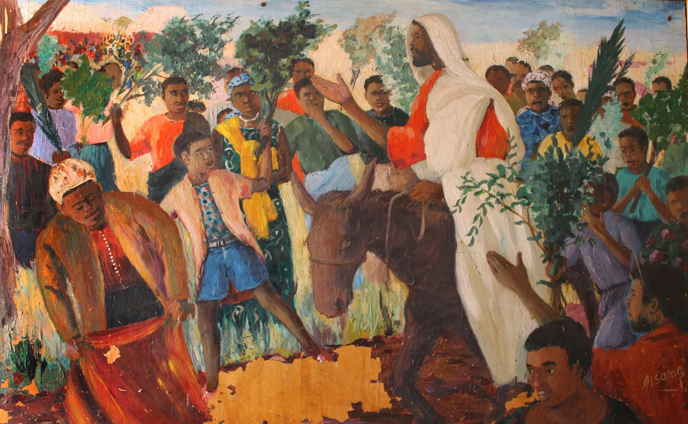
What kind of King is Jesus?

Slide 2
Shalom
“universal flourishing, wholeness, delight”
“the way things ought to be”

Slide 4
What kind of King is Jesus?

Slide 5
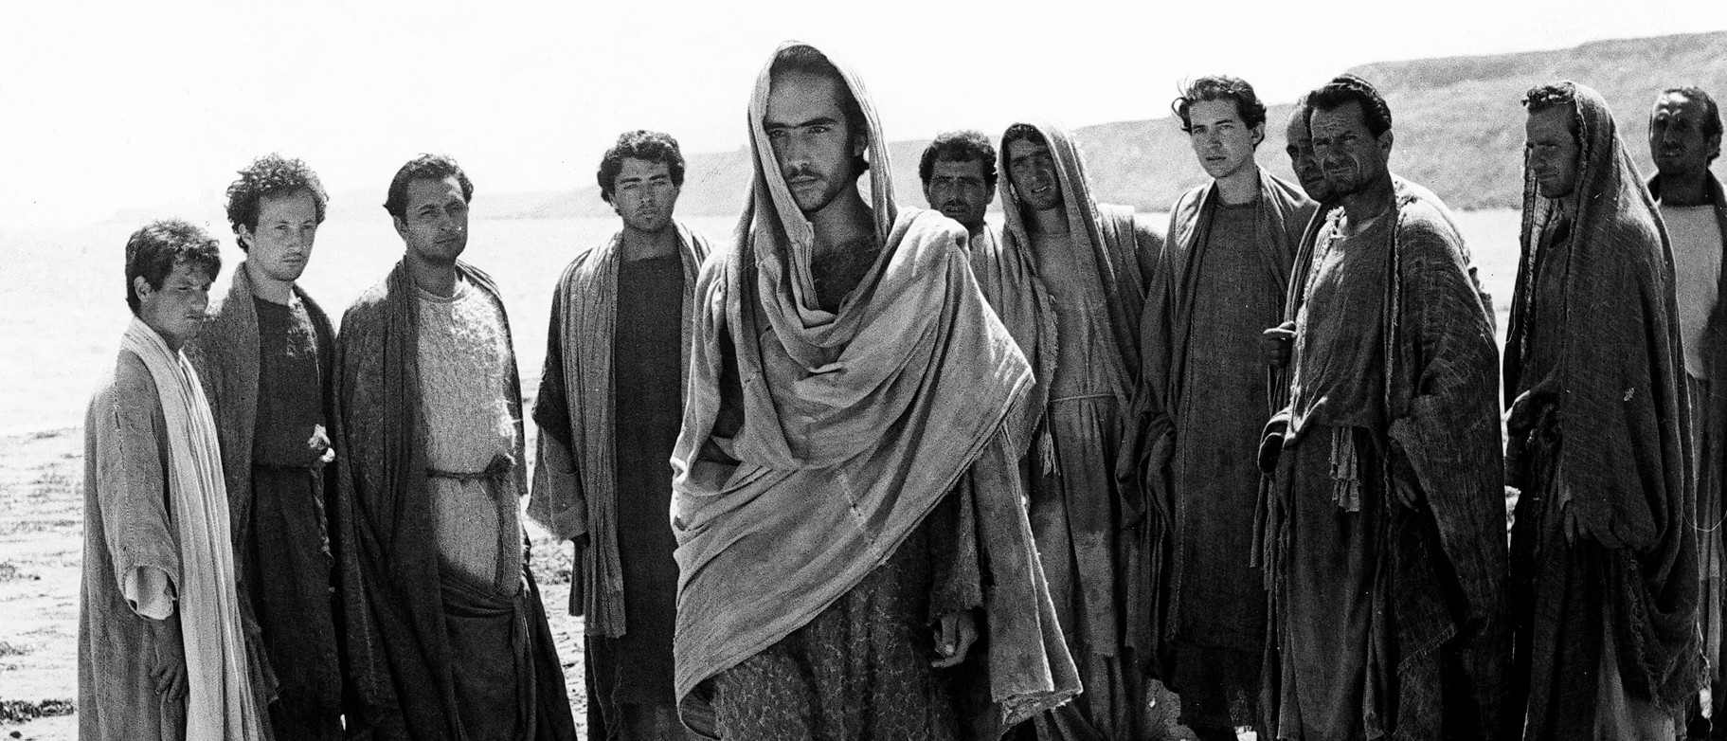
Gospel According to St. Matthew (1964)
Piero Paolo Pasolini, director

Slide 7
Luke 9:51
“When the days drew near for him to be taken up, he set his face to go to Jerusalem.”

Slide 8
Gospel of Luke
1
4
9
24
Birth
Early ministry
Journey to Jerusalem & Cross

Slide 9
13:22
“Jesus went through one town and village after another, teaching as he made his way to Jerusalem.”
17:11
“On the way to Jerusalem Jesus was going through the region between Samaria and Galilee”
18:31
“‘See, we are going up to Jerusalem, and everything that is written about the Son of Man by the prophets will be accomplished.’”

Slide 11
Luke 19:38
“‘Blessed is the king who comes in the name of the Lord! Peace in heaven, and glory in the highest heaven!’”

Slide 12
What kind of King is Jesus?

Slide 13
Luke 19:39-40
“Some of the Pharisees in the crowd said to him, ‘Teacher, order your disciples to stop.’ He answered, ‘I tell you, if these were silent, the stones would shout out.’

Slide 14
What kind of King is Jesus?

Slide 15
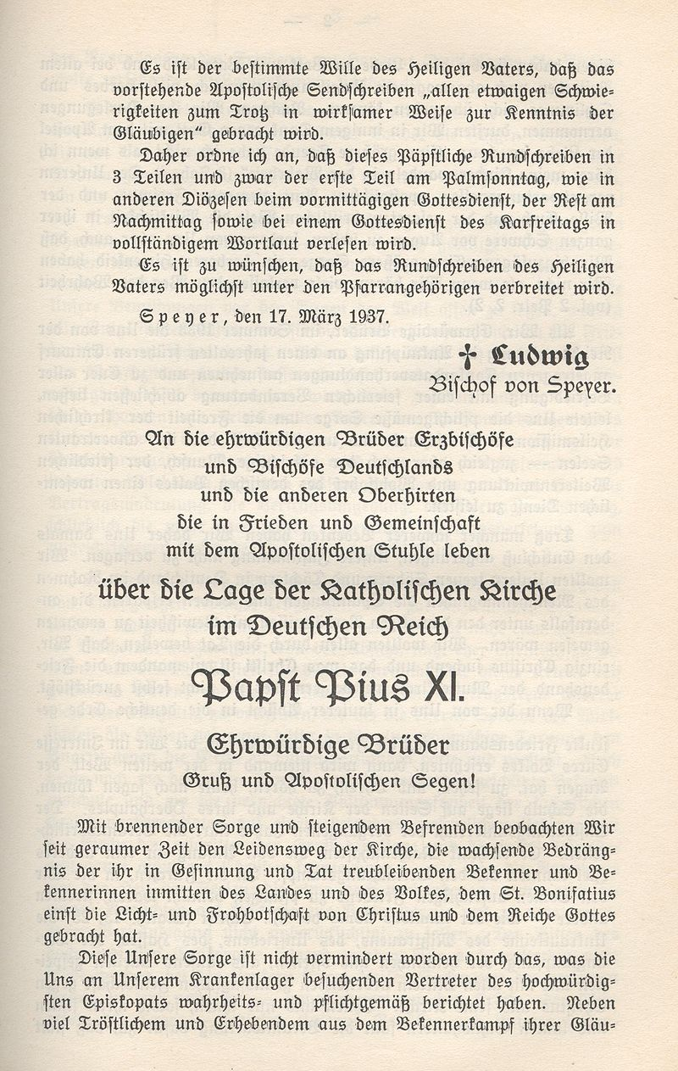
Mit brennender Sorge (Palm Sunday, 1937)

