Slide 2
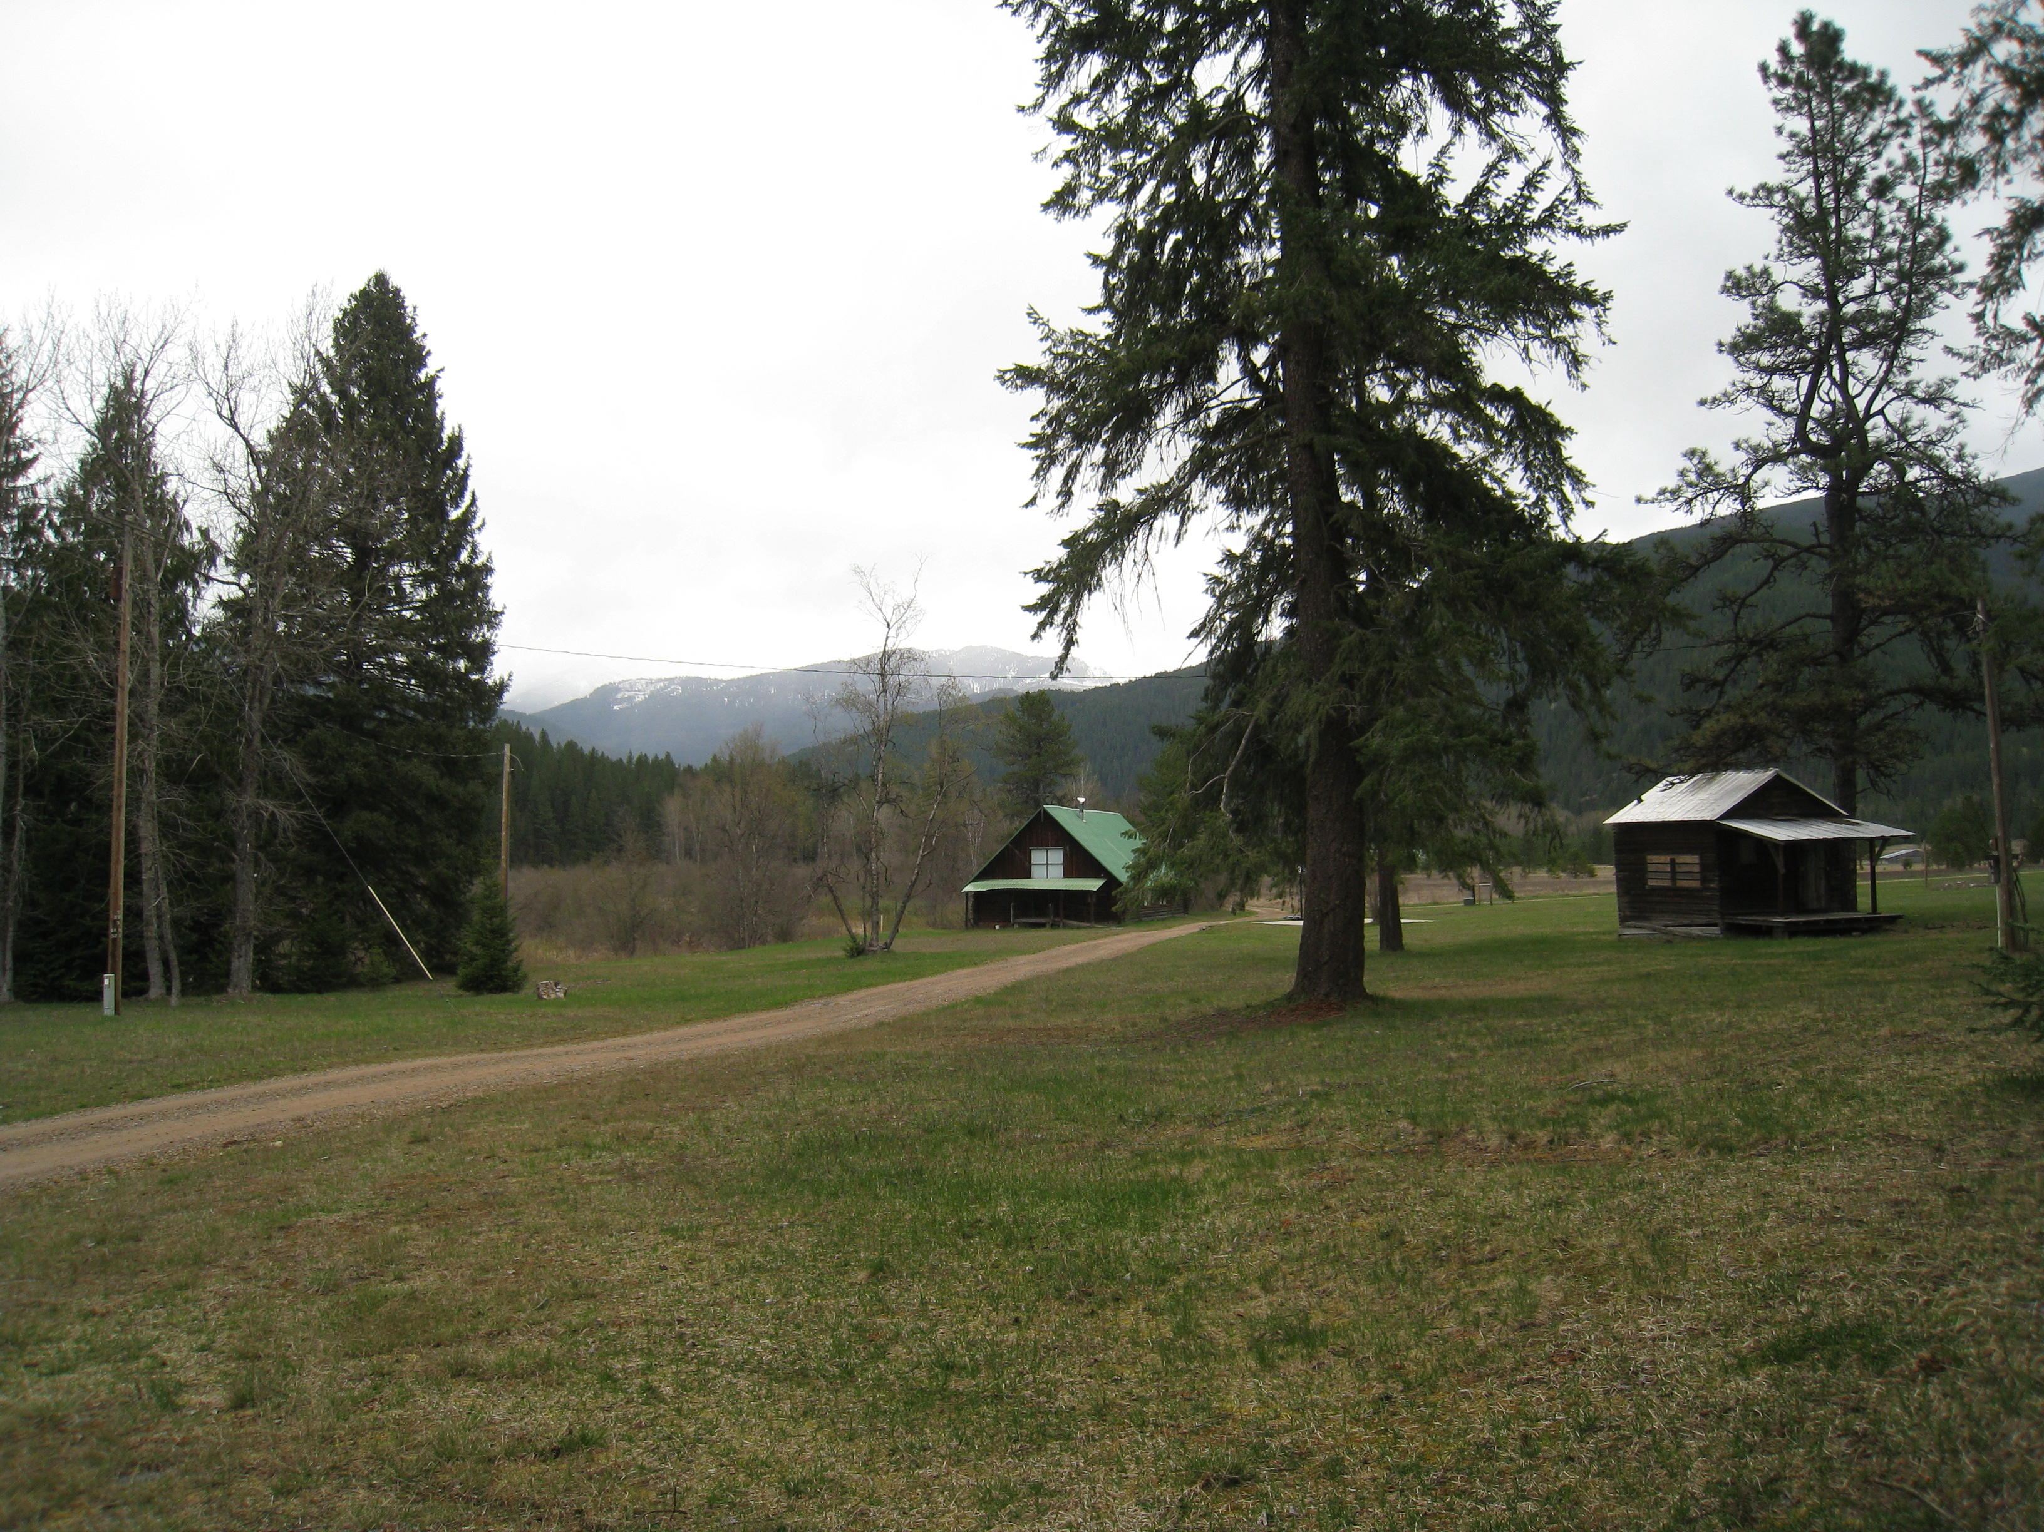
Pentecost
Solid Rock Church
Bull River, Montana

Slide 3
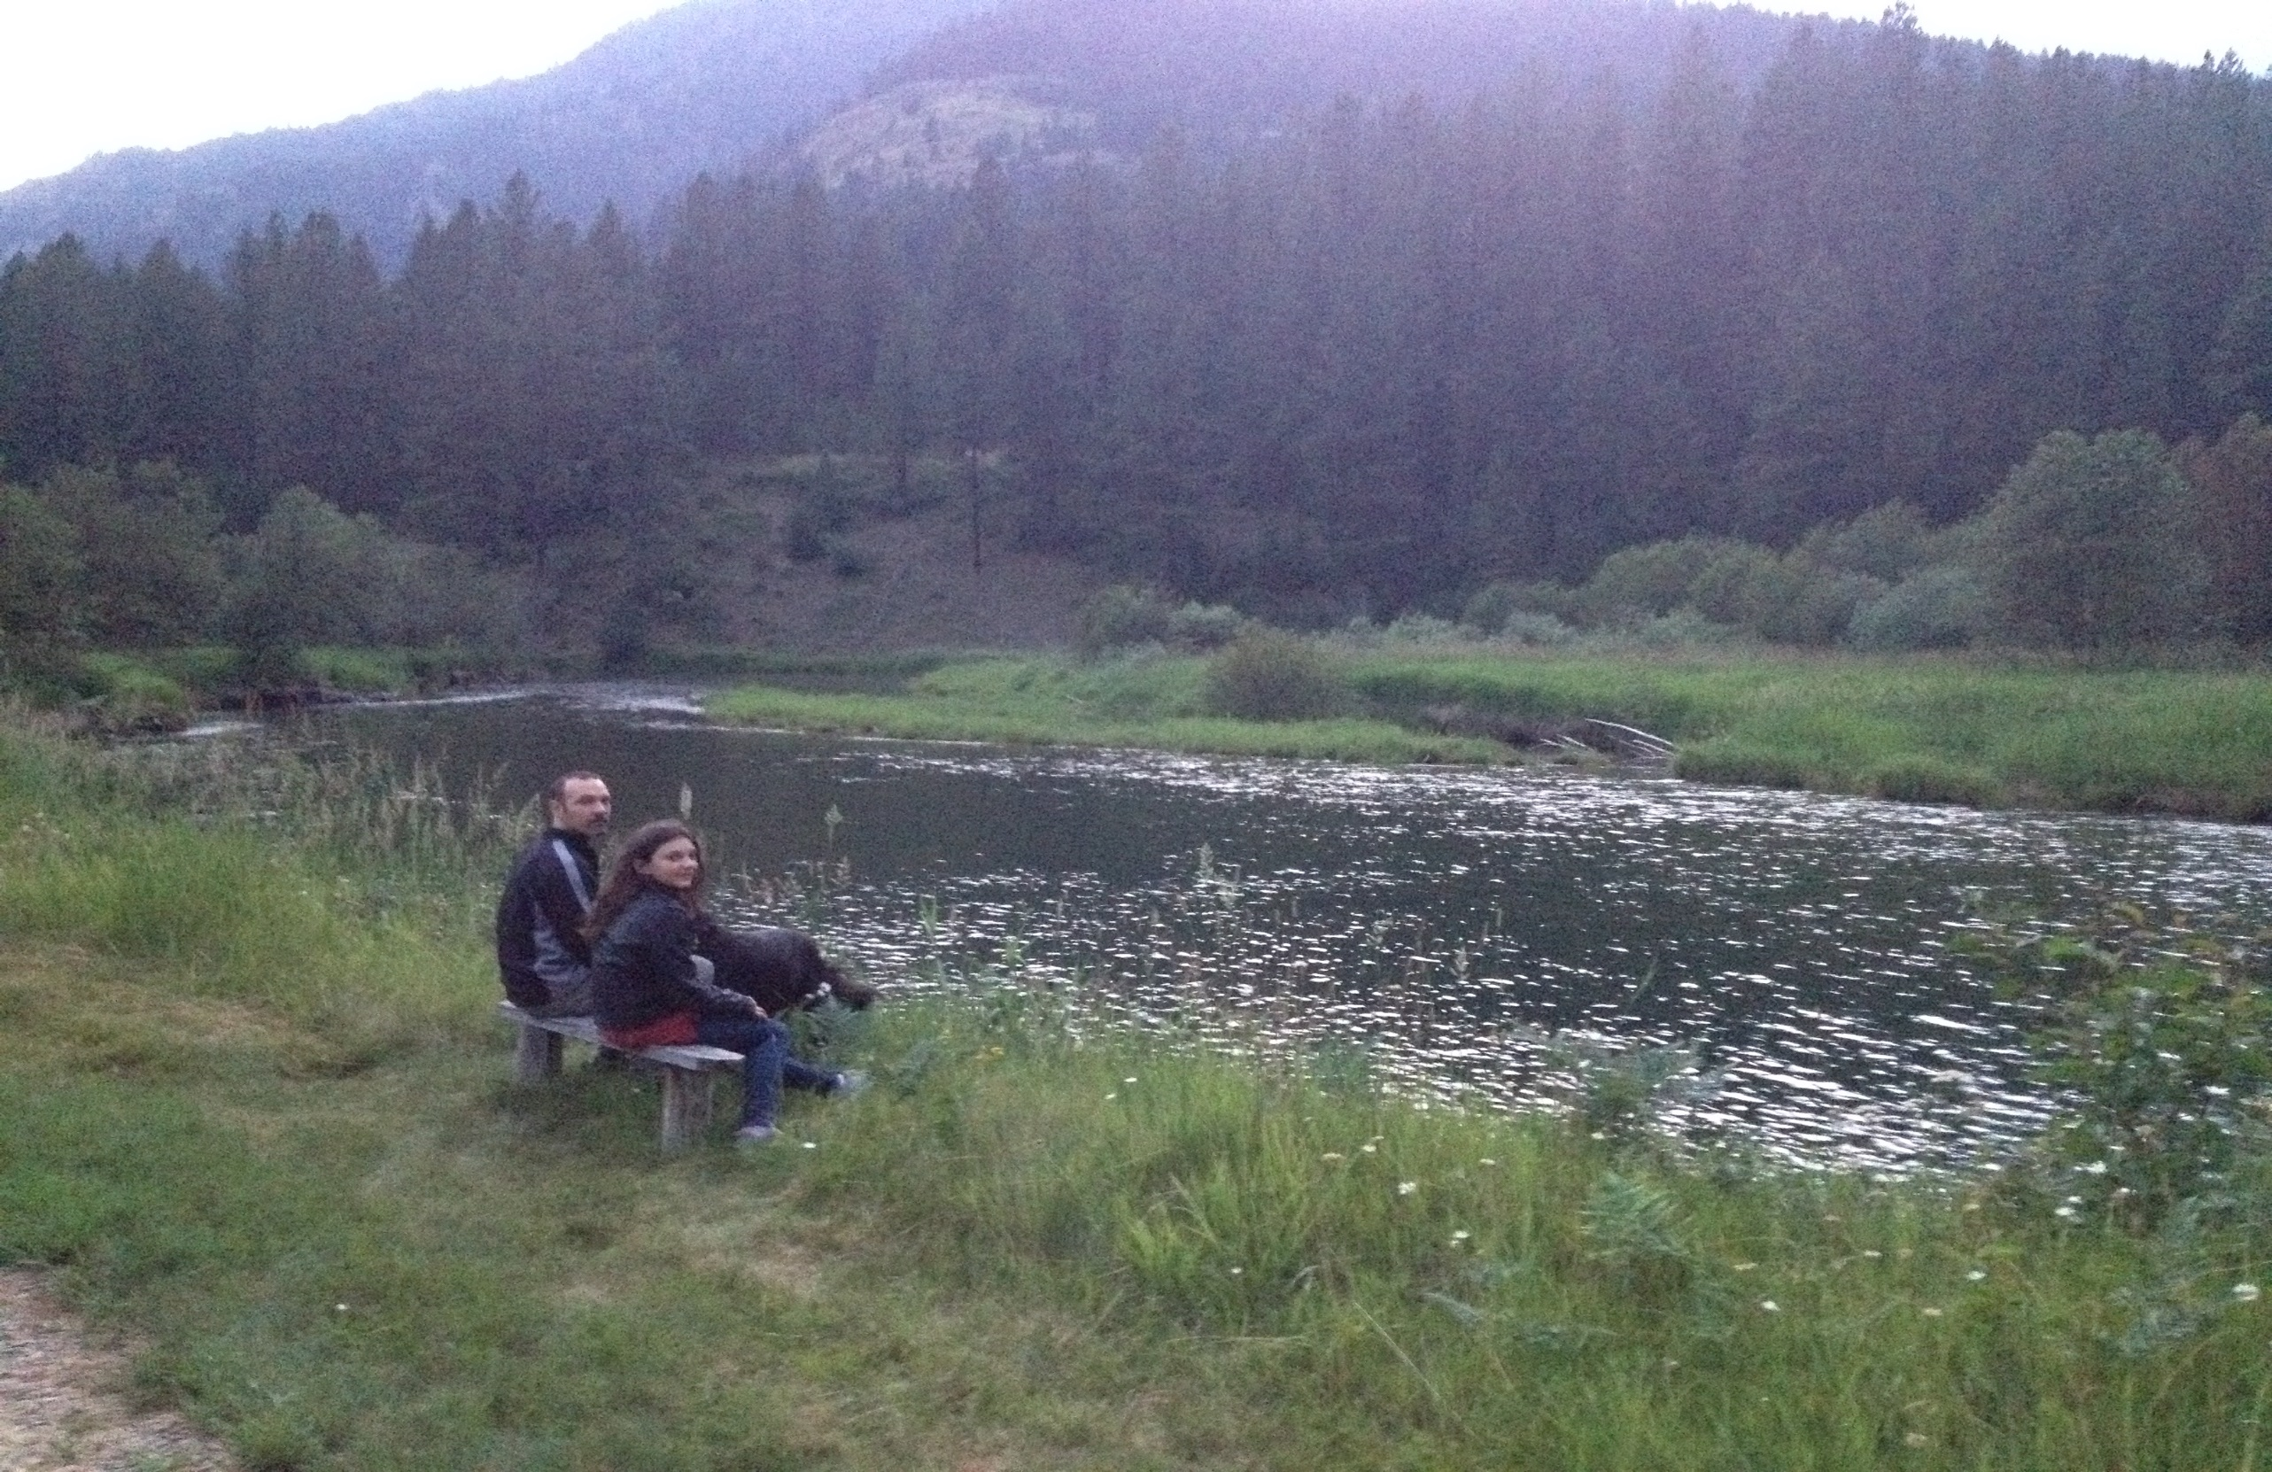

Slide 4
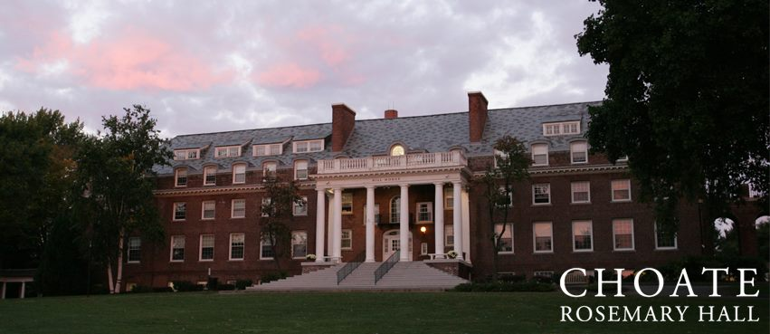

Slide 5
Acts 1: 1-5 NIV
In my former book, Theophilus, I wrote about all that Jesus began to do and to teach until the day he was taken up to heaven, after giving instructions through the Holy Spirit to the apostles he had chosen. After his suffering, he presented himself to them and gave many convincing proofs that he was alive. He appeared to them over a period of forty days and spoke about the kingdom of God. On one occasion, while he was eating with them, he gave them this command: “Do not leave Jerusalem, but wait for the gift my Father promised, which you have heard me speak about. For John baptized with water, but in a few days you will be baptized with the Holy Spirit.”

Slide 6
Joel 2:27-29
You will know that I am in the midst of Israel,
and that I am the Lord your God—no other exists;
never again will my people be put to shame.
After that I will pour out my spirit upon everyone;
your sons and your daughters will prophesy,
your old men will dream dreams,
and your young men will see visions.
In those days, I will also pour out my
spirit on the male and female slaves.

Slide 7
Acts 2: 1-4 (NIV) When the day of Pentecost came, they were all together in one place. Suddenly a sound like the blowing of a violent wind came from heaven and filled the whole house where they were sitting. They saw what seemed to be tongues of fire that separated and came to rest on each of them. All of them were filled with the Holy Spirit and began to speak in other tongues as the Spirit enabled them.
Acts 2: 1-4 (NIV) When the day of Pentecost came, they were all together in one place. Suddenly a sound like the blowing of a violent wind came from heaven and filled the whole house where they were sitting. They saw what seemed to be tongues of fire that separated and came to rest on each of them. All of them were filled with the Holy Spirit and began to speak in other tongues as the Spirit enabled them.

Slide 8
Shavu'os, the Festival of Weeks, is the second of the three major festivals with both historical and agricultural significance (the other two are Passover and Sukkot). Agriculturally, it commemorates the time when the first fruits were harvested and brought to the Temple, and is known as Hag ha-Bikkurim (the Festival of the First Fruits). Historically, it celebrates the giving of the Torah at Mount Sinai, and is also known as Hag Matan Torateinu (the Festival of the Giving of Our Torah).

Slide 9
The period from Passover to Shavu'os is a time of great anticipation. We count each of the days from the second day of Passover to the day before Shavu'os, 49 days or 7 full weeks, hence the name of the festival. (See The Counting of the Omer.) The counting reminds us of the important connection between Passover and Shavu'os: Passover freed us physically from bondage, but the giving of the Torah on Shavu'os redeemed us spiritually from our bondage to idolatry and immorality. Shavu'os is also known as Pentecost, because it falls on the 50th day;

Slide 10
Leviticus 23: 15-17 “‘From the day after the day of rest — that is, from the day you bring the sheaf for waving — you are to count seven full weeks, until the day after the seventh week; you are to count fifty days; and then you are to present a new grain offering to Adonai. You must bring bread from your homes for waving — two loaves made with one gallon of fine flour, baked with leaven — as firstfruits for Adonai.
Deuteronomy 16: 9-10 “You are to count seven weeks; you are to begin counting seven weeks from the time you first put your sickle to the standing grain. You are to observe the festival of Shavu‘os [weeks] for Adonai your God with a voluntary offering, which you are to give in accordance with the degree to which Adonai your God has prospered you.
(Complete Jewish Bible)

Slide 11
Tonight Erev Shabbos we come to the end of the Omer Count and we count: Today is, The Forty Ninth Day, which is Seven Weeks Days in the Omer. 5th of Sivan,
Blessed are You HASHEM, King of the Universe who has made us holy through His commandments and commanded us about the counting of the Omer.
"Today is: The Forty Ninth Day, which is Seven Weeks in the Omer. Sovereignty in Sovereignty"

Slide 12
Matthew 9:37-38 Then he said to his disciples, “The harvest is plentiful but the workers are few. Ask the Lord of the harvest, therefore, to send out workers into his harvest field.”
Matthew 28: 19-20 Therefore go and make disciples of all nations, baptizing them in the name of the Father and of the Son and of the Holy Spirit, and teaching them to obey everything I have commanded you. And surely I am with you always, to the very end of the age.”

Slide 13
Passover freed us physically from bondage, but the giving of the Torah on Shavu'os redeemed us spiritually from our bondage to idolatry and immorality. It is noteworthy that the holiday is called the time of the giving of the Torah, rather than the time of the receiving of the Torah. The sages point out that we are constantly in the process of receiving the Torah, that we receive it every day, but it was first given at this time. Thus it is the giving, not the receiving, that makes this holiday significant.

Slide 14
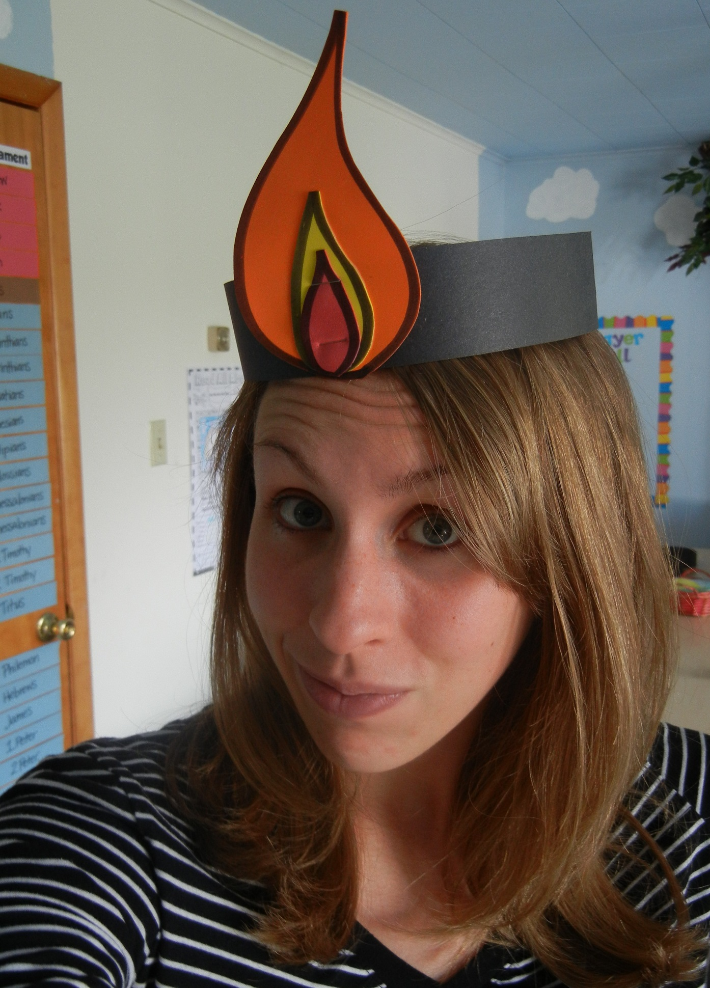
Pentecost crafts and cupcakes!

Slide 15
Luke 11:11-13 Complete Jewish Bible (CJB)
“Is there any father here who, if his son asked him for a fish, would instead of a fish give him a snake? or if he asked for an egg would give him a scorpion? So if you, even though you are bad, know how to give your children gifts that are good, how much more will the Father keep giving the Ruach HaKodesh from heaven to those who keep asking him!”

Slide 16
1 Corinthians 12: 7-11 (NIRV)
The Holy Spirit is given to each of us in a special way. That is for the good of all. To some people the Spirit gives a message of wisdom. To others the same Spirit gives a message of knowledge. To others the same Spirit gives faith. To others that one Spirit gives gifts of healing. To others he gives the power to do miracles. To others he gives the ability to prophesy. To others he gives the ability to tell the spirits apart. To others he gives the ability to speak in different kinds of languages they had not known before. And to still others he gives the ability to explain what was said in those languages. All the gifts are produced by one and the same Spirit. He gives gifts to each person, just as he decides.

Slide 18
Benediction
Father God, we know that all good gifts come from you.
You have promised the gift of the Holy Spirit to be poured out on everyone.
As your son Jesus taught, let us keep asking for the Holy Spirit to be the nourishment that empowers us each day.
Amen.

