Slide 1
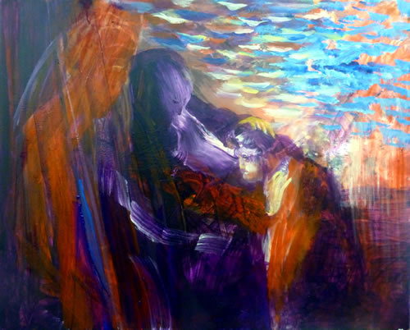

Slide 2
“Go to my land and my family and find a wife for my son Isaac there.”
The servant said to him, “What if the woman doesn’t agree to come back with me to this land? Shouldn’t I take your son back to the land you left?”

Slide 3
Abraham said to him, “Be sure you don’t take my son back there. The Lord, God of heaven—who took me from my father’s household and from my family’s land, who spoke with me and who gave me his word, saying, ‘I will give this land to your descendants’—he will send his messenger in front of you, and you will find a wife for my son there. If the woman won’t agree to come back with you, you will be free from this obligation to me. Only don’t take my son back there.” Genesis 24:4-5 (CEB)

Slide 4
And the servant ran toward her and said, “Pray, let me sip a bit of water from your jug.” And she said, “Drink, my lord,” and she hurried and lowered her jug onto her hand and let him drink. And she let him drink his fill and said, “For your camels, too, I shall draw water until they drink their fill.” And she hurried and emptied her jug into the trough and she ran again to the well to draw water and drew water for all his camels.” Genesis 24:17-21 (Alter)

Slide 5
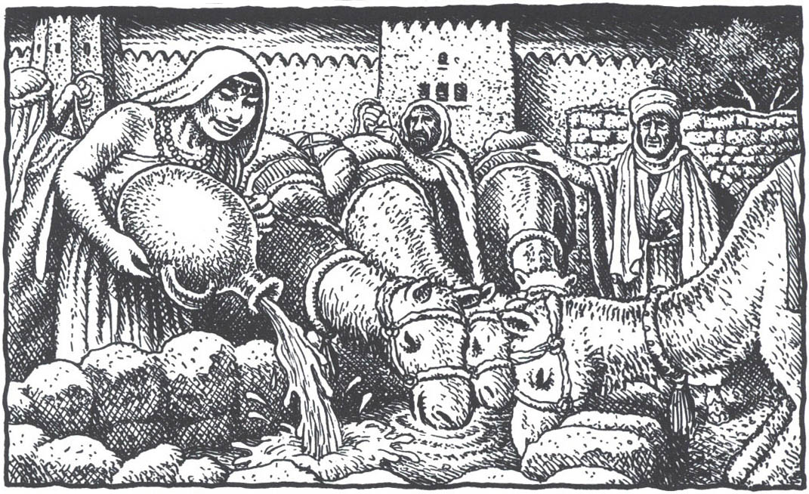

Slide 6
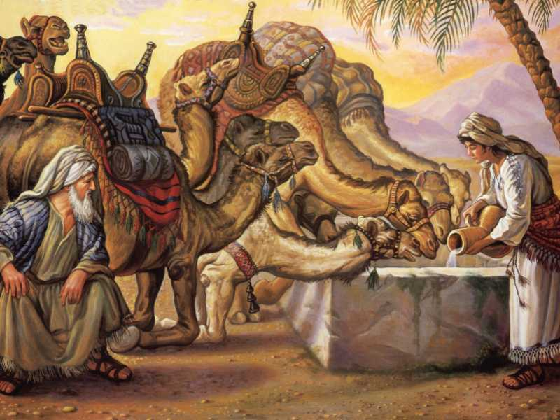

Slide 7
And Laban answered and said: “From the Lord this thing has come; we can speak to you neither good nor evil. Here is Rebekah before you. Take her and go and let her be wife to your master’s son as the Lord has spoken.”
Genesis 24:50-52 (Alter)

Slide 8
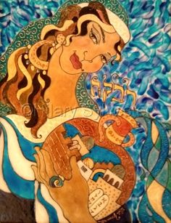

Slide 9
Our sister, become hence myriads teeming.
May your seed take hold of the gate of its foes.
Genesis 24:60

Slide 10
Isaac brought Rebekah into his mother Sarah’s tent. He received Rebekah as his wife and loved her. So Isaac found comfort after his mother’s death.
Genesis 24:67 (CEB)

Slide 11
“Two nations- in your womb,
two peoples from your loins shall issue.
People over people shall prevail,
the elder, the younger’s slave.”
Genesis 25:23 (Alter)

Slide 13
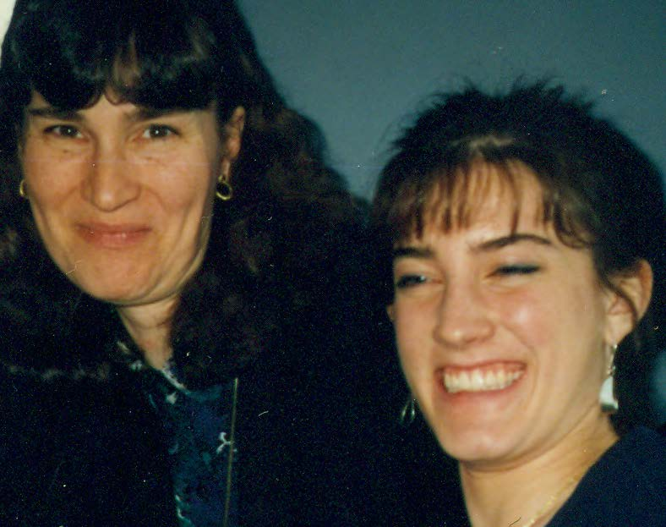

Slide 14
