Slide 1
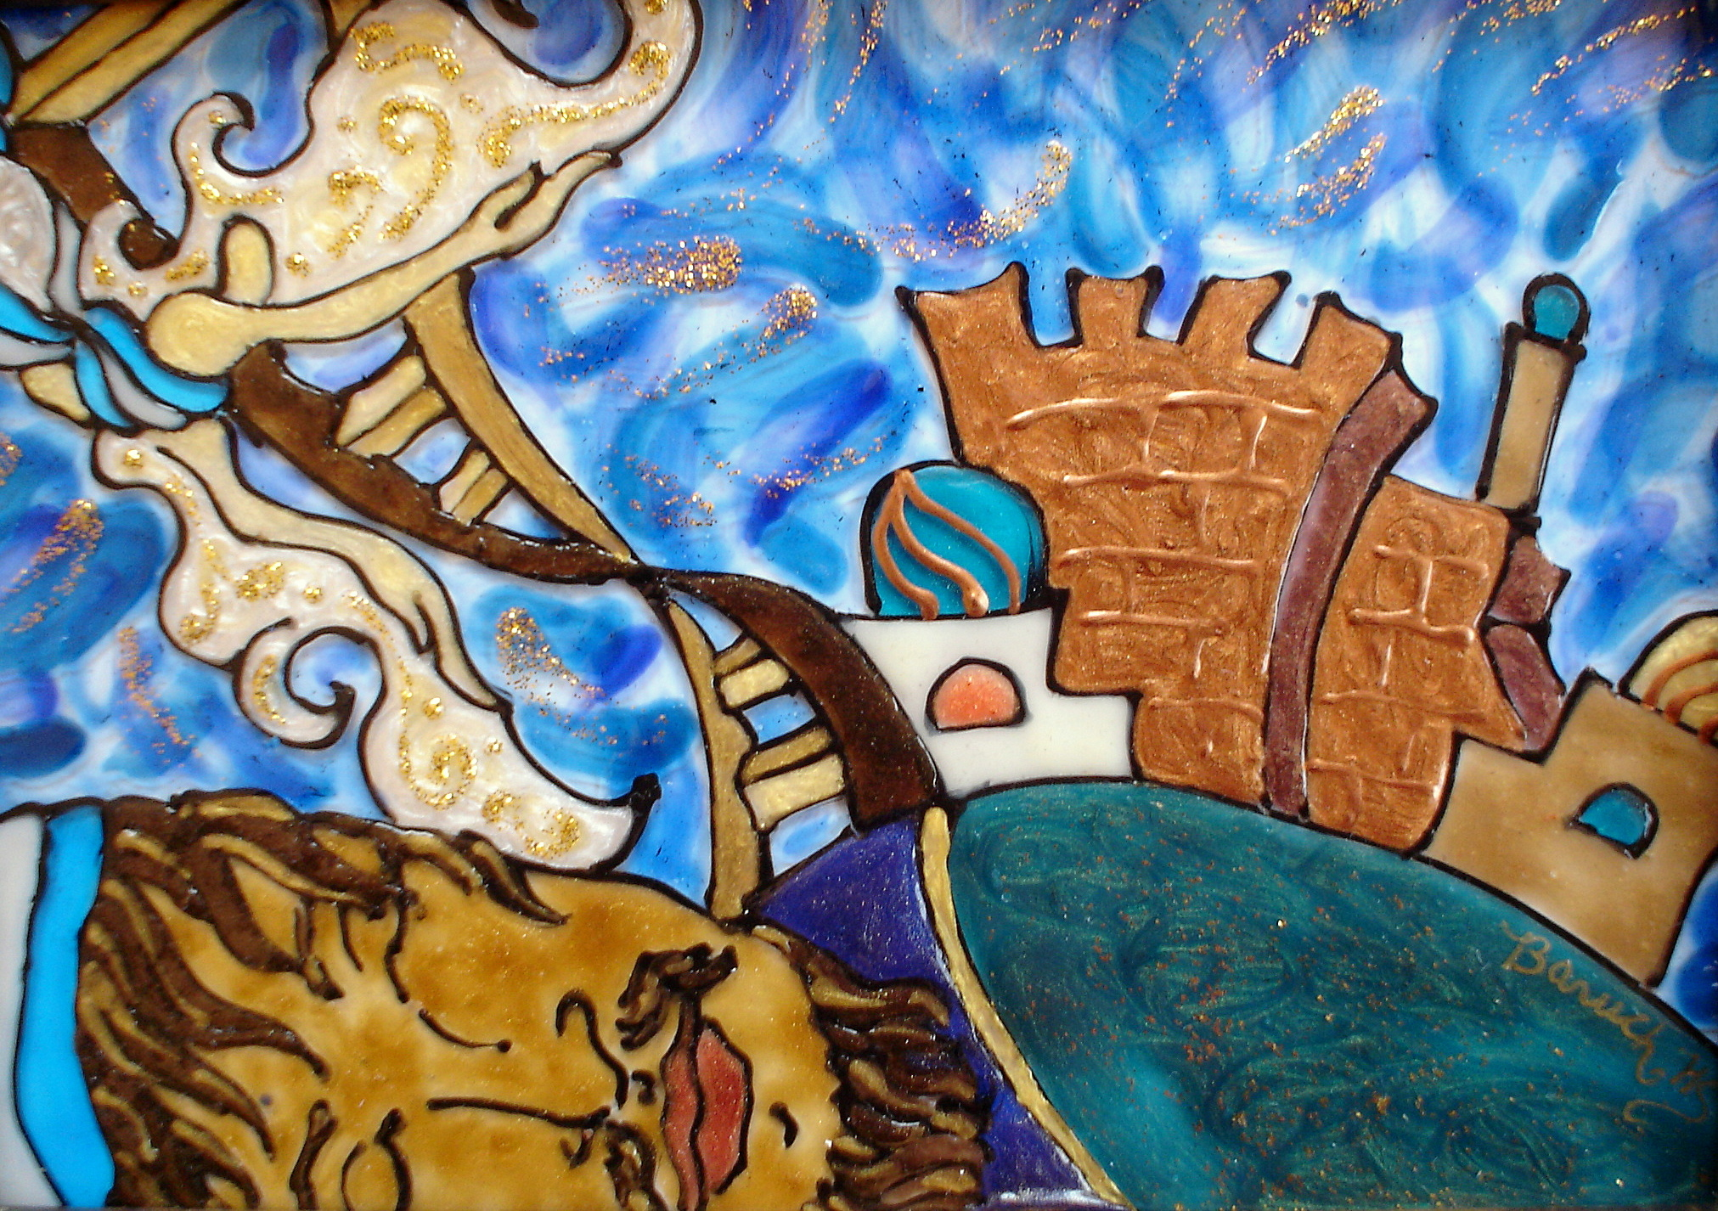

Slide 2
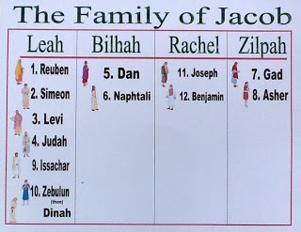

Slide 3
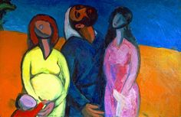

Slide 4
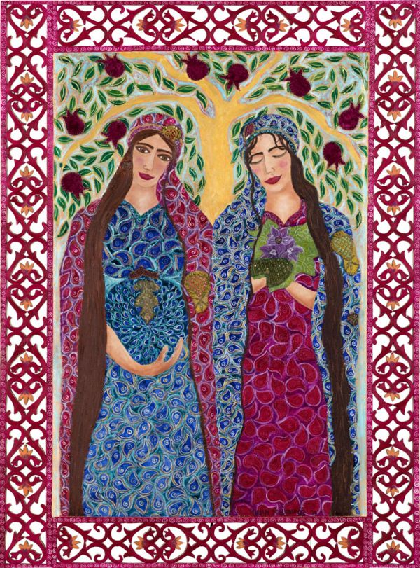

Slide 5
And Jacob sent and called Rachel and Leah out to the field, to his flocks, and he said to them, “I see your father’s face, that it is not disposed toward me as it used to be, but the God of my father has been with me. And you know that with all my strength I have served your father. But your father has tricked me and has switched my wages ten times over, yet God has not let him do me harm. If thus he said, “The spotted ones will be your wages,” all the flocks bore spotted ones. And if he said, “The brindled ones will be your wages,” all the flocks bore brindled ones. And God has reclaimed your father’s livestock and given it to me.

Slide 6
And so, at the time when the flocks were in heat, I raised my eyes and saw in a dream and, look, the rams mounting the flocks were brindled, spotted, and speckled. And God’s messenger said to me in the dream, ‘Jacob!’ and I said, ‘Here I am.’ And he said, ‘Raise your eyes, pray, and see: all the rams mounting the flocks are spotted, brindled, and speckled, for I have seen all that Laban has been doing to you. I am the God who appeared to you at Bethel, where you anointed a pillar and made me a vow. Now, rise, leave this land, and return to the land of your birthplace.’” Gen 31:4-13 (Alter)

Slide 7
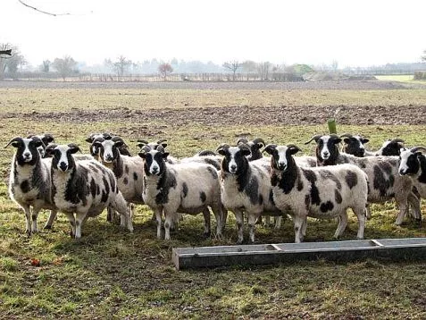

Slide 8
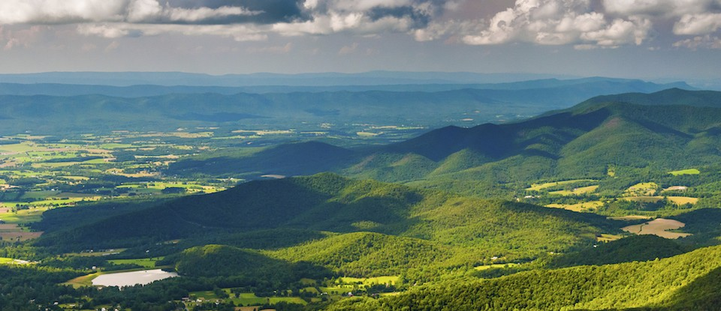

Slide 9
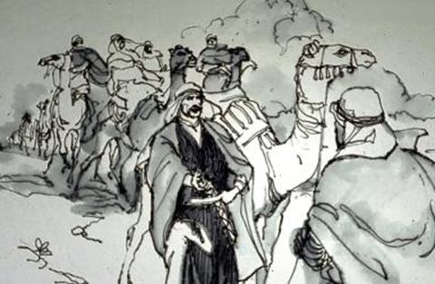

Slide 10
And Laban caught up with Jacob, and Jacob had pitched his tent on the height, and Laban had pitched with his kinsmen in the high country of Gilead. And Laban said to Jacob, “What have you done, deceiving me, and driving my daughters like captives of the sword? Why did you flee in stealth and deceive me and not tell me? I would have sent you off with festive songs, with timbrel and lyre. And you did not let me kiss my sons and my daughters. O, you have played the fool!

Slide 11
My hand has the might to do your harm, but the god of your father said to me last night, ‘Watch yourself, lest you speak either good or evil.’ And so, you had to go because you longed so much for your father’s house, but why did you steal my gods?” And Jacob answered to Laban, “For I was afraid, for I thought, you would rob me of your daughters. With whomever you find your gods, that person shall not live. Before our kinsmen, make recognition of what is your with me, and take it.” But Jacob did not know that Rachel had stolen them. Genesis 31:25-32 (Alter)

Slide 12
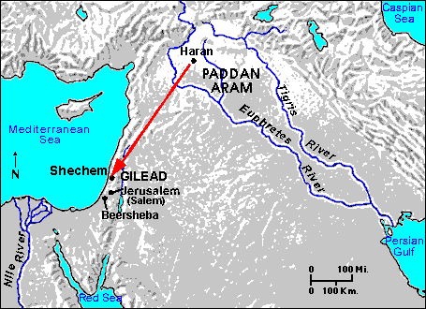

Slide 13
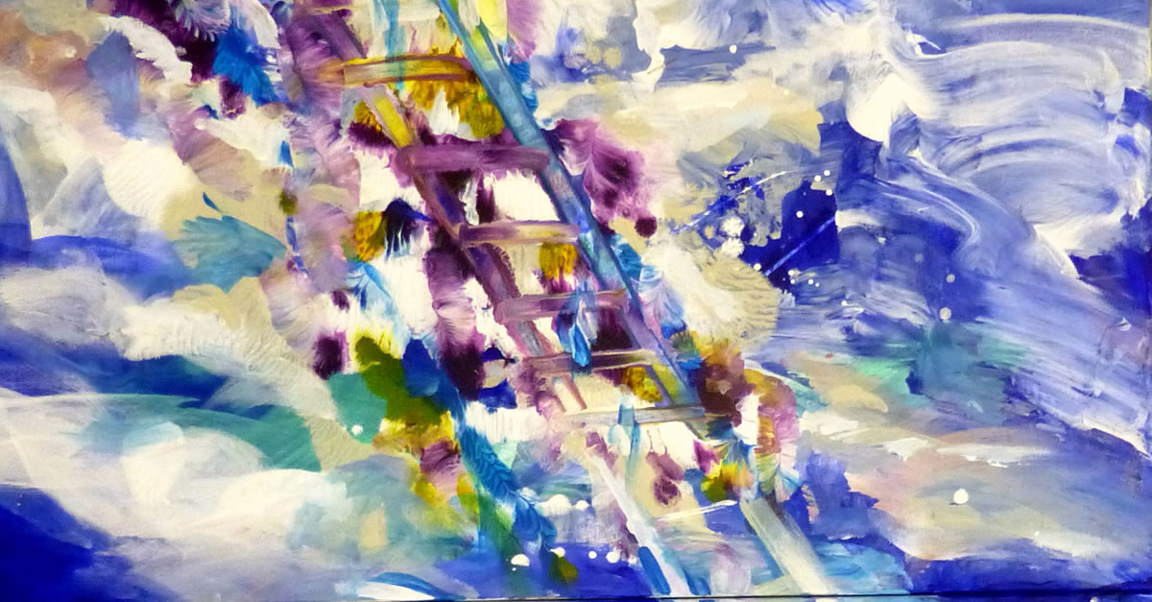

Slide 14
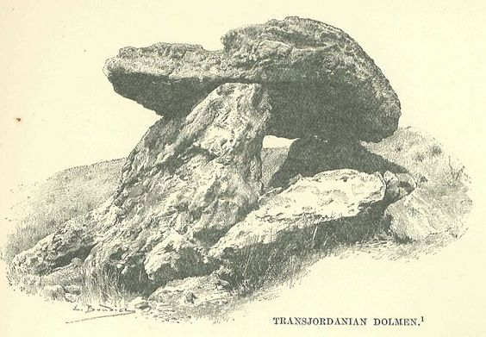

Slide 15
And Jacob had gone on his way, and messengers of God accosted him. And Jacob said when he saw them, “This is God’s camp,” and he called the name of that place Mahanaim. And Jacob sent messengers before him to Esau his brother in the land of Seir, the steppe of Edom. And he charged them, saying, “Thus shall you say- ‘To my lord Esau, thus says your servant Jacob: With Laban I have sojourned and I tarried till now. And I have gotten oxen and donkeys and sheep and male and female slaves, and I send ahead to tell my lord, to find favor in your eyes.’”

Slide 16
And the messengers returned to Jacob, saying, “We came to your brother, to Esau, and he himself is coming to meet you, and four hundred men are with him.” And Jacob was greatly afraid, and he was distressed, and he divided the people that were with him, and the sheep and the cattle and the camels, into two camps. And he thought, “Should Esau come to the one camp and strike it, the remaining camp will escape.” And Jacob said: “God of my father Abraham and God of my father Isaac! Lord who has said to me, ‘Return to your land and your birthplace, and I will deal well with you.’

Slide 17
I am unworthy of all the kindness that you have steadfastly done for your servant. For with my staff I crossed this Jordan, and now I have become two camps. O save me from the hand of my brother, from the hand of Esau, for I fear him, lest he come and strike me, mother with sons. And You Yourself said, ‘I will surely deal well with you and I will set your seed like the sand of the sea multitudinous beyond all count.’”
Genesis 32:1-12 (Alter)

Slide 18
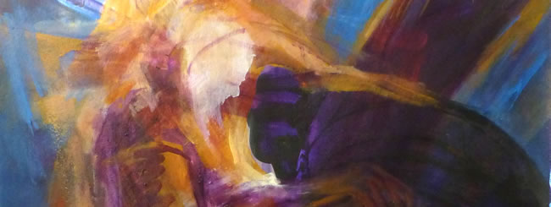

Slide 19
“And, look, I am with you and I will guard you wherever you go, and I will bring you back to this land, for I will not leave you until I have done that which I have spoken to you.”
Genesis 28:15 (Alter)
And the Lord said to Jacob, “Return to the land of your fathers and to your birthplace and I will be with you.”
Genesis 31:3 (Alter)

Slide 20
