Slide 1
Galatians 6:
The collective work of living
in the new law of Christ

Slide 2
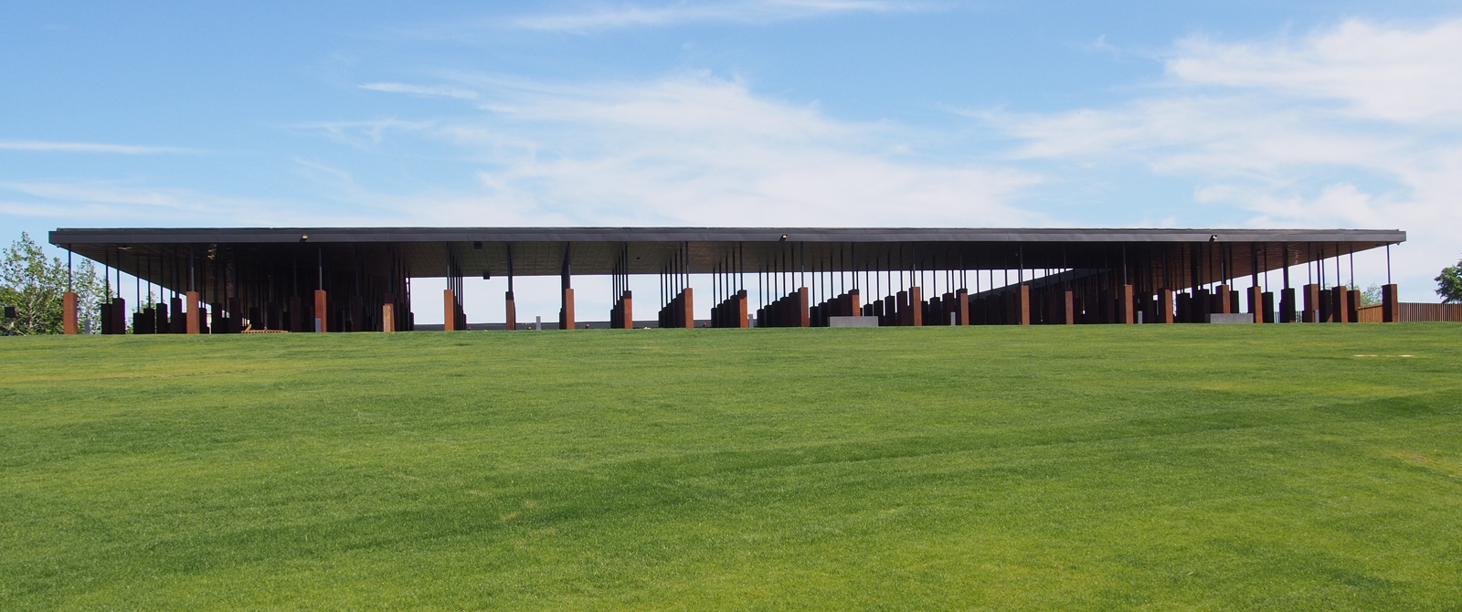

Slide 6
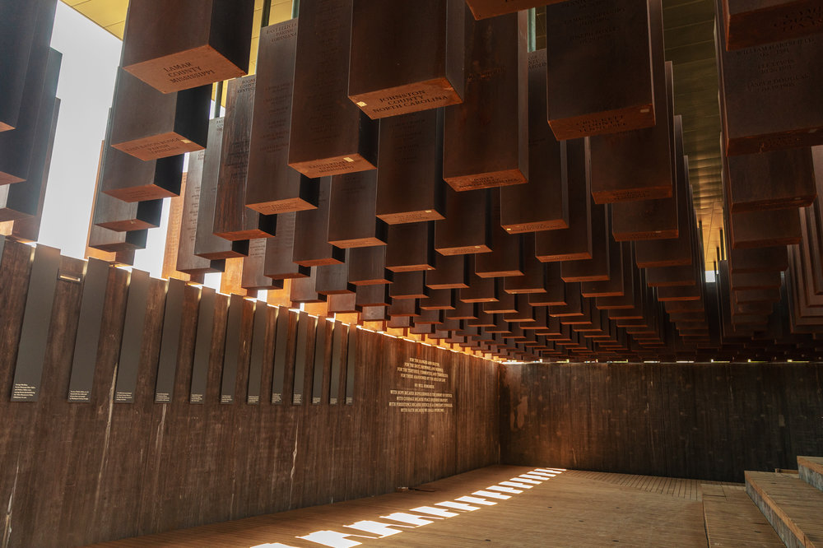

Slide 7
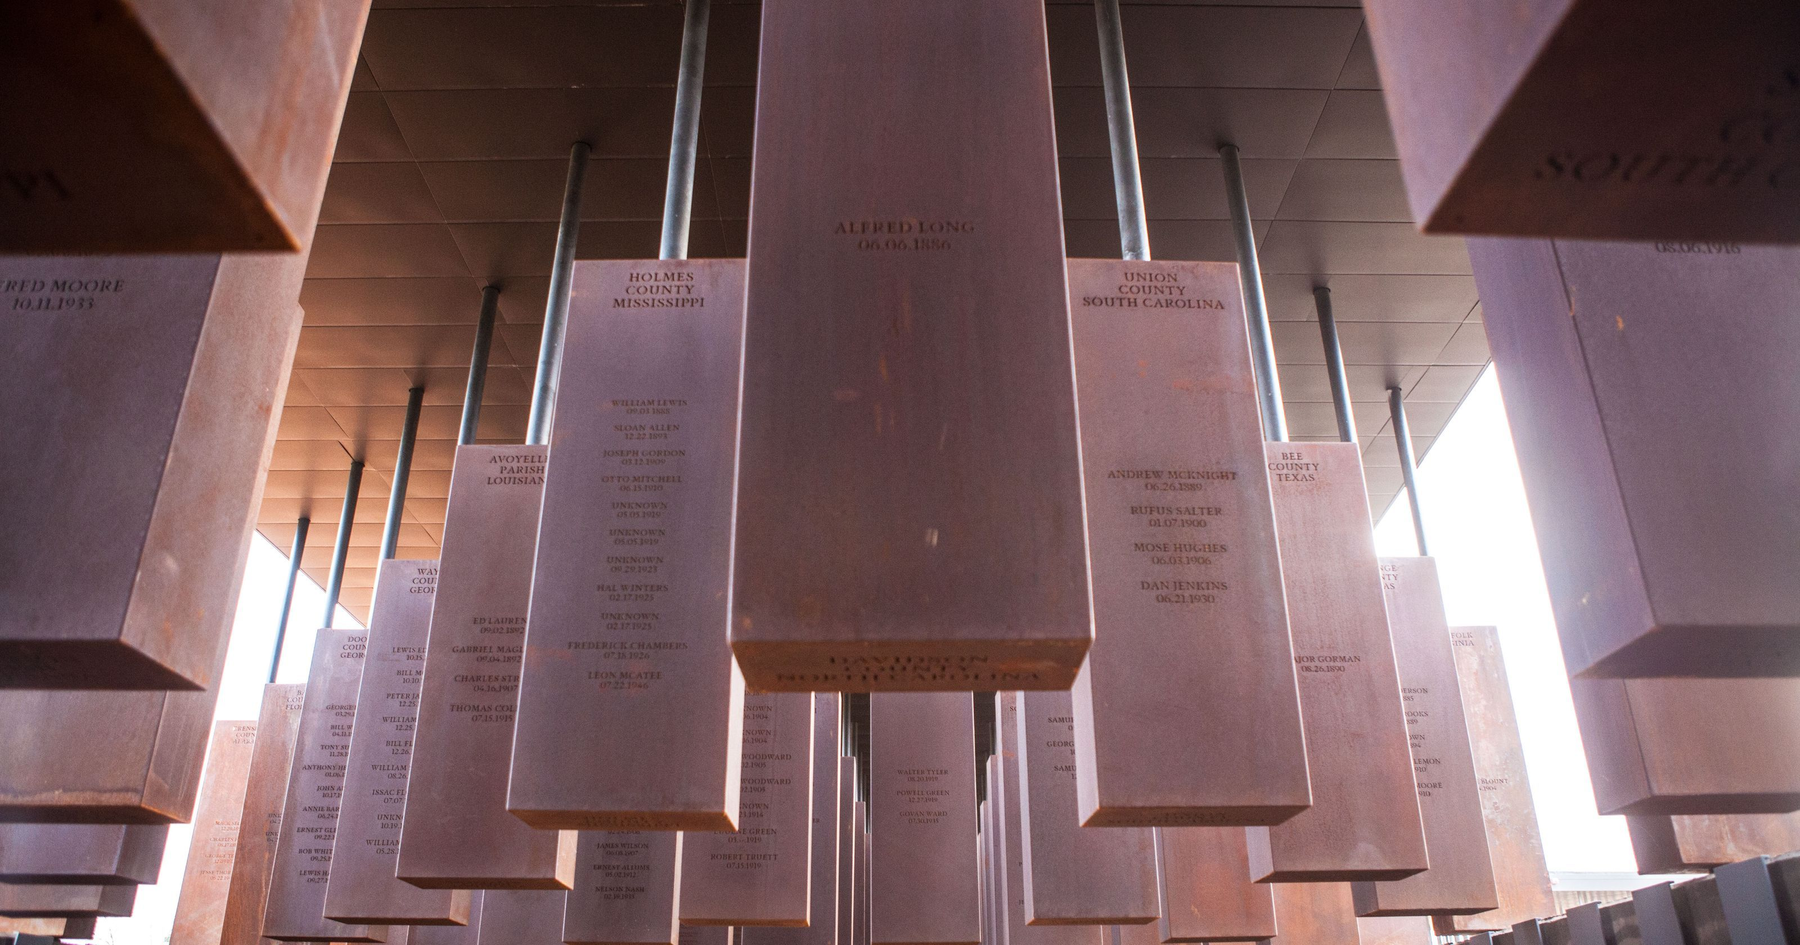

Slide 8
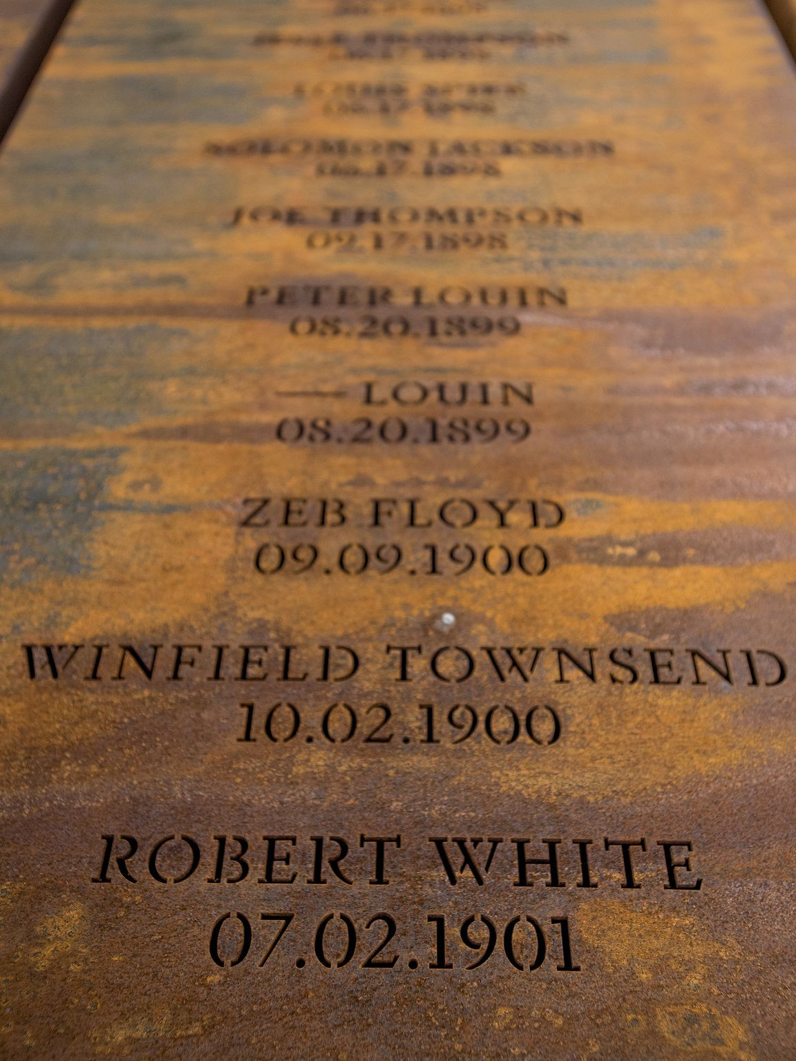

Slide 11
Galatians 6:1-5
1 My friends, if anyone is detected in a transgression, you who have received the Spirit should restore such a one in a spirit of gentleness. Take care that you yourselves are not tempted.
2 Bear one another’s burdens, and in this way you will fulfill the law of Christ.
3 For if those who are nothing think they are something, they deceive themselves. 4 All must test their own work; then that work, rather than their neighbor’s work, will become a cause for pride. 5 For all must carry their own loads.

Slide 13
