Slide 1
Humanity fully alive
Hebrews 1 & 2
Hebrews and the possibility of change
September 15, 2019
New Covenant Fellowship

Slide 2
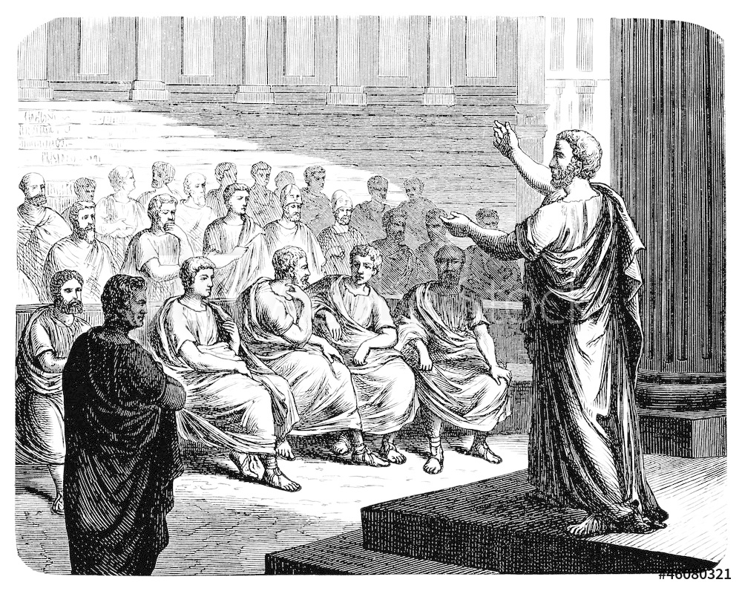

Slide 4
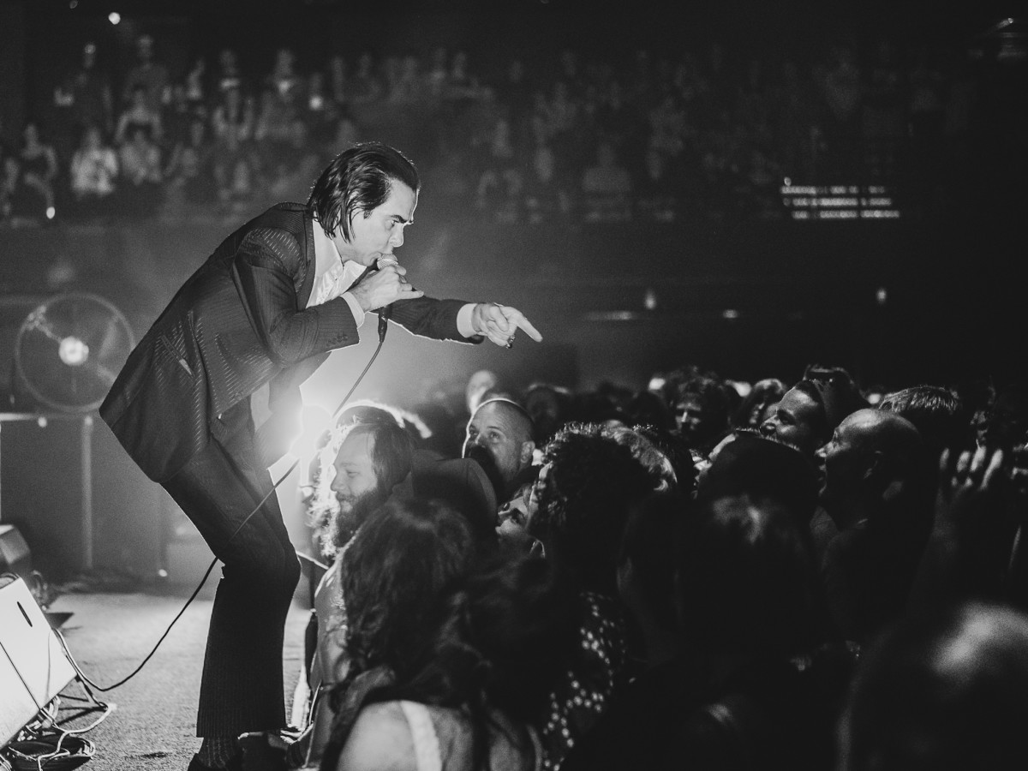

Slide 5
Hebrews 1:1
Long ago God spoke to our ancestors in many and various ways by the prophets…

Slide 6
Hebrews 1:5
To which of the angels did God ever say:
"You are my Son, today I have begotten you" or
"I will be His Father, and he will be my Son?"

Slide 7
Hebrews 1:1
Long ago God spoke to our ancestors in many and various ways by the prophets, but in these last days he has spoken to us by a Son.

Slide 8
Hebrews 2:11
So now Jesus and the ones he makes holy have the same Father.

Slide 9
Hebrews 2:12
“I will proclaim your name to my brothers and sisters, in the midst of the congregation I will praise you.”

Slide 10
“The Glory of God
is humanity fully alive.”
- Ireneus, 2nd century A.D.

Slide 11
Hebrews 2:14
Because God’s children are human beings—made of flesh and blood—the Son also became flesh and blood. For only as a human being could he die, and only by dying could he break the power of the devil, who had the power of death.

Slide 12
Hebrews 2:18
Because he himself was tested by what he suffered, he is able to help those who are being tested.

