Slide 1
2020 Collaboration
A New Vision for the Body

Slide 2
Overview
Why Do Something Different?
Altering Our Mindset
Let’s Get Messy!
Guess What? This is not new…nor Radical
How?
Action: Let’s Get Real

Slide 3
UNITY

Slide 4
Notes:
One of the best Homewood-Flossmoor Wrestling Teams in the school’s history
Some may say, “THE BEST”
Why? One of the only teams in history that had 4 wrestlers with a 30-Win Season; One of the only Conference Champs (as a team) and 2nd Place at Regionals as a team
But it was much more than that… after all, there were 13 guys on a roster. We talked about how we all pulled for one another and supported each other. Even the guys who did not have many wins, worked hard and improved throughout the season even though they knew, due to inexperience, would not win very often. Despite that, they gave it their all for the team. And we all realized we sank and swam as a team. At the end of the day, although I do not think we realized it at the time (given we were teenagers) and only later, the team was family.

Slide 5
What Does the Bible Say?
Romans 12:4-6
For as in one body we have many members, and the members do not all have the same function, so we, though many, are one body in Christ, and individually members one of another. Having gifts that differ according to the grace given to us, let us use them: if prophecy, in proportion to our faith;

Slide 6
What Does the Bible Say?
Ecclesiastes 4:9-12
Two are better than one, because they have a good reward for their toil. For if they fall, one will lift up his fellow. But woe to him who is alone when he falls and has not another to lift him up! Again, if two lie together, they keep warm, but how can one keep warm alone? And though a man might prevail against one who is alone, two will withstand him—a threefold cord is not quickly broken.

Slide 7
What Does the Bible Say?
1 Corinthians 1:10
I appeal to you, brothers, by the name of our Lord Jesus Christ, that all of you agree, and that there be no divisions among you, but that you be united in the same mind and the same judgment.

Slide 8
Collaboration Nehemiah: Rebuilding the Wall in Jerusalem
Nehemiah 4:15-23
15 When our enemies heard that we were aware of their plot and that God had frustrated it, we all returned to the wall, each to our own work.
16 From that day on, half of my men did the work, while the other half were equipped with spears, shields, bows and armor. The officers posted themselves behind all the people of Judah 17 who were building the wall. Those who carried materials did their work with one hand and held a weapon in the other, 18 and each of the builders wore his sword at his side as he worked. But the man who sounded the trumpet stayed with me.
19 Then I said to the nobles, the officials and the rest of the people, “The work is extensive and spread out, and we are widely separated from each other along the wall. 20 Wherever you hear the sound of the trumpet, join us there. Our God will fight for us!”
21 So we continued the work with half the men holding spears, from the first light of dawn till the stars came out. 22 At that time I also said to the people, “Have every man and his helper stay inside Jerusalem at night, so they can serve us as guards by night and as workers by day.” 23 Neither I nor my brothers nor my men nor the guards with me took off our clothes; each had his weapon, even when he went for water.
Notes:
When Nehemiah was leading the rebuilding of the wall around Jerusalem, enemies of the Israelites kept trying to attack them while they worked! But this passage from Nehemiah shows how great teamwork helped get the job done. Half of the Israelites worked on the wall while the other half stood guard. Everyone worked together to rebuild the wall.

Slide 9
Nehemiah - Background
Notes:
God’s judgement (Assyrians 722 BC defeat the northern kingdom); 10 “Lost Tribes” of Israel – never allowed to go back to their land and Assyrians sent Gentiles to live there. Remember, my teaching with Jonah, … the Assyrians were pretty mean people
Babylonians destroy Jerusalem in 586 BC and take many people to Babylon, including Ezekiel
Jeremiah warned Zedekiah to not rebel against Babylon but did anyway and led to the destruction of Jerusalem. Temple and Wall destroyed.
50 Years Later…Persians defeat the Babylonians in 538 BC
536 BC First group leaves for Jerusalem; They begin rebuilding the temple
81 Years after that…
455 BC Ezra leads a second group to Jerusalem (1500 men and their families)
10 Years after Ezra…
445 BC Nehemiah speaks to and gets permission from the king to go to Jerusalem and rebuild the wall

Slide 10
Nehemiah - Background
Notes:
Many of the dispersed Jewish exiles decided to stay in Persia and not return to Jerusalem
Only a handful of God’s people returned to rebuild the temple and the wall (wasn’t for everybody apparently… apathy?)
Nehemiah was a cup bearer of the king (pretty nice gig). Heard about the troubles of the people in Jerusalem and was compelled to do something about it.

Slide 11
Haters
Notes:
First 14 verses describe the haters
The surrounding tribes and people ridiculed and rebuffed the undertaking

Slide 12
Nehemiah Haters
Ridicule (2:9, 4:1-3)
Wrath (4:1, 6-9)
Discouragement (4:10)
Fear (4:11-23)
Internal Strife (5:1-5)
Laziness (4:10)
Satanic subtlety (6:1-8) compromise
Lying prophets (6:10-14)

Slide 13
Nehemiah: Building the Wall Takes Teamwork
Notes:
It was not just about building a wall, it was about restoring God’s people
What did it take?
Nehemiah used what he had… networking resources

Slide 14
Each Part Working Properly
Ephesians 4:15–16
15 Rather, speaking the truth in love, we are to grow up in every way into him who is the head, into Christ, 16 from whom the whole body, joined and held together by every joint with which it is equipped, when each part is working properly, makes the body grow so that it builds itself up in love.
Notes:
Let’s get biological

Slide 15
Collaboration Makes Us Stronger
Notes:
We had something unifying us and one outcome of that unification was working through and solving a problem. In this case, an escape room where it takes each person contributing to make it through.

Slide 16
Building Our Wall is Tearing them Down
Notes:
There is a sharp irony to my use of this story of Nehemiah to emphasize the importance of UNITY. Unlike with Nehemiah, building the wall was a practical and symbolic way of restoring God’s people, tearing down the walls in Christianity today is a practical and symbolic way of restoring God’s people. We got into the wall building mode and went overboard.

Slide 17
Tearing Down Walls Can Get Dangerous
Notes:
Fred Hampton was a civil rights advocate and part of the Black Panthers
One of the most powerful messages he shared was how racism is a tool to promote division which hinders progress for the vast majority of people
How amazing is it to have a confederate flag wearing white guy say, “the black panthers have my back and I have theirs”

Slide 18
Why So Scary?
Notes:
What made this idea of UNITY so frightening to people that the FBI had to assassinate a 21 year old?
J. Edgar Hoover… “Justice is incidental to law and order”
Why did Nehemiah’s haters not want him to succeed? Why is there still opposition to those that seek unity?
In Nehemiah, it was partially about control… if they could keep them from building the wall, they could take over anytime they wanted
My healthcare teaching experience… people opposing things that helps everyone, which will ultimately, help themselves

Slide 19
So Why Do it? Just Mercy
Notes:
In his book and subsequent movie about his work, Bryan Stevenson shares how 1 out of 9 people on death row (43% white, 42% black, 12% Hispanic; 54% people of color) do not receive proper representation

Slide 20
States with the Death Penalty
Notes:
4.1% of wrongful death row convictions

Slide 21
1 out of 20
Notes:
Why does 1 out of 20 matter?
Let’s go with some non lethal examples first: 1 out of 20 important pieces of mail not delivered; you did not show up to work; there was no one to teach or no worship ready
Lethal examples: 1 out of 20 bottled water was poisonous; medication/pills killed you; airplanes crashed
If you put yourself in that situation, or saw someone you loved in that situation or at least, identified with that person, how strongly would you respond?

Slide 22
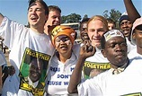
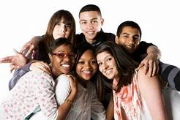
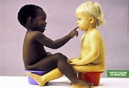
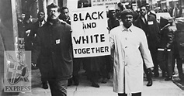
So Why Do It?
Notes:
Why go through all the ridicule? The judgement? The rumors? The lying? The Hate? The Work? The Apathy? The Danger? The Discouragement? The Wrath?

Slide 23
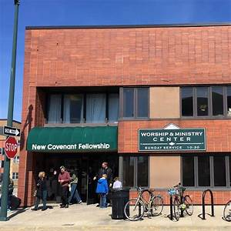
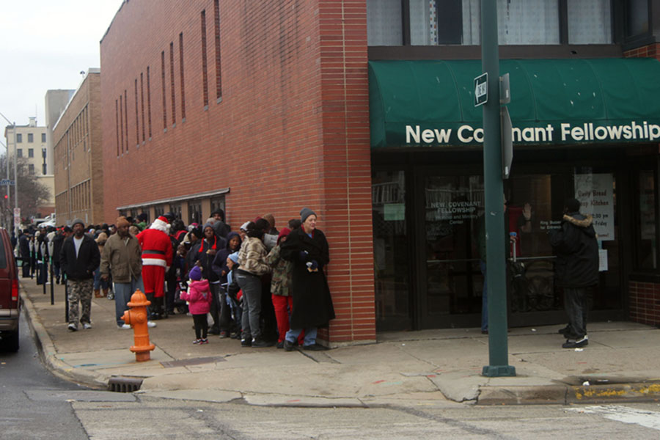
Why Should NCF Do It?
Notes:
UNITY led to several ministries that originating in this body of believers

Slide 24
Because It MAKES A DIFFERENCE
Notes:
“Moreover, I am cognizant of the interrelatedness of all communities and states. I cannot sit idly by in Atlanta and not be concerned about what happens in Birmingham. Injustice anywhere is a threat to justice everywhere. We are caught in an inescapable network of mutuality, tied in a single garment of destiny. Whatever affects one directly, affects all indirectly.” Letter from Birmingham Jail
As we celebrate MLK, there are opportunities to collaborate, to unify more than usual. Please take advantage of these opportunities. Your very own Pastor Renee will be sharing a stage with other church and community leaders. Please come and support these efforts. The cause of helping young people with education, makes a difference

Slide 25
Closing Scripture
1 Peter 4:8-10
Above all, keep loving one another earnestly, since love covers a multitude of sins. Show hospitality to one another without grumbling. As each has received a gift, use it to serve one another, as good stewards of God’s varied grace.
Notes:
Jesus is our ultimate example of unity. He brought people of all backgrounds and situations in life together. This message of love for God and for one another continues to have a ripple effect 2000+ years later. As we go to communion, let us remember that he too, paid the ultimate sacrifice to see UNITY unfold by offering everyone to be his brothers and sisters.
Prayer: Let us remember we are all on the same team.

