Slide 1
What Does It Mean To Be Free?
Notes:
Over 50 years ago when I was starting out in ministry, Tom Skinner, a very intimidating black evangelist, intimidating by design by the way, wrote a book, “If Jesus is the Answer, What are the Questions?” This morning, I want to raise one of those questions and speak to how Jesus is the answer.
My Christian journey started in a serious way in high school. I wasn’t raised in a Christian family. I had Christian relatives, but my immediate family was anything but. I spent a fair amount of time during my high school years breaking up fights between two drunken parents. In addition to that, like most teenagers, I was bottled up with any number of internal struggles. A sense of freedom was not easy to come by. However, I was introduced to Christ in a new way through a parachurch organization in my school, Voice of Christian Youth (VCY). Somehow through that ministry and several ministries in college I began to discover a newfound freedom in Christ.

Slide 2
Freedom
John 8:32 You will know the truth, and the truth will set you free.” John 6:36 If therefore the Son shall make you free, you shall be free indeed.
Notes:
These two verses suggest that freedom is at the core of what God wants for us. To be completely unchained, emancipated, delivered, liberated. But how many of us experience that and to what degree.

Slide 3
Freedom
How Does Truth Set Us Free?
How Does Jesus’ Set Us Free?
What Does “Freedom” Mean To You?
Notes:
If freedom is at the core of what God wants for us how do you answer the following questions. SLIDE [for the online version of our service: Though I know we can’t interact and I wish we could, I want to give you a moment to think about these questions. PAUSE Some responses to the last question I’ve heard are: “the right to do as I please”, “doing whatever I want”, “the power to do that which is right for me”, “to escape from internal bondage and chains”, “not having anyone tell me what to do”, “being my own person”, “not having to take care of anyone else but my self”.
Now I would like to give you another way to think about these questions: I want to play a song by my favorite Country and Western singer Garth Brooks. He recorded this song in 1991 in the aftermath of the Rod King beatings, a black man, by the Los Angeles police force.

Slide 4
Another Way To Think About Freedom

Slide 5
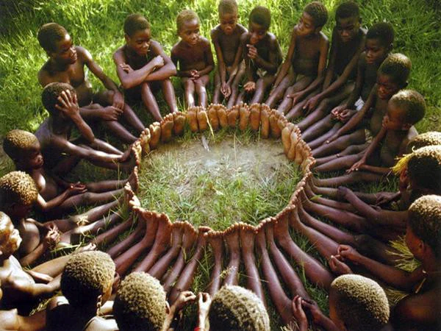
Freedom
It’s Not Just An Individual Experience
It’s A Collective Experience
There is neither Jew nor Gentile, neither slave nor free, nor is there male and female, for you are all one in Christ Jesus. (Galatians 3:28)
That all of them may be one, Father, just as you are in me and I am in you. May they also be in us so that the world may believe that you have sent me. (John 17:21)
Notes:
If you hadn’t heard it before, I hoped you liked that song. The biggest impact it had on me was to make me realize that freedom, freedom in Christ, is not exclusively an individual experience, but also as a collective one.
Individual Experience: When I became a Christian, I thought it was just Jesus and me. For the longest time, my walk with him was a solitary stroll. I worked very hard at knowing him, and living a life that would honor him. But it was just that. Me and him. Me trying to be a good person in the world. Sometimes succeeding, most times not.
It is amazing how, particularly in our American culture of rugged individualism, I was encouraged to think that it was all about my individual relationship and status with Jesus.
If you think your relationship with Jesus is exclusively an individual experience, you are NOT yet free.
Collective Experience:
An anthropologist proposed a game to the kids in an African tribe. He put a basket of fruit near a tree and told the kids that the first one to find the fruits would win them all. When he told them to run they all took each others hands and ran together, then sat together, enjoying their fruits. When he asked them why they ran like that as one could’ve taken all the fruits for one’s self, they said, “Ubuntu”, how can one of us be happy if all the others are sad?”
UBUNTU – an African phrase which essentially means “I am because we are”. It conveys the notion of living collectively rather than in isolation or simply for oneself. It speaks to the importance of others in our lives, not just for affirmation and connectedness, but for wholeness and centeredness. When I am here at New Covenant, I truly believe “I am because we are”. When I am in a weekly zoom group of Christian men that I have known for over 50 hears that started up during the pandemic, I experience Ubuntu. I experience Ubuntu with family and friends.
If you are NOT experiencing Ubuntu, Christ has not set you completely free.

Slide 6
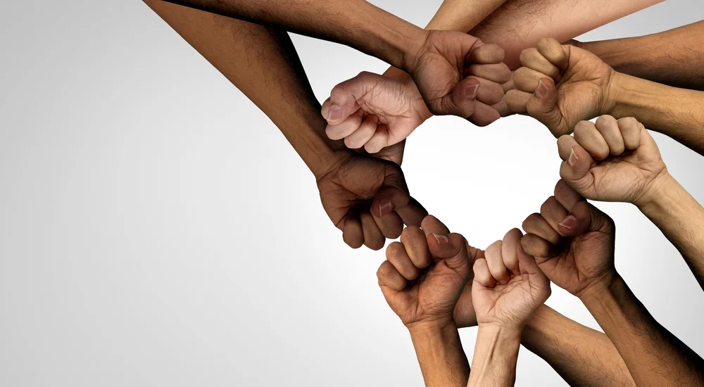
Freedom
It’s Not Just An Individual Experience
It’s A Social Justice Experience
When you have done it for the least of these, you have done it for me. (Matt 25:40)
Give justice to the weak and the fatherless; maintain the right of the afflicted and the destitute. (Psalm 82:3).
Learn to do good; seek justice, correct oppression; bring justice to the fatherless, and please the widow's cause. (Isaiah 1:17)
Notes:
Social Justice Experience: When Judy and I came to New Covenant years ago we were your fairly typical evangelicals. Social justice was not ingrained in our belief structure.
It was through observing and listening carefully to those in the fellowship who possessed a passion for social justice that we began to understand the important and imperative nature of social justice to living out our faith. Indeed, New Covenant introduced us to social justice not only as a concept but as a commitment and lifestyle. Racism, gender equality, and economic sustainability are faith issues as much as political and social issues. Today we need to continue to be increasing our awareness of injustice - racial, gender, privilege, and try to address these issues in whatever way we can.
If you are NOT increasing your awareness of and your commitment to social justice, Jesus has not set you completely free yet.

Slide 7
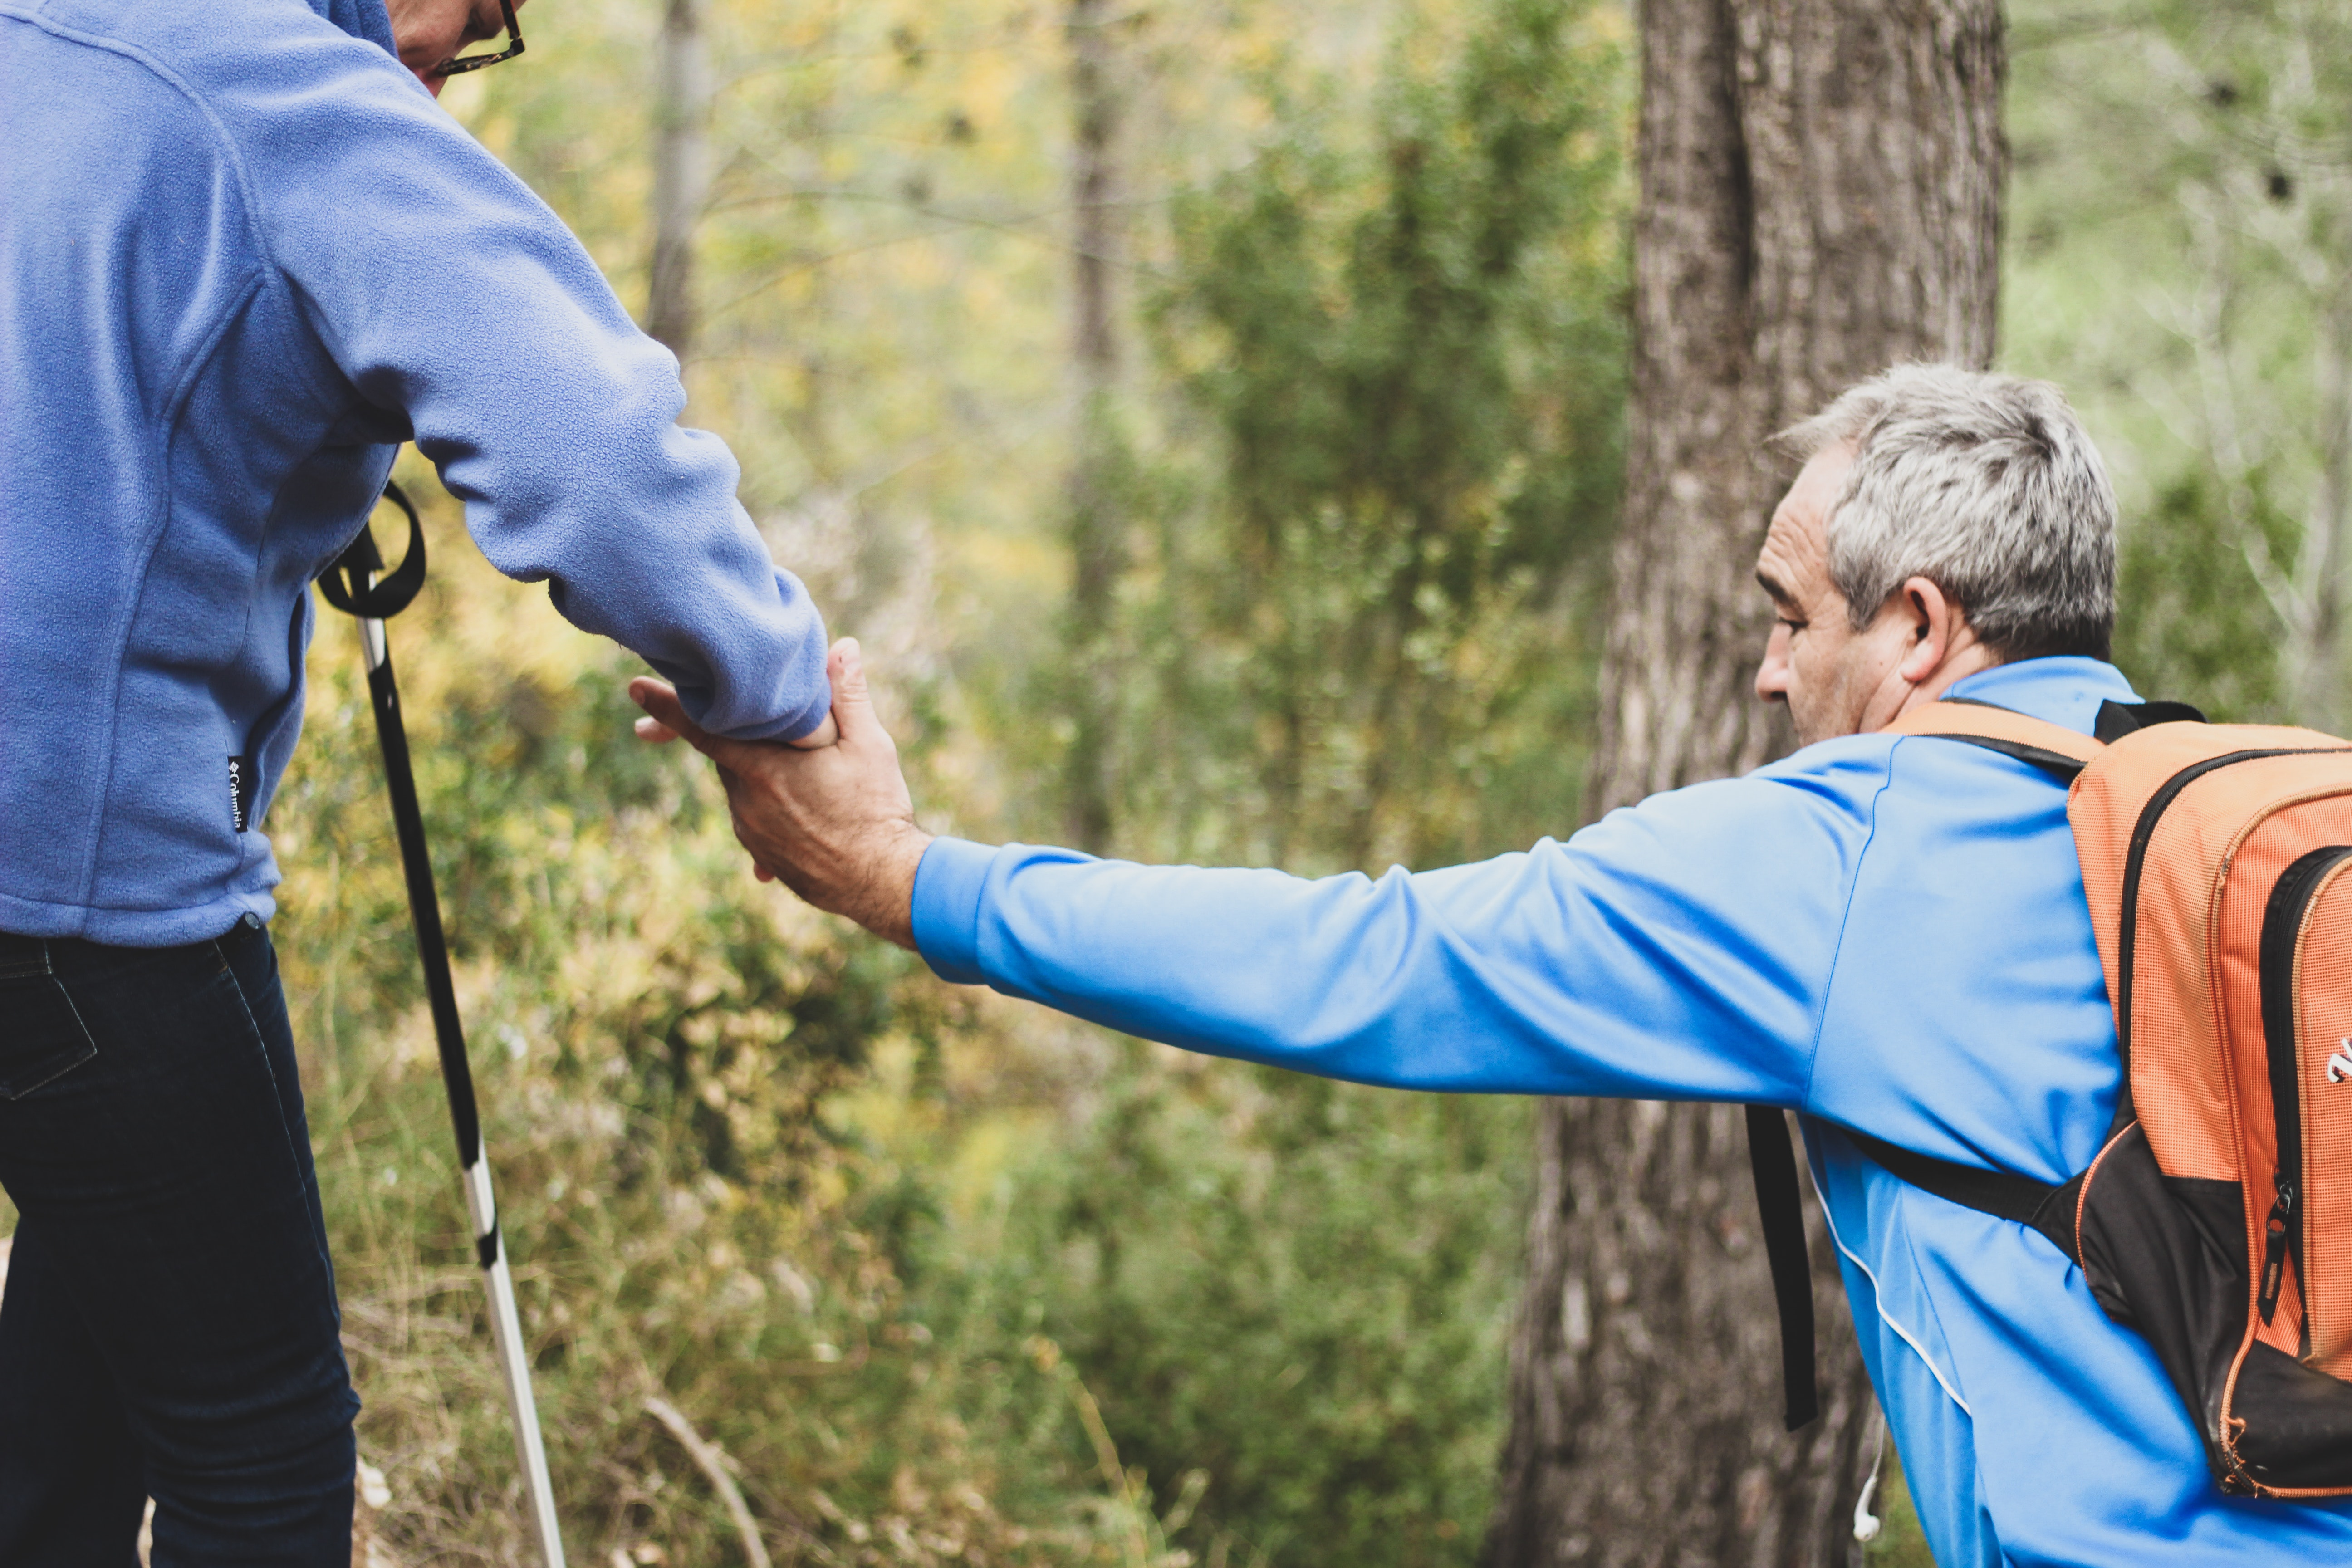
Freedom
It’s Not Just An Individual Experience
It’s A Relational Experience
Do good, be rich in helping others, be extravagantly generous.(I Timothy 6:18)
The world of the generous gets larger and larger; the world of the stingy gets smaller and smaller. The one who blesses others is abundantly blessed; those who help others are helped. (Proverbs 11:24-25)
Notes:
Rational Experience: An organizational behavior scholar at the University of Pennsylvania, Adam Grant, wrote a national bestseller, “Give and Take”. In his book, he identified 3 types of people – givers, takers, and matchers.
Givers are those who give their attention, time, and support to others freely. They are essentially “other centered”. They give without the need to get in return. Matt 25:40 “When you have done it for the least of these, you have done it for me”.
Takers are those who connect with others but only if it benefits them. They are essentially “self centered”. Today, “narcissism” has become a part of our national vocabulary, primarily because of a recent past president. Narcissism is an extreme form of being a taker. Takers are all about me “even if disguised, it is still all about me”.
Lastly, he identifies matchers as those who give to others, but as a transaction. I will give to you if you give to me. They don’t mind giving, but they expect reciprocation. Matchers keep score. They are essentially “relational score keepers”.
If you are NOT a giver, but a taker or matcher, you are not yet totally free in Christ.

Slide 8
Freedom
It’s Not Just An Individual Experience
It’s An Economic Experience
I’ve learned by now to be quite content whatever my circumstances. I’m just as happy with little as with much, with much as with little. (Phil 4:12)
A generous person will prosper; whoever refreshes others will be refreshed. (Proverbs 11:25)
Notes:
Economic Experience: When I suggest freedom is an economic experience, I am asserting that our sense of freedom can easily be controlled by our financial circumstances.
An intriguing study asked people at all different economic levels (rich to poor) how much they needed to live on. What do you think they said? No matter what level people were at economically, the majority said they needed about 10% more than they had. Philipines 4:12 “I know the experience of being in need and of having more than enough; I have learned the secret to being content in any and every circumstance, whether full or hungry or whether having plenty or being poor”.
A Ted talk asked the question, “Can money buy you happiness?” The surprising answer from multiple studies was YES. The catch, it only brought lasting happiness when it was spent on others. So, giving to the reparations fund, taking someone out to coffee and buying, paying for the person’s groceries in front of you are all examples of spending it on others. Proverbs 11:25 A generous person will prosper; whoever refreshes others will be refreshed.
So, if you are among those who need just 10% more or spend your money primarily on yourself, you are NOT yet free.

Slide 9
Christ has set us free to live a free life. Just make sure that you don’t use this freedom as an excuse to do whatever you want and destroy your freedom. Rather, use your freedom to serve one another in love; that’s how freedom grows.
Galatians 5:1, 13-14
(The Message)
Notes:
Indeed we have been set free. But we all are still learning, striving, and practicing how to be completely free.in Christ.

