Slide 1
How Do We See?
¹³ This is why I speak to them in parables:
“Though seeing, they do not see; though hearing, they do not hear or understand.¹⁴ In them is fulfilled the prophecy of Isaiah:
“‘You will be ever hearing but never understanding; you will be ever seeing but never perceiving. ¹⁵ For this people’s heart has become calloused; they hardly hear with their ears, and they have closed their eyes. Otherwise, they might see with their eyes, hear with their ears, understand with their hearts and in turn, and I would heal them.’
Notes:
Matt 13: 13-15
When it comes to understanding why the world seems to often stray from what God would like to see, this passage says it all.
The disciples were asking Jesus, why do you use parables when talking to the people. He refers to a passage in Isaiah that talks about the barriers between God and people.
This passage was used three times in the Bible
Isaiah proclamation after God’s people were putting their hope, safety and security in alliances with Assyria and Egypt instead of God
By Jesus in his attempt to share God’s will, purpose, plan and way with those around him
3) When Paul (noted in the book of Acts) was witnessing and sharing about Jesus in Rome, trying to convince the leaders there to believe in Jesus

Slide 2
Many Don’t See
What is consistent in each example, is that it is known by the speaker that many that hear their words will not truly HEAR their words
In the case of Isaiah, only a 10th would get it
We do not know how many did when Jesus and Paul quoted this scripture, but it was clearly not 100%
Notes:
My teaching today will focus on how do we be those that truly hear, both in general terms in fulfilling God’s will and specifically with fulfilling our individual and collective calling to bring racial justice in this world.

Slide 3
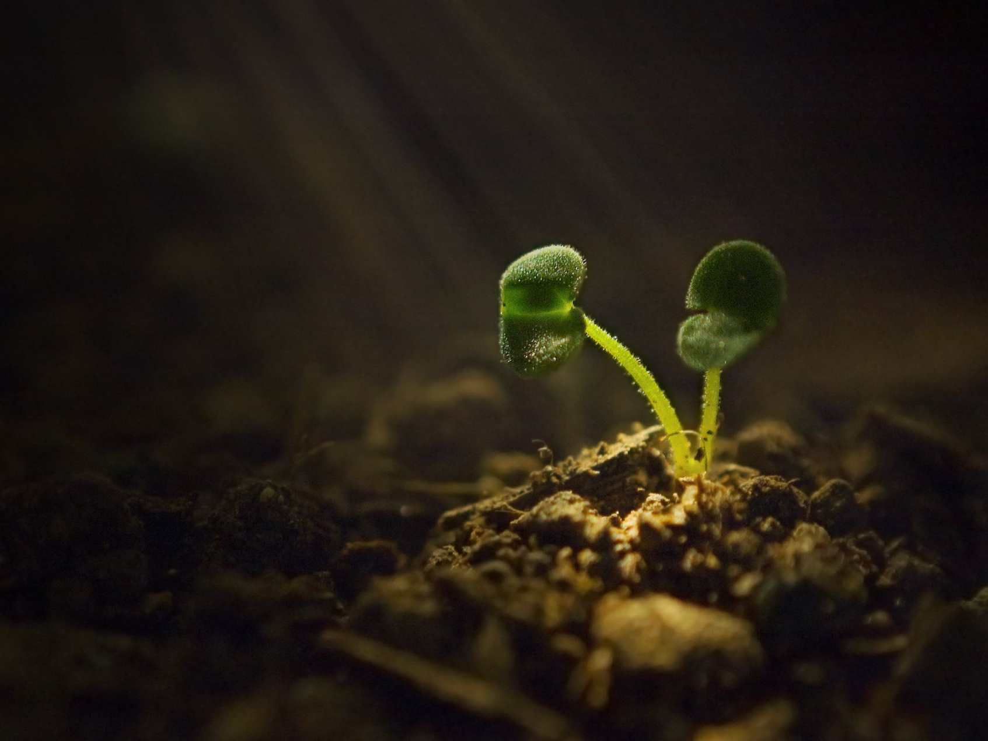
What Happened to Your Seed?
Notes:
To do this, we will discuss the passage in Mathew 13 about seeds

Slide 4
Parable of the Seeds
What inhibits our ability to hear, absorb, and live out God’s word?
Jesus provides 4 illustrations about seeds to reveal what happens when we are presented with something of God
As I truly believe racial justice is a part of God’s will and part of making the kingdom on Earth as it is in Heaven, I will specifically relate it to racial justice

Slide 5
An Example
Tulsa Oklahoma. –Greenwood – most successful black community in the country
Hundreds killed (100-300)
1256 Homes and other buildings burned (35 block area)
Lives of survivors filled with trauma
Dynamite dropped from planes into the town
No attempt to help by the authorities (no police or fire protection)
Notes:
Not one of these criminal acts was then or ever has been prosecuted or punished by government at any level

Slide 6
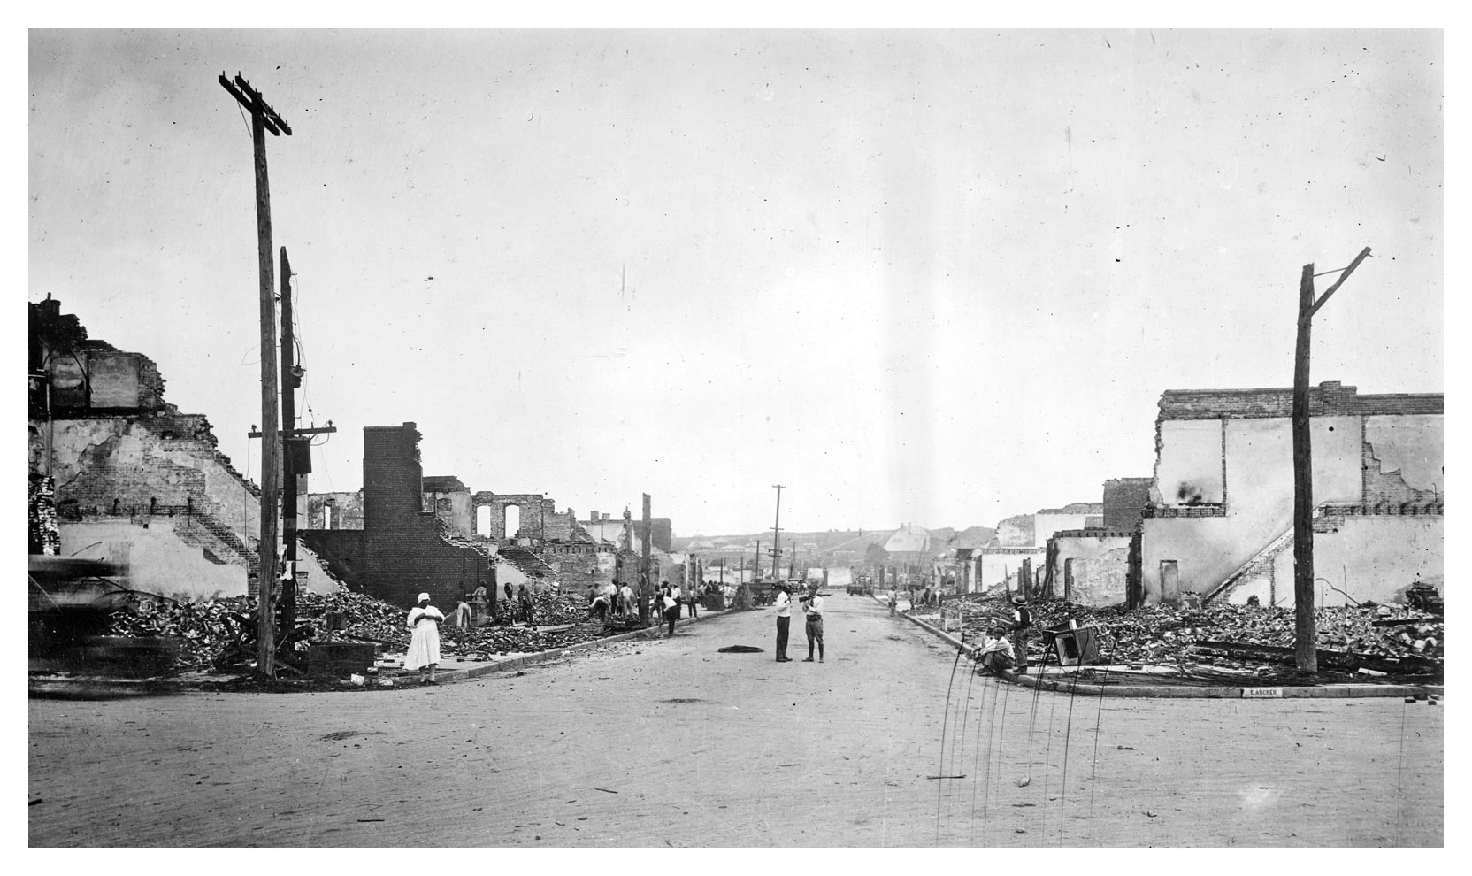
An Example
Tulsa Oklahoma
3 Survivors appeal for reparations
The court system is utilized to seek justice
Judge throws out the case based on:
1) Undue financial hardship on the city
2) Cannot blame the government for what happens in a riot
Notes:
Amos 5:24. But let justice roll on like a river, righteousness like a never-failing stream!

Slide 7
The BIRDS!!!
What are the birds today?
Notes:
People do not fulfill God’s Word because the birds eat the seeds before they are even in the ground.
1963 Alfred Hitchcock thriller: The Birds
You would not think birds could do so much damage. However, in this parable, they are the ones that destroy the hope of God’s word being believed an enacted before it can be considered
There are MANY birds today.
The worst part is when it comes to race, it is all made up, just a construct created absent of reality

Slide 8
The Birds
News Media
Social Media
The Church
Friends
Family
Notes:
Amos 5:24. But let justice roll on like a river, righteousness like a never-failing stream!

Slide 9
The Birds
Mugshots were used in coverage of 45% of cases involving Black people accused of crimes compared to only 8% of cases involving white defendants
White victims were nearly four times more likely to be presented in photos with friends and family than Black people victimized by crime
Media coverage was 50% more likely to refer to white defendants by name as compared to Black defendants

Slide 12
The Church
White Christians are consistently more likely than whites who are religiously unaffiliated to deny the existence of structural racism.
White Christians — including evangelical Protestants, mainline Protestants and Catholics — are nearly twice as likely as religiously unaffiliated whites to say the killings of Black men by police are isolated incidents rather than part of a pattern of how police treat African Americans.
Christians are about 30 percentage points more likely to say monuments to Confederate soldiers are symbols of Southern pride rather than symbols of racism

Slide 13
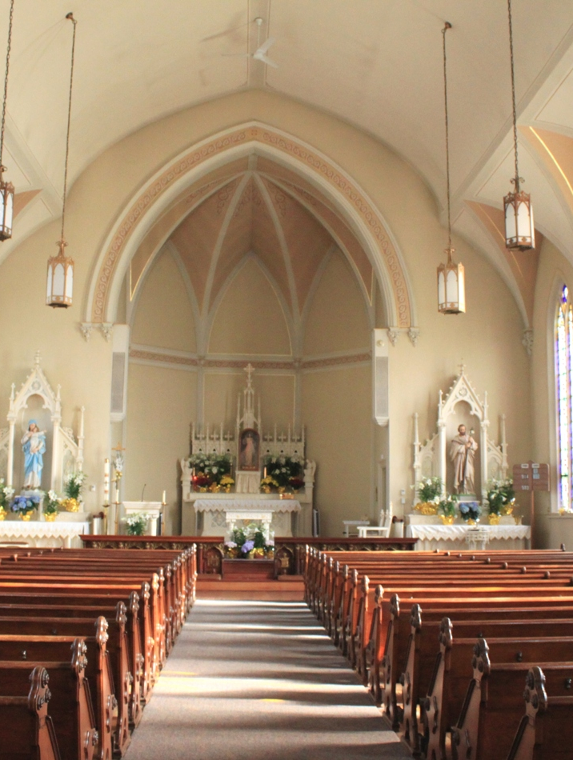
The Church
White Christians are also about 20 percentage points more likely to disagree with this statement:
"Generations of slavery and discrimination have created conditions that make it difficult for Blacks to work their way out of the lower class."
This Photo by Unknown Author is licensed under CC BY
Notes:
When visiting Mississippi and Clarksdale – stark contrast in wealth
That construct embedded itself in the church and is still rampant to the point that those “without knowing God” are better than those that are
That is remarkable and makes you wonder if there are other areas where church people are worse than non-Christians. Or maybe it’s just race

Slide 14
Family & Friends
Many people in the last few years have become estranged from various family and friends as the country has become more divided
It is a sad and a scary reality (ex. D and J)
One of the toughest areas to navigate due to the relationship you have with someone
Notes:
Maybe that is why Jesus said in Mathew 19:29 And everyone who has left houses or brothers or sisters or father or mother or wife or children or fields for my sake will receive a hundred times as much and will inherit eternal life.

Slide 15
The Rocky Ground
²⁰ The seed falling on rocky ground refers to someone who hears the word and at once receives it with joy. ²¹ But since they have no root, they last only a short time. When trouble or persecution comes because of the word, they quickly fall away.

Slide 16
The Rocky Ground
“I got your back, WAAAAAAYYYY back”
What happens when it is time to sacrifice something to fulfill God’s word?
Examples: advice to pastors, provost presenting reparations to faculty with zero follow through, organizations sending reaction letters to the public with no follow through on programs that could make a difference

Slide 17
The Thorns
The seeds have gotten in the ground, they have taken strong roots, but the plant gets choked out
For those that are fighting the good fight and get burned out, or get so tired of fighting, grows callous.
It is DIFFICULT work to sustain. Not easy to keep going when you encounter one disappointment after another.

Slide 18
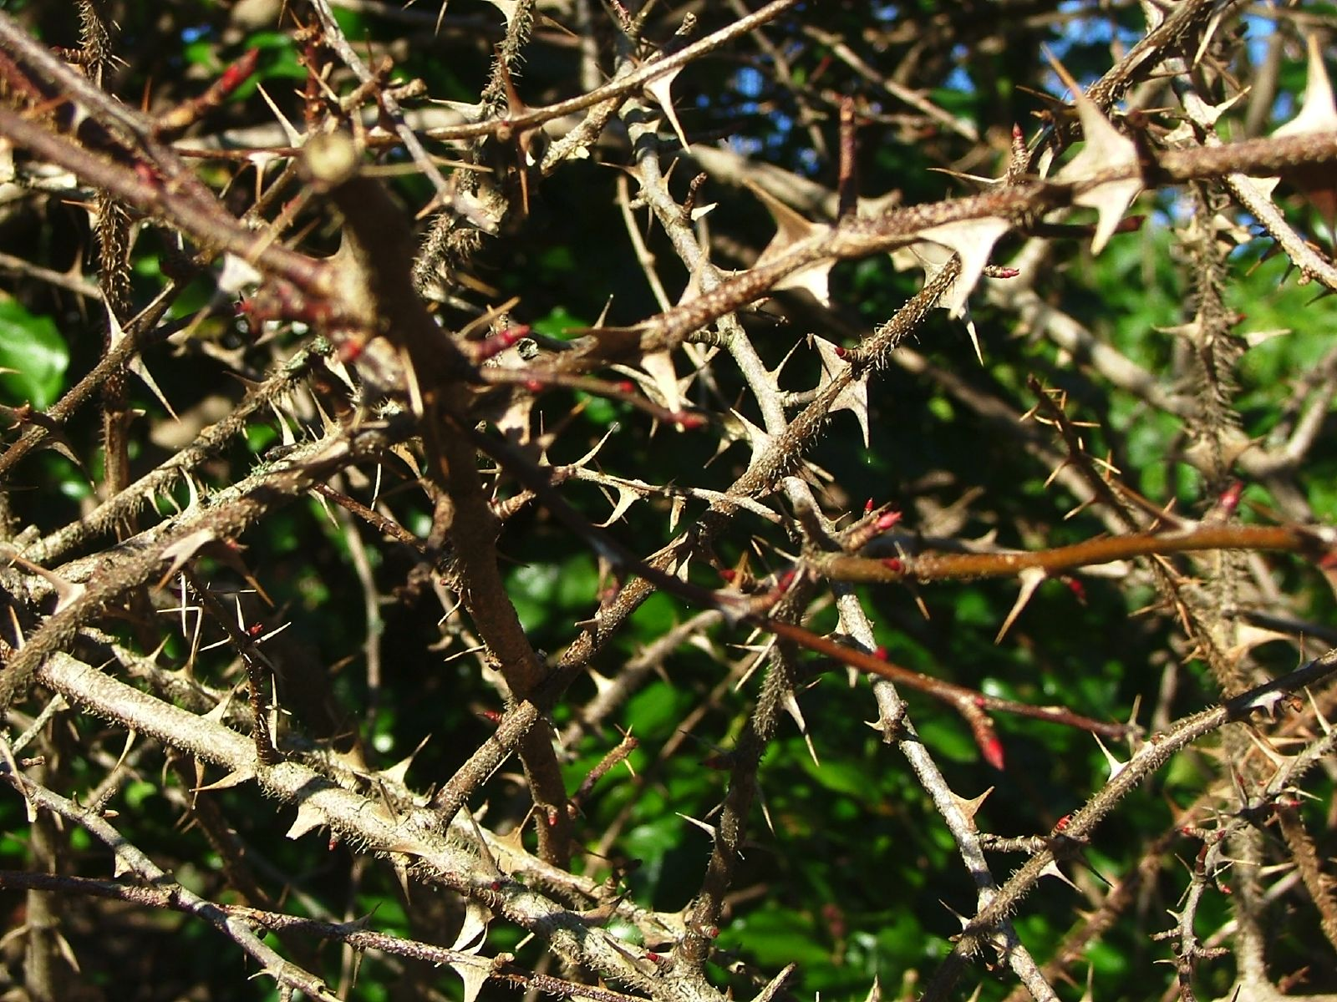
This Photo by Unknown Author is licensed under CC BY
Notes:
Who would want to walk through that???
You KNOW it’s going to hurt and there is no end in sight
The injustices are so great that even when you are willing to sacrifice, things around you tend to slow your progress and keep you from moving forward
NOTE HERE: There is nothing wrong with your soil. The seed of God’s word was planted; you act on that word, but as you do, it seems like the world is against you and get distracted, come up against resistance to great to overcome, or just ended up in the wrong place at the wrong time in life… the reasons are bountiful

Slide 19
The Successful Plant
Avoided the birds
Avoided The Rocky soil
Avoided the thorns
Result: Multiplied the effects 30, 60, 100 times
Notes:
What can we do to allow God’s word and way to multiply???

Slide 20
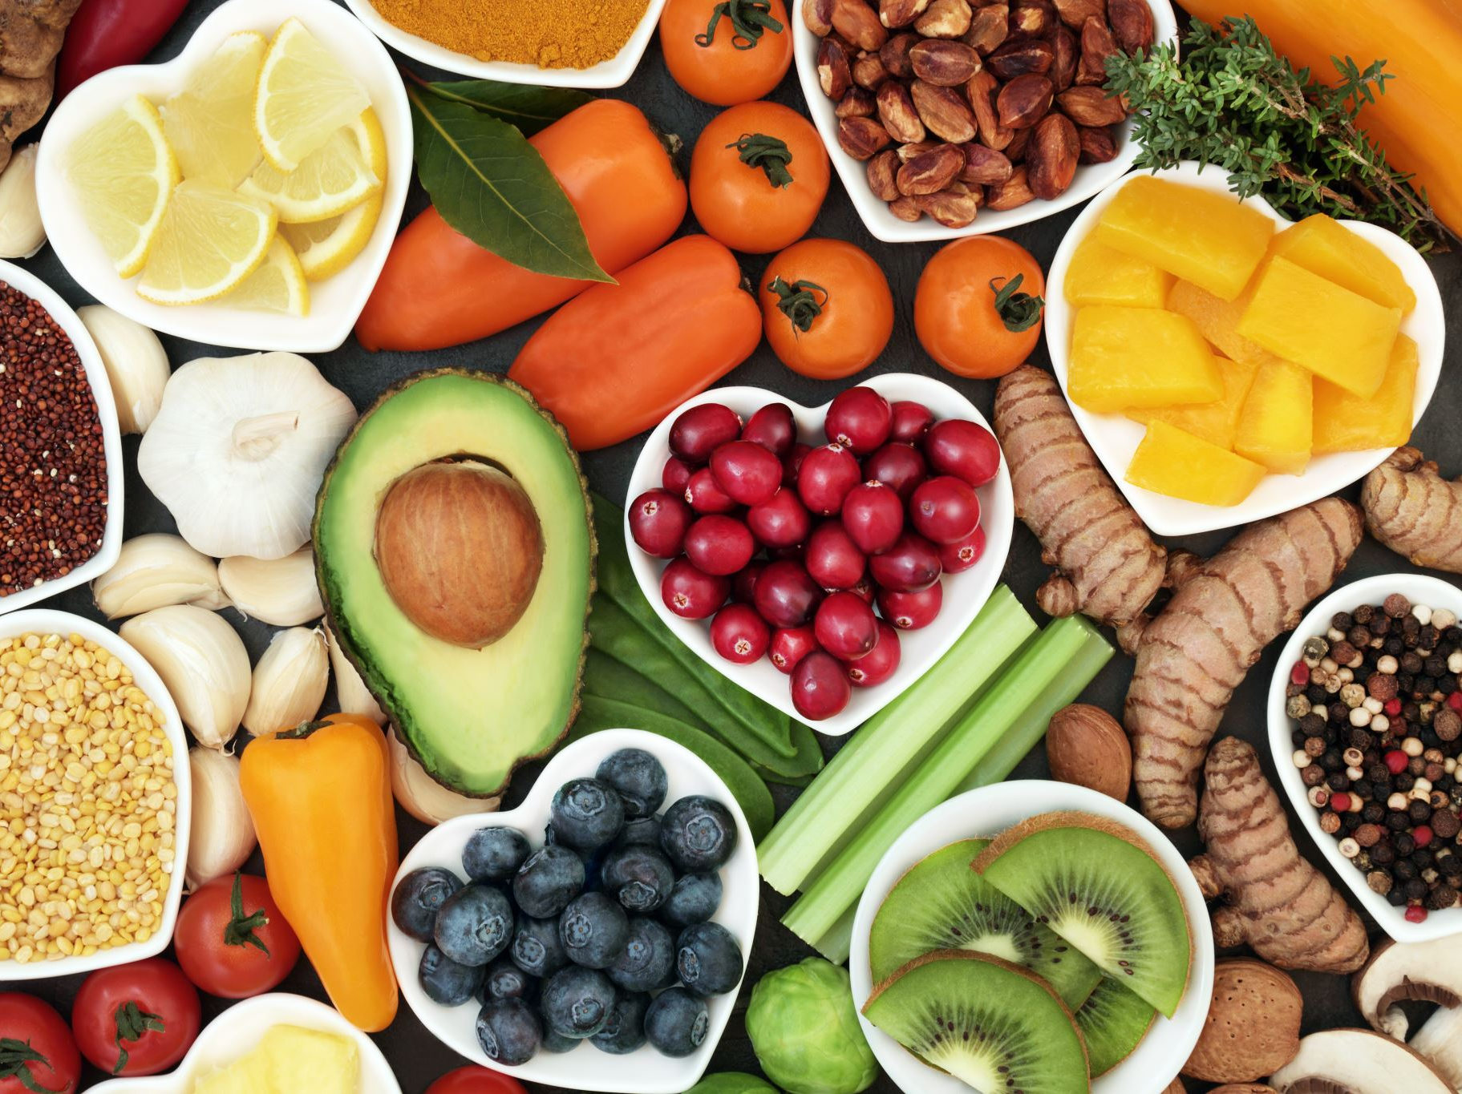
Forget the Results
While good results are wonderful by-products of the fruit of your sacrifice, it cannot be the driving force of why you do what you do
Notes:
I have had the privilege to speak in many venues in various formats to varied audiences about racial justice and similar topics. Most of the time, the presentations go with little to no compensation, and I have no idea what the effects of my talk will have on those that hear me speak.
Sometimes I receive glimpses or even direct evidence what I might have said, did make a tangible difference. And that is wonderful when it occurs. But it would never be enough to balance the time, energy, effort, preparation, mental capacity, stress, and other sacrifices to make it feel “worth it”
So often, when we feel like we are really knocking it out the park in terms of doing what God wants us to do, we typically expect to notice a change. It’s like when we first start our diet or exercise program and get frustrated when we do not see results quick enough. It is an irrational expectation to begin with but does not keep us from allowing those things to turn into thorns.

Slide 21
A Calling Beyond YOU
Another key is trying to always remember, “It is not about you”.
Giving makes us happier
Notes:
I thought the research that Bob Husband shared in his teaching recently about how the connection to happiness and money is when we give it away was telling.
Remembering the WE instead of ME is essential to growing healthy plants.
If everyone could embrace the WE. The TOTAL WE (as in EVERYONE), issues of racial justice would not even exist. Since we fall short, it is that much more imperative we allow our seeds to grow and multiply. Lord knows there are a lot of weeds out there.

Slide 22
The Source of Your Help
Psalm 121: 1-2
I lift up my eyes to the mountains— where does my help come from? ² My help comes from the Lord, the Maker of heaven and earth.
Notes:
We all have a River of Life flowing through us. And while we’ll often do our best to damn up the river or let others do so, it is an ever-flowing stream with everlasting life
It is the source that feeds and nurtures those seeds inside of us, that grows those seeds into plants, plants that reproduce themselves 30,60, 100 fold

