Slide 1
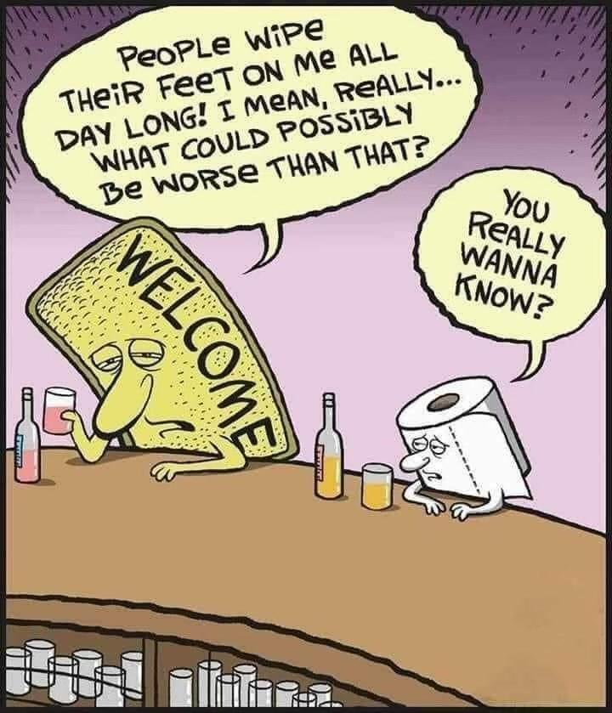
Notes:
Life can be difficult
There is an essential element in life that God designed in us that keeps us from feeling like the welcome mat or, worse yet, toilet tissue

Slide 2
Legal Firm Commercial
A harm was committed (hit by a truck, negligence in a medical procedure, etc.)
There was an acknowledgement of that harm being committed
There was restitution of the person being harmed
Notes:
We normally have to fight for someone to atone for their actions. Atonement does not come easy

Slide 3
Yom Kippur
Day of Atonement – Holiest day in Judaism
Old Testament – a day when all of Israel’s sins are forgiven through repentance and restitution. Originated with Moses and Aaron in the book of Leviticus
God’s design includes 2 key things here: 1) We all fall short of the mark, 2) We need a way to atone for falling short

Slide 4
Leviticus 16: 29-30
²⁹ “This is to be a lasting ordinance for you: On the tenth day of the seventh month you must deny yourselves^{[c]} and not do any work—whether native-born or a foreigner residing among you—³⁰ because on this day atonement will be made for you, to cleanse you. Then, before the Lord, you will be clean from all your sins.

Slide 5
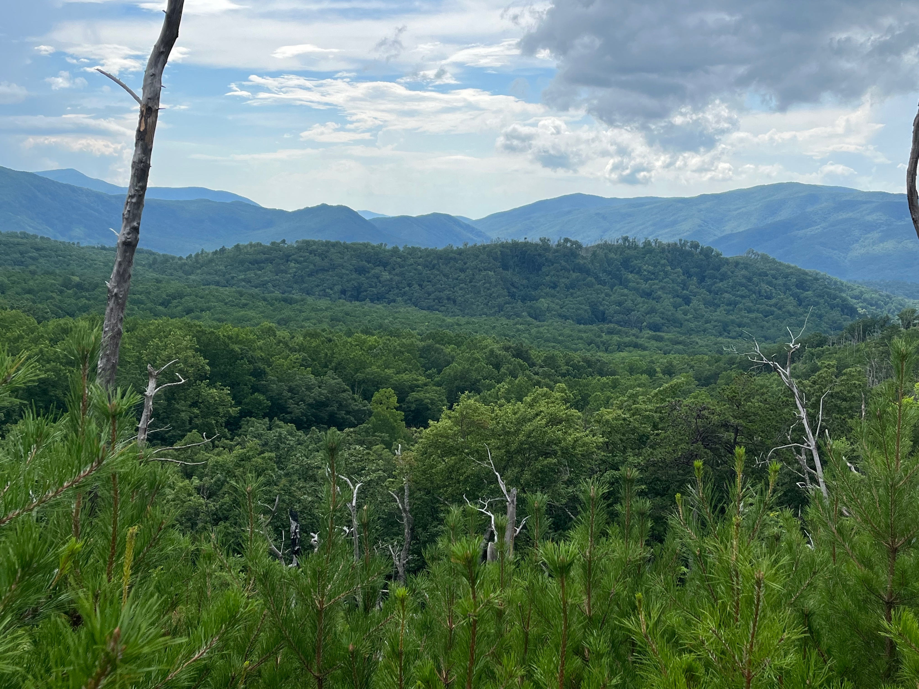
Notes:
Nature is a great example of seeing God’s renewing power
How can we resemble nature’s renewing and restoring power in our own lives?

Slide 6
Restore, Renew, Reinvest
Atonement as a path to righteousness
Notes:
One of the grants CCCHC has received bears this concept in mind
Illinois Authority of Criminal Justice Information
Source of the R3 funds stem from wrongfully jailed or sentenced people of color related to using and/or selling marijuana

Slide 7
Essential Element
Why do we seek atonement? Why not just “not care”?
A few genuinely do not care
Some say they do not care but really do
Most people care when they are responsible for wronging someone and want to make amends
Notes:
God designed us to care for one another. We know there are certain malfunctions in that design sometime, based on either something biological, experiential, or both. But, by and large, that is essentially who we are.
Most people who say they don’t care, really do care but since caring is so scary, they pretend they don’t
The very element in all the Bible centers around us falling short and needing forgiveness

Slide 8
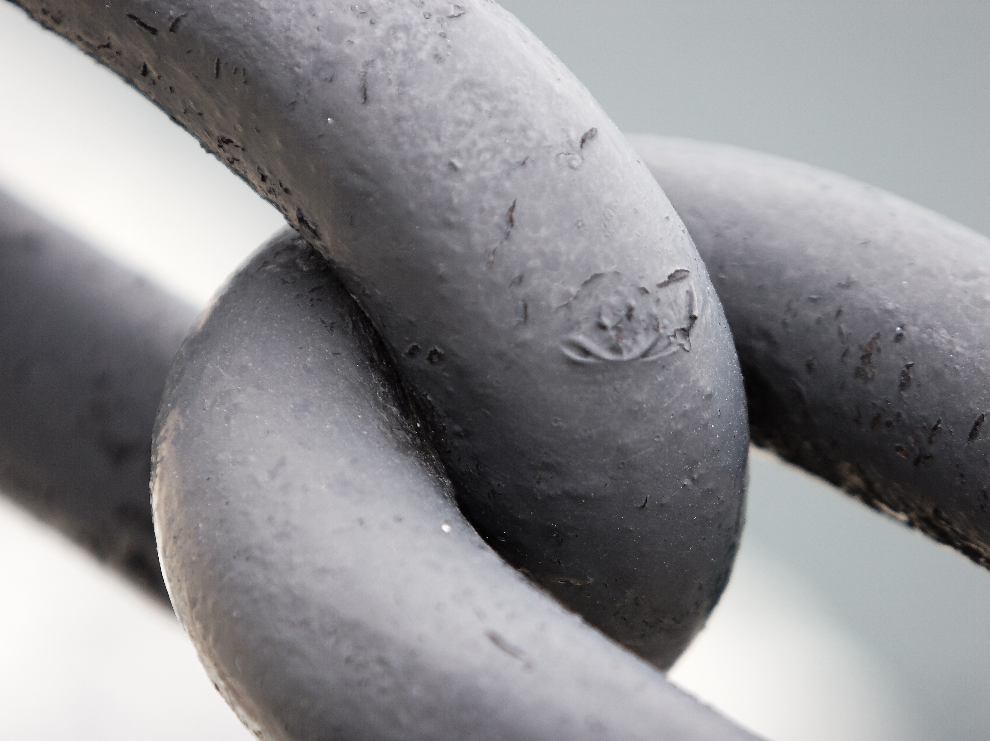
Notes:
When we do not atone for wrong, we live life in bondage. Atonement allows us to go about life with the chains broken
It is part of that freedom we experience in God

Slide 9
John 13: 34-35
³⁴ “A new command I give you: Love one another. As I have loved you, so you must love one another. ³⁵ By this everyone will know that you are my disciples, if you love one another.”
Notes:
It is the very way we are identified in the world. How we love one another. Forgiveness and restitution are major components of that love

Slide 10
Adverse to Atonement
Admitting you fouled someone in basketball (honor system)
Forgiveness and Restitution (the other team getting the ball back, might lose the game, etc.)
Rather be Right than Righteous
We will argue knowing (consciously or subconsciously) that we are wrong just so we can feel or think we are right
A story of forgiveness and restitution (CCDA – Glen Kehrien)
Notes:
We are adverse to atonement like many of us are adverse to interacting with creepy or crawly things. I once read that biologists say that we tend to have that jumpy, eerie feeling around insects/bugs, snakes, and the like due to natural instinct in human development over the years

Slide 11
Adverse to Atonement
It is difficult for us to admit wrong – Externally
Society is harsh on those admitting fault
The church is usually even more harsh than that
Corporate fault is even more difficult
Wasn’t ME!!! (losing in basketball)
Wasn’t ME!!! (happened a long time ago and I was not even here)
Notes:
In basketball, rest assure, I would have made some mistakes as well, but since I did not really flub it up like the other players, I have this righteous indignation and do not see any of my contributions to the loss
Multiply this effect when it comes to our country’s corporate fault in relation to racial justice. Most people respond by saying, ”I wasn’t even there”. What people choose not to see is that the country, the United States of America, was there as it is here now. And the country has a debt to pay. If you just to happen to be part of that country, the debt is on you as well by default.
God punished the children of Israel corporately. And some of those punishments had long lasting effects beyond the generation that messed things up. An Israelite child might have been born in captivity hundreds of years after God allowed a warring people like the Assyrians or Babylonians to destroy Israel and put their people in captivity. I am sure that kid that grew up in captivity and learned of his/her ancestor’s history was ticked off that those before him/her were responsible for their life being more difficult

Slide 12
Adverse to Atonement
It is difficult for us to admit wrong – Internally
Pride (not the good kind) and arrogance (Lev 26 – Price to pay for ignoring God’s decrees)
¹⁸ “‘If after all this you will not listen to me, I will punish you for your sins seven times over. ¹⁹ I will break down your stubborn pride and make the sky above you like iron and the ground beneath you like bronze. ²⁰ Your strength will be spent in vain, because your soil will not yield its crops, nor will the trees of your land yield their fruit.
Jesus was most harsh on those with pride and arrogance
Notes:
Think of how hard it is to let go of one’s pride in these two instances
OT – If you do not let go of your foolish pride, all these horrible things will happen to you. AND in some cases, as we know, it did!
NT – You have the SON OF GOD right next to you… taking and interacting with you... And you think you can get the upper hand and school Jesus on something? Well, you might say, “they did not KNOW it was Jesus”. However, if you are a spiritual, God fearing individual, shouldn’t you get some sense that God is present right next to you? Others did (like John the Baptist)

Slide 13
Atonement Opens Doors
No baggage, no guilt/shame, but freedom
Glen Kehrien – the rest of the story
Evanston Reparations
Restoration to descendants of slaves sold by University of Georgetown and Jesuits
God’s Kingdom
Notes:
27 million dollars with a commitment to give $100 million
The church should have a good understanding about corporate fault/sin and seek to lead the way in atoning for wrongs committed by the church.

Slide 14
1 John 1: 5-7
⁵ This is the message we have heard from him and declare to you: God is light; in him there is no darkness at all. ⁶ If we claim to have fellowship with him and yet walk in the darkness, we lie and do not live out the truth. ⁷ But if we walk in the light, as he is in the light, we have fellowship with one another, and the blood of Jesus, his Son, purifies us from all^{[b]} sin.
Notes:
The ultimate restitution will not come until Jesus renews, restores, and reinvests in this world. In most cases, no amount of resources can atone for wrongs committed. However, we all will be made whole again upon Christ’s return.

