Slide 1
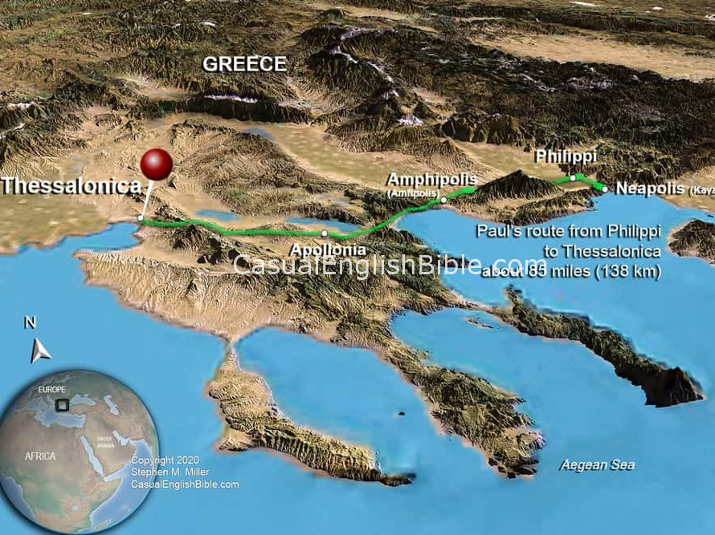
Notes:
When you have to deliver an unpopular message or say something to others that may not be where the group think is at the moment
Usually by walking, Paul traveled an estimated 12,400 miles in all his missionary journeys
(He would have racked up some serious frequent flyer miles today)
Paul travels across Asia Minor and Greece. 85 miles between his last stop in Philippi and Thessalonica

Slide 2
1 Thessalonians 2:1-8
You yourselves know, brothers and sisters, that our coming to you was not in vain, but though we had already suffered and been shamefully mistreated at Philippi, as you know, we had courage in our God to declare to you the gospel of God, despite great opposition. For our appeal does not spring from deceit or impure motives or trickery, but just as we have been approved by God to be entrusted with the message of the gospel, even so we speak, not to please mortals, but to please God who tests our hearts. As you know and as God is our witness, we never came with words of flattery or with a pretext for greed; nor did we seek praise from mortals, whether from you or from others, though we might have made demands as apostles of Christ. But we were gentle among you, like a nurse tenderly caring for her own children. So deeply do we care for you that we are determined to share with you not only the gospel of God but also our own selves, because you have become very dear to us.
Notes:
Lectionary for today highlights I Thessalonians 2: 1-8

Slide 3
Spreading Change
A system was in place and people understood that system
Paul's message of the gospel of Christ, sparked controversy and was a catalyst for change where change was not welcomed
While each town is different, Paul lays out the methods to promote change and encourage adaptation

Slide 4
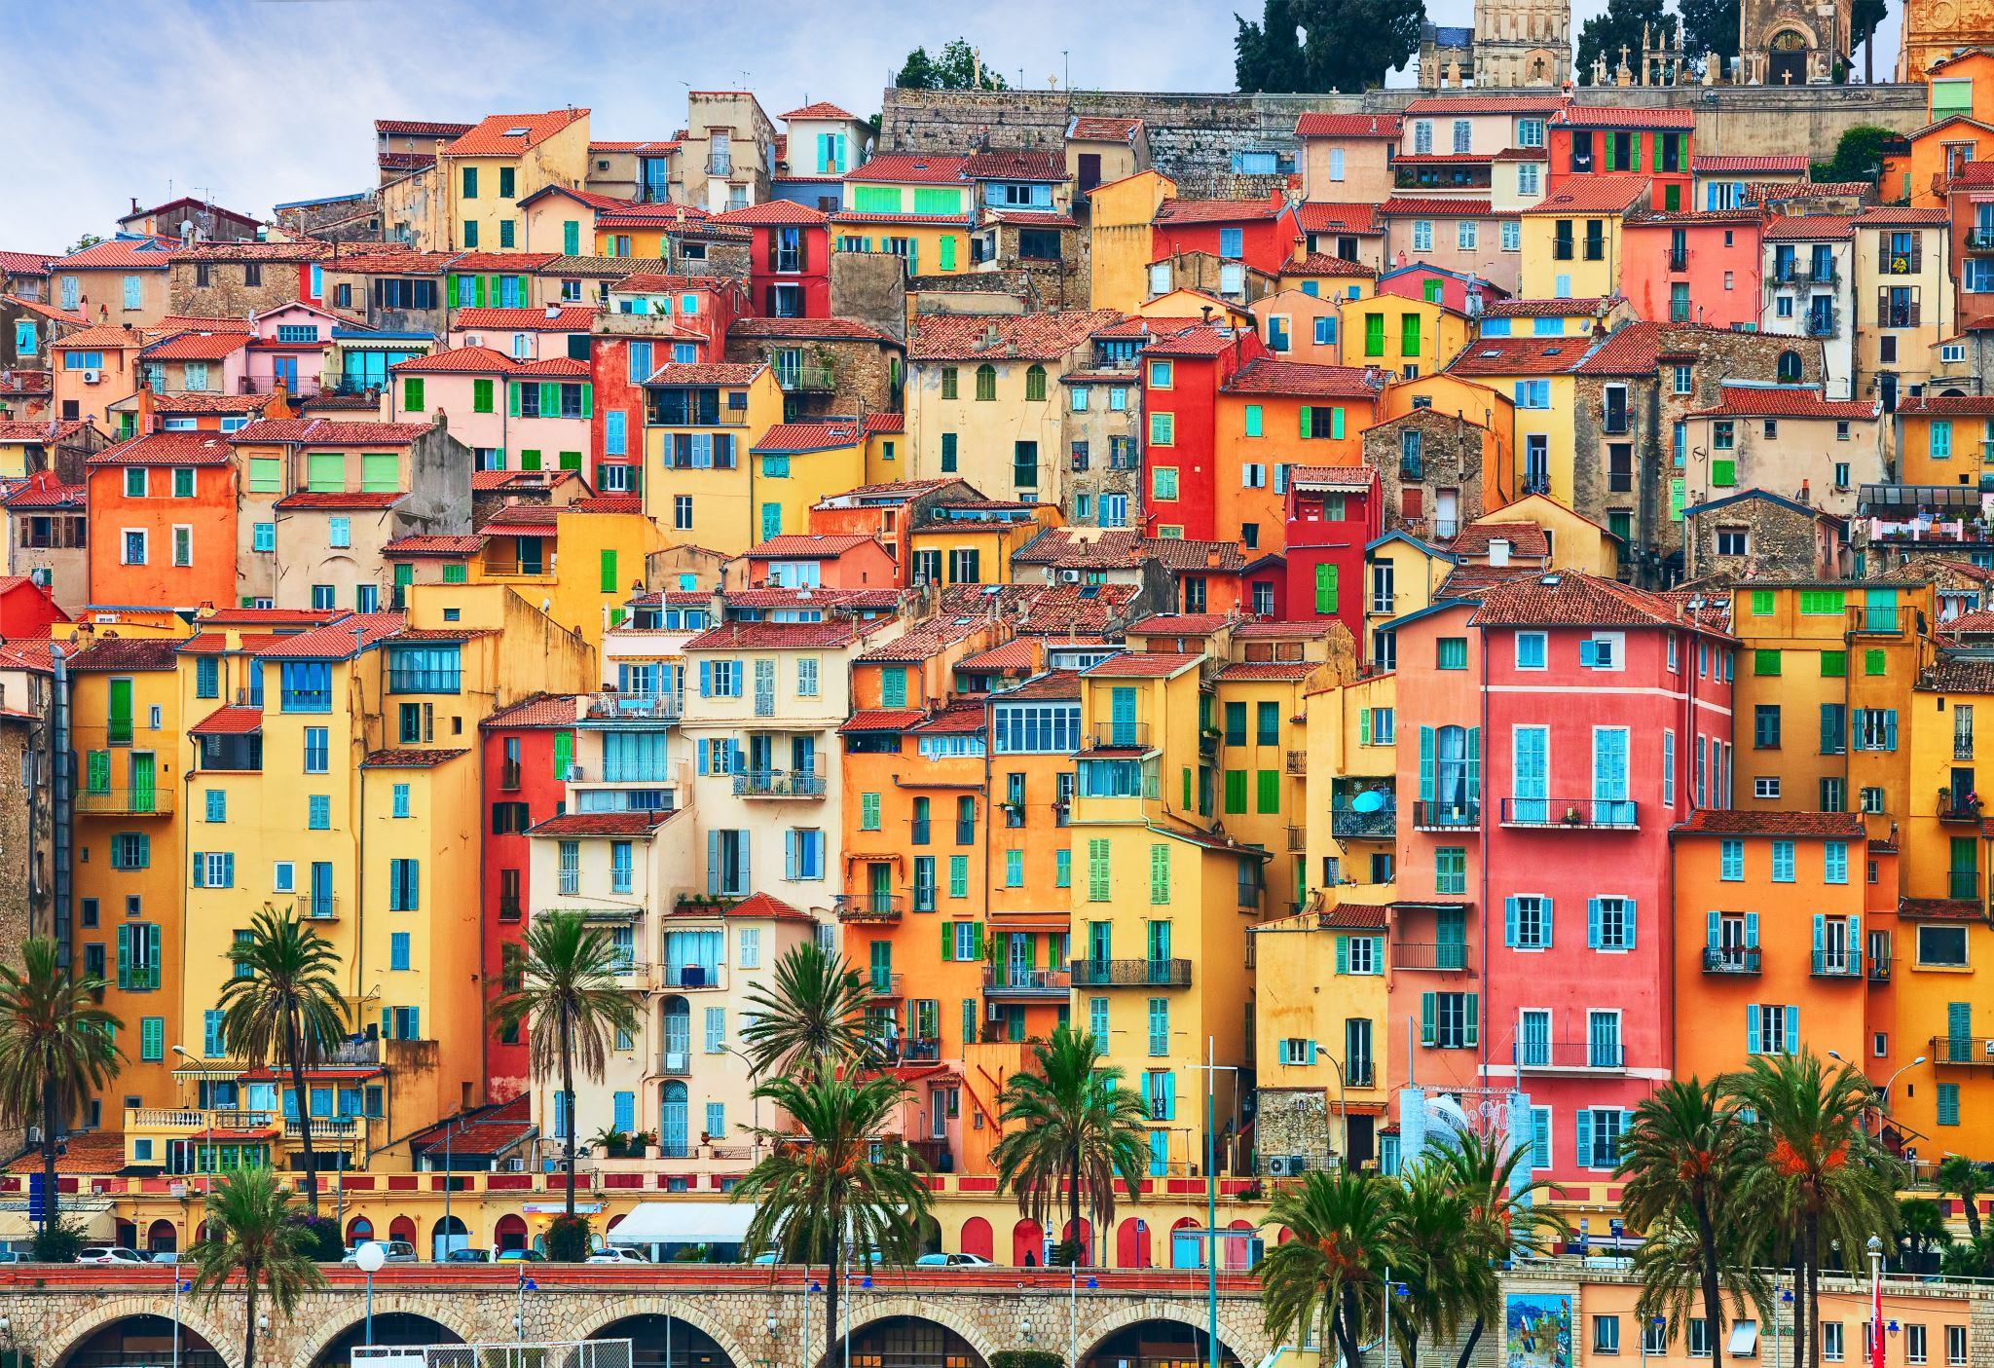
Cities like Thessalonica
Difficulties
Isolated and independent
Sought status among other Greek cities – not likely to just adopt the latest craze because other places do
Message of the gospel would not have resonated with individuals in the cities because they might be considered weak and foolish by accepting this crazy story about Jesus
Notes:
At that time, there was even pressure for Christ to return in Paul’s time – to legitimize the message.

Slide 5
I Thessalonians 2: 1-8
So deeply do we care for you that we are determined to share with you not only the gospel of God but also our own selves, because you have become very dear to us.
Notes:
Change comes through relationships

Slide 6
The Path and Journey to the Kingdom
How to Work Through the Resistance for Doing Good
Notes:
Being a believer is not an individual experience – there is a calling larger than any individual
There is a collective purpose. Seen throughout the Bible in the Old and New Testaments. The Bible is not a collection of autobiographies with a first-person perspective. Every prophetic story is wrapped around a group of people, or even an entire nation.
While each of our paths may be different and specific to who we are, our journeys are not traveled alone in isolation, but shared. And as believers, we all have the same ultimate destination.
And our path leads somewhere specific. We are not aimlessly traveling. We are not Alice in Wonderland when she asks the cat “which way should I go” and the Chelshire cat asks “where are you headed”, and she says, “I don’t know”, then he replies, ”then any road will get you there”
Paul had a path and proceeded with his journey with a destination in mind (not necessarily geographically speaking, although that was part of it, but with a specific goal – to share the gospel of Jesus to anyone he could reach) – to build God’s kingdom on earth
What is our destination today? And a better question is, what does our path look like to get us there?

Slide 7
Penny for Your Thoughts
Radio Discussion about Reparations
Notes:
My current path/journey
The day before…
“The discussion for reparations is very simple, there should not be any”
Hopefully Renee and I planted some seeds that otherwise, would not have been planted

Slide 8
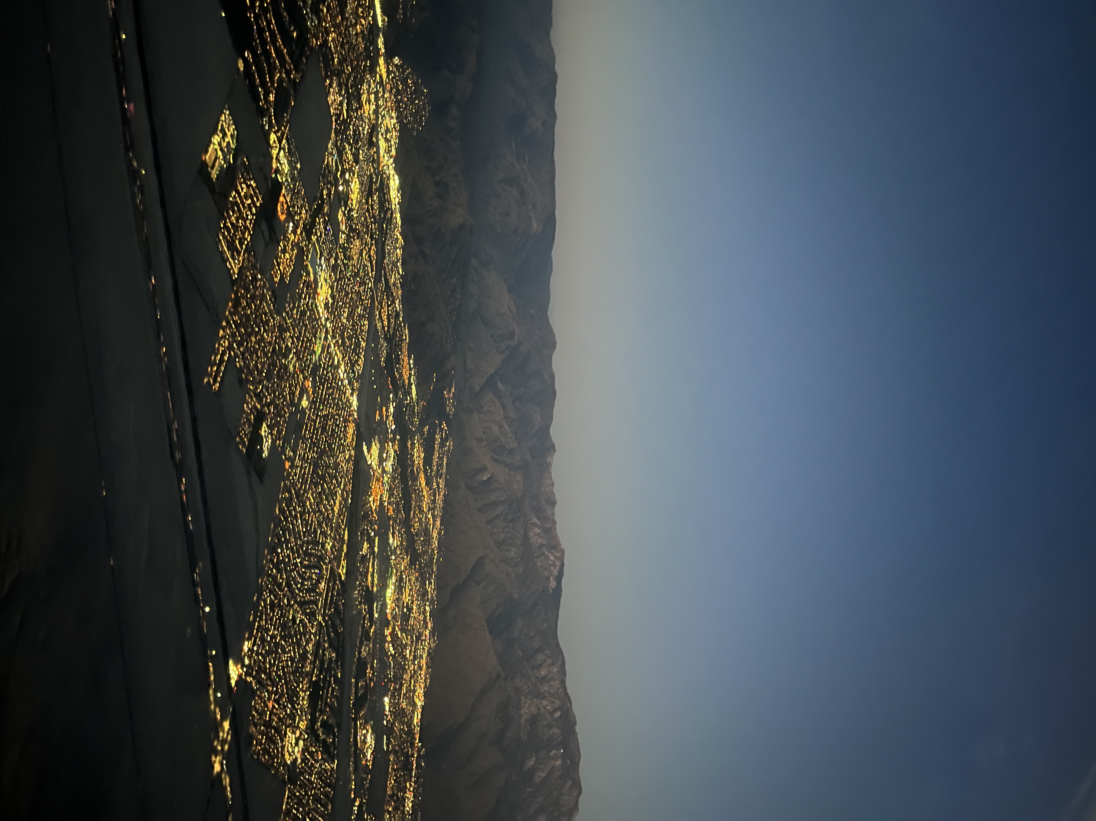
Notes:
The message of racial justice and reparations to today’s cities (Picture of Palm Springs, CA - National Association of Free and Charitable Clinics Conference)
68% of the US population is against reparations for African-Americans
Very fascinating statistic to me as most people most likely do not even have a clear picture of what reparations might be or even look like
I share this as I believe NCF will be faced with answering questions from those that resist change
I even believe this may be the next Civil Rights ”like” movement in the years to come. Initially, thought of as crazy even though treating people with civility was always the right thing to do. Then Rosa Parks refused to give up her seat that sparked the movement (I see George Floyd in similar context) and then people collectively pushed for change through protests, collaboration, passion, and courage.

Slide 9
Courage & Boldness
Resistance is par for the course
Most of us avoid conflict and feeling uncomfortable
Going with the flow, not against the stream or against the grain seems easiest initially, but in the long-run, it can have greater consequences
Notes:
I think about it like skydiving with much smaller consequences if things do not go according to plan.
Have you ever had an experience where you took the easier option only to realize that the more difficult option initially was the easier option overall?
It’s like maintenance for your car. Putting the money and time in to get an oil change is an inconvenience and sacrifice. However, if you go the easier route in the moment and ignore it, you will end up with much bigger problems that will cost a LOT more time and money
While we rarely may see the consequences on an individual scale, when we sidestep something God is leading us to do, there is a bigger price to pay down the line than the immediate sacrifice and inconvenience. Collectively, this country mistreated African-Americans and there are countless negative results of that mistreatment. I am often amazed of how much criticism is directed towards AAs for the situation our community is in … as if the reasons why there are income and wealth disparities exists is due to some inherent lack of will to be successful. Or that the lacking of education is due to lacking appreciation of education versus the numerous factors that lead to educational disparities.
We often hear disparaging comments towards homeless people and see their situation as strictly self-inflicted. When I see a homeless person or family, I see it as a failure in our system, in our society. Sure there is some room for individual consequences and choices, but given the dynamics of our country, I place the vast majority of the problem on our collective failure to fulfill God’s calling in loving our neighbor.
While I believe both of these examples are not only reasonable, but statistically proven, it is often the unpopular stance in many circles.

Slide 10
Moving Along the Path/Journey
Education
You learn about something first
Preparation
You do your due diligence and plan
Faith
Notes:
Skydiving
Do your homework… learn how to jump out the plane, when to pull the ripcord, etc.
You check and double check everything about your parachute
You take the big leap out the plane
Believers Journey
Do your homework… learn the path and direction God wants you to take individually and collectively
You check and double check everything about what you need to have a successful journey
You take the big leap out in the world

Slide 11
Check Your Motives
Who do we seek to please? And why?
Where do our thoughts and opinions originate?
Why do we hold on to certain beliefs?
Why do we share those beliefs? Or why do we stay silent about them?
Who are you worried about disappointing or upsetting and why?
What are you afraid of losing?

Slide 12
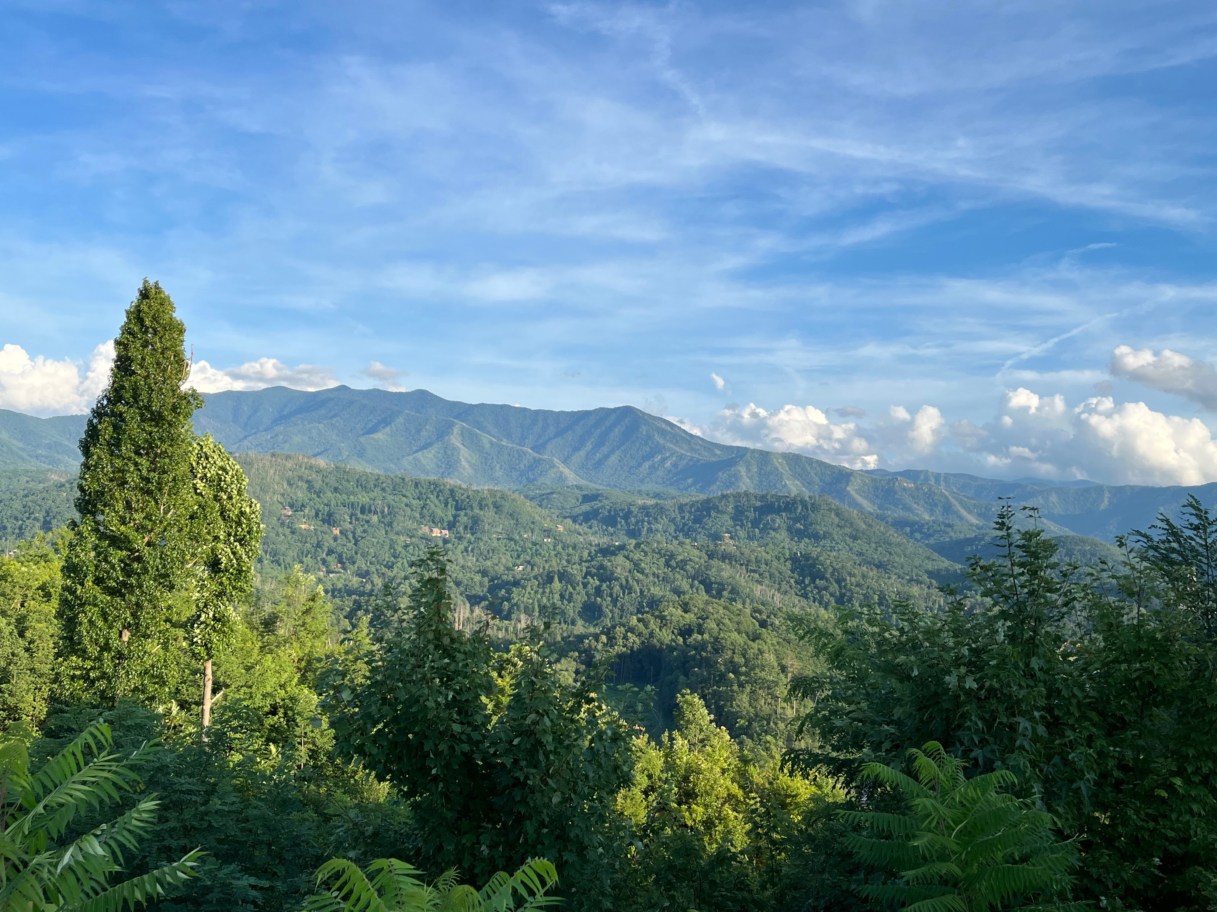
Notes:
I enjoy hiking. There is such beauty in the world and hiking allows you to experience it directly.
But hiking is not easy. You see, there’s these things called hills and mountains. And hiking requires you to climb up or work your way down these hills and mountains over and over again. Depending on the season, there is also the case of dealing with bugs. Or the cold. Or the heat. Depending on where you hike, interacting with wildlife can be dangerous. You could get lost. You will get tired, and sweaty, and even smelly. After a while, your body will ache.
While the journey is beautiful in the big picture, going through the actual path is not simple and easy. However, we still do it because the overall purpose of hiking is more important and fruitful than all the obstacles and calamities we have to endure.

Slide 13
Champaign County Christian Health Center
A Difficult Path and Journey with a Worthwhile Destination
Notes:
When I think of the clinic, I see the same process. Sustaining an organization that provides much needed healthcare to people free of charge is as beautiful as that picture of the Appalachian Mountains big picture wise. But down on the path, rest assure, there are obstacles and calamities to work through to reach the destination. And like hiking, it is more than worth it.
Thank you to all of you who have supported and continue to support CCCHC.

Slide 14
Starts with Caring
We have to care for those we are hoping will journey with us.
Notes:
Paul makes it personal. These Thessalonians are not just another notch on Paul’s evangelism belt. He is sharing himself as much as he is sharing the gospel. There is a very common saying that says, “I don’t care how much you know, until I know how much you care”
We want to care, not in a manipulative way or disingenuous way – as Paul pointed out… we are not here to flatter you or get something from you. We want to care about the person receiving the message and about the message itself.
That’s how we bring people together.

Slide 15
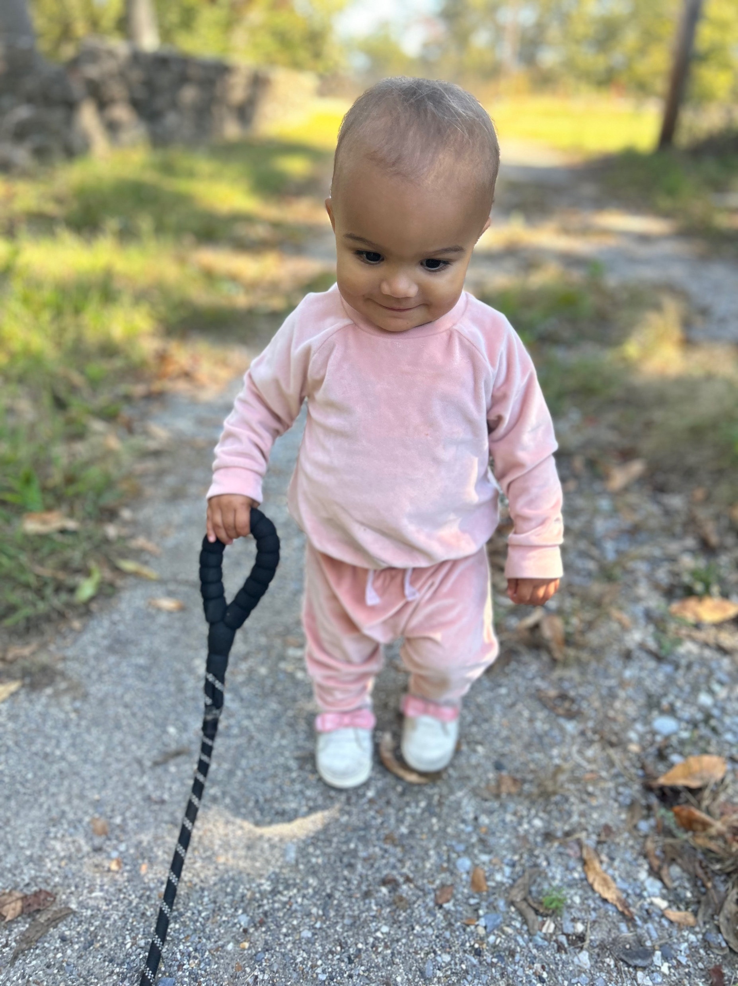
Ends with Hope
Striving towards this destination has purpose beyond our comprehension
Making the path better – making it more robust and common
Setting an example for the next journey
Notes:
I wonder how much those who struggled through Civil Rights could envision what their work would result in down the line. While there is progress yet to be made, their sacrifice paved the way for younger generations to live in a better world.
I cannot help to think about my granddaughter, when someone like her would not likely exist because as few as 60 years ago, when the Supreme Court finally deemed banning interracial marriage unconstitutional (1967).
How might a movement that strives for universal reparations transform the future for not only people of color, but for everyone?

Slide 16
Proverbs 8: 19-21
¹⁹ My fruit is better than fine gold; what I yield surpasses choice silver. ²⁰ I walk in the way of righteousness, along the paths of justice, ²¹ bestowing a rich inheritance on those who love me and making their treasuries full.
Notes:
I am excited to travel this journey with you. I do not know how it will go but I am glad to be on it with you all

