Slide 1
Notes:
I love escape rooms. I remember the very first one I tried. It was the early days of escape rooms before they realized people really want to be successful and therefore, this escape room was extremely difficult. It also had an element I have yet to see replicated in any other escape room (and I have done a good number if them). The room was called, “Trapped in a Room With a Zombie”. And the unique feature it had was a person dressed and made up like a zombie, with a chain around their neck, stalking around the room. Every 5 minutes in our hour-long experience, the chain would extend further, allowing the zombie to roam around more freely about the room. Given the difficulty of the room, the inexperience of the participants and stalking zombie, let’s just say we did not do well. However, I learned something about myself and other people that day.

Slide 2
Notes:
I learned that part of my personality includes trying to reach a goal till the bitter end. There were 12 of us in the room (half were family and the others were strangers) and it was not too long before the other participants starting worrying more about the zombie than solving puzzles, unlocking locks and reading clues. Matter of fact, about halfway in, only 3 of the 12 of use were actually trying to still solve the room’s riddles. You would have thought the person stalking around in the chain was a real zombie. Me and remaining 2 problem solvers still had a bunch of boxes and cabinets to unlock and clues to solve while the clock went down to last 5-10 minutes. Eventually, the last two participants rendered the cause unless and joined the others in running around the room to avoid the zombie. I, on the other hand, kept trying to solve clues until the last second ticked off the clock.

Slide 3
Keeping the Faith Through Perseverance
^{We have a clock}
^{We have a goal}
We have obstacles along the way
Notes:
Point 1: We literally have a clock in life. No one is immortal, no one is going to live in this body on this earth for eternity. The timer started the moment we were born and tick ticking away. We have a finite amount of time to reach our goals
Point 2: We have a goal. As a believer in Jesus, we have a calling to build God’s kingdom on Earth as it is in heaven. That may come in countless shapes and forms and will likely change throughout our lives, but the point is that we are not aimlessly wondering about this life without something to strive towards
Point 3: We have obstacles… Man, do we have obstacles. Just like the escape room, we have life’s riddles we have trouble solving; life’s clues we have trouble interpreting; life’s locks waiting to be opened; all the while trying to collaborate with other people who may do as much harm as help (I had a young woman push me out of a spot to save herself from the zombie and make me a sacrificial lamb); AND let’s not forget about the stalking zombie, getting more and more leeway as time presses on.

Slide 4
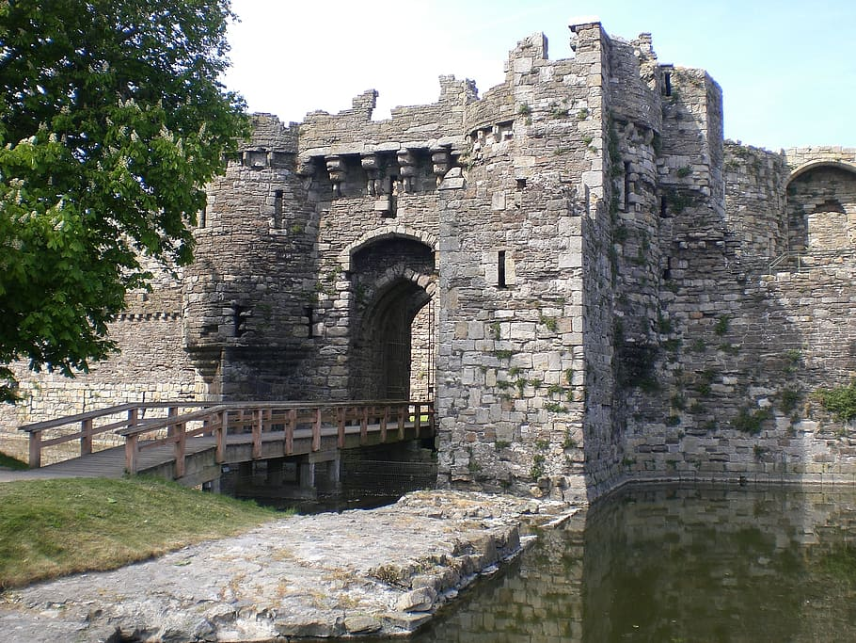
Falling of a Kingdom
Book of Zephaniah the Prophet
Last decades before Babylon destroys and takes the southern kingdom of Judah
King Josiah, one of the good kings, tries to bring the people back from their idolatry but they are too far gone
Zephaniah, a contemporary of Jeremiah, is letting the people know what is eventually going to happen
Notes:
The Babylonians will come and plunder Judah and God will allow that to happen because of their unwillingness to be faithful

Slide 5
Zephaniah 1:7, 12-18 1:7 Be silent before the Lord GOD! For the day of the LORD is at hand; the LORD has prepared a sacrifice, he has consecrated his guests. 1:12 At that time I will search Jerusalem with lamps, and I will punish the people who rest complacently on their dregs, those who say in their hearts, "The LORD will not do good, nor will he do harm." 1:13 Their wealth shall be plundered, and their houses laid waste. Though they build houses, they shall not inhabit them; though they plant vineyards, they shall not drink wine from them.
Notes:
Complacency is poison.
The lectionary this week, had a clear theme. 1 Thessalonians talks about Jesus coming as a thief in the night. Growing up, that phrase was always used to scare us into “living right”... Don’t do wrong because, Jesus is bound to come back and sneak up on you if you do. But what Paul is really saying is that we should always be trying to fulfill God’s word
The Matthew passage for this week was about the servants use of the talents given to them by their master, The servant that had 5 talents turned it into 10, the one with 2 turned it into 4 and the one with one, did nothing. I used to hate that story as it felt unfair and very capitalistic in nature. Only the servants that make his master some money get rewarded? What’s up with that? But it was not about that at all. It was about what are you doing with what God has given you and how unfortunate it would be to waste what God has given you by burying it in the ground. - complacency is poison.
Even our song today, Keep Your Lamps Trimmed and Burning is about being ready for Jesus’ return – with 5 of 10 bridesmaids not having their lamp oil ready for the groom that came in the night
I used to think these stories and passages were all about punishment and fear. But they’re not. The point is to motivate us to keep trying and not be complacent. It’s not about the outcomes. Just as many commercials say, “RESULTS MAY VARY”

Slide 6
Zephaniah 1:7, 12-18 1:14 The great day of the LORD is near, near and hastening fast; the sound of the day of the LORD is bitter, the warrior cries aloud there. 1:15 That day will be a day of wrath, a day of distress and anguish, a day of ruin and devastation, a day of darkness and gloom, a day of clouds and thick darkness, 1:16 a day of trumpet blast and battle cry against the fortified cities and against the lofty battlements.
Notes:
The people of Judah became complacent, and God was not having it. Zephaniah predicted what would happen and a few decades later, it did.
Even when things seem hopeless, we are tasked with trying till the end anyway. There is always a point to trying till the end… even if, or especially if we cannot see it. It is about our faithfulness

Slide 7
Zephaniah 1:7, 12-18 1:17 I will bring such distress upon people that they shall walk like the blind; because they have sinned against the LORD, their blood shall be poured out like dust, and their flesh like dung. 1:18 Neither their silver nor their gold will be able to save them on the day of the Lord's wrath; in the fire of his passion the whole earth shall be consumed; for a full, a terrible end he will make of all the inhabitants of the earth.
Notes:
This prophecy is for all of us.
Emphasis on our resources not being able to save us. I think for people in the US, it is a good reminder that we are not worthy to be part of God’s kingdom other than by our faith in the redemptive power in Jesus.

Slide 8
People of Judah
They became to preoccupied with the zombie, they were not living their best life for God
Their mistake was not failing to get out the escape room, their mistake was to stop trying
In the end, this led to a remnant of God’s people remaining – those that kept trying despite all the pitfalls around them

Slide 9
The Good News
God will restore the remnant
Justice will prevail
The end is not the last tick on the clock

Slide 10
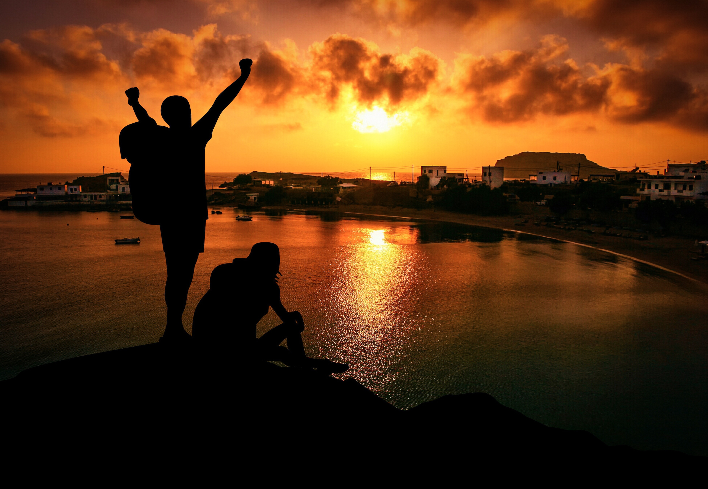
The Difference
The End Goal in Life and Escape Rooms is NOT the Same
The Point in life is NOT TO WIN by escaping, but to KEEP TRYING till the very end – Not about the results
In this life, we will never unlock every lock or solve every riddle or accurately interpret every clue, and that’s ok
In this life, the goal is to keep trying to do those things, despite life’s obstacles, until the last second ticks off the clock
Notes:
Life is a journey without ever reaching the destination – at least not in this world and in this body

Slide 11
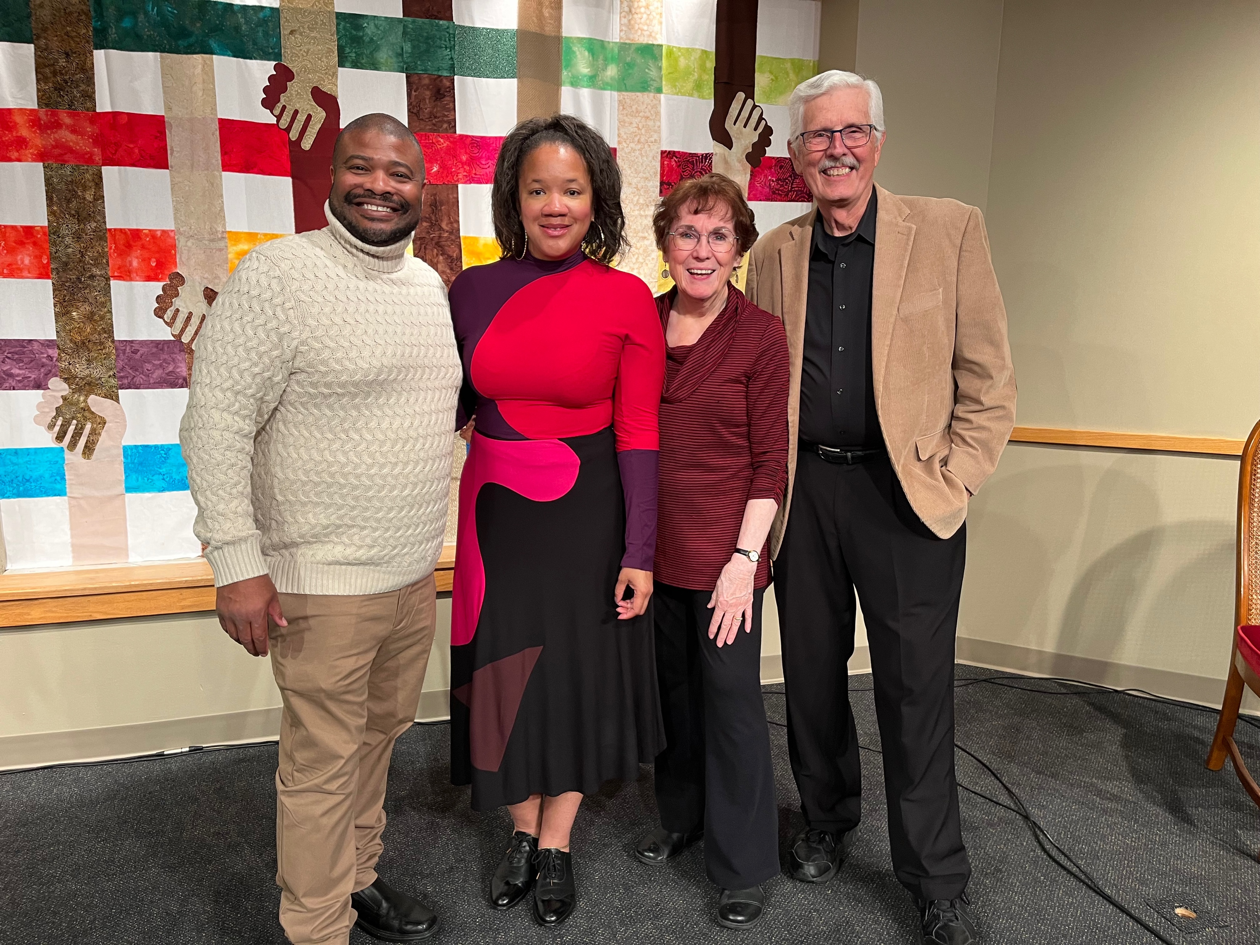
Path to Reparations
I asked Robin Rue Simmons, who led the reparation efforts in Evanston, what would the Robin today say to the Robin before all this started, if should could go back in time and meet herself.
She said that despite the host of obstacles, threats, and disappointments, she would tell herself to press on anyway, because it is worth it
Notes:
Our church, our community, our country is just starting the escape room of reparations. We certainly have riddles to solve, clues to interpret, and locks to unlock, along with distractions and other obstacles. However, as Ms Simmons said, it is worth it

Slide 12
Paul’s Encouragement II Thessalonians 1: 3-8
³ We ought always to thank God for you, brothers and sisters,^{[b]} and rightly so, because your faith is growing more and more, and the love all of you have for one another is increasing. ⁴ Therefore, among God’s churches we boast about your perseverance and faithin all the persecutions and trials you are enduring.⁵ All this is evidence that God’s judgment is right, and as a result you will be counted worthy of the kingdom of God, for which you are suffering. ⁶ God is just: He will pay back trouble to those who trouble you ⁷ and give relief to you who are troubled, and to us as well. This will happen when the Lord Jesus is revealed from heaven in blazing fire with his powerful angels.

Slide 13
Paul’s Encouragement II Thessalonians 1: 11-12
¹¹ With this in mind, we constantly pray for you, that our God may make you worthy of his calling, and that by his power he may bring to fruition your every desire for goodness and your every deed prompted by faith. ¹² We pray this so that the name of our Lord Jesus may be glorified in you, and you in him, according to the grace of our God and the Lord Jesus Christ.^{[c}

Slide 14
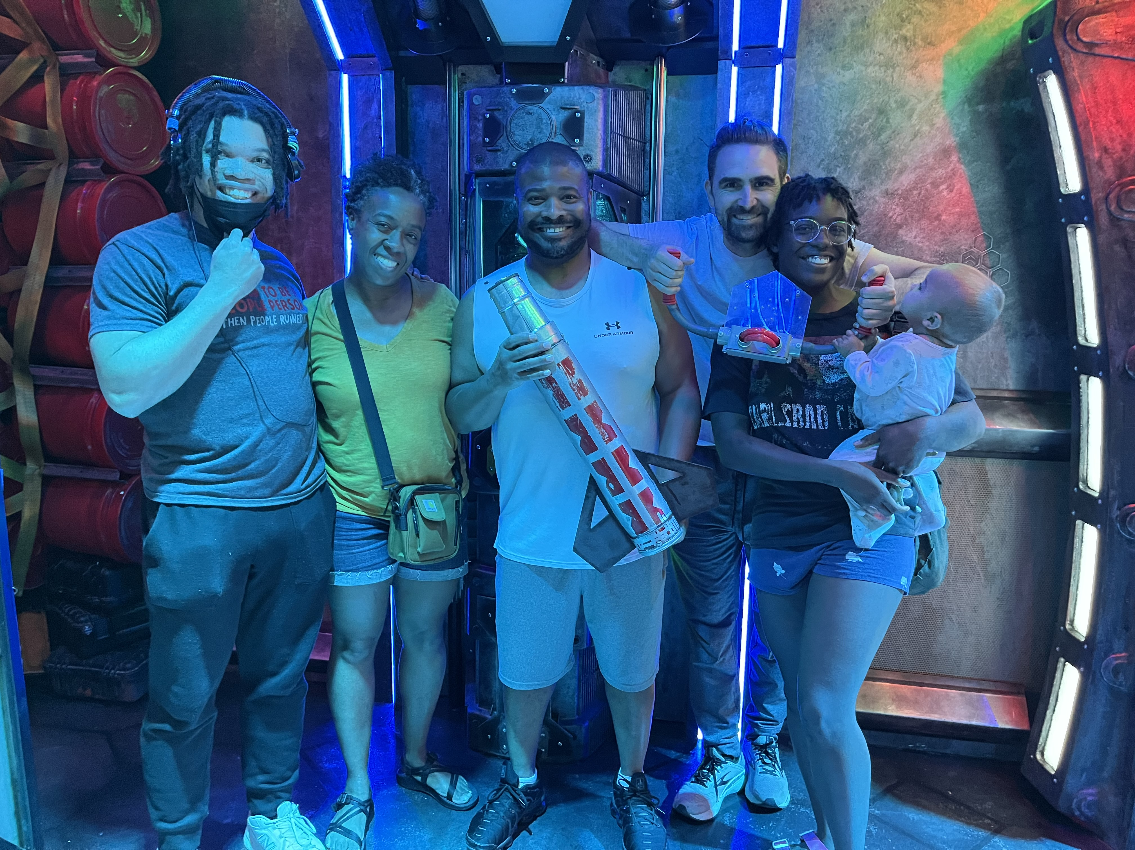
Life’s Journey
Life is like a roller coaster. There will be ups and downs, twists and turns; times when you feel your stomach in your mouth and times of pure exhilaration;
Ultimately, the good news is that through it all, God is with us and for us so let’s strap on that seat belt, lower the harness, and enjoy the ride

