Slide 1
Urbana Neighborhood Connections Center
“Where our youth will grow, our parents will help, and our community will share.”

Slide 2
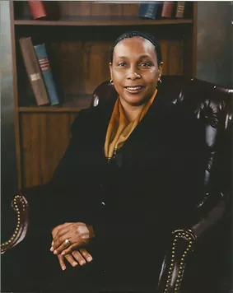
1401 E. Main St.
Urbana, IL 61802
(Across the street
from the VFW Post 630)
Founder & First CEO,
Mrs. Janice Mitchell
Jan. 19, 2010
Vision: A place in southeast Urbana for after-school programming and youth development with a strong academic focus.

Slide 3
Who we serve
Students ages 5-17 in summer, afterschool, all-day program, and high school students in College & Career Readiness program; ages 16-24 in Summer Youth Employment program
Currently between 55 and 60 consistent youth | 85 consistent young adults
Residing in Champaign County, mainly Urbana
Summer & Days Out Program Participants all day 8am-5:30pm
After-school Program Participants from 3-6pm
Individuals from a wide range of socioeconomic backgrounds
Students performing at a variety of academic and behavioral levels
Families in the community, in need of services provided by Urbana Neighborhood Connections Center

Slide 4
Program Components
Academic Support
STEAM Enrichment
Cultural Awareness
Social-Emotional Learning
Service Learning
Transportation from school to our facility
Nutritious meals upon arrival

Slide 5
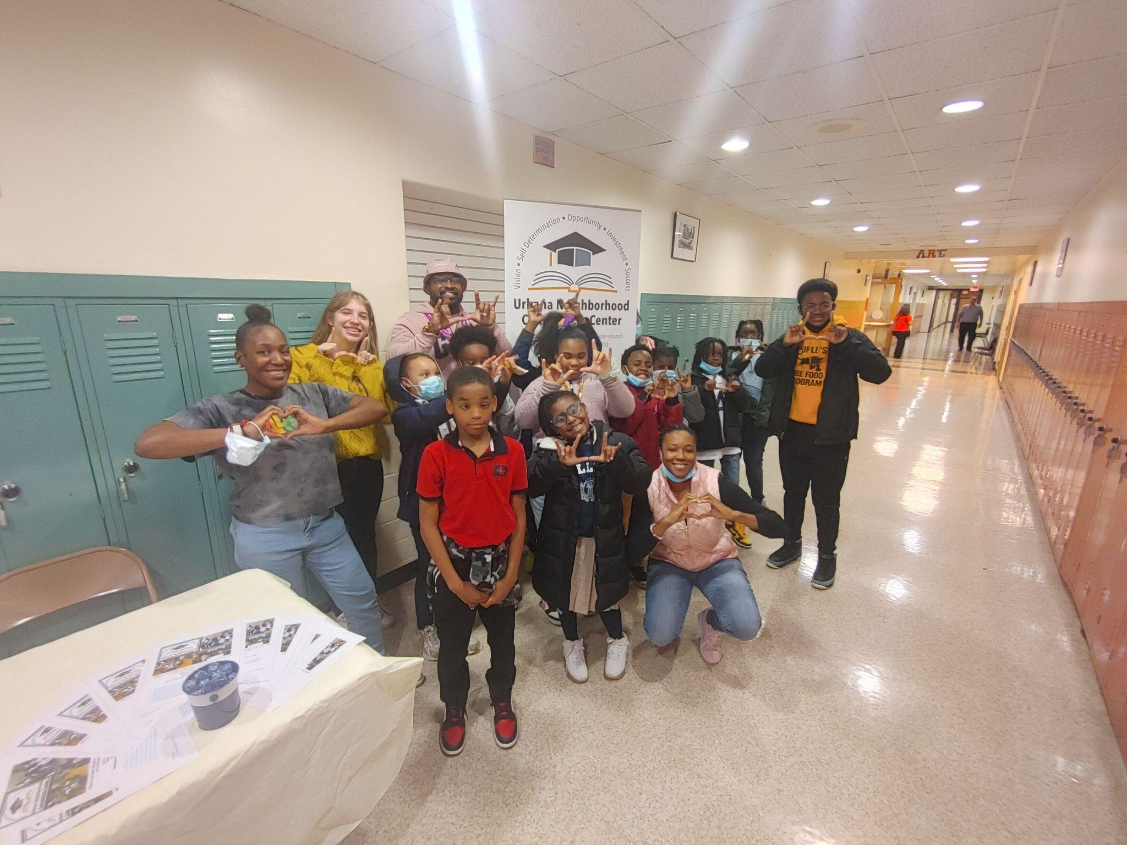

Slide 6
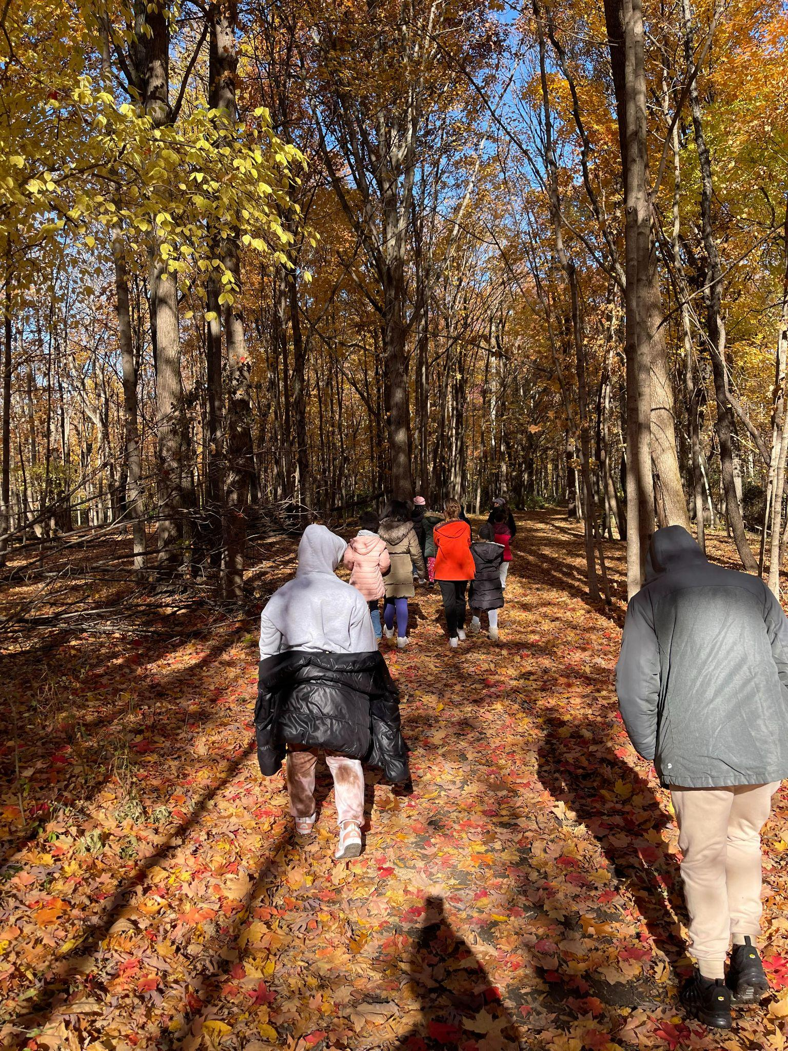
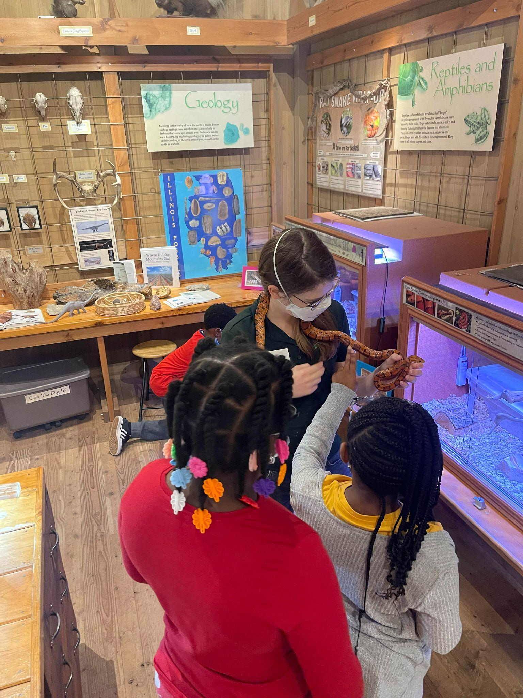
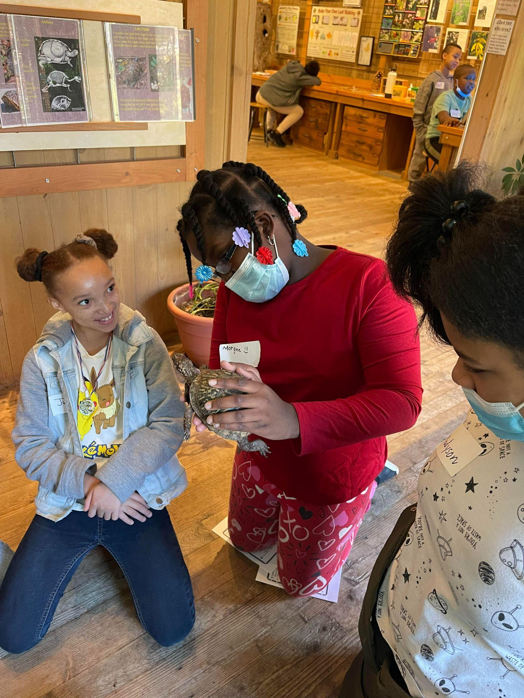

Slide 7
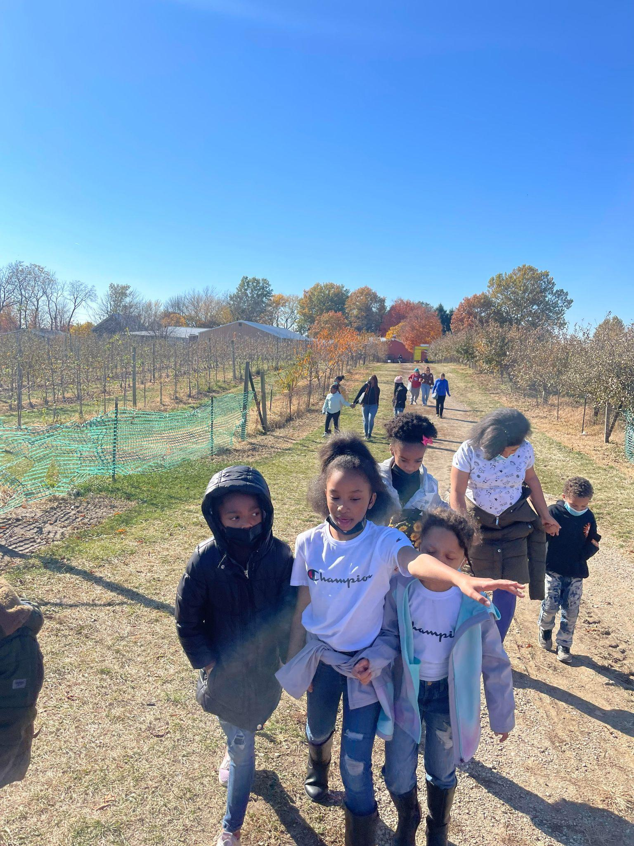
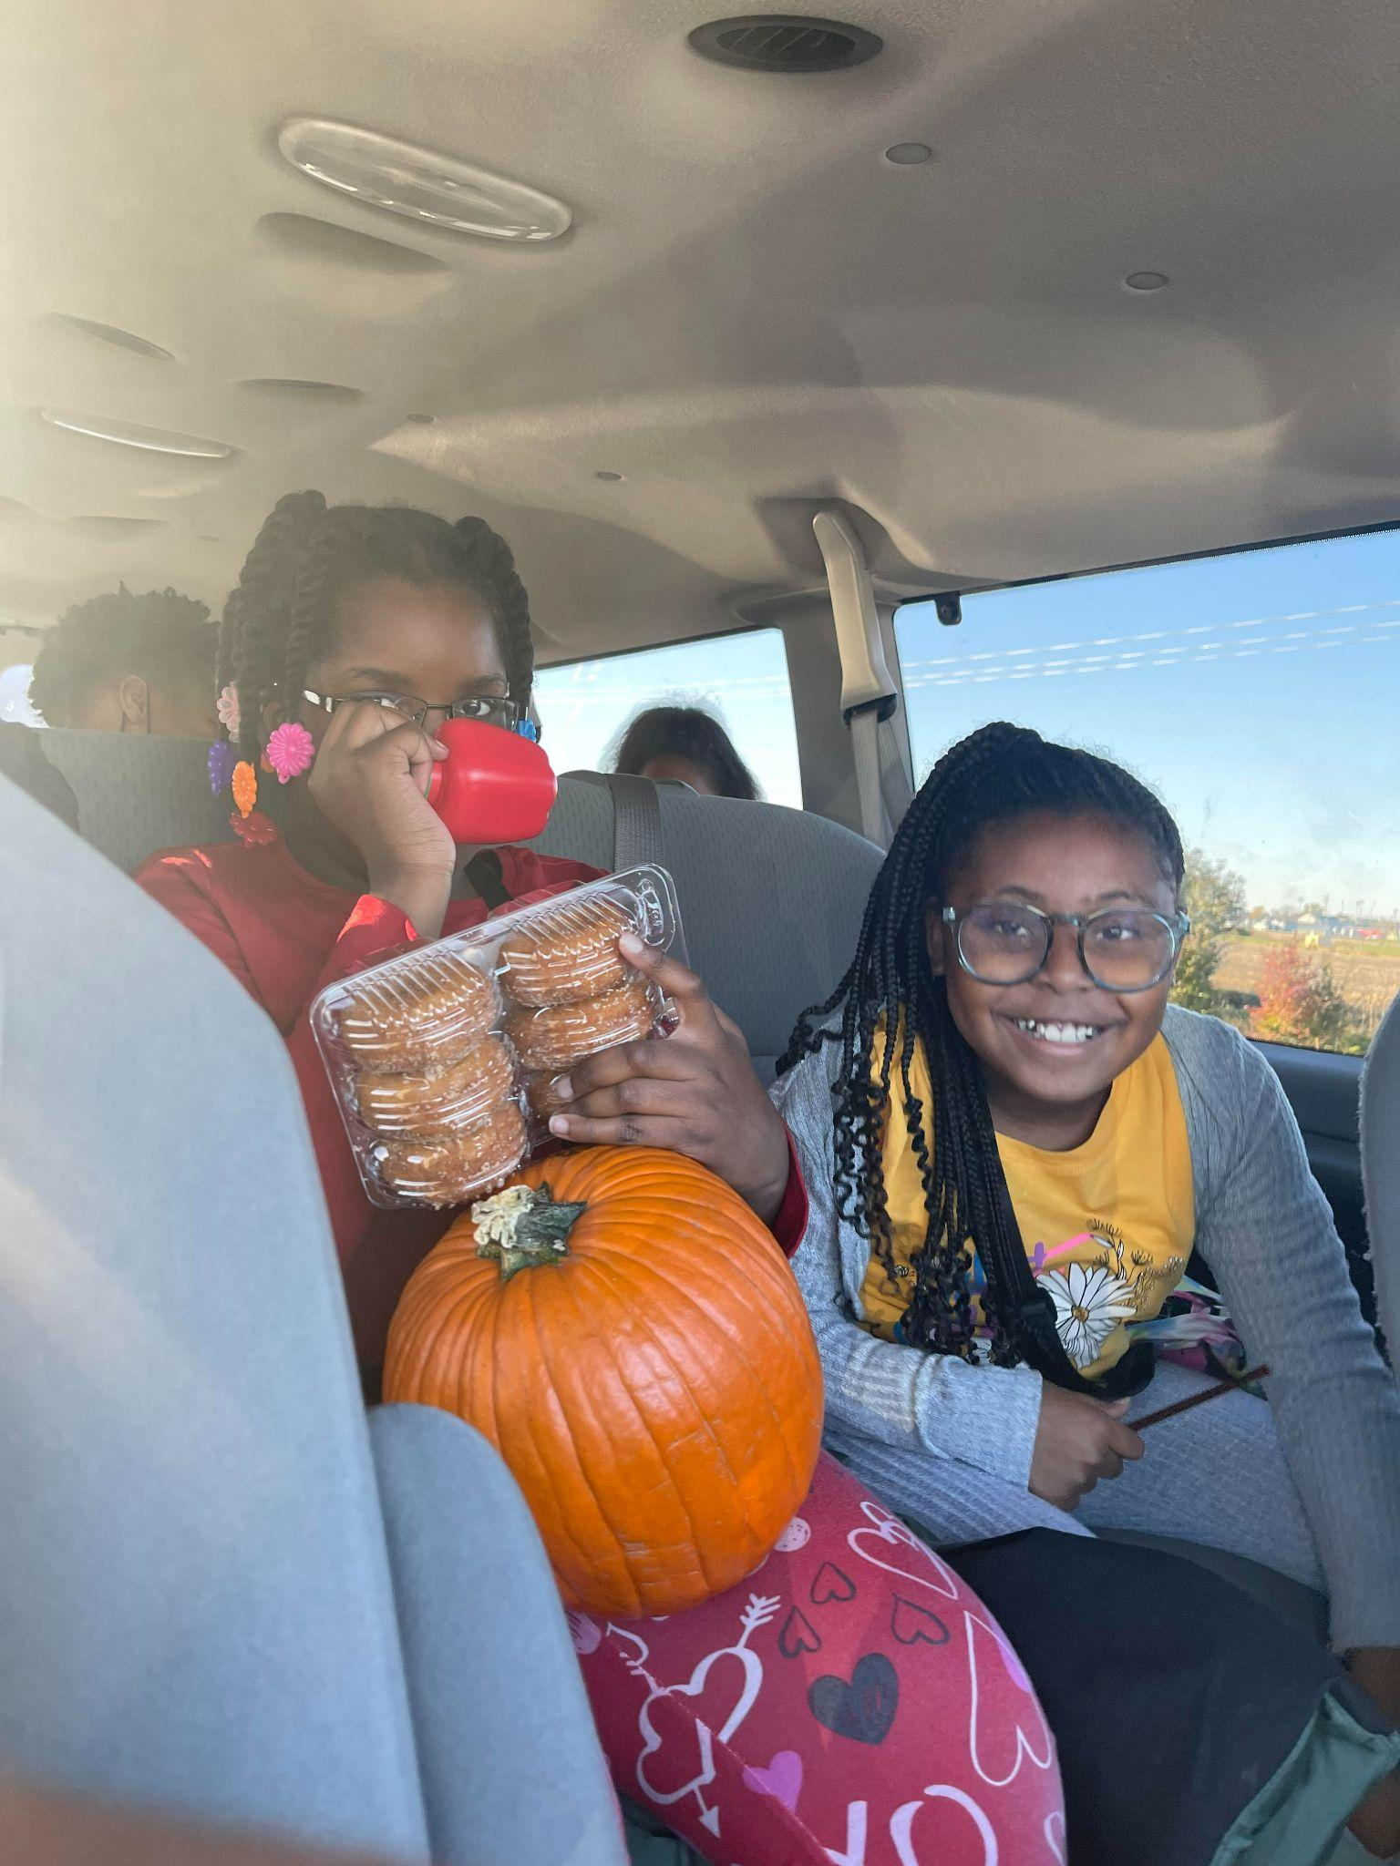

Slide 8
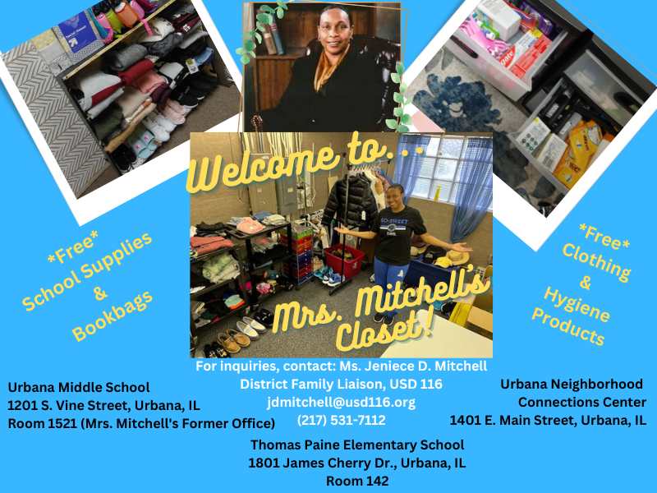
What’s new?

Slide 9
High Need Items
Preferably NEW | Clean and gently used is acceptable
Shoes & Winter boots in various sizes
Jeans or sweatpants for both males and females in various sizes
We have an Amazon wishlist: https://tinyurl.com/MrsMitchellsCloset3

Slide 10
Themed Days
MATH MONDAY
LET’S TALK ABOUT IT TUESDAY
WISDOM WEDNESDAY
READING THURSDAY
FUN FRIDAY

Slide 11
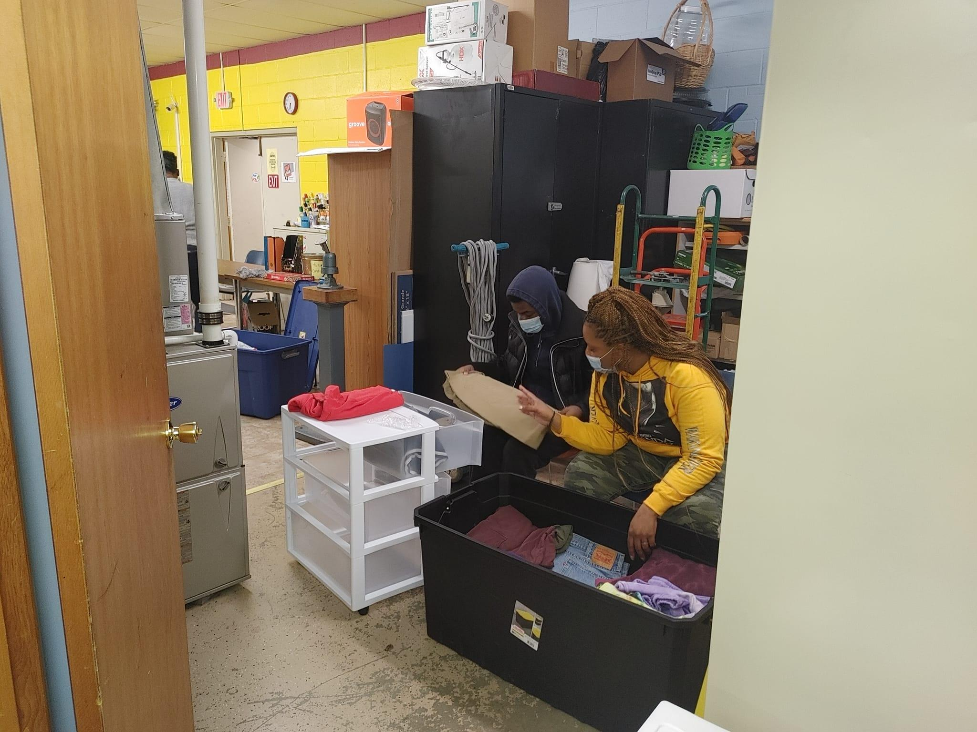
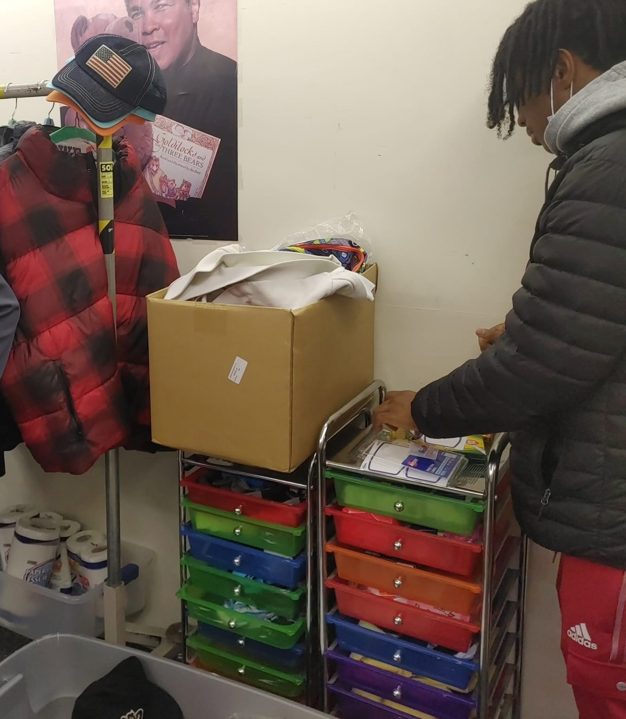
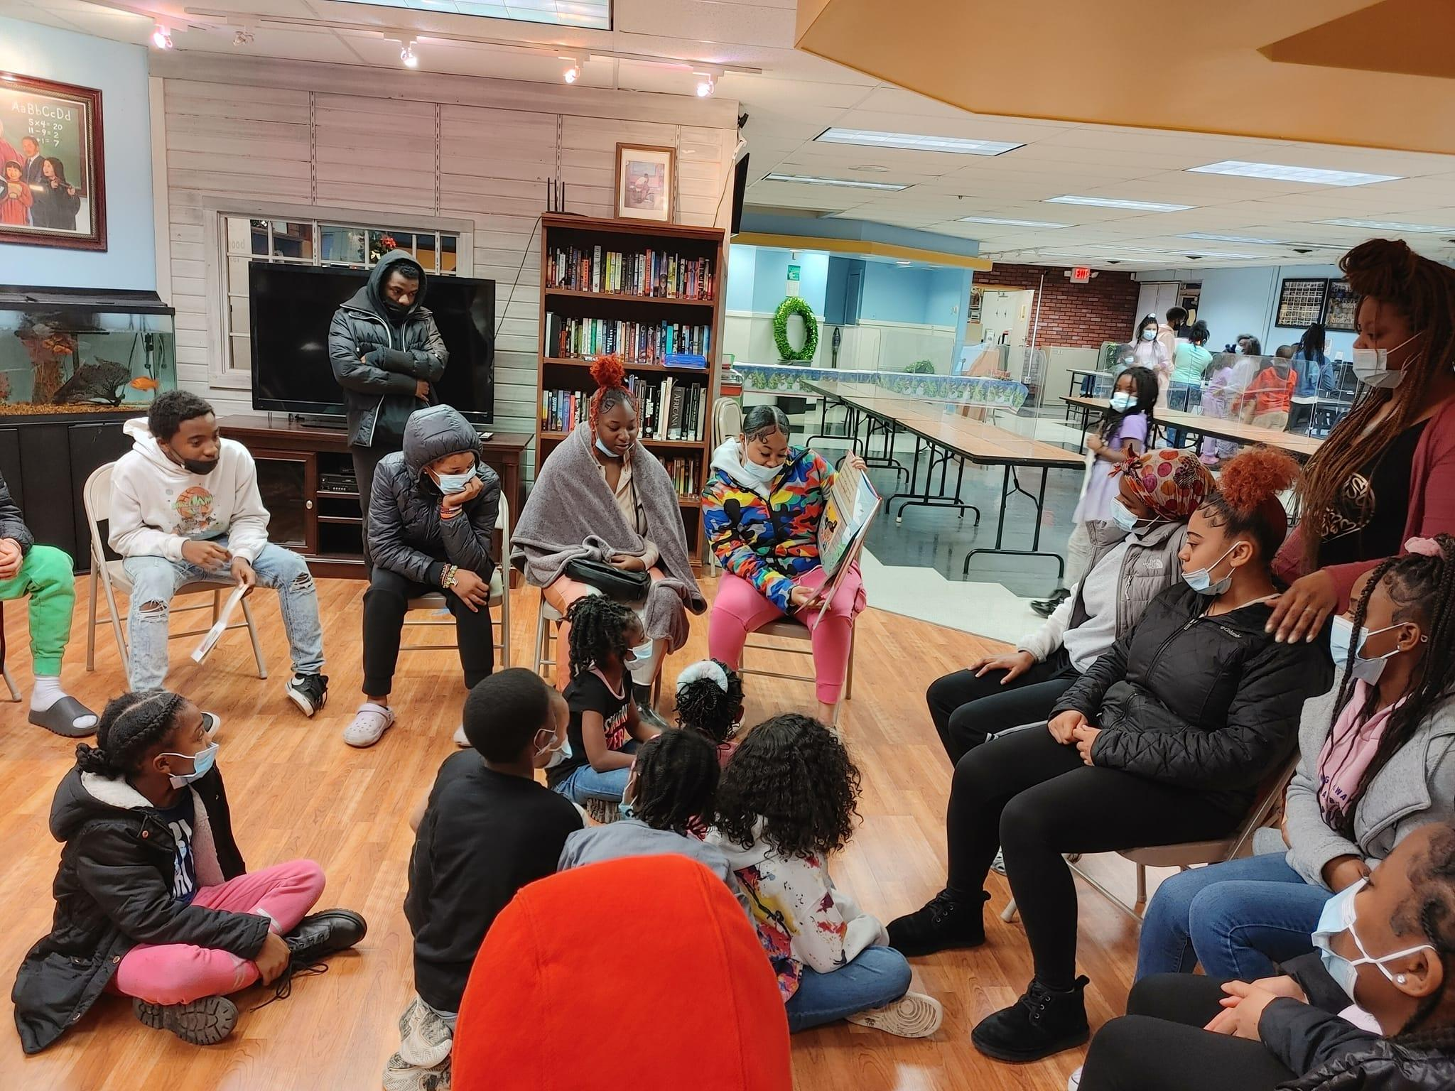
How Can You Help?
Volunteer
Donate
Recommend

Slide 12
How to reach me
jeniece@urbanaconnectionscenter.org
(217) 954-1749
(217) 850-3337

