Slide 1
Prayer for Spring
Thank you for all the ways you have blessed Spring- From the idea to the incredibly impactful program it has been for over a decade.
Thank you for the ripple effects of Spring – all the other people positively impacted by this work. The families, the community, the future generations to come, all better off due to this wonderful group of dedicated people
Lord, we lift up the leaders and all the other Spring staff, volunteers, and their families who help bring hope and healing to the Mississippi Delta region. We pray for their protection, peace, and success.
We pray for each young person that have been, are, and will be a part of Spring. We pray for a future full of hope, promise, and success for each of them.
May God continue to provide so this program can not only survive, but thrive

Slide 2
3rd Sunday of Advent - Hope
It is often difficult to imagine having hope in our world
But we have to remember, hope is designed to get us through difficult times, to anticipate a better future
After all, if everything was perfect and easy, we wouldn’t need hope
As we celebrate this 3rd Sunday of Advent, we are reminded of the long-awaited hope of the Messiah, spoken of by the prophets like Isaiah, came to fruition upon the birth of Jesus
Notes:
Today, I want to talk about that hope: What keeps us from it; How do we maintain it; and What it ultimately leads to

Slide 3
Advances in Tech
This Photo by Unknown Author is licensed under CC BY-SA-NC
Notes:
Black and White v. Color
Knobs v. Remote Control (mom calling me from downstairs to change the channel)
Box projection (heavy) v. Flat
Invented in the 1920s but did not hit peoples’ homes till the 1950s – about 70 years

Slide 4
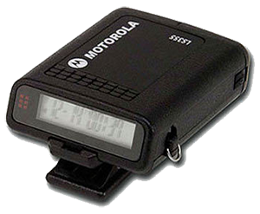
Advances in Tech
Notes:
Rotary dial – took longer to dial the number than the phone call
Pager – probably wondering, “how do you talk back into this device?” You don’t. You have to get a page (a number will pop up) and you call them back
Iphone – mobile computers (would taken several floors of a building to put the computing power of an iphone in a computer of the 1940s)

Slide 5
Advances in Tech
Notes:
Voice, “You go mail” – today that voice would be nonstop.
4.37 billion (over half the Earths population) people around the globe send 347.3 billion emails every day as of 2023

Slide 6
Advances in Tech
Notes:
Much quicker, time saving, safer
Less arguments – probably saved a number of relationships and marriages
Less liars – asking people for directions

Slide 7
Advances in Tech
Technology advances so rapidly, the next 30 years will see leaps greater than the last 100 years
What does that mean for us? We have to be adaptable (ex. Smart Failure)
Notes:
Why do we adapt to technology the way we do? Because you have to … or live a much different lifestyle

Slide 8
Advances in Christianity?
What might smart failure look like in the church today?
How do we keep the faith, maintain our joy, and be forever hopeful in a world we often feel like is crumbling around us?
Notes:
Has Christianity “advanced”? In some ways, maybe not, but in other ways, absolutely!

Slide 9
Openness to Another Way
What if protesting for voting rights was just as spiritual as praising God through singing?
What if working towards ending the wealth/poverty gap was just as holy as coming to church every Sunday?
What if pushing for reparations was just as Christian as praying or partaking in communion?
Notes:
Note, I am not discounting or creating an “either/or” scenario. There is beauty, comfort, power, and love in the things we do to praise God and build God’s kingdom.
My case, is that there is more. And that “MORE” is what we need to bring HOPE to the HOPELESS. And keep in mind, my lens today is about suffering communities. You can take this concept of Openness to Another Way to bring hope to any person, community, or situation where hope does not exist.
Because if God wants the kingdom in heaven to resemble the kingdom or Earth, then there is a way. We have to rely on our hope to find the way.

Slide 10
Jeff’s Not Making This Up
Isaiah 61:1-4, 8-11 61:1 The spirit of the Lord GOD is upon me, because the LORD has anointed me; he has sent me to bring good news to the oppressed, to bind up the brokenhearted, to proclaim liberty to the captives, and release to the prisoners; 61:2 to proclaim the year of the Lord's favor
Notes:
This is not the gospel according to Jeff.
Isaiah spoke of the end of persecution for God’s people.
Isaiah did not say, He has sent me to sing praises to the Lord, to pray for your well-being, or encourage everyone to go to church. He said he is bringing the good news (i.e. HOPE) to the oppressed, to heal those that are hurt, to proclaim freedom to those in chains, to set free the bonded, and let all those suffering that God is with you.

Slide 11
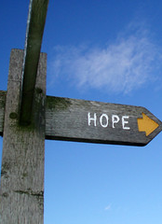
This Photo by Unknown Author is licensed under CC BY
Notes:
On two separate occasions, from two separate sources, in a matter of a couple of days, I heard the same sad tale. When asking young black men what their hopes are for the future, they in essence said, “What future?” They could not see any picture of their lives as adults. Being 25 or older was a mythical paradise. There has been and continues to be an epidemic of hopelessness among oppressed communities.
Instead of seeing every route (in picture) or option as one of hope and not giving up, these young men see dead ends whichever way they turn.

Slide 12
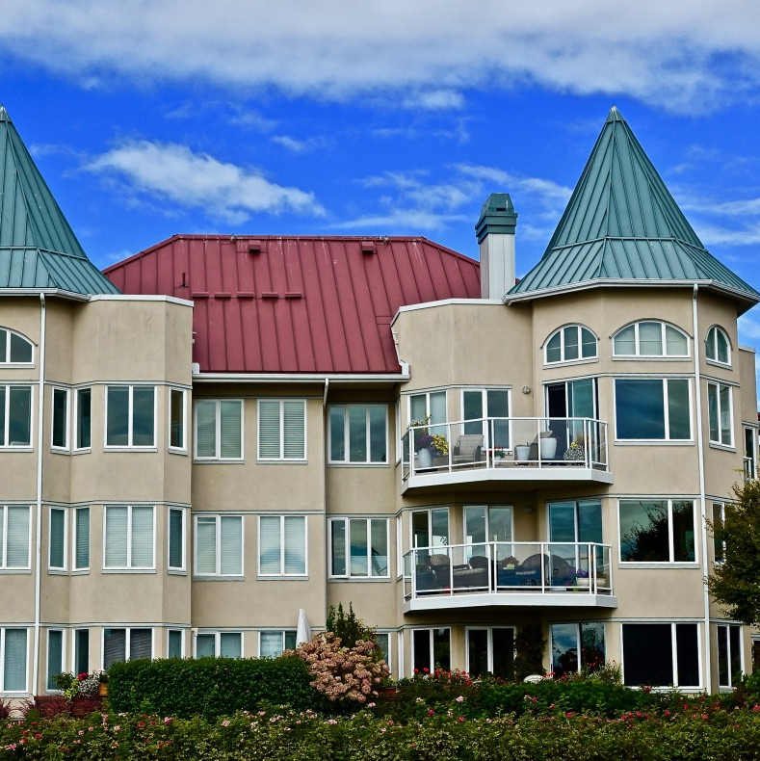
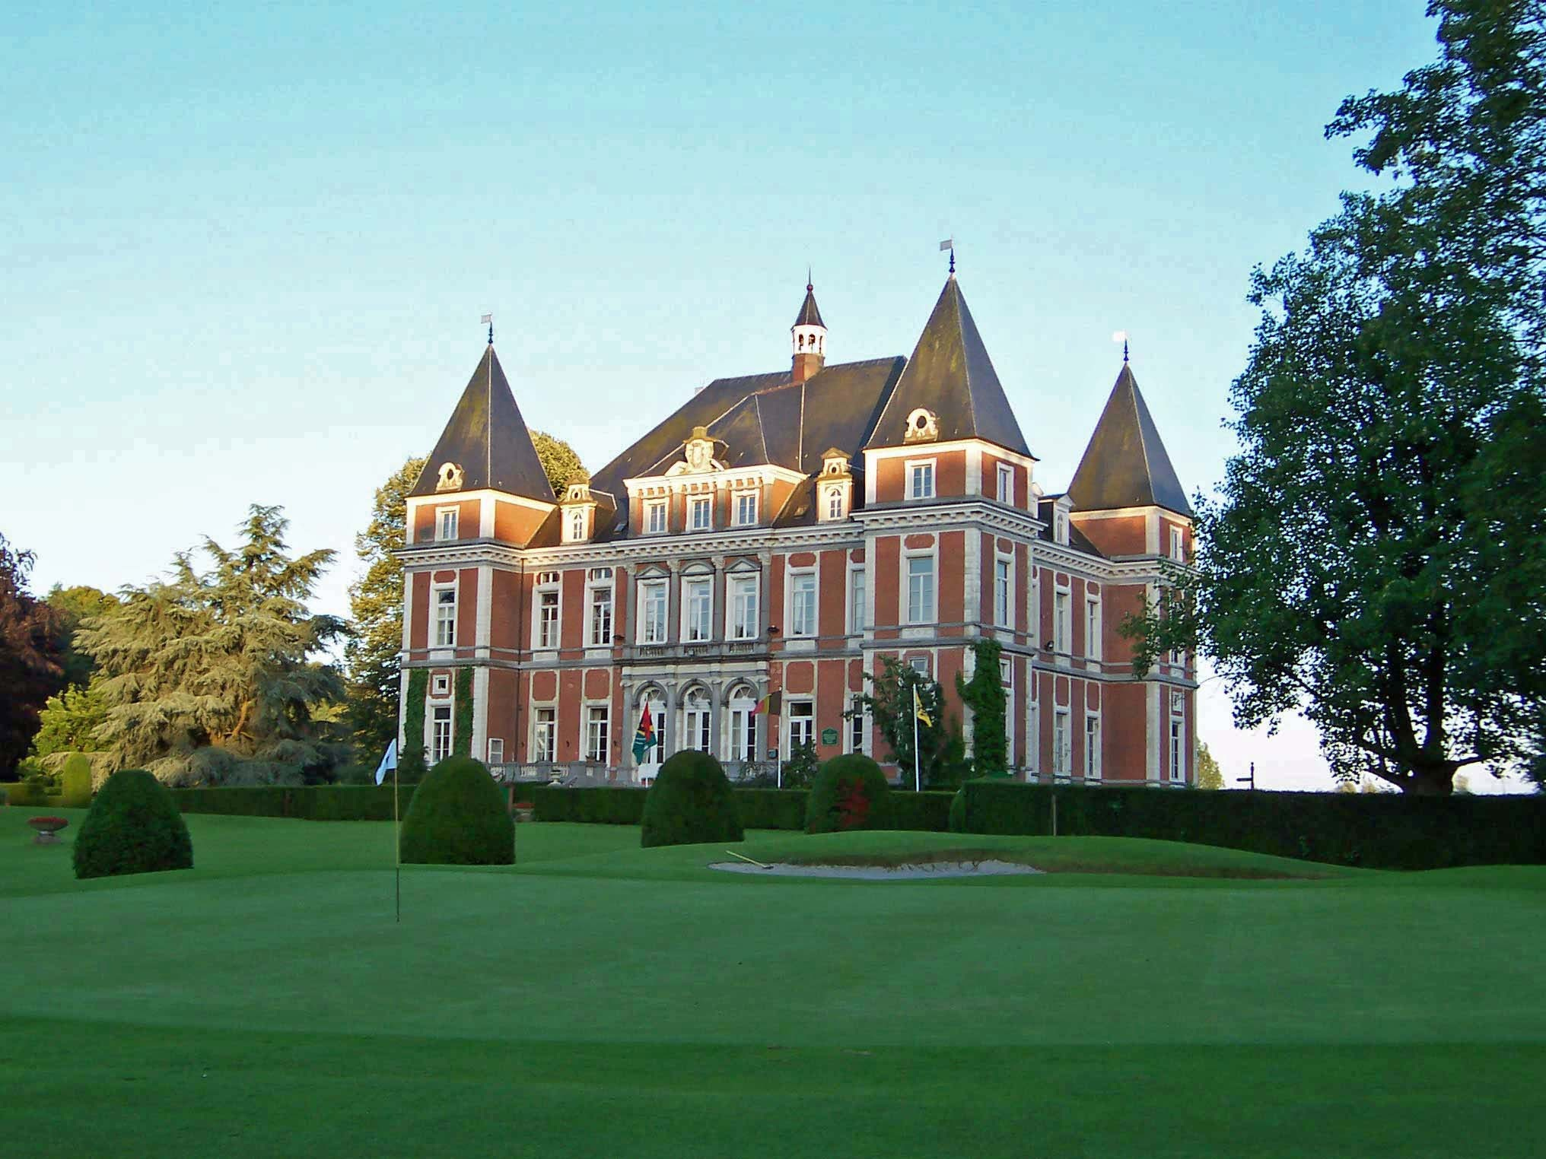
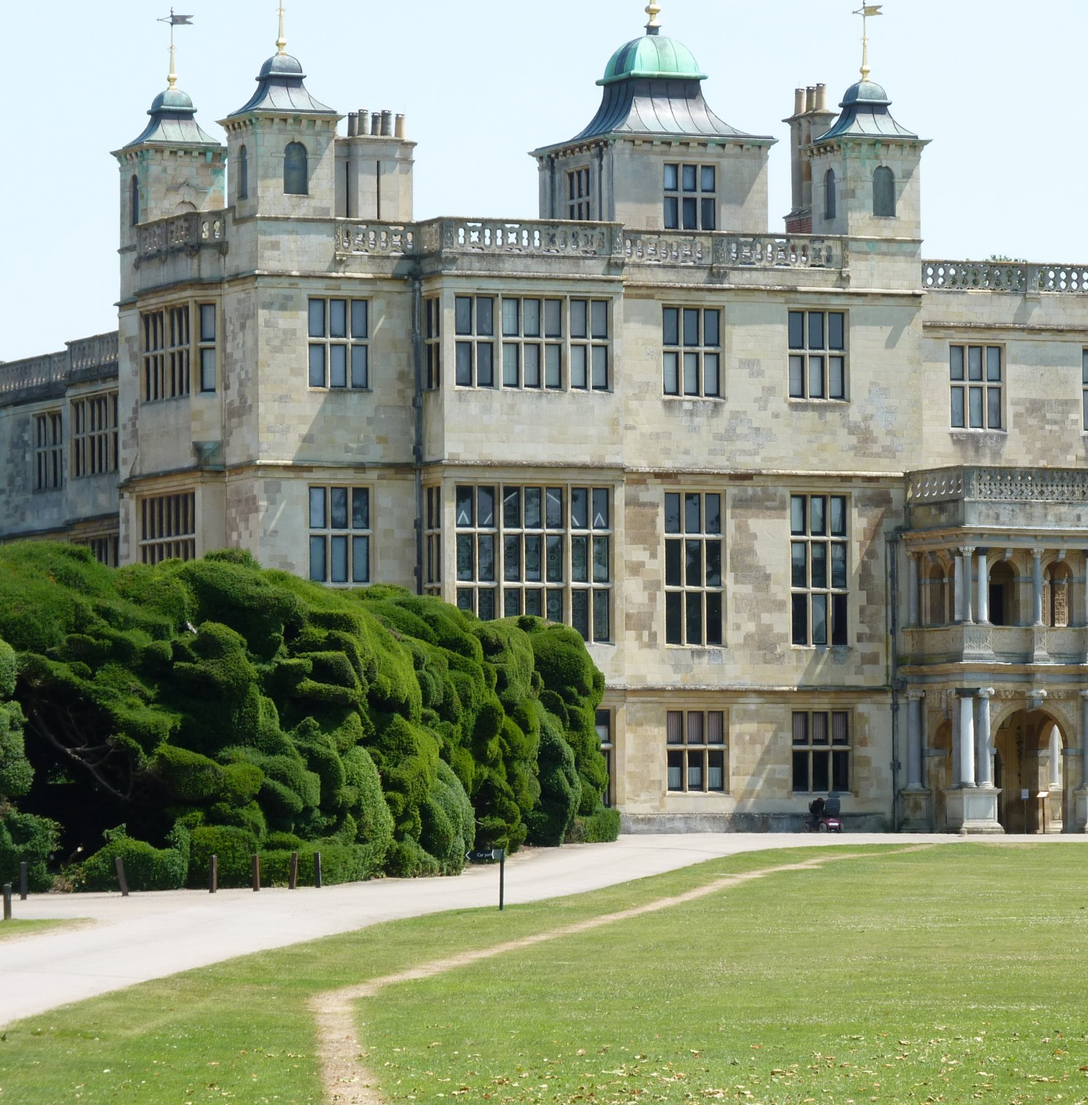
Notes:
A young lady at an event Friday night at the Virginia Theater concerning the black church mentioned how low the reading scores were for black children in Champaign Urbana, now registering in the single digits. You can sense the passion and despair in her voice as she asked the panel, what will the black church do about this. This is just one of the myriad of examples that come out of centuries of being left out, mistreated, discriminated against, and harmed in every way imaginable.
And not much has changed and there has not been enough of an outcry to make things change.
While some great things have come out of the church in the form of mercy, justice has often been hidden. It is like the church in America saying, from their mansions, “Don’t worry, your mansion awaits you in heaven”. Easy for the person with the mansion now to say.

Slide 13
Having and Bringing Hope
^{listening}
^{Meeting felt needs}
^{Moving forward together}
Notes:
Point 1: A key first step to bringing hope is listening. We tend to believe we know what the problem is and how to solve it, but the best person to explain how to solve the problem is the person needing the hope. And for those fix it types like me, I know it’s difficult. We want to jump right in and solve the puzzle and move on to the next challenge.
Point 2: We cannot ignore the felt needs that are apparent right now. Jesus often fed, healed, or comforted someone before giving any message. And sometimes, there was not message at all other than meeting the needs of that person or group at that time.
Point 3: We are truly ONE body. We have to fight this notion of every person for themselves all the time. So much is framed in ZERO/SUM paradigm instead of a WIN/WIN opportunity. I catch this all the time in talking about reparations. That thinking overshadows the main point of bringing equity to our society. We all suffer from racism (what’s the saying, cutting off your nose to despite your face?) and we can all benefit through reparations/repairing the part of the body that is suffering.

Slide 14
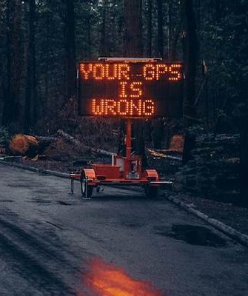
WRONG TURNS
Notes:
We will not have it all figured out.
We may take the unnecessary long way sometimes or end up in a totally different place than we anticipated
But we keep looking. We keep searching. We keep learning from failures.

Slide 15
Luke 4: 14-21
¹⁴ Jesus returned to Galilee in the power of the Spirit, and news about him spread through the whole countryside. ¹⁵ He was teaching in their synagogues, and everyone praised him.
Notes:
And then one day, we won’t have to hope any longer.
By this time in Jesus ministry, he became popular. He’d been healing and feeding folks and was running the circuit teaching and preaching

Slide 16
Luke 4: 14-21
¹⁶ He went to Nazareth, where he had been brought up, and on the Sabbath day he went into the synagogue, as was his custom. He stood up to read, ¹⁷ and the scroll of the prophet Isaiah was handed to him. Unrolling it, he found the place where it is written:¹⁸ “The Spirit of the Lord is on me, because he has anointed me to proclaim good news to the poor. He has sent me to proclaim freedom for the prisoners and recovery of sight for the blind, to set the oppressed free,
Notes:
He went back to his hometown, where it all started

Slide 17
Luke 4: 14-21
¹⁹ to proclaim the year of the Lord’s favor.”^{[f]20} Then he rolled up the scroll, gave it back to the attendant and sat down. The eyes of everyone in the synagogue were fastened on him. ²¹ He began by saying to them, “Today this scripture is fulfilled in your hearing.”
Notes:
Jesus drops the mic and walks away

Slide 18
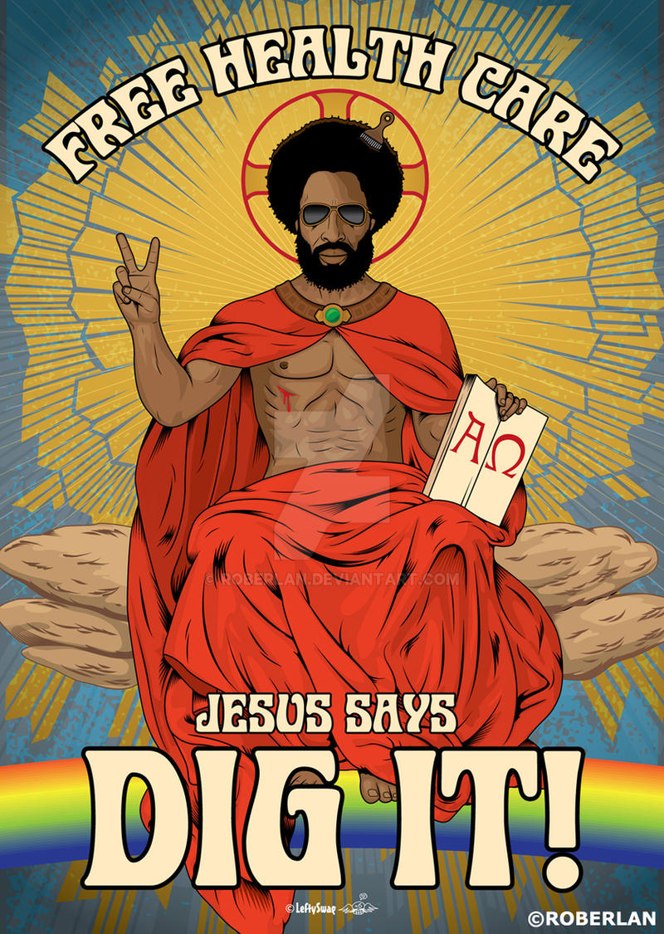
BRINGING HOPE
This Photo by Unknown Author is licensed under CC BY-NC-ND
Notes:
Picture of a group of us at the National Symposium for State and Local Reparations Leaders… in a CHURCH discussing reparations
Example of society’s bias
Looked up “Jesus” by itself, all white
Looked up “Black Jesus” got satirical Jesus’ although I have to admit, I really do like this one

