Slide 1

Conflict Is Inevitable
Combat Is Optional

Slide 2
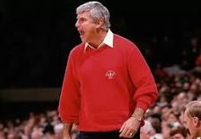
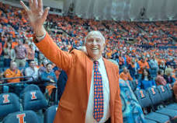
Conflicts
All relationships have them

Slide 3


How Do You View Conflict?
This

Slide 4



2 Timothy 2:23–24
Again, I say, don't get involved in foolish, ignorant arguments that only start fights. A servant of the Lord must not quarrel but must be kind to everyone, be able to teach, and be patient with difficult people. [NLT]
What does this verse say to you about you and conflict?

Slide 5
Interpersonal Conflict – An Elegant Model
Simple
ego
Pseudo

Slide 6



Some Possible Solutions
Simple
Pseudo
ego

Slide 7

2 Timothy 2:23–24
(paraphrased)
Again, I say, don't get involved in “ego conflicts” which are only the beginning of prolonged fights. You must not engage in personal battles, attacking when under attack, but seek resolution while being patient with difficult people. [NLT]

