Slide 1
Reveal Parties
Notes:
We are big on planned surprises and cliffhangers

Slide 2
The Great Reveal
Notes:
When Jesus returns and God’s kingdom will be FULLY REVEALED
TOURING AROUND the NEW HEAVENS and EARTH
Here is the built-in cabinet space filled with everlasting JOY
Here is your fireplace in a room composing of ultimate PEACE
Here is your large landscaped backyard flowing with never-ending JUSTICE
Here is you main living area abundant with unconditional LOVE

Slide 3
The Great Reveal
And Everything That Comes With It
Notes:
Covey principle #2 of habits of highly effective people is to “BEGIN with the END in MIND”
God has a plan… Scripture outlines that plan from start to finish.

Slide 4
Epiphany Sunday
A celebration acknowledging the beginning of God’s plan to bring forth a Messiah for all people
I Peter 1: 20-21 on Jesus
²⁰ He was chosen before the creation of the world, but was revealed in these last times for your sake. ²¹ Through him you believe in God, who raised him from the dead and glorified him, and so your faith and hope are in God.
Notes:
God’s Plan can be generally broken down in three parts
First to Middle – God’s creation of everything to the Epiphany, the Messiah (Emmanuel) walking the Earth
Middle to End – Jesus sacrifice and defeat of death to Jesus return
We are in between the 2nd and Last part of God’s Plan

Slide 5
The Beginning to Middle
Genesis 1: 1-3
In the beginning, God created the heavens and the earth. ² Now the earth was formless and empty, darkness was over the surface of the deep, and the Spirit of God was hovering over the waters.
³ And God said, “Let there be light,” and there was light.

Slide 6
God’s First Creation
In the Beginning…
Notes:
God’s first creation was TIME
The very concept of TIME was invented by God. There was no such thing before that. Everything was eternal, infinite, timeless.

Slide 7
What would you do?
Notes:
So much of our lives is dictated by time – from down to the minute, like when to show up to work every morning to our very existence as a living being on Earth
For a moment, think what you life would look and feel like, if there was no such thing as time.
It’s like the multi billionaire concept – You ask someone, if you had billions of dollars, more money than you could ever dream of spending, what would you do for the rest of your life? After you got all your initial material dreams and desires out the way, what is left? What would you spend you days doing? Whatever that is, that’s what you are most passionate about.
But what if we did that with time. If you had more time than you could ever dream of having, what would you do with it? After you did all the material stuff like all those home projects you put on hold and never got around to… what would you do?
It is a nice exercise to gain perspective and a reminder that this is what’s to come for all of us. According to God’s word, there is an eternity awaiting us. Seems oxymoronic I know, but one day, there will be no more days. Or weeks. Or years. Just us, God, and everything in heaven.

Slide 8
From Creation to Jesus
Notes:
FOR NOW, however, we still exist in time.
The Old Testament is full of foreshadowing and predictions of a coming Messiah. After many generations coming from Abraham and onward, Jesus makes his appearance. Foretold before time itself, ushering in the last times as Peter said.

Slide 9
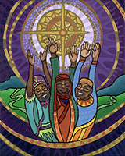
Epiphany of the Lord
Notes:
Joseph and Mary go to Bethlehem to register for the census. As a town of about 1000 people, they really did not have “inns” or hotels and we tend to think of it. Because everyone was in town for the census, the family space was packed and there were only so many places Mary could give birth and lay Jesus down. What we tend to think was this down and out manger scene was actually more of a crowded house full of family.
On top of being surrounded by family, people from elsewhere were able to join in the celebration of Jesus coming: local shepherds that was informed by angels, and of course the 3 wise men from 3 very different parts of the world
Following the star, bearing gifts, the three wise men were part of welcoming Jesus/God to Earth

Slide 10
Herod’s Failed Attempt
Matthew 2: 12
2:12 And having been warned in a dream not to return to Herod, they left for their own country by another road.
They were WISE men after all
Notes:
Herod tried to thwart God’s plan. When his scheme to get the wise men to snitch did not work out, he sent to have babies fitting Jesus’ description (boys 2 years and younger in Bethlehem and surrounding vicinities) killed. However, Joseph was warned in a dream ahead of time and got to Egypt to avoid the baby massacre.
It is amazing what people will do to hold on to power. We often gloss over things in the Bible. Especially the horrific things. But a man went on a killing rampage of babies 2 years old and younger to avoid having someone usurp his power.

Slide 11
What Did Jesus Bring?
A ministry that included
Feeding people
Healing
Embracing the estranged
Economic Justice
Notes:
Jesus was turning over tables, literally and figuratively. He upset the apple cart of society at the time and was making a major impression on the people.
Jesus was giving out free food and healthcare while challenging the economic injustice that existed

Slide 12
Jesus of Justice
Psalm 72:1-7, 10-14
72:1 Give the king your justice, O God, and your righteousness to a king's son. 72:2 May he judge your people with righteousness, and your poor with justice. 72:3 May the mountains yield prosperity for the people, and the hills, in righteousness. 72:4 May he defend the cause of the poor of the people, give deliverance to the needy, and crush the oppressor.
Notes:
Speaking of Solomon with Jesus in mind
Mountains could be interpreted as cities and hills as towns

Slide 13
Jesus of Justice
72:10 May the kings of Tarshish and of the isles render him tribute, may the kings of Sheba and Seba bring gifts. 72:11 May all kings fall down before him, all nations give him service. 72:12 For he delivers the needy when they call, the poor and those who have no helper. 72:13 He has pity on the weak and the needy, and saves the lives of the needy. 72:14 From oppression and violence he redeems their life; and precious is their blood in his sight.
Notes:
While written for Solomon, both Christian and Jewish scholars agree these passages were meant for the coming Messiah – especially given that Solomon’s reign was on the downward trend.

Slide 14
Salvation for All
Ephesians 3: 5-6
3:5 In former generations this mystery was not made known to humankind, as it has now been revealed to his holy apostles and prophets by the Spirit: 3:6 that is, the Gentiles have become fellow heirs, members of the same body, and sharers in the promise in Christ Jesus through the gospel.

Slide 15
Sharers in What Exactly?
Notes:
We are sharers in an existence without the constraints of time, without the worry of lacking resources, devoid of pain and suffering, but with great JOY, PEACE, JUSTICE, and LOVE
For now, we live in the shadow of what is to come. And just like a shadow, we can surmise a general shape of what forms the shadow, we are far from seeing the fullness the source of the shadow entails

Slide 16
Imagine your 2024
So here we are in 2024
In what ways can you help usher in God’s kingdom and bring Jesus-like justice?
A helpful tool
Notes:
It is easy to see another year just as another year.
I challenge each of us to begin this year with the end in mind. And not just the end of this year.

Slide 17
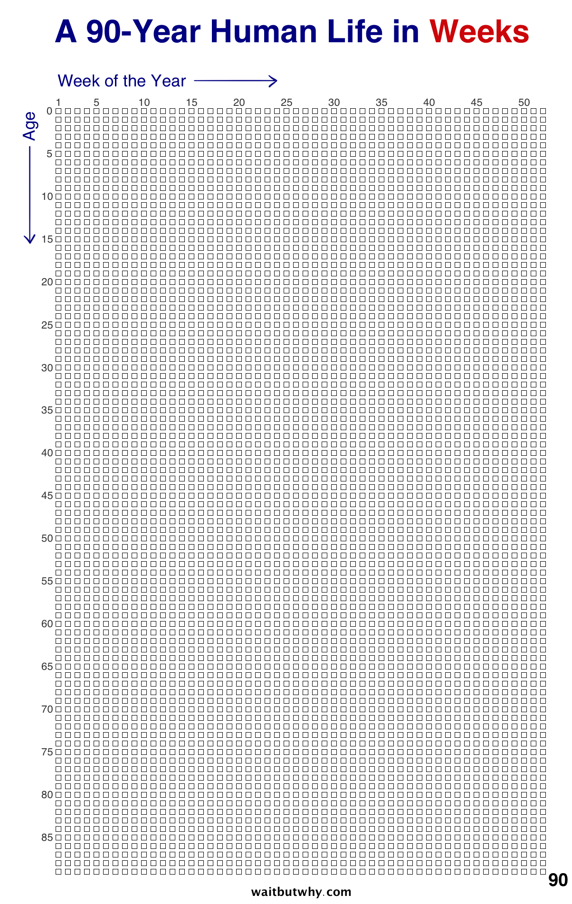
Notes:
Helpful way to plan (and not procrastinate)
When it comes to dieting to lose weight, they say the only path to success is a lifestyle change. Any fad diet results in regaining what was loss after you go back to your usual habits (95% of people that lose weight, gain it back within a year)
We should think of life the same way. Setting up 2024 to X, Y, Z is like the fad diet. We should make lifestyle, lifelong, goals and changes
This tool might help
(procrastination monster can be kept at bay)

