Slide 1
Prayer is the Key, Faith Unlocks the Door
The Amazing, Confusing, Unknown, Powerful, Wonderful World of Prayer
Notes:
I do not pretend to have answers to much of what I will be teaching about, but I will offer some ways to think about things that may help us navigate this practice in Christianity called praying

Slide 2
The Promise
The Father of Generations
Notes:
Our relationship with God starts with a promise. Or in more modern terms, a layout about how things are and how they are to go.
God told Abraham at the age of 75
“I will make you into a great nation, and I will bless you; I will make your name great, and you will be a blessing.^{[a]} ³ I will bless those who bless you, and whoever curses you I will curse; and all peoples on earth will be blessed through you.”
Me and my grandbaby are outcomes of the promise God gave Abraham and are part of that blessing

Slide 3
Faith Unlocks the Door
Romans 4: 13
¹³ It was not through the law that Abraham and his offspring received the promise that he would be heir of the world, but through the righteousness that comes by faith.
Notes:
From Abraham on down the line, we can access our promise through faith
As we can see from this picture, Abraham had unwavering faith
Feels like a cruel game. Abraham wait all that time for an heir. They finally get one. God says to go kill him.
Abraham must have believed something was going to happen so God’s promise would stick.
Think about faith as a criteria you need to become eligible for God’s promise. It’s like when I write a grant for the health center.
There is certain criteria required before you can even be eligible to apply.

Slide 4
The Elephants in the Room
God Knows Already
Delusional
Unintended Consequences
The Tug of War
Trivial Prayers?
The Chain of Events
No Measures
Notes:
What are the problematic aspects of prayer?
I want to offer a perspective that may help how we see the role of prayer in our lives

Slide 5
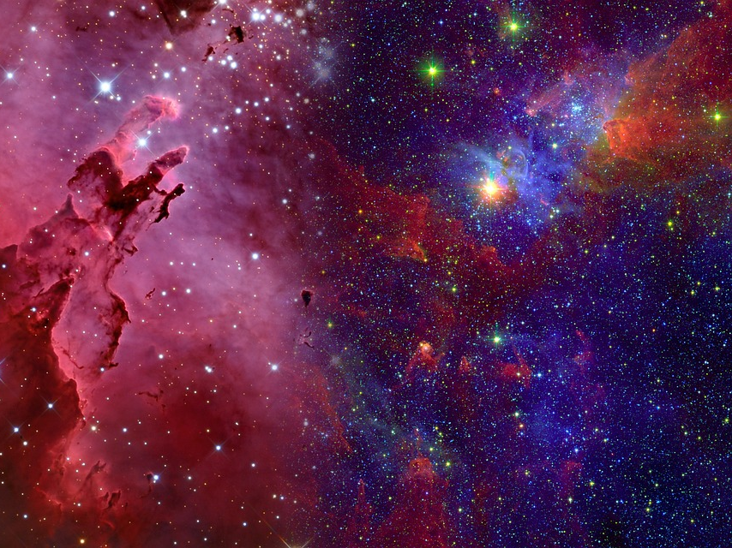
Good Knows Already
God is ALL KNOWING, ALL POWERFUL, OMNIPRESENT, OMNISCIENT
Notes:
I love watching shows that talk about how the universe was made, what it consists of now, where it’s going. For example, how every atom will ultimately expand into nothingness.
A God that created the cosmos, billions of galaxies, each with billions of stars with countless planets
What is the point of praying if God knows everything, including our thoughts, already?
I refer to something Ron points out. If Jesus, who was God on Earth, thought it necessary to pray, then we probably should too
But also, like I mentioned in my pastoral letter, there is a TV show that had a believer and skeptic. The skeptic asked the believer, ”You talk to God?”
The believer responds, ”No, I listen”
If you want to tap into that master plan, prayer is that key.

Slide 6
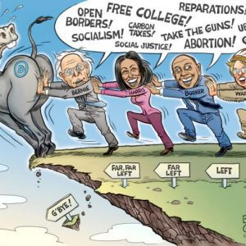
Delusional?
Beyond logic and reasoning
Beyond comprehension
Beyond our finite existence
Notes:
When I searched the word delusional in the online pictures, this one came up. I wanted to use it just to show how reparations was included in the list of issues
I think what bothers me about this aspect of prayer is how beyond logic our prayers can be. I shutter when I think of the times Christians criticize each other, claiming that your prayers were not answered because you did not pray long enough or hard enough (I always wondered what praying hard looked like). Like prayer is this magic potion available most to those who have the most intense prayer lives.
Sometimes if feels delusional to pray and believe our prayers will be answered. But at the end of the day, it is not about us, but about God. And we are not short of examples of those who seemed delusional in the Bible who were doing God’s will. It’s just part of the territory. And frankly, whether a person believes in another religion or believes purely in science, we are all delusional together

Slide 7
The Answered Prayer: Unintended Consequences
I gain, but at what cost?
What ripple effects would your prayer have on others?
Notes:
Do you ever wonder why of all the agencies and departments in the government, the one that asked you a critical health related question concerning organ donation comes from the department of transportation?
There are over 111,000 people waiting for organ donations and many of those organ donations (particularly organs no one has to spare like their heart) come from fatal car accidents. I imagine there are many people on the organ donation list along with their families praying for an organ to become available. It is not that people are praying for a traffic fatality, but there is no ignoring that until science is able to create new organs, that is what needs to happen to save the life of the person on the list.
That made me think about all the things we pray about and I honestly never considered what might be on the other side of my prayers. By no means would I say that answered prayers causes accidents or is even correlated in any way. But this dilemma emphasizes why prayer has to be more about God’s will being done, and not our own. Thy will be done or earth as it is in heaven.

Slide 8
The Tug of War Prayers
Notes:
I have always been a sports fan. And I would fully admit that I have prayed for my sports team to win. ESPECIALLY THE CUBS. ESPECIALLY IN 2016 when they won the world series. I often playfully wondered, which team has the most prayers going to God? And even if we had a tally, would certain peoples’ prayers weigh more heavily than others? Would it be the number or prayers or the total minutes in praying that would turn the tide?
What happens when there are people fervently praying on two sides but only one side can have their prayers answered? Or perhaps praying for such matters is completely frivolous and inconsequential.

Slide 9
Trivial Prayers?
Level of Importance?
Important to who?
What’s small may have large repercussions
Notes:
Have you ever prayed to get that close parking space? Or to find your keys? Or to make any daily decision that would not impact much one way or another? Are those things worth praying for? Are we bothering God with the petty?

Slide 10
The Chain of Events
Degrees of separation
The Unknown
Butterfly Effect
Notes:
Do you ever think about the long-term impact of prayer?
Do you ever imagine a prayer someone might have made 20 years ago, 200 years, ago or 2000 years ago, might have an impact on your life today?
Certainly, the prayers of those in the Bible, particularly Jesus, has made an impact on us today.
Do you ever imagine that your prayers could make an impact on someone 20 years from now, 200 years from now, or 2000 years from now?
As overwhelming as this might sound, it actually brings me comfort as it acts as a reminder that my prayers are about faith. About believing God knows what to do, when to do it, and where to do it. That my role is to tap in the space God created and experience it more so than trying to manipulate or control it. It is a reminder to that things are not in my hands, but God’s.

Slide 11
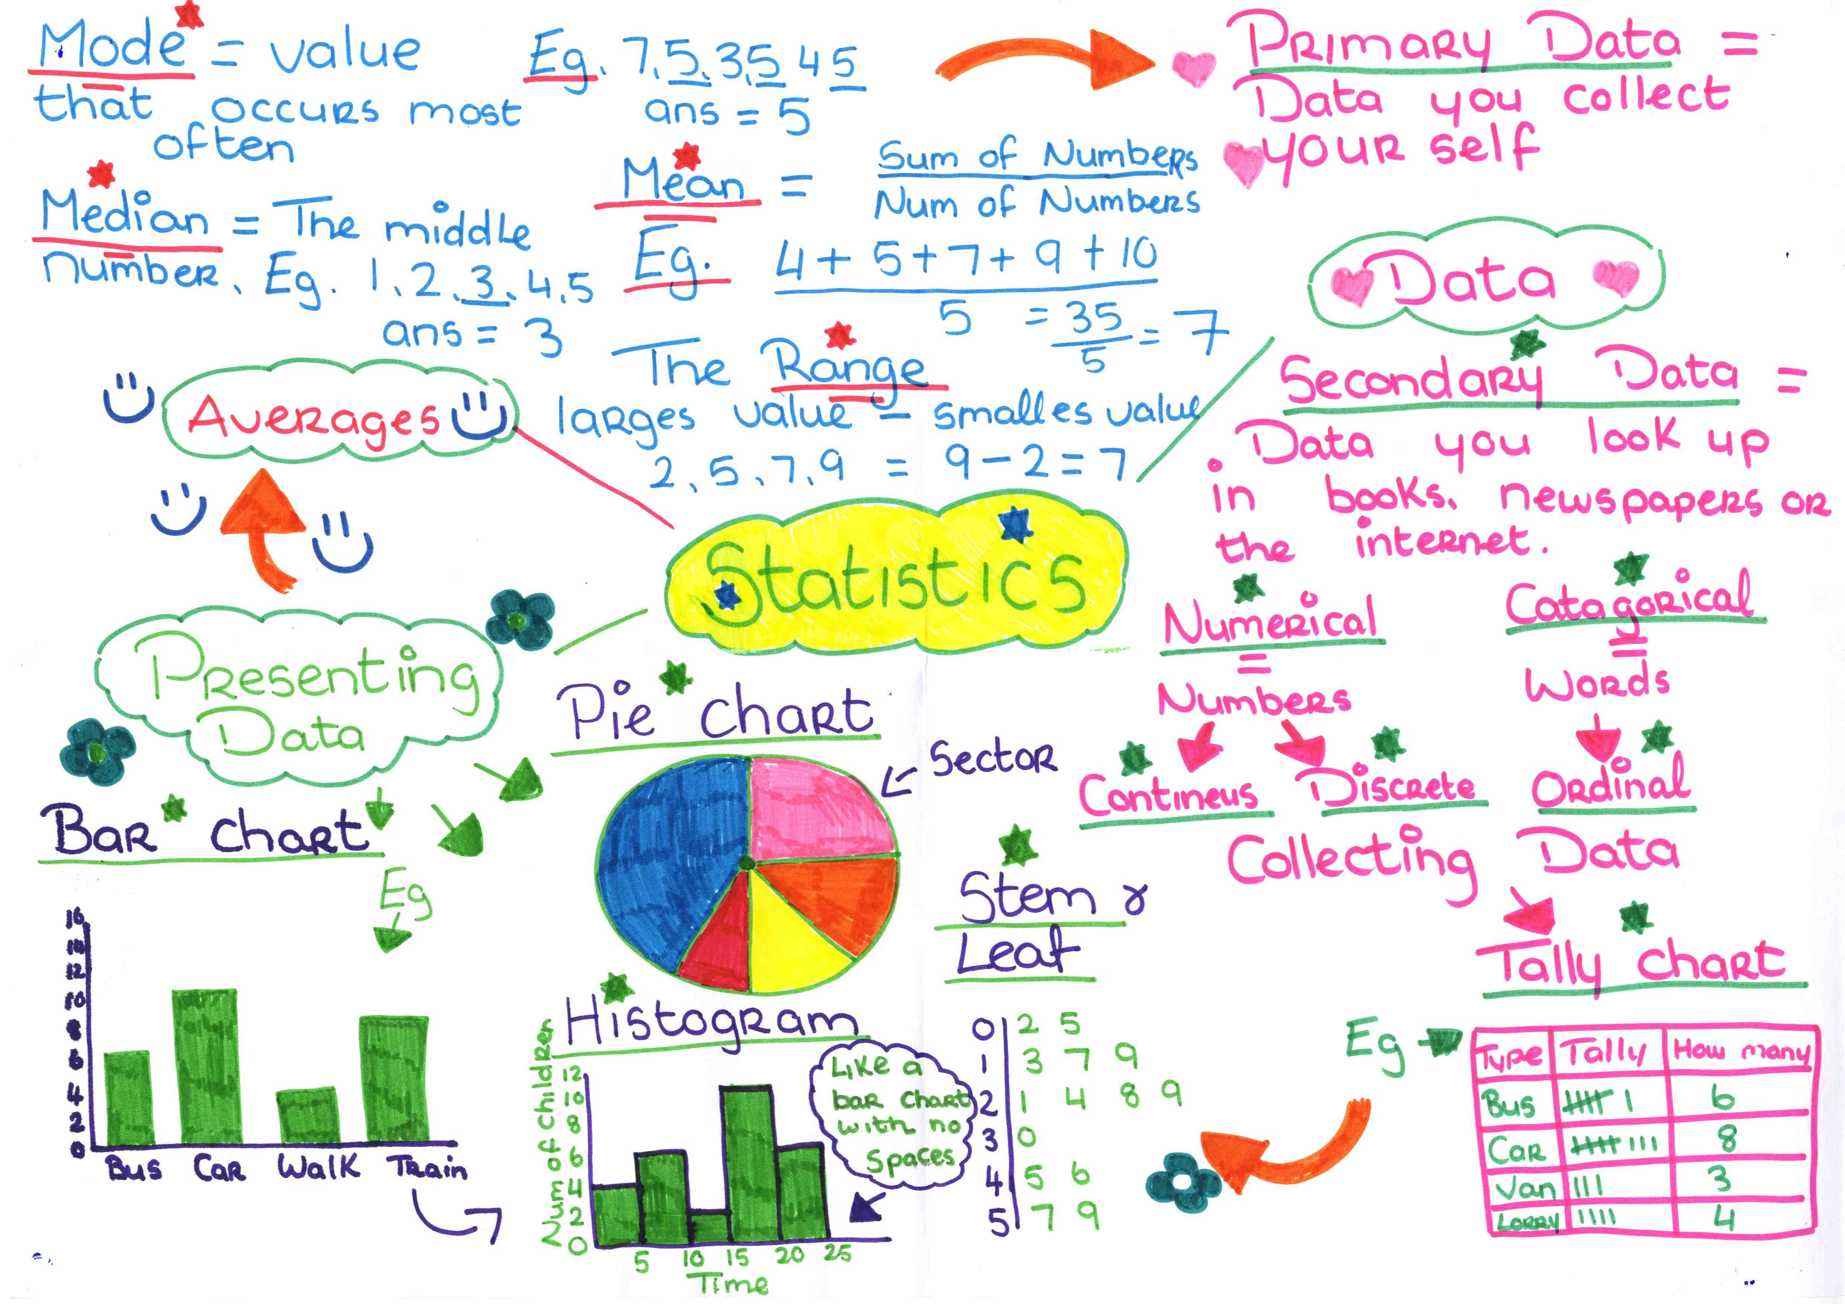
Proof?
If this prayer thing works, shouldn’t there be proof by now?
Notes:
Of course, there have been studies of praying and how it helps us physiologically, that it relieves stress, and other positive outcomes
However, we have yet to prove the miraculous. And how would we prove prayer works given the tug of war and chain of events issues I described?

Slide 12
Prayer is Paying Attention
God speaks in many ways
Dreams
Visions
Thoughts
Creative space
Environment
People

Slide 13
God Revealed in Dreams: Genesis 15: 12-14
¹² As the sun was setting, Abram fell into a deep sleep, and a thick and dreadful darkness came over him. ¹³ Then the Lord said to him, “Know for certain that for four hundred years your descendants will be strangers in a country not their own and that they will be enslaved and mistreated there. ¹⁴ But I will punish the nation they serve as slaves, and afterward they will come out with great possessions.
Notes:
Story of what to teach about during campus ministry days

Slide 14
Comes Down to Faith
Hebrews 11:1 Faith is the substance of things hoped for and the evidence of things not seen.
Notes:
¹⁸ Against all hope, Abraham in hope believed and so became the father of many nations, just as it had been said to him, “So shall your offspring be.”^{[b]} ¹⁹ Without weakening in his faith, he faced the fact that his body was as good as dead—since he was about a hundred years old—and that Sarah’s womb was also dead. ²⁰ Yet he did not waver through unbelief regarding the promise of God, but was strengthened in his faith and gave glory to God, ²¹ being fully persuaded that God had power to do what he had promised. ²² This is why “it was credited to him as righteousness.” ²³ The words “it was credited to him” were written not for him alone, ²⁴ but also for us, to whom God will credit righteousness—for us who believe in him who raised Jesus our Lord from the dead. ²⁵ He was delivered over to death for our sins and was raised to life for our justification.

