Slide 1
Growth
There is something about witnessing life and growth
Notes:
As I near my 49 birthday this month, I can’t help but to think about how much has happened in my life both personally and in the world around me.
And the more things I come to know, the more I realize I don’t know.
Today, I want to emphasize the need for growth – no matter who you are, how much you/ve experienced, how educated you are, or how many years you’ve been blessed to live your life. Growth is critical and should be never ending

Slide 2
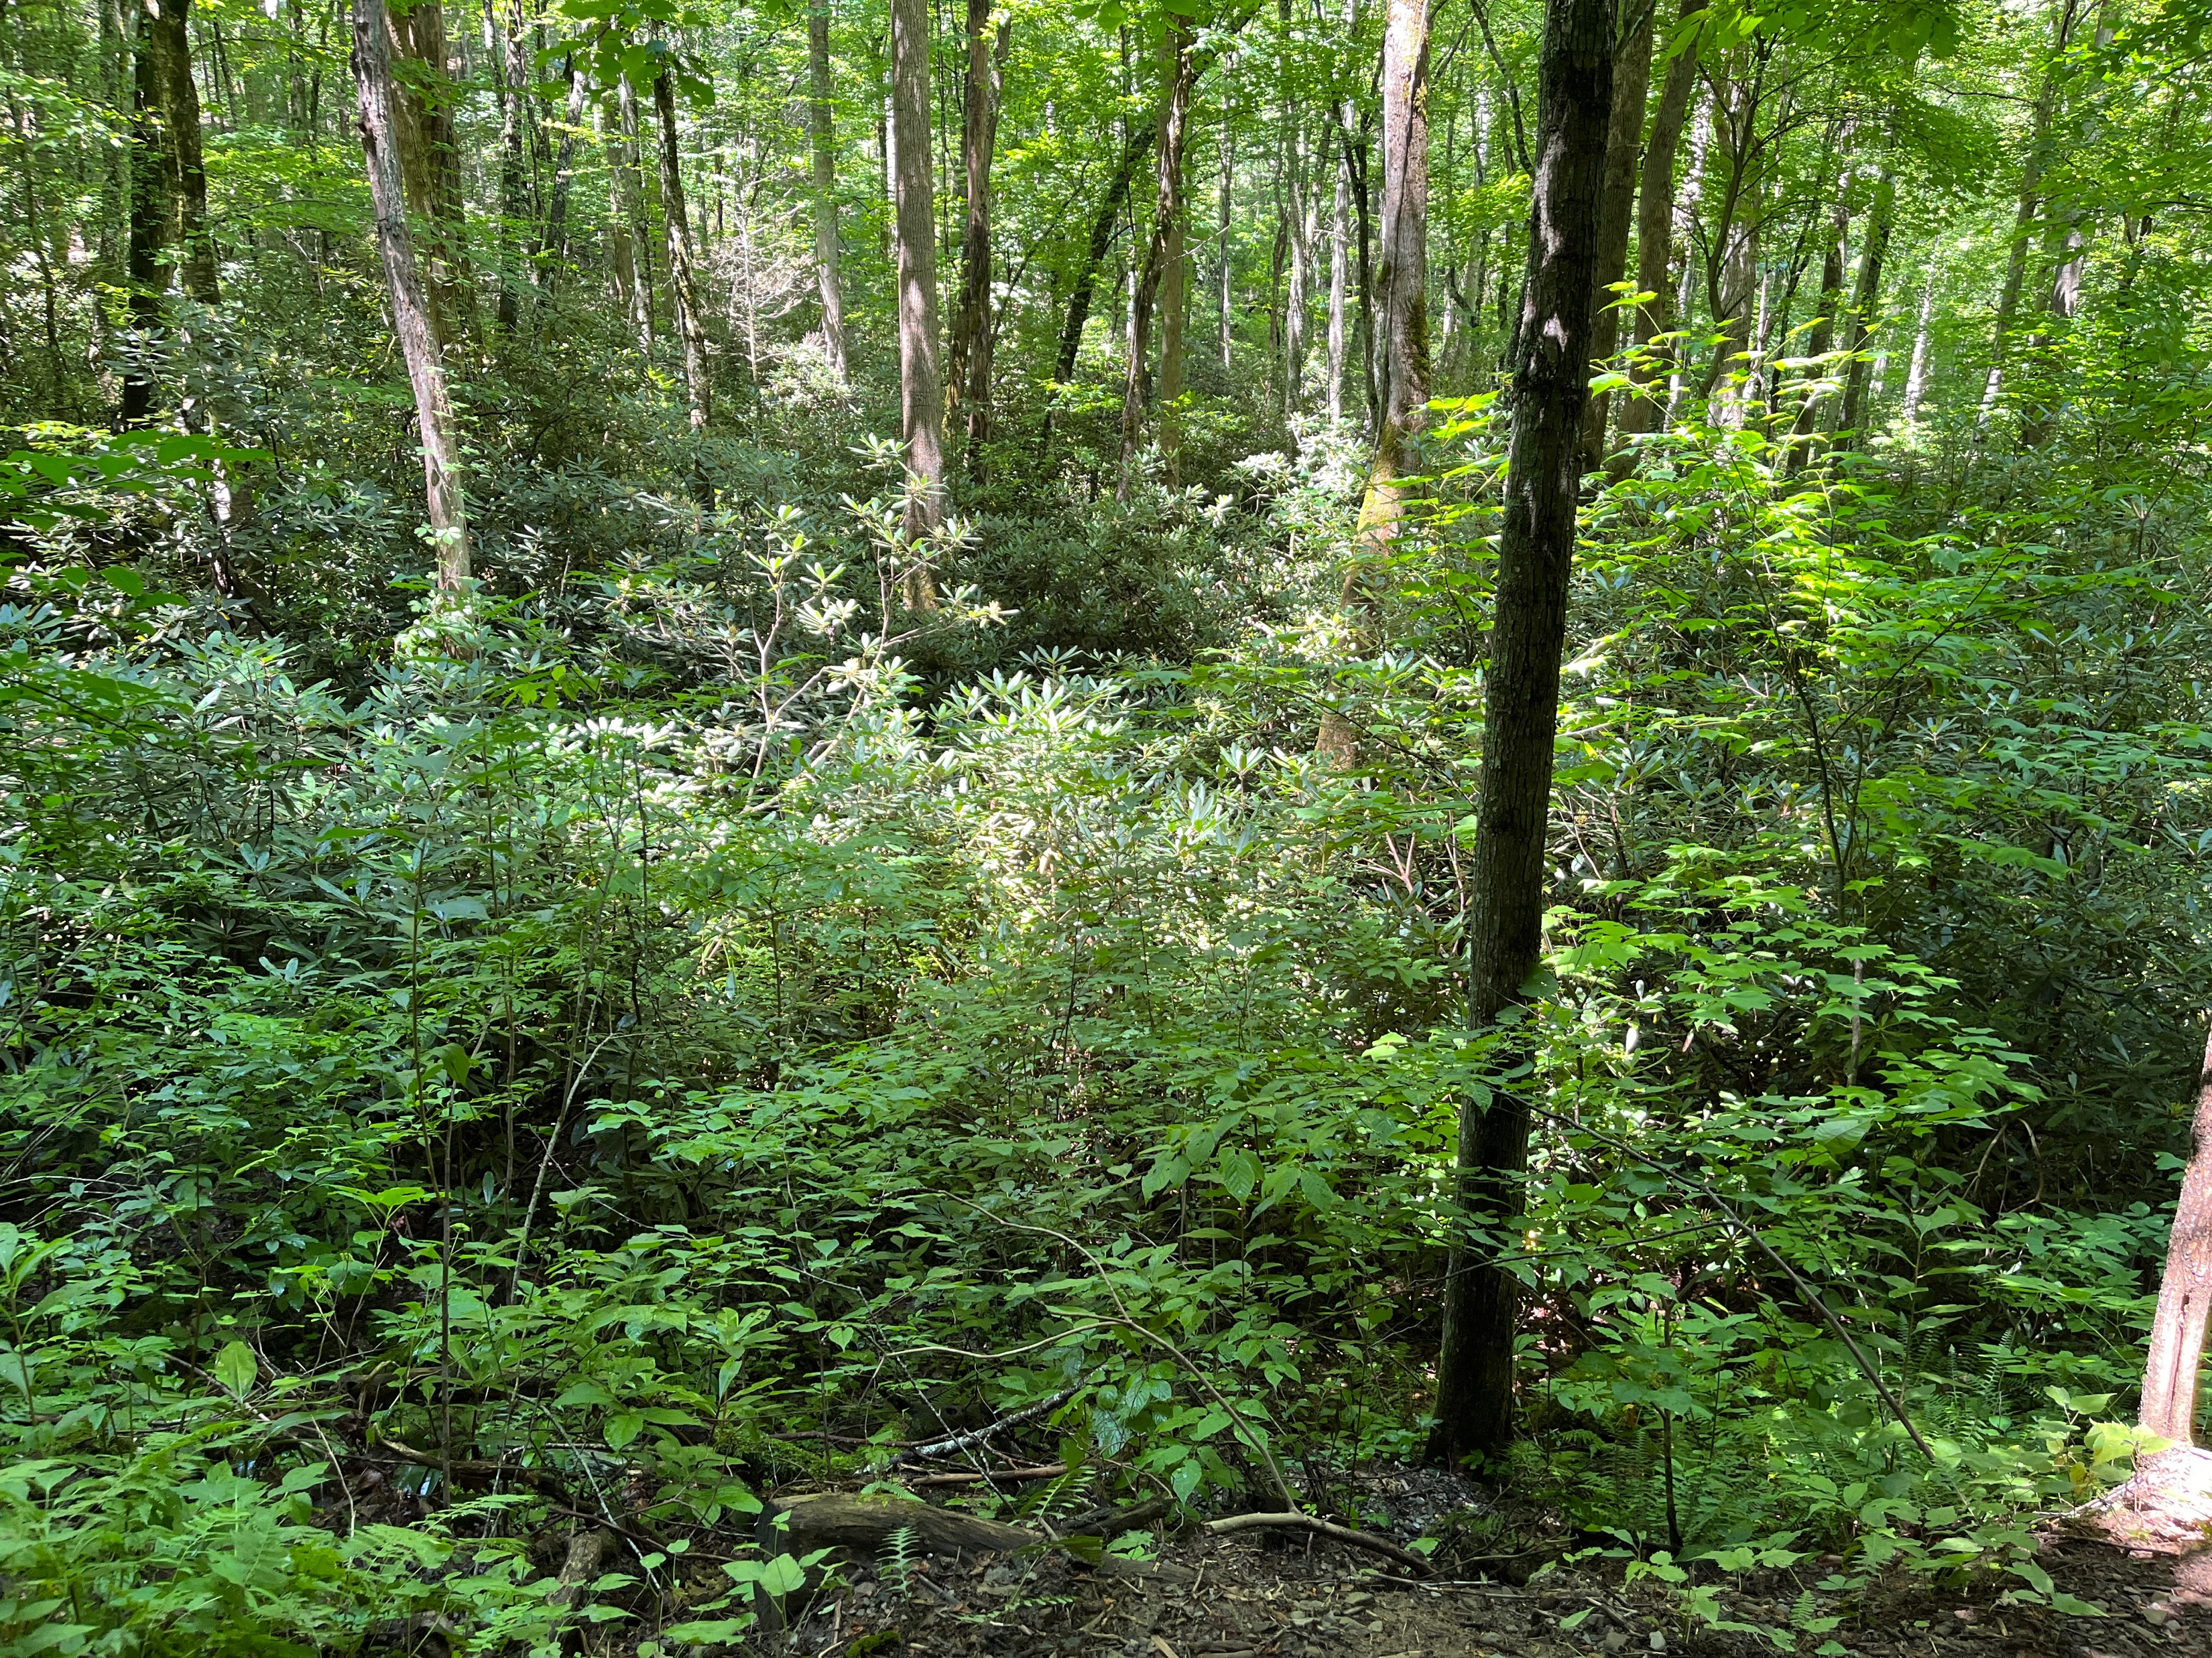
Notes:
For all you nature people, gardeners, and the like, you witness and enjoy growth in plant life.

Slide 3
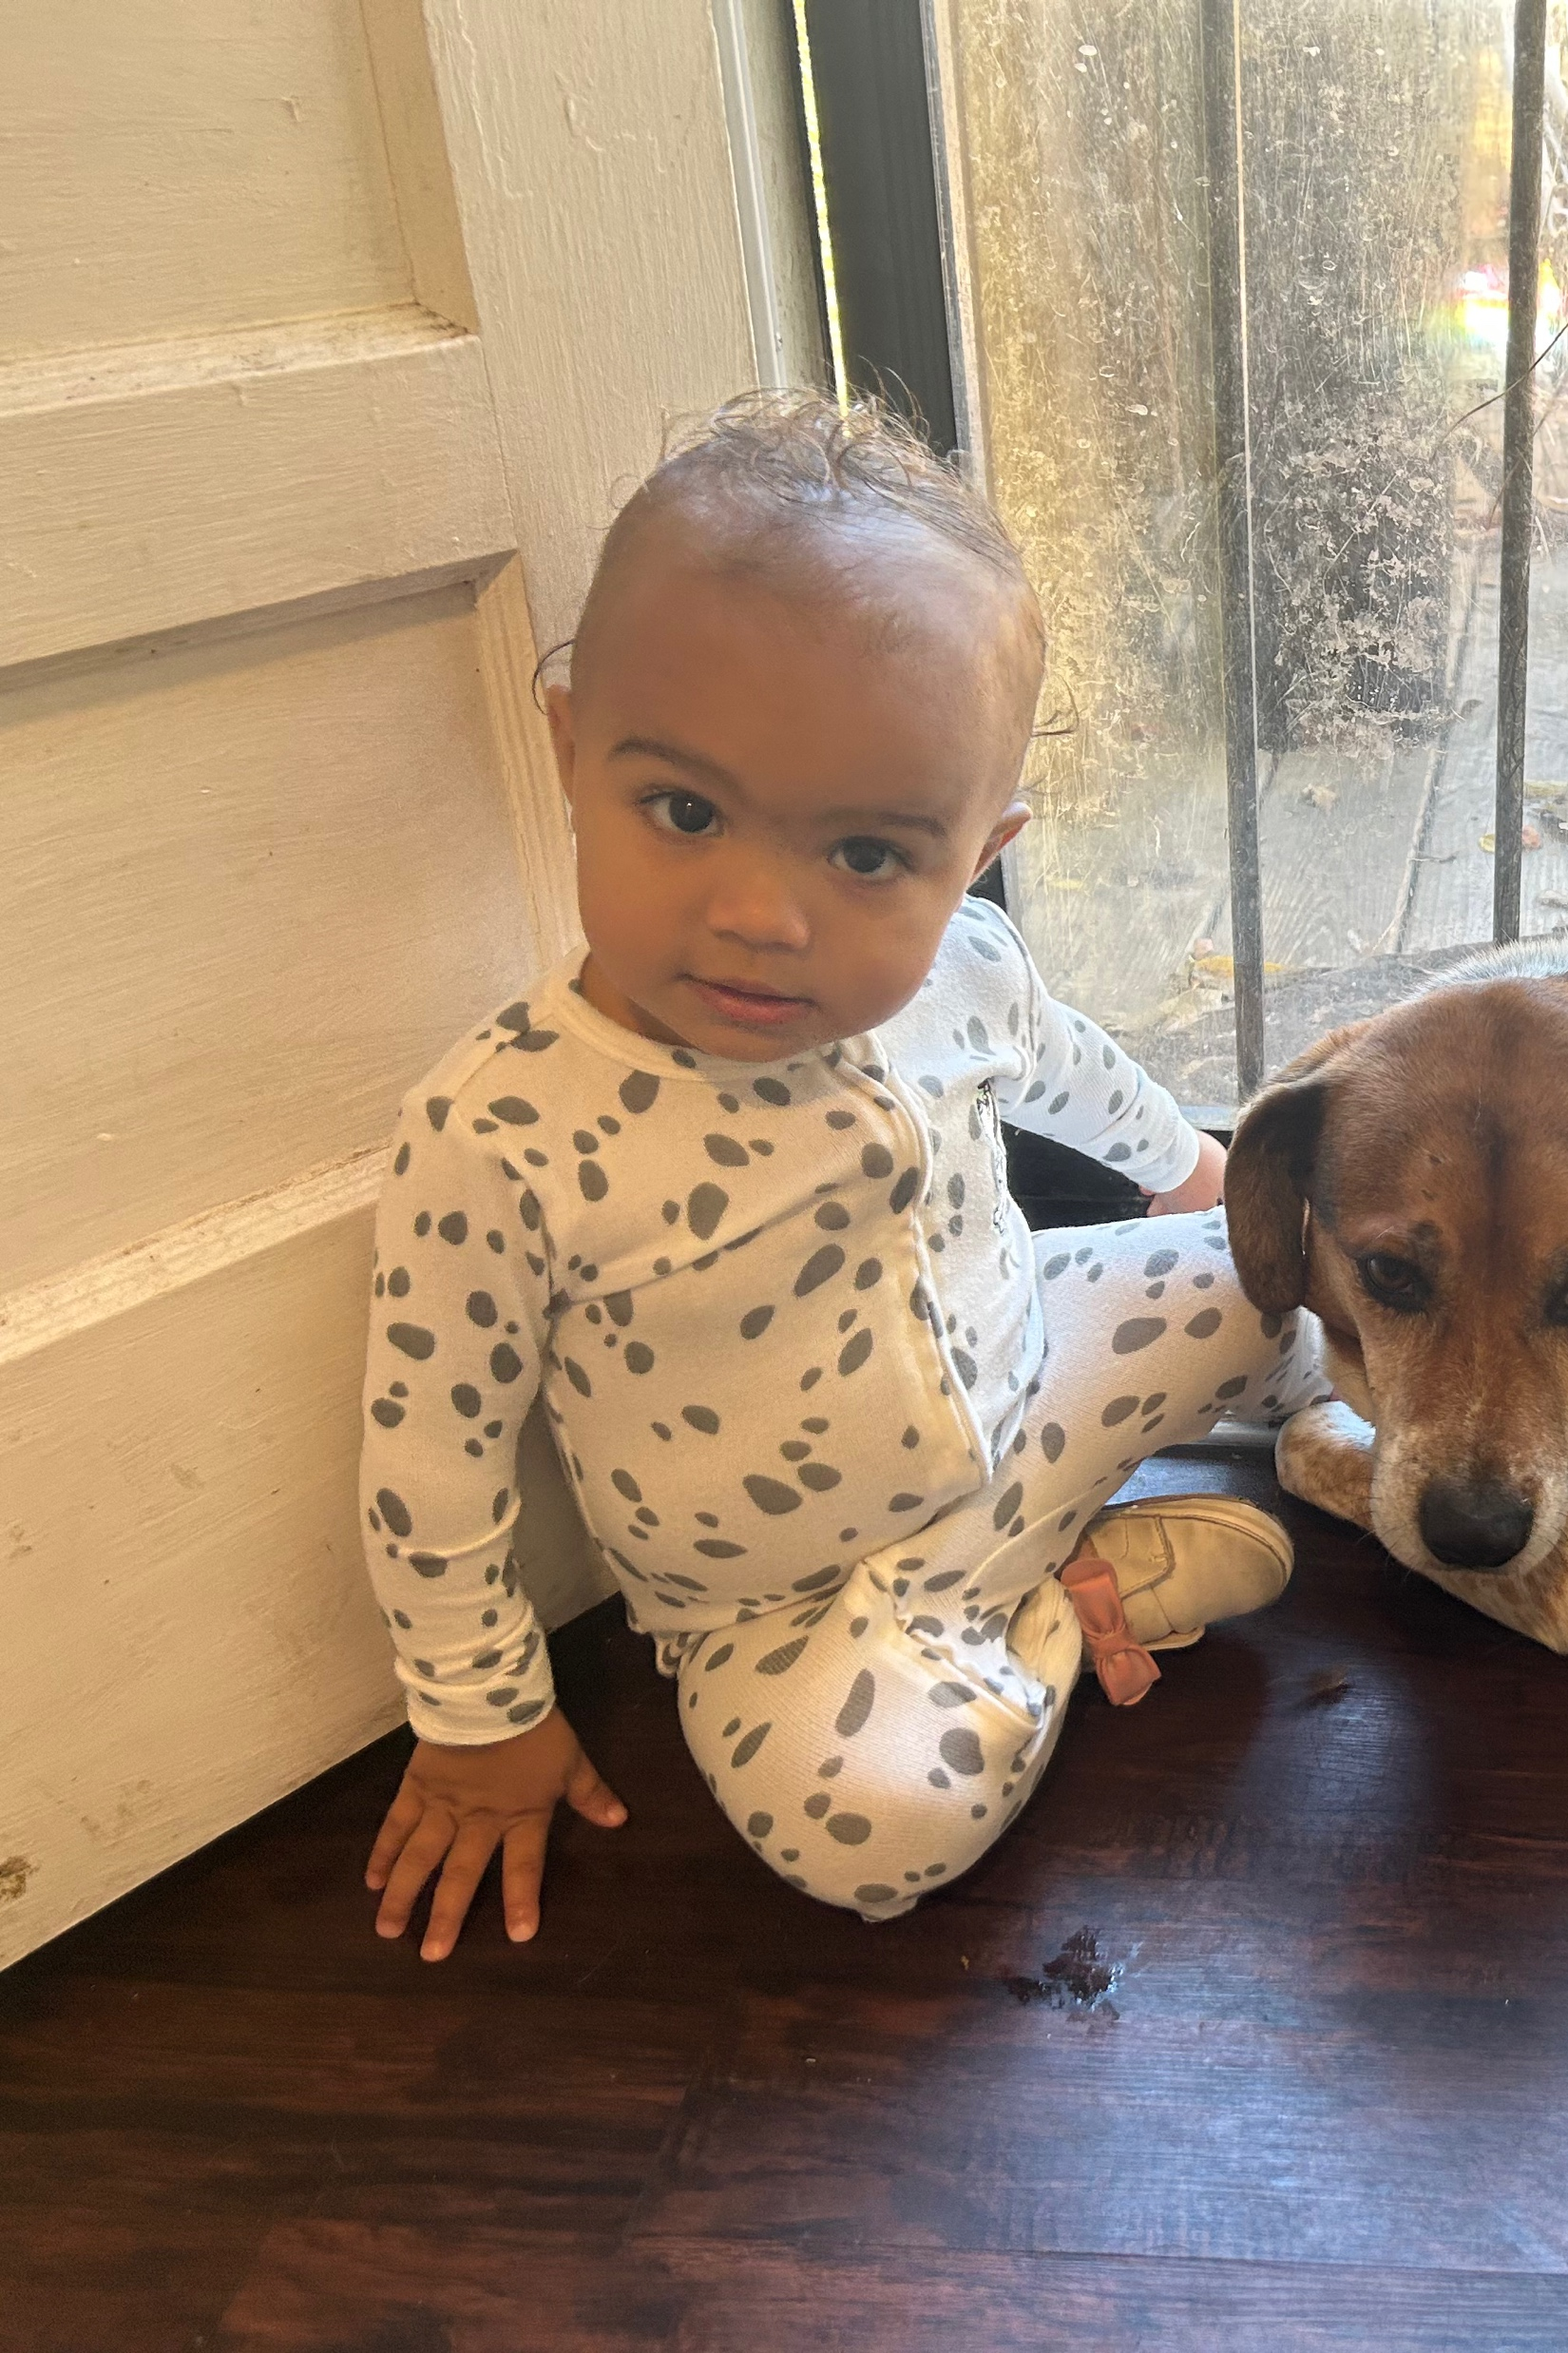
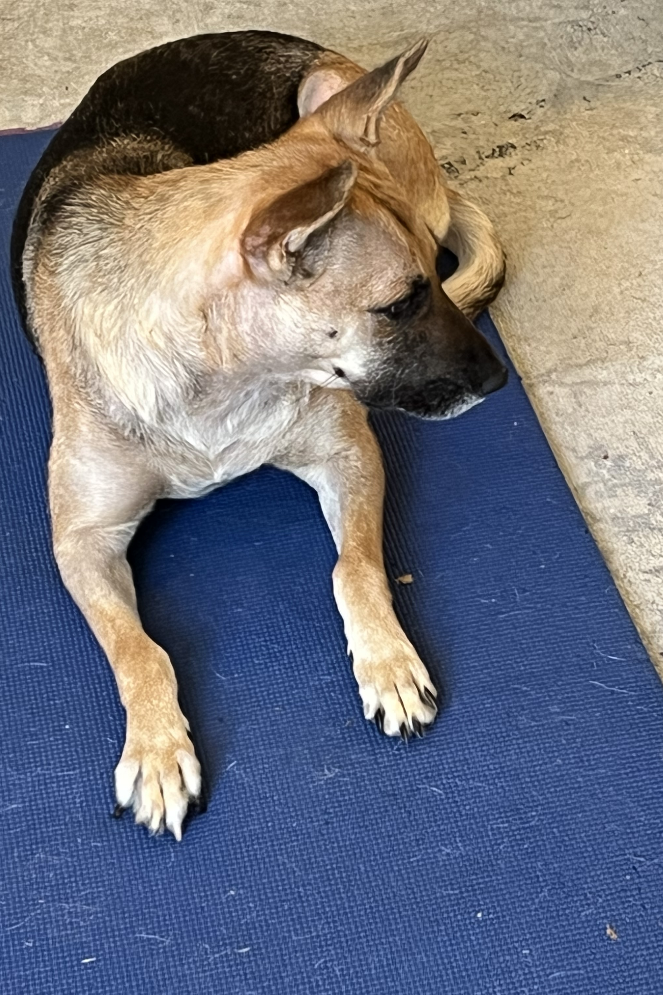
Notes:
For all you parents and pet owners, you witness and enjoy growth, seeing your children develop into little people and your pets being a family member

Slide 5
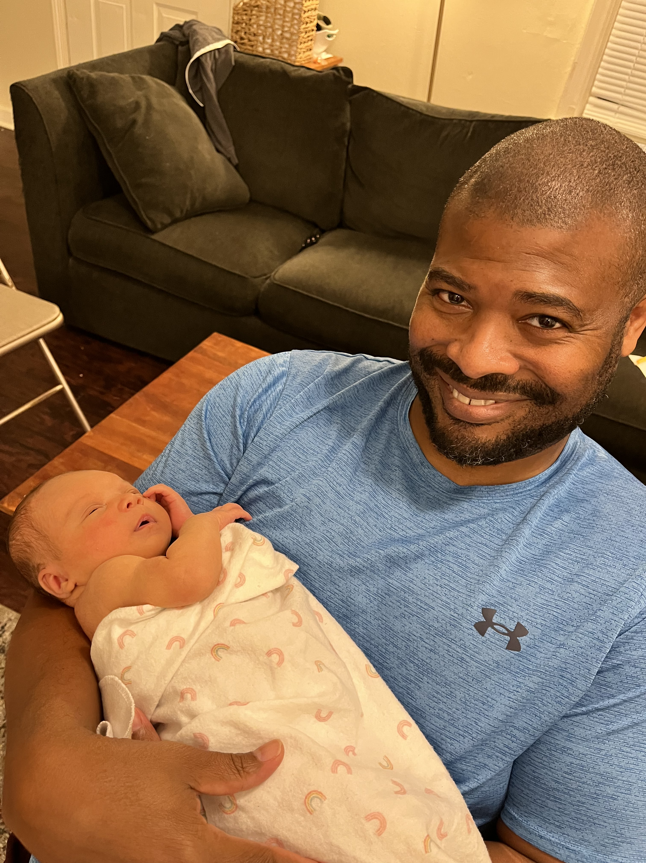
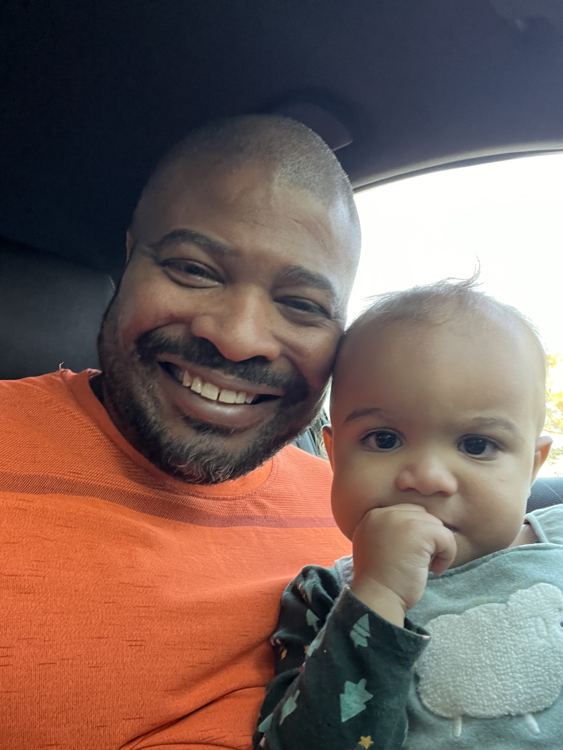
Notes:
For all the grandparents, we witness and enjoy growth in our grandchildren

Slide 6
Love to Grow, Grow to Love
Notes:
Growing is a natural part of life and is essential
Without growth, there is no change, no development, and new life. One of the defining characteristics of life is that living things grow. It’s what makes us different than rocks or a car.

Slide 7
Love to Grow
Our Minds
Our Relationships
Our Collective Consciousness
Our Culture
Our Faith
Notes:
There is a common phrase in academia used to describe the pursuit of knowledge. It is being a “life-long learner”. Meaning there is no point in which a person should stop learning or believe he or she knows enough.
This is even more essential given the rate of information compared to the rate of learning today.
Just like plants, pets, children, or grandchildren, we should not only pursue growth, but to love it, enjoy it, and see it as an essential part of living.

Slide 8
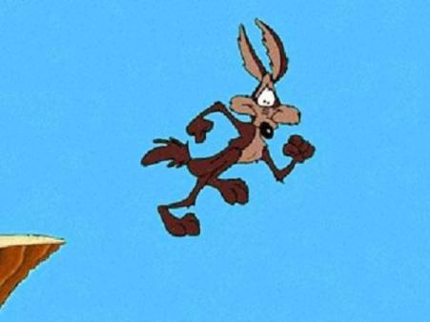
Notes:
Have there ever been something that you learned later in life that you wish you knew earlier?
Or has there ever been something you never knew to even inquire about but found out that it was something important?
Ex. When I discovered what chitlins were
Ex. When they discovered how smoking causes lung cancer

Slide 9
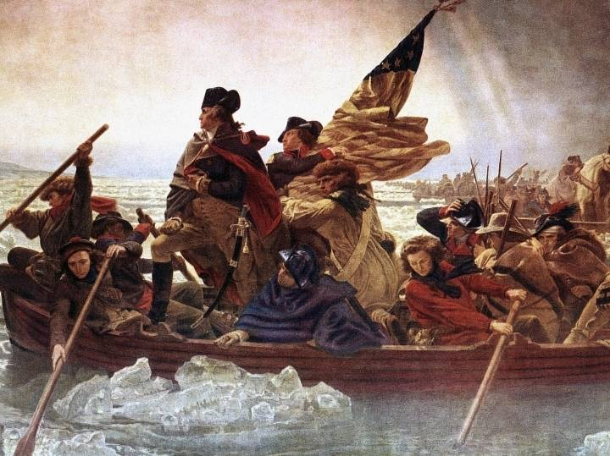
Notes:
In my regular research regarding racial justice and reparations, I came across information about the Revolutionary War that surprised me. Probably shouldn’t have at this point with other discoveries I have made but this one still threw me for a loop.
When one thinks of why the colonists broke away from England, 99/100 people would say it was due to no taxation without representation, or religious freedom from the Church of England.
However, what if I told you a major factor, and possibly the most critical factor leading to the Revolutionary War was about slavery?
(read excerpt from William Darity’s book)

Slide 10
Notes:
One of the main reasons we must seek to constantly grow is that what we feel we know or believe now, may actually be wrong.
My daughter often criticizes me because she says that I think that I am right all the time. My thoughts are, ”who doesn’t”?
I think most people that say things believe they are right or otherwise would not say it. I guess it is more about my presentation.
I admit, on the record, that I have been wrong about something plenty of times. Have you ever been so sure about something only to find out that you were wrong about it the entire time?
It happens all the time, right? Whether finding out Pluto really isn’t a planet or that you never really stop parenting no matter how old your kids get. I remember always bragging about how I’ll be 43 when my youngest is 18 and all my kids will be independent, and my job as a parent will be done. Here I am about to be 49 in 11 days and have conceded that I’ll be parenting till I die.

Slide 11
Love to Grow
Acts 10: 44-46
⁴⁴ While Peter was still speaking these words, the Holy Spirit came on all who heard the message. ⁴⁵ The circumcised believers who had come with Peter were astonished that the gift of the Holy Spirit had been poured out even on Gentiles. ⁴⁶ For they heard them speaking in tongues and praising God.
Notes:
The need for growth was critical amongst the early believers
Why were they so surprised?
They made an assumption that was dead wrong

Slide 12
Background
²⁸ He said to them: “You are well aware that it is against our law for a Jew to associate with or visit a Gentile…”
Notes:
Peter says in Acts 10: 28 makes it clear that the LAW or mandatory custom of that day was NOT to associate with Gentiles… AT ALL!

Slide 13
Groundwork
Jesus’s interactions with Gentiles
Vision to Cornelius – The right person for the right time
Vision to Peter
Notes:
Similar, in my opinion, about President Obama. It took a specific type of black person to make it all the way to the presidency. He was able to unite people and cross bridges that not all black people can do.
Cornelius was respected by the Jewish people. He was a generous man. If ever a Gentile was going to be allowed in the kingdom, he was it.
God also prepared Peter through his vision. Peter responds TO GOD with righteous indignation, opposing what God was telling him to do. And even afterwards, Peter was scratching his head wondering what that was all about. It wasn’t until he connected with Cornelius that he realized the meaning of his vision

Slide 14
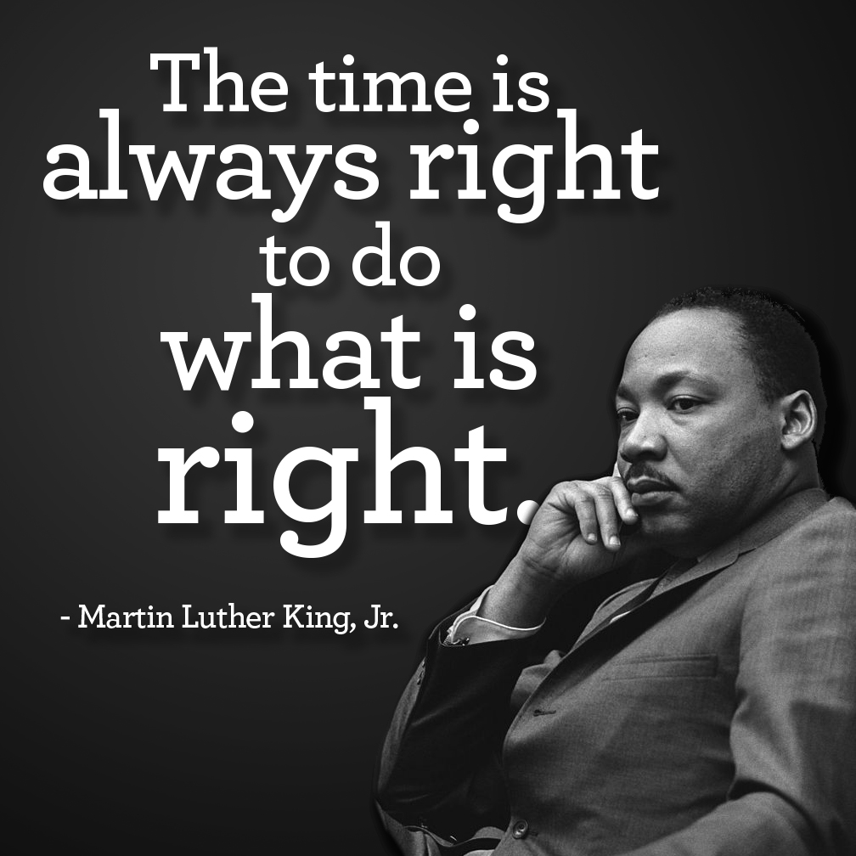
Notes:
God is always hoping that we grow. Jesus showed us that we should always seek to listen to God – no matter how much we think we know or have it all figured out. If Jesus had to keep seeking God to grow, I imagine we need to also.
One of the difficulties is being willing to grow even when everything around you is content right where they are.
Have you ever noticed that we describe those that fight and advocate for justice in our world as RADICAL? In AA history, Fred Hampton, Rev Dr Martin Luther King Jr, Malcolm X, and even Jesus were all considered radicals even though their main message and mission was to bring about more justice on this earth.
By the way, I did purposely include Jesus as part of African American history but that is another teaching all together.
It would be nice to have a world where seeking justice and doing the right thing was not radical.
In slavery days, abolitionists were considered radical
In the Jim Crow days, civil rights leaders were considered radical
Today, those that advocate for reparations are considered radical

Slide 15
Grow to Love
Ephesians 4: 1-7
As a prisoner for the Lord, then, I urge you to live a life worthy of the calling you have received. ² Be completely humble and gentle; be patient, bearing with one another in love. ³ Make every effort to keep the unity of the Spirit through the bond of peace. ⁴ There is one body and one Spirit, just as you were called to one hope when you were called; ⁵ one Lord, one faith, one baptism; ⁶ one God and Father of all, who is over all and through all and in all.⁷ But to each one of us grace has been given as Christ apportioned it.
Notes:
Paul gives us the ingredients for GROWTH. Humble, gentle, patient, and as Ron highlighted in his teaching last week, bearing with one another in love

Slide 16
Grow to Love
Ephesians 4: 11-13
¹¹ So Christ himself gave the apostles, the prophets, the evangelists, the pastors and teachers, ¹² to equip his people for works of service, so that the body of Christ may be built up ¹³ until we all reach unity in the faith and in the knowledge of the Son of God and become mature, attaining to the whole measure of the fullness of Christ.
Notes:
God will work on both sides or all parts of the equation as he did with Cornelius and Peter. It takes all parts to listen, to learn, to grow and become what God intended it to be
Paul describes some of the roles we all must play to that the BODY OF CHRIST MAY BE BUILT UP
Until we all reach UNITY IN THE FAITH and in the KNOWLEDGE of the Son of God.

Slide 17
Grow to Love
Ephesians 4: 11-13
¹¹ So Christ himself gave the apostles, the prophets, the evangelists, the pastors and teachers, ¹² to equip his people for works of service, so that the body of Christ may be built up ¹³ until we all reach unity in the faith and in the knowledge of the Son of God and become mature, attaining to the whole measure of the fullness of Christ.
Notes:
God will work on both sides or all parts of the equation as he did with Cornelius and Peter. It takes all parts to listen, to learn, to grow and become what God intended it to be
Paul describes some of the roles we all must play to that the BODY OF CHRIST MAY BE BUILT UP
Until we all reach UNITY IN THE FAITH and in the KNOWLEDGE of the Son of God.

Slide 18
Grow to Love
Ephesians 4: 14-16
¹⁴ Then we will no longer be infants, tossed back and forth by the waves, and blown here and there by every wind of teaching and by the cunning and craftiness of people in their deceitful scheming. ¹⁵ Instead, speaking the truth in love, we will grow to become in every respect the mature body of him who is the head, that is, Christ. ¹⁶ From him the whole body, joined and held together by every supporting ligament, grows and builds itself up in love, as each part does its work.
Notes:
Just like the Jewish believers that thought Jesus and the Holy Spirit was just for them only to be shown a different way, I believe believers in this country have to experience a realization that black people are truly fully human and fully part of God’s kingdom.
You might say, Jeff, of course believers believe black people are fully human. I would argue that any fully human being deserves justice and as long as justice is being denied, in particular by believers, an awakening still needs to occur.
Unfortunately, New Covenant is radical. It is a church that has declared with words and deeds that black Americans deserve justice. Until what is radical becomes the norm, God and all of us, still have some work to do.
I am grateful God gave us a roadmap to get there and that I can be part of a fellowship that is reading and willing to grow so they can follow the path where the map leads.

