Slide 1
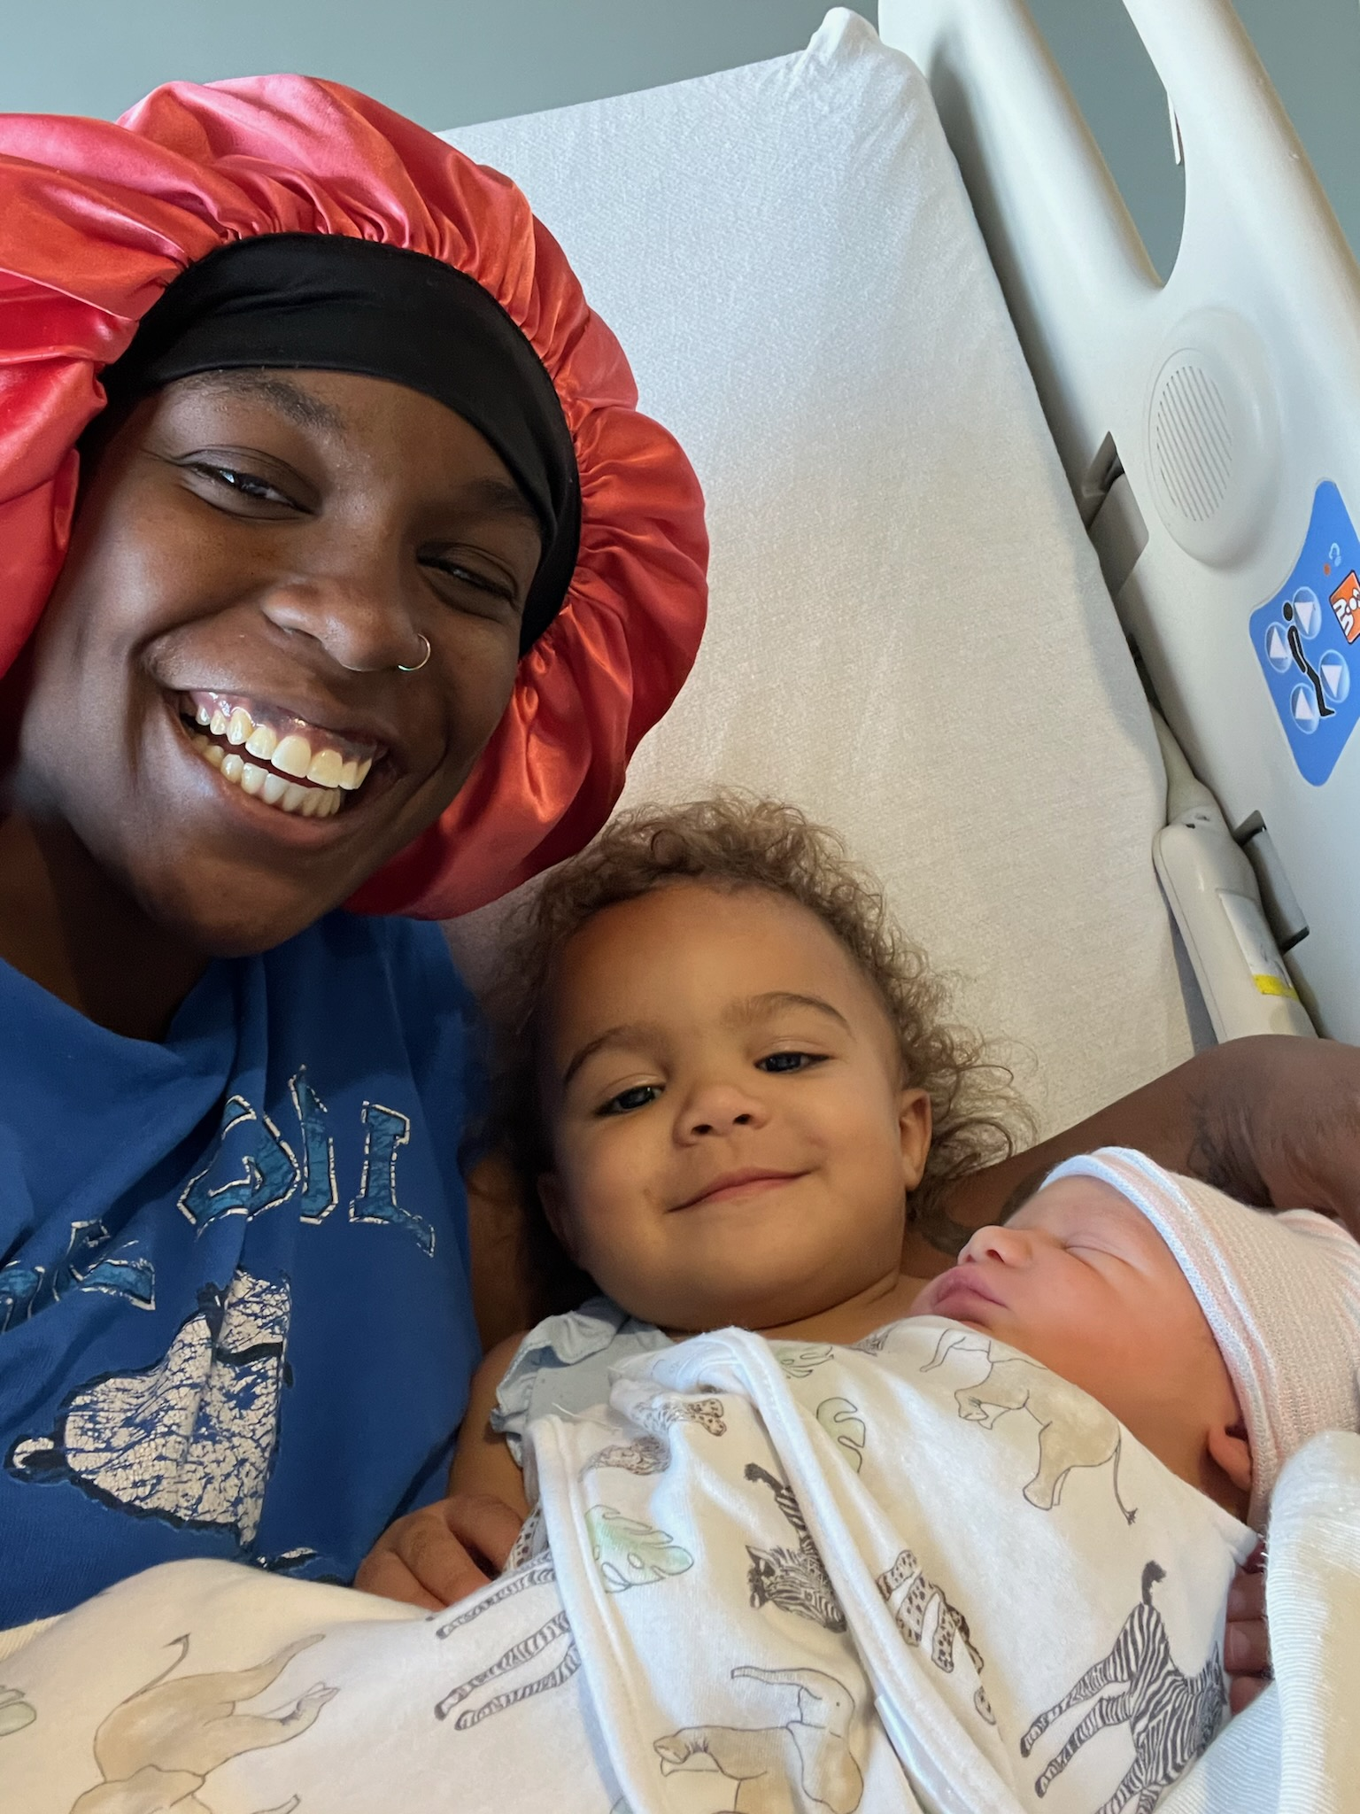
Notes:
Birth of my second grandbaby – Amari Chico – July 17th
1st grandbaby turned 2 - July 29th – Amaya Josephine

Slide 2
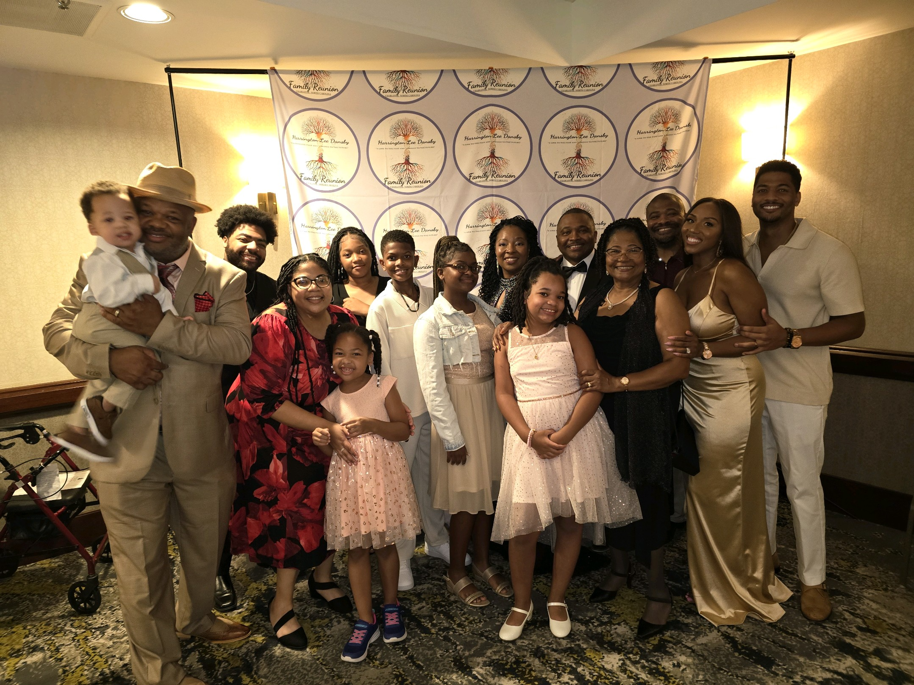

Slide 3
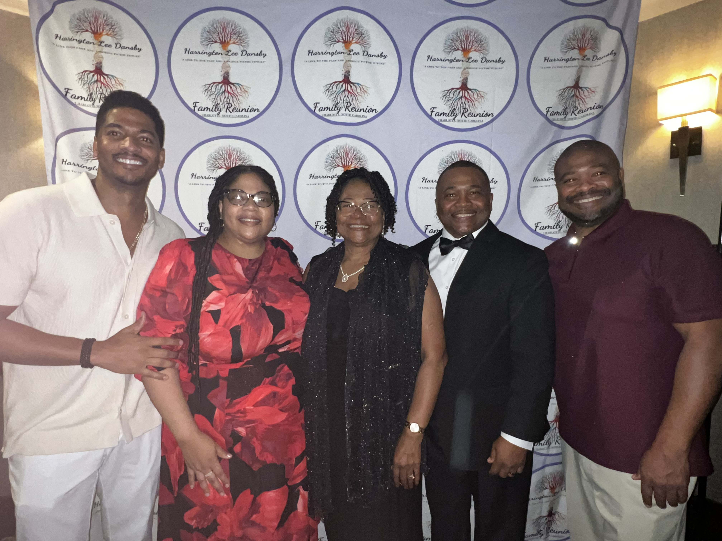
Notes:
However, did you know the Statue of Liberty was originally designed and gifted to celebrate the end of slavery in the US? The first design actually had lady liberty holding broken shackles instead of a tablet in her other hand. Matter of fact, the broken chains did get included but they are not very visible.
The person that came up with the idea was Edouard de Laboulaye was an expert on the US Constitution and at the close of the Civil War, the president of a committee that raised and disbursed funds to newly free slaves. He hosted a meeting with abolitionists at his home to flesh out the idea.
Perhaps it is fitting that the broken chains are barely visible

Slide 4
Reparations Movement
Evanston – Robin Rue Simmons

Slide 5
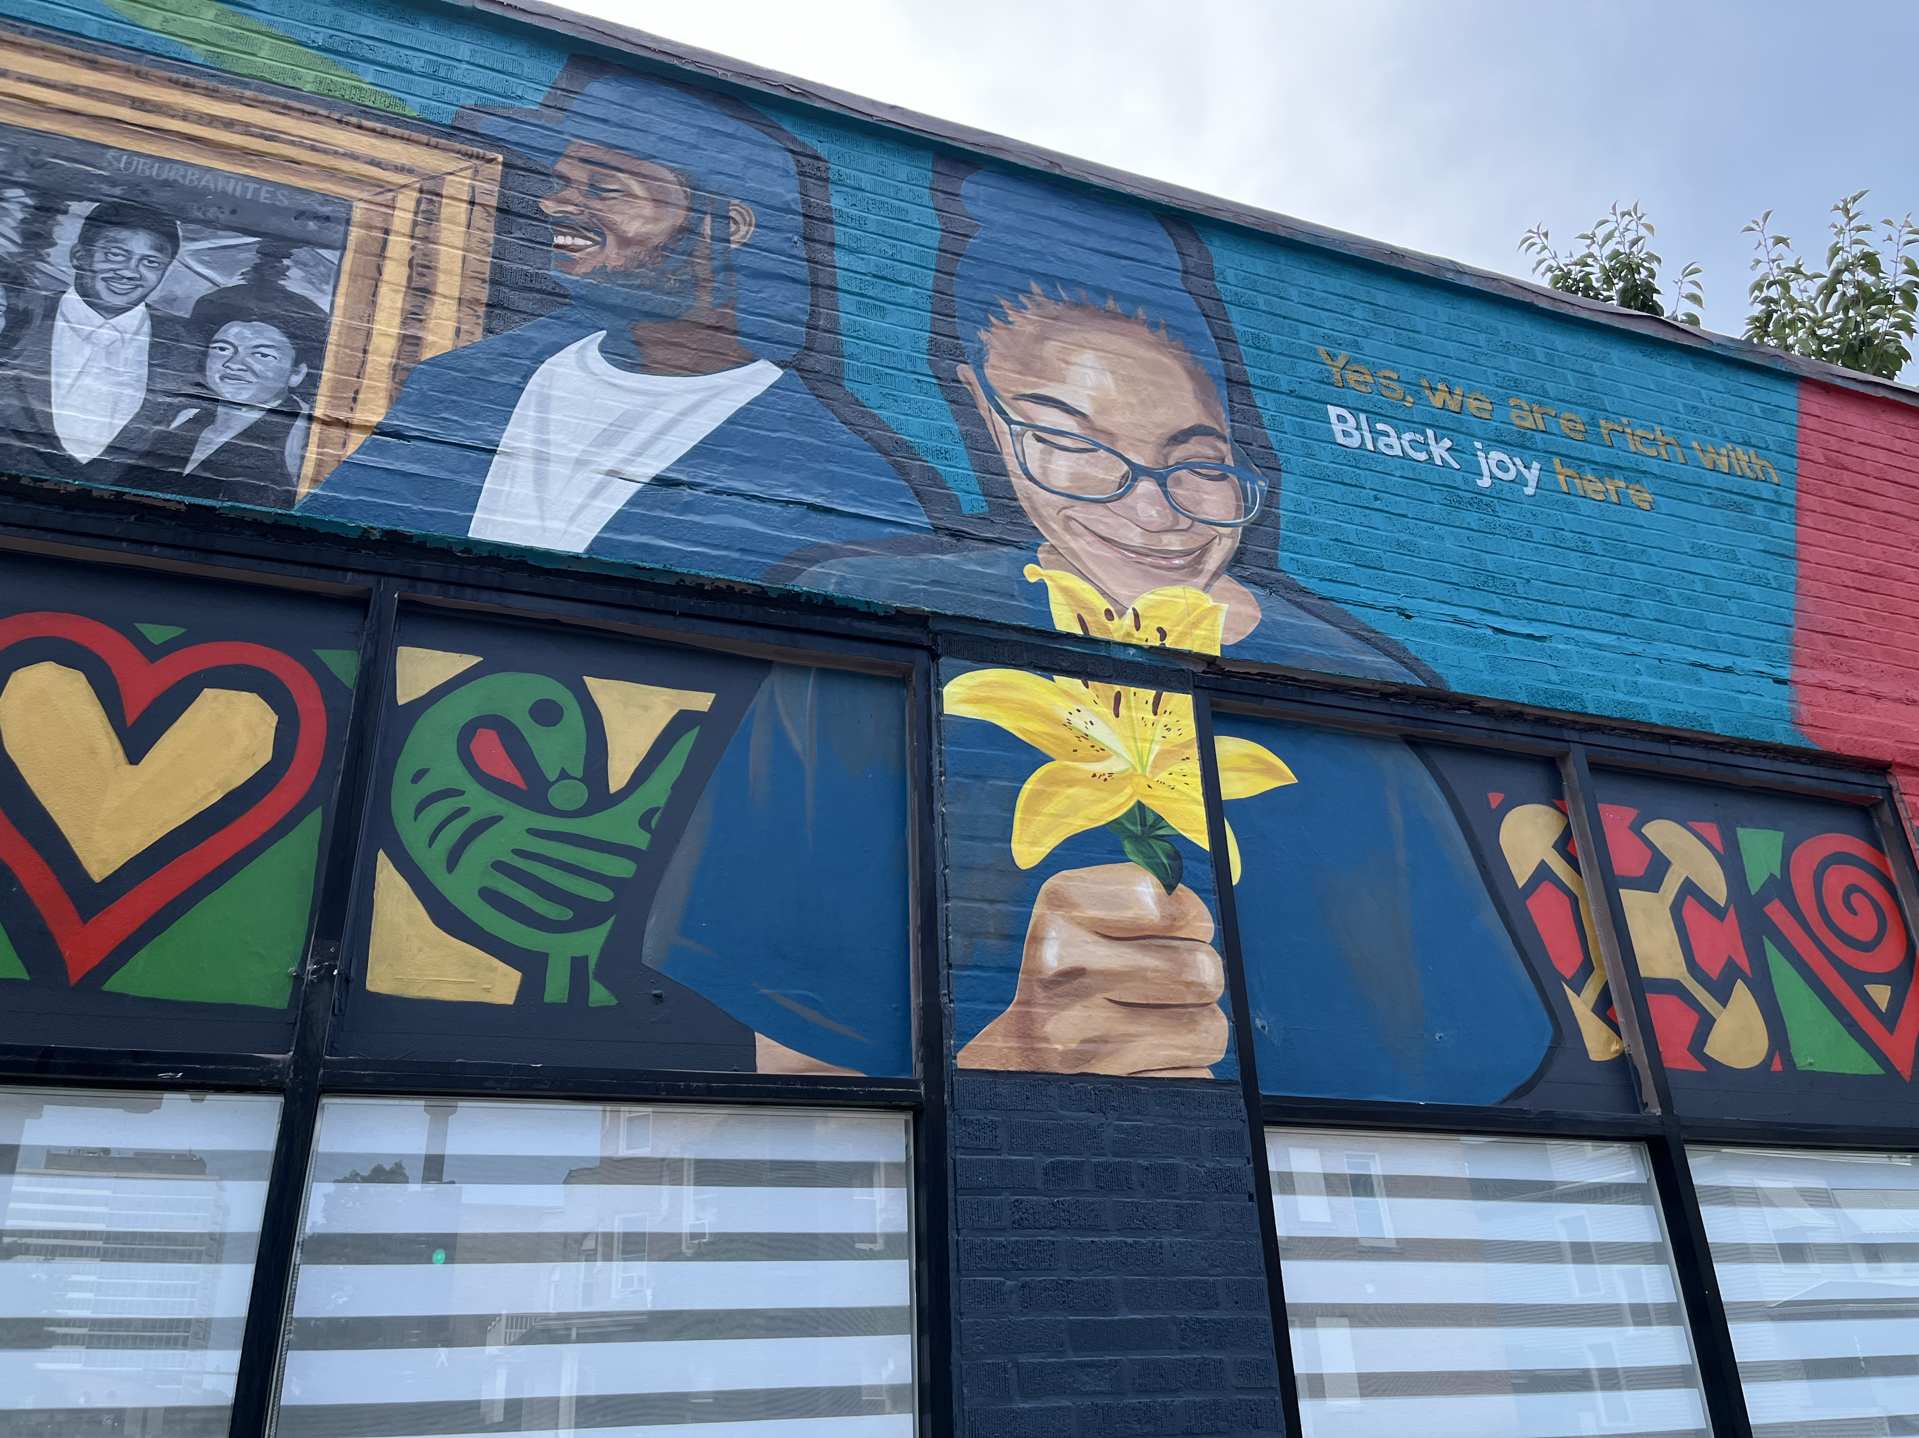
Notes:
Today, I want to talk about FREEDOM… but first a little nugget of knowledge
The statue of liberty is perhaps one of the most iconic monuments in the world. A gift to the United States from France. Today, this statue supposed to represent what distinguishes the United States from other countries in the world… a notion that no matter who you are and where you come from, this is the place that anyone dealing with oppression can find freedom
Interestingly, the statue was given, timing wise, to mark the 100 year anniversary of the Declaration of Independence in 1876… only 11 years after the Civil War AND right before the end of Reconstruction which was from 1865 after the Civil War to 1877. When I saw the timing, I got curious.

Slide 6
VP Kamala Harris
Do we realize that is should not be a thing?
46 presidents – not one woman – should have had 23
46 presidents – one African-American – should have had 6-7
What kind of world might it be with fair representation?
Notes:
Woman – should have had 23 by now
Black – should have had 6 by now

Slide 7
Sonya Massey
Ultimate Expression of Power & Hate
Springfield, Il – National Headlines
Black woman who called the police fearing she had an intruder
No signs of an intruder, police were about to leave. One of the officers wanted to question her about a headlight on her car that was broken. They came into the house.
After a few minutes, Sonya Massey was shot 3 times, one shot in the face after saying to the officer, “I rebuke you in the name of Jesus”

Slide 8
Enough Is Enough
I mean that in 2 ways:
1) The angry version
2) The logical version
Notes:
The ”They” Peter is referring to are false teachers

Slide 9
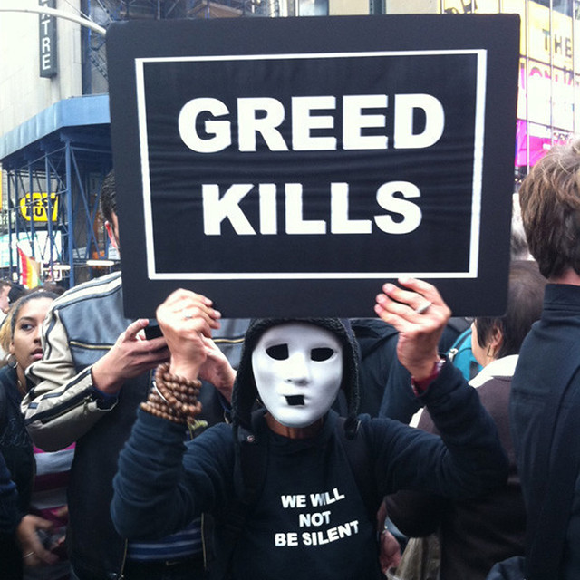
David’s Greed
II Samuel 11 & 12
Notes:
We are familiar with the story. A couple of things jump out at me with this story, however.
One, Nathan says that if David wanted more than what he had (which was practically all you could hope for), God would have given it to him
8 listed wives with a referenced few more plus a number of concubines… yet, he schemed to take Uriah’s wife

Slide 10
An Interesting Parallel
Notes:
Want to share a few informational nuggets with you
Not only does the top 20% of the US population have more than the remaining 80%, but the top 1% has more than that same 80%
If you were to spread personal assets evenly to all adult Americans (approx. 266 million people), every person would have over $445,000 in personal assets. That’s about 3 million people with more assets than 212 million people
Income wise, $682,577 a year is the base number for the top 1%, $252,840 for the top 5%, $169,800 for the top 10%, and $130,000 for the top 20%

Slide 11
The Top 1%
Notes:
How is this lesson in economics related to David? Or Us? Or Sonya Massey?
Glad you asked.
The top 1% (and even some in the 20%) have cultivated a culture driven by the same greed that David expressed and achieved by designing a society to thrive off of hate.
David was a 1%er and used his power, money, and authority to take from someone with much much less than him

Slide 12
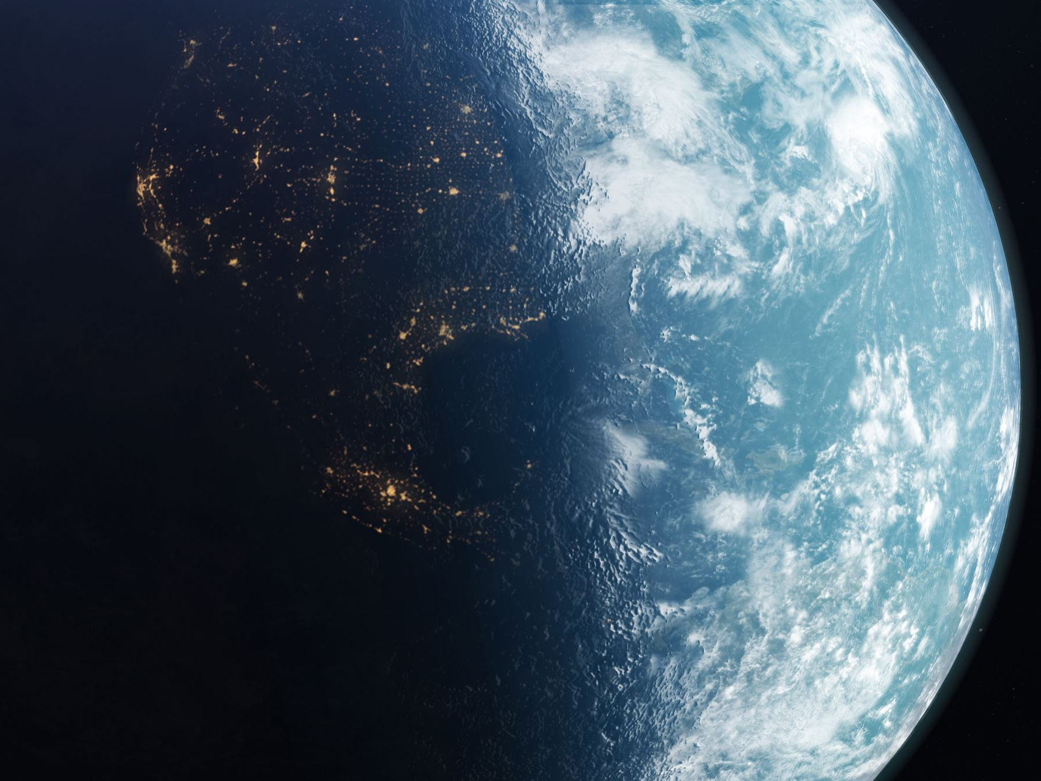
Notes:
You may be thinking, Jeff, I am not and my family was never part of the top 1%
True, however, you are living in a world in large part designed by the 1%. You should want to know that design and how it affects you and others. After all, David’s greed did not only affect him. If affected his entire family and the whole nation before all was said and done (source of rebellion from David’s own son for example).
While there are many ways this impact is felt (I can give you many examples of power and money dictating other peoples’ lives – lobbying against predatory lenders or federal healthcare legislation that left seniors picking up the tab for pharmaceutical companies)
For this teaching, I will focus on how racism has been used to design our society – particularly in the United States.

Slide 13
The Results of the 1%ers Greed
Creation of racial Division
1619 First enslaved peoples in the colonies
1776 - 25% of the population were black (90% enslaved)
Notes:
Before the introduction of slavery, they [black people] accumulated land, voted, testified in courts, and mingled with the masses of Whites on a basis of relative equality… Freedom preceded slavery and integration preceded racism.
The transition due to growing need for labor, such as the tobacco farms the arrow started pointing to slavery (growing costs for white indentures from Europe and the loss of the indentured fulfilling their obligations). Additionally, sending too many white laborers to the colonies would up the price for white labor at home (England). An added bonus, black skin made it easier to recognize, track and capture when trying to escape.

Slide 14
The Results of the 1%ers Greed
Creation of racial Division
Bacon’s Rebellion – created fear in the 1%
Result – laws written to convince economically poor whites to “imagine that tremendous social significance – inherent difference and inferiority lay beneath black skin
Notes:
Laws were created to allow white people to skirt fatherhood and promote raping of black women, to bully, beat, and even murder enslaved blacks without repercussion, and disrupt the unity previously seen between indentured servants and black people.
Free labor also provided the ability for the colonies to become self-sufficient enough to rebel against England

Slide 15
Ephesians 4: 14-16
We must no longer be children, tossed to and fro and blown about by every wind of doctrine, by people's trickery, by their craftiness in deceitful scheming. But speaking the truth in love, we must grow up in every way into him who is the head, into Christ, from whom the whole body, joined and knit together by every ligament with which it is equipped, as each part is working properly, promotes the body's growth in building itself up in love.

Slide 16
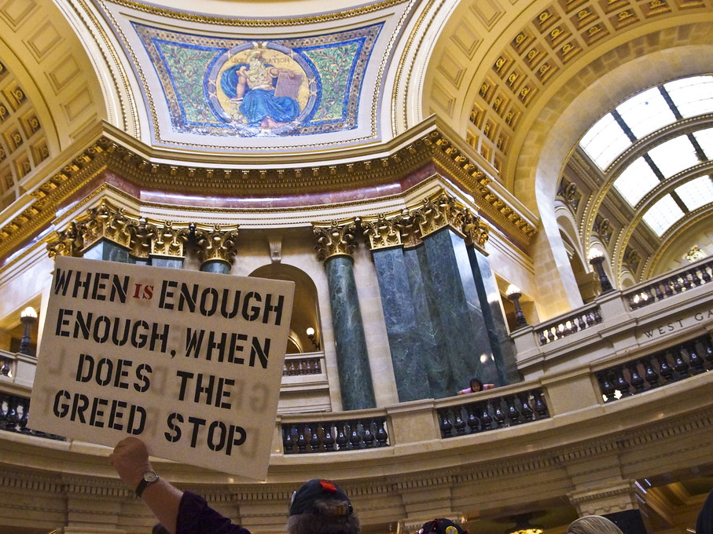
This Photo by Unknown Author is licensed under CC BY-NC
Notes:
Amari Chico – Named after a young man who was victim to a society designed for his demise due to this greed. Young black boys and men are presented with a myriad of obstacles just to have a reasonable life, let alone a successful one
The joy of a family reunion and seeing my siblings together is a reminder of generations of African Americans who were separated from their families, lost loved ones, never to experience that joy of togetherness ever again due to this greed
Without this greed, First Repair would not need to exist. And all the time, energy, efforts, loss of life, stress, injury, pain, and suffering expensed to repair the damage done to African Americans could have been used for other things to better the world
Greed disallowed this country to grow healthily, properly representing the people as a true democracy would. There would not have been historical and current efforts to prevent fair representation
Greed led to a police officer so convinced of his level of power that he believed he could kill an innocent black woman and not face any real justice (he pleaded not guilty)

Slide 17
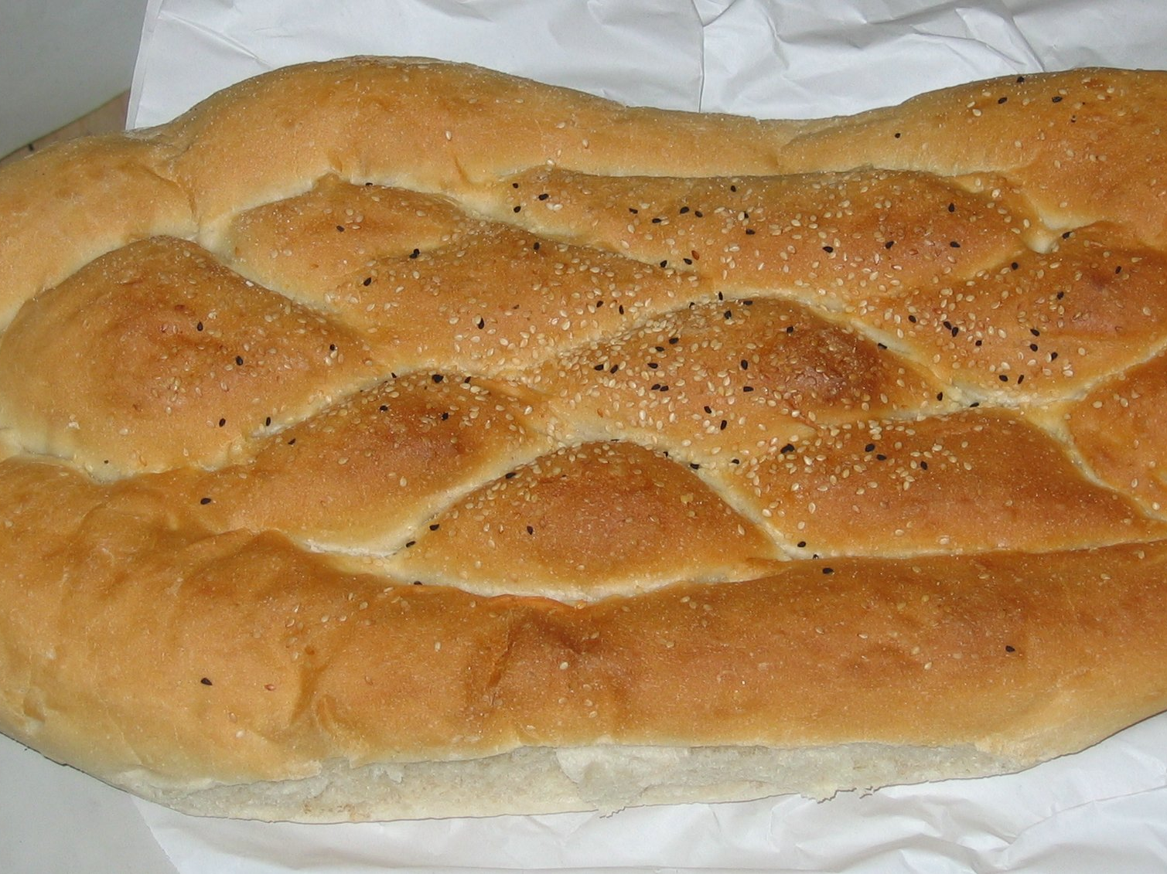
God’s Provision
Exodus 16
God provided everything the children of Israel needed
John 6
Jesus provided everything all the world needed
“Very truly, I tell you, it was not Moses who gave you the bread from heaven, but it is my Father who gives you the true bread from heaven. For the bread of God is that which comes down from heaven and gives life to the world.”
Notes:
What is interesting in the Exodus passage is that some people grabbed a lot and some grabbed a little, but everyone got what they needed – nothing more, nothing less
It is also worth noting that those not willing to trust in God’s provision, who disobeyed by attempting to keep mana overnight, found their greed led to food infested with maggots

Slide 18
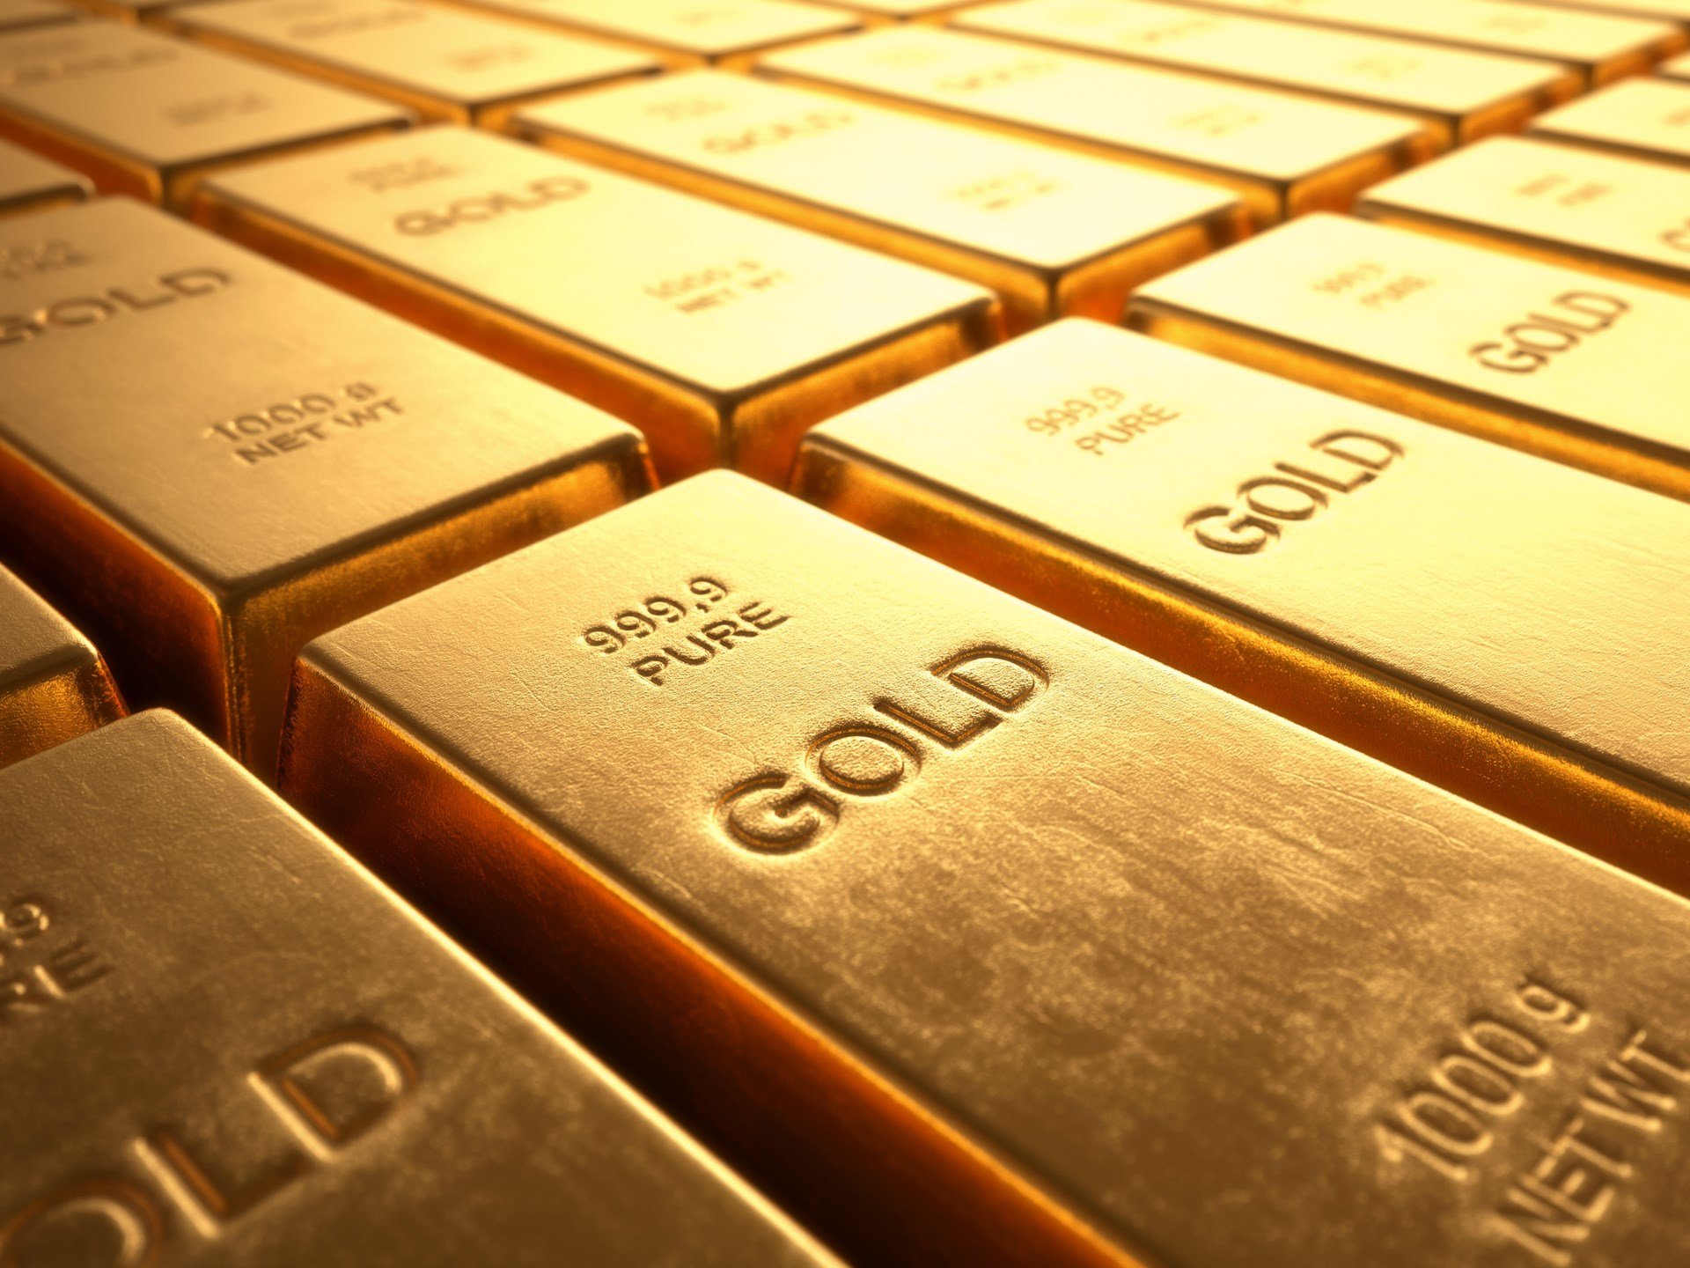
Can’t Take It With You
Notes:
Never could understand 1%ers greed. Billionaire selling his book to a black, lower income community. Friends with more money than they know what to do with, not willing to give a dime to any charitable cause. It baffles the mind.
Once upon a time there was a very rich businessman who was near death. Having worked hard all his life, he desperately wanted to be able to take some of his wealth with him to heaven and was eventually given special permission by God to bring one suitcase. Overjoyed, the businessman gathered his largest suitcase, filled it with pure gold bars and placed it beside his bed. Shortly afterwards the man died and showed up at the Pearly Gates where he was greeted by St. Peter. Seeing the suitcase, St. Peter said: "wait, you can't bring that in here." The businessman explained that he had been granted permission by God. St. Peter checked out the story and confirmed: "Yes, you have permission to bring in one case, but I must check its contents before letting it through." So St. Peter opened the suitcase to inspect the worldly items that the businessman found too precious to leave behind. As the lid sprang back to reveal the gold, St. Peter exclaimed: "You brought pavement for the streets?"

Slide 19
Ephesians 4: 1-6
As a prisoner for the Lord, then, I urge you to live a life worthy of the calling you have received. ² Be completely humble and gentle; be patient, bearing with one another in love. ³ Make every effort to keep the unity of the Spirit through the bond of peace. ⁴ There is one body and one Spirit, just as you were called to one hope when you were called; ⁵ one Lord, one faith, one baptism; ⁶ one God and Father of all, who is over all and through all and in all.

