Slide 1
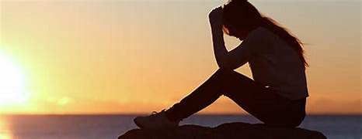
Lament

Slide 2
Seasons of Joy and Celebration Seasons of Sorrow, Anger, Regret AND seasons always change.

Slide 3
We’re supposed to…. Lament Challenges False World

Slide 4
That is why we don’t lose heart. And though this physical self of ours may be failing into decay, the inner self is renewed day by day. These light and momentary troubles train us to carry the weight of an eternal glory….visible things last only for a time, but the invisible are eternal. II Corinthians 4:17-18

Slide 5
For we know that when our earthly tent is folded up, there is waiting for us a house build by God, an everlasting home in the heavens, not made by human hands. And while in this tent, we lament—we groan—longing to be clothed with our heavenly home. II Corinthians 15:1-2…

Slide 6
People’s “sins” and Spiritual Forces of “SIN” Our hearts have been broken… We have broken other people’s hearts… Life breaks all our hearts… Lament is honest, appropriate response!

Slide 7
“A Liturgy of Loss” --Address God directly. Like a stag, a doe, longing for streams of cool water, my whole being longs for you, my God. My soul aches with thirst for God, for a god that lives! When can I go and see God face to face? Psalm 42: 1-2

Slide 8
--Express our complaint My only food, day or night, is my tears; people recriminate. “Where is your God?” they say. These things I remember as I pour out my soul like water—How I’d go with the crowds and lead them into God’s house, amid cries of gladness and thanksgiving, drunk with the dance of celebration. Psalm 42: 3-4

Slide 9
--Ask God for Help: Do something Why are you so silent? Listen to me! Comfort me! Take this cup from me!

Slide 10
--Ask God for Help: Forgiveness O God, have mercy on me! Because of your love and your great compassion, wipe away my faults, wash me clean of my guilt; purify me of my sin. For I am aware of my faults and have my sin constantly in mind. I sinned against you alone…. Psalm 51:1-4

Slide 11
--Ask God for Help: Transformation Compassion for others Willingness to help others

Slide 12
--Choose to Trust God “Why so dispirited,” I ask myself. “Why so churned up inside. Hope in God!” I know I’ll praise God once again, for you are my Deliverance; you are my God. Ps. 42: 5 Life is a mystery of suffering. God is Laboring in love to transform us in that suffering.

Slide 13
Lament. A dead-end road of sorrow? No, a conduit for renewed faith. While we are in this tent, we groan…so that what is mortal is swallowed up by life. God made us for this very purpose and gave us the pledge—the downpayment—of the Spirit to safeguard our future. II Cor. 5:4-5

Slide 14
We lament in private, With trusted friends, With the family of God together. And always, with God.

