Slide 1
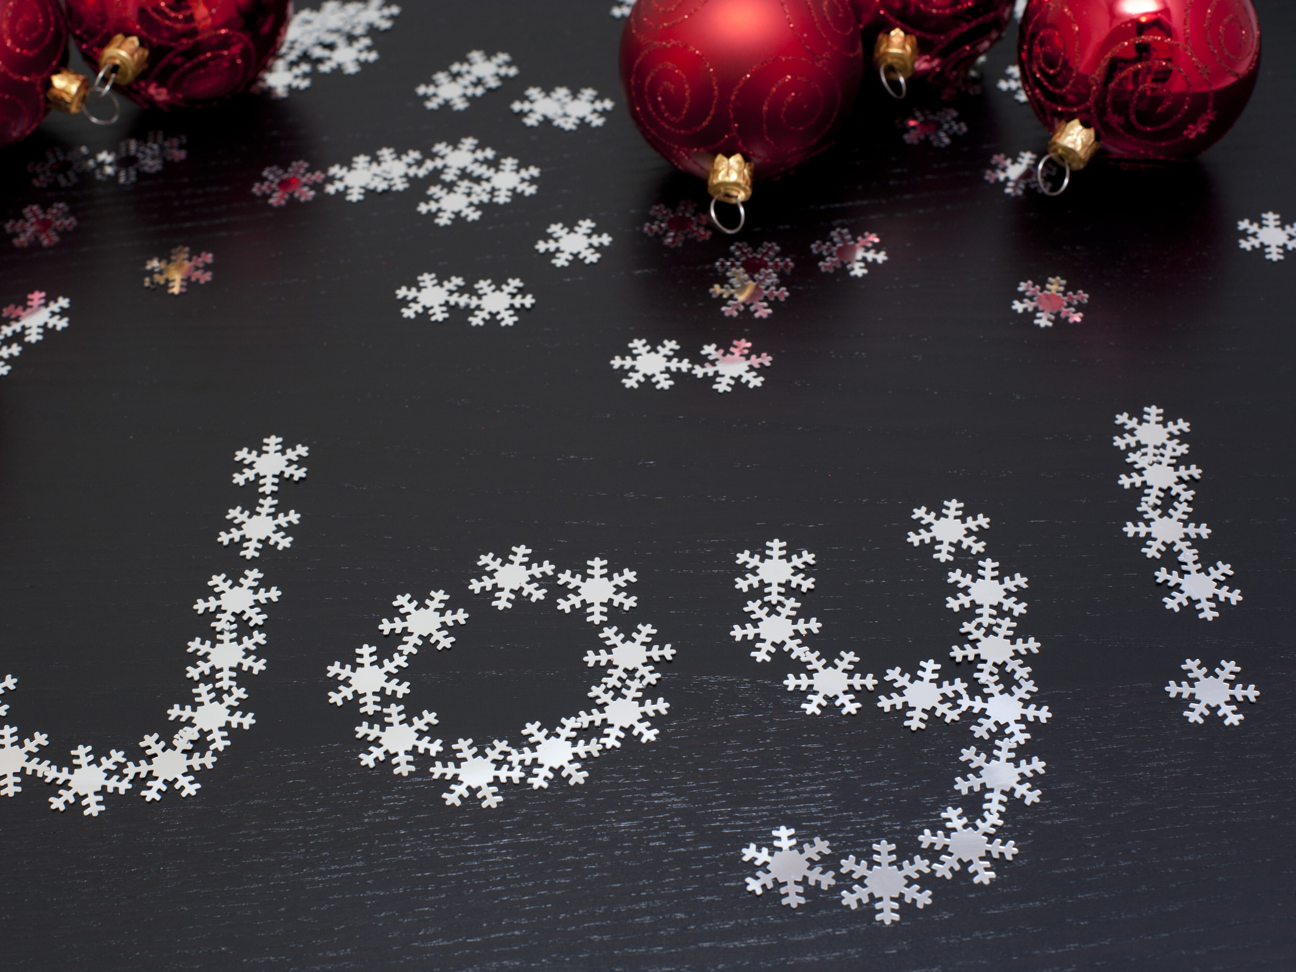
We Will See Jesus Again… But Not Yet
JOY TO THE WORLD
Notes:
The third Sunday of Advent is centered around the Joy associated with the coming of Jesus on Earth
There are numerous Old Testament scriptures predicting the coming of a Messiah ranging from Moses (in Genesis 3:15) to Malachi (3:1) spanning 1000 years!!! Plus another 400 in between the last prophecy and Jesus actually coming

Slide 2
624AD Prediction
During the Roman Empire, Persian Empire, the very beginnings of Islam in the Arabian Peninsula, the Tang Dynasty in China, the Early Medieval Period in Europe, the Maya Civilization, and Kingdom of Aksum (modern Ethiopia) and Ghana Empire
Notes:
Can you imagine that?!?!?! Something that was prophesized and predicted for so many years was finally going to happen in real life?
That would be like someone predicting something would happen in the year 624 AD and this year it actually was going to happen.
Now, we are in eager anticipation for Jesus to return. Jesus’ return will usher in peace on Earth.
Imagine that… peace everywhere.
Imagine a world with no violence, no hunger, no one left out in the cold, no poverty, no hatred, no sickness, no suffering.
That’s why we have the Christmas song, Joy to the World, the Lord has Come.

Slide 3
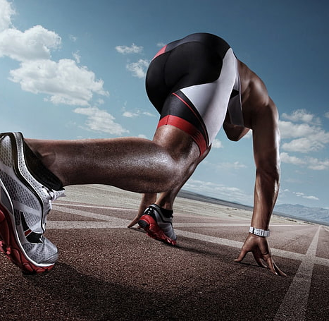
Before we reach the finish line
Knowing Yourself
Finding Purpose
Evolving
Notes:
When I grew up in church, we often used the language, we have to run this race.
This metaphor was used to symbolize running a life for Jesus. As believers, we are running this race to build God’s kingdom in the time we have
So while we eagerly anticipate Jesus return we have to run towards him in the meantime
I am going to highlight a few things I believe are critical in running the best race we can run until Jesus’ return

Slide 4
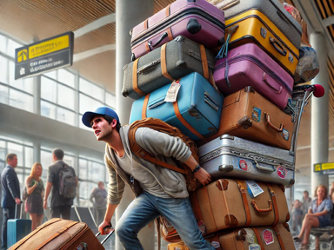
Notes:
There are lots of people and things that will convince you that you are something that you are not
Family, Friends, Media, Social Media, Community, Society
This constant barrage of messaging telling you that you are anything short of God’s creation can be very damaging and affect your ability to run your race
Imagine trying to run a race with all the baggage this guy has to carry
Regardless of what you are told, the truth is that you are beautifully and wonderfully made. What the world may perceive or say is wrong about you is not what God created you to be. And all that should matter is what God created you to be.

Slide 5
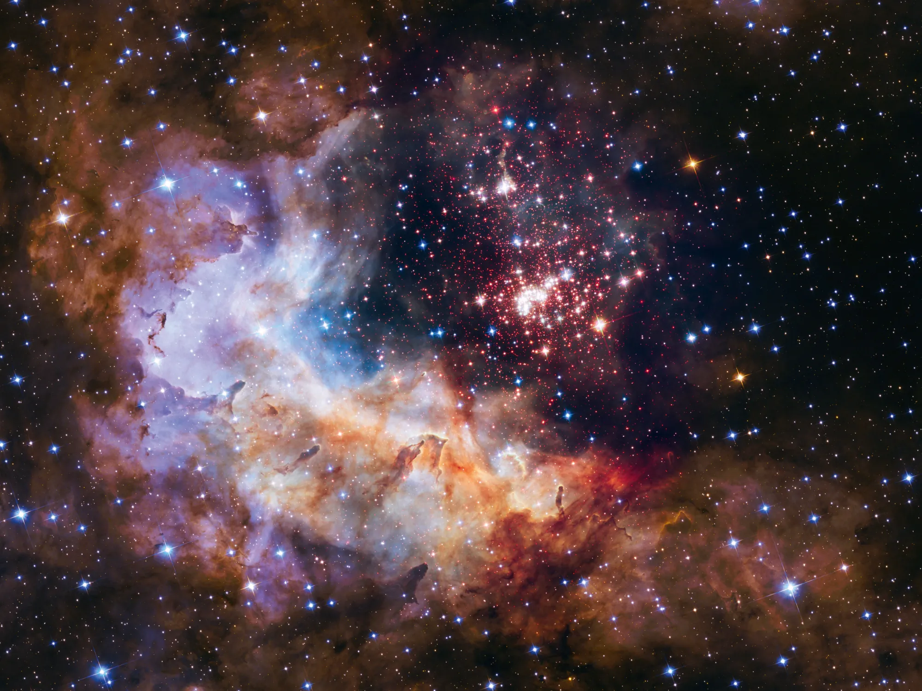
Notes:
The Universe is vaster than our minds can imagine. There are 2 trillion galaxies that we know of and 10 to the 24th power of stars which is more than grains of sand you find on Earth

Slide 6
10 to the 24th power
10x10x10x10x10x10x10x10x10x10x10x10x10x10x10x10x10x10x10x10x10x10x10x10
1,000,000,000,000,000,000,000,000
Notes:
10x10=100x10=1000x10=10,000x10=100,000x10=1,000,000x10=10,000,000x10=100,000,000x10=1,000,000,000x10=10,000,000,000 (10 Billion)
That’s just the first 10

Slide 7
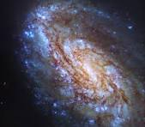
Notes:
Each of the 2 trillion galaxies (like our Milky Way) has about 100 billion stars

Slide 8
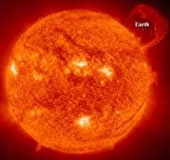
Notes:
Our star, the Sun, is about 1 million times the size of Earth

Slide 9
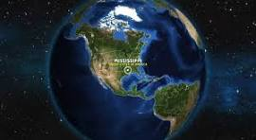

Slide 10
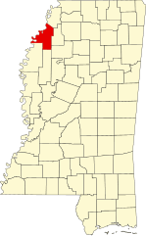

Slide 11
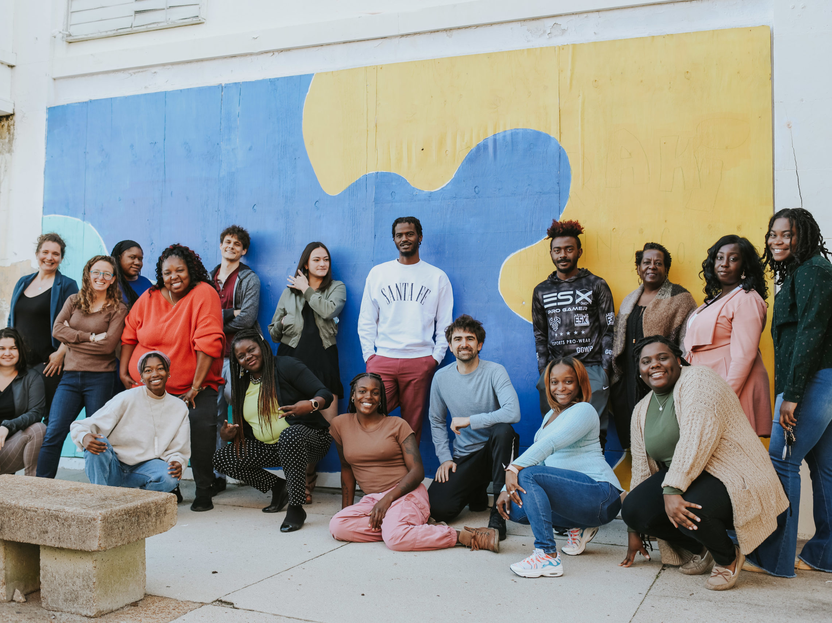
Notes:
MLK during the signing of the Voting Rights Act and Civil Rights legislation

Slide 12
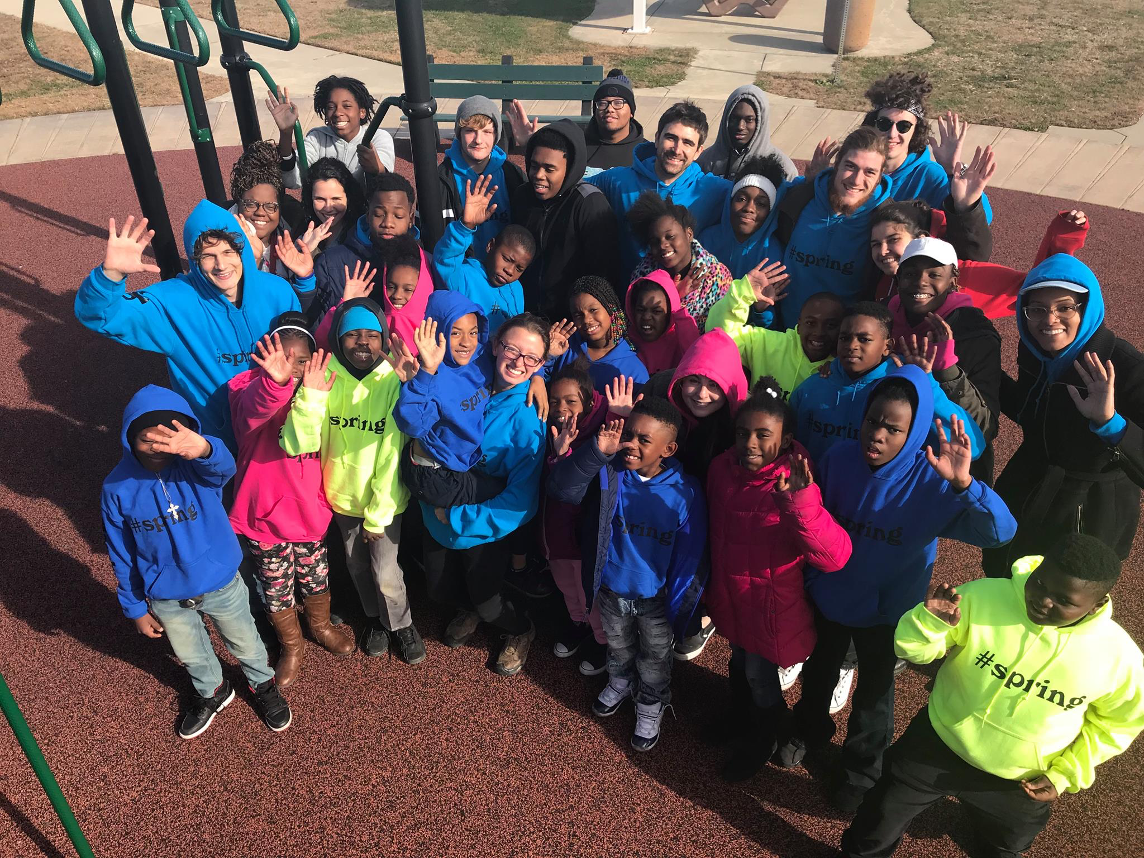
Notes:
Bryan Stevenson, Just Mercy – fighting to get African American fair sentencing or freedom if innocent

Slide 13
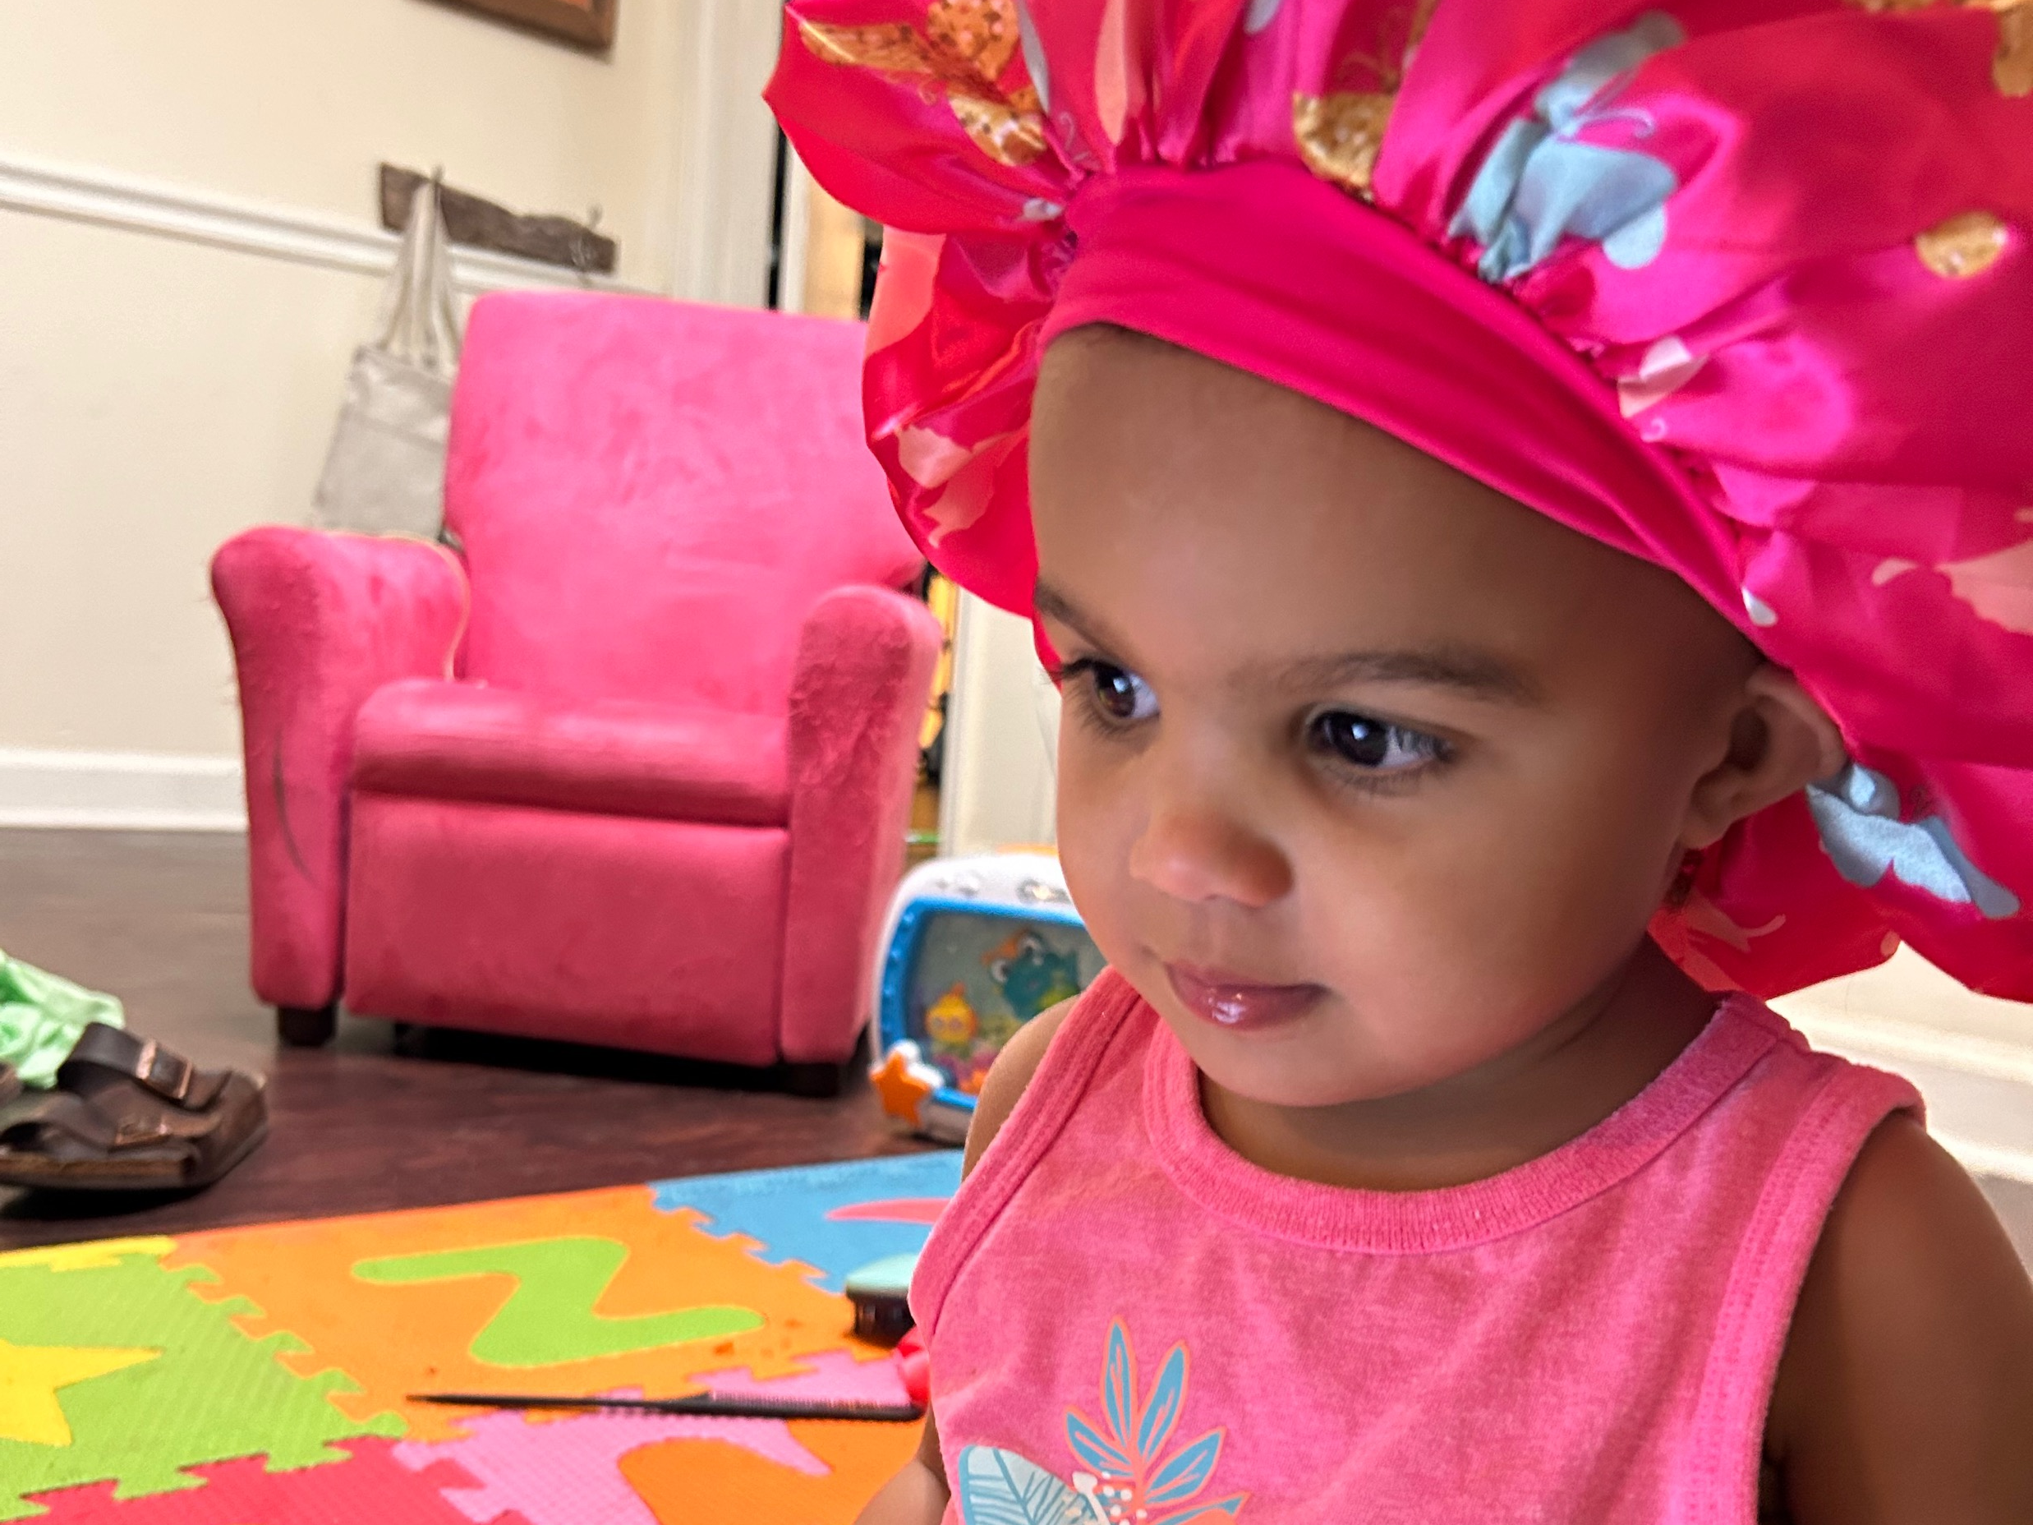

Slide 14
Notes:
The Universe is vaster than our minds can imagine. There are 2 trillion galaxies that we know of and 10 to the 24th power of stars which is more than grains of sand you find on Earth

Slide 15
Notes:
Each of the 2 trillion galaxies (like our Milky Way) has about 100 billion stars

Slide 16
Notes:
Our star, the Sun, is about 1 million times the size of Earth

Slide 18
Notes:
Victory is not hanging our heads in defeat or feeling like giving up but transferring that energy into building up this world (not just the US) into what God wants it to be
Amaya’s says, “We got this!”

Slide 19
Notes:
MLK during the signing of the Voting Rights Act and Civil Rights legislation

Slide 20
Notes:
Bryan Stevenson, Just Mercy – fighting to get African American fair sentencing or freedom if innocent

Slide 21
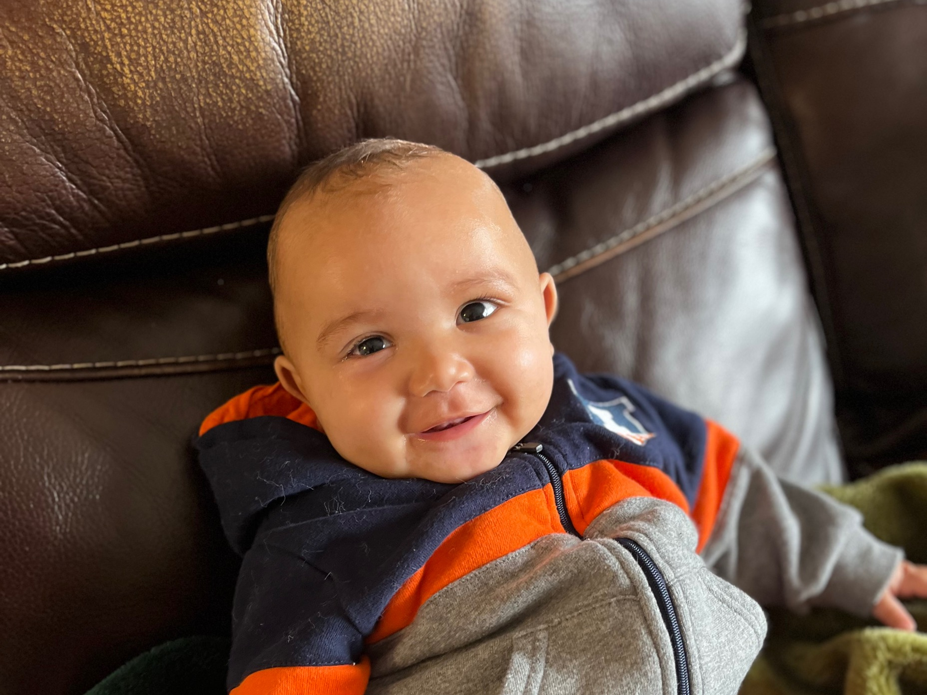

Slide 22
Philippians 4: 4-7
4:4Rejoice in the Lord always; again, I will say, Rejoice.
Notes:
So what does running the race look like

Slide 23
KEY PATTERNS OF BEHAVIOR REFLECTIVE OF P.T.S.S. Insufficient development of what Dr. DeGruy refers to as primary esteem, along with feelings of hopelessness, depression and a general self-destructive outlook. Extreme feelings of suspicion perceived negative motivations of others.
Notes:
Why wouldn’t we already know our true selves?
There is a LOOOOONNNGG history of this country trying to convince people that they are different than what God made them to be. No group has this happen more so with than with black people
Example: Parent talking about their children

Slide 24
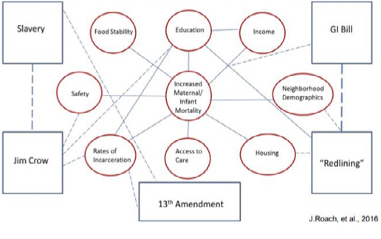
Notes:
Santa Claus Poll
Jesus Poll

Slide 25
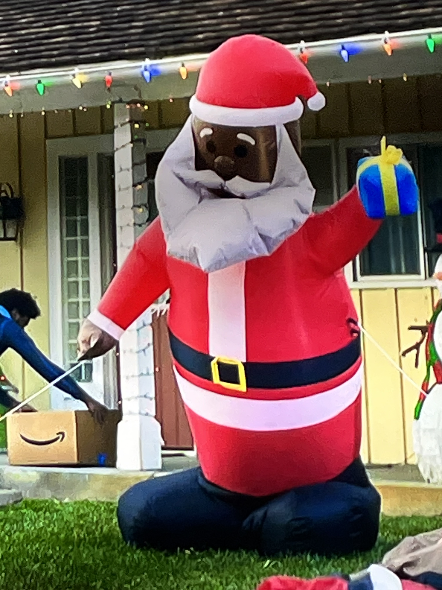
Notes:
So it is important to understand this and realize you may not receive the right message from the world about who you are

Slide 26
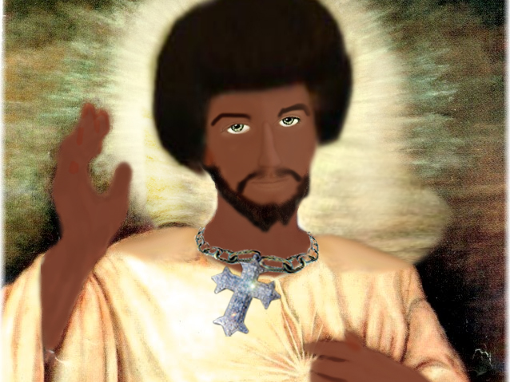
Notes:
So it is important to understand this and realize you may not receive the right message from the world about who you are

Slide 27
Finding Purpose
Notes:
A key to running a good race is finding a purpose
Know that there can be multiple purposes simultaneously, and purposes can change over time, but it is key to find something that inspires you, excites you, energizes you, and gives you an opportunity to give something to the world, something beyond yourself.

Slide 28
Phillipians 4: 4-7
4:5Let your gentleness be known to everyone. The Lord is near.

Slide 29
Early Purpose
Notes:
From an early age, I hated seeing people suffer in any way.
When I was 15, I devised a plan to end poverty in the world. Drew a diagram of a city where problems would be solved and everything. It was just something God put on my heart at an early age.
That purpose has led me on many paths, but they all led and continue to lead to the same destination.
We live in a broken world that is good at breaking people. I like to think of myself like a society mechanic. Trying to fix things best I can and help heal this broken world

Slide 30
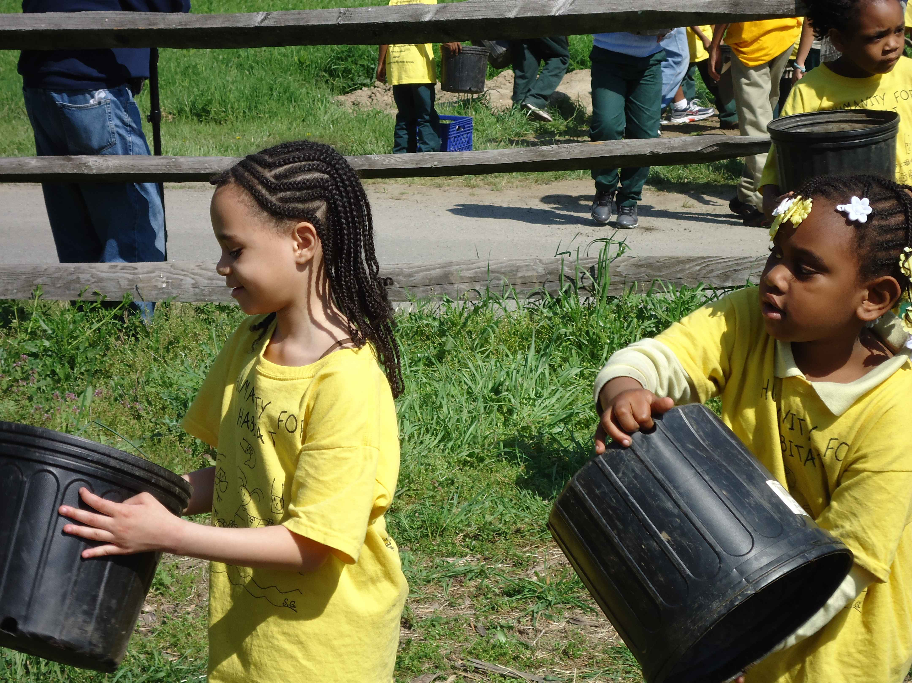
What’s One of Your Current Purposes?
Helping others?
Being successful in school?
Being a good friend?
Being a good neighbor?
Being a good brother or sister?
Change the world?

Slide 31
Learning, Unlearning, Relearning
Notes:
A key to running a good race before Jesus return is the ability to evolve which includes learning, unlearning, and relearning
Our minds tend to be like concrete, thoroughly mixed up and permanently set

Slide 32
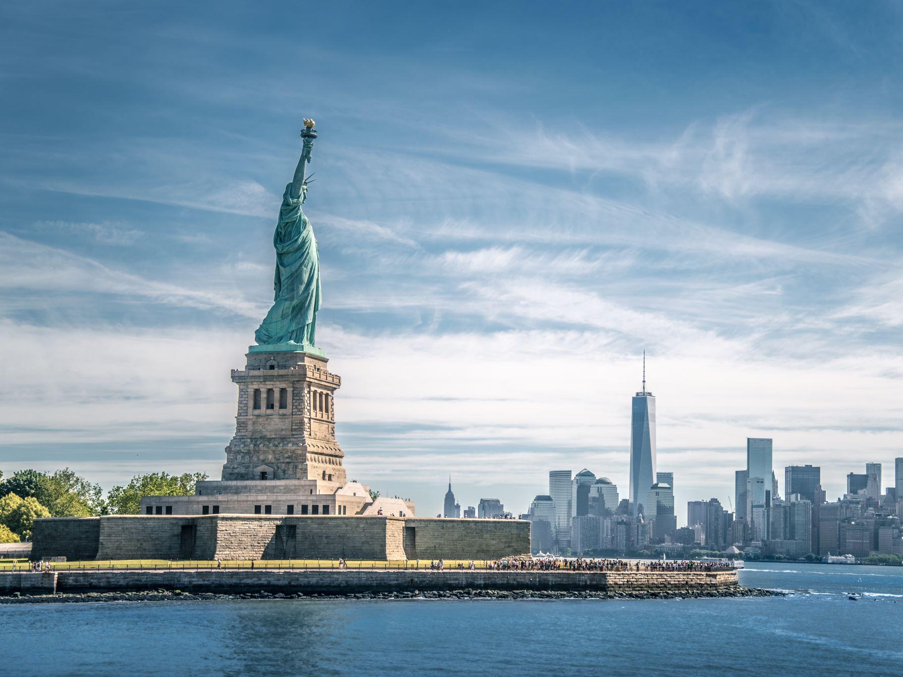
Unlearning
Who had to unlearn the real purpose and meaning behind the Statue of Liberty?
Notes:
A key to running a good race before Jesus return is the ability to evolve which includes learning, unlearning, and relearning
Our minds tend to be like concrete, thoroughly mixed up and permanently set

Slide 33
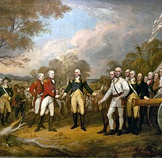
Learning
Who knew that there were two American wars fought over the desire to maintain slavery

Slide 34
Critical Thinking
Notes:
Why do people believe what they believe – vaccine hesitancy study
The best thing you can do is learn how to research/study and think for yourself

Slide 35
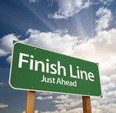
Jesus Return
While we do not know when Jesus will return, we believe he will. And when he does, this world will be everything God intended it to be. In the meantime, our faith should lead us to run the race best we can.

Slide 36
Philippians 4: 4-7
4:6Do not be anxious about anything, but in everything by prayer and supplication with thanksgiving let your requests be made known to God.
4:7And the peace of God, which surpasses all understanding, will guard your hearts and your minds in Christ Jesus.
Notes:
So what does running the race look like

