Slide 1
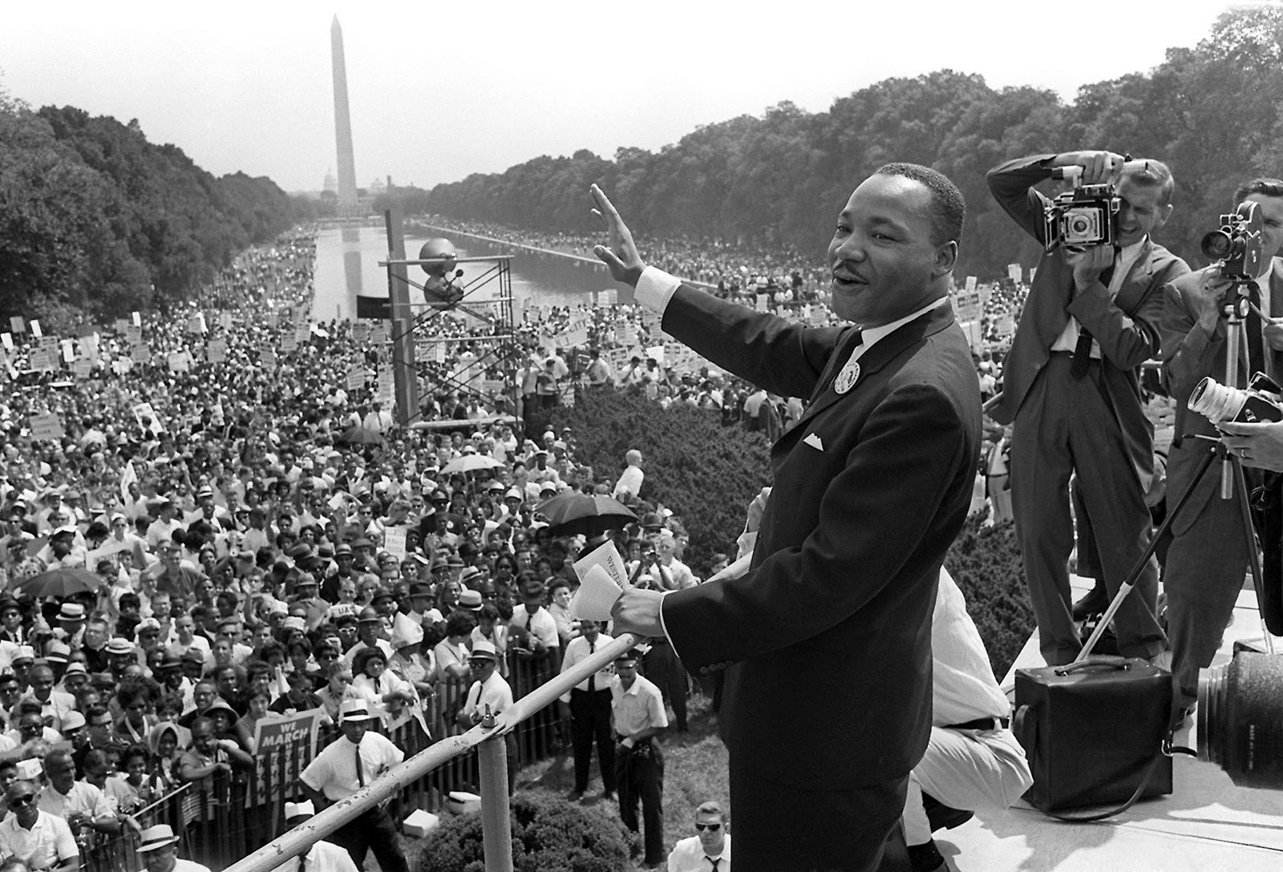
Imagining a Dream Fulfilled
AND HOW WE GET THERE
Notes:
Challenge at the National Symposium for Reparations for State and Local Leaders
Imagine a world where reparations existed. What would it look like. And I have to admit, I really had not spent any time imagining that world.
I was so caught up in addressing the shortcomings, putting my head down to do the work, that I did not spend time to consider what a dream fulfilled looked like
In the days since then, I have come to realize the importance of imagining the dream coming to reality.

Slide 2
Why Dream?
Romans 12:1
Therefore, I urge you, brothers and sisters, in view of God’s mercy, to offer your bodies as a living sacrifice, holy and pleasing to God—this is your true and proper worship.
Notes:
Dreams are important in making a difference in this world.
At the clinic the other day and a guy, a patient, who needed a prescription called in came knocking on the door (we were not open at the time)
It was one of those cold days we had recently, and he was dealing with having pneumonia. It was not an out of the ordinary thing to happen but what got me was that he said he needed the prescription to be called in to the Meijer on Prospect. I couldn’t figure out why there since, after some conversation, he said he lived nearby. We have a Walgreens a block away from the clinic, so I was confused. As it turns out, the patient only had about

Slide 3
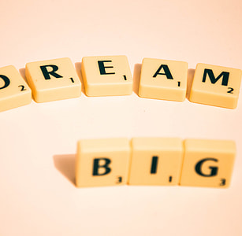
Dream Disruptors
Not admitting there is a need to dream
Living your dream and that is enough
Letting others crush your dream
Losing hope for your dream

Slide 4
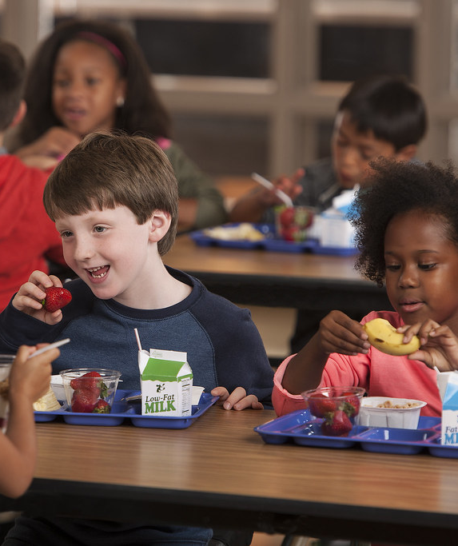
A Dream Fulfilled in Education
Percentage of succuss the same for all children
Discipline the same
Free and reduced lunch
Access to technology
Coats, Gloves, Scarfs
Notes:
Only 3.5% Black children in Urbana at reading at grade level compared to 13% overall while 1.1% Black children in Urbana are at math level compared to 15% overall
Discipline: suspensions, expulsions, detentions, etc.
Same percentages of black and white children on free and reduced lunch
Same access to technology – Covid exposed these disparities more so than usual
Same resources to stay warm

Slide 5
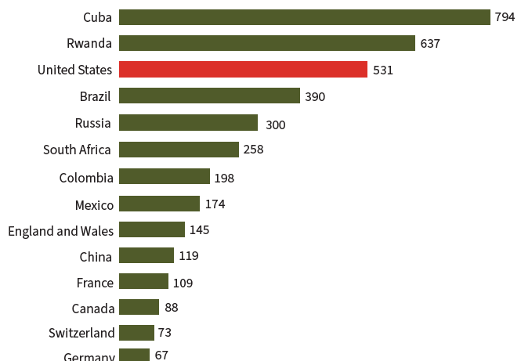
Notes:
2022 Data. Prisoners per 100,000
2 of the 5 million are black
Uncle – almost all black and brown

Slide 6
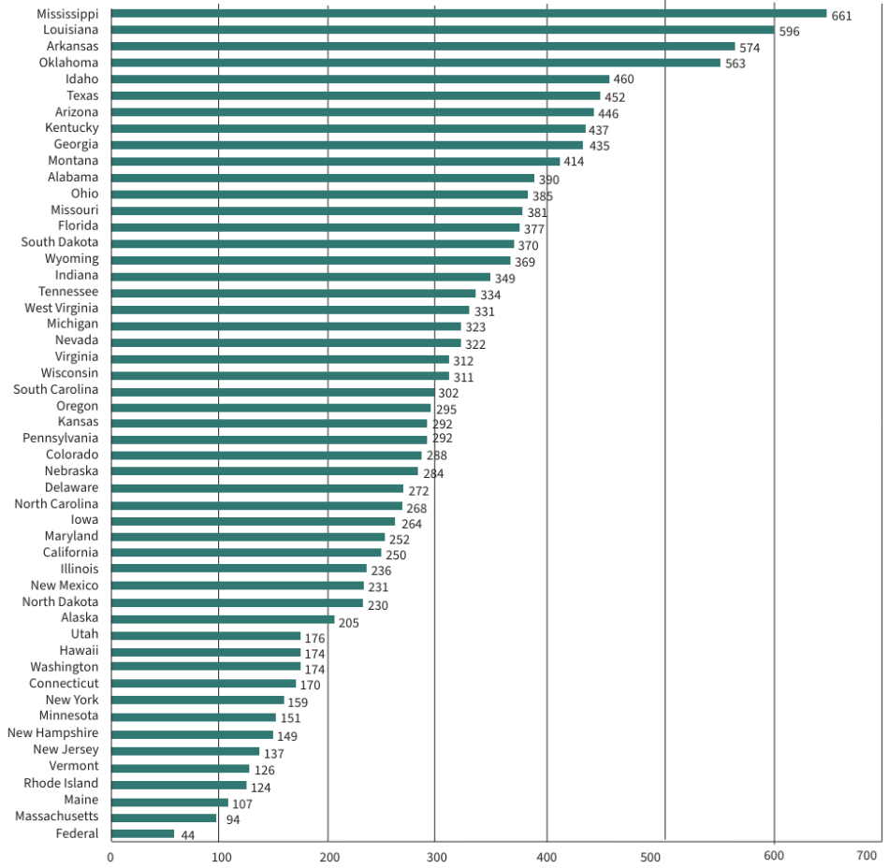
Notes:
Mississippi, Louisiana, Arkansas, Oklahoma, Idaho top five

Slide 7
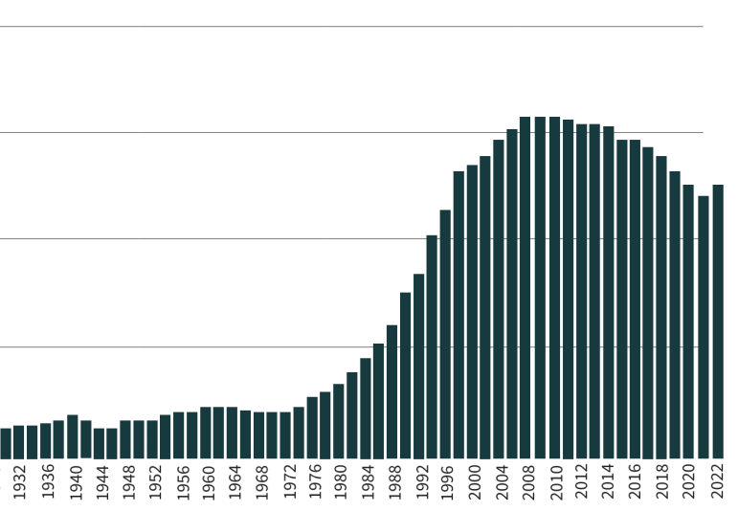
Notes:
Incarceration rates
King’s dream was 1968

Slide 8
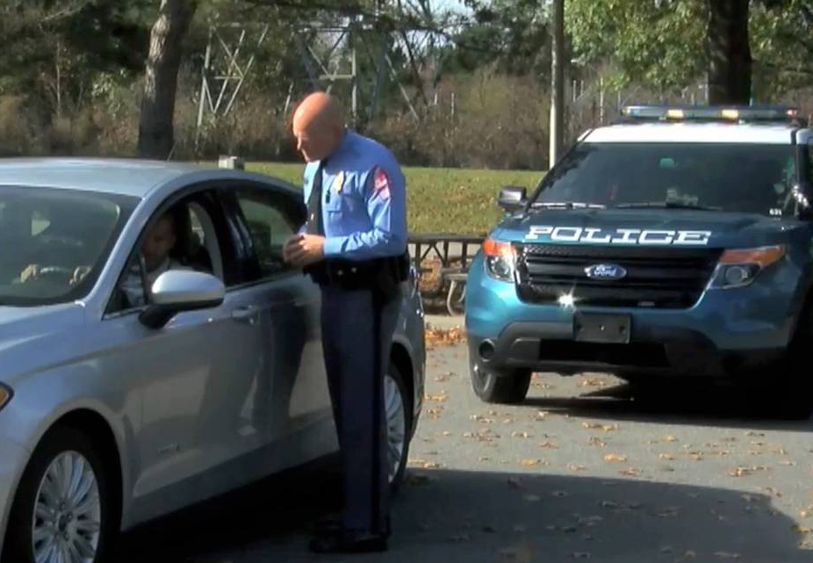
Notes:
Champaign Urbana statistics
Investigative Project on Race and Equality, in 2022, the City of Champaign’s Black population was 17.9 percent. Yet, it constituted more than 56 percent of traffic stops. In Urbana, Black people represented 18.3 percent of the population. However, they made up nearly 46.5 percent of that city’s traffic stops. Champaign County Sheriff's Annual Reports note that over the last five years the average percentage of jail bookings to the Champaign County Jail is 57 percent African American.

Slide 9
A Dream Fulfilled in Healthcare
No healthcare disparities
Black babies live as long as white babies
Black mothers live as often as white mothers in childbirth
Black people receive the same level and kind of care as white people
Black people have the same access to care as white people
Black people have the same # of medical providers as other races
Notes:
Illinois Department of Public Health, Champaign County leads the state in infant mortality (rate of 9.4), surpassing Chicago (6.3) and East St. Louis (9.3). The maternal mortality rate among African American women is 11.4 compared with 5.5 for Caucasian women

Slide 10
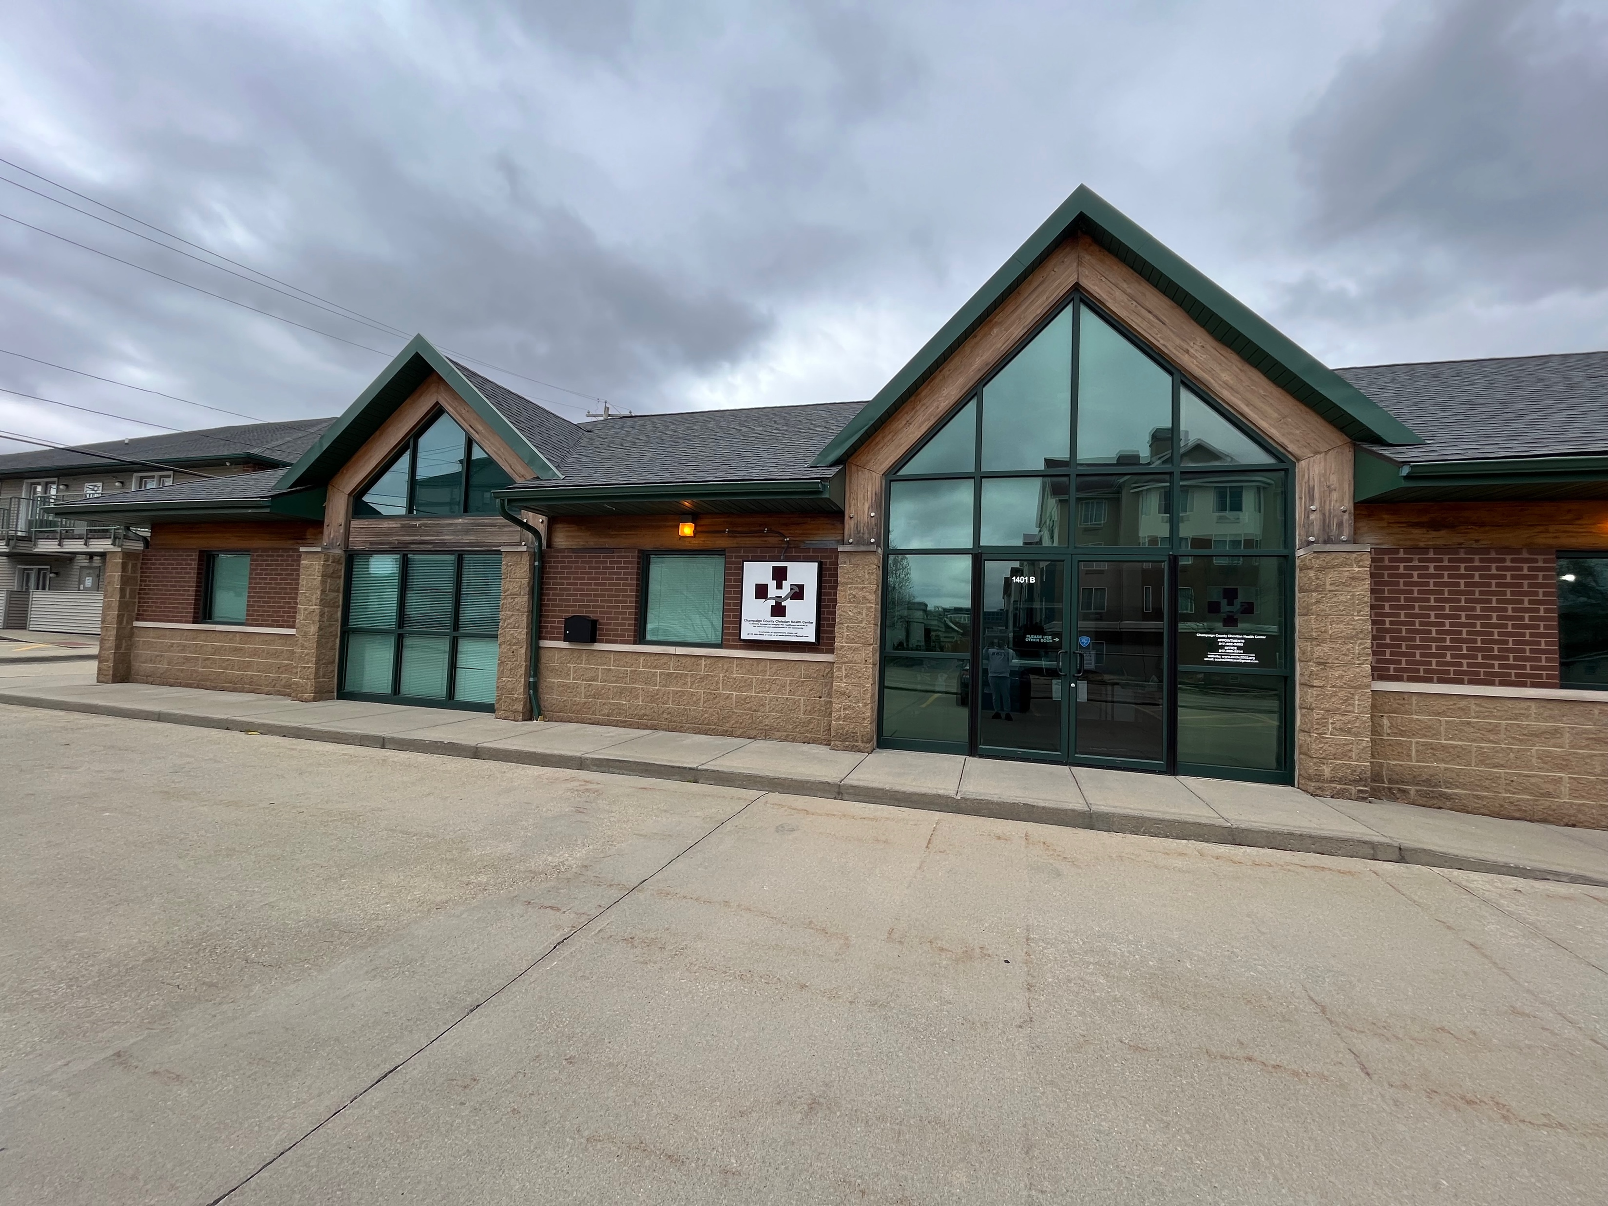
Notes:
In my dream of equality, free clinics would be the norm because all people would have access to care – period. The US would resemble every other country in the world and make basic healthcare universal

Slide 11
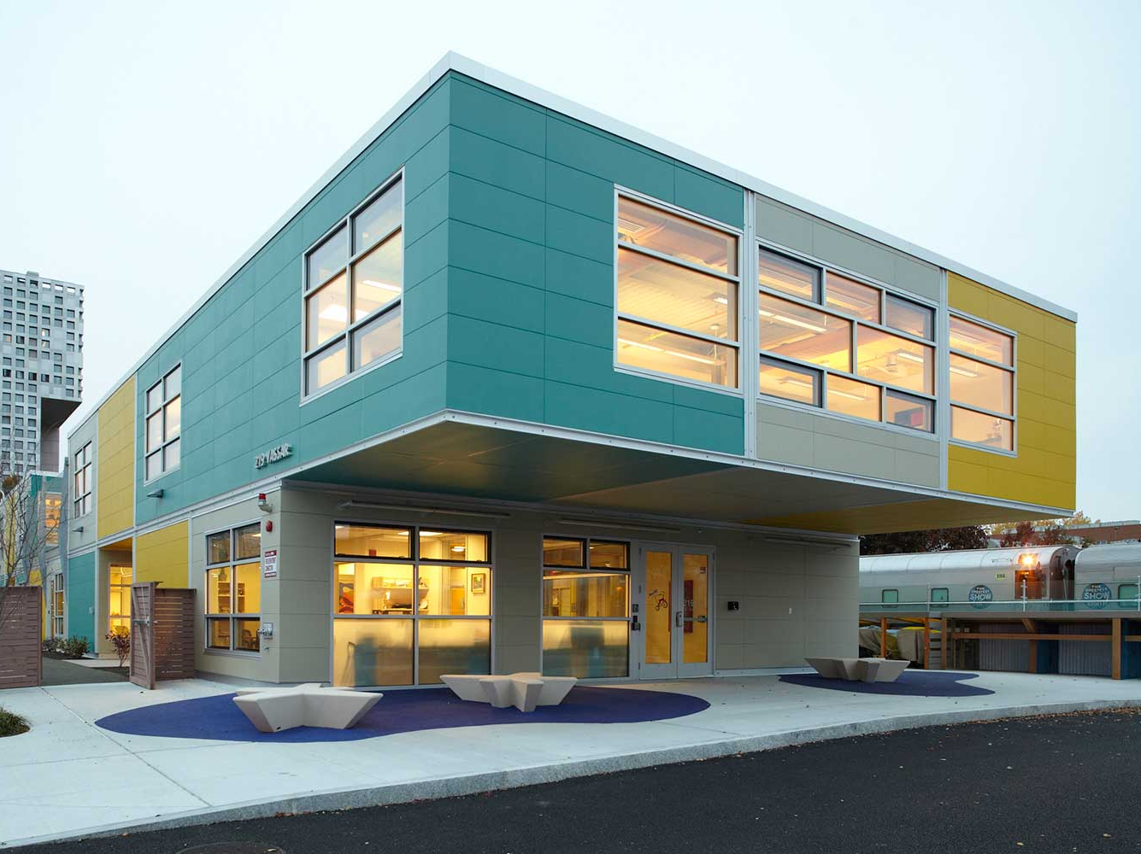
Notes:
We would have health education centers around the country that emphasizes population health and try to help people from getting sick in the first place
Difference between pulling teeth and saving teeth through community health workers

Slide 12
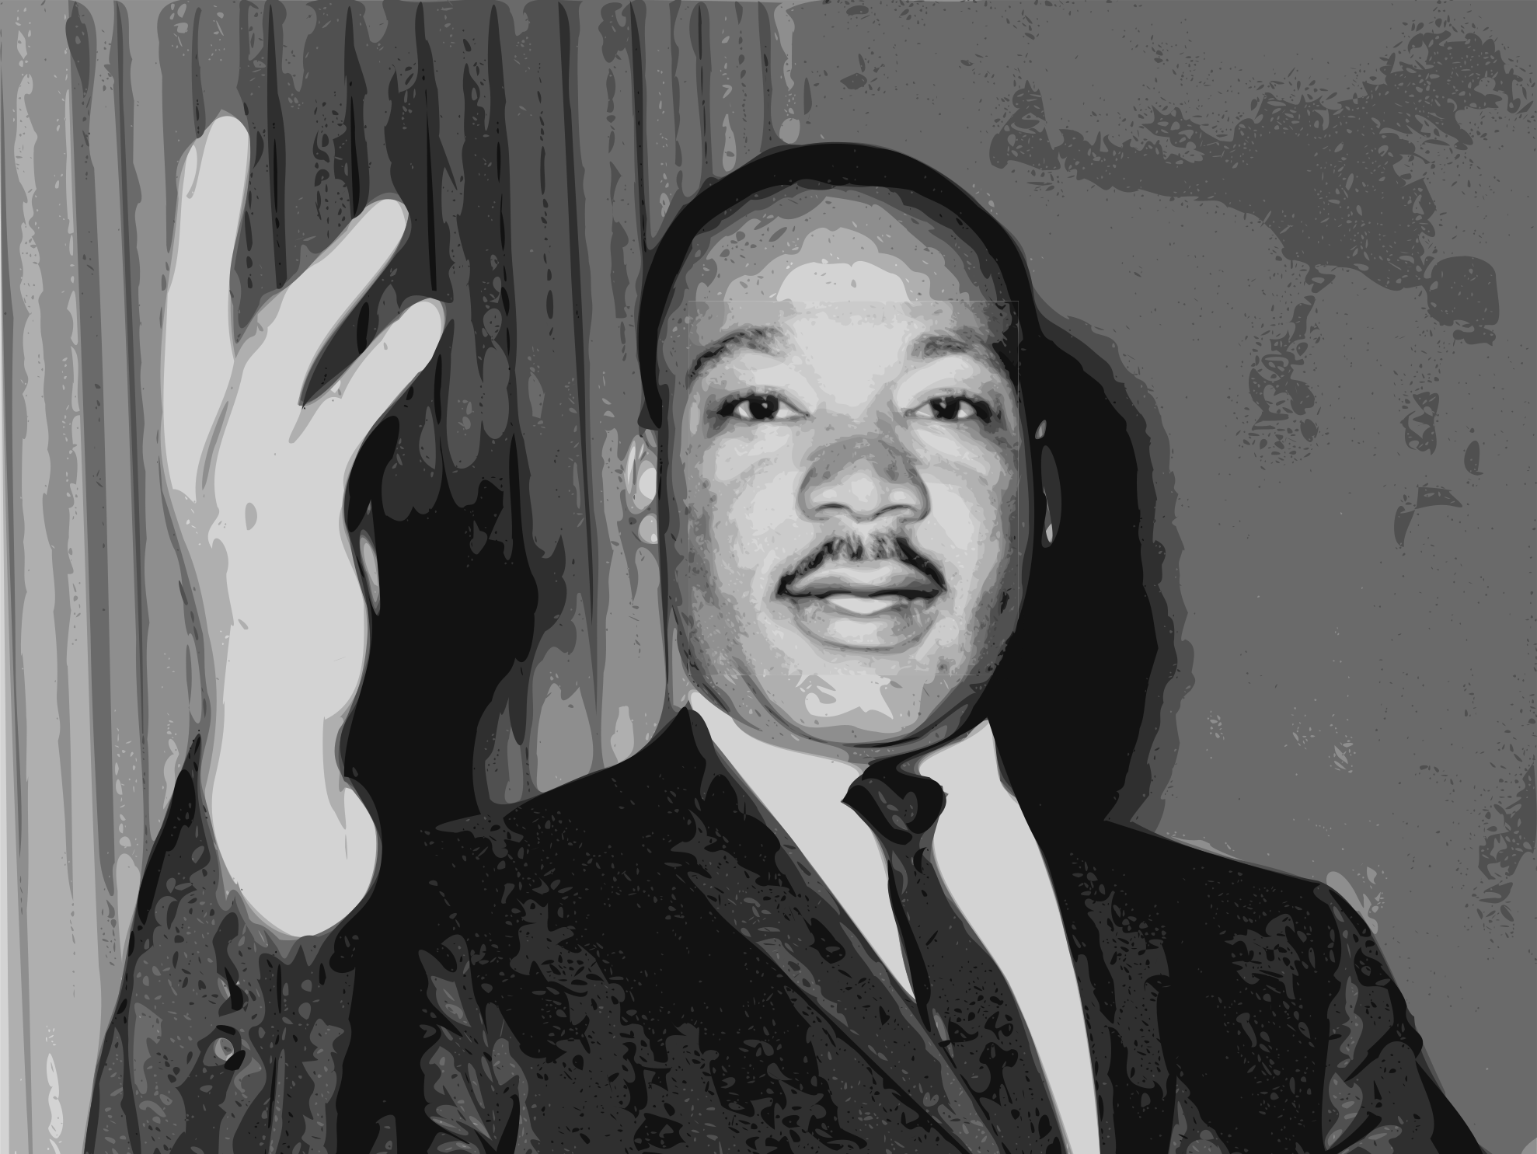
Notes:
Imagine Dr. King, Fred Hampton, Medgar Evers, Malcolm X, the thousands that were lynched, the countless that were broken, wrongfully jailed, choked, shot, and silenced all lived out their days to the fullest, striving towards building a better world as opposed to being eliminated because of the good they were doing.

Slide 13
Living Beyond Your Dream
Do not conform to the pattern of this world, but be transformed by the renewing of your mind. Then you will be able to test and approve what God’s will is—his good, pleasing and perfect will.
Notes:
Seeing God’s and Dr. King’s Dream shattered has to be UNACCEPTABLE
I’ve had sayings and teaching titles trying to emphasize that we are all in this together
“I’m OK, it’s OK”
“It’s about JUSTICE, not JUST US”
And I get it… it’s so easy to retreat in the comfort of a comfortable situation. It is so tempting to not engage, especially in times when you feel like the world has lost its mind. But if that was the way to go, when Jesus reappeared after the crucifixion, would have told his disciples to go back to what they were doing... To the things they felt comfortable with, to the place where they felt the most comfortable and live out your remaining days as comfortable as you can
How much emphasis does this country place on comfort??? Many times using the fear of not being comfortable to encourage ultimate conservation and project the notion that you never have enough?

Slide 14
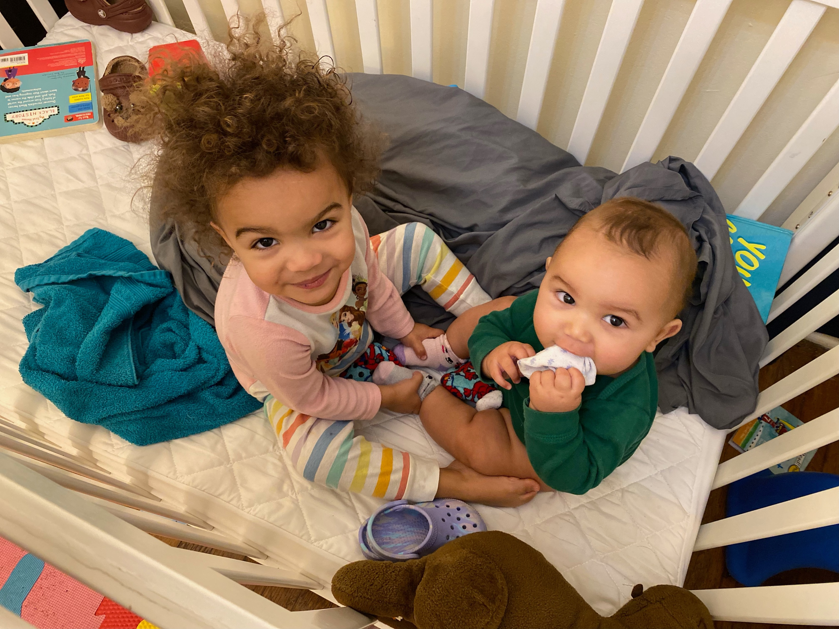
Notes:
We must strive for the comfort of others
Hebrews 13:16 "And do not forget to do good and to share with others, for with such sacrifices God is pleased.”
1 John 3:17 "If anyone has material possessions and sees a brother or sister in need but has no pity on them, how can the love of God be in that person?”
Proverbs 3:27 ~ "Do not withhold good from those to whom it is due, when it is in your power to act.”
We can start simply beyond ourselves. I have that much more motivation to strive towards a just world because of these amazing human beings. I want them to have a better taste of God’s and King’s dream than I did.

Slide 15
Don’t Let Others Crush Your Dream
³ For by the grace given me I say to every one of you: Do not think of yourself more highly than you ought, but rather think of yourself with sober judgment, in accordance with the faith God has distributed to each of you. ⁴ For just as each of us has one body with many members, and these members do not all have the same function, ⁵ so in Christ we, though many, form one body, and each member belongs to all the others.⁶ We have different gifts, according to the grace given to each of us. If your gift is prophesying, then prophesy in accordance with your^{[a]} faith;⁷ if it is serving, then serve; if it is teaching, then teach; ⁸ if it is to encourage, then give encouragement; if it is giving, then give generously; if it is to lead,^{[b]} do it diligently; if it is to show mercy, do it cheerfully.

Slide 16
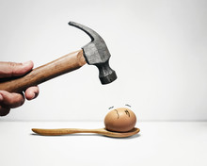
Notes:
What gives someone the right to crush your dream?
I’m sure we all had moments like this poor egg. We had a dream and someone came along with a hammer and wanted to crush it.
But scripture tells us that NO ONE is better than someone else. That each of us has something to offer. That we are all part of the same team.
Many things you do will attract doubters and naysayers. We have to remember, however, WHY WE DREAM, WHY OUR DREAM MATTERS, and HOW IMPORTANT OUR DREAM IS FOR OTHERS

Slide 17
Losing Hope for Your Dream
¹² Be joyful in hope, patient in affliction, faithful in prayer.

Slide 18
Notes:
TRAPPED IN A ROOM WITH A ZOMBIE
Living the dream is not based on how much of it is realized. It is based on striving towards it till you cannot any longer. Even when it feels hopeless.
WE ARE ALL TRAPPED IN A ROOM WITH A ZOMBIE and we have to work towards solving the puzzles until the last second ticks off the clock
It is a hard but can also be a fun process

Slide 19
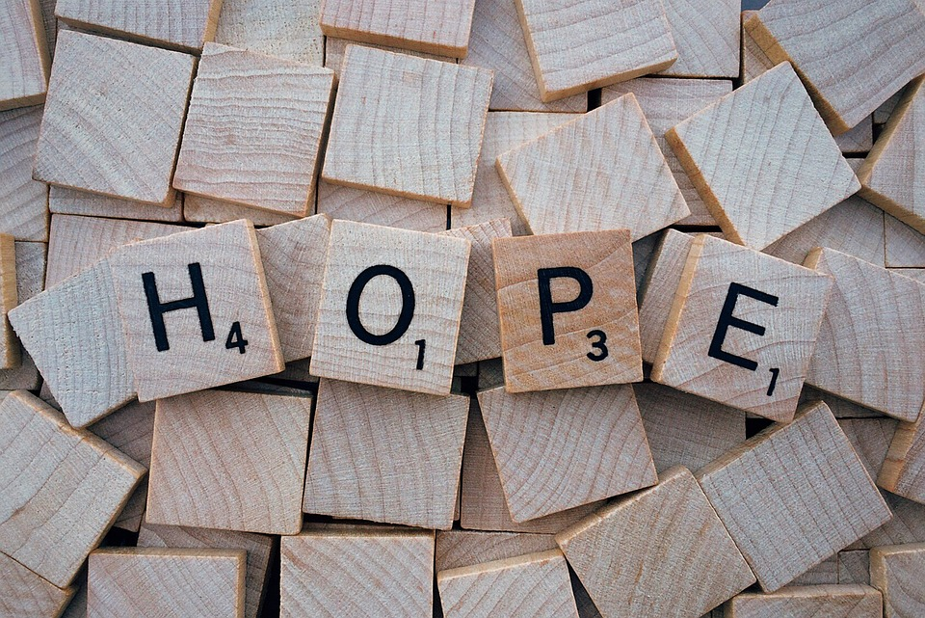
Notes:
One of the most critical problems in individuals, families, and communities is losing hope. Not much else matters if we give up.
Even when hoping seems crazy… maybe especially when it seems crazy, we need to hang on to it. Our dreams bring us hope. That’s why it is so important that we keep dreaming

Slide 20
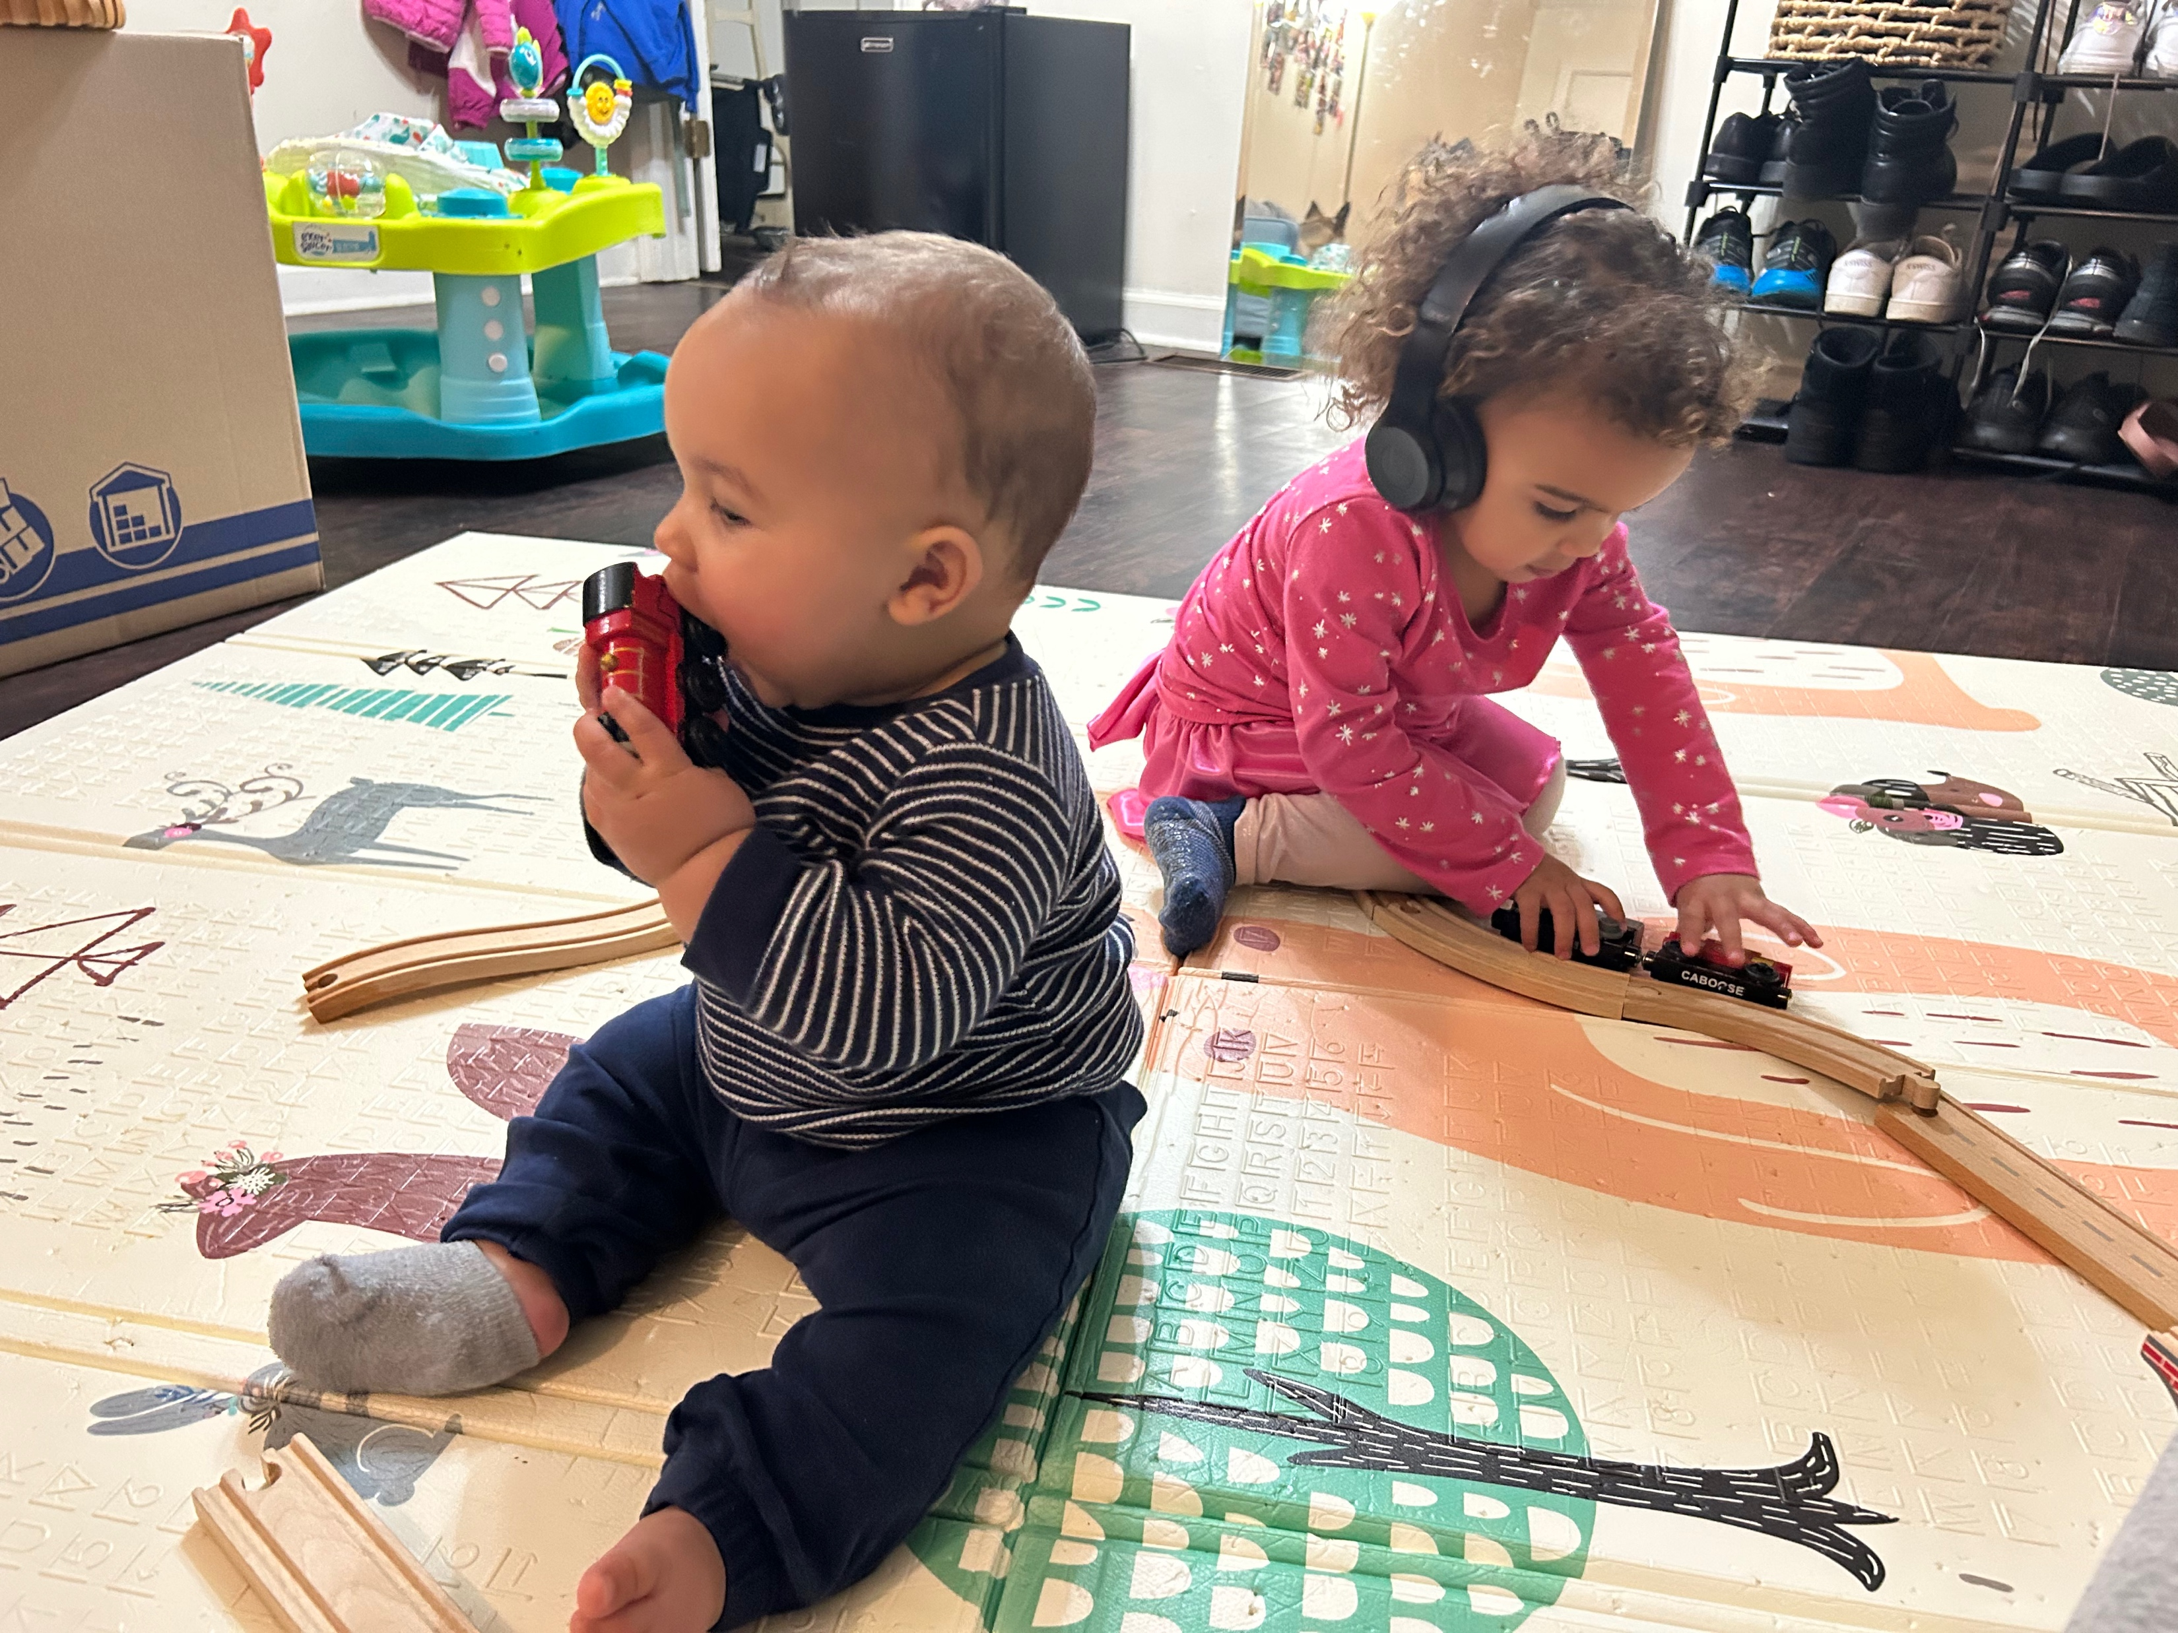
Notes:
We have to keep working. Just like Amaya is building her train set and Amari is inspecting the train cars through taste

Slide 21
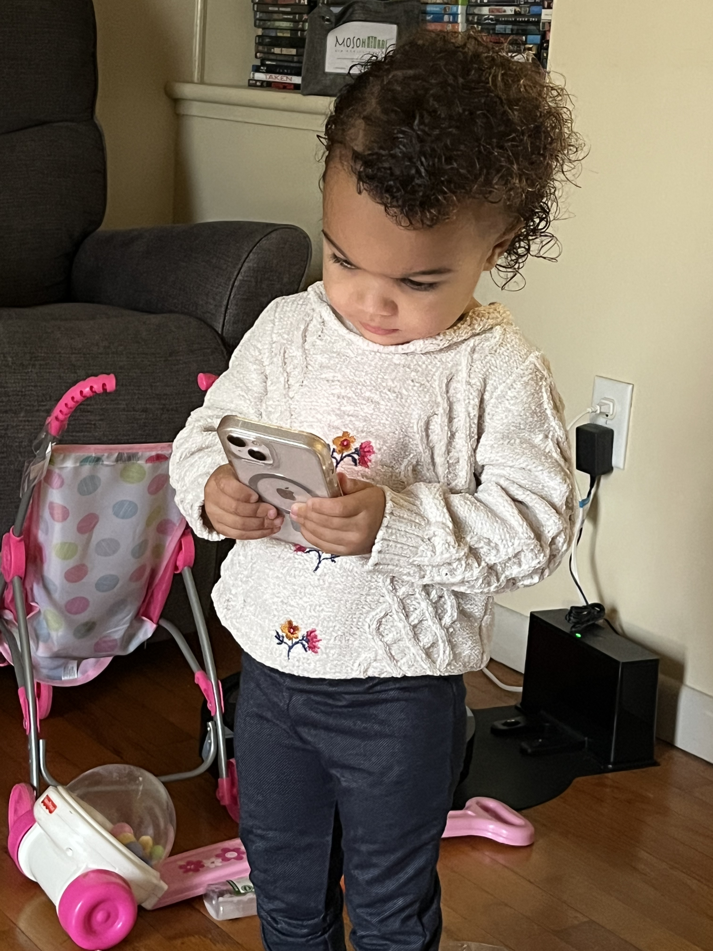
Notes:
We have to stay engaged and willing to be uncomfortable for the sake of others

Slide 22
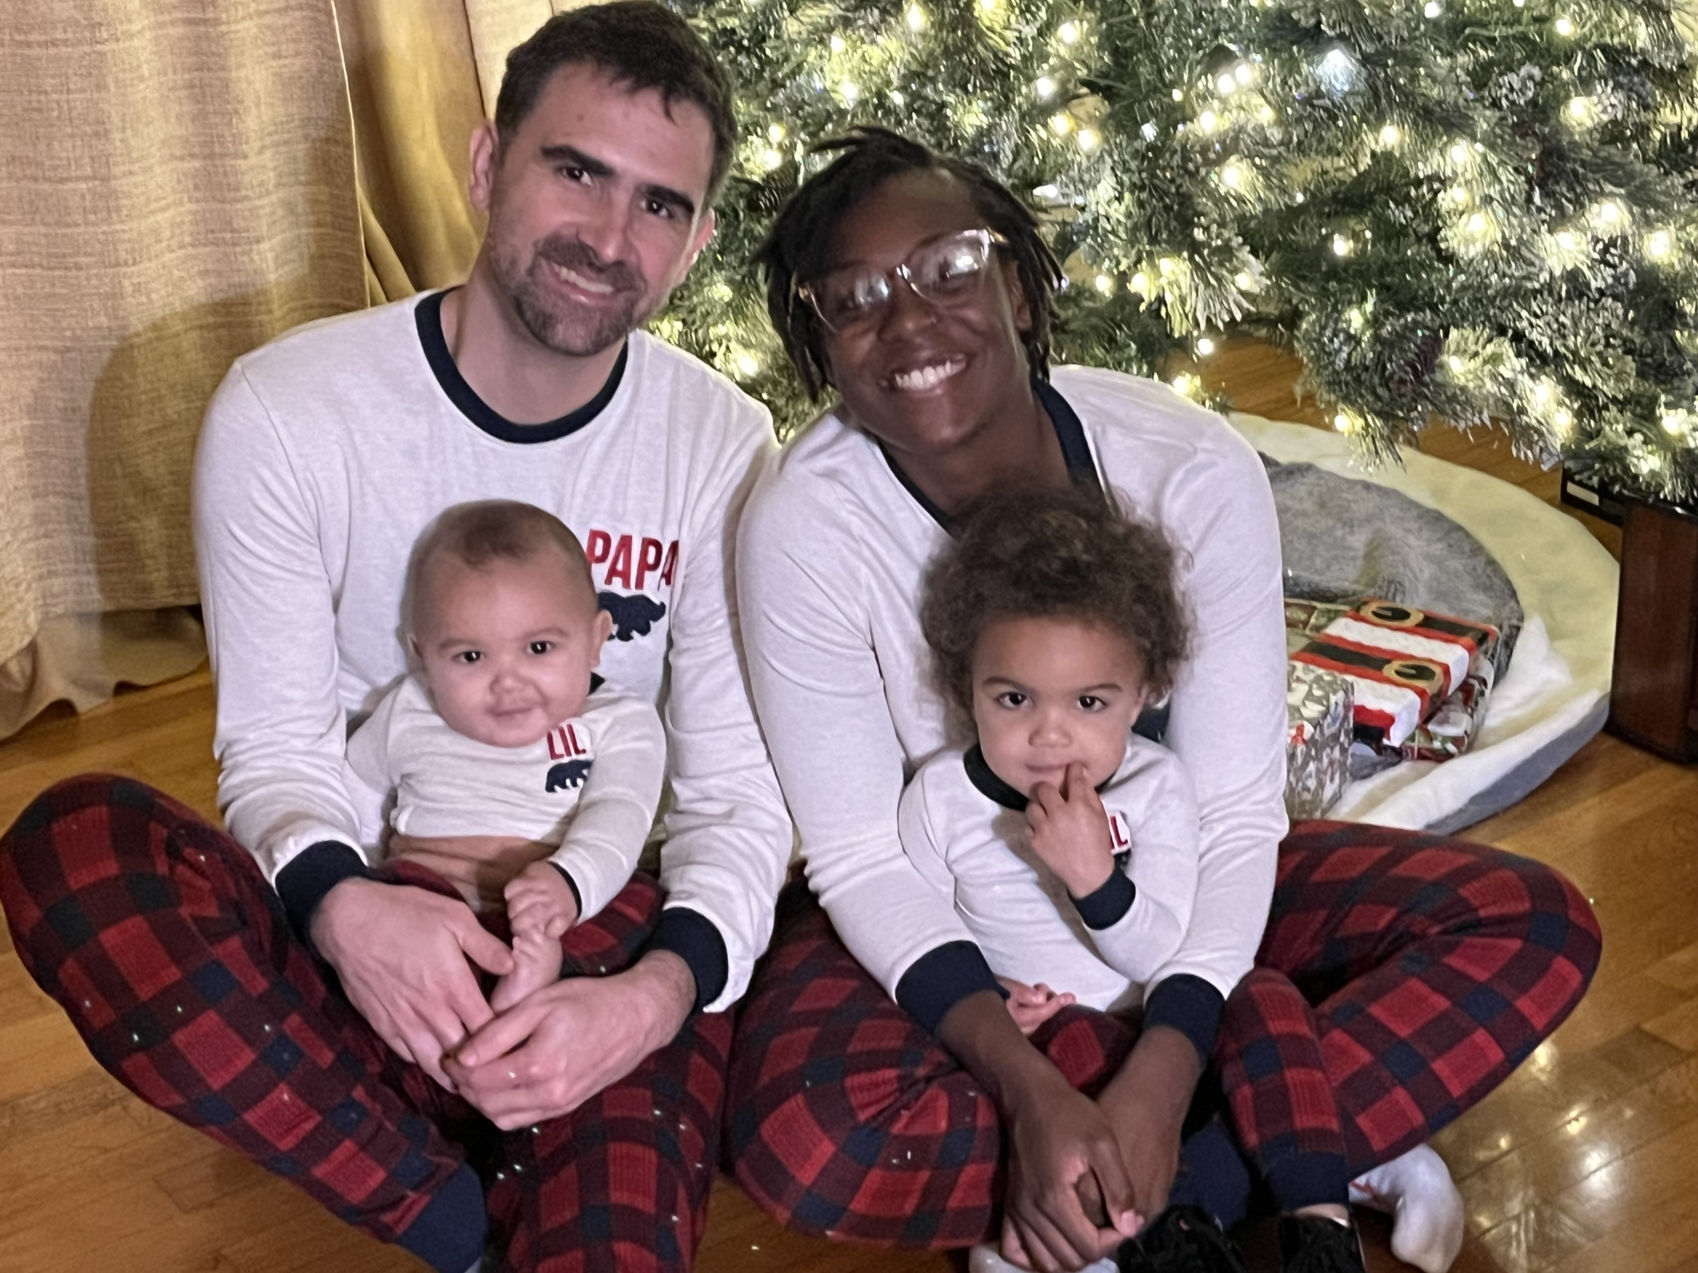
Notes:
We have to remember we are all part of the same body.

Slide 23
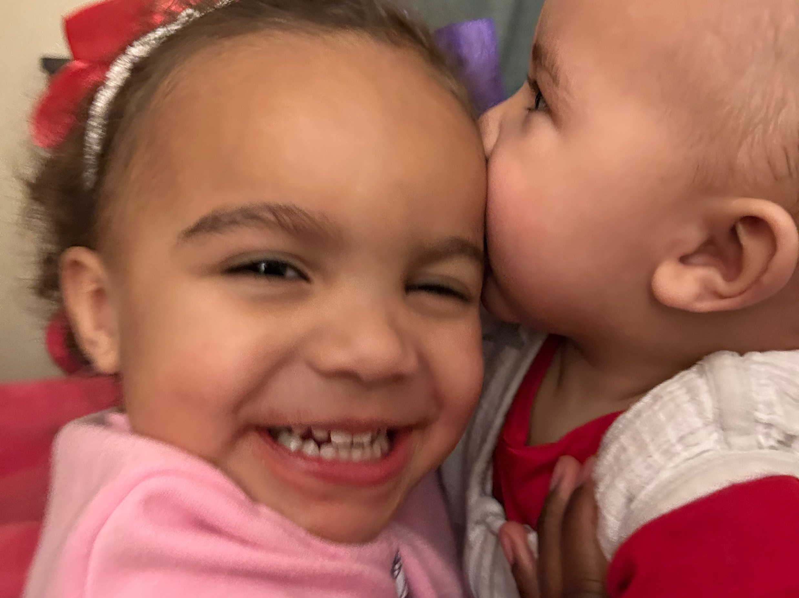
Notes:
We have to keep loving each other knowing that are all the same in God’s eyes and therefore, when one suffers, we all suffer. When one rejoices, we all rejoice

Slide 24
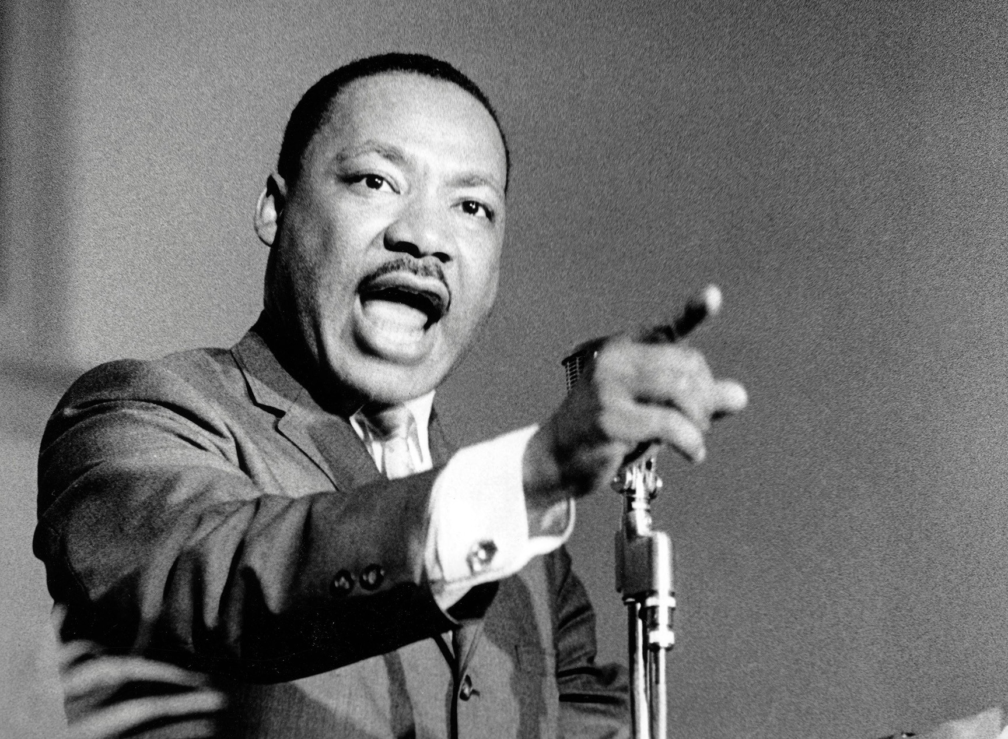
Notes:
Evil may so shape events that Caesar will occupy a palace and Christ a cross, but that same Christ arose and split history into A.D. and B.C., so that even the life of Caesar must be dated by his name. Yes, “the arc of the moral universe is long, but it bends toward justice.”
We have to continually learn what the moral universe looks like because nowadays, morally is being defined as something much different that what God intended

Slide 25
The Ultimate Dream
Jesus was part of God’s dream to see us love each other enough to give our lives for each other (let alone our comfort)
Jesus’ return is the final clue and key to the escape room
Until that happens, let’s work together to figure this thing out

