Slide 1
Who Cares About Money? Five biblical principles to guide our financial stewardship New Covenant Fellowship February 23, 2025 Lyle Miller, M.Div., CGPA Lyle.miller@everence.com

Slide 2
Who cares about money?
We care about money
Society cares about money
God cares about money

Slide 3
God cares about money
Faith: 200
Prayer: 225
Love: 700
Money: 2000-2300
Between one-third and one-half of Jesus’ parables.

Slide 4
God cares about money
TEMPTATION AND SEX
9%
CHARACTER
20%
CHOOSING WISE WORDS
9%
OTHER
13%
MONEY & BUSINESS
18%
RELATIONSHIPS
15%
SPIRITUAL HEALTH
16%
“Adapted from Bible Connection. Content adapted from the NIV Kids’ Visual Study Bible and the NIV Quest Study Bible.”

Slide 5
Who cares about money?
We care about money
Society cares about money
God cares about money

Slide 6
Everything belongs to God.
Ps. 24:1: The earth is the Lord’s and all that is in it, the world, and those who live in it;
Photo: Lyle Miller

Slide 7
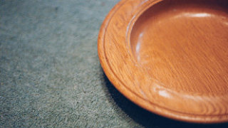
Generosity is an act of worship.
Gen. 6:19: And of every living thing, of all flesh, you shall bring two of every kind into the ark, to keep them alive with you; they shall be male and female.
Gen. 7:2-3: Take with you seven pairs of all clean animals, the male and its mate; and a pair of the animals that are not clean, the male and its mate; and seven pairs of the birds of the air also, male and female, to keep their kind alive on the face of all the earth.
Photo: https://www.ministrymatters.com/all/entry/2704/losing-the-offering-plate

Slide 8
Generosity is an act of worship.
Gen. 8:20: Then Noah built an altar to the Lord, and took of every clean animal and of every clean bird, and offered burnt offerings on the altar.
Photo: https://www.ministrymatters.com/all/entry/2704/losing-the-offering-plate

Slide 9
Generosity is an act of worship.
14.2857%
Photo: https://www.ministrymatters.com/all/entry/2704/losing-the-offering-plate

Slide 10
Generosity is an act of worship.
Sing
Sermon
Pray
Offer a “good and acceptable gift”
Photo: https://www.ministrymatters.com/all/entry/2704/losing-the-offering-plate

Slide 11
Generosity is an act of worship.
Does the tithe still apply?
Gross or net?
Employment or investment?
Even our estate?
New Covenant vs. other ministries?
Photo: https://www.ministrymatters.com/all/entry/2704/losing-the-offering-plate

Slide 12
Generosity is an act of worship.
How much should I give to God?
vs.
How much should I keep for myself?
Photo: https://www.ministrymatters.com/all/entry/2704/losing-the-offering-plate

Slide 13
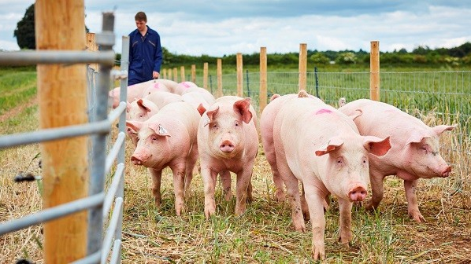
We are called to be managers.
steward (n.)
Old English stiward, stigweard "house guardian, housekeeper," from stig "hall, pen for cattle, part of a house" (see sty (n.1)) + weard "guard" (from Proto-Germanic *wardaz "guard," from PIE root *wer- (3) "perceive, watch out for").
https://www.etymonline.com/word/steward
Photo: http://www.pig-world.co.uk/news/pig-farm-incomes-forecast-to-more-than-double-in-201617.html

Slide 14
We are called to be managers.
Prov. 21:5: The plans of the diligent surely lead to abundance, but everyone who is hasty only comes to poverty.
Prov. 6:6-8: Go to the ant, you lazybones; consider its ways, and be wise. Without having any chief or officer or ruler, it prepares its food in summer, and gathers its sustenance in harvest.
Photo: http://www.pig-world.co.uk/news/pig-farm-incomes-forecast-to-more-than-double-in-201617.html

Slide 15
We are called to be managers.
Prov. 22:7: The rich rule over the poor, and the borrower is the slave of the lender.
Ecc. 11:2: Divide your means seven ways, even eight, for you do not know what disaster may happen on earth.
Photo: http://www.pig-world.co.uk/news/pig-farm-incomes-forecast-to-more-than-double-in-201617.html

Slide 16
We are called to be managers.
Prov. 30:8b: Give me neither poverty nor riches; feed me with the food that I need.
“…Give us this day our daily bread….”
Photo: http://www.pig-world.co.uk/news/pig-farm-incomes-forecast-to-more-than-double-in-201617.html

Slide 17
Stewardship is a communal activity.
Acts 2:41-47
⁴¹ So those who received his word were baptized, and there were added that day about three thousand souls. ⁴² And they devoted themselves to the apostles’ teaching and the fellowship, to the breaking of bread and the prayers. ⁴³ And awe came upon every soul, and many wonders and signs were being done through the apostles. ⁴⁴ And all who believed were together and had all things in common. ⁴⁵ And they were selling their possessions and belongings and distributing the proceeds to all, as any had need… And the Lord added to their number day by day those who were being saved.
Graphic: https://www.pghcitypaper.com/pittsburgh/a-list-of-mutual-aid-funds-and-volunteer-groups-to-help-pittsburghers-in-need/Content?oid=16971439

Slide 18
Stewardship is a communal activity.
Acts 4:31-35
³¹ When they had prayed, the place in which they were gathered together was shaken; and they were all filled with the Holy Spirit and spoke the word of God with boldness. ³² Now the whole group of those who believed were of one heart and soul, and no one claimed private ownership of any possessions, but everything they owned was held in common. ³³ With great power the apostles gave their testimony to the resurrection of the Lord Jesus, and great grace was upon them all. ³⁴ There was not a needy person among them, for as many as owned lands or houses sold them and brought the proceeds of what was sold. ³⁵ They laid it at the apostles’ feet, and it was distributed to each as any had need.
Graphic: https://www.pghcitypaper.com/pittsburgh/a-list-of-mutual-aid-funds-and-volunteer-groups-to-help-pittsburghers-in-need/Content?oid=16971439

Slide 19
Stewardship is a communal activity.
“As early as 1557, candidates for church membership were asked if they were prepared to give of their goods for the benefit of others (Christian or not) in need.” ¹
“Every Christian is under duty before God to use from motives of love all [his] possessions to supply the necessities of life to any of [his brethren].” ²
1. Glen A. Roth and Glenn M. Lehman, An Instrument of God’s Grace: The Story of Sharing Programs/Brotherly Aid (Morgantown Pa.: Masthof Press, 1995), x-xi.
2. Donald F. Durnbaugh, ed., Mutual Aid and Christian Community in the Free Churches, 1525-1675 (Philadelphia: Temple University Press, 1974), 6.
Graphic: https://www.pghcitypaper.com/pittsburgh/a-list-of-mutual-aid-funds-and-volunteer-groups-to-help-pittsburghers-in-need/Content?oid=16971439

Slide 20
Stewardship is a spiritual practice.
2 Corinthians 8-9
Their abundant joy…
overflowed in generosity…
(They) begged us…
for the privilege of sharing…
Photo: https://www.revlydia.com/blog/2018/10/4/the-importance-of-regular-spiritual-practices

Slide 21
Stewardship is a spiritual practice.
2 Corinthians 8:1-7
Love
Eagerness
Knowledge
Speech
Faith
Generosity
As you excel…
Photo: https://www.revlydia.com/blog/2018/10/4/the-importance-of-regular-spiritual-practices

Slide 22
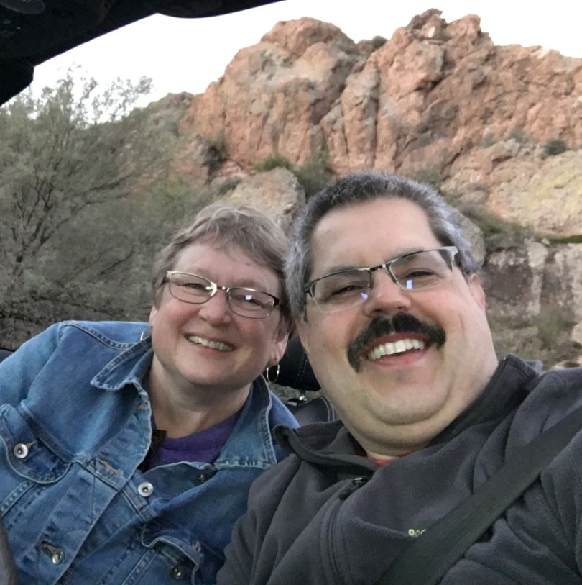
Stewardship is a spiritual practice.
God does not need my generosity!
Photo: https://www.revlydia.com/blog/2018/10/4/the-importance-of-regular-spiritual-practices

Slide 23
Stewardship is a spiritual practice.
…to accept
…to understand
…to live
Photo: https://www.revlydia.com/blog/2018/10/4/the-importance-of-regular-spiritual-practices

Slide 24
Everything belongs to God.
Photo: Lyle Miller

Slide 25
Everything belongs to God.
Generosity is an act of worship.
Photo: https://www.ministrymatters.com/all/entry/2704/losing-the-offering-plate

Slide 26
Everything belongs to God.
Generosity is an act of worship.
We are called to be managers.
Photo: http://www.pig-world.co.uk/news/pig-farm-incomes-forecast-to-more-than-double-in-201617.html

Slide 27
Everything belongs to God.
Generosity is an act of worship.
We are called to be managers.
Stewardship is a communal activity.
Graphic: https://www.pghcitypaper.com/pittsburgh/a-list-of-mutual-aid-funds-and-volunteer-groups-to-help-pittsburghers-in-need/Content?oid=16971439

Slide 28
Everything belongs to God.
Generosity is an act of worship.
We are called to be managers.
Stewardship is a communal activity.
Stewardship is a spiritual practice.
Photo: https://www.revlydia.com/blog/2018/10/4/the-importance-of-regular-spiritual-practices

