Slide 1
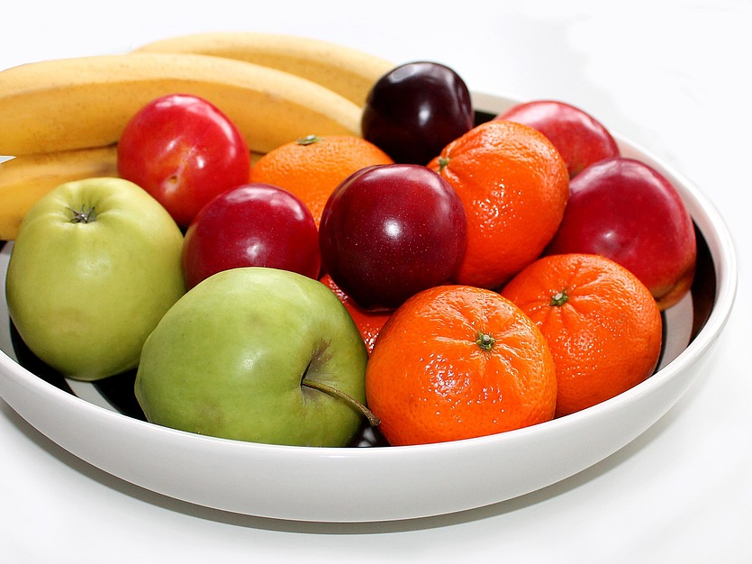
Fruits of Justice
WOES & BLESSINGS
Notes:
Do you ever wonder why fruit is so often used to symbolize good or bad things that happen when we do good or bad things?
Started day one of humanity when Adam and Eve at the “forbidden fruit” (btw, apples get a bad rap as we don’t know what fruit they ate). Fruit is mentioned 60 times in the new testament alone.
Why not the vegetables of the Spirit? Well, I think we all know why that is… there is a reason why kids don’t like eating their broccoli
Or the beans of the Spirit? If that was chosen, you would have loss me right away (bean story)
Or the rocks of the Spirit? Or the water of the Spirit? Or animals? Or clouds?

Slide 2
Significance of Fruit
Something that grows from something planted
Something that could be good or bad
Something very pleasing if good and very unpleasant if bad
Something everyone could understand and relate to
Notes:
Seems like we might need an update: From fruit to dollars of the spirit.

Slide 3
Significance of Money
Something that grows from something planted (investments)
Something that could be good or bad (legitimate v. blood money)
Something very pleasing if good and very unpleasant if bad (money well spent v. money wasted or money ruining people)
Something everyone could understand and relate to (well... Enough said)
Notes:
Seems like we might need an update: From fruit to dollars of the spirit.

Slide 4
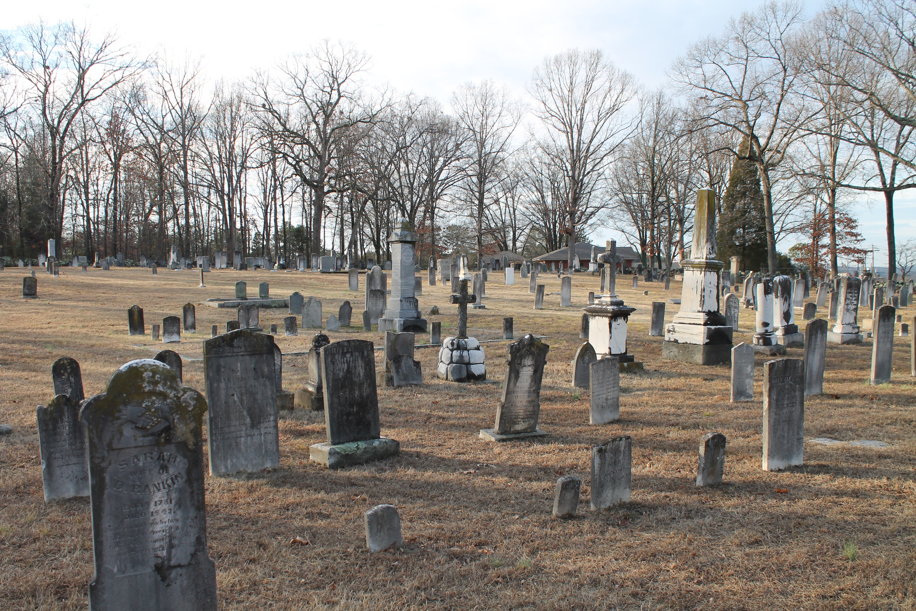
The Setting
The ”Level” place
Redemption
What to do while we wait
Notes:
The word “level” often refers to places of corpses, disgrace, idolatry, suffering, misery, hunger, annihilation, and mourning
The idea is that Jesus is expressing how God will redeem these level places
The crowd would have been thinking that this redemption was going to happen soon

Slide 5
A CHOICE between WOES & BLESSINGS
Blessings lead to a pleasant end when the world is redeemed by God
Woes lead to an unpleasant one
Notes:
When parents encourage, force, or urge their children to do their homework, kids often interpret their compliance or lack of compliance to pleasing or not pleasing their parents. While pleasing or not pleasing parents might be a satisfying outcome, the point is that doing homework is not for the parents, it is for the child. The parents would have already went through that phase of life and have no direct benefit of the child completing homework (other than pleasant or unpleasant teacher-parent conferences).
As believers, I often think we approach scriptures as the child being forced to do homework and deciding whether we want to please our parents or not. While God definitely prefers us to choose to do what leads to better outcomes, we are the ones that will deal with the consequences one way or another.
Challenge is how do we not be that child and realize these choices are a gift to us to be appreciated. We are not left in the dark concerning what is to be done. Guidance is a gift not to be wasted. And choice is a gift God provides us instead of being mindless robots. The least we can do is realize the instruction/homework is for our well being and not designed to make our lives unnecessarily miserable.

Slide 6
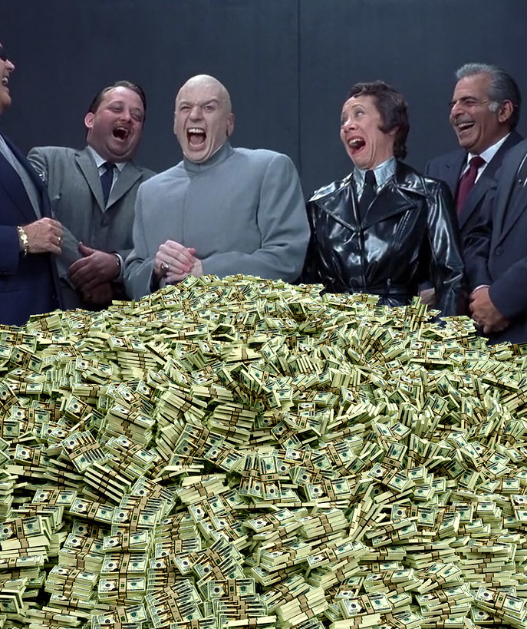
THE WOES
RICH
FULL
LAUGHING
WELL SPOKEN OF

Slide 7
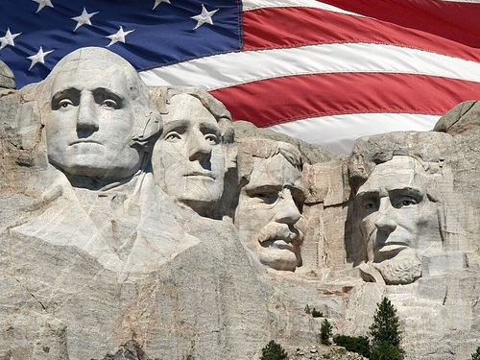
Notes:
In an earlier teaching, I spoke about how my ancestors would practically blow off 4 more years of a racist president given what they went through.
While I am not surprised or shocked that this country had not made the progress we think we made, it is sad to realize how far we have not come.
In light of the celebration of President’s Day, I want to highlight a few DID YOU KNOWS about our presidents when it comes to race
Mt. Rushmore (2 of the top 4 memorialized owned slaves. If the other two lived today, they both be considered racist simply as products of their time)

Slide 8
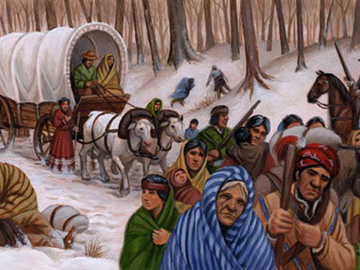
Notes:
Andrew Jackson
Manifest Destiny did not start with him, but he put it on steroids
Native Americans worked through the system and won… but then loss
Not shown in the picture are the 2500 to 6000 enslaved black people that died along the way (owned by the five “civilized” native American tribes)
LAND AND MONEY

Slide 9
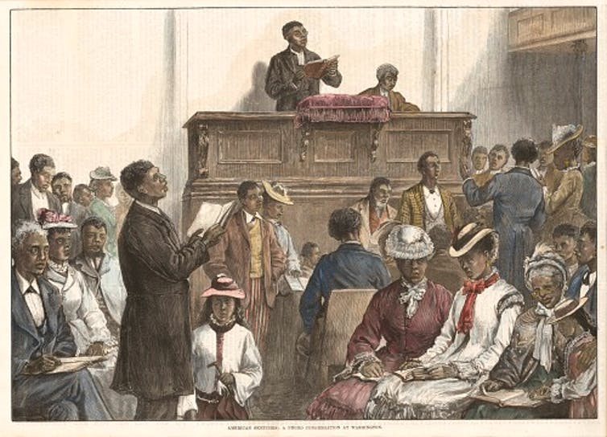
Notes:
Andrew Johnson – A compromise choice (Southerner) to appease the racist South in accepting Abraham Lincoln. John F. Kennedy did the same in selecting Lyndon B. Johnson as VP 100 years later.
When given an opportunity to begin the healing process after a bloody, violent Civil War, President Johnson immediately rescinded the order
Ulysses S. Grant, the president after Johnson, a former Union general failed to reinstate reconstruction due to white supremacy takeover and the growing “weariness” of the issue
LAND and MONEY – the property highlighted in one of the videos today report that 40 acre plots are worth millions of dollars (valuable coastal property)

Slide 11
Worth Millions

Slide 12
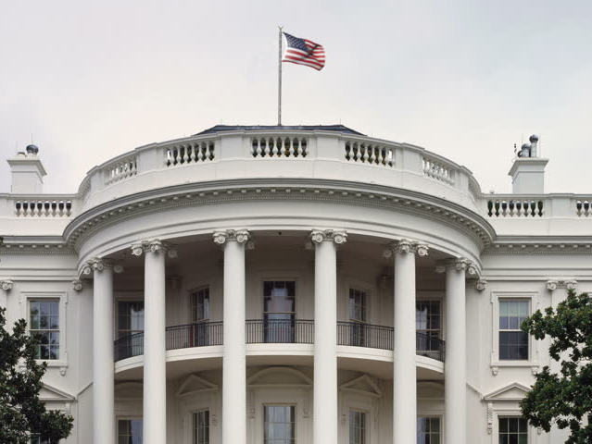
Inspiration from the White House
1915 Film screening of the “The Birth of a Nation” KKK propaganda film
Notes:
The 2nd major wave of the KKK was in the early 19 teens and 20s

Slide 13
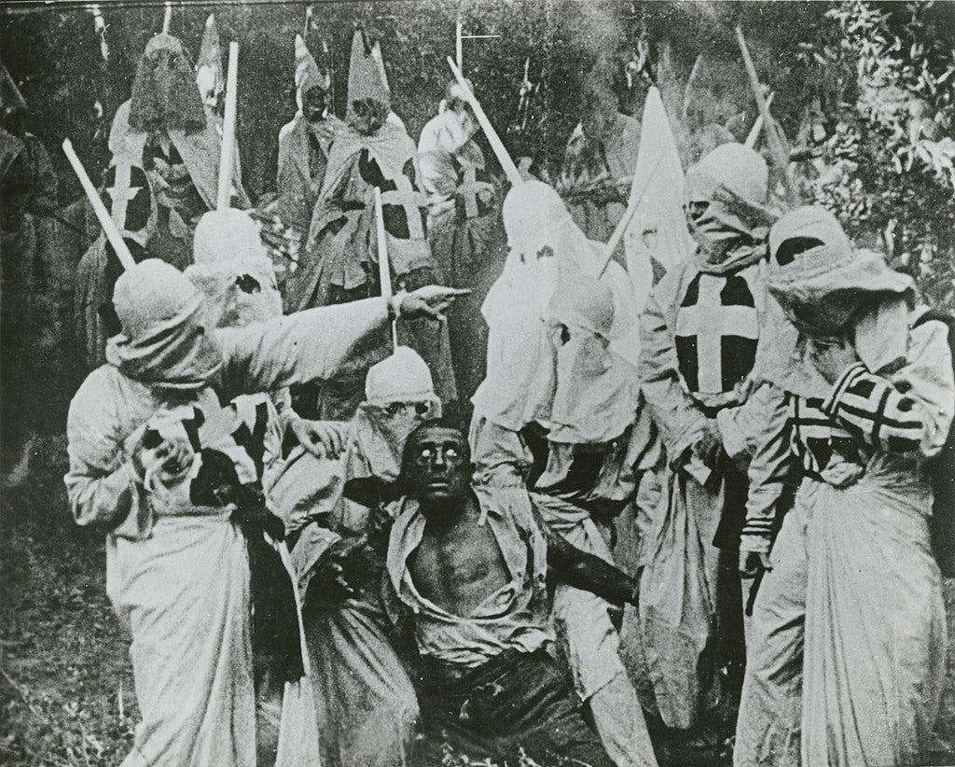
Notes:
Widespread riots in the 1910s and 1920s due to the great migration of blacks from the South moving North
Perceived competition for jobs and housing translated into race riots across the North
Blaming ”the other” led to violent race riots in Chicago, Washington DC, East St. Louis, Tulsa Oklahoma and many other areas

Slide 14
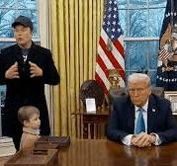
Notes:
A person that won office by convincing the country that immigrants are murderers and rapists
Who is now making a pointed effort to eradicate anything related to DEI efforts that were designed to provide the slightest bit of fairness in this country (which it has not in most ways)
The veil is lifted. Even the Andrews and good Ole Woodrow did not have the rich openly controlling the government

Slide 15
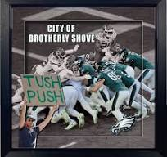
Notes:
This unhealthy relationship with riches is maintained with the oldest playbook in history and it does not seem like we can ever stop the play despite knowing what is coming.
That is only possible when your team cannot stop the inertia of the moment, when you can know exactly what they are doing but still cannot stop it… like the tush push

Slide 16
Blessings
Blessed are the poor
Blessed are the hungry
Blessed are those that mourn
Blessed are those that not well regarded

Slide 17
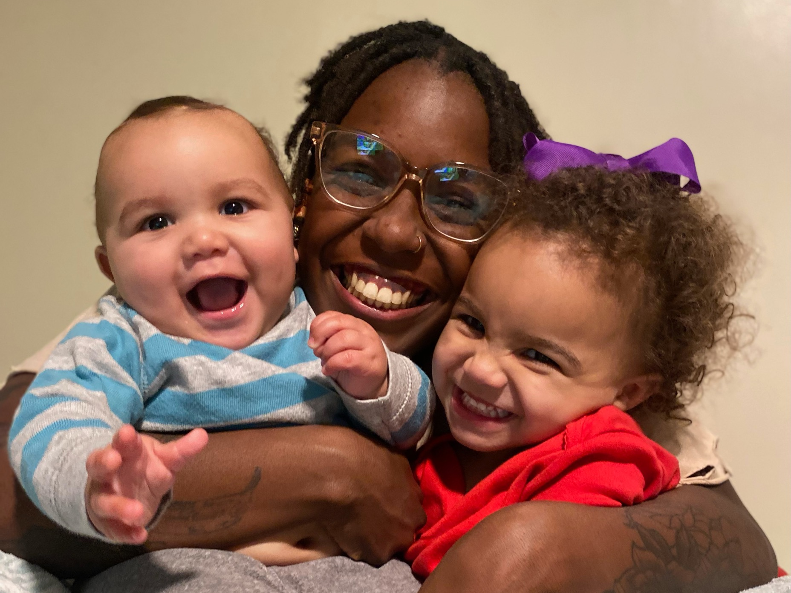
Notes:
Let’s get off the extreme bus for a minute and think about what Jesus is saying. Do you have to live a life of complete financial destitution to be blessed? Maybe… but I would contend it may not need to be that extreme
Those that have contributed to NCFs reparations fund are all more poor (materially speaking) than before you gave. Helping these two angels have a better future is certainly a blessing.

Slide 18
Notes:
Maybe being hungry leads to ongoing quests for knowledge and discovery. I went to a function at First Repair after the public hearing in Evanston last week where they had a short film screening of Marcus Garvey along with a Jamaican professor, who is an expert in Marcus Garvey, do a lecture and lead a discussion. I learned so much about Marcus Garvey in that short window.
Being hungry spiritually is vital for growth. If you are never hungry, you never eat, you never grow.

Slide 19
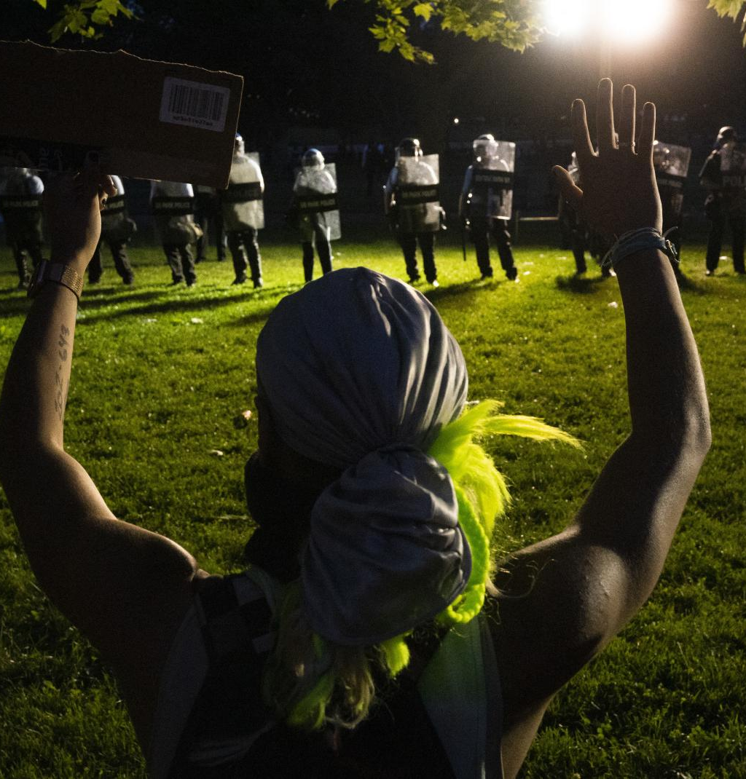
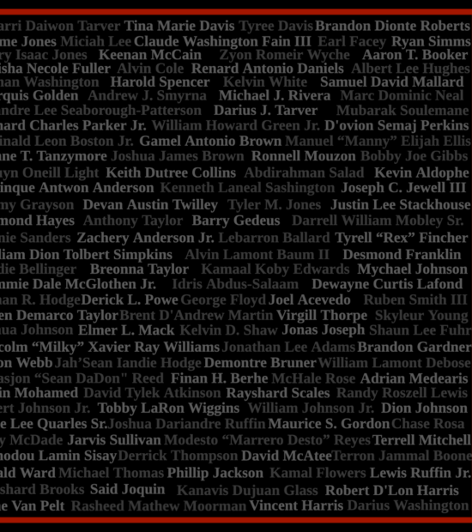
Notes:
Pictured is Sonya Massey. Shot and killed at the age of 36 by a Springfield Illinois police officer for saying she rebukes him in the name of Jesus.
164 Black People killed by police officers in the first 8 months of 2020
WOE to anyone that does not mourn!!! I cannot imagine the state of being a person who would not mourn such tragedy must be in
Blessed are those that care as that concern can lead to actions. Those actions can lead to change. That change leads to God’s kingdom being here on Earth as it is in heaven

Slide 20
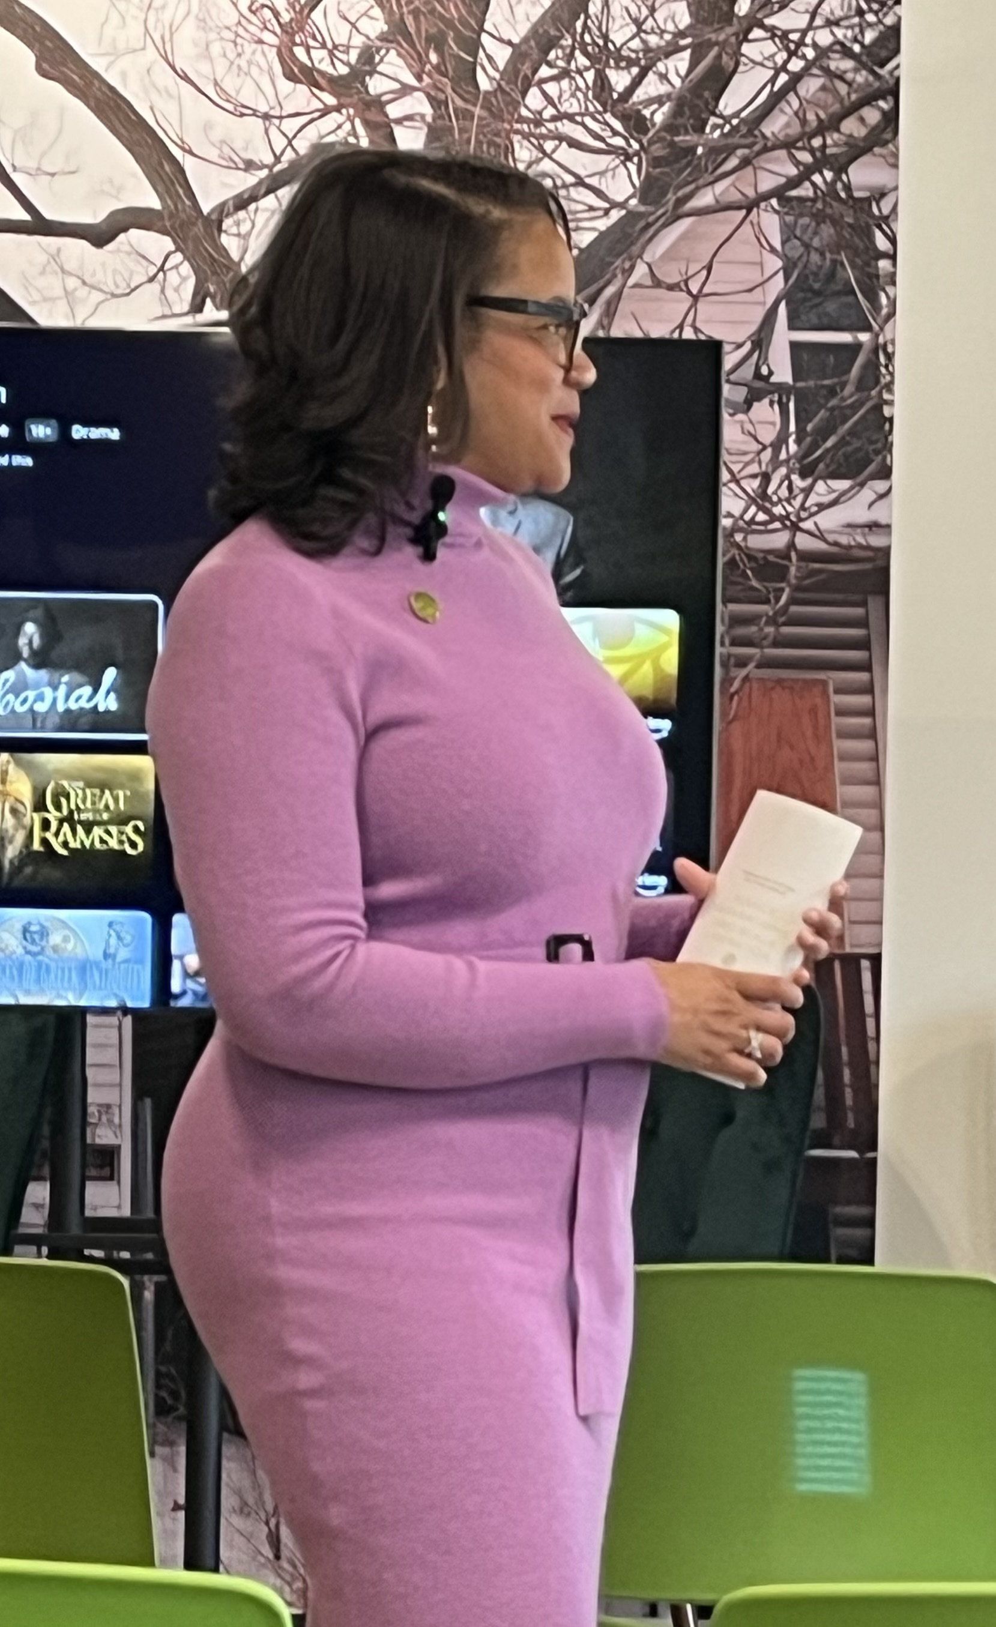
Notes:
Robin Rue Simmons endured a lot of pushback for her leadership in the reparations movement. If you have watched the Big Payback, you would have heard Robin share how she received death threats and people threatening her daughter.
While that does not sound like a blessing, the work that she is doing that drew that anger, is. Currently, to the tune of over 5 million dollars

Slide 21
Notes:
While the WOES and BLESSINGS certainly are designated for the future, they are both experienced in the now given the known future ahead
For example, if someone told you that in a week from now, you will be forced on a plane destined to crash and kill you. How do you think you would be spending those days prior to that? That knowledge would certainly affect you in the days leading to your doomed flight

Slide 22
Notes:
There might be a couple of ways to cope with such a doomed future
You might just say, ”SKIP IT” and focus on getting the most out of the 7 days you can, doing anything you want, breaking the law, treating others poorly, etc.

Slide 23
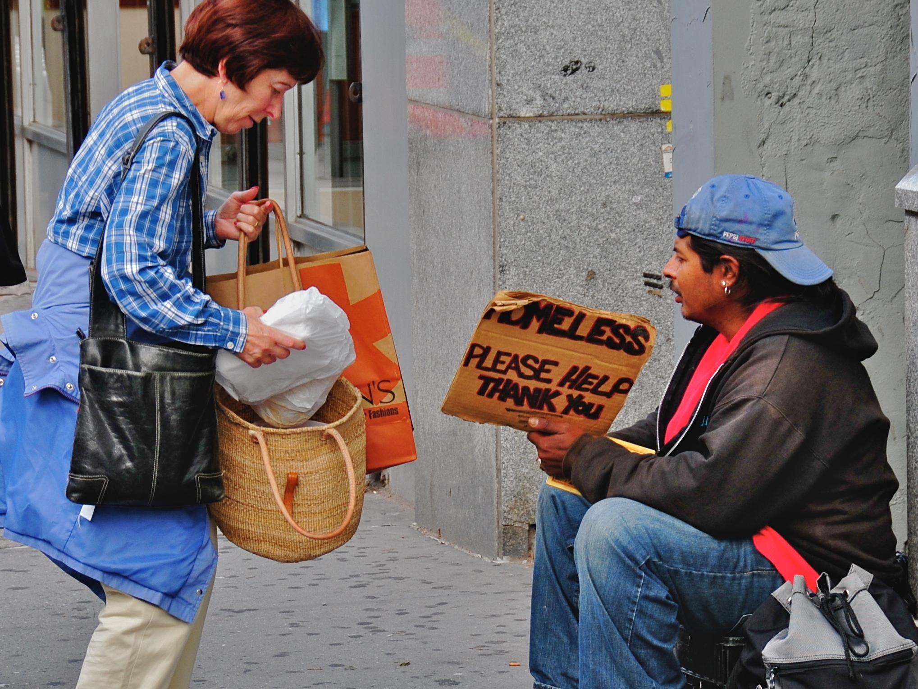
Notes:
OR you might spend that time trying to make amends for any wrongs you have done, trying to repair broken relationships, make one last ditch effort to make the world a better place before your future crash and death

Slide 24
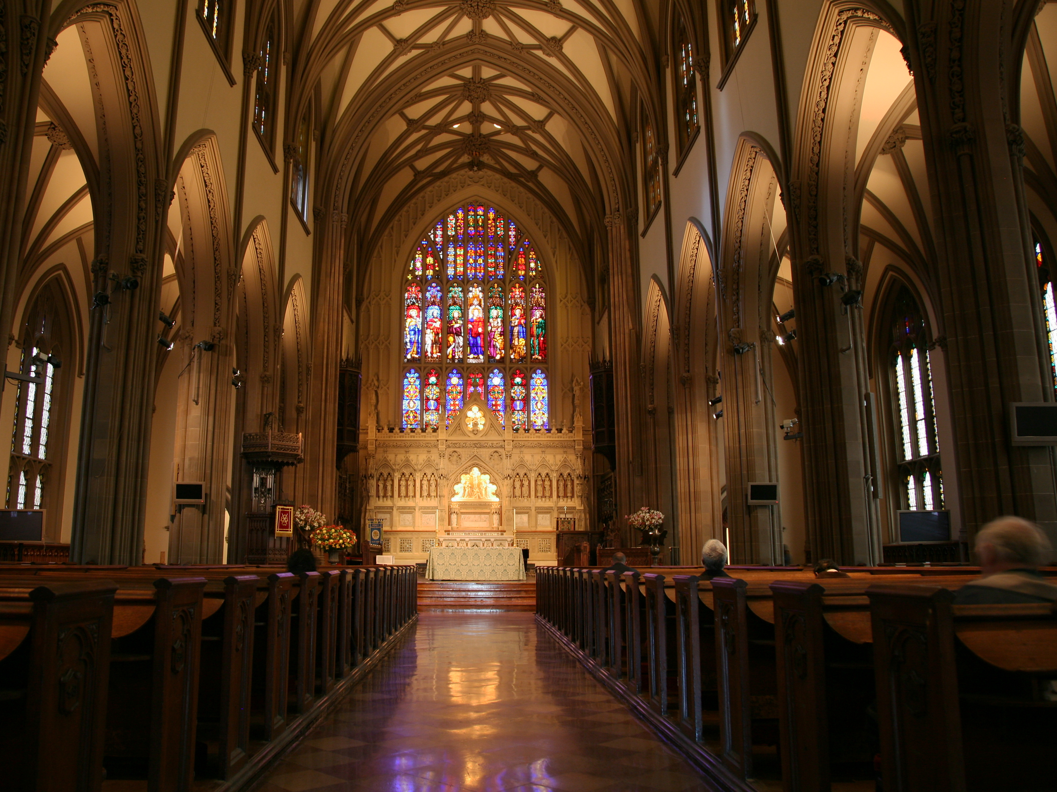
Notes:
Makes you really think about what the church really looks like. Is it large institutions with ridiculous amounts of wealth and prestige that have participated and perpetuated the evils in this world? Or is it people that are ridiculed and threatened to for seeking to make this world more just?

Slide 25
Notes:
So let’s strive to be more poor

Slide 26
Notes:
Be and stay hungry

Slide 27
Notes:
Let us care and mourn because we share each others’ pains.
One of CCCHC’s longtime board members, Clif Burdette passed away recently. We mourn with the family and ask for prayers.

Slide 28
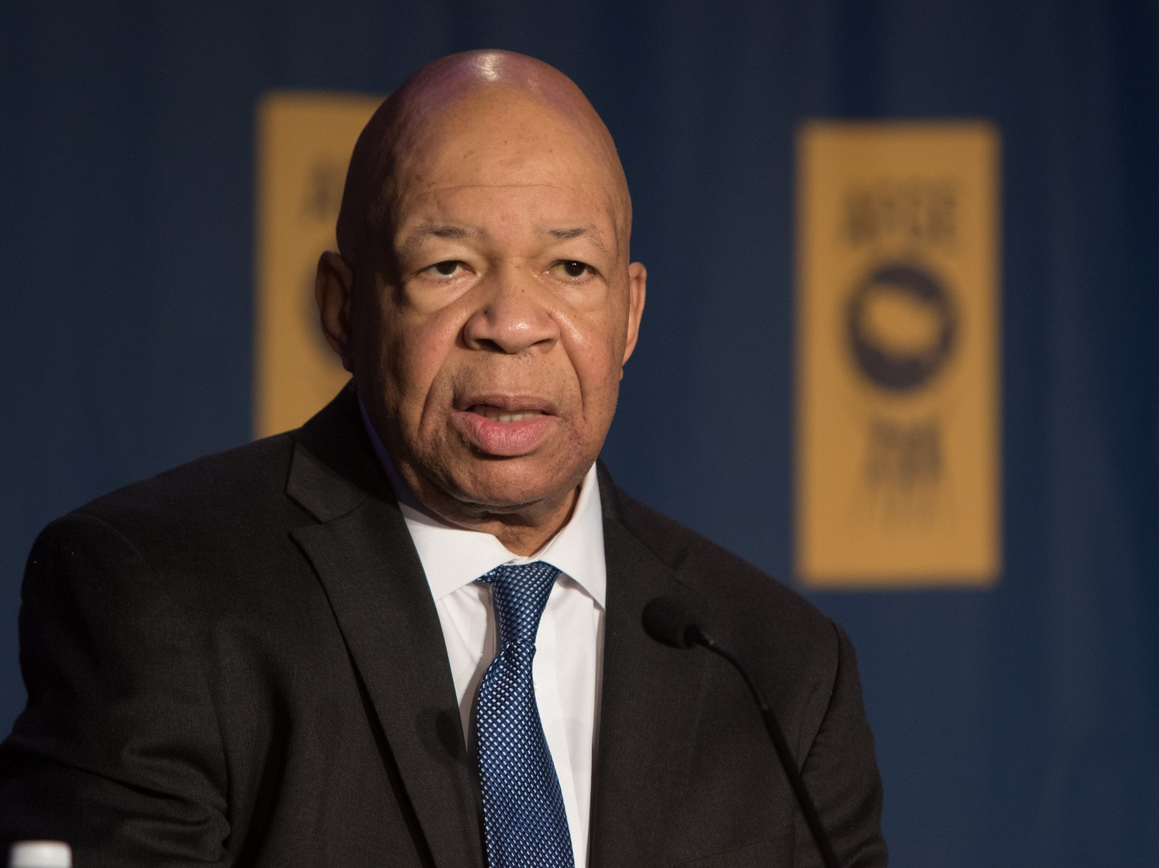
Notes:
Let’s work hard at being ridiculed for our work towards justice
As Elijah Cummings would say, let’s get into Good Trouble

Slide 29
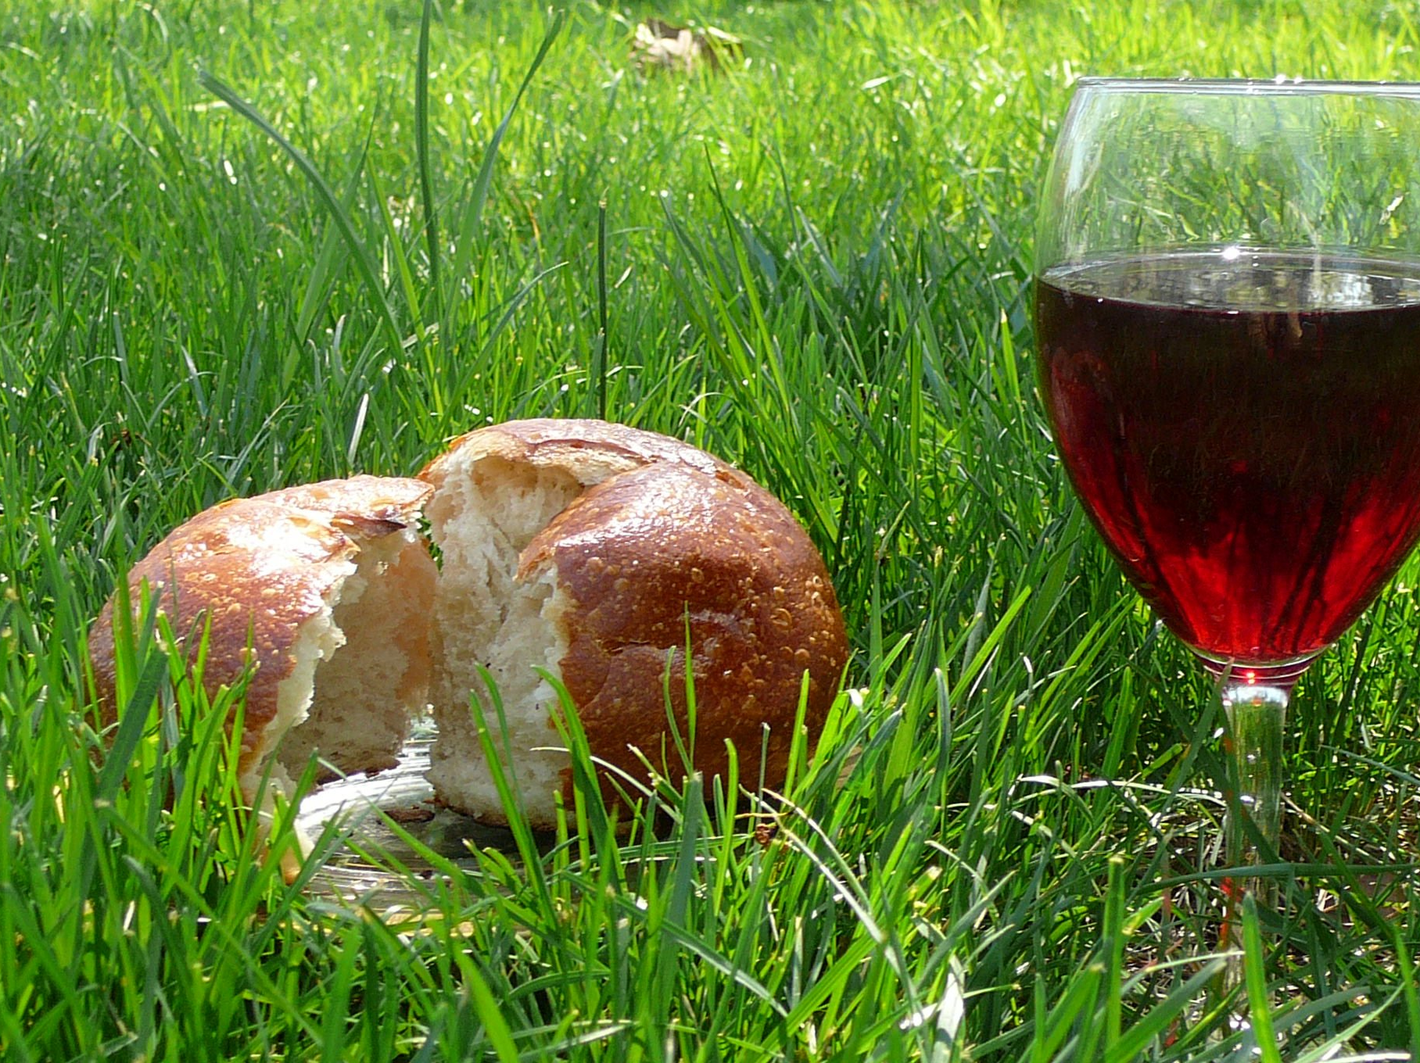
Notes:
Let us sacrificially, hungrily, caringly, and boldly await Christ’s return so that we may not only receive riches in heaven, but help make this world be what is was designed to be

