Slide 1

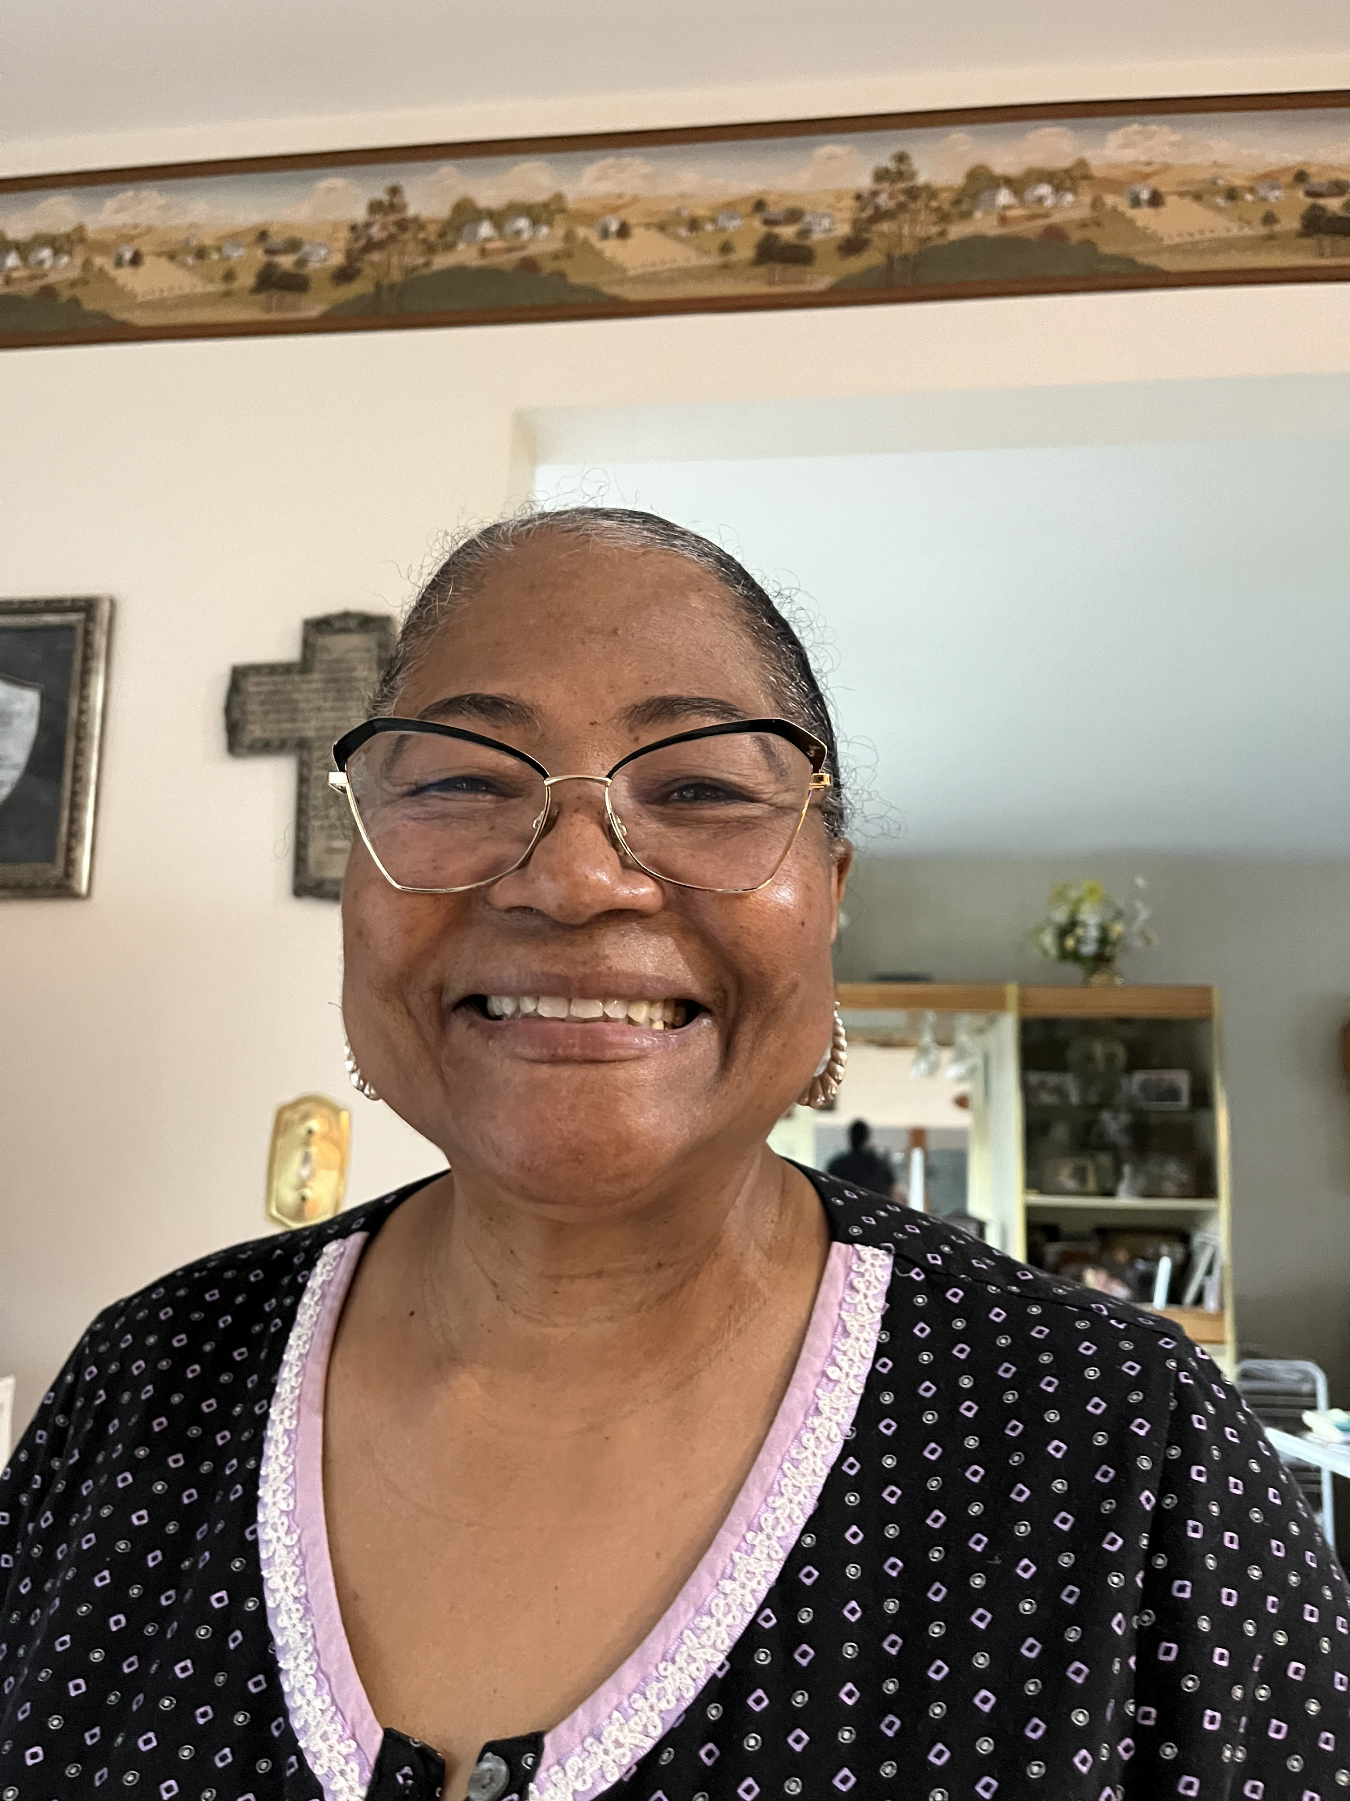

Slide 2
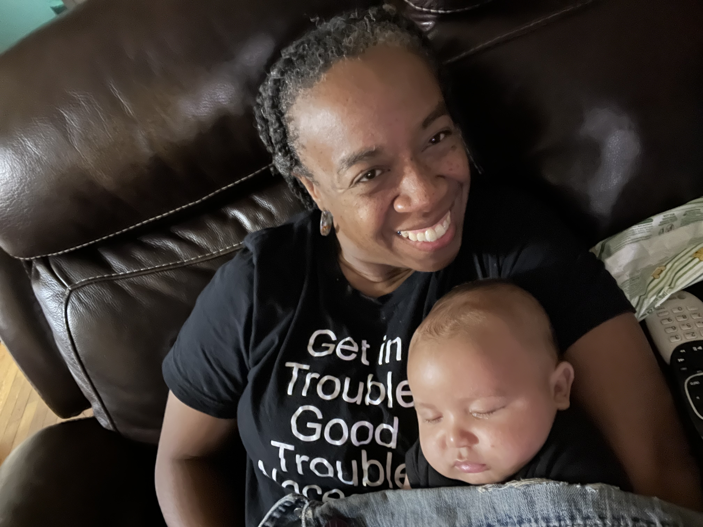
Notes:
Resolution declaring National Reparations Day for the City of Chicago

Slide 3
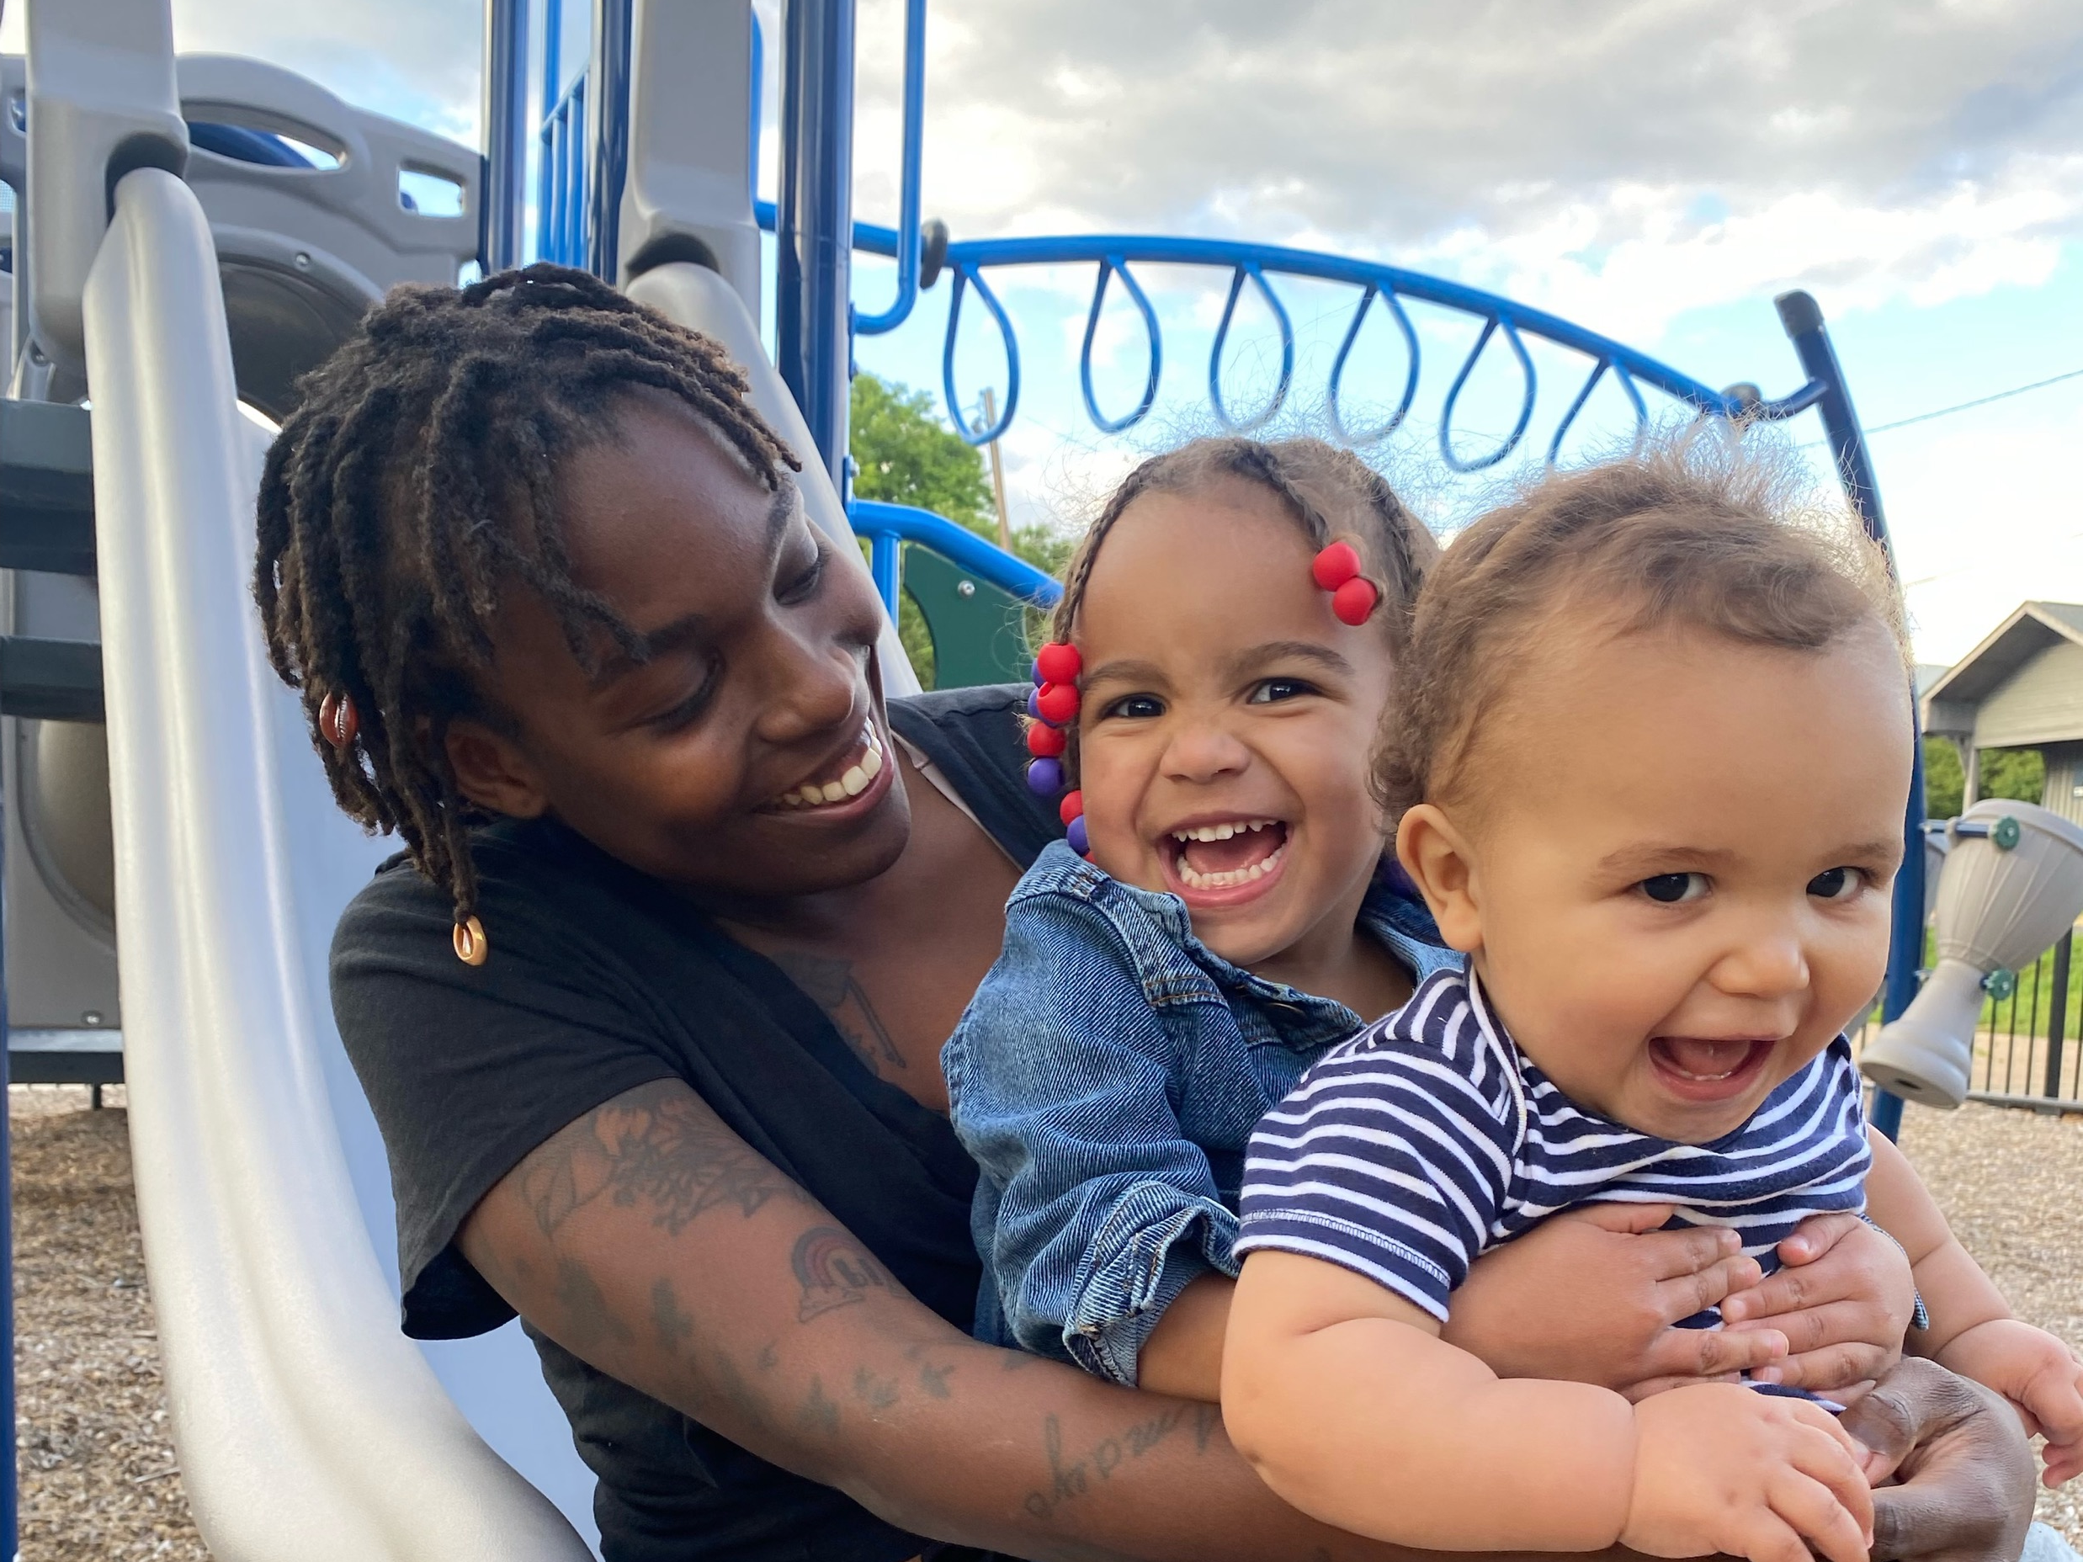

Slide 4
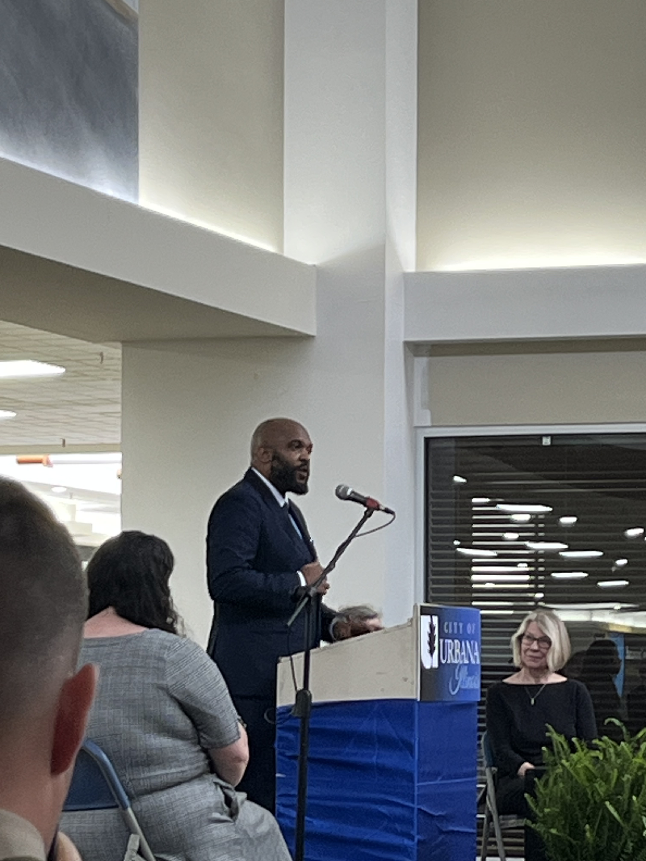

Slide 5

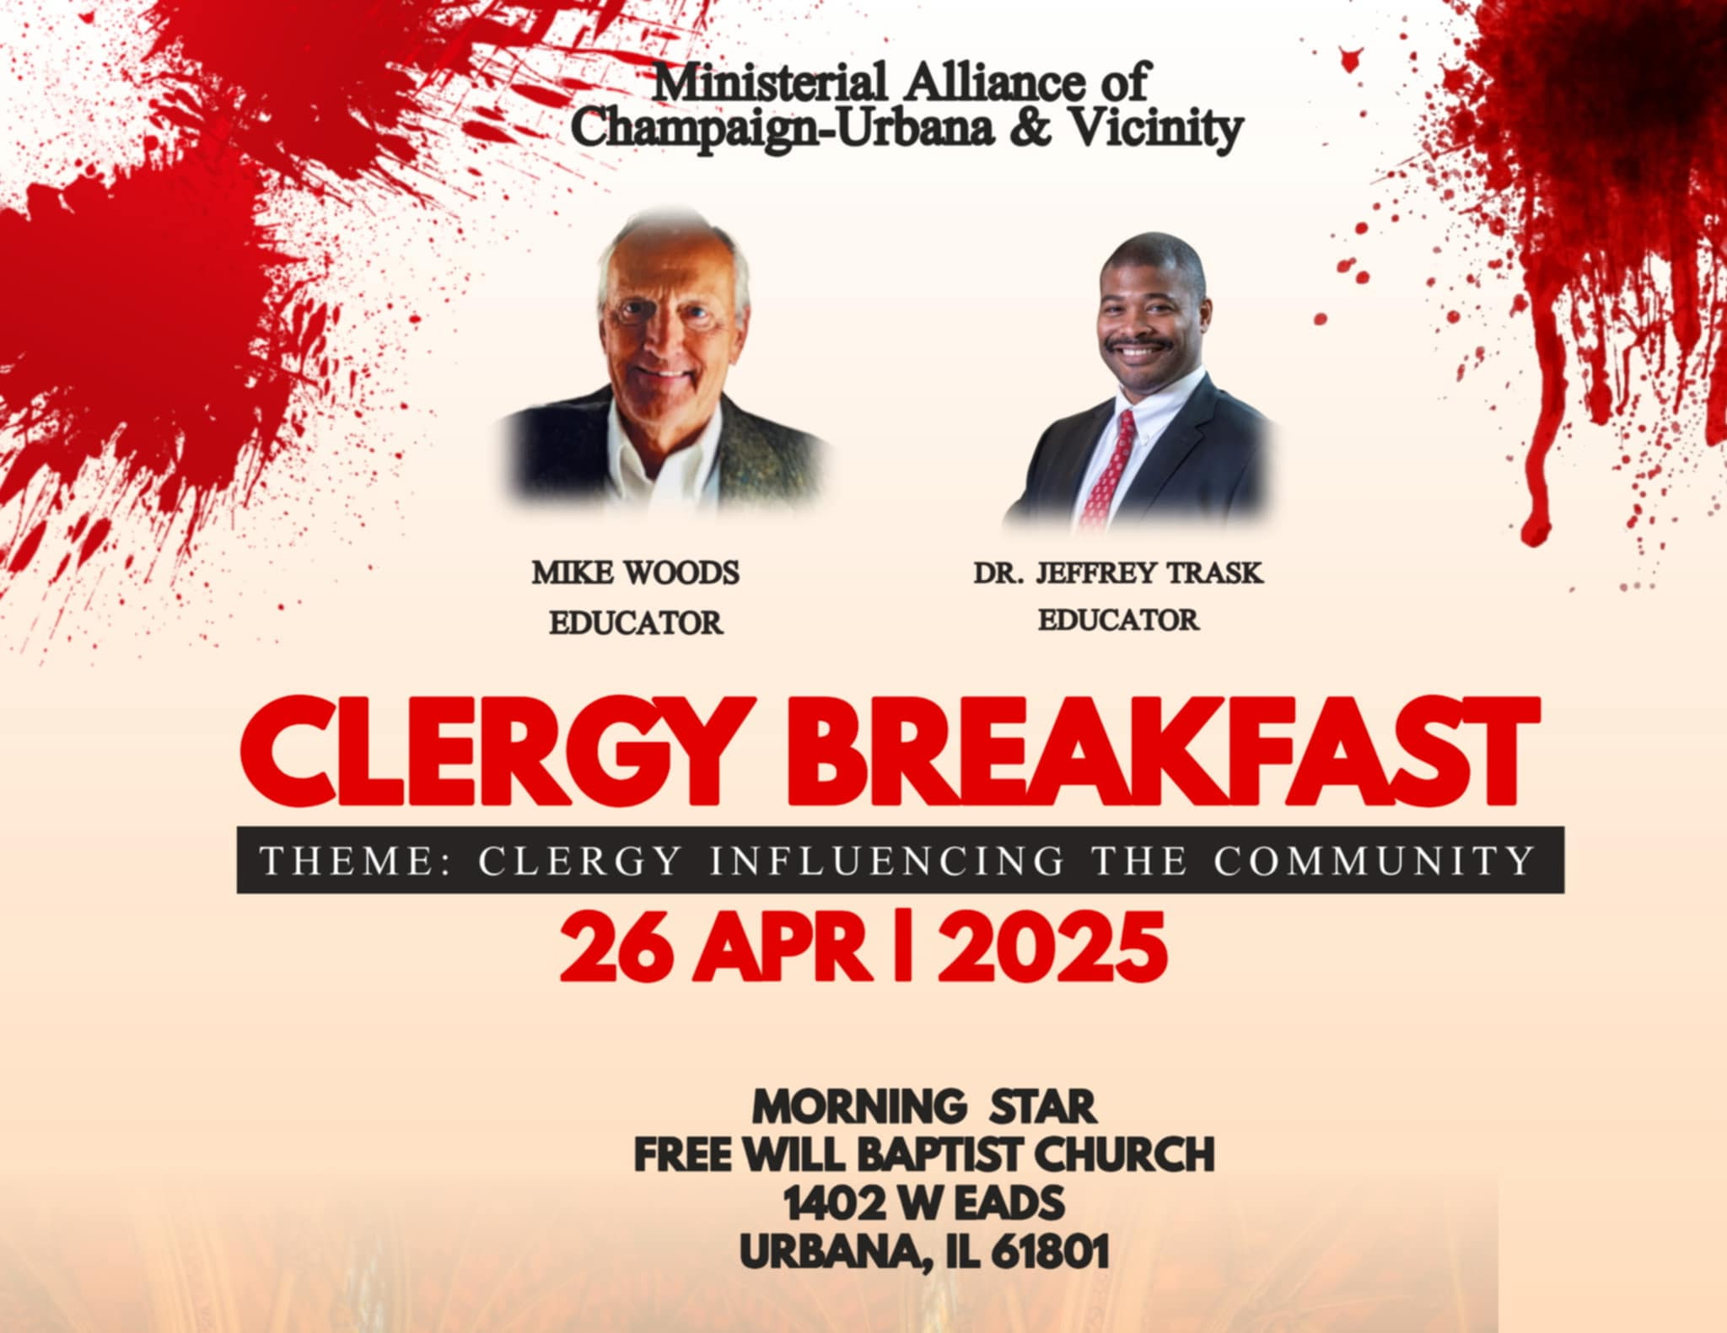


Slide 6


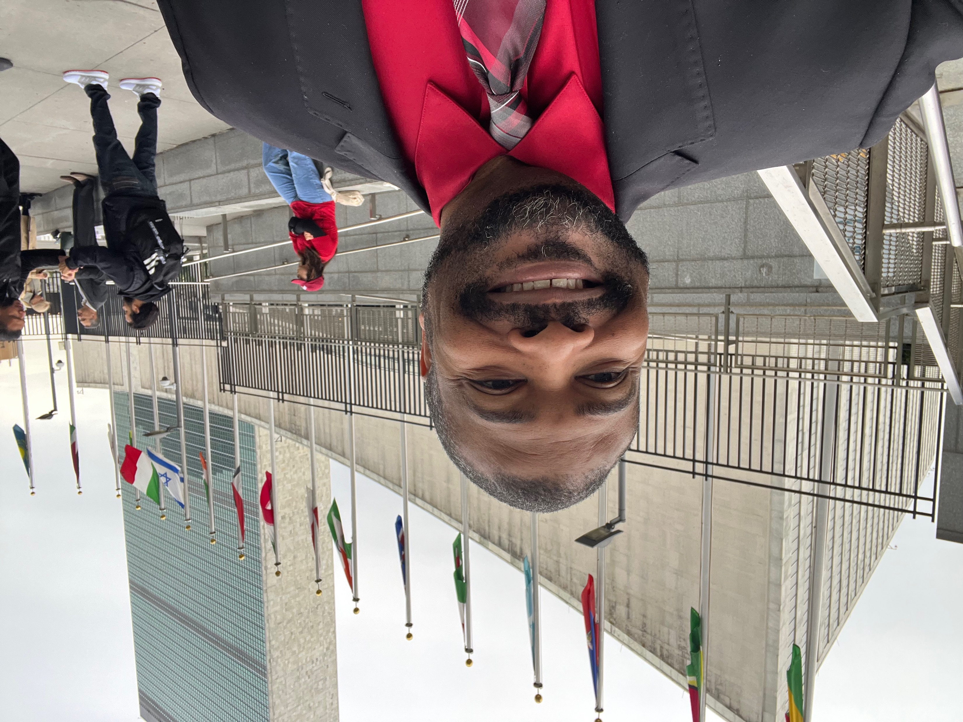
United We Stand
Psam 133:1 How good and pleasant it is when God’s people live together in unity!

Slide 7

UNITY
Acts 1: 12-14
Jesus JUST left
The MOTLEY crew still together
They (the disciples) ALL joined together with the women
Notes:
¹² Then the apostles returned to Jerusalem from the hill called the Mount of Olives, a Sabbath day’s walk^{[c]} from the city. ¹³ When they arrived, they went upstairs to the room where they were staying. Those present were Peter, John, James and Andrew; Philip and Thomas, Bartholomew and Matthew; James son of Alphaeus and Simon the Zealot, and Judas son of James. ¹⁴ They all joined together constantly in prayer, along with the women and Mary the mother of Jesus, and with his brothers.

Slide 8
Why Divide Ourselves?
By Race
By Gender Identity
By Ethnicity
By Religion
By Country, Region, State, City, Neighborhood
By Age
By Socioeconomic Status
Notes:
Desire to feel special or unique, to judge, to belong, to feel superior, to know oneself, to make sense of the world?
If everyone is treated equally and equitably, there is no scenario where division helps

Slide 9
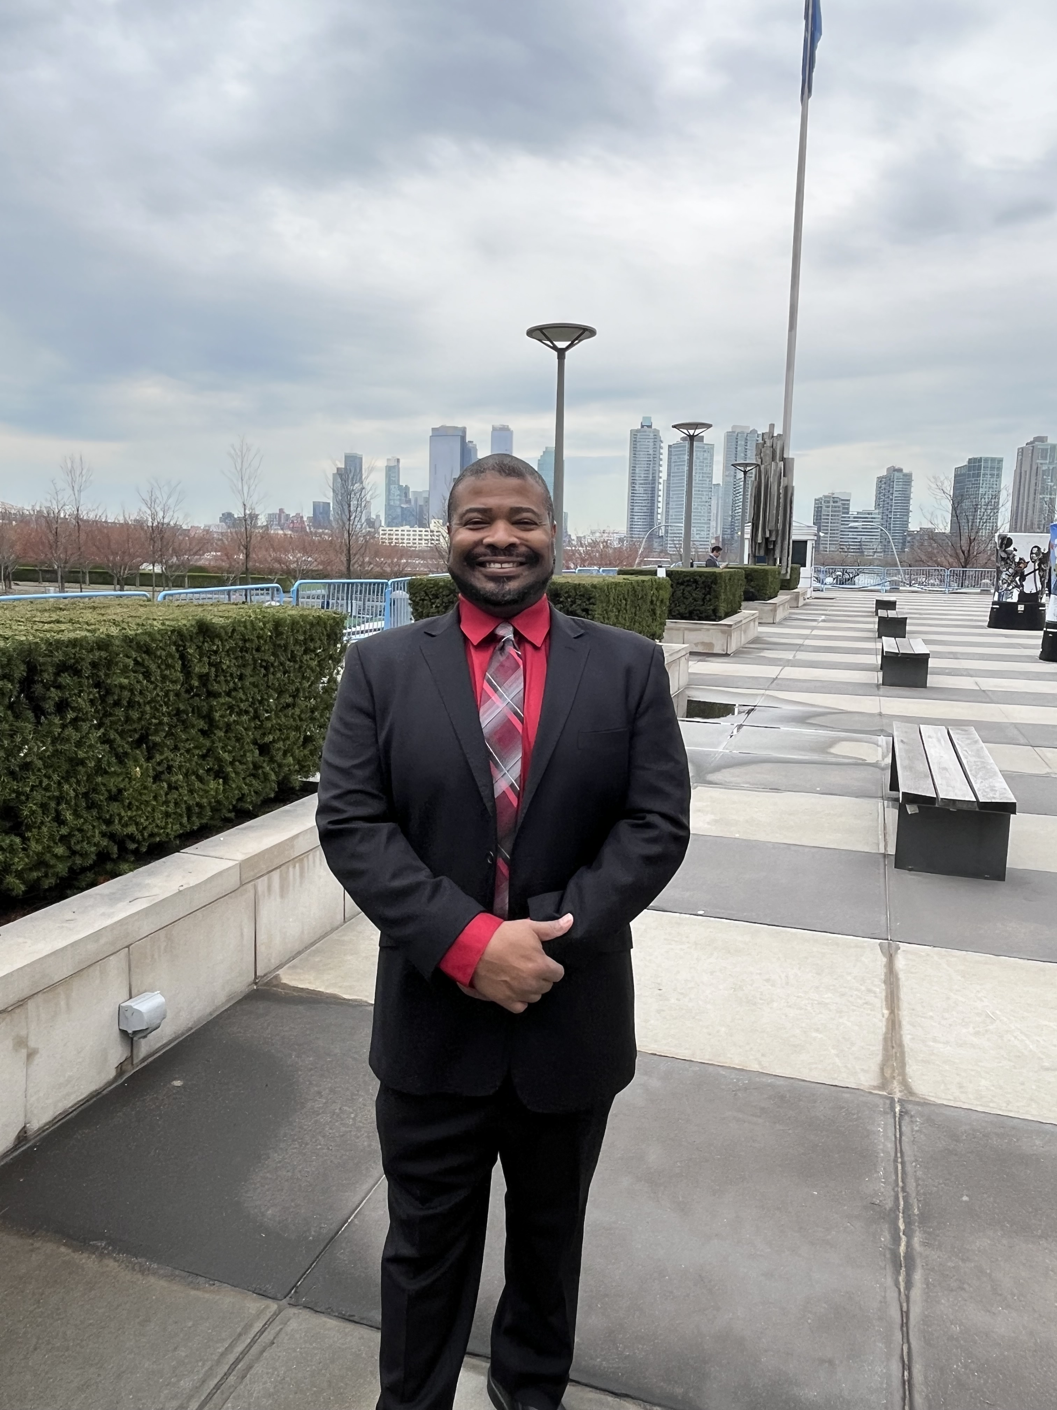
Notes:
Show video

Slide 10
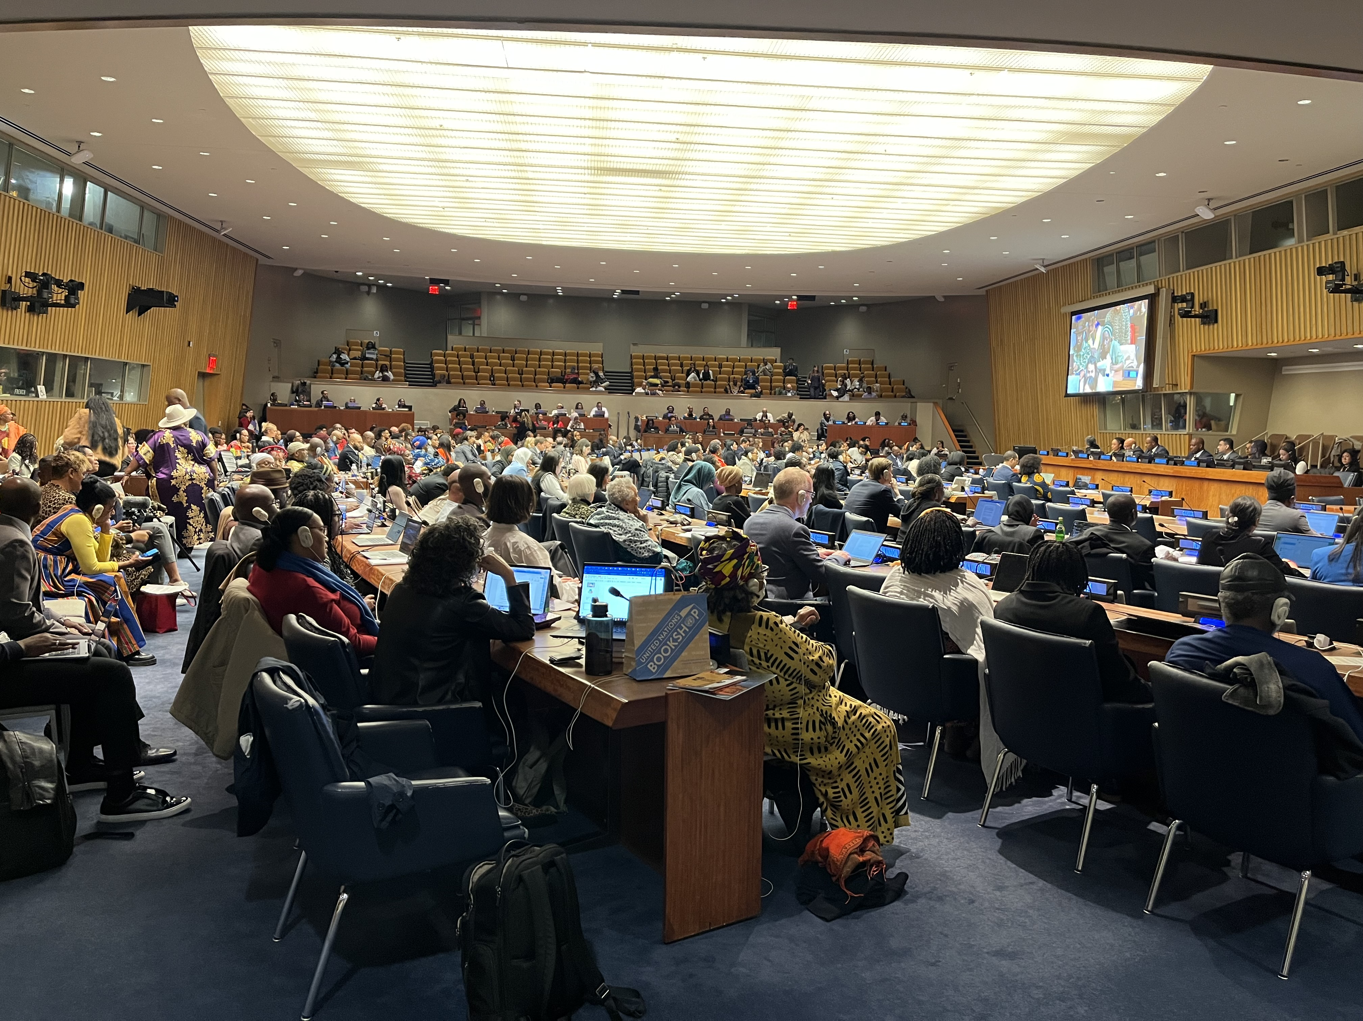
Notes:
A few notable items
No European countries or US delegate present throughout the forum
Many other countries were present throughout Africa, South America, and the Caribbean
Delegates and other attendees had 2 minutes to share: express frustration, raise concerns, make recommendations, etc.
Sessions were not long enough to hear everyone that wanted to speak – led to an outburst but also led to the UN leaders saying they will try to change the format to be sure more people are heard
Only one country was booed – the Dominican Republic. I did not have the translation device on so I don’t know what he was saying, but it was pretty intense.
Robin was one of the few who received multiple cheers. Shows how well respected she is in this venue
Highlight was conversations about Haiti and discussions about them receiving reparations for them paying reparations
(Sir Hilary Beckles – History of Haiti)

Slide 11
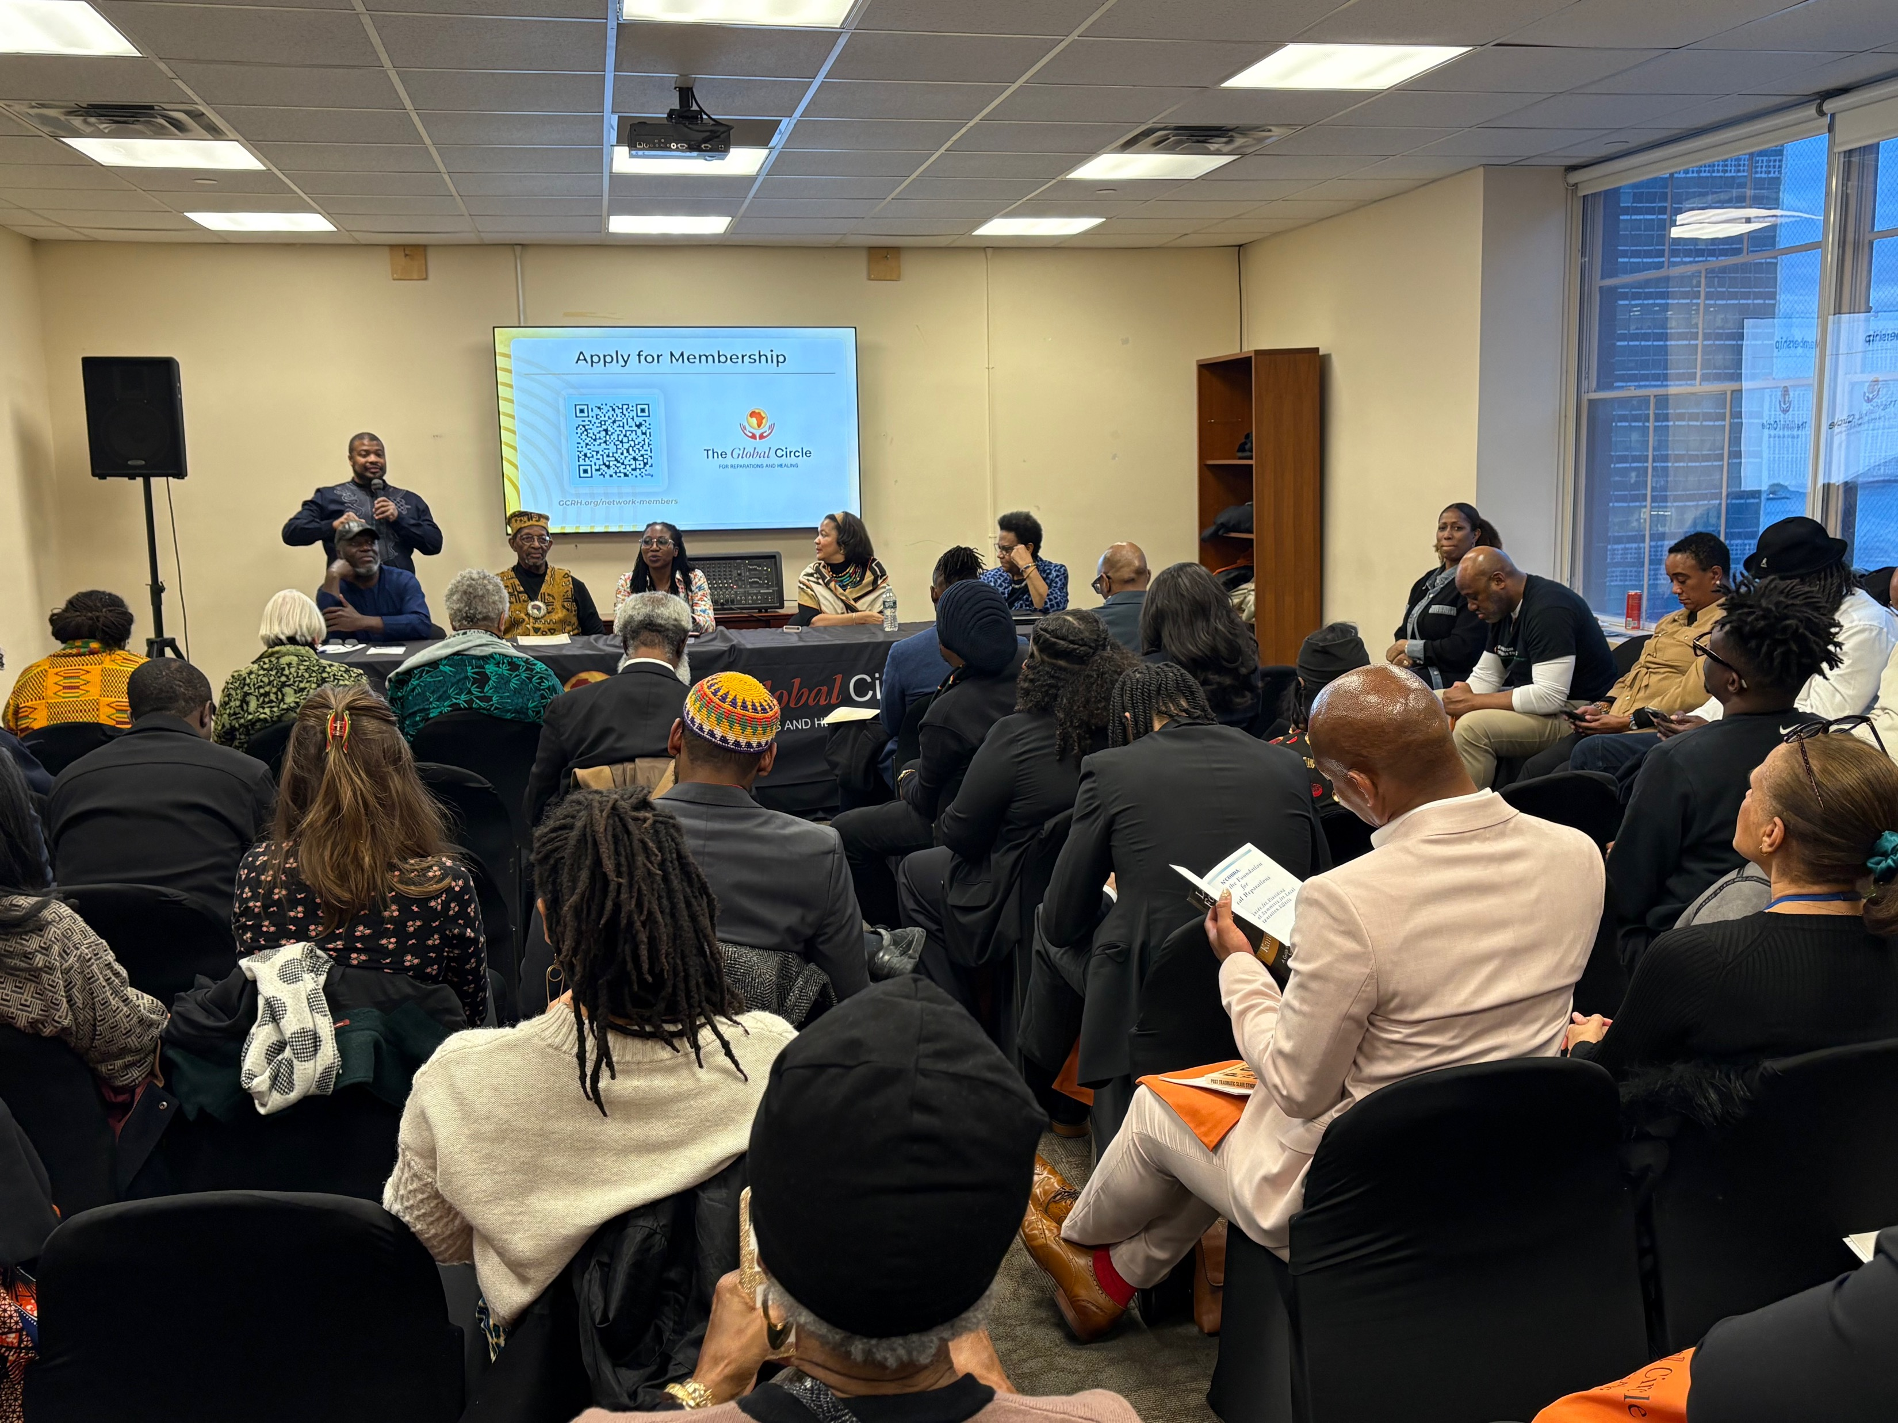
Notes:
There were several side events that had a more intimate setting and where plans to do the work of reparations were being made
This meeting was for the Global Circle – a group started by several reparations leaders like Robin Rue Simmons to coordinate and organize reparations efforts all over the world
I was happy that I was able to help with the logistics for this function as well. The First Repair team was having a difficult time finding a black caterer for the event. Just so happens that I have a decent number of family members in New York and particularly, a cousin who is well connected and found us a black caterer that did an excellent job. The day before the event, Robin asked if my cousin knew a back photographer and he found someone for that as well.

Slide 12
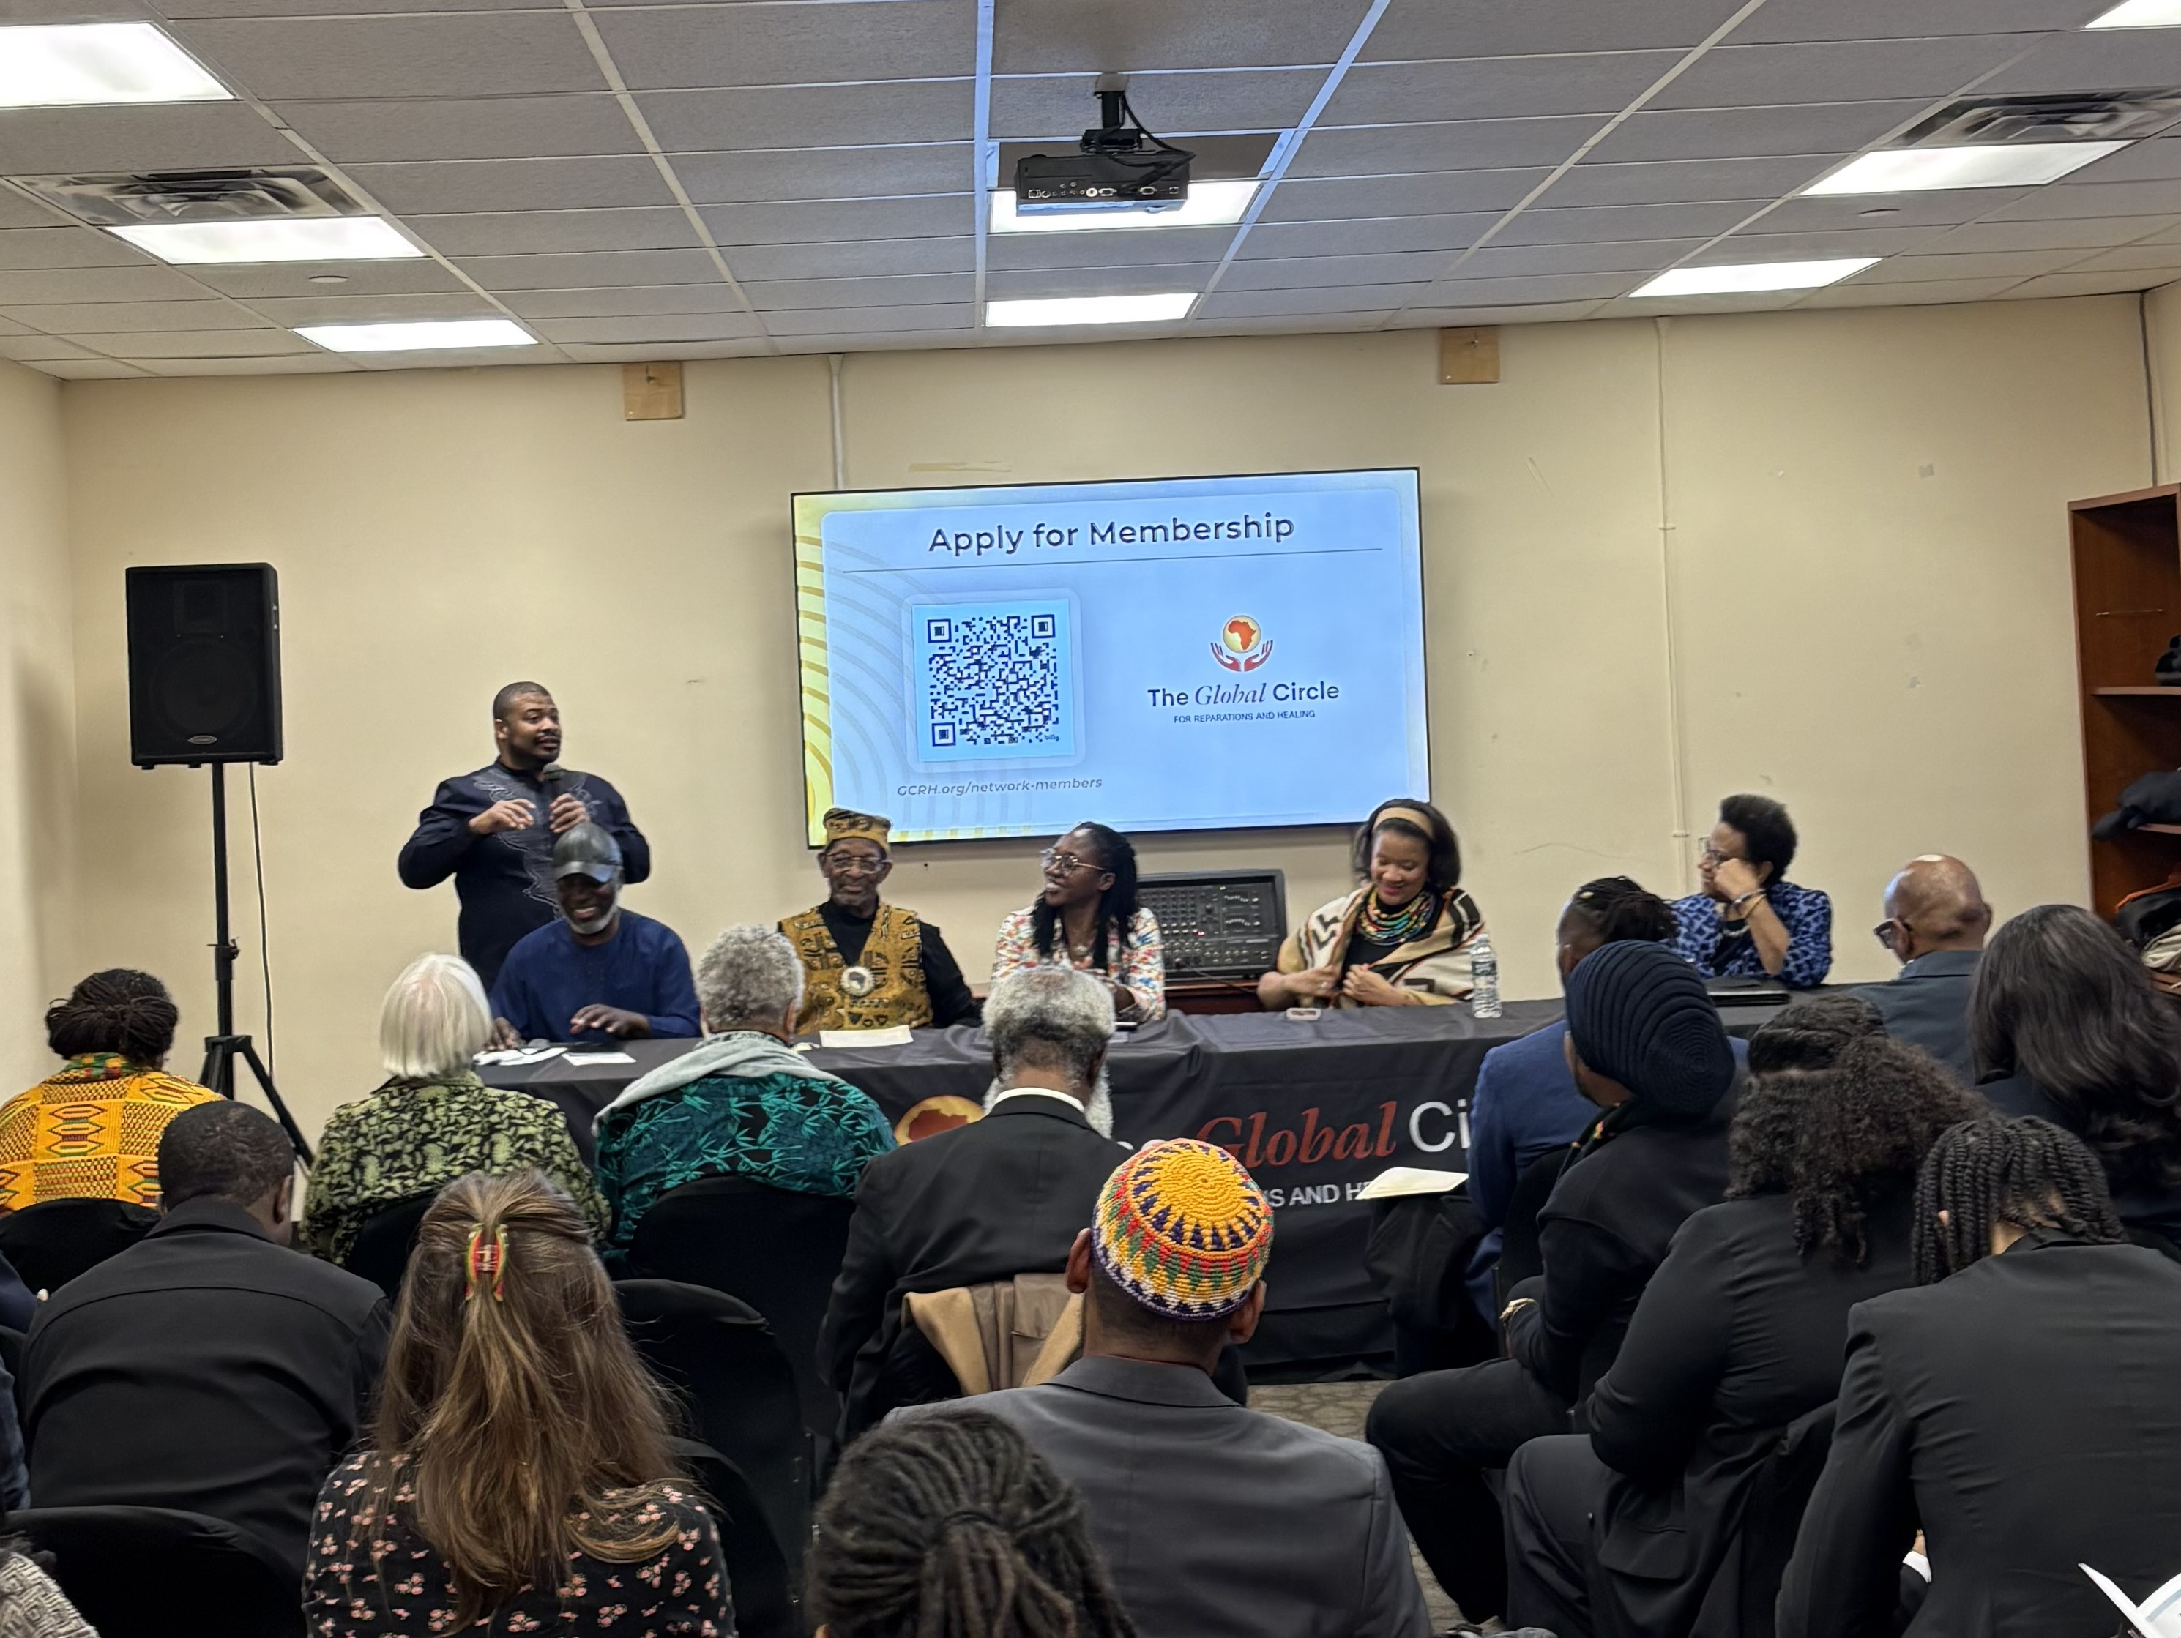
Notes:
.
I was the moderator or ”MC” for this side event.
The event went great as people got a chance to learn more about the Global Circle and join one of the six working groups. I am on the Partnerships and Movement Building working group.
This picture shows the panel smiling because I said the Avengers (Capt America, Iron Man, Thor) had nothing on this panel. Which they don’t

Slide 13
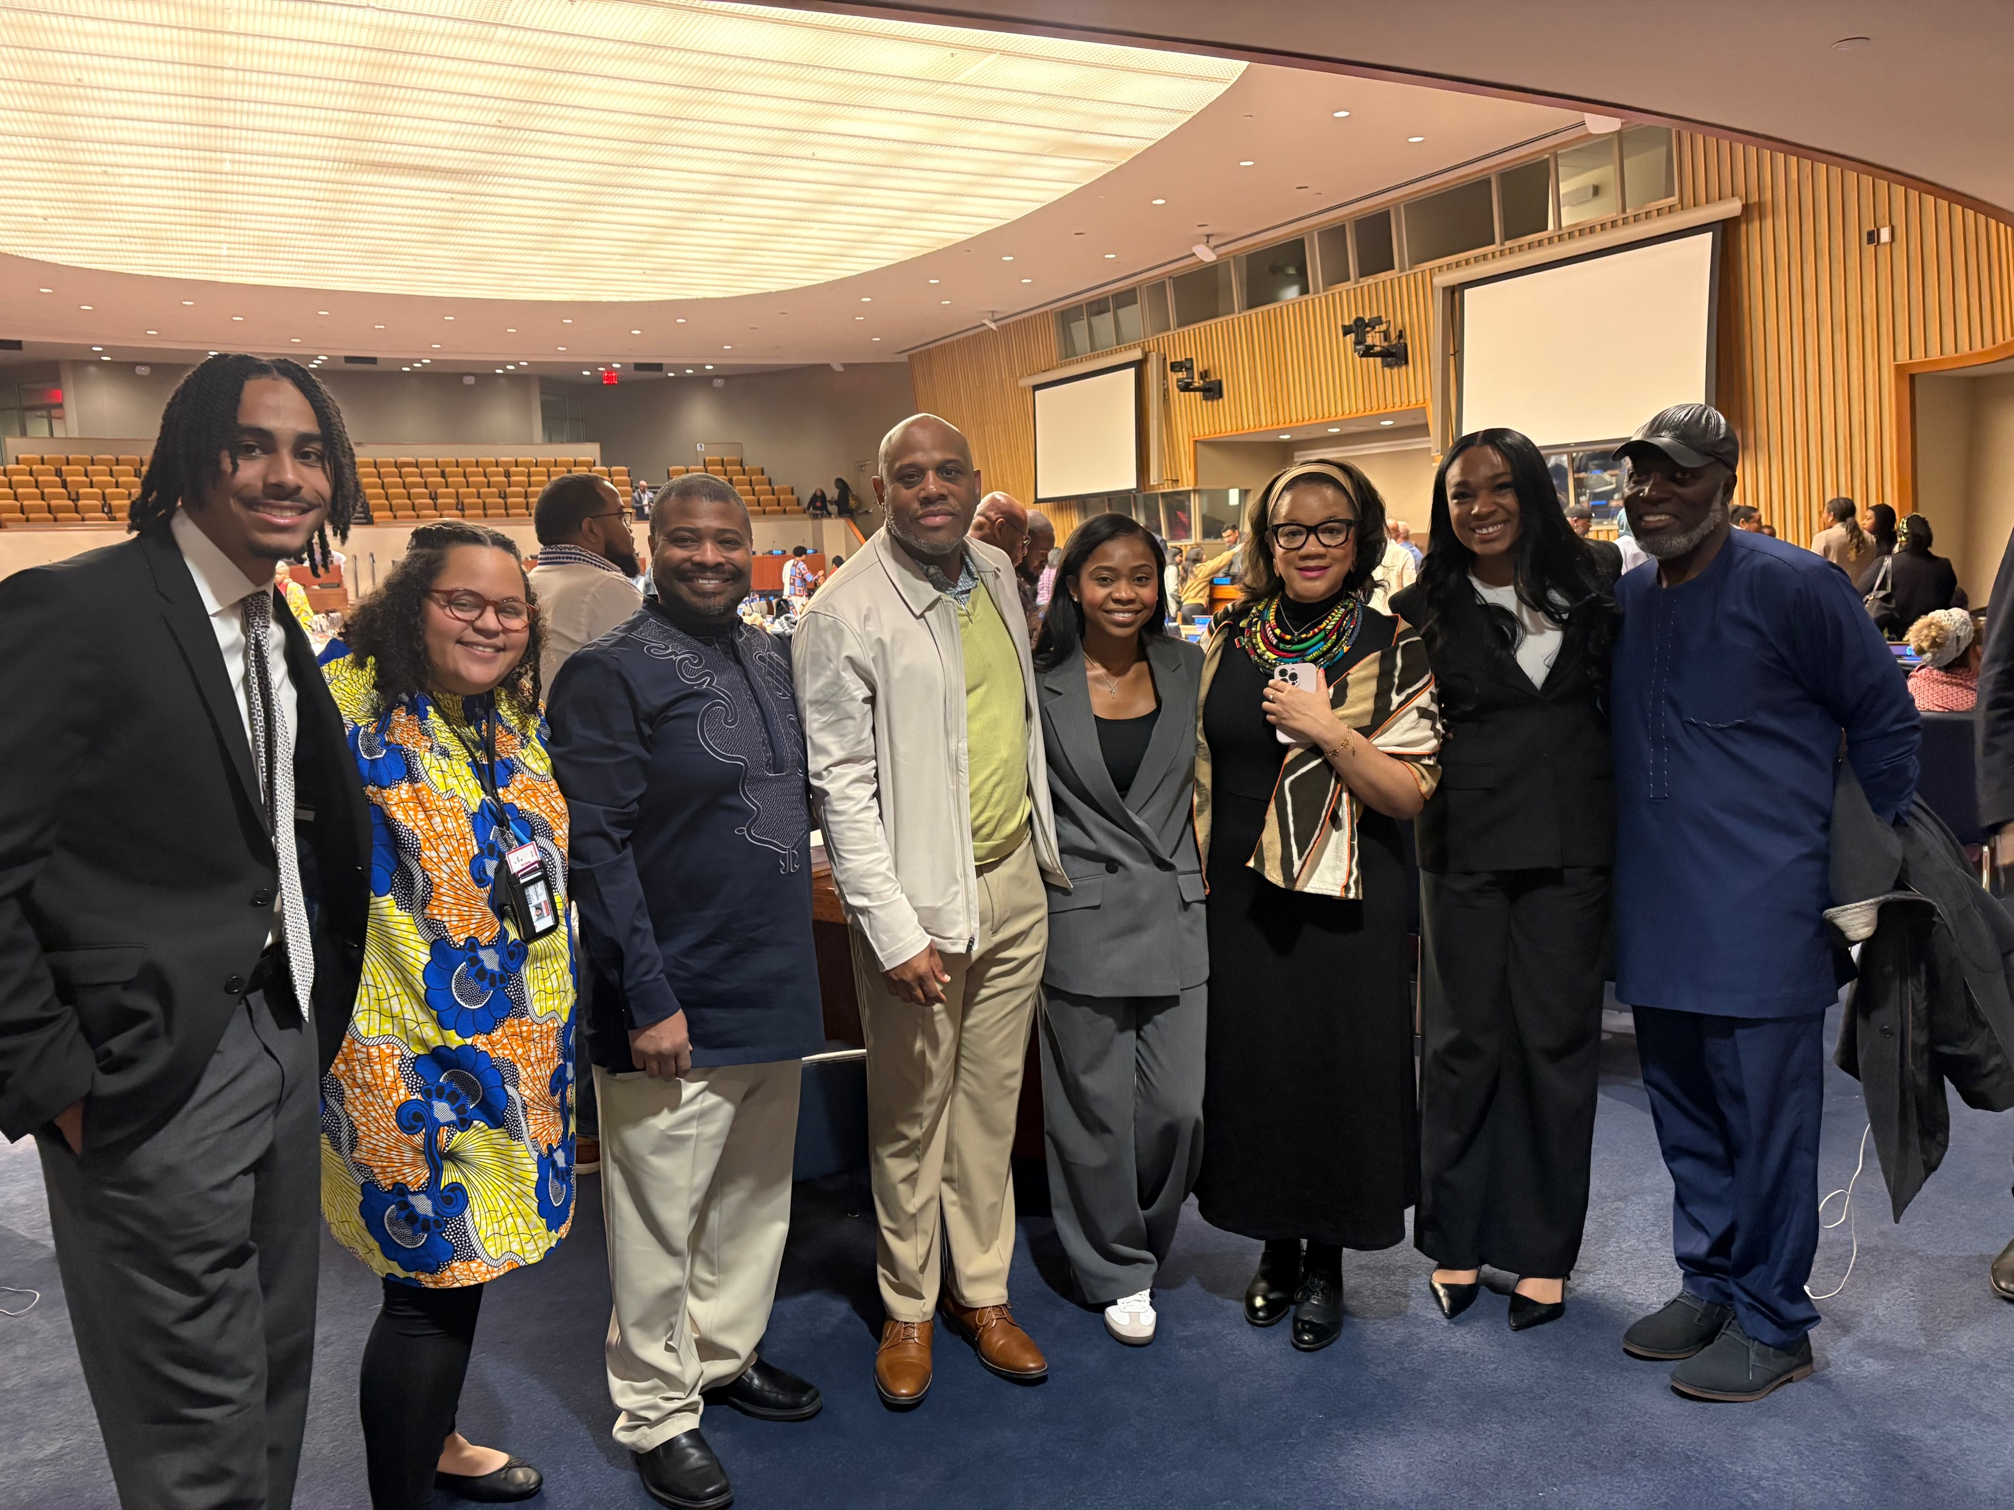
Notes:
All in all, it was an amazing experience and I am very grateful NCF helped make it happen.
This is the Evanston group and Kamm Howard in the forum

Slide 14


Reparations is the Road to Unity
Reparations is the opposite of being divisive
Reparations comprise of two basic concepts: Apology and Compensation for Harm
Notes:
When does healing ever lead to divisiveness?

Slide 15
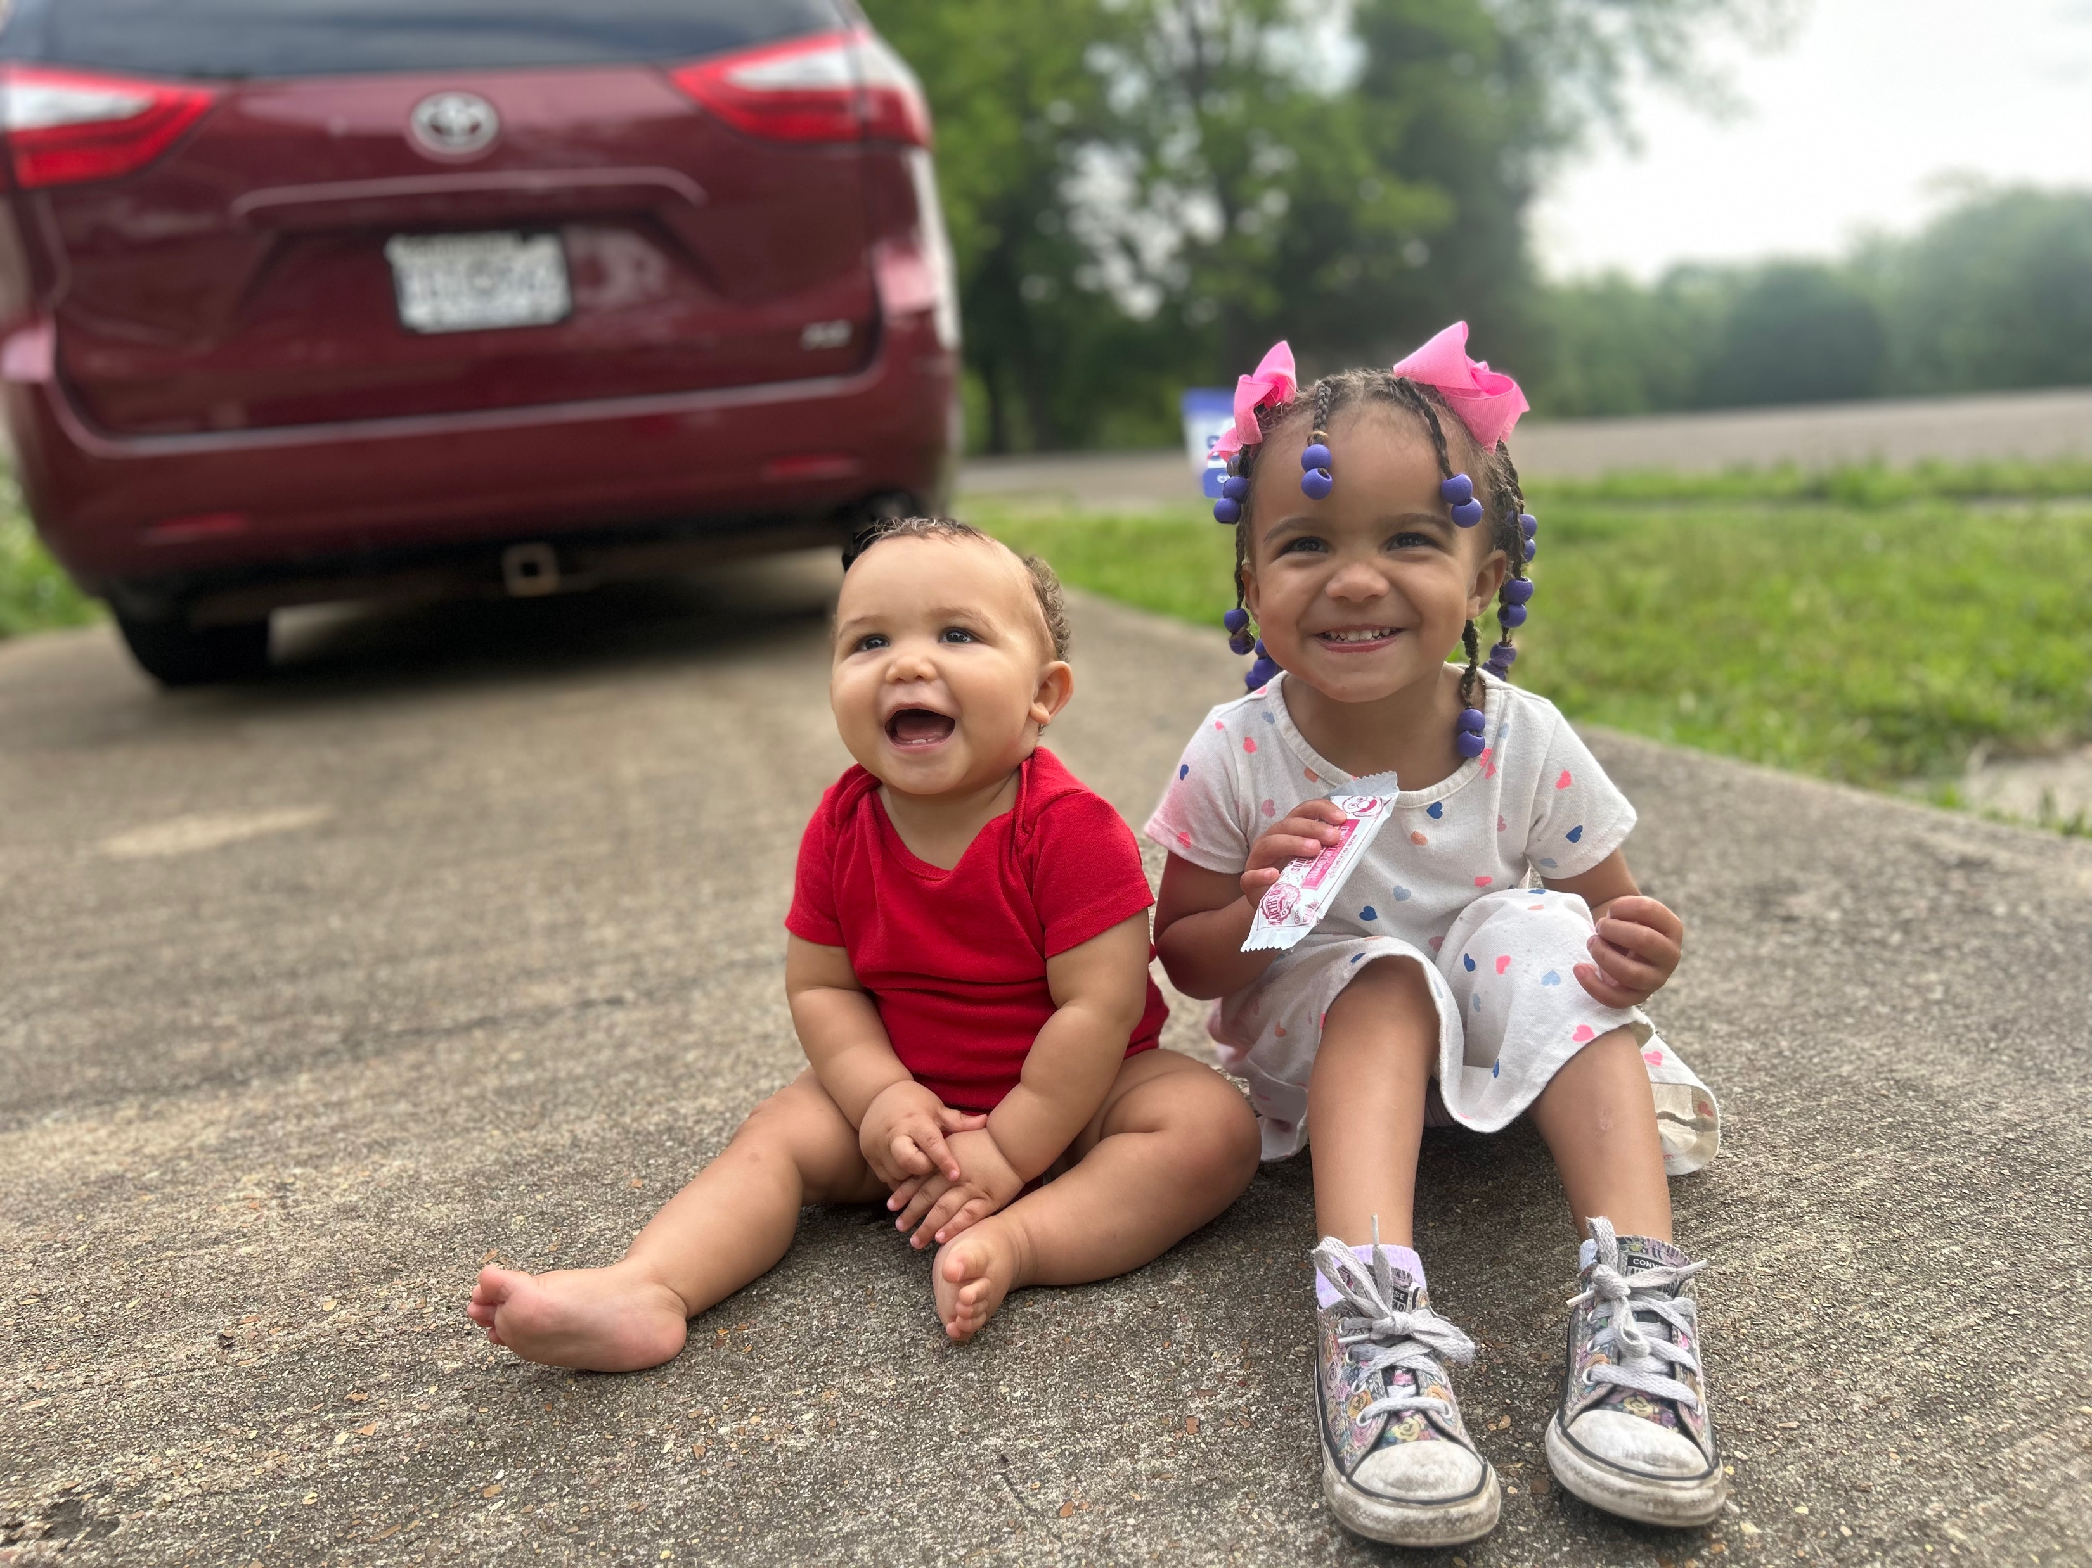
Notes:
This road has led to NCF being a part of the future success of the cutest grandchildren ever

Slide 16
Colossians 3: 12-14
¹² Therefore, as God’s chosen people, holy and dearly loved, clothe yourselves with compassion, kindness, humility, gentleness and patience. ¹³ Bear with each other and forgive one another if any of you has a grievance against someone. Forgive as the Lord forgave you. ¹⁴ And over all these virtues put on love, which binds them all together in perfect unity.
Notes:
Some of you may recall the BRIDGE acronym NCF used back in the day… two of the components was doing justice and embracing diversity…
It is somewhat fitting doing justice preceded embracing diversity as it is a prerequisite
And when we think of the word EMBRACING… I imagine it like the movies when people survive something dramatic or see each other when they thought they never would see each other again

Slide 17
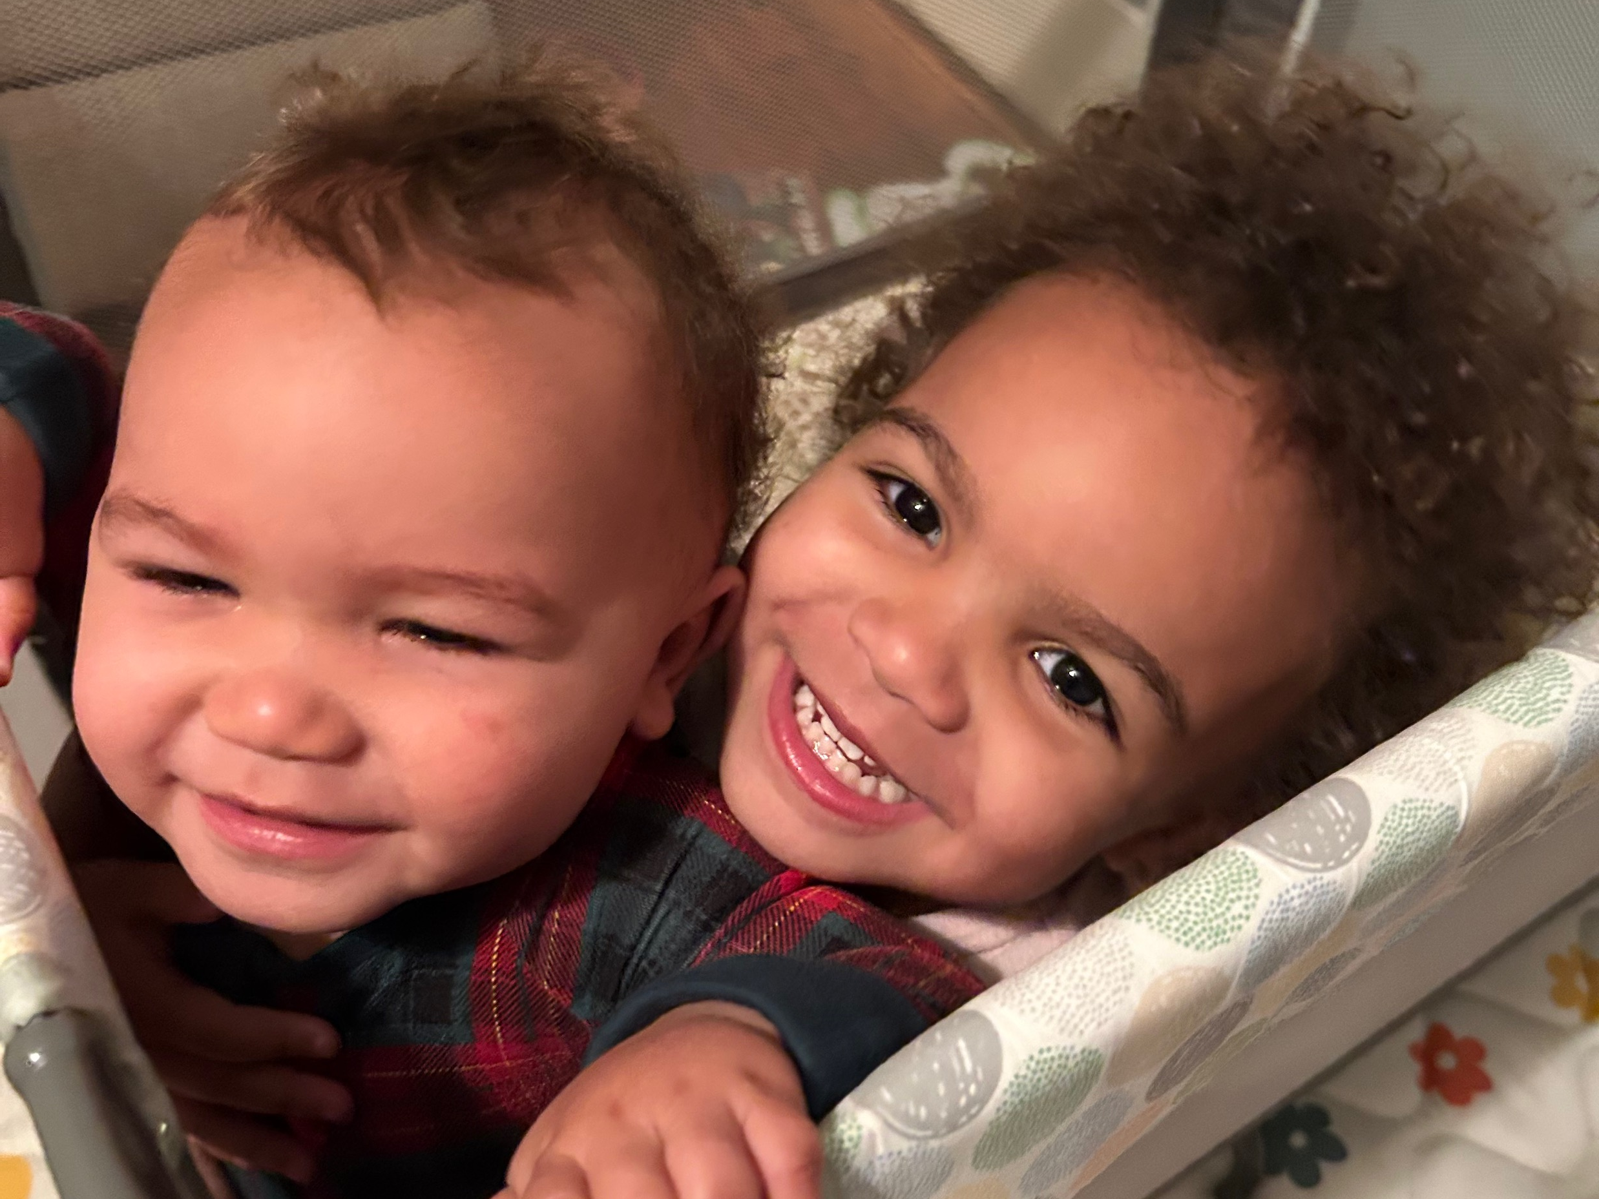
Notes:
Example of UNITY

Slide 18
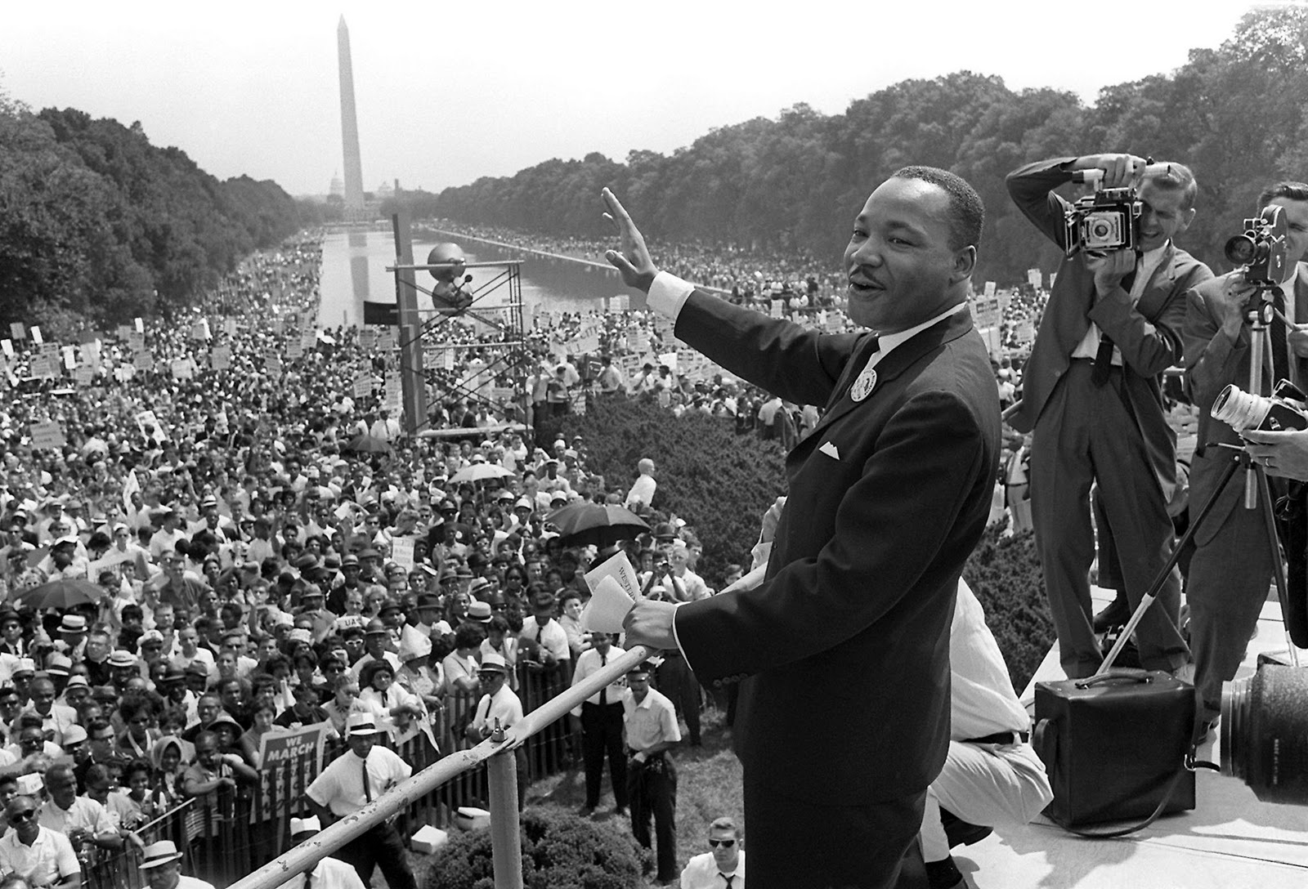
This Photo by Unknown Author is licensed under CC BY
Notes:
This is an example of UNITY
Of the 250,000 people present, 20-25% were white and 75-80% were black
Even in the 60s, it was not just a black thing to fight for justice

Slide 19
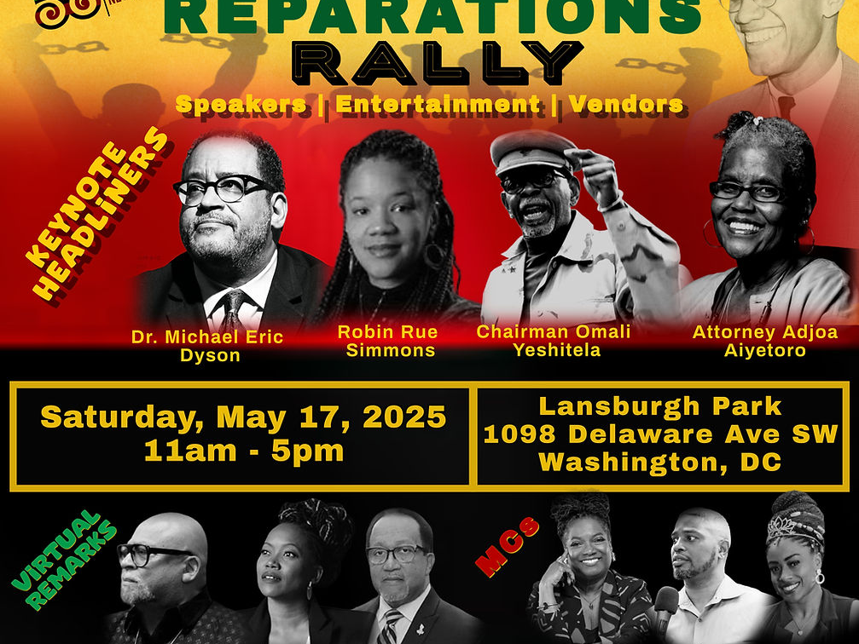
Notes:
I hope to witness UNITY at the DC Rally next week

Slide 20
The Power of Unity is in US
²⁰ “My prayer is not for them alone. I pray also for those who will believe in me through their message, ²¹ that all of them may be one, Father, just as you are in me and I am in you. May they also be in us so that the world may believe that you have sent me. ²² I have given them the glory that you gave me, that they may be one as we are one—
Notes:
Jesus gives the answer to the test… the cheat sheet if you will.
By being unified with the principles and practices that are outlined in scripture and Jesus’ life, we can truly be one

