Slide 1
THEME FOR TODAY: HOLY SPIRIT OR RELIGIOUS SPIRIT? TRUSTING OR PRETENDING?
TEXT FOR TODAY: Acts 4:32-5:16

Slide 2
We Have Been:
GOING THROUGH the ending of Luke and the beginning of Acts the last few months
PRAYING for “MORE OF THE HOLY SPIRIT” in light of the Exciting Texts about the Sharing Community of Early Jesus Followers
But, TODAY’S TEXT is “JARRING”

Slide 3
TODAY’S TEXT IS JARRING:
Some of you may not like this text at all
Many do not
Personal Note about my “theology”
At least, bare with me on this text

Slide 4
The CONTEXT for TODAY’S TEXT (1)
Acts 2 - a forgiven, joyful, SHARING COMMUNITY of Jesus followers. Sharing all the basics of life – TIME, MEALS, HOMES, PRAYERS, RESOURCES. Experiencing healings and wholeness and miracles.
Grown to well over 5000 by Acts 4:4
Meeting regularly in the Temple area – 5:12

Slide 5
The CONTEXT for TODAY’S TEXT (2)
Meeting in various house-church settings throughout Jerusalem:
Acts 4 -- still SHARING all of the basics of life—TIME, MEALS, HOMES, PRAYERS, and RESOURCES.
Praying for BOLDNESS, rather than Security! (Acts 4:29-30)

Slide 6
Jarring:
Did Luke consider leaving this jarring text out even though he claims to have interviewed eyewitnesses before he wrote his 2 books? (I have no idea.)
The Biblical writers are pretty consistent about reporting the “people of God” with all their warts, issues, and weaknesses, AND an UNTAMED GOD!
UNLIKE most national history, or church history, or the AI picture editor

Slide 7
SO HERE IS OUR “JARRING” TEXT (CEB) ACTS 4:32-5:11 (1)
³⁴ There were no needy persons among them. Those who owned properties or houses would sell them, bring the proceeds from the sales, ³⁵ and place them in the care and under the authority of the apostles. Then it was distributed to anyone who was in need.
³⁶ Joseph, whom the apostles nicknamed Barnabas (that is, “one who encourages”), was a Levite from Cyprus. ³⁷ He owned a field, sold it, brought the money, and placed it in the care and under the authority of the apostles.

Slide 8
SO HERE IS OUR “JARRING” TEXT (CEB) ACTS 4:32-5:11 (2)
5 However, a man named Ananias, along with his wife Sapphira, sold a piece of property. ² With his wife’s knowledge, he withheld some of the proceeds from the sale. He brought the rest and placed it in the care and under the authority of the apostles. ³ Peter asked, “Ananias, how is it that Satan has influenced you to lie to the Holy Spirit by withholding some of the proceeds from the sale of your land?

Slide 9
SO HERE IS OUR “JARRING” TEXT (CEB) ACTS 4:32-5:11 (3)
⁴ Wasn’t that property yours to keep? After you sold it, wasn’t the money yours to do with whatever you wanted? What made you think of such a thing? You haven’t lied to other people but to God!” ⁵ When Ananias heard these words, he dropped dead. Everyone who heard this conversation was terrified. ⁶ Some young men stood up, wrapped up his body, carried him out, and buried him.

Slide 10
SO HERE IS OUR “JARRING” TEXT (CEB) ACTS 4:32-5:11 (4)
⁷ About three hours later, his wife entered, but she didn’t know what had happened to her husband. ⁸ Peter asked her, “Tell me, did you and your husband receive this price for the field?”
She responded, “Yes, that’s the amount.”

Slide 11
SO HERE IS OUR “JARRING” TEXT (CEB) ACTS 4:32-5:11 (5)
⁹ He replied, “How could you scheme with each other to challenge (test) the Lord’s Spirit? Look! The feet of those who buried your husband are at the door. They will carry you out too.” ¹⁰ At that very moment, she dropped dead at his feet. When the young men entered and found her dead, they carried her out and buried her with her husband. ¹¹ Trepidation and dread seized the whole church—and all who heard about what had happened.

Slide 12
WHAT IS HAPPENING HERE?
IN THIS HIGHLY ELECTRIC CONTEXT OF RISKY SHARING, BOLDNESS, and SIGNS AND WONDERS, this couple who have been experiencing these amazing things along with the others –
--make a decision to be hypocritical, to pretend to be more spiritual than they are in order to acquire more status in the community. They adopt what I call “the religious spirit” in place of “the Holy Spirit.”

Slide 13
PETER IS CLEAR: (1)
It is NOT about the MONEY – “It was Yours”
It is NOT because they haven’t grown as much as they should/could have

Slide 14
PETER IS CLEAR (2)
It is about:
“the Adversary/Satan” filling the place in their hearts that is made for the Holy Spirit to fill.
Satan/Spiritual Evil – Walter Wink on “Unmasking the Powers”
Biblically – the real issue is Human Choices, not Satan

Slide 15
PETER IS CLEAR (3)
It is about:
About them choosing to “lie to the Holy Spirit,” lie to God, and “test/challenge the Holy Spirit”
About choosing the Religious Spirit over the Holy Spirit…Pretense over Trust

Slide 16
PETER IS CLEAR (4)
It is about:
The Couple deciding that they can “have it both ways” –Acquire more social standing without the Vulnerability of Risking what they are pretending to be doing.

Slide 17
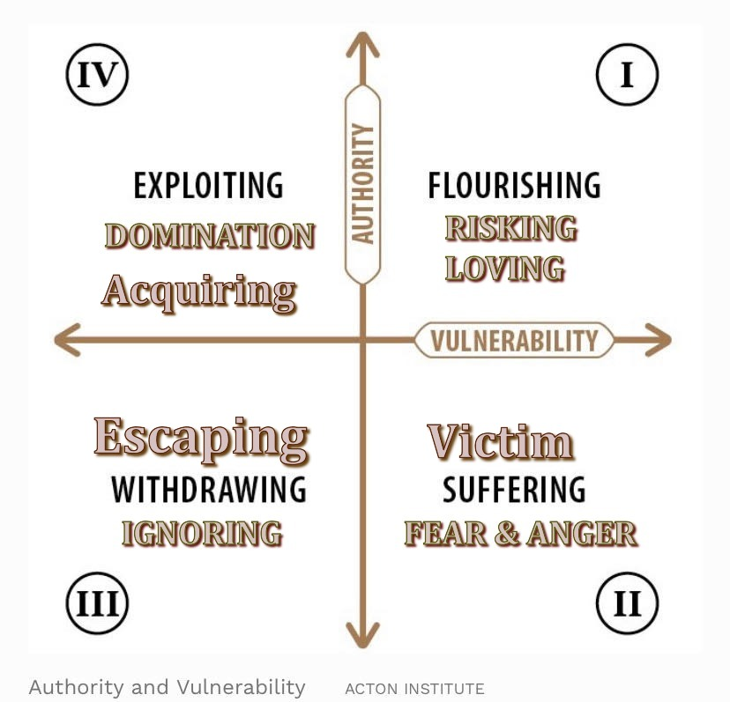
Think they can pretend to live in #I while really choosing to live in #IV

Slide 18
WHAT IS AT STAKE HERE? THAT IS SO DANGEROUS TO THE SHARING COMMUNITY? (1)
What would have happened to this electrifying, joyful, sharing community if this had been allowed to become the norm -- “the way things were done?”
--I think from church history we know!

Slide 19
WHAT IS AT STAKE HERE? THAT IS SO DANGEROUS TO THE SHARING COMMUNITY? (2)
2. What does church history tell us occurred as this “religious spirit” of pretense, domination, and acquisition became labelled as serving God and Jesus – as it often came to be the norm?
How many people do you know who refuse to even consider God or Jesus because of this history? “Why would I want any part of ‘that’!”

Slide 20
WHAT IS AT STAKE HERE? THAT DANGEROUS TO THE SHARING COMMUNITY? (3)
3. What does the current situation in the USA tell us occurs when this “religious spirit” of pretense, domination, and acquisition is widely labelled “Christian”-claiming to be serving God and Jesus?
How many people do you know, often people who grew up in church, and have a good heart, who refuse to even consider God and Jesus because of this?

Slide 21
PERHAPS THE RIGHT QUESTIONS TO BE RAISED BY THIS JARRING TEXT ARE:
Since this religious spirit is so destructive, Why isn’t God doing this kind of spiritual surgery far more often to protect the integrity of church communities?”
But, where today could God find communities of Jesus followers as open as the SHARING COMMUNITY OF ACTS 2-6, So FILLED With The Holy Spirit Of God That Incarnated Jesus’ Life – Communities this JOYFUL, this BOLD, this COMMITTED to SHARING LIFE IN THE SPIRIT TOGETHER, displaying HEALINGS and MIRACLES, SHARING the BASICS of LIFE SO FREELY?”

Slide 22
SO, WHAT IS LUKE DESCRIBING AS HAPPENING ON A PHYSICAL LEVEL?
“Dropped Dead” – Acts 5:5, 10
Context: This highly keyed up electrifying community of joy, sharing, signs and wonders.
I think--Luke describes “being scared to death” as they realize they are fully, really, in God’s presence!

Slide 23
CLEVELAND CLINIC 10/12/20 on Internet (1)
“It’s True (But Rare) That You Can Be Scared to Death.
Unexpected scares can have powerful effects on your body.
We often look forward to scary movies, and we’ll casually talk about being “scared to death” if we’re suddenly surprised or startled.
But want to know the really scary thing? Fear can actually have some extreme physiological effects. It’s rare, but it can happen.”

Slide 24
CLEVELAND CLINIC 10/12/20 on Internet (2)
“Intense emotion can actually trigger a heart attack in susceptible individuals (especially those suffering from other heart conditions). But even people without an underlying heart problem can literally be scared (almost) to death.”
(RS - followed by descriptions of cardiomyopathy, broken heart syndrome, excessive adrenalin rushes, and acute arrythmia.)

Slide 25
CLEVELAND CLINIC 10/12/20 on Internet (3)
“Fortunately, in most cases this condition is reversible and the heart function returns to normal over time. Unfortunately, in rare instances, it can cause sudden death, he (Dr. Gillinoy) says.”

Slide 26
ASIDE:
Dying Due to Being Foolish, Mistaken, Even Sinful is NOT the Same as God’s Forever Judgment.
I have known pretty godly people to do foolish, mistaken, even sinful things and die because of it.
We don’t know Ananias and Sapphira’s deep heart, whether this was a tragic slip up or a deep permanent choice. God does!

Slide 27
THE REST OF OUR TEXT – Acts 5:12-16 THE RESULTS OF THIS EVENT (1)
¹² The apostles performed many signs and wonders among the people. They would come together regularly at Solomon’s Porch. ¹³ No one from outside the church dared to join them, even though the people spoke highly of them. ¹⁴ Indeed, more and more believers in the Lord, large numbers of both men and women, were added to the church.

Slide 28
THE REST OF OUR TEXT – Acts 5:12-16 THE RESULTS OF THIS EVENT (2)
¹⁵ As a result, they would even bring the sick out into the main streets and lay them on cots and mats so that at least Peter’s shadow could fall on some of them as he passed by. ¹⁶ Even large numbers of persons from towns around Jerusalem would gather, bringing the sick and those harassed by unclean spirits. Everyone was healed.

Slide 29
RESULTS?
GOD IS FREE TO KEEP DOING AMAZING THINGS
“Men and Women were added” – easily over 10,000 Jewish people are now part of this worshipping and sharing community of Jesus followers.
Many others are interested and watching
Even out of town people come to check it out

Slide 30
CONCLUSIONS: (1)
I hope this is an encouragement to keep praying for
more of the SPIRIT THAT INCARNATES JESUS TO INCARNATE OUR COMMUNITY MORE FULLY – It is an exciting prayer.
2. This text reminds us that God wants authenticity, not religious pretense. We don’t need to pretend to be more than we are. We just need to take risks to keep growing!

Slide 31
CONCLUSIONS: (2)
A Community Filled with More of the HOLY SPIRIT that Incarnates Jesus is a JOYFUL and EXCITING Community to be a part of because God is Present and Wants to be Even More Present!
(Every little taste that I have ever had of it
tastes like more)

Slide 32
CONCLUSIONS: (3)
4. We don’t know exactly what a big “yes” will look like for us today if we keep asking for More of the Holy Spirit . . . . We live NOW, not THEN.
5. But, we are dealing with the same “God and Father of our Lord Jesus the Mesiah.” And, we do know it will be JOYFUL and ELECTRIFYING to be more and more deeply FILLED and EMPOWERED by God’s Spirit – and that we, as well as others, will be blessed!

Slide 33
MY PRAYER:
“Father, as Jesus told his followers to do long ago, we want to “keep on asking for more of the Holy Spirit,” and look forward to seeing what you do with us, in us, and through us! Amen!”

Slide 34
COMMUNION:
Jesus Invites You to Come as You Are to God’s Open Table, Without Any Pretense of Being More Than You Are.
Come Willing to be Open and Filled with More of God’s Holy Spirit that Incarnates Jesus.

