Slide 1
THEME FOR TODAY’S TEACHING
RELATIONSHIPS:
*With God
*With Other Humans
*With Our Own Self-Identity

Slide 2
THREE THEOLOGIANS WHO I WANT TO
CREDIT
FOR IMPACTING THIS TEACHING.

Slide 3
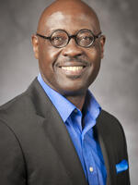
DR. Willie James Jennings

Slide 4
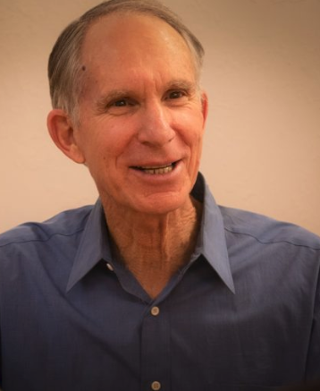
Rabbi Nahum Ward-Lev

Slide 5
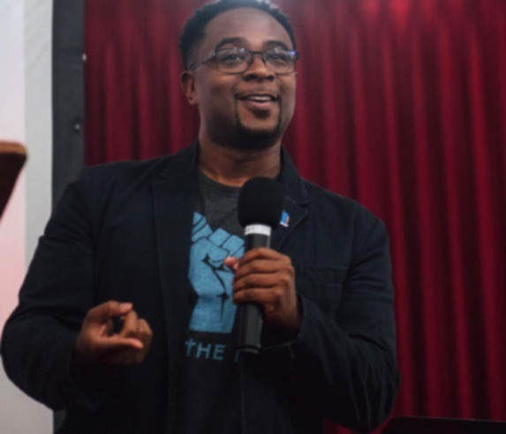
Dr. Jemar Tisby

Slide 6
Contrast Transactional vs. Interpersonal Relationships (1)
Transactional:
win/win, but often become win/lose
--ultimately about control and domination
--necessary at times, but not growth producing interpersonally between humans

Slide 7
Contrast Transactional vs. Interpersonal Relationships (2)
Interpersonal Relationships:
--belonging, oneness, transformative,
--deep commitment to want and do good for the other (agape/hesed/covenant)

Slide 8
Interpersonal Relationships:
Sounds Wonderful!
So, what makes them so difficult and scary for us?

Slide 9
Interpersonal Relationships:
They require:
*Giving up control
*Allowing the Other to Choose much of how it moves forward
*Risks
*Vulnerability
*Risking hurt – sometimes very deep hurt

Slide 10
Theme: Bible Is All About These Interpersonal Relationships
I want to Illustrate from Genesis
(Rabbi Ward-Lev)
then Acts
(Jennings and Tisby)

Slide 11
GENESIS 1-11: contrary to Calvinism’s “whatever is, is God’s will”
God chooses to let humans choose how to relate to God and to one another. Genesis 1-11 narrates how costly God’s choice can be for God and for us humans.
God chooses vulnerability and risk and allows hurt rather than choosing domination and control in order to make real interpersonal relationships with us possible!

Slide 12
GENESIS 4
Cain states a theme relevant for
the rest of the Bible:
“Am I My Brother’s Keeper?”

Slide 13
GENESIS: Interpersonal Relationships: Examples (1)
*God’s relationship with Abraham and with a future people
*Abraham and Sarah – many ups and downs between them. Am I my “brother’s/sister’s keeper?” Both choose – sometimes!
*Abraham and Lot – Lot chooses not to be his uncle’s keeper in favor of personal “control.” Clearly hurts Abraham deeply.

Slide 14
GENESIS: Interpersonal Relationships Examples (2)
Sarah and Hagar – these “sisters” who legally share a “son” never mend their relationship
Isaac and Ishmael – will they manage to be civil despite their parents’ failures in their relationships? Barely -- by keeping a distance! Transactional, not Personal.

Slide 15
GENESIS: Interpersonal Relationships Examples (3)
Jacob and Esau – can this sibling rivalry—not my brother’s keeper-- be healed? – Barely by keeping safe distance from one another! Transactional, not personal. (Jacob and Laban – pretty much the same.)
Leah and Rachel – competition for attention, honor, and love never ceases, and it bleeds into the relationships between their children

Slide 16
GENESIS: Interpersonal Relationships Examples (4)
*Joseph and his brothers:
terrible and tragic relationships with one another
Definitely not “my brother’s keeper”

Slide 17
GENESIS: Interpersonal Relationships Examples (5)
*BUT finally GENESIS ENDS WITH TWO BREAKTHROUGHS:
-Judah, unlike his earlier choice leading to Joseph’s enslavement as an immigrant in Egypt, now risks his life for Benjamin, chooses to be “my brother’s keeper”
-then Joseph becomes willing to “be his brothers’ keeper” and saves them and their families from certain impoverishment and possible starvation

Slide 18
WHY THIS TIME IN GENESIS WHEN I AM SUPPOSED TO BE TEACHING FROM ACTS?
To Illustrate: This theme of successes and failures in our interpersonal relationships with God and with our fellow humans is a key theme of the entire Bible.
*God’s vulnerable, risky choices
*And Our vulnerable, risky choices as humans

Slide 19
ACTS (1)
Acts 1- Acts starts with God and Jesus making the vulnerable and risky choice of putting the future of what God has just done through Jesus in the hands of the disciples who had just abandoned Jesus when he needed them most!
Acts 2 – can the new relationship with God through Jesus BE SHARED between those who followed Jesus and those “God-fearing” people who have tacitly approved of Jesus’ execution by their leaders? (Acts 2:36-40 – YES! – same forgiveness/Spirit!) (My hope depends on this “yes!”)

Slide 20
ACTS (2)
Acts 2:42-48 – But, will this be really interpersonal or just surface? YES, REAL! SHARING of TIME, TABLE, and TREASURE by all as “brothers and sisters” in the new Jesus-family of God.
Acts 4 – what about when the system turns on you and it becomes dangerous? Yes! They Continue the SHARING of TIME, TABLE, and TREASURE

Slide 21
ACTS (3)
Acts 6 will the widows of Hellenized Jewish people – the “other kind of Jewish women” in dress, accent, etc.” -- be treated as equal “sisters”? (Yes, after a bit)
Acts 8 – God’s Spirit is withheld until Samaritans accept Jewish Apostles and Jewish Apostles accept Samaritans as brothers and sisters. Then – Holy Spirit is poured out.

Slide 22
ACTS (4)
Acts 8 – THEN, a black man who is sexually ambiguous
--a person who was seen as somewhat alien in most cultures of the day (and in most of American society and churches for centuries)– will he be invited to “be a brother?” (YES! God sends Phillip running after him!)

Slide 23
ACTS (5)
Acts 9 –Jesus to Saul “Saul, Saul, why are you persecuting ME?” - persecuting my brothers and sisters is persecuting me! (Compare Jesus parable in Matthew 25:33-48 –“when you did it for the least of these, my brothers and sisters, you did it for ME!”
= being our brother’s and sister’s keeper is very important to Jesus!

Slide 24
ACTS (6)
Acts 9 – Jesus makes it clear to Ananias that his own relationship with Jesus needs to include accepting (this dangerous persecutor—at least he was 72 hours ago) Saul/Paul as a brother!

Slide 25
Finally, today’s text? – ACTS 10:1-8 – Let’s begin with what makes Cornelius very difficult for Peter
“Caesarea” – he lives in the most Roman/pagan city in Israel, filled with Roman palaces, gymnasiums, and idols.
“Cornelius” – a Latin name, emphasizing his deep Roman family roots. Ethnically and culturally and religiously, he is “other” not “one of us.”
“a Centurion of the Italian regiment” – an officer in the occupying army that enforced Roman taxes and oppressive authority throughout Israel

Slide 26
ACTS 10:1-8 – The relationship Cornelius and God share – without/before Jesus (1)
Cornelius and his family are “DEVOUT and GOD-FEARING” ie., God HONORING/WORSHIPING
“He gave generously to those in need”
“He prayed regularly to God”

Slide 27
ACTS 10:1-8 – The relationship Cornelius and God share – without/before Jesus (2)
He experiences “a vision of an angel” – he saw and heard an angel/messenger/aide of God
He is Called by name by God’s angel -- “Cornelius.” God making it clear that they already have a very personal relationship.
God’s response to Cornelius’ relationship with God is– “Your prayers and gifts to the poor have come up as a memorial offering before God.”

Slide 28
ACTS 10:1-8 – The relationship Cornelius and God share – without/before Jesus (3)
Cornelius’ response to God is IMMEDIATE ACTION– “he sent” for a Jew and invites him to his home – he immediately responds and does what he is told to do even though he cannot imagine where this is all leading.
-I would love it if someone could describe my life that way! Especially an angel sent from God!!!

Slide 29
But – deep as the relationship is:
Though Cornelius doesn’t know it yet
God knows their relationship will deepen if Cornelius experiences what God has done for him through Jesus

Slide 30
Acts 10 – Peter’s Relationship with God and Jesus is about to lead to changes he could not imagine!
Peter’s prayer time vision of the non-kosher animals
“Take and eat”
Peter’s interpersonal relationship with God “voice from heaven” includes arguing with God (like the prophets) about Scriptures, etc.
Ultimately -- He goes to Cornelius’ home

Slide 31
What’s Next?
This has to feel very VULERNABLE and RISKY to BOTH PETER and CORNELIUS!
Will this just be a Transactional Relationship or will it lead to a genuinely Interpersonal Relationship of “Brothers?”
The will Both have BIG CHOICES to make!

Slide 32
God’s Risky Vulnerability
GOD is willing to RISK this opportunity into the hands of two humans – who will have to make hard, risky choices
GOD could have just had the Angel tell Cornelius about Jesus! But the Vulnerability of Risking Us is God’s Way.

Slide 33
NOW - We Watch the “Dance.” (1)
They both come from
cultural, class, and religious backgrounds
that tend to look down on and to misunderstand one another.

Slide 34
We Watch the “Dance” (2)
Acts 10:25 - Cornelius falls down on his knees to honor/worship Peter as God’s messenger –already a Gentile/Jewish clash of cultures.
--And Peter then tells him – “get up!” I doubt that Cornelius is used to being confronted with a mistake in front of his family either!

Slide 35
We Watch the “Dance” (3)
Acts 10:26-29 – Then Peter, with his usual bluntness, explains that yesterday he thought of Cornelius and his family as “unclean” and “impure,” but because God told him not to think that way he came to talk to them. (He doesn’t choose to explain how long he argued with God before making this choice.)
Acts 10:30-33 – Amazingly, Cornelius is very polite in his response, and explains that God’s angel told him to send for Peter and to listen to him. And, he is ready to do just that!

Slide 36
We Watch the “Dance” (4)
Acts 10:34-35– Peter says that he now knows (for 24 hours) that God isn’t partial and “cares about people from all ethnicities/nations” Gr. ethnos/ Heb goyim in Peter’s mind

Slide 37
Acts 10:36-ff. Peter then shares the “Good News” about what God has done through Jesus (1)
that Jesus is God’s Anointed One/Messiah,
that Jesus’ ministry was spent bringing physical and spiritual healing to people,
that he was executed on a tree,
that God raised him from death,

Slide 38
Acts 10:36-ff. Peter then shares the “Good News” about what God has done through Jesus (2)
that Peter and his friends back in Jerusalem walked and talked and ate with the risen Jesus,
and that God has appointed that Jesus to be our judge as fellow humans,
and that Jesus is God’s way of bringing us a new level of forgiveness we all need!!

Slide 39
WHAT IS SUPPOSED TO HAPPEN NEXT?
PETER SEEMS UNSURE . . .
SO, GOD INTERVENES MOMENTARILY . . .
and POURS OUT THE HOLY SPIRIT ON THESE GENTILES THE WAY GOD DID FOR THE JEWS ON PENTECOST (Acts 10:44). Peter then baptizes them in Jesus’ Name.

Slide 40
BUT, Will this “brother and sister” relationship become really real in practice?
Acts 10:48 - . “And they asked Peter to stay with them a few days!”
A vulnerable, risky request, and Peter’s says a vulnerable and risky “Certainly!” And, does what he couldn’t imagine doing a day earlier.
He eats non-kosher food, in a non-kosher Gentile home, with “Gentile brothers and sisters” in God’s new Jesus-family!

Slide 41
Acts 11 – an initially uneasy follow-up with a “family relationship” back home. (1)
Peter comes down off the “high” and now must defend himself back home to his fellow Jewish leaders in Jerusalem.
Acts 11:17 “So if God gave them the same gift as he gave us, who believed in the Lord Jesus the Messiah, who was I to think that I could oppose God?”

Slide 42
Acts 11 – an initially uneasy follow-up with a “family relationship” back home (2)
But, it ends with a new step of risk and vulnerability in relationships made by the Jewish leaders of the Jesus Movement in Jerusalem (Acts 11:18):
“When they heard this, they had no further objections and praised God, saying, “So then, God has granted even the Gentiles (Gr. ethnos for Hebrew goyim) repentance unto life.”
Ie., Clearly these Gentiles are (to our surprise) our “brothers and sisters” in God’s new Jesus-family.

Slide 43
IN CLOSING:
As we are Praying for -- More of the Holy Spirit – Let’s remember -- IT IS ALL ABOUT RELATIONSHIPS
Openness to deeper relationship – with God, with Jesus, and with others,
allows God to pour out more of God’s Spirit in our lives!!!

Slide 44
Question: Are we praying for Transactional or Interpersonal Relationships?
If our prayers are really that we “win” and that we gain “control” in this society, we are not really praying for more of the Holy Spirit.
God is calling us to the risky vulnerability in our relationship with God and Jesus -- that chooses “faithfulness at all costs” as our goal—win or lose, not “winning at all costs.”
God is calling us to the risky vulnerability of “doing good for our fellow humans” not “trying to control their choices.”

Slide 45
Reflect with me before God: Where is God calling you as an individual to be vulnerable and to risk deeper relationships with your fellow humans? (1)
maybe those very close to you – risk more vulnerability and depth?
maybe those in our fellowship?
maybe those in our wider circle of acquaintances or work relationships?
maybe those who individually just don’t click for you?
maybe people identified with groups that you have shied away from?

Slide 46
Reflect with me before God: Where is God calling us as NCF to be vulnerable and risk deeper relationships with our fellow humans?
Maybe with one another?
Maybe with people identified with groups and ethnicities we do not find comfortable and easy (just like Peter and Cornelius with one another)?

Slide 47
PRAYER:
“God and Father of Our Lord Jesus the Messiah,” like Peter and Cornelius long ago, help us give You permission to deepen our relationships – to make them more interpersonally real – with you, with those we know and love, and with those we tend to see as “other” –but who you see as open and genuine. In Jesus’ name we pray. Amen!

Slide 48
COMMUNION: JESUS INVITES YOU TO JOIN HIM AT GOD’S TABLE
To deepen your experience of Jesus being your keeper – as his brother/sister
To deepen your experience of being in God’s family of those learning to be vulnerable and risky in the growing relationships of “brothers and sisters” in the family of God

