Slide 1

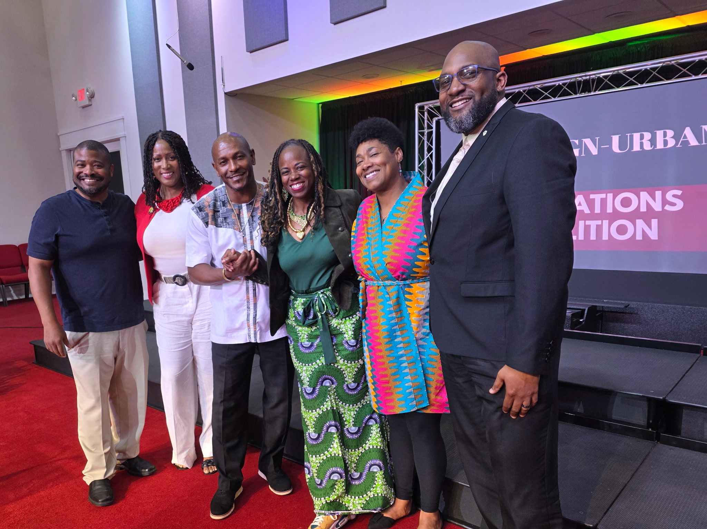
Notes:
June 4th Town Hall

Slide 2
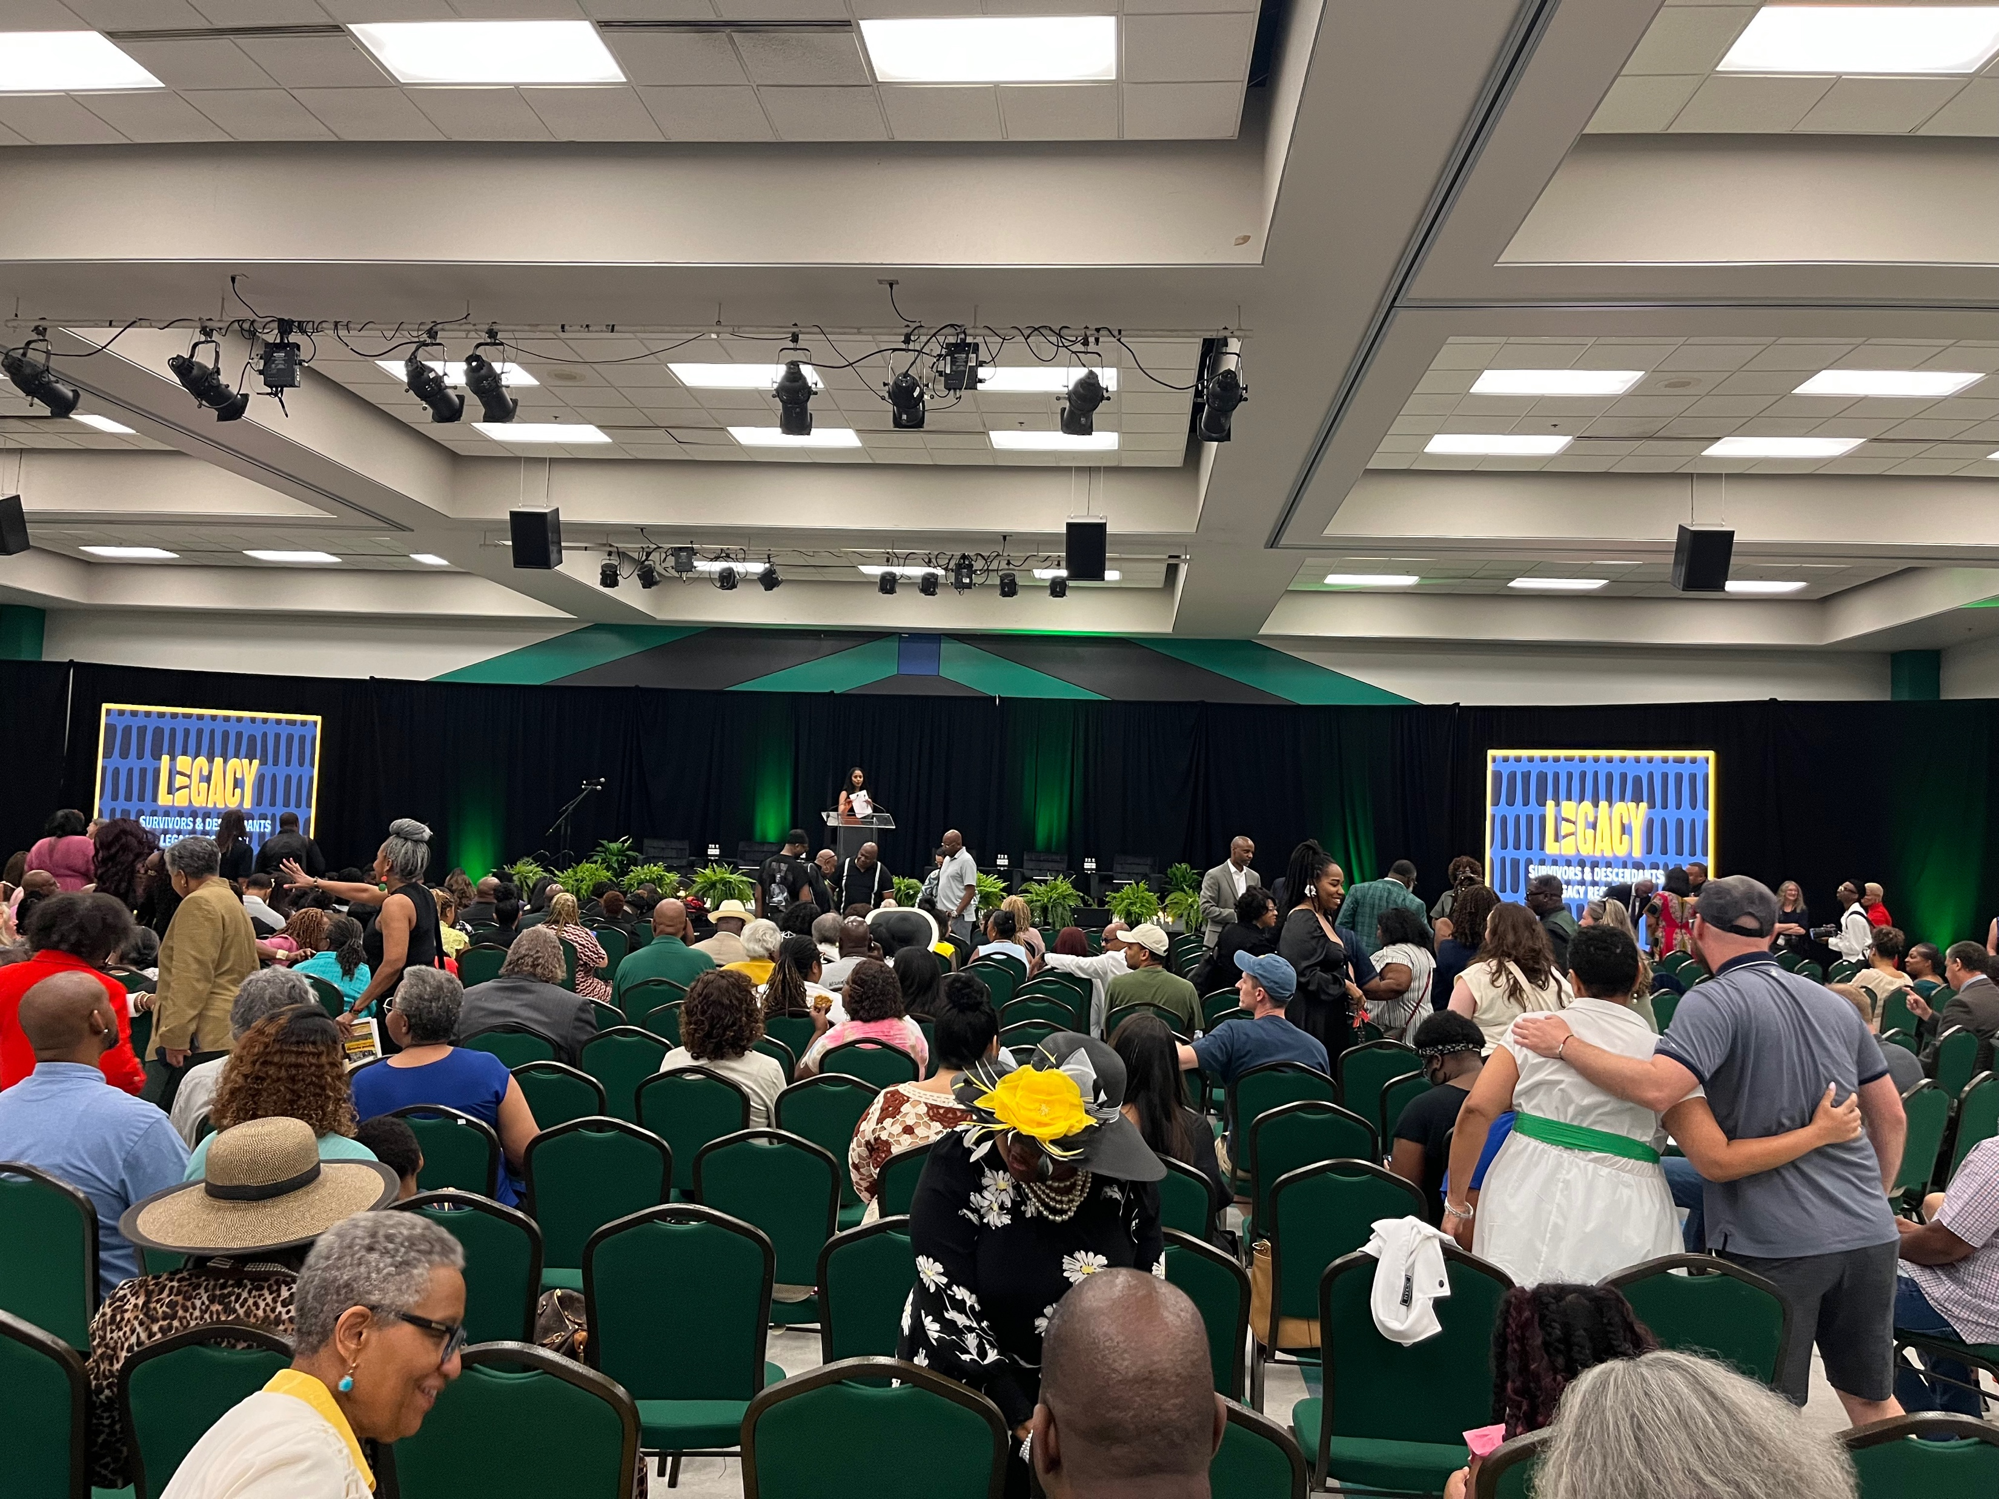
Notes:
Tulsa Oklahoma where they announced the release of documents about the massacre and a private fund to raise over 100 million in reparations for the victims and their descendants

Slide 3
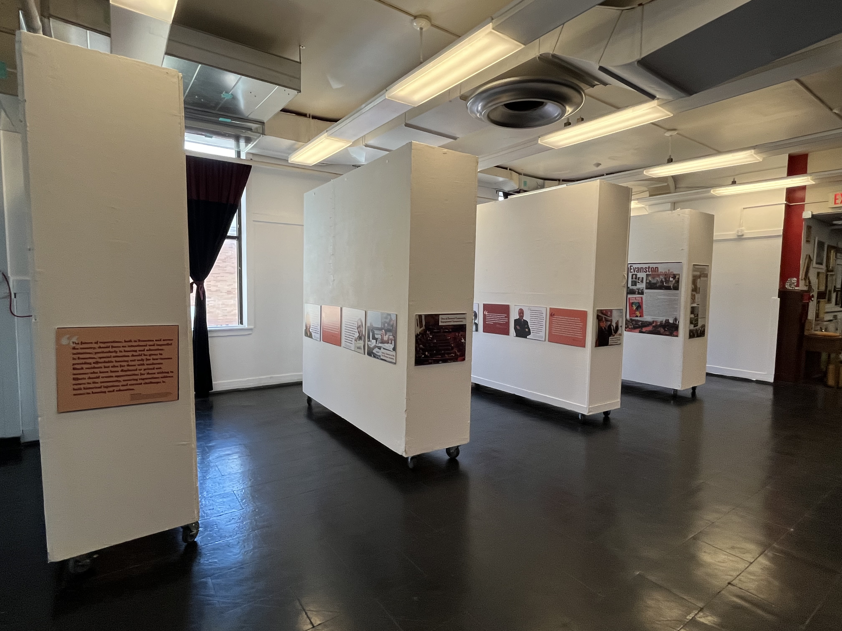
Notes:
July 5th Panel and First Repair Display at the IMC

Slide 4

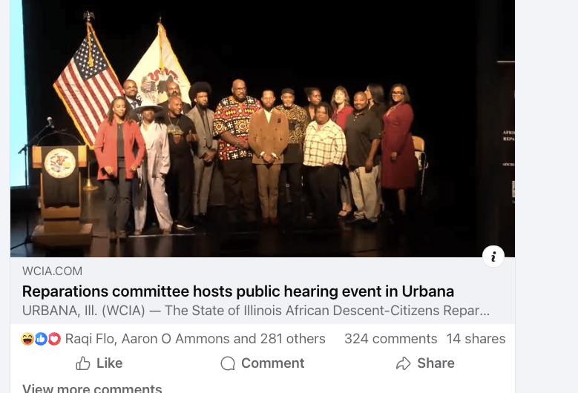

Notes:
Oct 4 Public Hearing

Slide 5
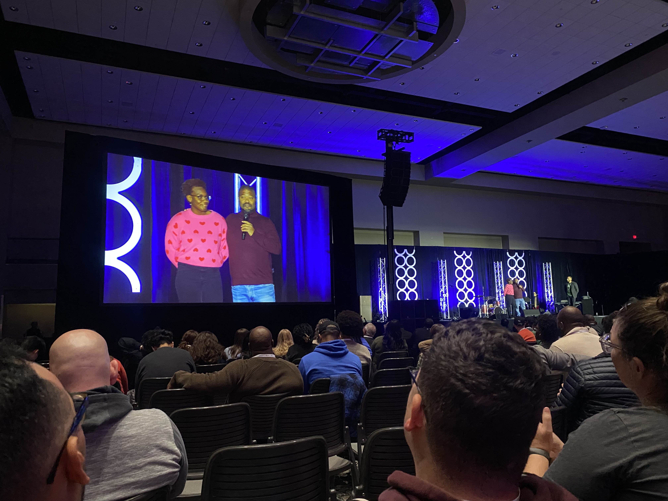
Notes:
CCDA Conference earlier this month (November)
Did a workshop on Reparations (well received)

Slide 6
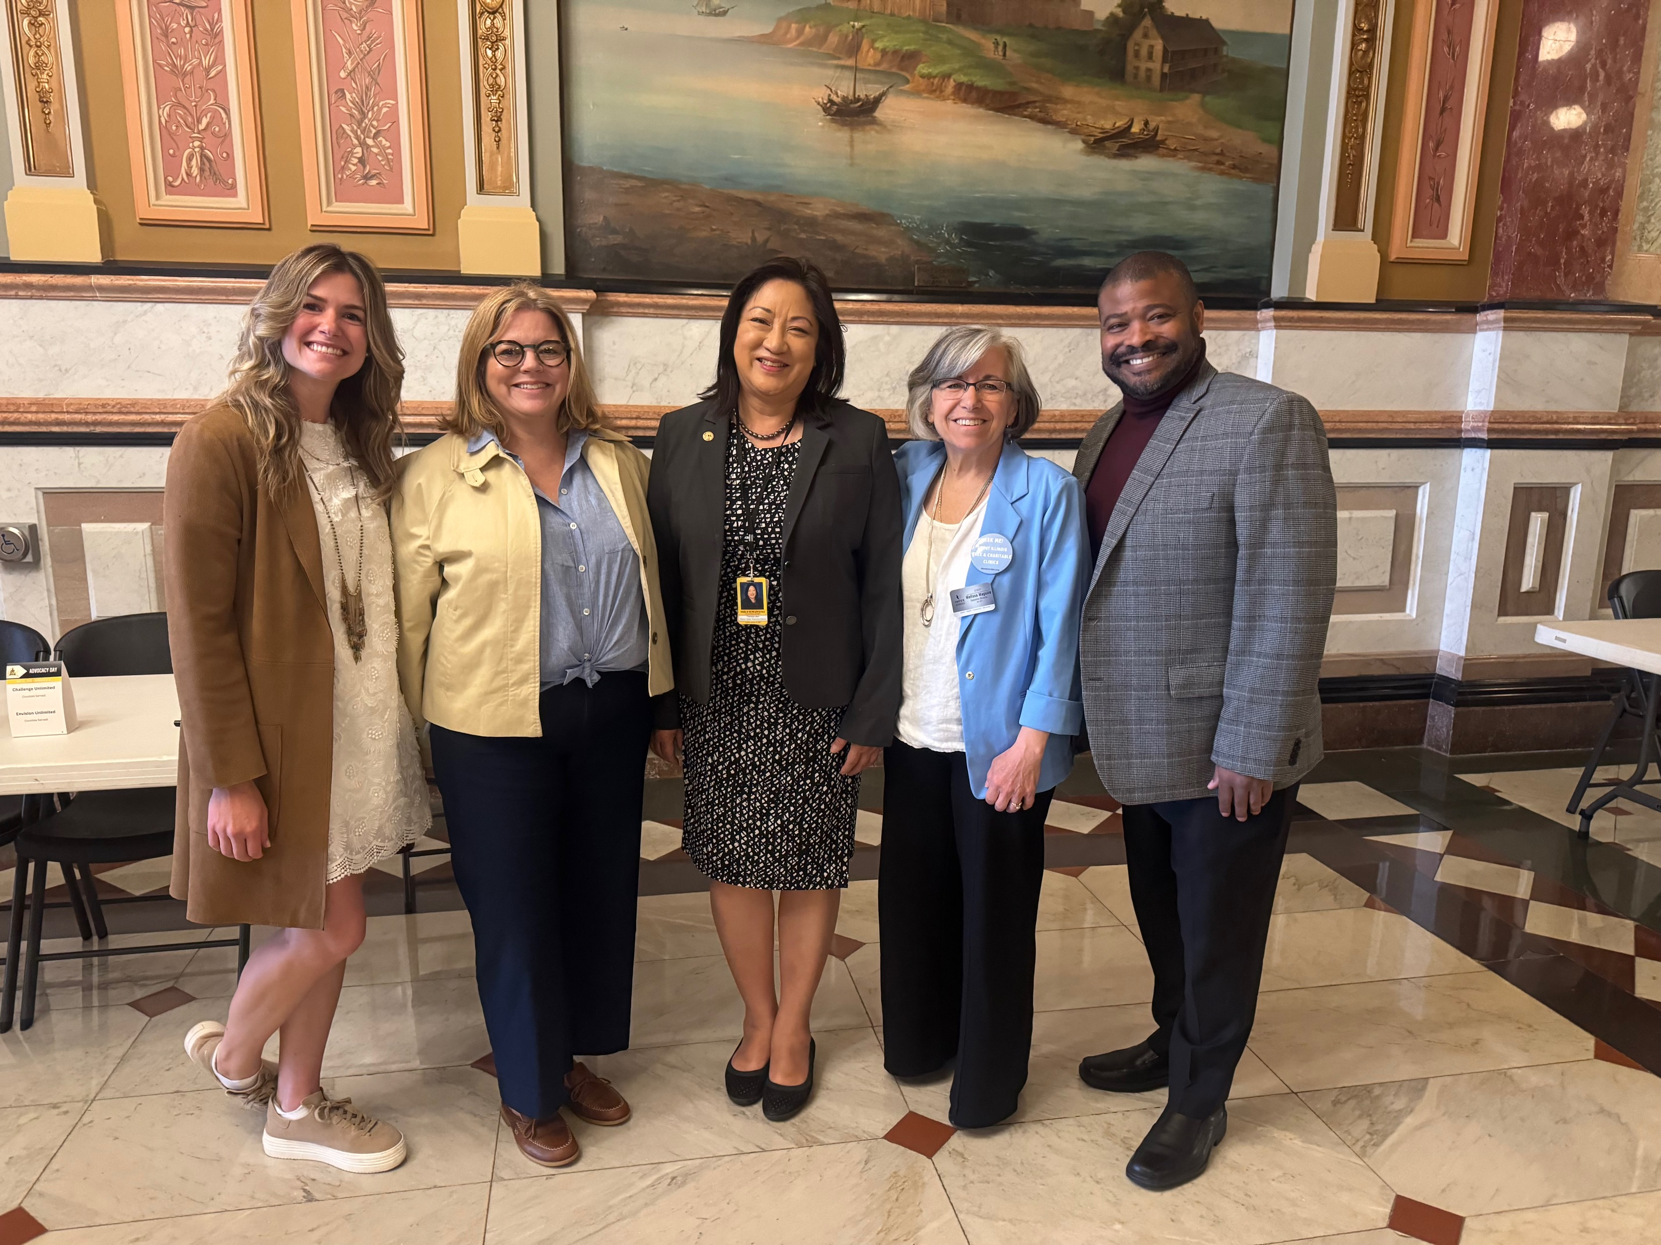
Notes:
Springfield legislative hearing that secured another 9 million dollars for free and charitable clinics across the state

Slide 7
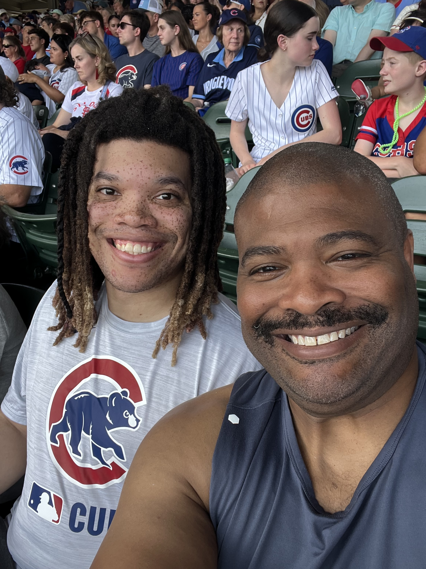
Notes:
Cubs game – record number of home runs against the Cardinals
Lots of reading, Lots of basketball, Lots of time with the family and grandkids

Slide 8


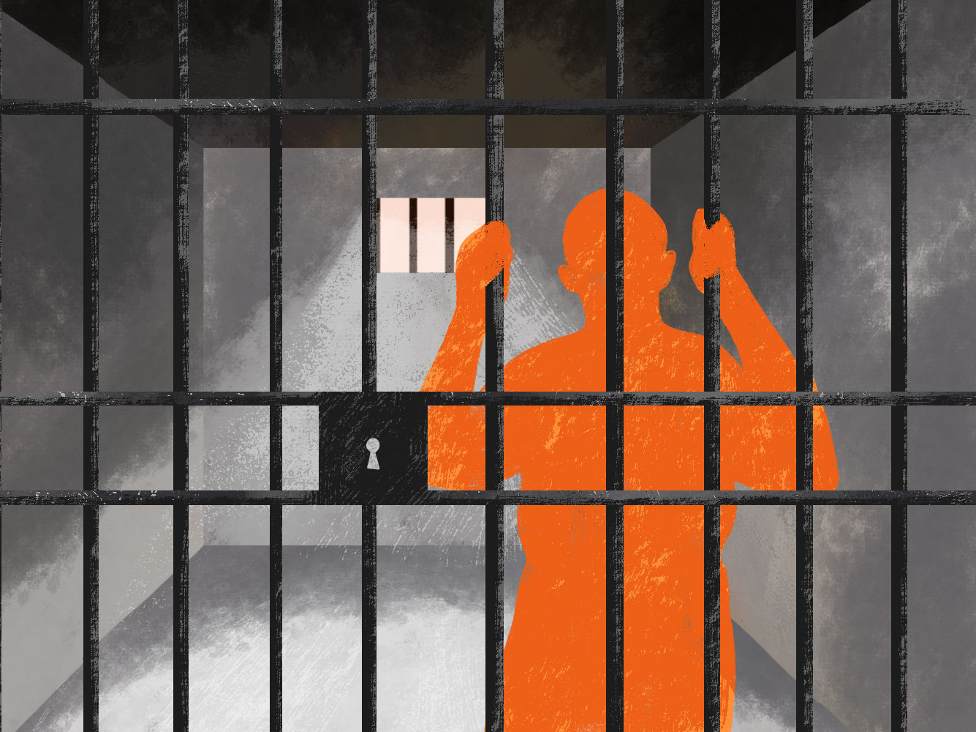
Freedom Beyond Understanding
God is Present in Our Prisons
Notes:
Acts 12: Peter escapes from Prison

Slide 9

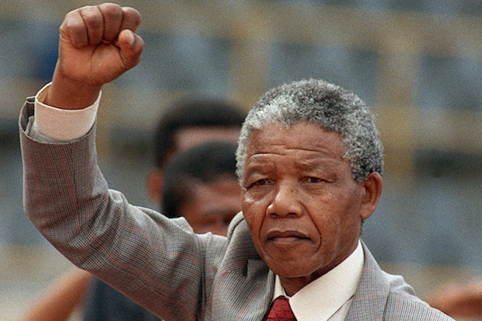
The Ordinary Horrific
  Peter
  Slave Trade
  Nelson Mandela
  Immigrants
  Clarksdale, MS
  Our Prisons
Notes:
We are going to look at various examples of God’s presence in various types of prisons and some tools to survive and thrive through it

Slide 10
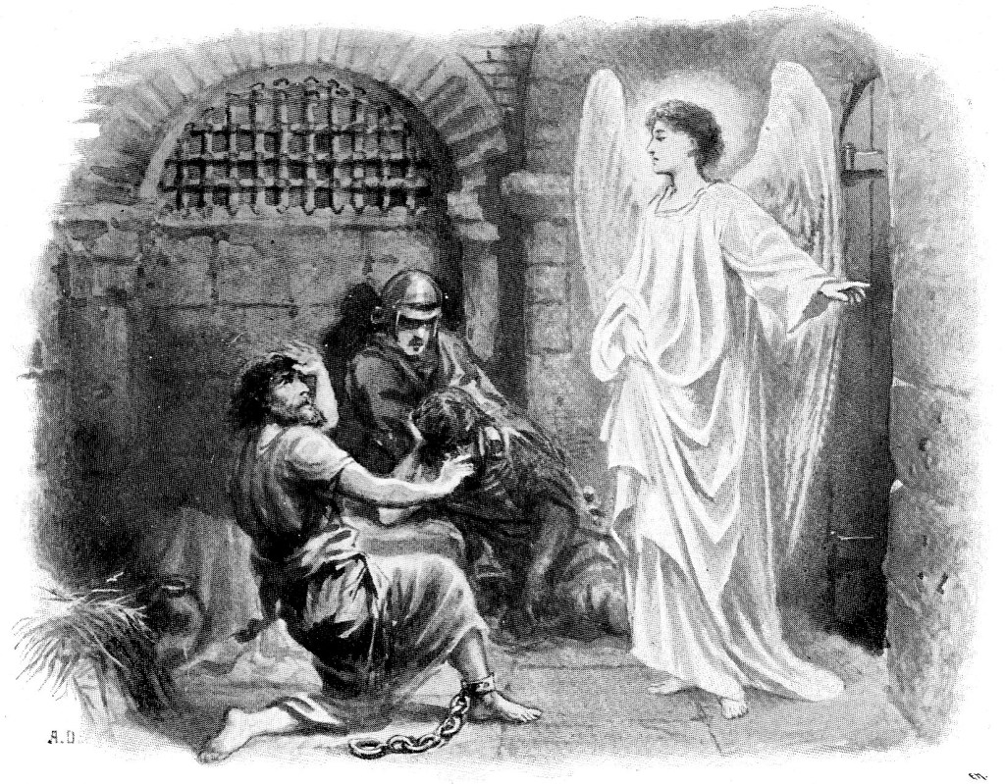
Notes:
The Ordinary – The Horrific –
At this point in time King Herod Agrippa was trying to gain favor among the elite and killing those that followed Christ seem to do the trick. He had already murdered James by the sword which was the equivalent of a STATE ORDERED EXECUTION via a BEHEADING. Not a quiet assassination attempt in the dark of night. James was a leading figure in the movement and somewhat of a hothead to boot (nicknamed one of the SONs of THUNDER by Jesus). James was so fiery, it was said he led to one of his captors believing in Jesus on the spot who ended up being executed alongside James.
Historical accounts say the murder jarred those that believed in Jesus.
Jeff, if it was ordinary, why would it be jarring? The same way police brutality is ordinary, or school shootings are ordinary and yet, still jarring when it happens
Agrippa was planning on making a similar public display of Peter’s murder right after honoring God in the Passover.
Keep in mind that at this time, those that believed Jesus was the Messiah was considered a denomination of Judaism. There was not a clear break between what we call Christianity today and Judaism until decades after.
It’s one thing for your adversary to try and take you out because they don’t share your same beliefs and values. It’s another thing for someone to try and kill you because they want more friends. You can’t even publicly murder me for a significant cause?

Slide 11
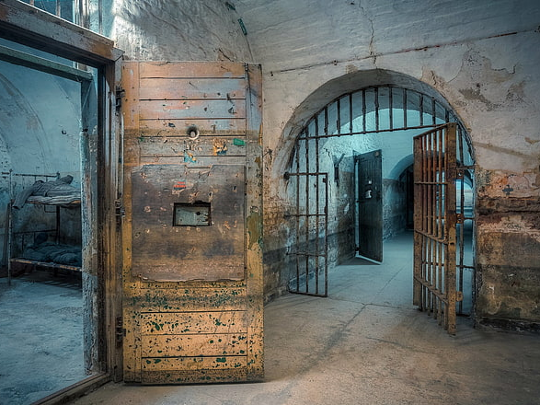
Notes:
Despite the Ordinary Horrific, God was present.
Some things to note:
The people were praying for Peter. Perhaps more fervently after witnessing what happened to James. Prayers kinda get amped up when you had a preview of what’s to come.
God REALLY showed out on this one. The angel could have just swooped Peter in and out like magic. If the angel was able to break the chains, open the doors, pass by 16 guards (two of which were right next to Peter), and walk a couple blocks down the street before anyone knew what was happening, I am sure the angel could have just teleported Peter to the others.
1) I believe God wanted Peter to witness the miracle in detail
2) I believe God wants us to do our part or to do A part (Peter had to get dressed and FOLLOW the angel’s instructions)
3) Don’t be so surprised when God answers prayers (they were so shocked they left Peter knocking on the door). The answers to our prayers could be knocking at the door but we are too busy not believing and fail to open the door.

Slide 12
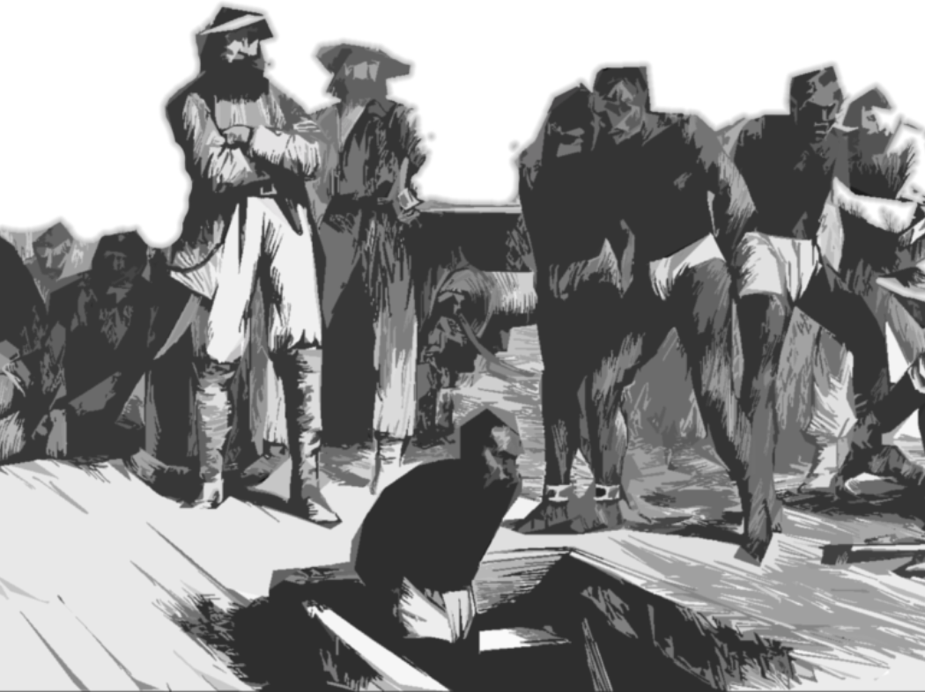
Notes:
The Ordinary Horrific
There could be a series of classes or a whole college major JUST on the normality of the slave trade and how integrated it was in the world. If you want to get a taste of that history, I suggest reading the book, “Ebony and Ivy” by Craig Steven Wilder
The conditions experienced by kidnapped Africans from the initial capture, to the slave centers on the African Coasts, to the slave trade ships (example of being held captive on the ship for 14 months before even heading off. The conditions of the ships unimaginable) and voyages, to the initiation upon arriving, to the torture and enslavement for them and generations and generations to come (246 years just in the US alone - from 1619 to 1865)
If anything can be described as the ordinary horrific, it is the slave trade.

Slide 13
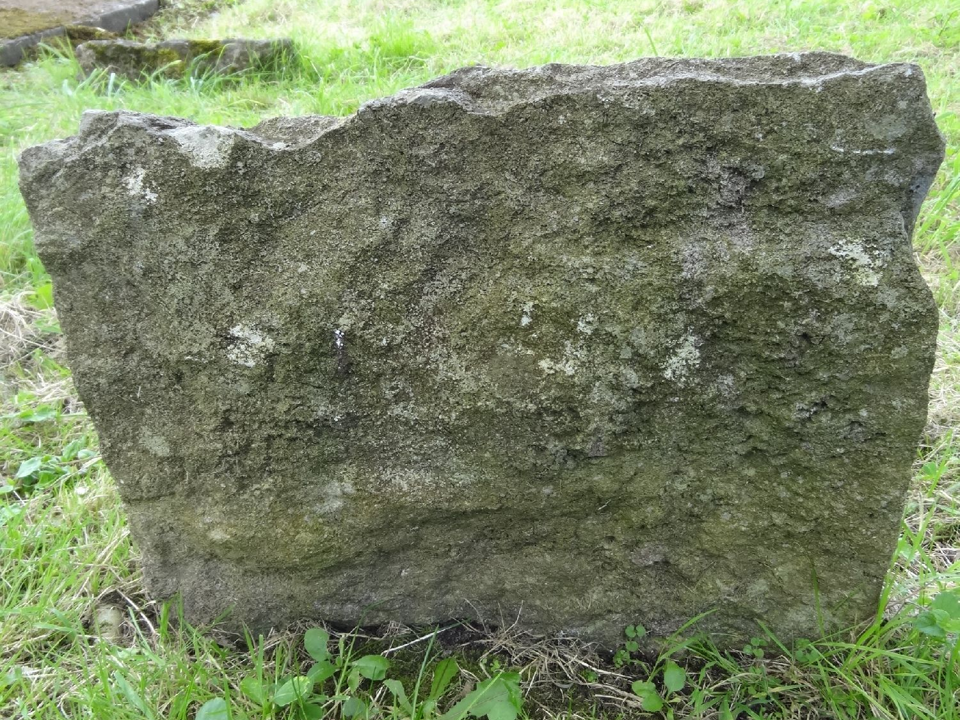
Notes:
The Ordinary Horrific
So Jeff, how is God anywhere associated with such a prison?
Remember that our God is beyond our concept of time. What may seem like complete abandonment and persecution at a time, can translate into freedom for others down the line. Just like James, the brother of John, who was not spared but his death meant something, we can remember those that were not spared and find purpose in their sacrifice.
With that said, I would like to take a moment to honor those that died during a voyage among a group of 257 enslaved people in 1733 on a ship called the Catherine.
The book I read this in reported these deaths in what to me was a very powerful way. While there was not any identifiable factors for each person outside their sex and general age group, it still listed almost every person individually.
READ page 55
I would like to take a moment of silence for those that died during that voyage.
May their lives and memories live on in the work for justice

Slide 14
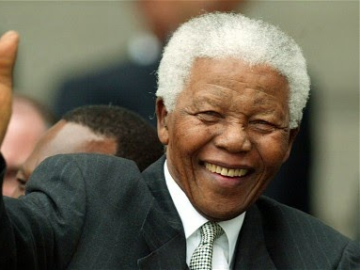
Notes:
The Ordinary Horrific
Nelson Mandela spent 27 years in prison (after an earlier 5-year stint) for fighting apartheid and for human rights, democracy and racial equality.
Let’s chew on this a bit more. A man spent a total of 32 years of his life in PRISON for standing up for human rights, democracy, and racial equality. He was famously quoted at his sentencing saying, “It is an ideal for which I am prepared to die”
I do not have time to get into the specifics of oppression in South Africa, but I assure you it fits the ordinary horrific category.
I will get more into how God was/is present through Mandela’s darkest of times later.

Slide 15
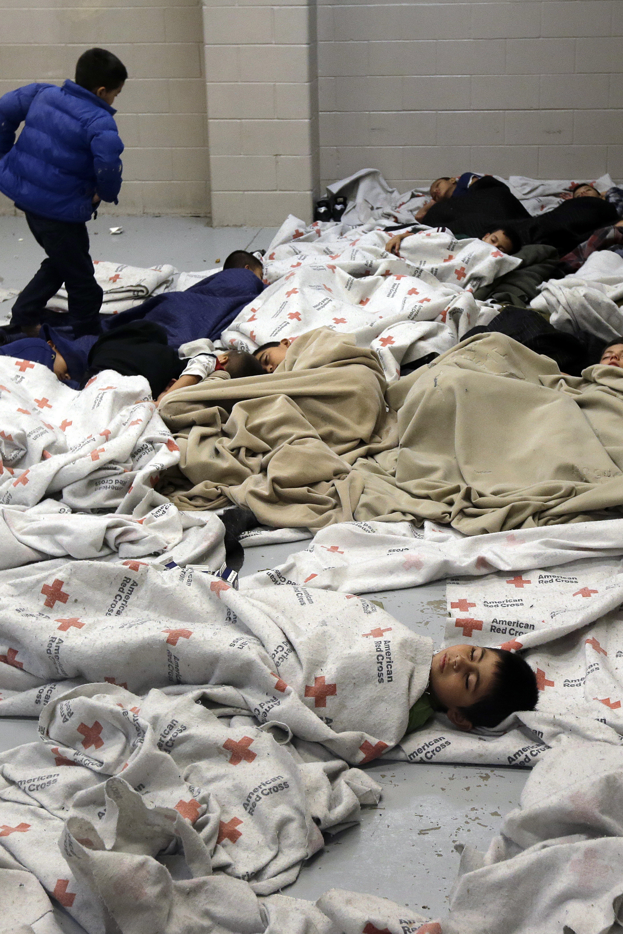
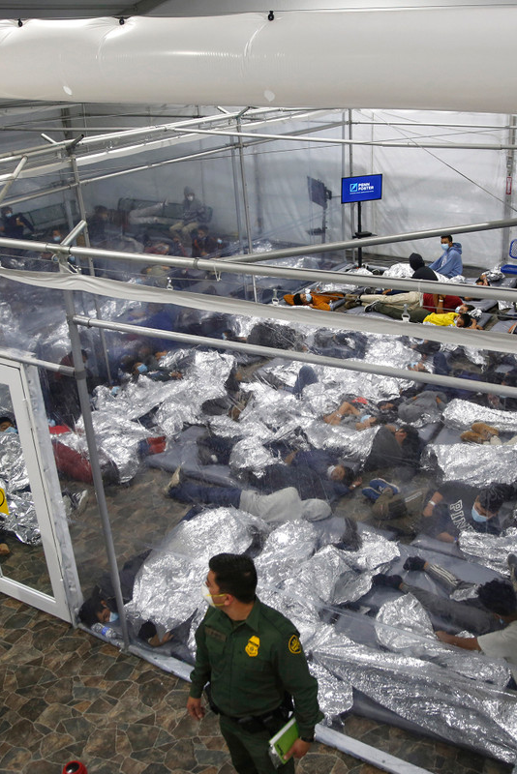
Notes:
The Ordinary Horrific
I am ongoingly appalled by how this country treats the foreigner. The bible highlights how we are supposed to treat the stranger.
What also continuously shocks me is how self-righteous people are about who can and cannot be in this country when you consider how it was taken in the first place.
And again, we seem to have made the horrific ordinary.

Slide 16
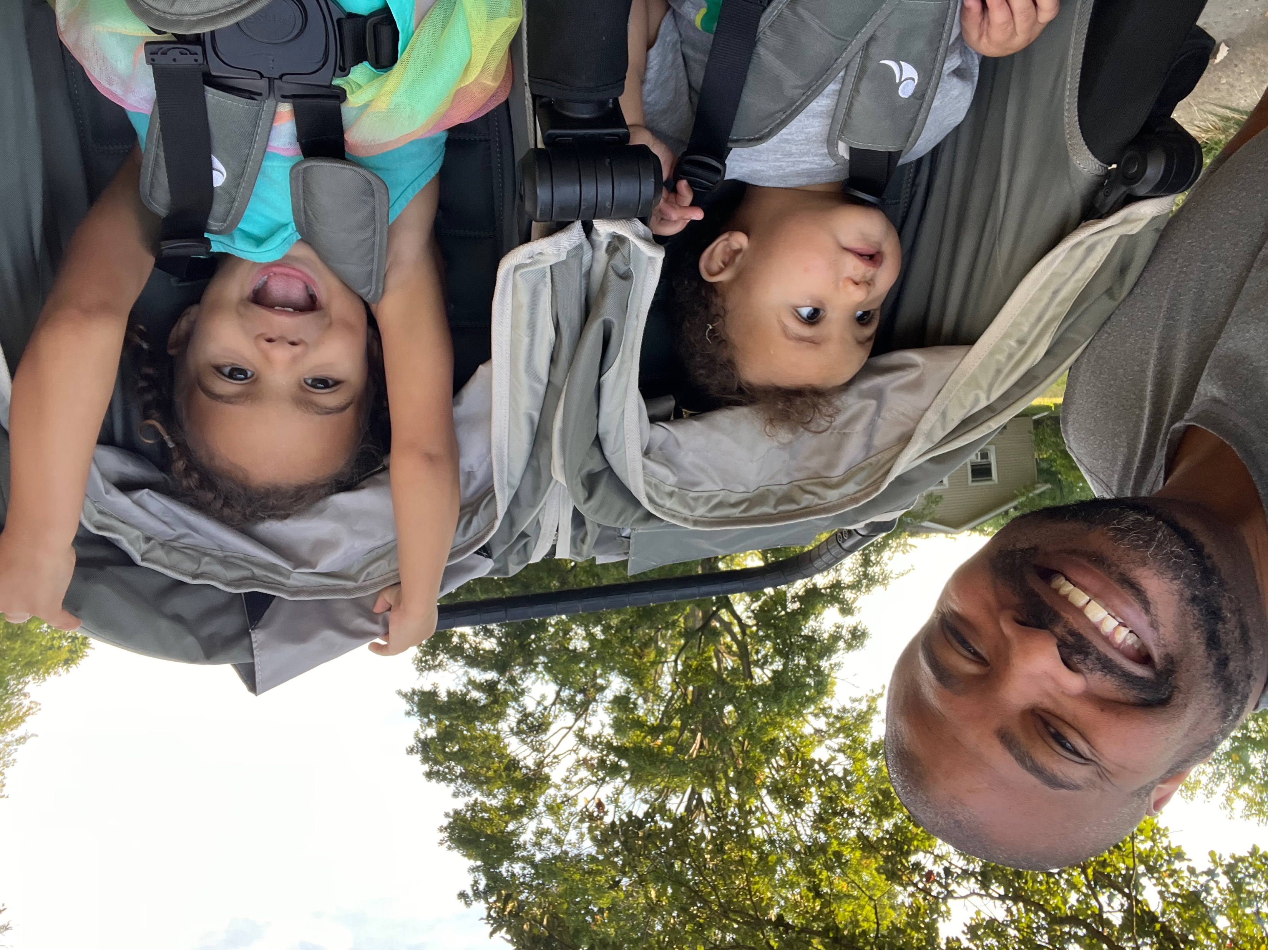
Notes:
The Ordinary Horrific
In Clarksdale Mississippi, the childcare center my grandkids go to may close. Governmental cuts have decreased the number of families that can leave their kids at the daycare while they go to work.
Two other local daycares have already closed.
There is a case where one woman had been bringing her child to work and leaving the child in the car so she would not lose her job and had no other place to leave her child.
The cuts also affect Aja and Matt and other Spring Initiative parents as the charges have significantly increased to make up for the daycare’s losses. My grandkids and other children love going to daycare and would be a tragic loss for many families.
They are looking for donations just to stay open
This is just, unfortunately, one tiny example of the pain people are and will go through with all the cuts to programs like SNAP, Medicaid, the ACA, and federal workers (note: African Americans heavily rely on government jobs and are disproportionately affected by federal layoffs).

Slide 17
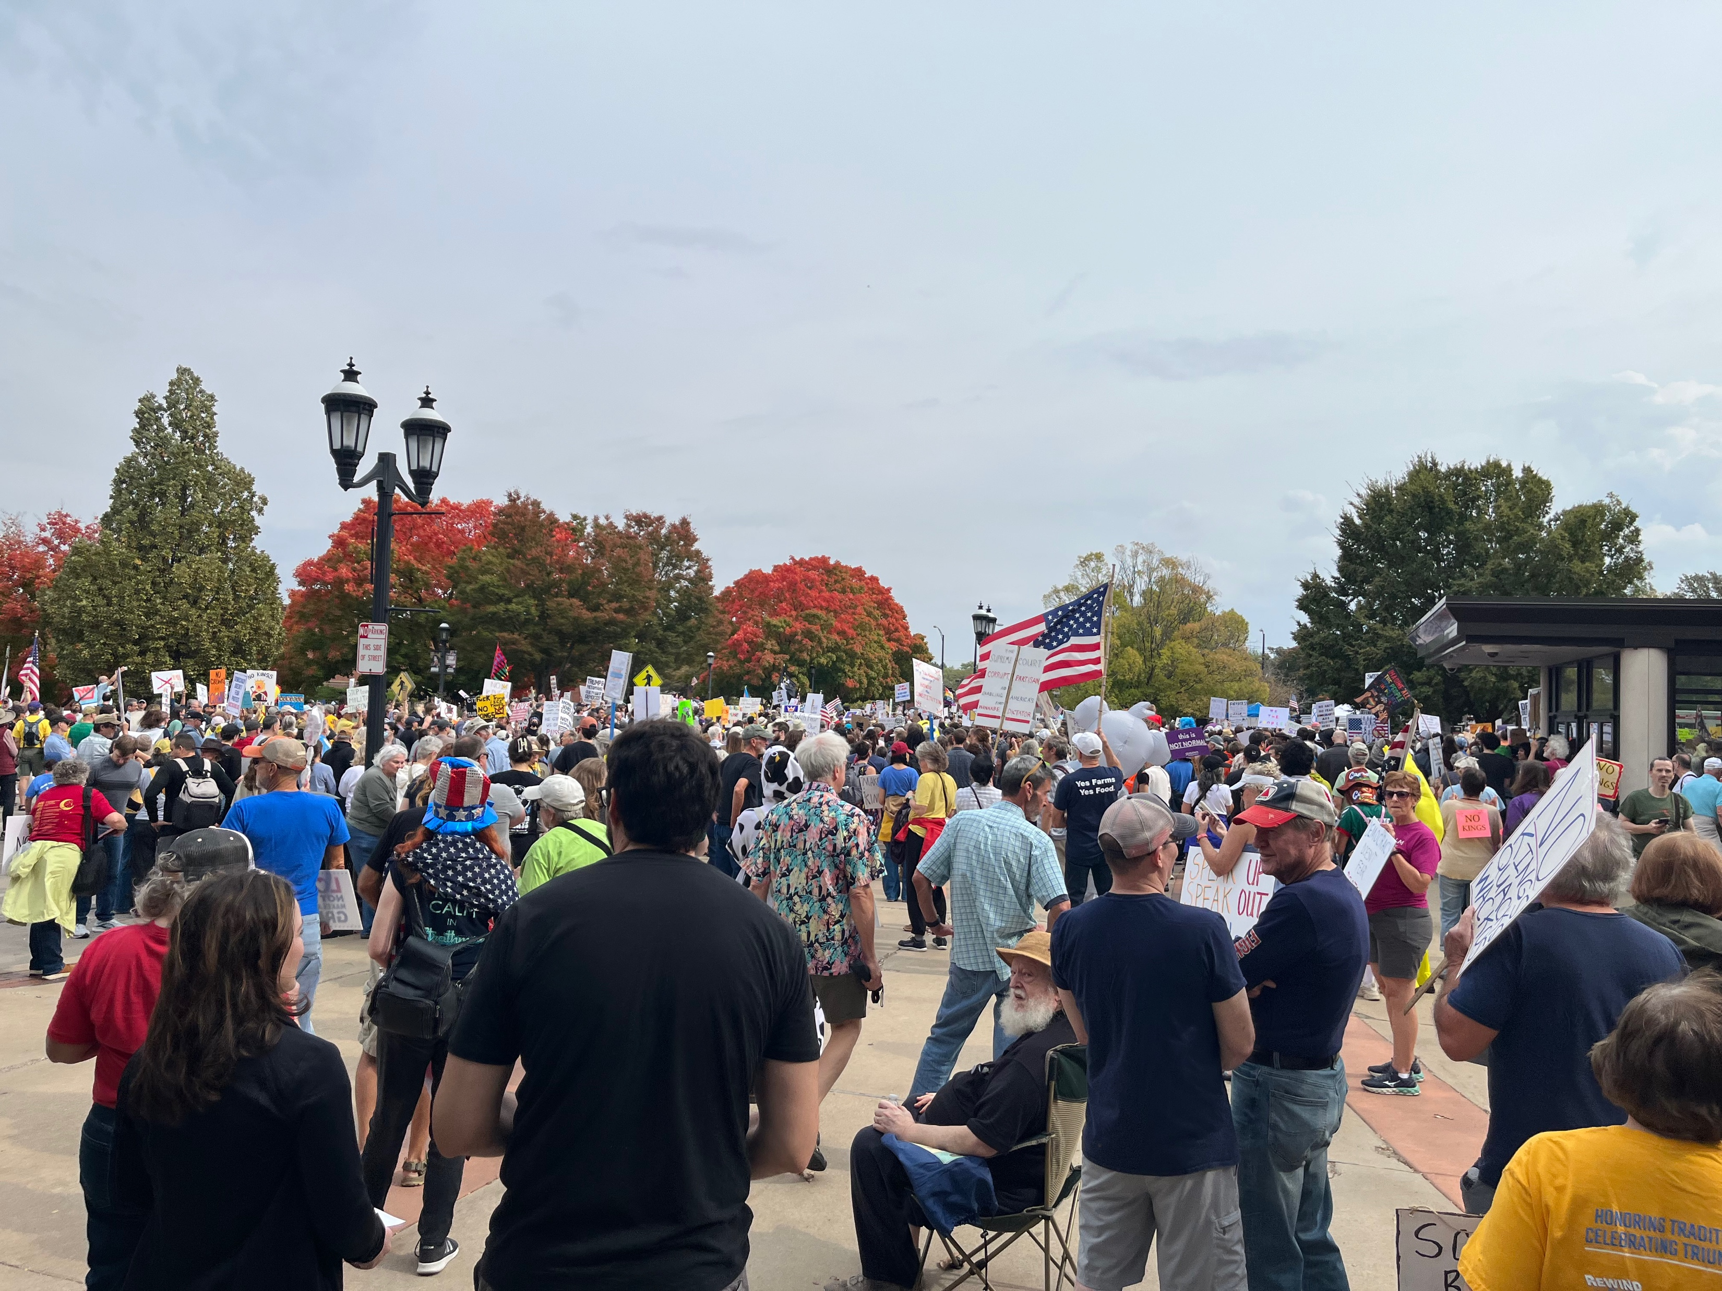
Notes:
More and more people are starting to engage and take notice of this horror and do something about it
I applaud NCF for being on the forefront of these issues and not being apathetic or complicit in these horrors.

Slide 18
II Corinthians 3:17
Now the Lord is the Spirit, and where the Spirit of the Lord is, there is freedom.
Notes:
For our personal and collective prisons
Remember: God is everywhere, knows everything, and cares about us, individually and collectively
Whatever prison you find yourself in, God is with you
Even if the outcome seems or is dire, you never know what God will do with it. If we can think more collectively, it will help us through.

Slide 19
Mandela’s Five
Clear sense of Purpose – what is your cause?
Mental discipline and Inner freedom
Hope and Optimism
Solidarity and Fellowship
Vision for Reconciliation
Notes:
God’s Kingdom building business and whatever branches or leaves that includes.
Star Wars Rogue One scene: in prison and tells the character that there are different types of prisons and he senses that he carries his prison with him wherever he goes.
Hope and Optimism – Mandela described optimism as a weapon. As a follower of Christ, we should be solid on this one but like the praying church folks for Peter, we often need reminders
Solidarity and Fellowship – We have the National Symposium for Local and State Reparations Leaders next month where those working towards reparations get more energized seeing so many others working towards this effort.
Whether to teach others about Jesus, to get reparations for slavery, to heal an apartheid-stricken country, to treat foreigners as God instructs, or to create a more just world that does not leave a place for kids to go to daycare, or getting through our personal prisons, having a vision for reconciliation is vital

Slide 20
The Ultimate Reconciliation
¹⁸ “The Spirit of the Lord is on me,
because he has anointed me
to proclaim good news to the poor.
He has sent me to proclaim freedom for the prisoners and recovery of sight for the blind,
to set the oppressed free,
¹⁹ to proclaim the year of the Lord’s favor.”
Notes:
Luke 4: 18-19
Freedom from our prisons comes from Jesus who gave us the ultimate freedom… eternal and abundant life.
We do not have to let our prisons rule us. Our freedom is within. Remember where the Spirt of the Lord is, there is Freedom.

