Slide 1

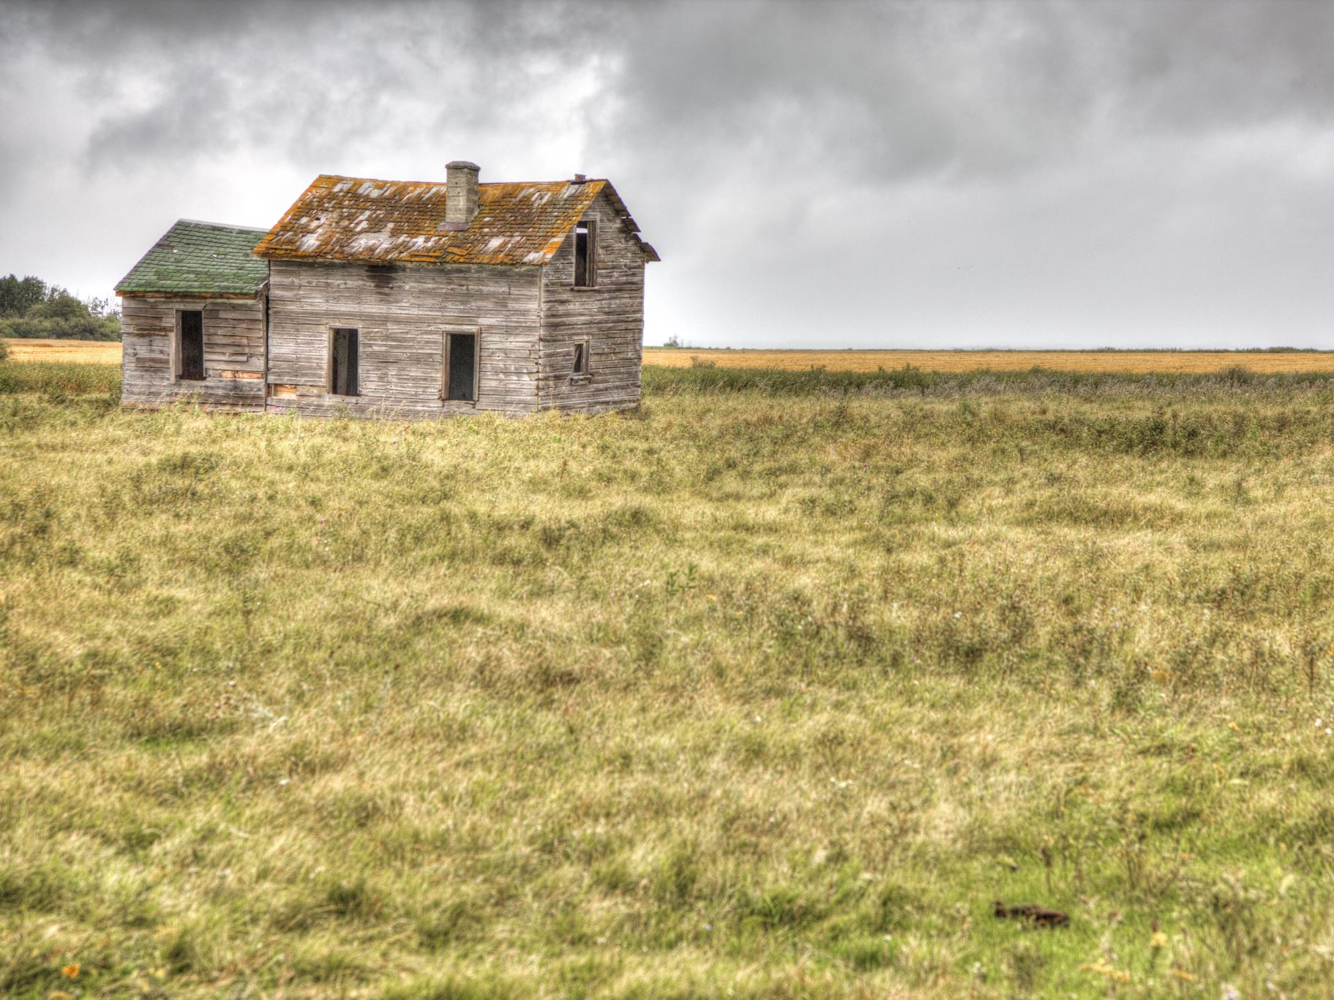
On Earth as it is in Heaven
The Work of Transforming Our Earthly Home to a Heavenly One
Notes:
Being a former UIUC student and permanent transplant from the Chicago area, I have had my share of homes since I arrived here in 1993.
My first home was 223 Blaisdell, Pennsylvania Ave Residence across the street from Florida Ave Residence. One summer back at my mom’s home.
First apartment on Stoughton in Urbana, then a summer sublet on 4th street (great deal – whole summer for $200)
Then student married housing on campus on Green St (married at the end of my Junior year - will be 30 years in May)
Another summer sublet on Green street near CVS, apartment at Hessel Park Apartments for a couple years (no help moving)
Townhome on John and Mattis in Champaign, until getting the home I am in now in Urbana (2002)
From 1993 to 2000, I live in 7 different locations,1 a year. Home shifted a lot until I got my home (thanks to some of the NCF Family that helped make that happen)
Every place I stayed for any longer than a couple months was HOME. A place that felt familiar, a place I slept, I ate, I watched TV, eventually raised my kids, and kept me warm during cold days like today

Slide 2

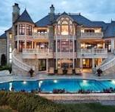
The Pleasures of Home
Some have been blessed with amazing homes
  Lights
  Things work
  Maintained
  Open to guests
Notes:
While the holiday season is a joyous time for many, it has the opposite effect for many others

Slide 3

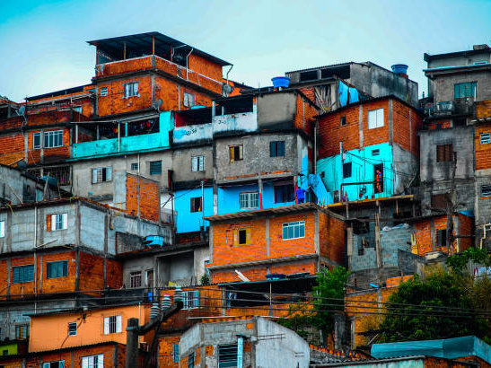
Notes:
Homes, while being blessings in many ways, also can be less than ideal, difficult, and even dangerous depending on ones experience.
There is little to no light, things don’t work, the home is in disrepair, and not particularly welcoming to guests
Therefore, while lots of good happens at home, it is also where we experience pain, suffering, helplessness, heartache, and discomfort (people generally do not say or acknowledge, the discomfort of home like they do the comforts of home)
Even if we have good memories, I would venture to say that many of us also or sometimes have negative feelings, memories, and associations with what we considered home.
So what do we do with that? How do we find God in these less than ideal, difficult, and even dangerous situations? How do we make home on earth as it is in heaven?

Slide 4

Notes:
As we celebrate the 3rd week of Advent with its emphasis on Joy, I want us to journey together on how we get to experience genuine joy, particularly in the midst of trouble
I believe Joy comes when we are preparing and working towards making this home on Earth of ours, resemble Heaven
To do that, we have to address the elephant in the room that impedes our ability to experience unrestrained joy. Many of us have been to those family gatherings with those unspoken, underlining, issues that seems best unearthed for the sake of calm. But by not addressing these issues, no one can really or fully relish the joy that should exist
Joy came because they literally had a taste of heaven (in Jesus) on Earth
How do we move towards getting that same taste of heaven now?

Slide 5
Put Not Your Trust in Princes
146 ^{n}Praise the LORD!
Praise the LORD, O my soul!
² I will praise the LORD ºas long as I live;
^{p}I will sing praises to my God while I have my being.
³ ^{q}Put not your trust in princes,
^{r}in a son of man, in whom there is ^{s}no salvation.
⁴ When ^{t}his breath departs, he returns to the earth;
on that very day his plans perish.
⁵ ^{u}Blessed is he whose help is the God of Jacob,
whose ^{v}hope is in the LORD his God,

Slide 6
⁶ ^{w}who made heaven and earth,
the sea, and all that is in them,
^{x}who keeps faith forever;
⁷ ^{y}who executes justice for the oppressed,
^{z}who gives food to the hungry.
ªThe LORD sets the prisoners free;
⁸ ^{b}the LORD opens the eyes of the blind.
^{c}The LORD lifts up those who are bowed down;
^{d}the LORD loves the righteous.

Slide 7
⁹ ^{e}The LORD watches over the sojourners;
^{f}he upholds the widow and the fatherless,
but ^{g}the way of the wicked he brings to ruin.
¹⁰ ^{h}The LORD will reign forever,
your God, O Zion, to all generations.
^{n}Praise the LORD!

Slide 8
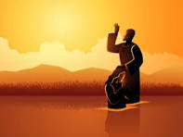
Notes:
What does heaven look like?
“Truly I tell you, among those born of women no one has arisen greater than John the Baptist; yet the least in the kingdom of heaven is greater than he.”

Slide 9

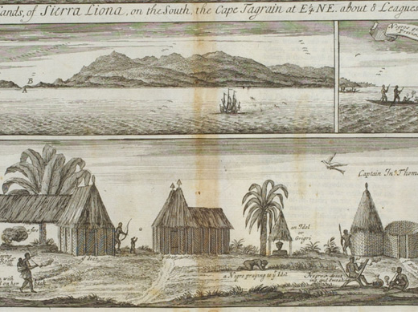

Notes:
Life in Sierra Leone before enslavement

Slide 10
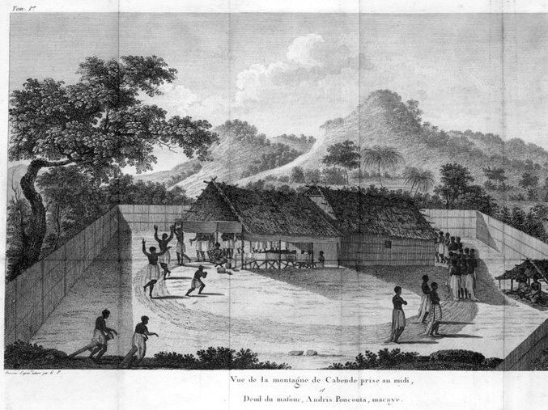
Notes:
A funeral in Angola

Slide 11

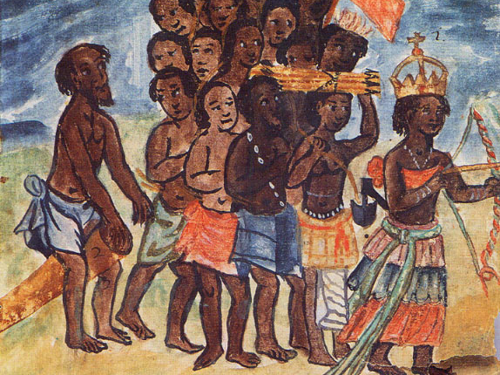
Queen Nzinga of the Kingdom of Kongo
Notes:
surrounded by drummers, trumpeters, and standard bearers during her seventeenth-century reign.

Slide 12
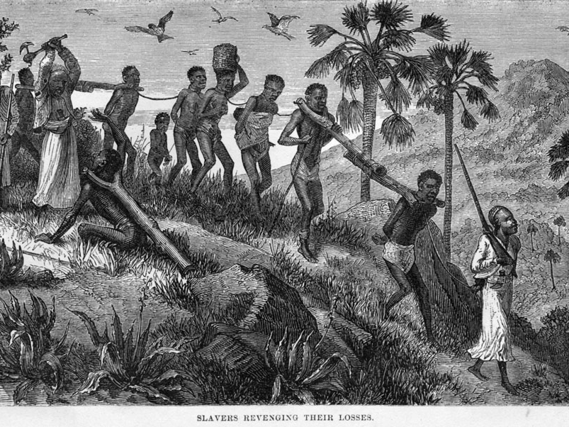
Notes:
Described trip to Ghana showing a reenactment of African participation in the slave trade.
Nigeria started a reparations commission

Slide 13
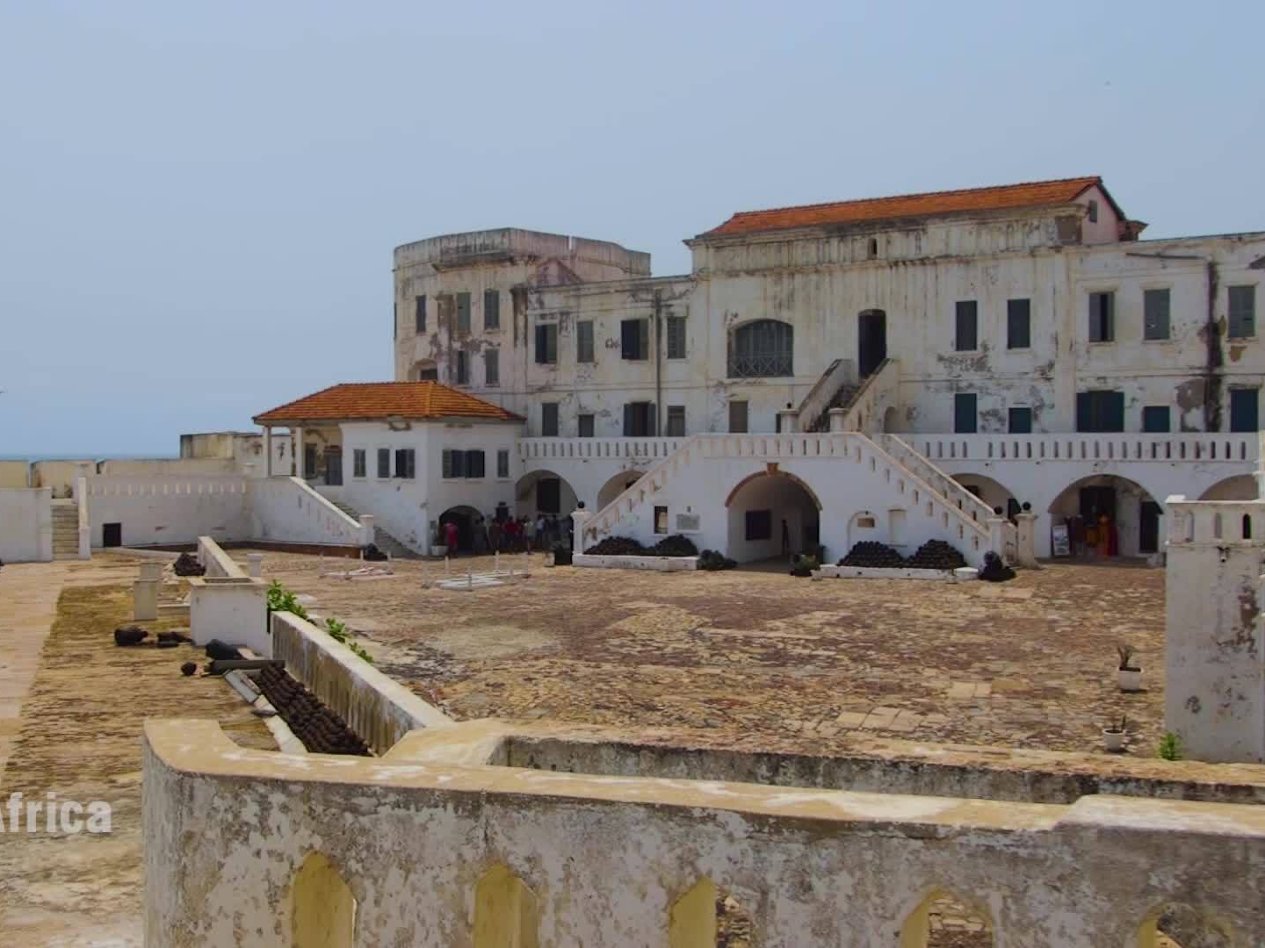
Notes:
Upon first glance, you’d think the captured Africans had a nice spot to stay before being trafficked across the Atlantic. However, what you see in this slide was not for the Africans but for the slavers

Slide 14
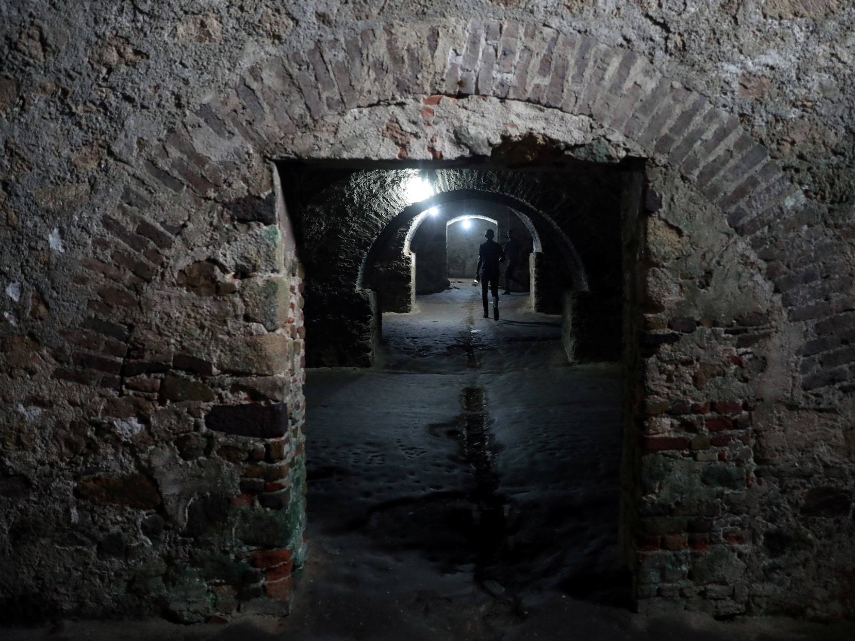
Notes:
The Africans new “home” was in the basement and cellars of these fortresses under inhumane conditions

Slide 15
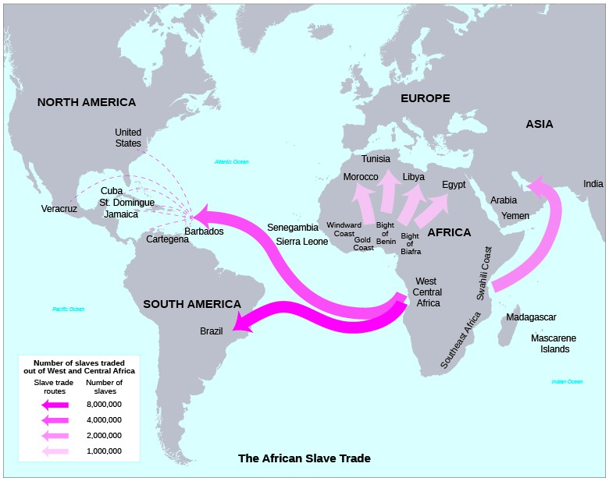
Slave Trade
13 million people later
Notes:
Between 1501 and 1867, nearly 13 million African people were kidnapped, forced onto European and American ships, and trafficked across the Atlantic Ocean to be enslaved, abused, and forever separated from their homes, families, ancestors, and cultures.

Slide 16
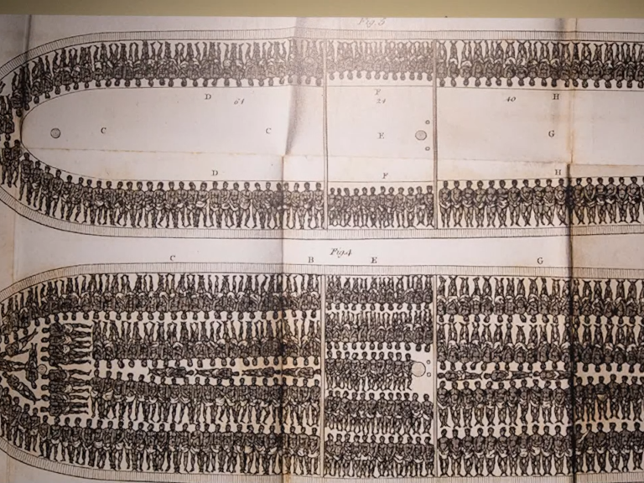
Notes:
For months, someone’s home was a space that you could barely move in. Strategy was used in the transport of humans – small spaces that had higher mortality but started with more or a bit more space with lower mortality that started with less.

Slide 17
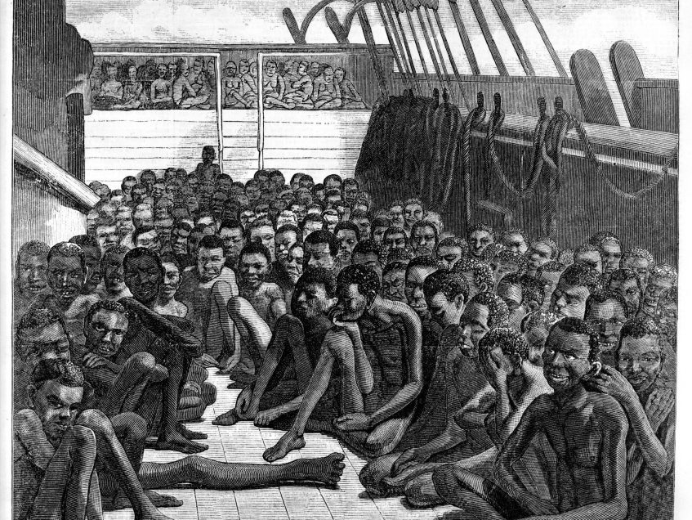
Notes:
Despite being from different tribes, using different languages, ascribing to different religions, these individuals found ways to survive and even rebel

Slide 18
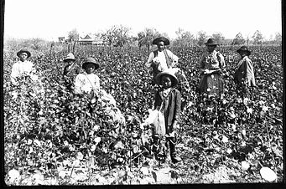
Notes:
Upon arrival, their new home included the cotton fields and tobacco farms where they would work from sunup to sundown under the harshest of conditions

Slide 19
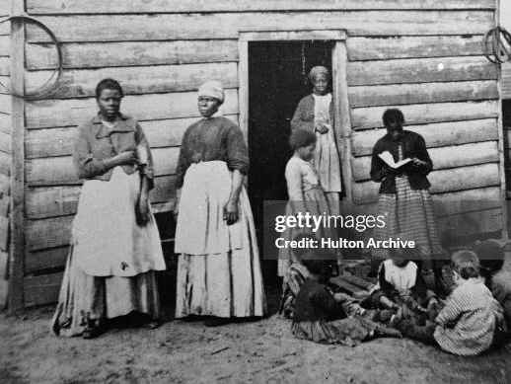
Notes:
Most stayed in huts kept together with clay
Most slept on floors, given one blanket a year, if lucky

Slide 20
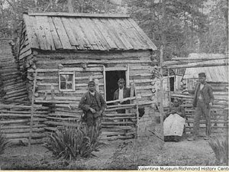

Slide 21
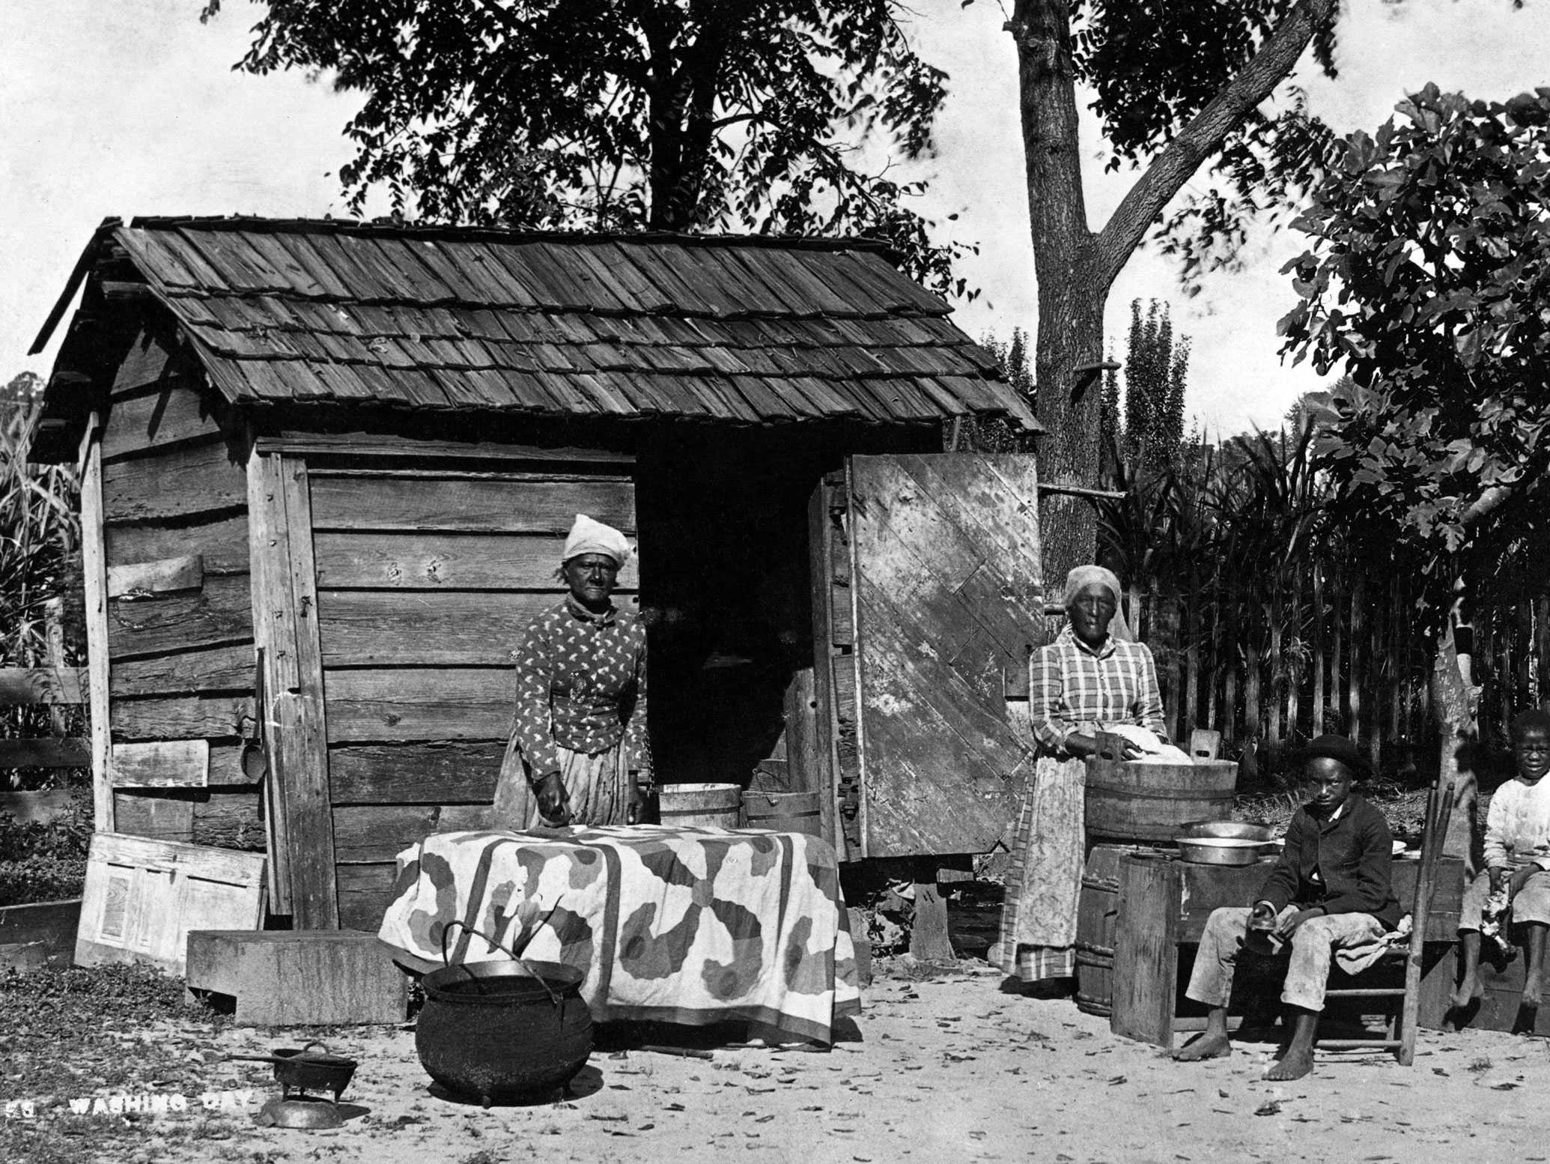
Notes:
Post Slavery

Slide 22
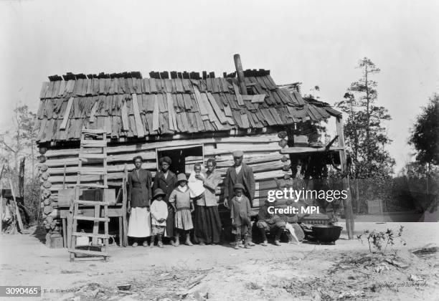
Notes:
Great Depression

Slide 23
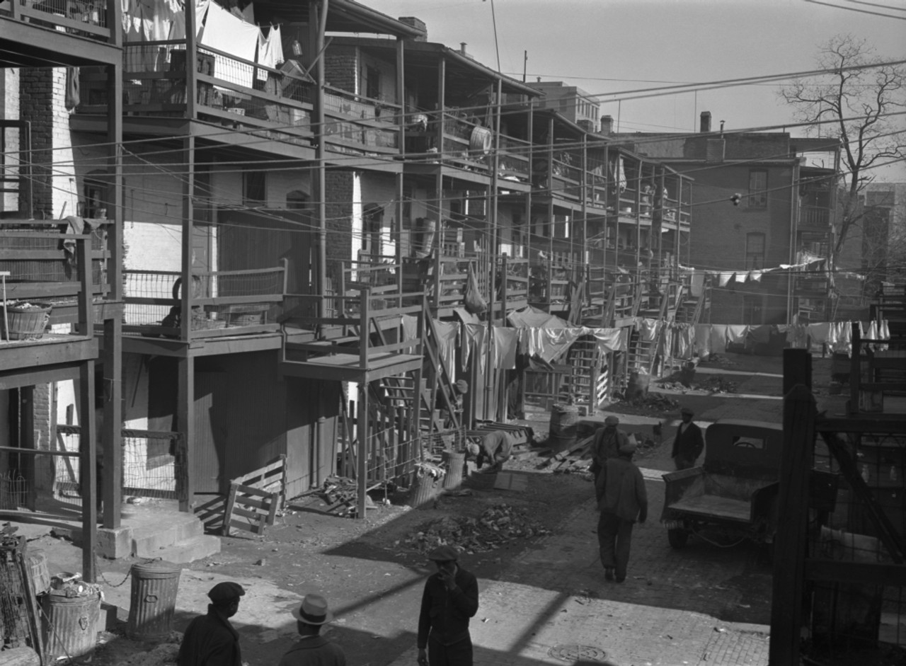
Notes:
During times like the Great Depression, home was even more depressed for black people.

Slide 24
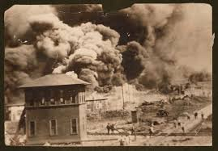
Notes:
1921 Tulsa Race Massacre
Even when African Americans succeeded in making this place their home, it was burned down in race massacres that took place all over the country

Slide 25
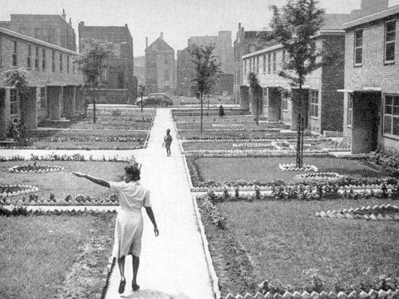
Notes:
Even when things improved, there were still shortcomings for black people such as not getting access to home loans in the 1950s

Slide 26
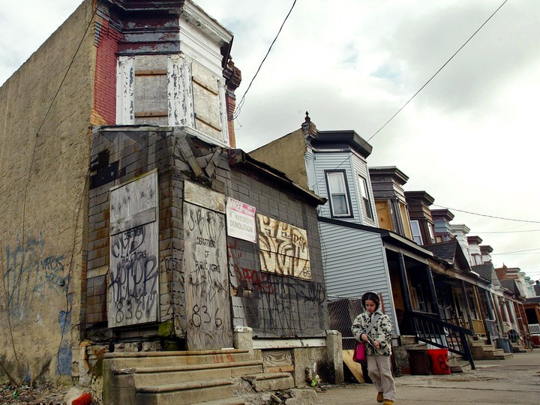
Notes:
This divestment and predatory practices related to black homes translated into slums and ghettos that exist today

Slide 27
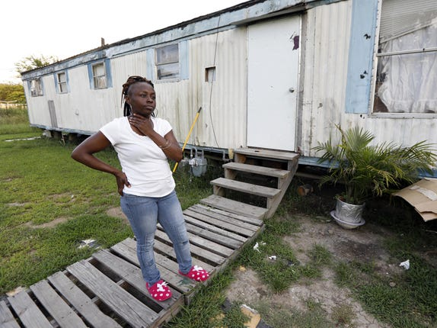
Notes:
Current day Mississippi
We see the effects in current day Mississippi

Slide 28
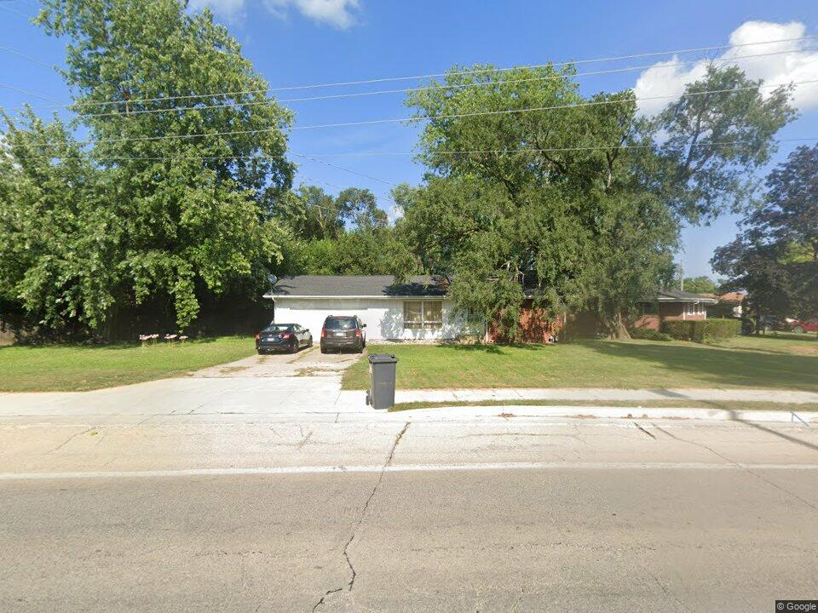
Notes:
City of Champaign vote attempting to address homelessness (disproportionate # of homeless are black)
I am joyful for all the sacrifices that have occurred over all these years that helped me have an opportunity for joy. I have been able to experience the joy of support and those encouraging and investing in me and my family.
Every black person ought to have that kind of support.

Slide 29
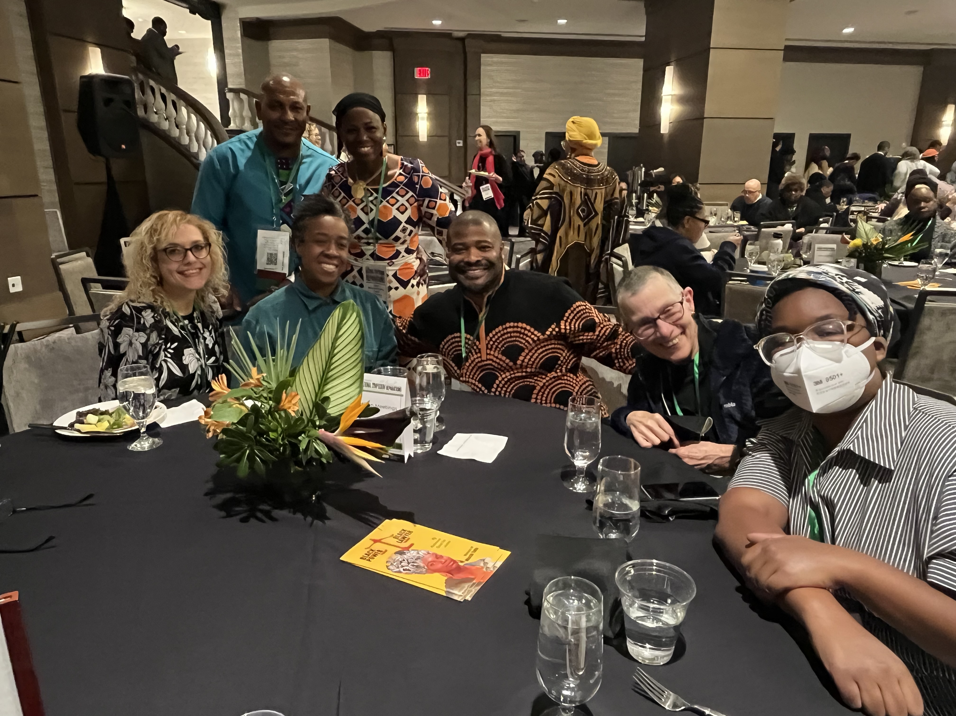
Notes:
I encourage each of us to address our elephants in the room. Do the difficult work of addressing issues that take away from our joy. On the other side is a taste of heaven
The joy of people working together to address the elephant in the room of injustice

Slide 30
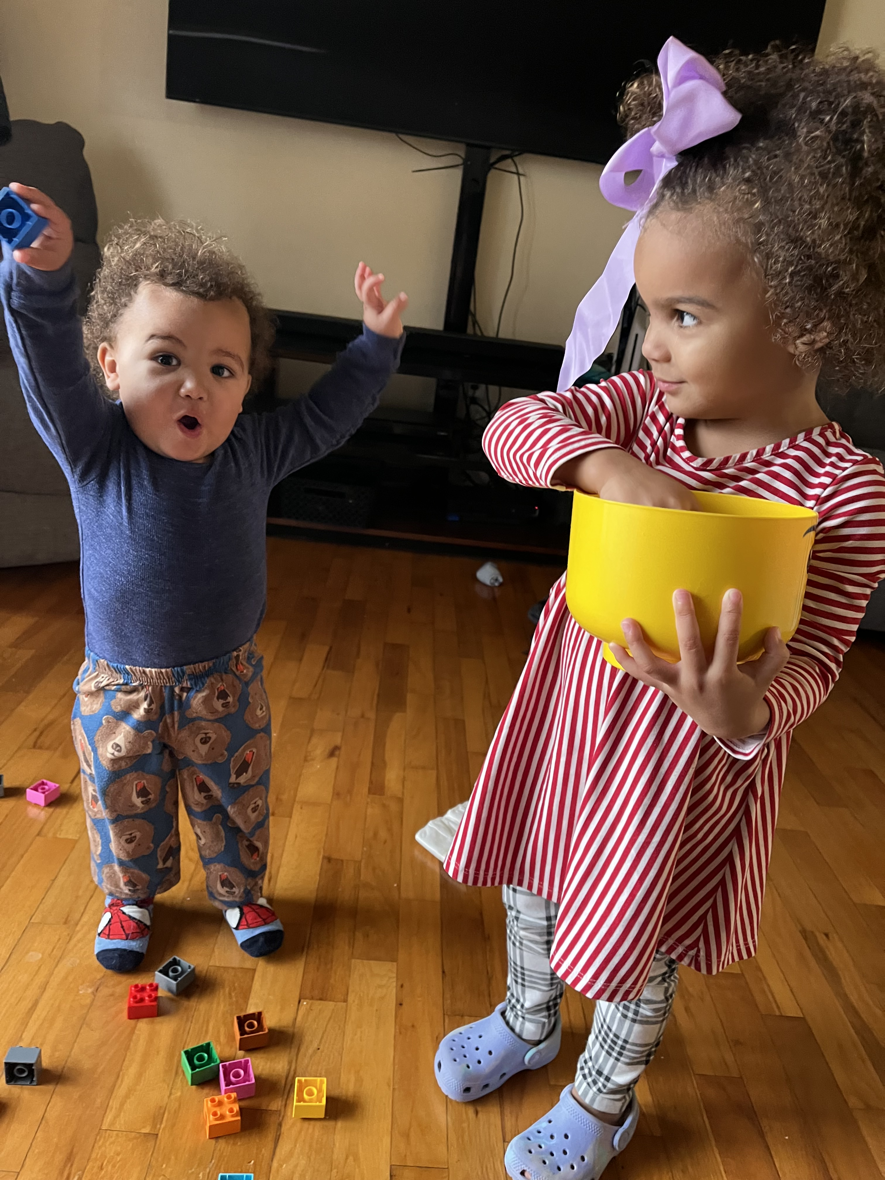
Notes:
The joy of seeing grandchildren grow up

Slide 31
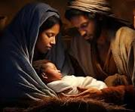
Notes:
The joy of having heaven on earth

