Slide 1

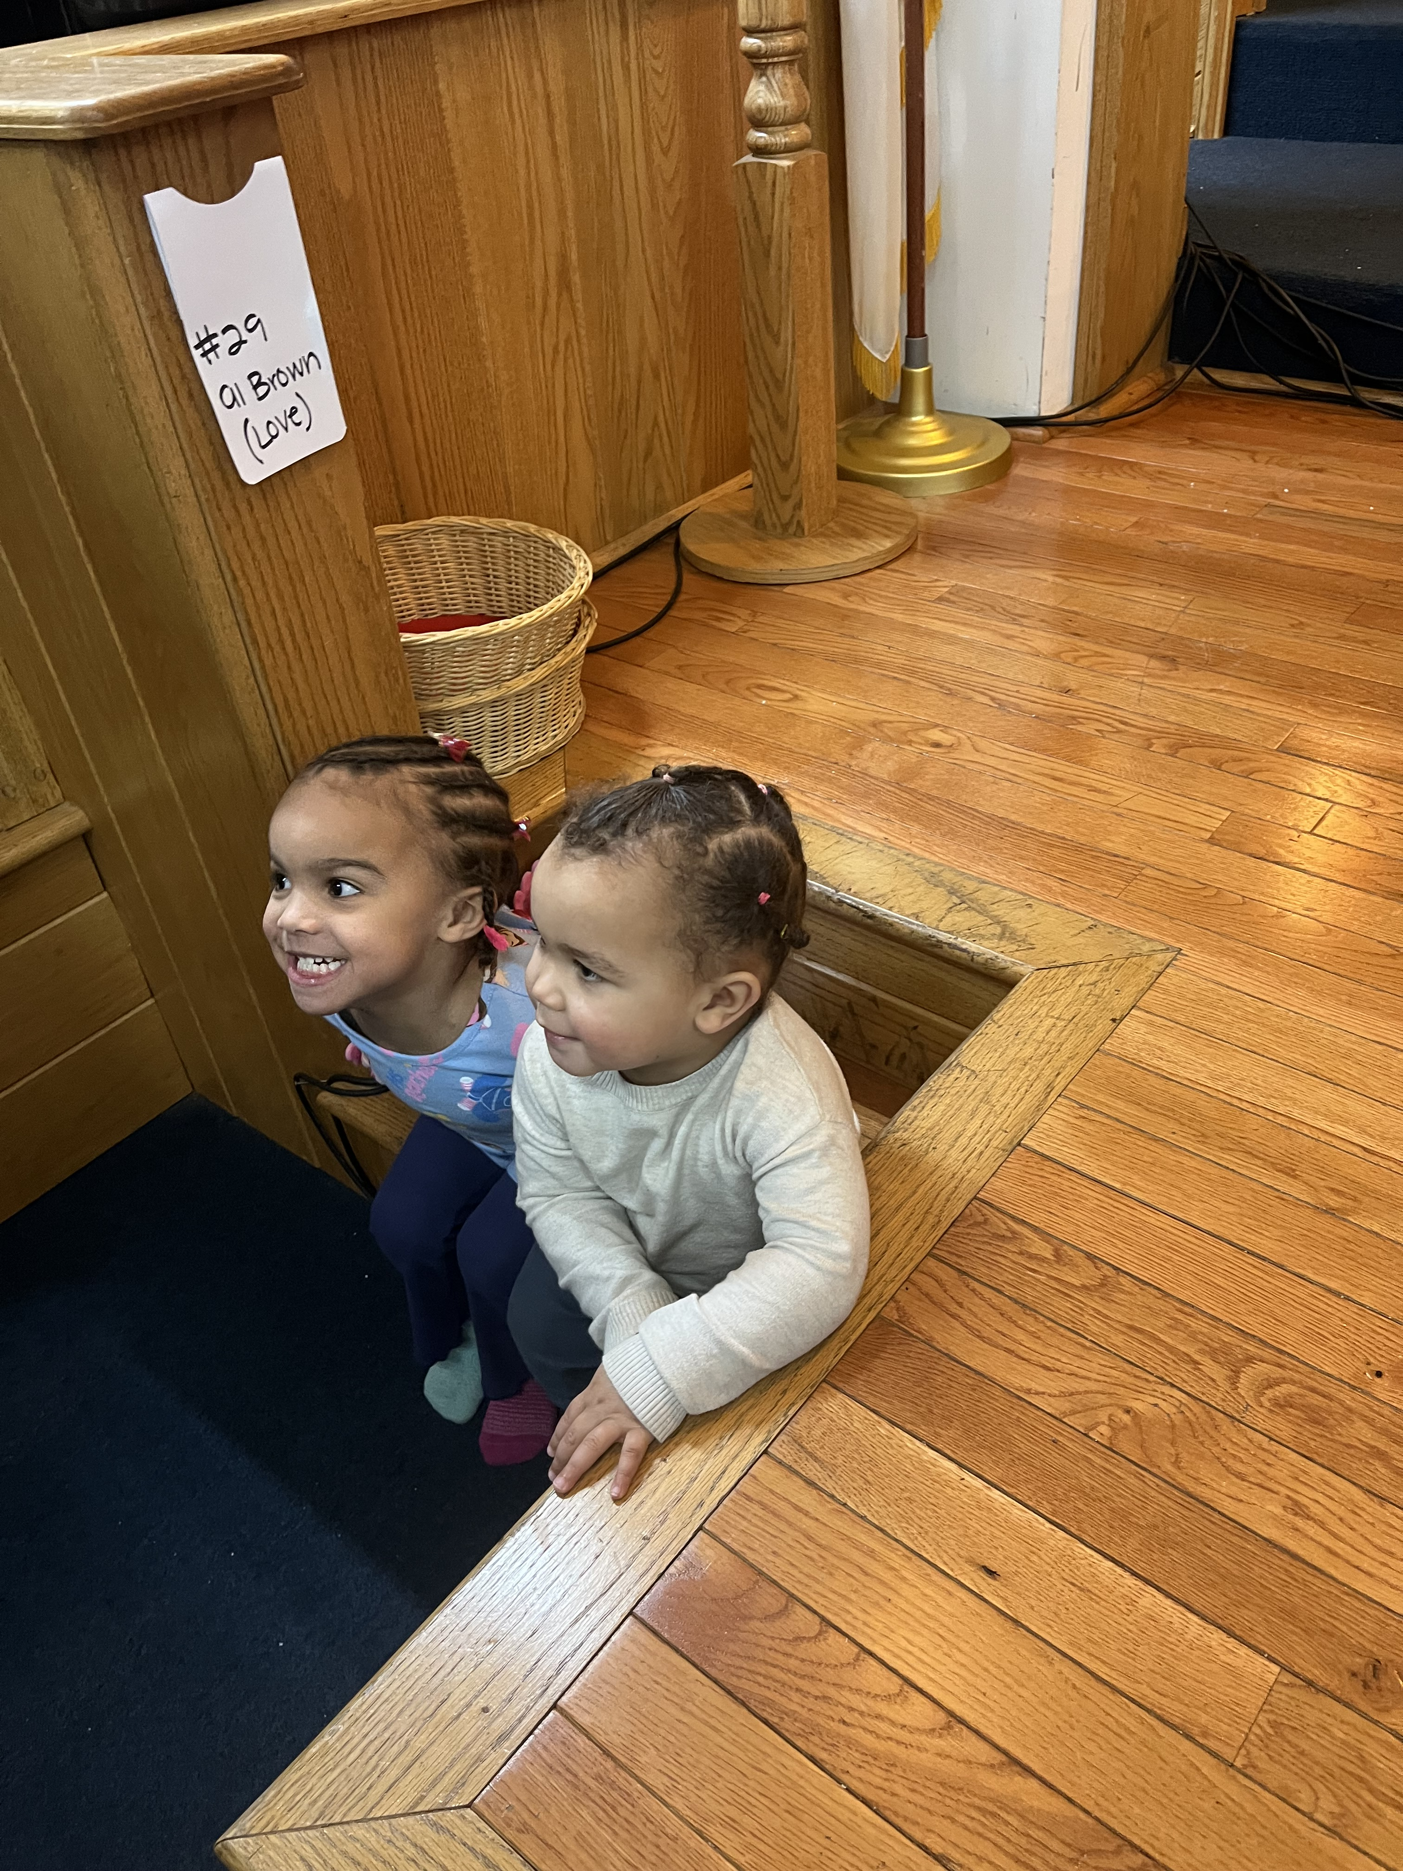


Notes:
Grandkids at a church ready to learn
Ground ourselves and pray. Need to start with prayer/meditation

Slide 2
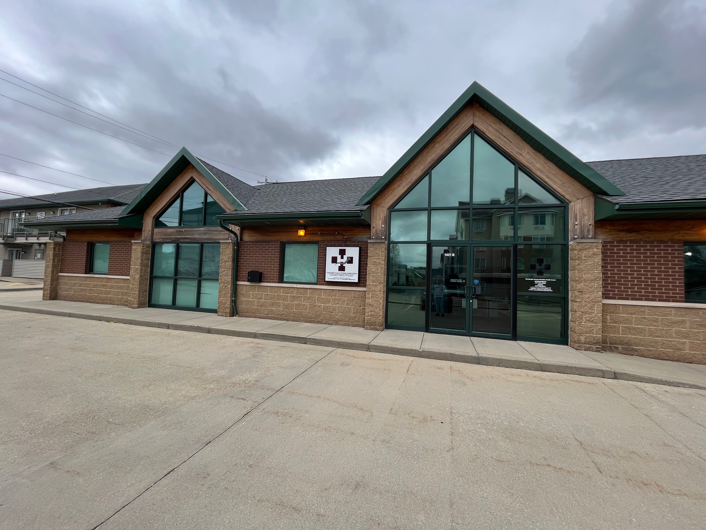
Notes:
CCCHC 1401 S State, Champaign location is officially paid off!!!
We have a building in perpetuity. No more moves (Salt and Light, CUPHD, CUPHD again, Dental Circle, OSF, 1st Methodist in Urbana, multiple satellites, NOW PERMANENTLY OURS – I do not have to move any more dental chairs!!!

Slide 3
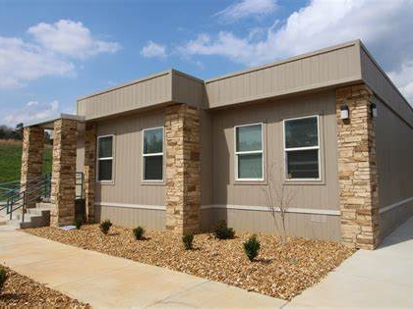
Notes:
Plans for a 2nd location at 1711 S Philo Urbana
Currently, it’s a parking lot in between McDonalds and a closed Walgreens
Hope to revitalize this area with a beacon of hope through providing preventative and primary healthcare to highest need populations

Slide 4

Notes:
This is my dream building

Slide 5
MLK Champions
Rep Justin Pearson
keynote speaker
Notes:
Also was awarded a Humanitarian Award from the MLK Advocacy for Justice Committee
Highlight was others hearing about the clinic and reparations work in town

Slide 6
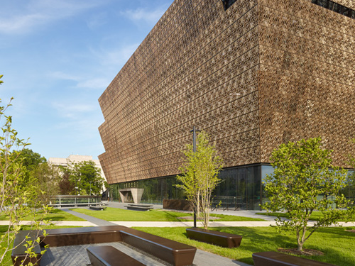
Notes:
Happy African American History Month
Why do we need a specific month? Because so much history was not acknowledged, lost, not taught, misunderstood, and ignored in the schools and other sources of historical information.
African American History Museum – An amazing museum that I believe EVERYONE should go visit
From basement (slavery) to top floor (Pres Obama)

Slide 7


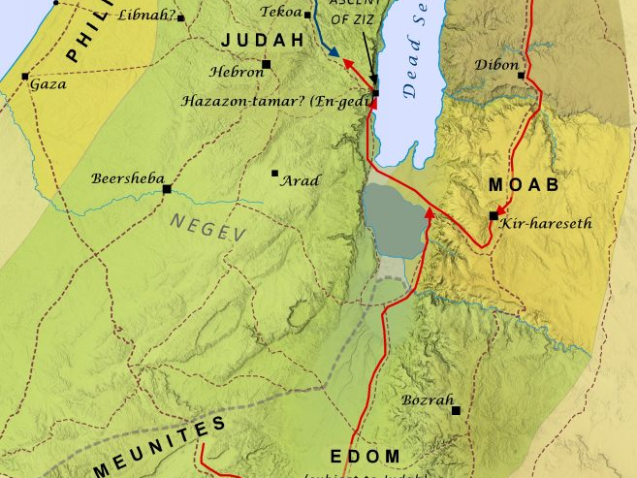

Realization, Resistance, Repair
A Model for Godly Action Amid Chaos

Slide 8
REALIZATION…

Slide 9
Notes:
Historical context
Peoples allowed to stay when Joshua and Israelites left Egypt into the promised land
Moabites shared ancestry with people of Israel and Judah. Moab was the son of Lot, who was Abraham’s nephew. The Ammonites from another son of Lot (Ben-Ammi). Meunites more of an obscure group from Edom territory (first to be wiped out in the internal battle)
History as a people was from the 14th century to 582 BC
Conflict started in the 13th century
King Saul battled the Moabites in the 11th century
King David got asylum from the Moabites when avoiding Saul; David later also fought the Moabites
Ruth, David’s great grandmother was a Moabite
Moabites regained independence after Solomon’s death and the splitting of the kingdom between Israel and Judah in 922 BC
King Omri, during his reign (884-872) reconquered Moabite lands
Moabites had a successful rebellion under King Ahab’s reign who died in 853 BC
This rebellion led to this moment with King Jehoshaphat, of Judah, faced with this combined force to take them out
There has been a struggle between these people for a long time. A long history.
I think of it as those that fight for justice as the Israelites and those who oppose justice as the Moabites
All people come from the same source. Same DNA. Found and continue to find ways to be divisive due to underlying issues. For this context, greed, ignorance, fear, hate, and the need to dominate.

Slide 10
II Chronicles 20: 1-30 King Jehoshaphat’s Faith
Jehoshaphat Defeats Moab and Ammon
20 After this, the Moabites and Ammonites with some of the Meunites^{[a]}came to wage war against Jehoshaphat.
² Some people came and told Jehoshaphat, “A vast army is coming against you from Edom,^{[b]} from the other side of the Dead Sea. It is already in Hazezon Tamar” (that is, En Gedi). ³ Alarmed, Jehoshaphat resolved to inquire of the Lord, and he proclaimed a fast for all Judah.⁴ The people of Judah came together to seek help from the Lord; indeed, they came from every town in Judah to seek him.⁵ Then Jehoshaphat stood up in the assembly of Judah and Jerusalem at the temple of the Lord in the front of the new courtyard ⁶ and said:
Notes:
A VAST ARMY COMING
ICE
National Guard – targeted 3 cities with black mayors
Dept of Justice
DOGE
Jan 6th Rioters
Supreme Court – President cannot commit a crime ruling
Epstein Files
Venezuela
Greenland
Economic Injustice, healthcare disparities, mass incarceration, community divestment stemming from redlining, wealth gap, higher unemployment, unaffordable housing, food scarcity, etc. TODAY
HISTORICAL LIST is too long to discuss in this teaching

Slide 11
Notes:
There has been a struggle between these people for a long time. A long history.
I think of it as those that fight for justice as the Israelites and those who oppose justice as the Moabites
It’s been like this epic Star Wars battle: The Force VS. The Darkside
All people come from the same source. Homo Sapiens all came out of Africa. Same DNA although Homo Sapiens that migrated interacted with Neanderthals where as 1-2% of Neanderthal DNA is still found in Homo Sapiens that did not stay in Africa.
A tiny % of DNA (far less than .1%) dictates skin color. Differences stem from adaptation, not genetics.
Found and continue to find ways to be divisive due to underlying issues. For this context, greed, ignorance, fear, hate, and the need to dominate.

Slide 12
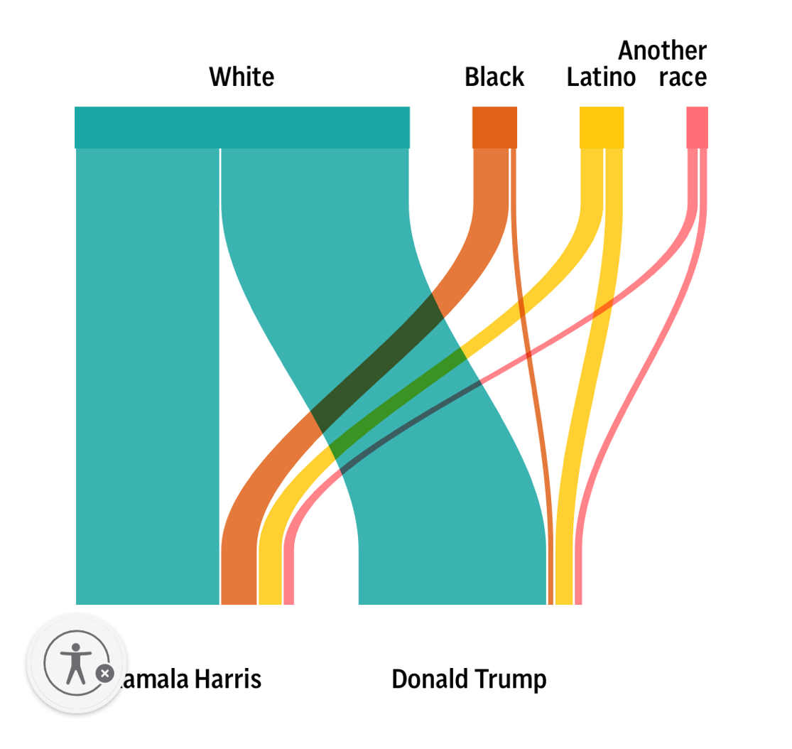
Notes:
And yet, race divides us today
Side note: Do not pay any attention to the narrative of black people (particularly men) that did not support Harris being a cause for the outcome of the election
Black voters – 86% Harris, 13% Trump (whole CNN story about black men that did not vote for Harris; Pres Obama scolding black men for not supporting a black woman even) (Black Men 77% Harris, 21% Trump … approx. 6% of the population in total – 77% of them voted Harris)
Latin X – 51% Harris, 46% Trump
Asian – 55% Harris, 40% Trump
White 57% Trump, 42% Harris (60% Trump/38% Harris White Men)(53% Trump/46% Harris White Women)
WHAT DOES THIS INDICATE REGARDING RACIAL VOTING BEHAVIOR???

Slide 13
II Chronicles 20: 1-30 King Jehoshaphat’s Faith
Jehoshaphat Defeats Moab and Ammon
“Lord, the God of our ancestors, are you not the God who is in heaven? You rule over all the kingdoms of the nations. Power and might are in your hand, and no one can withstand you. ⁷ Our God, did you not drive out the inhabitants of this land before your people Israel and give it forever to the descendants of Abraham your friend? ⁸ They have lived in it and have built in it a sanctuary for your Name, saying, ⁹ ‘If calamity comes upon us, whether the sword of judgment, or plague or famine, we will stand in your presence before this temple that bears your Name and will cry out to you in our distress, and you will hear us and save us.
Notes:
We must remember WHO WE ARE and WHO WE SHOULD BE
I find it so fascinating that the biggest sources of resistance to justice like reparations, comes from certain branches of the church.

Slide 14
II Chronicles 20: 1-30 King Jehoshaphat’s Faith
Jehoshaphat Defeats Moab and Ammon
’¹⁰ “But now here are men from Ammon, Moab and Mount Seir, whose territory you would not allow Israel to invade when they came from Egypt; so they turned away from them and did not destroy them. ¹¹ See how they are repaying us by coming to drive us out of the possession you gave us as an inheritance. ¹² Our God, will you not judge them? For we have no power to face this vast army that is attacking us. We do not know what to do, but our eyes are on you.”
Notes:
It is tempting to check out. I get it
BUT WE DO HAVE MORE POWER THAN WE CAN IMAGINE – WE JUST HAVE TO SHIFT OUR FOCUS
Today is the Super Bowl… the ultimate checking out sports event
BTW, $20 Billion spent for one game/day. Tickets, Advertisements, Food, Legal Gambling, etc.
This could pay for 133,333 homes (OUTRIGHT OWN) for the homeless, $1.67 million students could have a full ride at the average public college,
For the approximate 771,000 houseless people, $20 billion would provide enough meals for each to eat free for 4.7 years.
I could go on but you get the point. Just want to point out that checking out can be quite costly and the detriment for others

Slide 15
RESISTANCE

Slide 16
II Chronicles 20: 1-30 King Jehoshaphat’s Faith
Jehoshaphat Defeats Moab and Ammon
¹³ All the men of Judah, with their wives and children and little ones, stood there before the Lord.
¹⁴ Then the Spirit of the Lord came on Jahaziel son of Zechariah, the son of Benaiah, the son of Jeiel, the son of Mattaniah, a Levite and descendant of Asaph, as he stood in the assembly.
¹⁵ He said: “Listen, King Jehoshaphat and all who live in Judah and Jerusalem! This is what the Lord says to you: ‘Do not be afraid or discouraged because of this vast army. For the battle is not yours, but God’s. ¹⁶ Tomorrow march down against them. They will be climbing up by the Pass of Ziz, and you will find them at the end of the gorge in the Desert of Jeruel. ¹⁷ You will not have to fight this battle. Take up your positions; stand firm and see the deliverance the Lord will give you, Judah and Jerusalem. Do not be afraid; do not be discouraged. Go out to face them tomorrow, and the Lord will be with you.’”
Notes:
Do not be afraid or even discouraged!!! Gut Check = Faith Check
Take up your positions and stand firm
My mom recently expressed concern for my safety given the work that I am doing (which I get).
But I think about those that came before me… so so so so so so so so many people dealing with so so so so so so so so much. It inspires me and reminds me how important the work is because it is bigger than any individual any one church any one community.

Slide 17

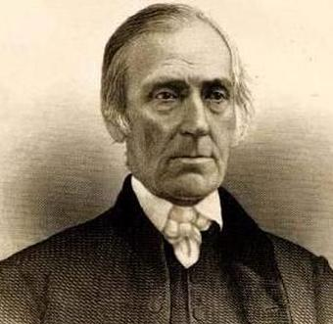
What Apathy Does NOT Look Like
“Grand Central Station” of the Underground Railroad
Average of 100 “fugitives” a year
Notes:
Taught enslaved people to read
Employed free Blacks in preference to Whites (“because I knew that they were often unjustly refused and neglected). Effective Affirmative Action
Employment allowed employees to buy their enslaved relatives
Opened a warehouse that sold goods made exclusively by free (non-enslaved) labor
Established an orphanage for African American children
Assisted with collection of food for distribution to formerly enslaved in the North
Post war, helped recently freed people to get educated and establish their own businesses
Lobbied the federal government to create the Freedman’s Bureau and raised funds for the Western Freedman’s Aid Society (created hundreds of schools for freedpeople in the South)

Slide 18
Meeting the Armies
https://youtube.com/clip/Ugkx_kZasT7NdGU7KJQj7rDIF0BczPm2dCKC?si=YQ_EWwmjnBTBCdvr

Slide 19
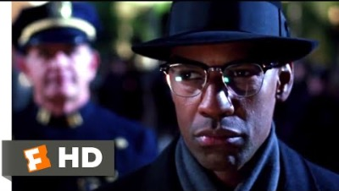

Slide 20
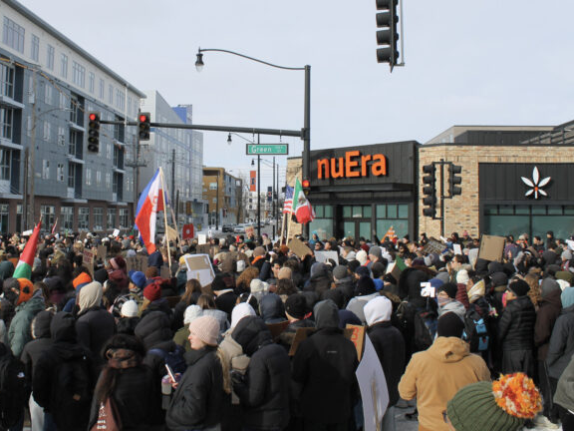
Notes:
Was at the Urbana courthouse march Fri, Jan 30th (same day as the student walk out)

Slide 21
Meeting the Armies
Justice is PASSIONATE
Justice is ACTIVE
Justice is willing to fight for FAIRNESS
Justice FACES ADVERSITY (despite fear)
Justice LOOKS AFTER those treated unjustly (like the Samaritan)

Slide 22
II Chronicles 20: 1-30 King Jehoshaphat’s Faith
Jehoshaphat Defeats Moab and Ammon
¹⁸ Jehoshaphat bowed down with his face to the ground, and all the people of Judah and Jerusalem fell down in worship before the Lord.¹⁹ Then some Levites from the Kohathites and Korahites stood up and praised the Lord, the God of Israel, with a very loud voice.
²⁰ Early in the morning they left for the Desert of Tekoa. As they set out, Jehoshaphat stood and said, “Listen to me, Judah and people of Jerusalem! Have faith in the Lord your God and you will be upheld; have faith in his prophets and you will be successful.” ²¹ After consulting the people, Jehoshaphat appointed men to sing to the Lord and to praise him for the splendor of his^{[c]} holiness as they went out at the head of the army, saying:
Notes:
WORSHIP – I say all the time, worship goes beyond the praise in a building. Worship is building God’s kingdom by any means necessary ☺

Slide 23
II Chronicles 20: 1-30 King Jehoshaphat’s Faith
Jehoshaphat Defeats Moab and Ammon
“Give thanks to the Lord, for his love endures forever.”²² As they began to sing and praise, the Lord set ambushes against the men of Ammon and Moab and Mount Seir who were invading Judah, and they were defeated. ²³ The Ammonites and Moabites rose up against the men from Mount Seir to destroy and annihilate them. After they finished slaughtering the men from Seir, they helped to destroy one another.²⁴ When the men of Judah came to the place that overlooks the desert and looked toward the vast army, they saw only dead bodies lying on the ground; no one had escaped.
Notes:
I find it fascinating that the passage says, AS THEY BEGAN to sing and praise, the armies destroyed each other.
AS THEY BEGAN – as if the praise was the actual weapon taking out the armies

Slide 24
REPAIR

Slide 25
II Chronicles 20: 1-30 King Jehoshaphat’s Faith
Jehoshaphat Defeats Moab and Ammon
²⁵ So Jehoshaphat and his men went to carry off their plunder, and they found among them a great amount of equipment and clothing^{[d]} and also articles of value—more than they could take away. There was so much plunder that it took three days to collect it.²⁶ On the fourth day they assembled in the Valley of Berakah, where they praised the Lord. This is why it is called the Valley of Berakah^{[e]} to this day.
Notes:
James 5: 7-8
⁷ Be patient, then, brothers and sisters, until the Lord’s coming. See how the farmer waits for the land to yield its valuable crop, patiently waiting for the autumn and spring rains. ⁸ You too, be patient and stand firm, because the Lord’s coming is near.
Our plunder in our current time may look like a growing movement in this country to address its white supremacy as many believed it no longer existed in mass

Slide 26
II Chronicles 20: 1-30 King Jehoshaphat’s Faith
Jehoshaphat Defeats Moab and Ammon
²⁷ Then, led by Jehoshaphat, all the men of Judah and Jerusalem returned joyfully to Jerusalem, for the Lord had given them cause to rejoice over their enemies. ²⁸ They entered Jerusalem and went to the temple of the Lord with harps and lyres and trumpets.
²⁹ The fear of God came on all the surrounding kingdoms when they heard how the Lord had fought against the enemies of Israel. ³⁰ And the kingdom of Jehoshaphat was at peace, for his God had given him rest on every side.
Notes:
Praise God before, during, and after

Slide 27
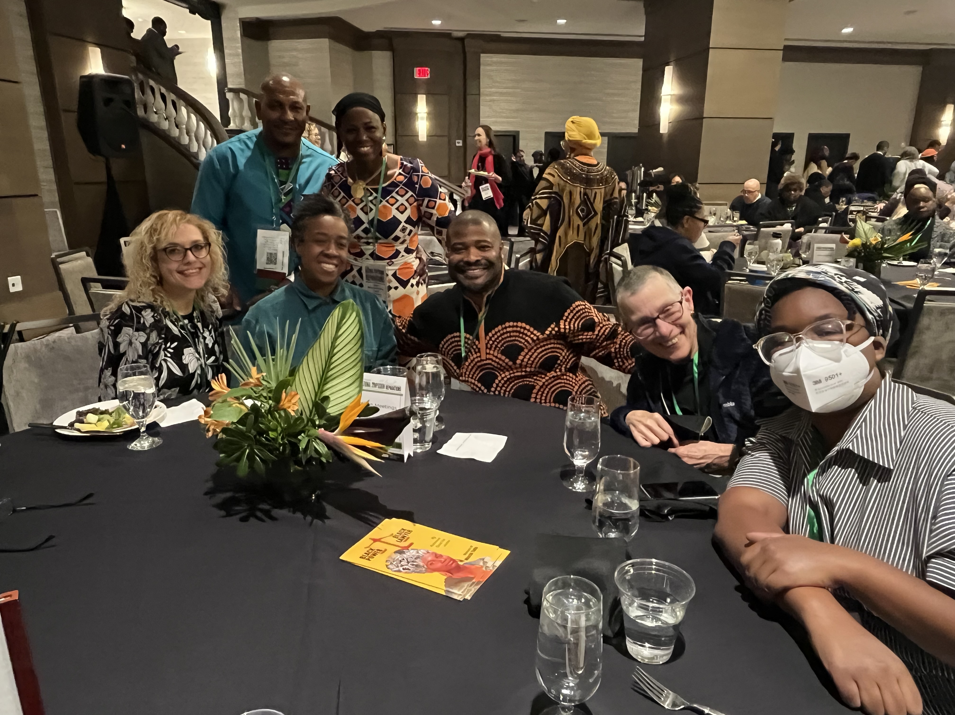
Notes:
A kingdom (world) at peace and rest on every side

Slide 28
IT’S FOR ALL OF US
“Tell them that reparations is ultimately redeeming for everyone, both those who give and those who receive; it is an opportunity for all of us to finally be healed.”
Justin Merrick, Reparations Advocate (Memphis, TN)

Slide 29
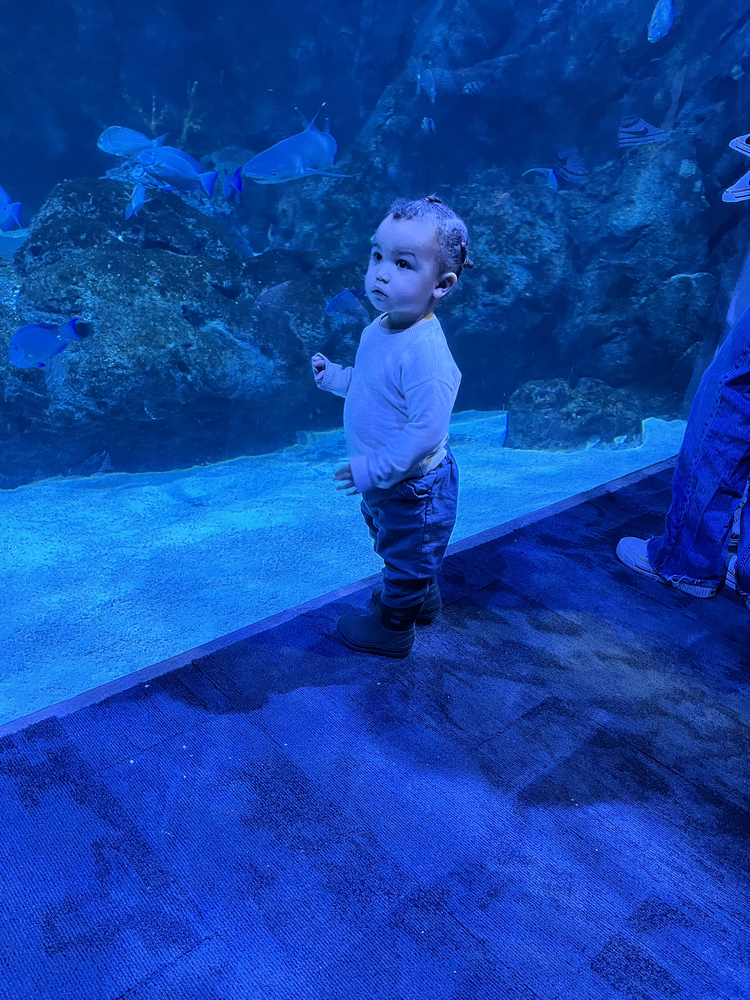
Notes:
St. Louis Aquarium
Let’s allow ourselves to discover new ways of being, new ways of thinking, explore the possibilities, and be in wonder with how God can redeem

Slide 30
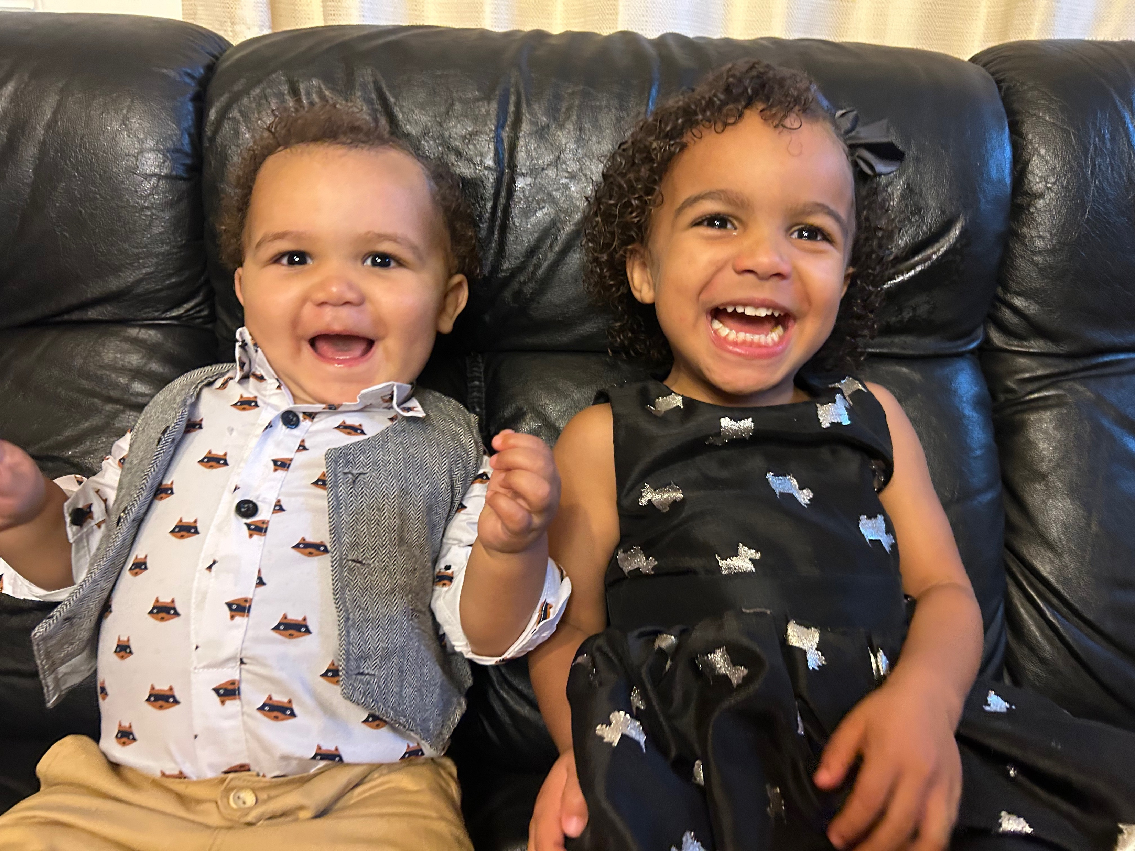
Notes:
I don’t know what heaven is like, but I can imagine this is the kind of joy that exists there. While we may never perfectly get there in this world, it can be very fun and exciting trying to make that happen
So that we can ultimately celebrate resembling God’s will being done on Earth as it is in Heaven

Slide 31
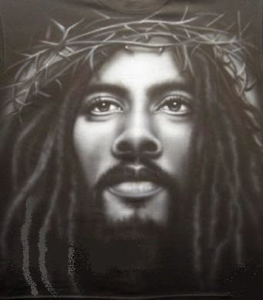
Notes:
That’s what Jesus died for after all

