Slide 1


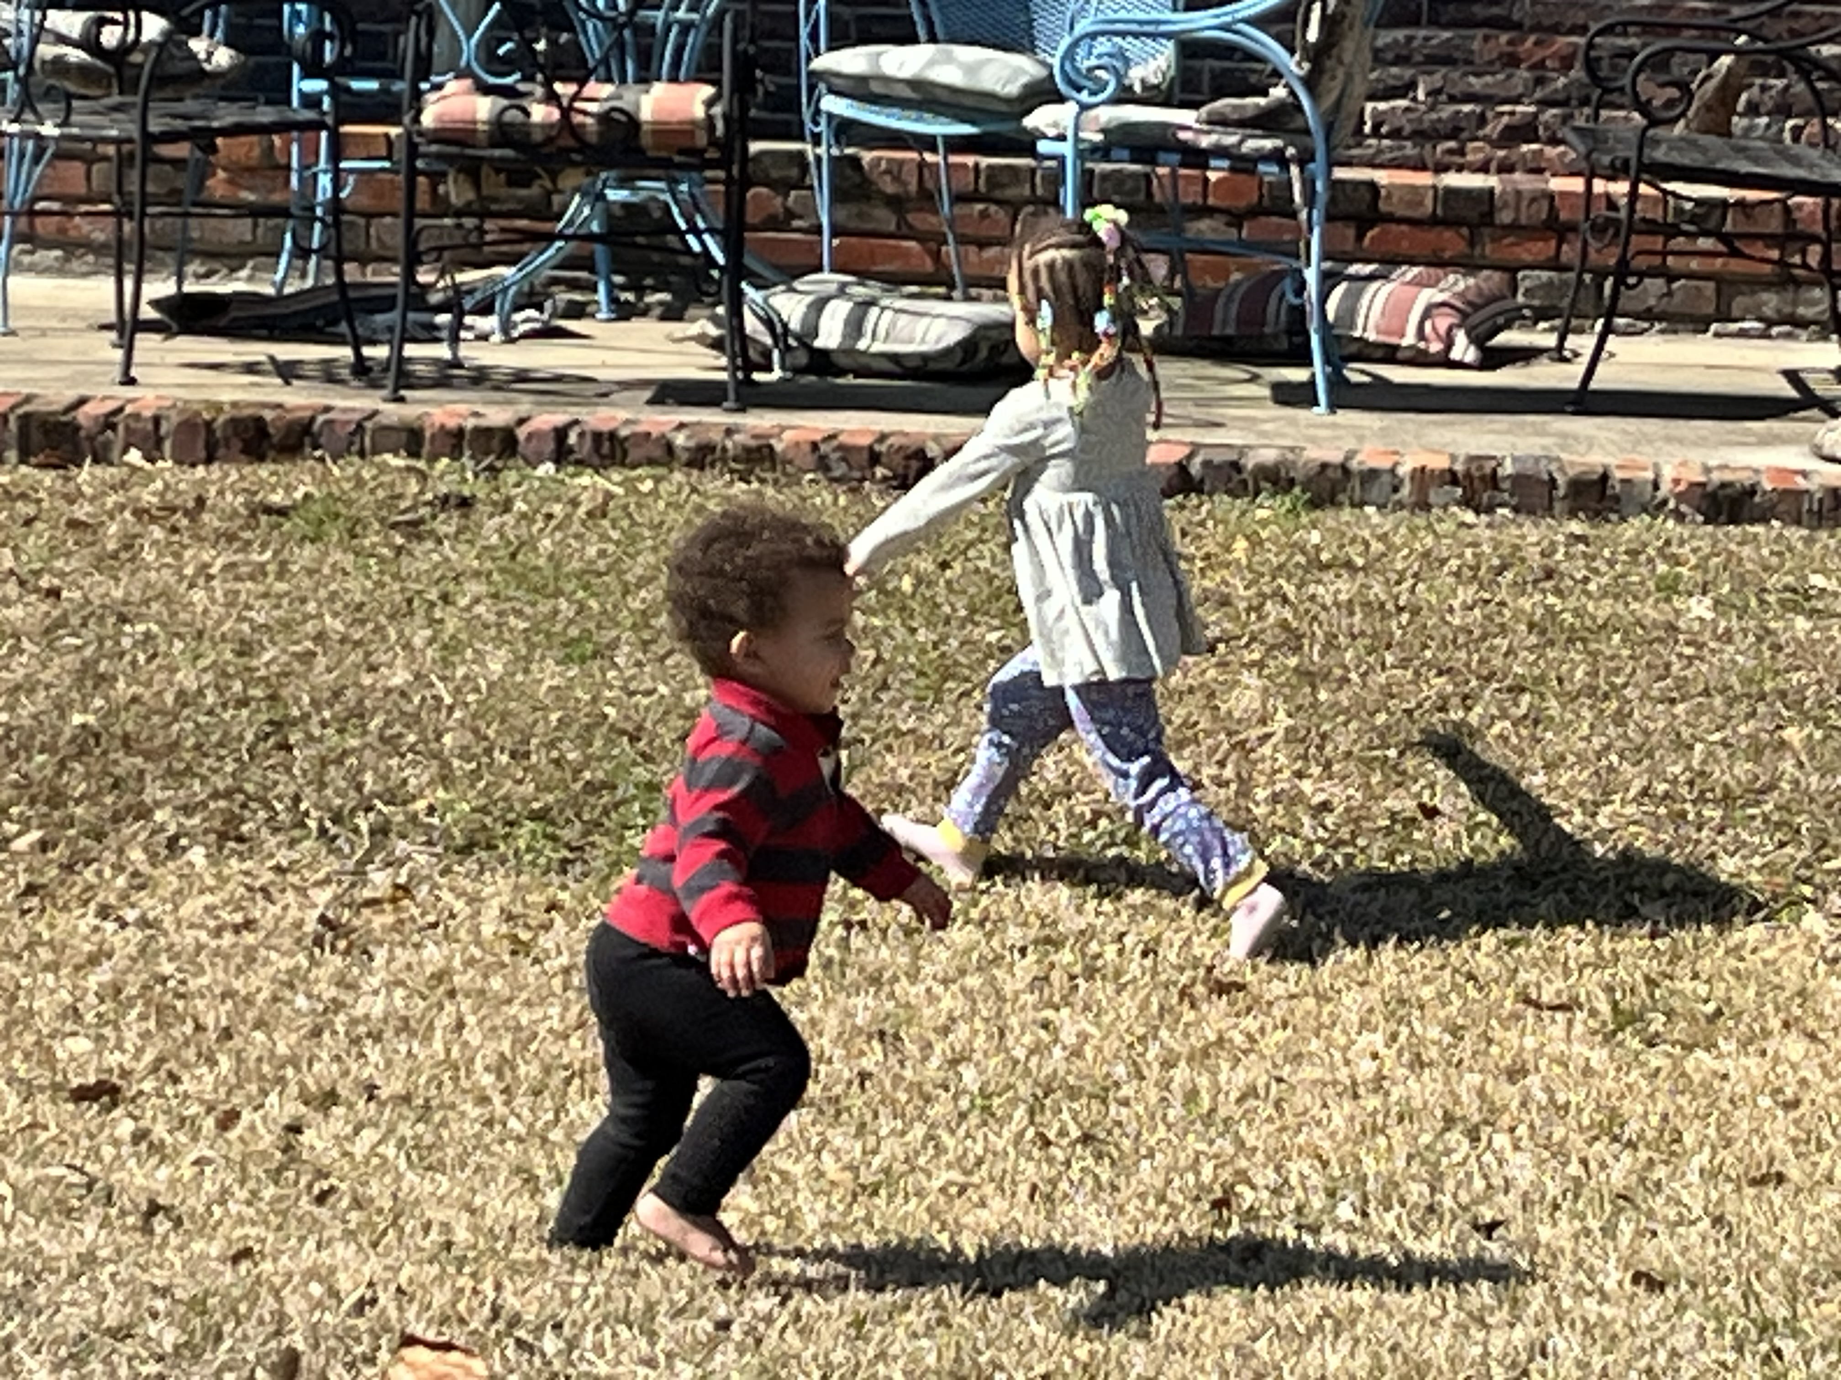

Notes:
Spring is here, or nearly here at least

Slide 2
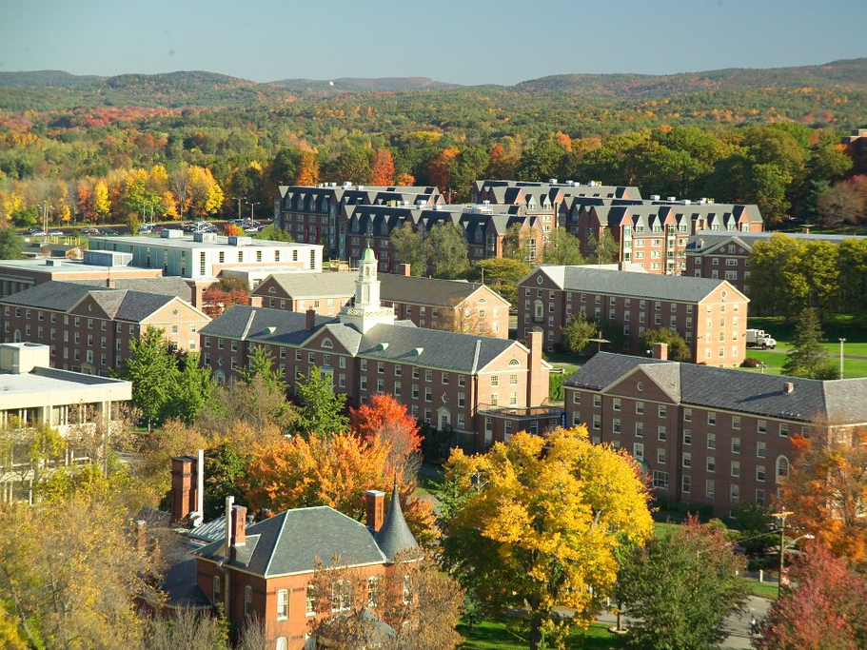
Notes:
TRASK 250?

Slide 3
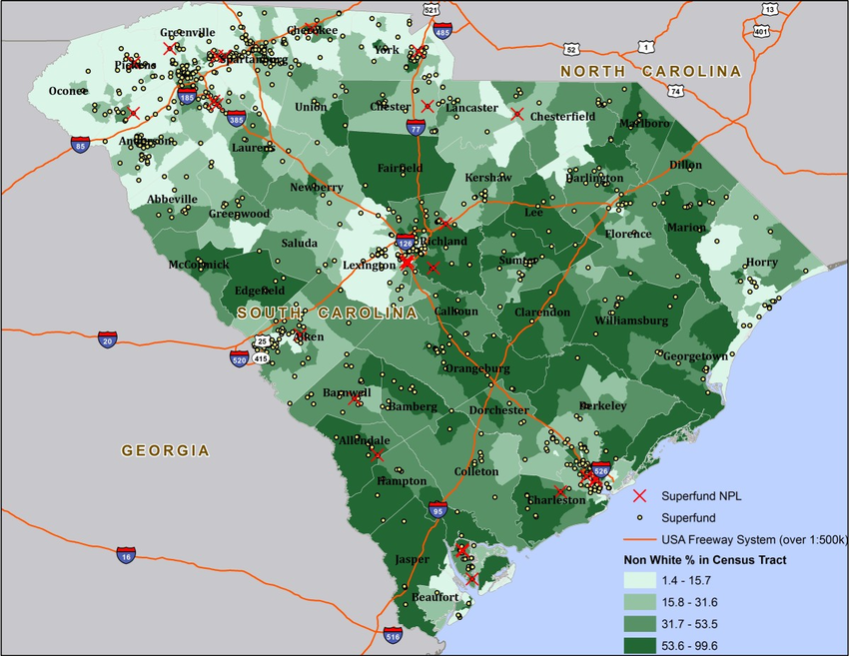
Notes:
One of several presentations I have given about reparations. This one is for a group called Faith In Place – a faith-based environmental group
Also did a presentations at Northeastern Illinois University, the African American Cultural Center at UIUC, Chicago Mennonite Church, the Independent Media Center (joint CURC/PSL Event), Douglas Library (joint CURC/TAKIR, and the YMCA at UIUC

Slide 4
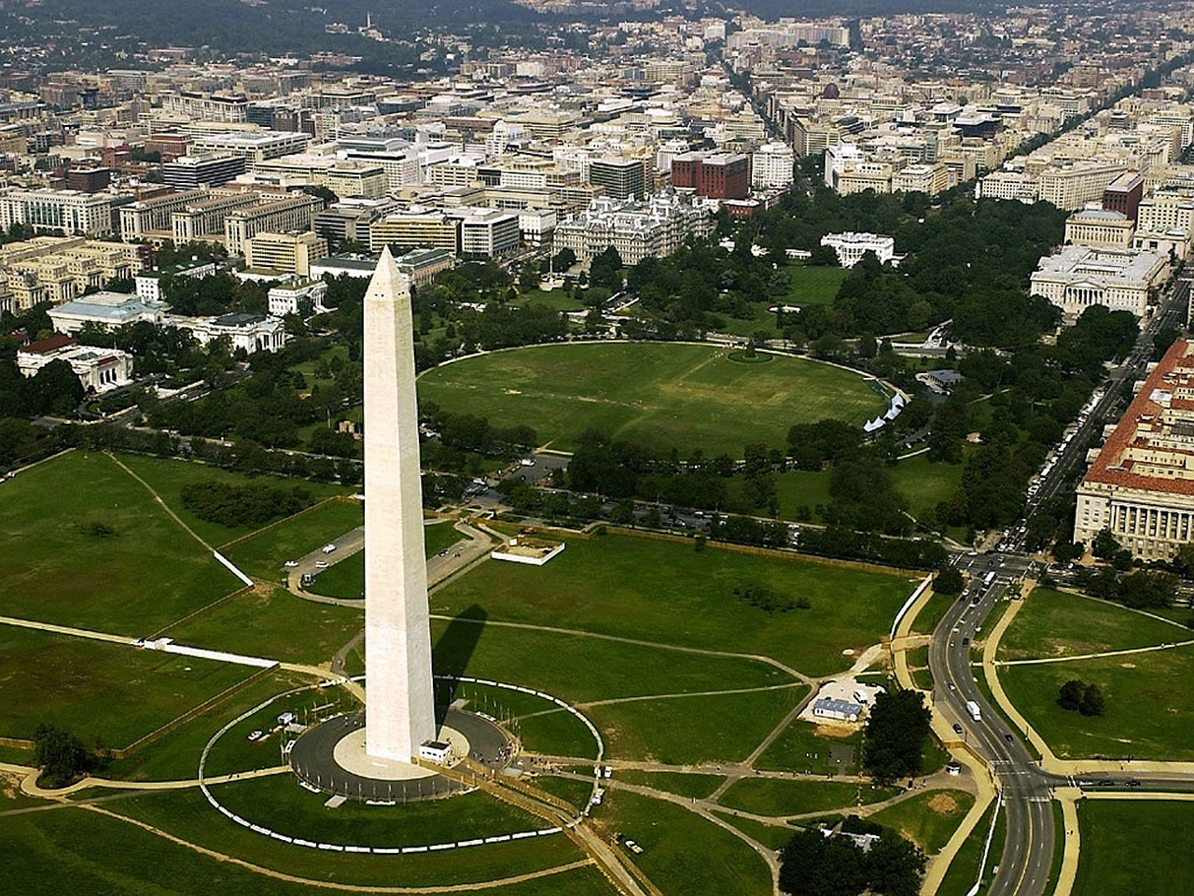
Notes:
National Reparations gathering in DC this week

Slide 5



WOKE, but Cannot SEE
“I prese toward the mark for the prize of the high calling of God in Christ Jesus”
Philippians 3:14
Notes:
We know the term woke has been used to describe a sensitivity to others and interestingly and ironically even, it is used as a criticism
Apparently, there are those that believe being asleep is the way to go
But my teaching is not geared towards people that refuse to be awake, but for us that are awake but still cannot see. I believe no one is exempt from this condition in some area in their lives. Some areas, we are open to learning and growth while other areas we feel we have it all figured out
It is difficult to press toward the mark for the prize when you think you have already passed the finish line

Slide 6
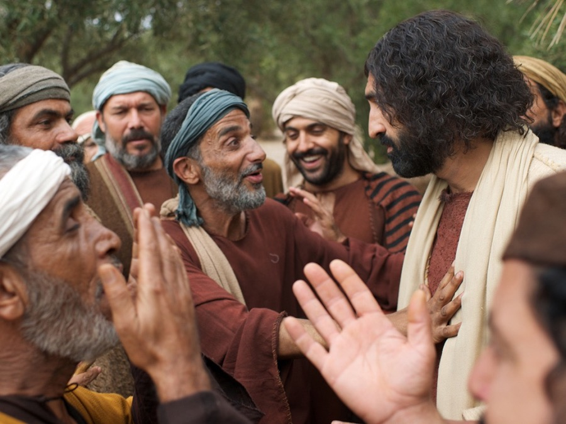
Notes:
Illustrated in John 9 concerning Jesus healing the blind man on the sabbath
My man my man, LOOK HERE, you’re not hearing me
All I can tell you is that about an hour ago, I was as blind as a bat and after this Jesus dude did his thing, I got 20/20 vision. That’s all I know. That’s all I can tell ya
Even though the formerly blind man was discounted due to his societal status, he was still ahead of Jesus’s know-it-all critics who thought they knew better. They were woke to God’s existence, but blind to God’s message

Slide 7
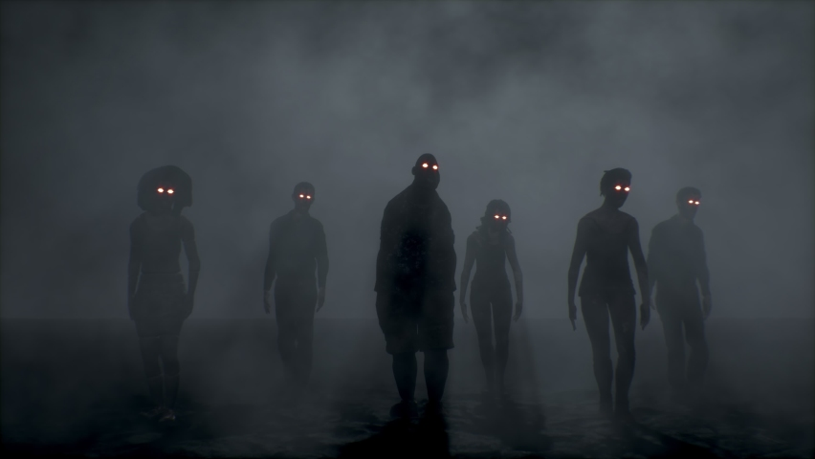
“Movement is Life” World War Z
Notes:
Word War Z - “Movement is Life”
Not growing on an ongoing basis in regard to gaining more knowledge and wisdom usually does not end well
In my presentations, I typically note how much I learn on an ongoing basis despite being immersed in the field. I have come to understand that the more you know, the more you realize you don’t know

Slide 8
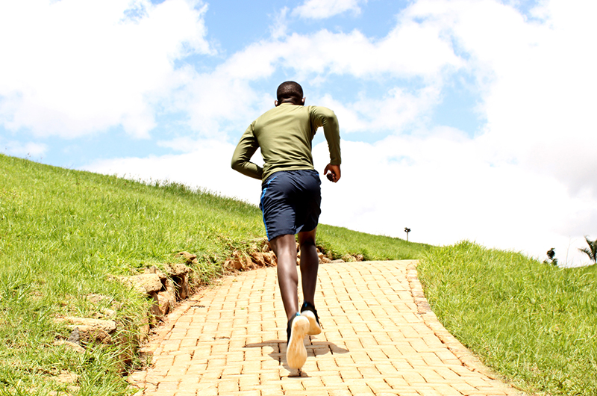
Not Easy
Notes:
Don’t let those zombies catch you even though it feels like you’re running uphill on a 100-degree day
You put your time in… you did your homework… maybe you even put in your 10,000 hours (Malcolm Blackwell - Outliers) ----- learn more on the peripheral related to your expertise, understand that the best have had it all wrong before
You know more than those around you ---- always seek out someone or someones that knows more than you
You’re busy ----- be sure to prioritize
You’re tired of running -------- self care (self care is not selfish, it’s sustaining)

Slide 9
Rule for Racing
Philippians 3:13
“Forgetting those things which are behind and reaching forth unto those things which are before”
Notes:
Forgetting has 2 parts: The good and the bad
The bad can get one stuck in shame, guilt, and fear of trying
The good can make you think you have arrived. Nice to celebrate it but have to be careful about past success not become a stumbling block.
Reaching forth
Implies effort to get something. If you are at a grocery store and reaching for something on the top shelf, there is a stretching that takes place. If it was close, you’d just grab it.
The scripture does not say and “grabbing” those things which are before

Slide 10
The Parable of the Seeds
“…everything that causes sin”
Notes:
I am not going to get into the issue of who is a weed and who is not. What I do want to point out is that during the harvest, everything that causes sin will be eliminated
I believe one of those things will be thinking we have it all figured out so we can continually learn and grow. A redeemed Earth and a redeemed US includes eliminating pride (the negative kind) that keeps us stuck
Note: It is also pride that keeps us stuck from releasing guilt. I mean if God can forgive us, why can’t we? Do we know better than God?

Slide 11

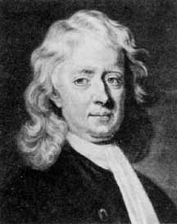
What Pressing for the Prize Looks Like
Born in 1725
Rebelled against religion and authority
A trafficker of enslaved people
Notes:
God’s kingdom on Earth as it is in Heaven
At age 23 (1748) (about middle age in those days), got scared straight from a violent storm and started a spiritual transformation and journey
It is worth noting, that the change was gradual… still trafficked people for several more years
Over time, his conscious deepened and began studying scriptures
He eventually became a minister in the Church (of England) and starting talking about the evils of slavery
At age 63 (1788) which is like 95 today wrote a powerful pamphlet condemning slavery called “Thoughts Upon the Slave Trade”
Became friends and mentor to William Wilberforce, a key leader that eventually helped end Britain's participation in the slave trade with the Slave Trade Act of 1807

Slide 12
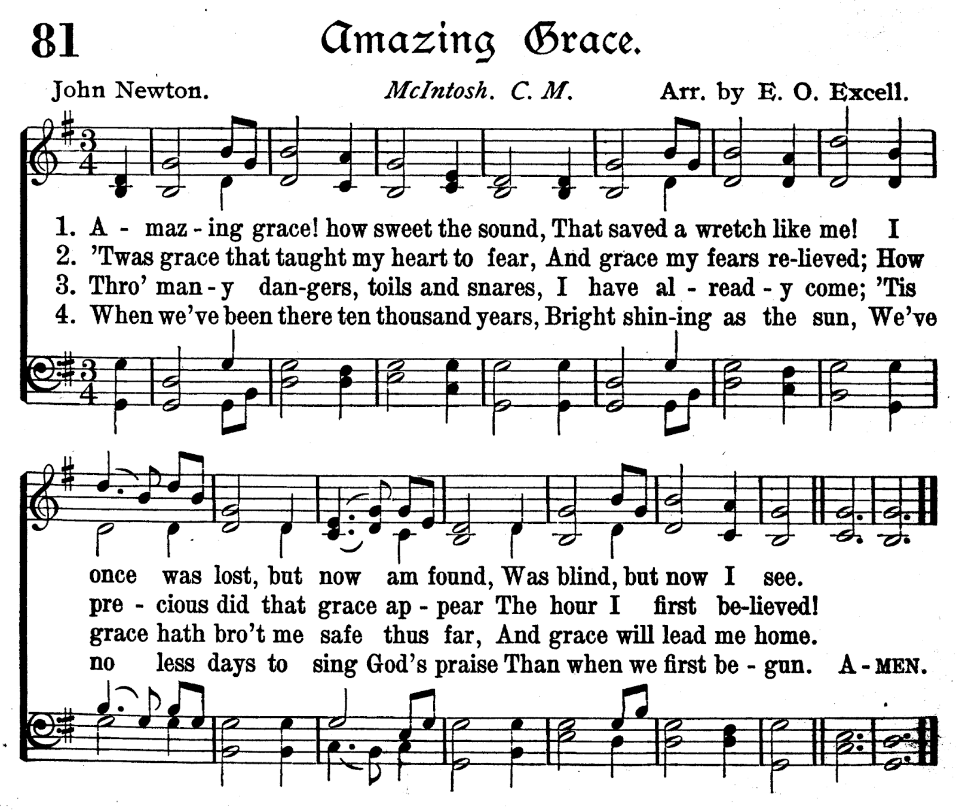
This Photo by Unknown Author is licensed under CC BY-SA-NC
Notes:
Famously quoted at the end of his life… “My memory is nearly gone; but I remember two things: that I am a great sinner, and that Christ is a great Savior”

Slide 13

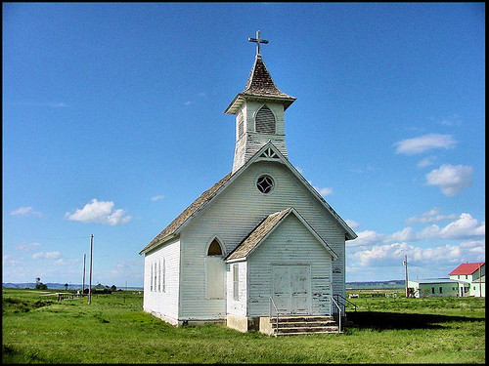
Stalled Out Church
Notes:
Just like individuals, churches can be WOKE but still cannot see
Can happen in even what I call the ”AP” churches
A question that came up at a Mennonite church in Chicago about Black Wallstreet in Tulsa (sideways form of being opposed to reparations)
How does the community ensure it keeps running the race (same issues as individuals but perhaps with bigger consequences)

Slide 14
Overcoming the Lack of Vision
Listen, then listen, then listen some more
Journey not a destination
Normalize the commitment
Review periodically
Keep listening, Keep Learning, Keep Growing

Slide 15

Notes:
Crazy attention with this shirt. Wore it to DC in May last year and everybody wanted one. Same thing happens when I am in town at speaking engagements (ex. Uni High)
Be willing to see the world differently
Public health identifies what is causing ill health for the public. Many would argue that the greatest increases in life expectancy was not due to medical innovation and technology nearly as much as public health efforts to control the spread of disease.
Florence Nightingale, another example of a life-long learner, realized that it would not matter how great of a surgeon a doctor was if he/she did not wash their hands before brain surgery
Today, public health departments have identified racism as the new cholera. Of course, racism has been around as long as cholera, but it is now becoming more apparent that it truly is a public health crisis (for everyone)

Slide 16
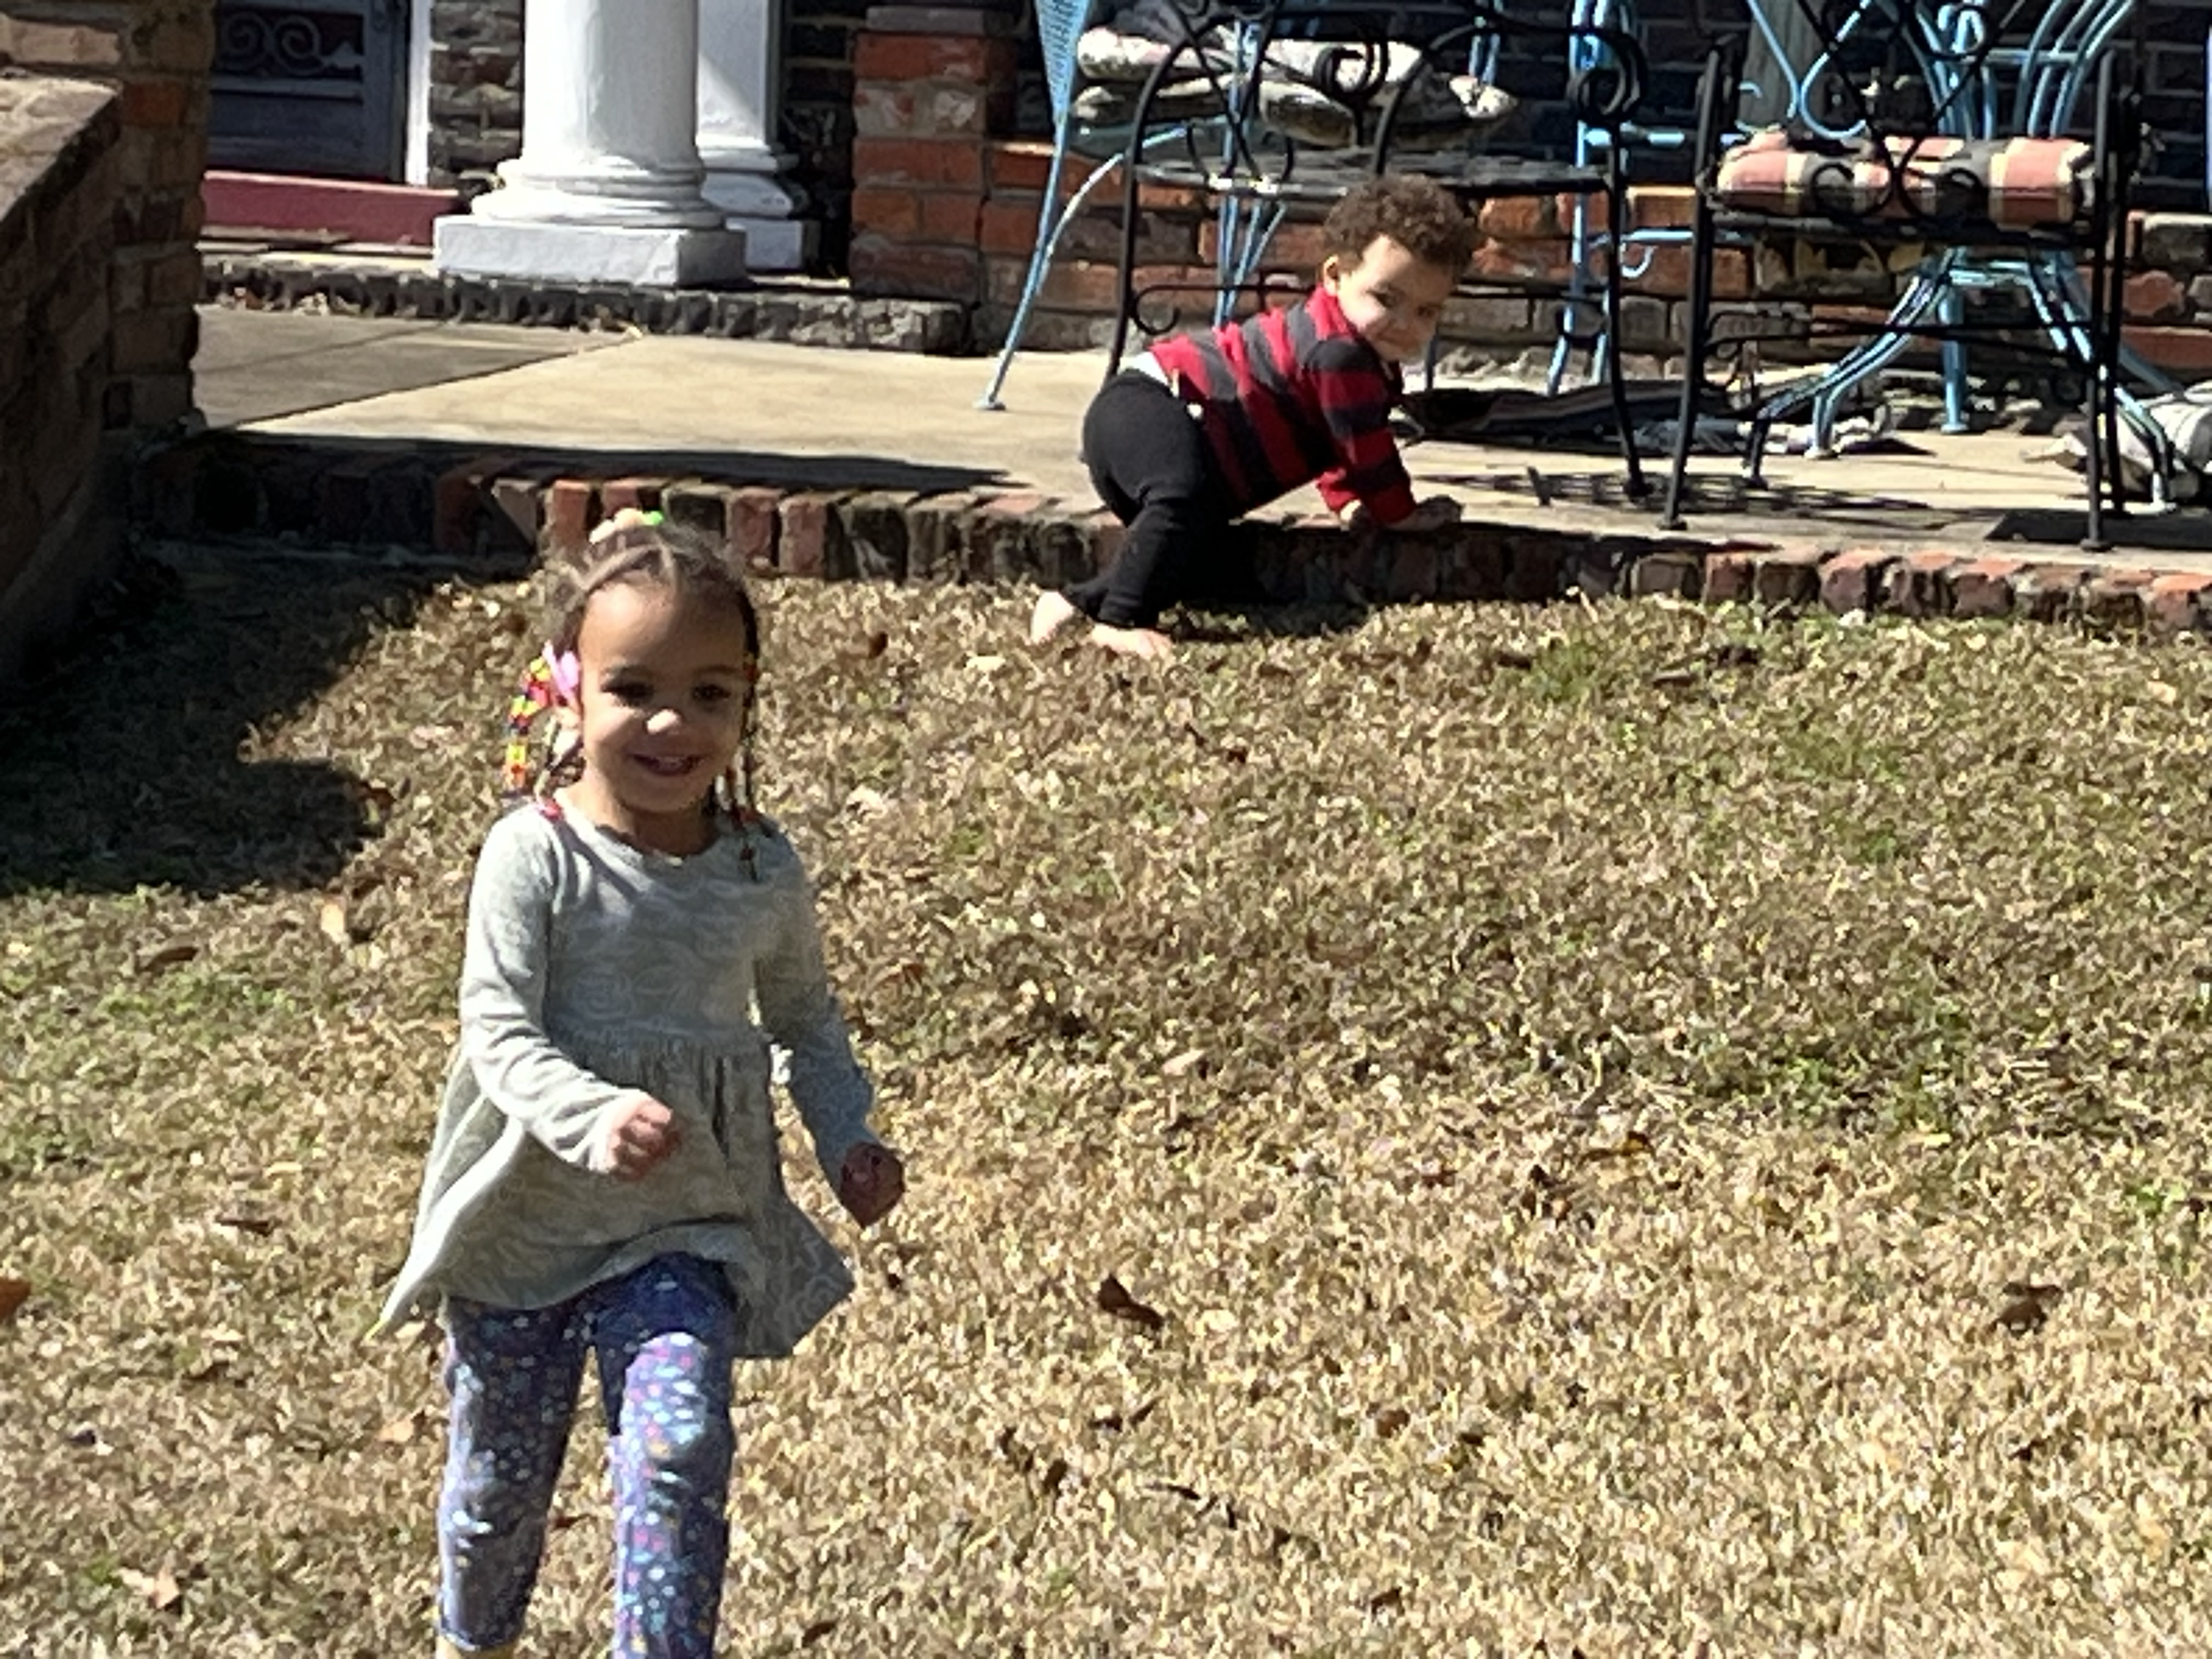
Notes:
So church, let’s not get left behind
Let’s race and reach forward for those things that are ahead for the prize of the high calling of God in Christ Jesus

Slide 17
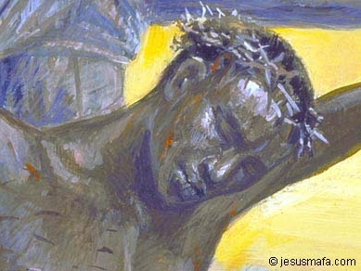
Notes:
As we continue through this season of Lent, let us remember the one who had all knowledge was humble enough to die on a cross for us know-it-alls.
I pray we continually work towards doing the same

