Slide 1

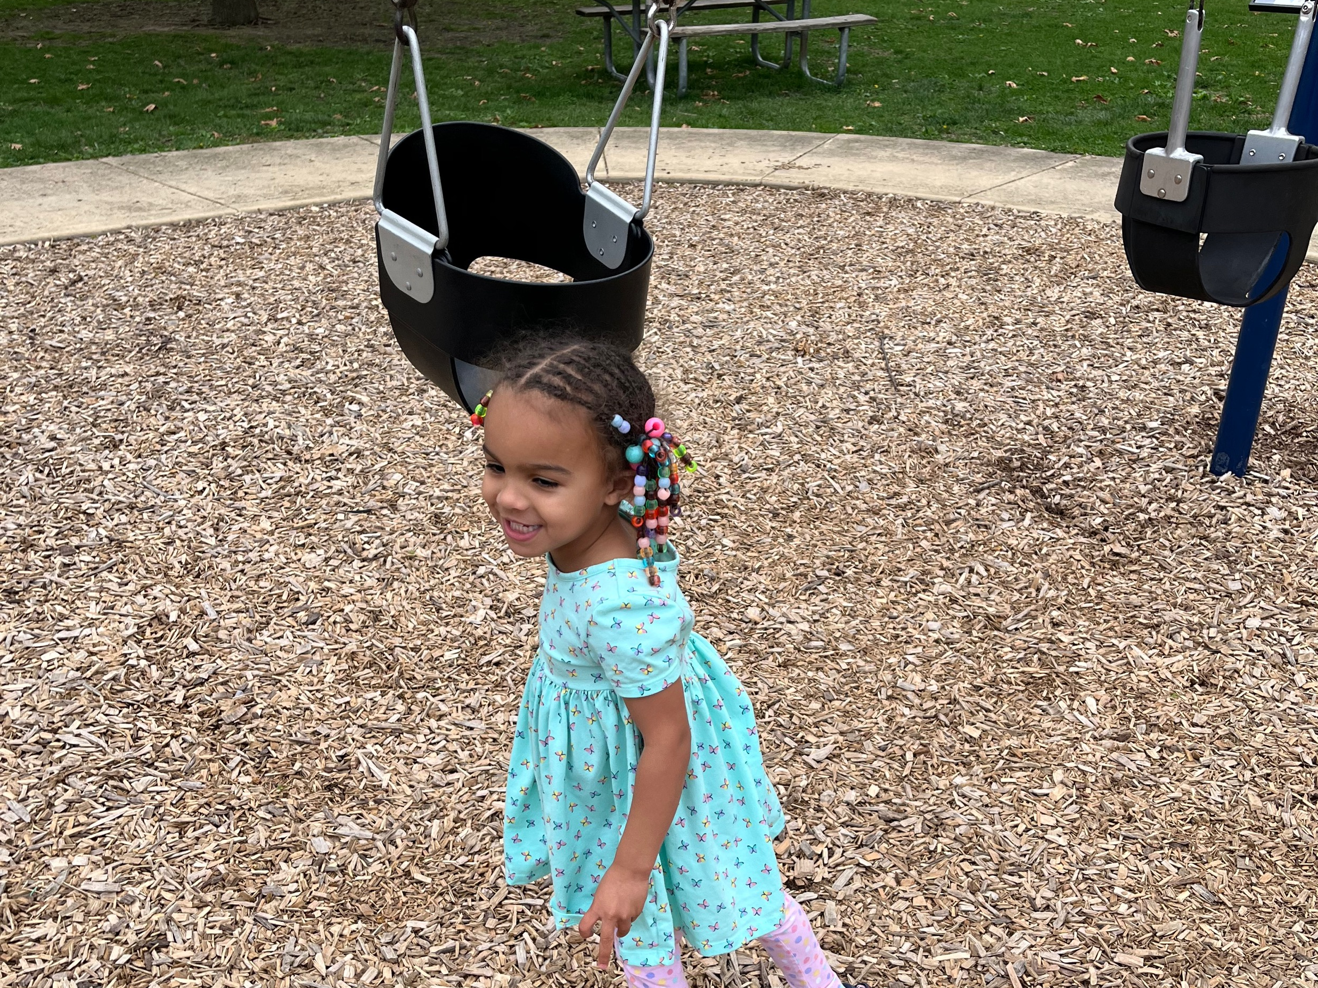


Notes:
What we do matters. As I have been discovering more about how our upbringings affect our today, I can’t help to think about how I might influence my grandchildren. Memories of my childhood started at 3 years old. Amaya’s current age.
My most vivid memory at that age included a day when my mom’s car broke down when she was taking nursing classes at a local college and her routine was to drop me off at the nearby preschool while she was in class.
I don’t know why but for whatever reason, the only option was to walk home – a 2 hour, 5 mile trek. What was significant about this experience was that I remember walking the entire way without needing to be picked up at all. It’s funny because when I told this story to my kids they did not believe me and we called my mom and she verified it.
I am not sure why this particular memory was retained over others, but the experience could have been thought of as a waste of time and/or energy. But it ended up being more than that in many ways. Besides me being able to brag about my walking prowess as a three-year-old and being able to use this story to give my kids some perspective, it gives me a good reminder of how everything we do or what happens to us matters. Even in this very moment.

Slide 2
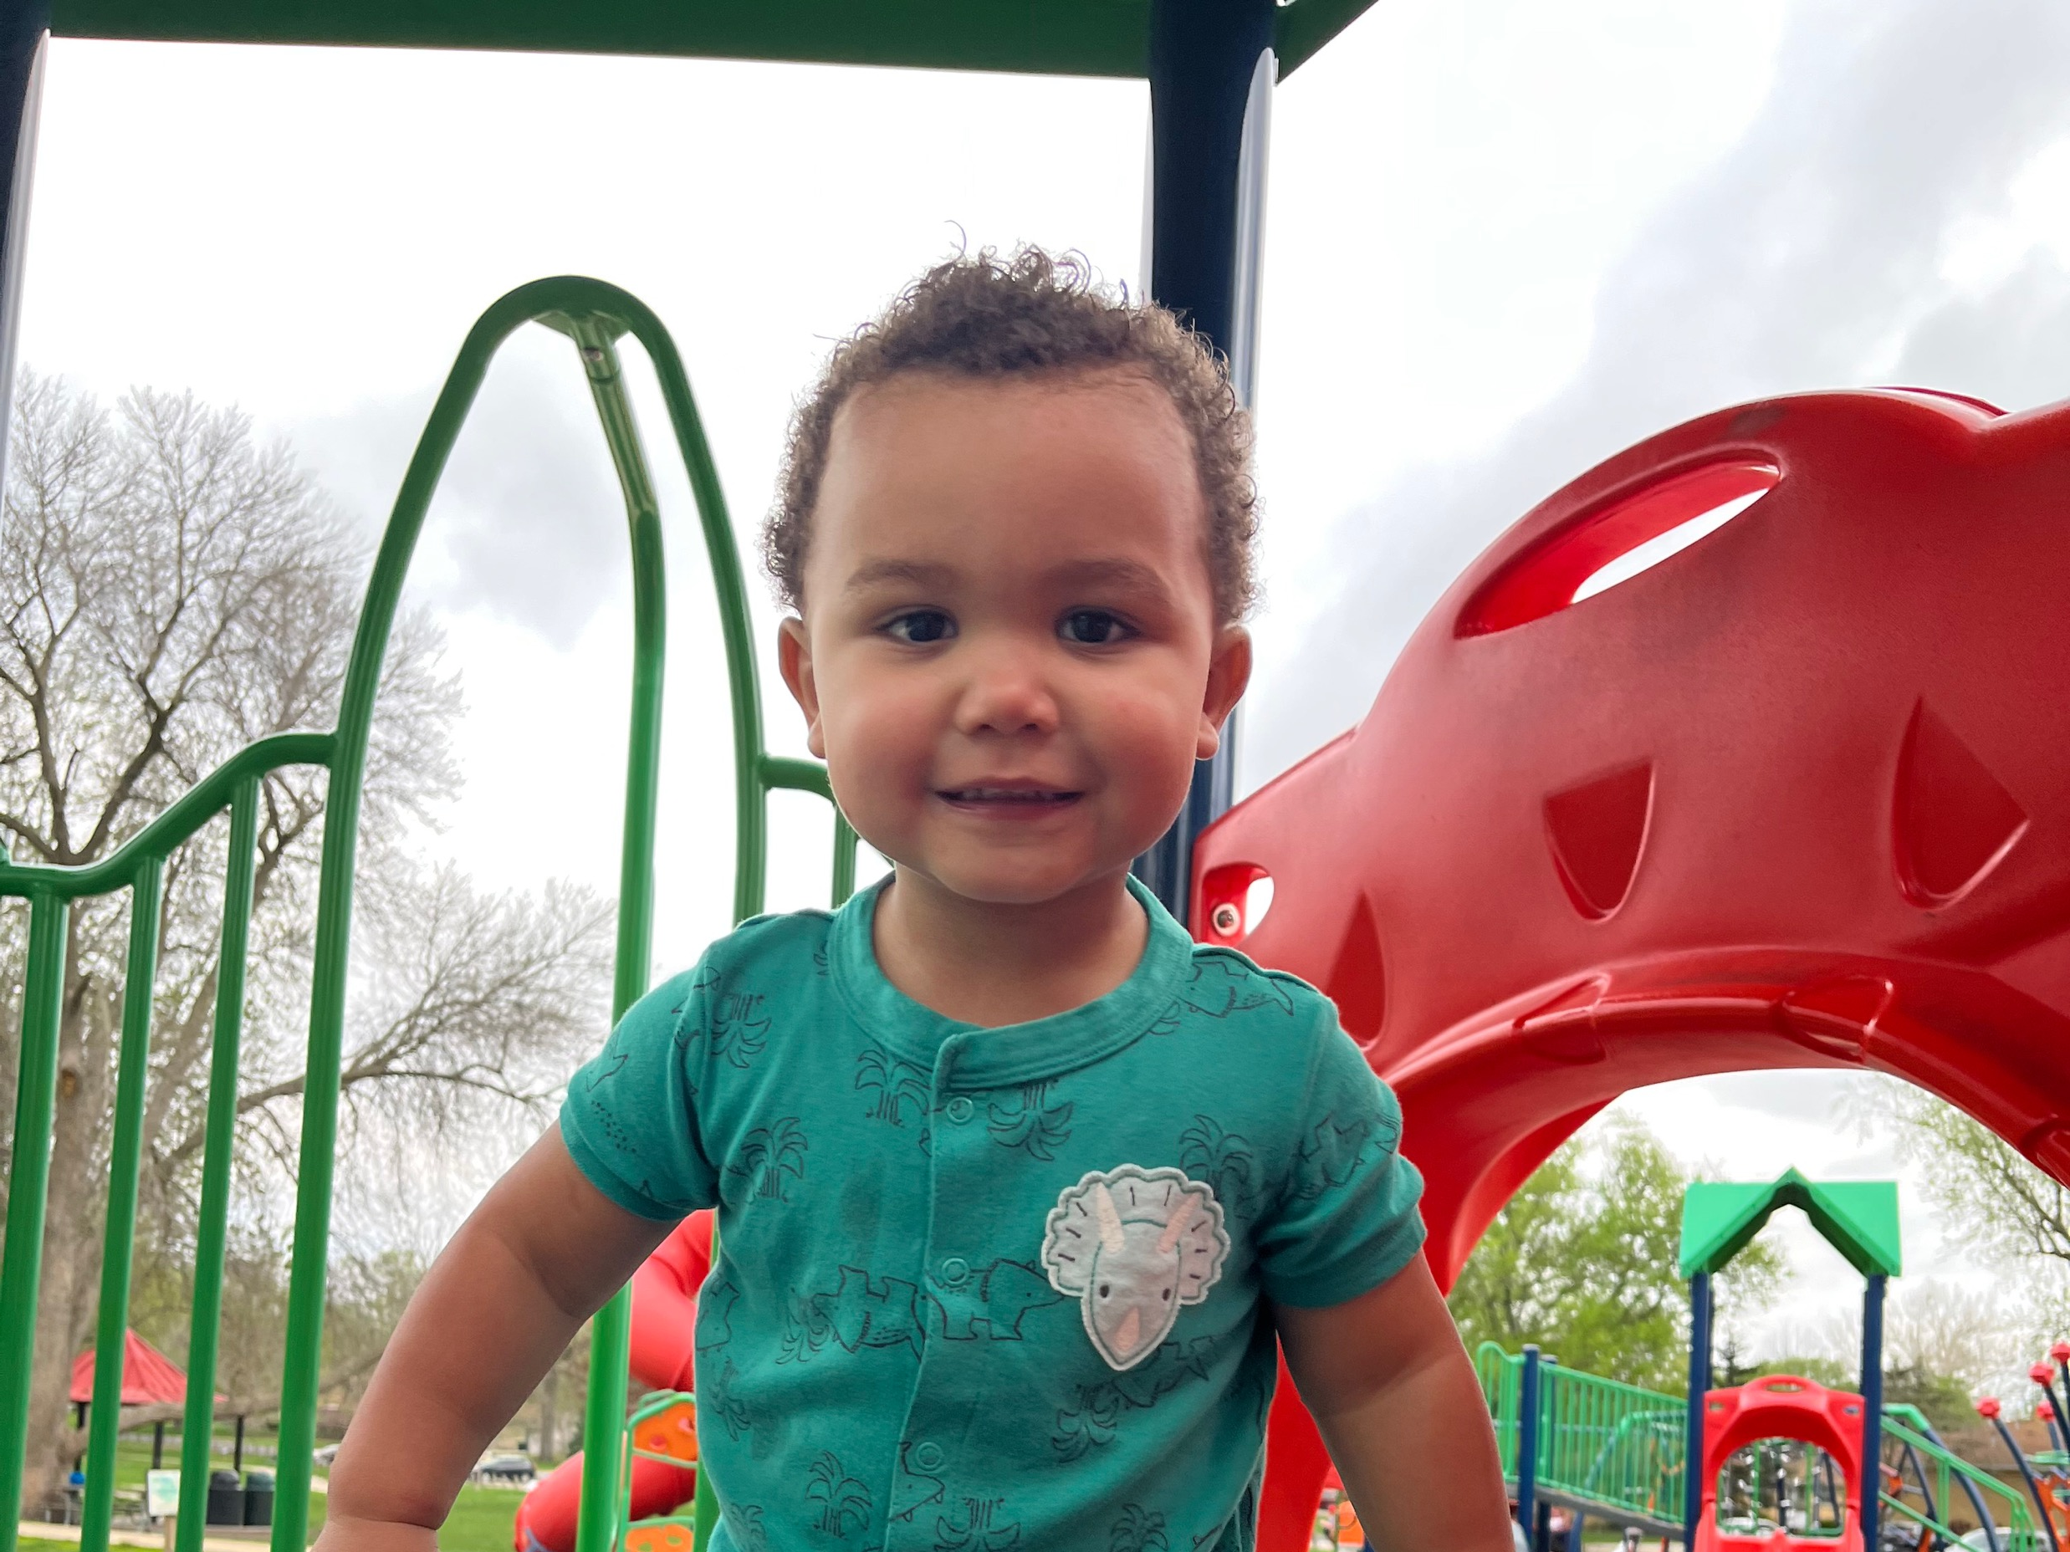
Notes:
As I show a picture of my one-year-old grandson, I am reminded that even if we do not remember things at that age, what happens still matters… maybe even more so before these memories form. We know, for instance, how crucial good prenatal care is for unborn children in their development throughout their lives.

Slide 3
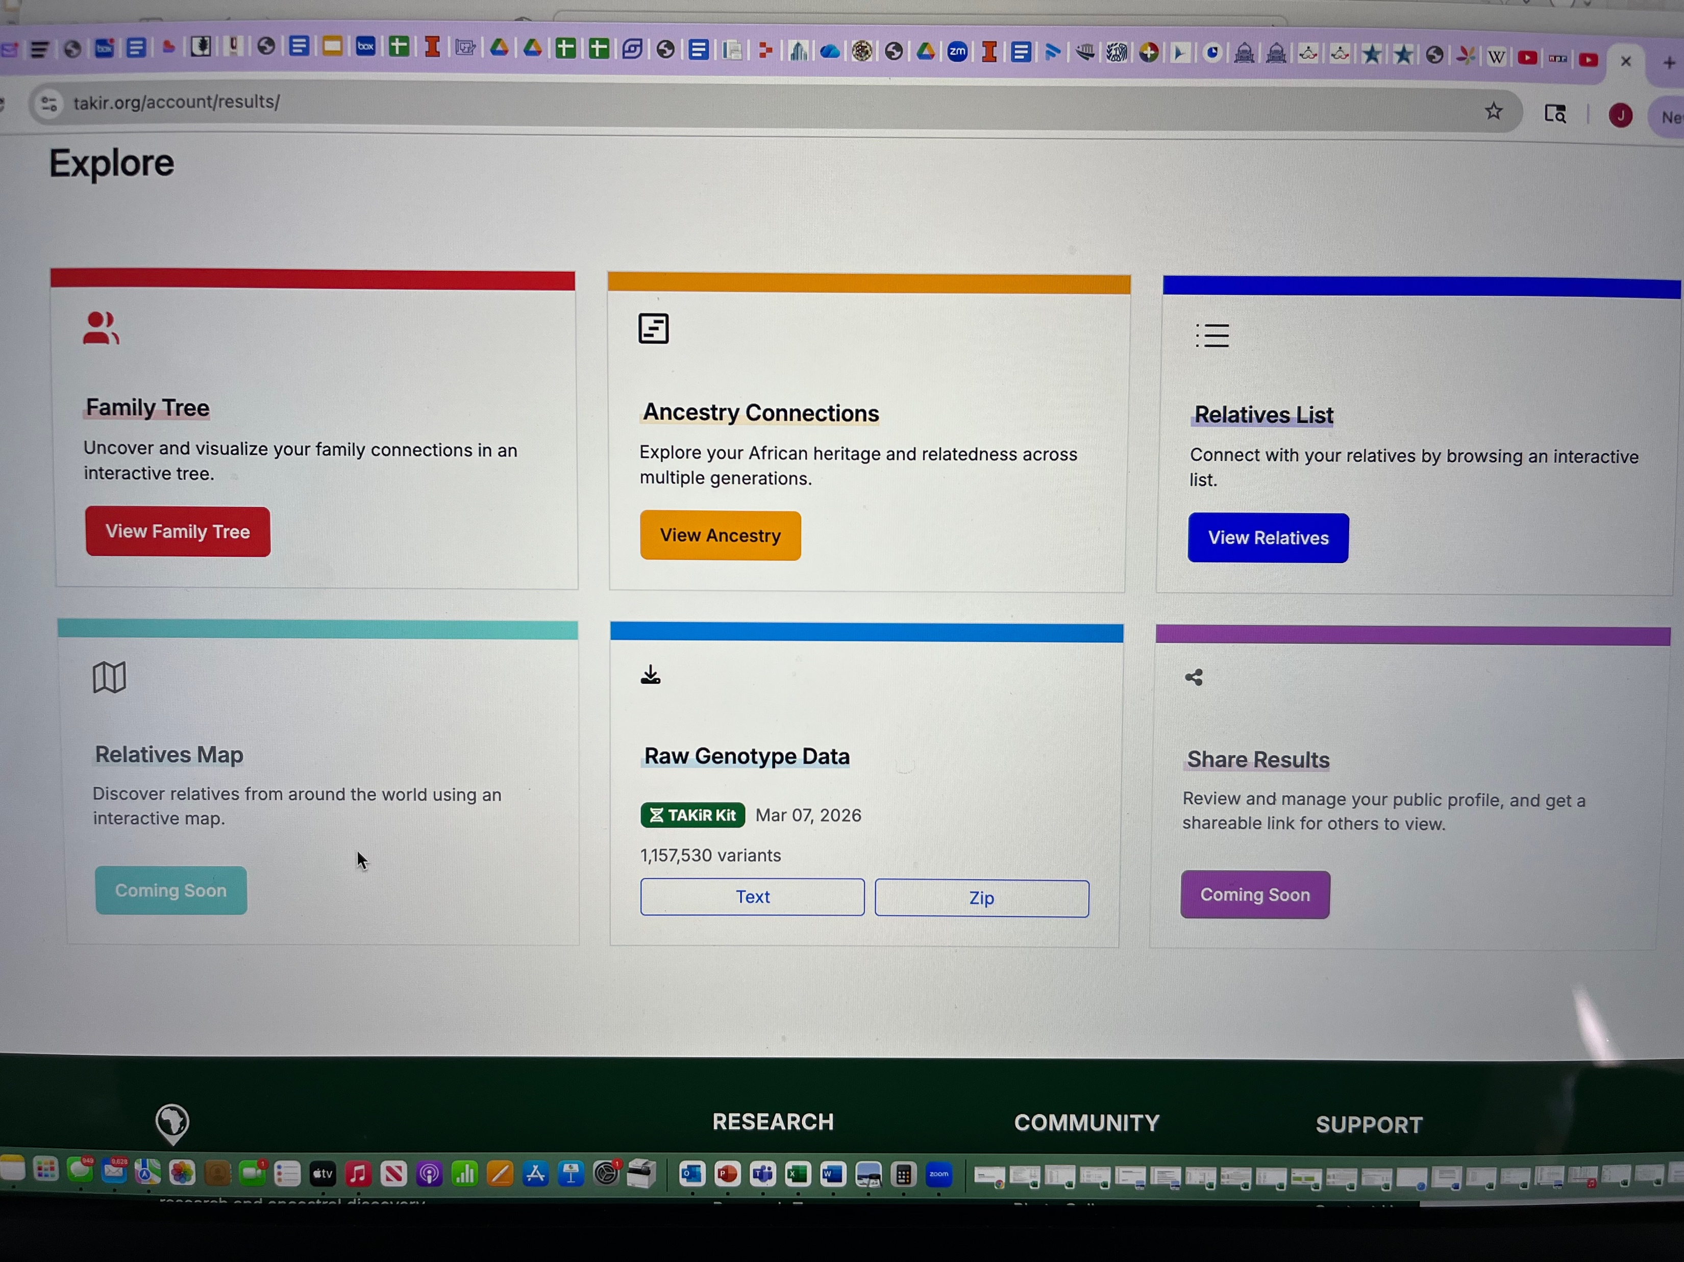
Notes:
I have gotten my DNA records recently, seeing a list of relatives not only from the US but from Ghana as well. I proudly claim my 9.31% Ghanaian background even though I am nearly 50% Nigerian (73% African overall). What’s fascinating about getting these results is seeing that I am made up of people from all over the globe. May be a small percentage but it’s in there.
This makes me think about how it took all these people to make me.
Such unexpected people such as my .83 Chinese, or .15 Northern India/Pakistani or .8 Native American (that one not as a surprise).
Even the unpleasant reality as 16.72% of me is from European ancestry, such as my .07 Scandinavian DNA. Also not a surprise as the last name Trask has English roots.
Every contribution to make me mattered. Nothing was wasted.

Slide 4
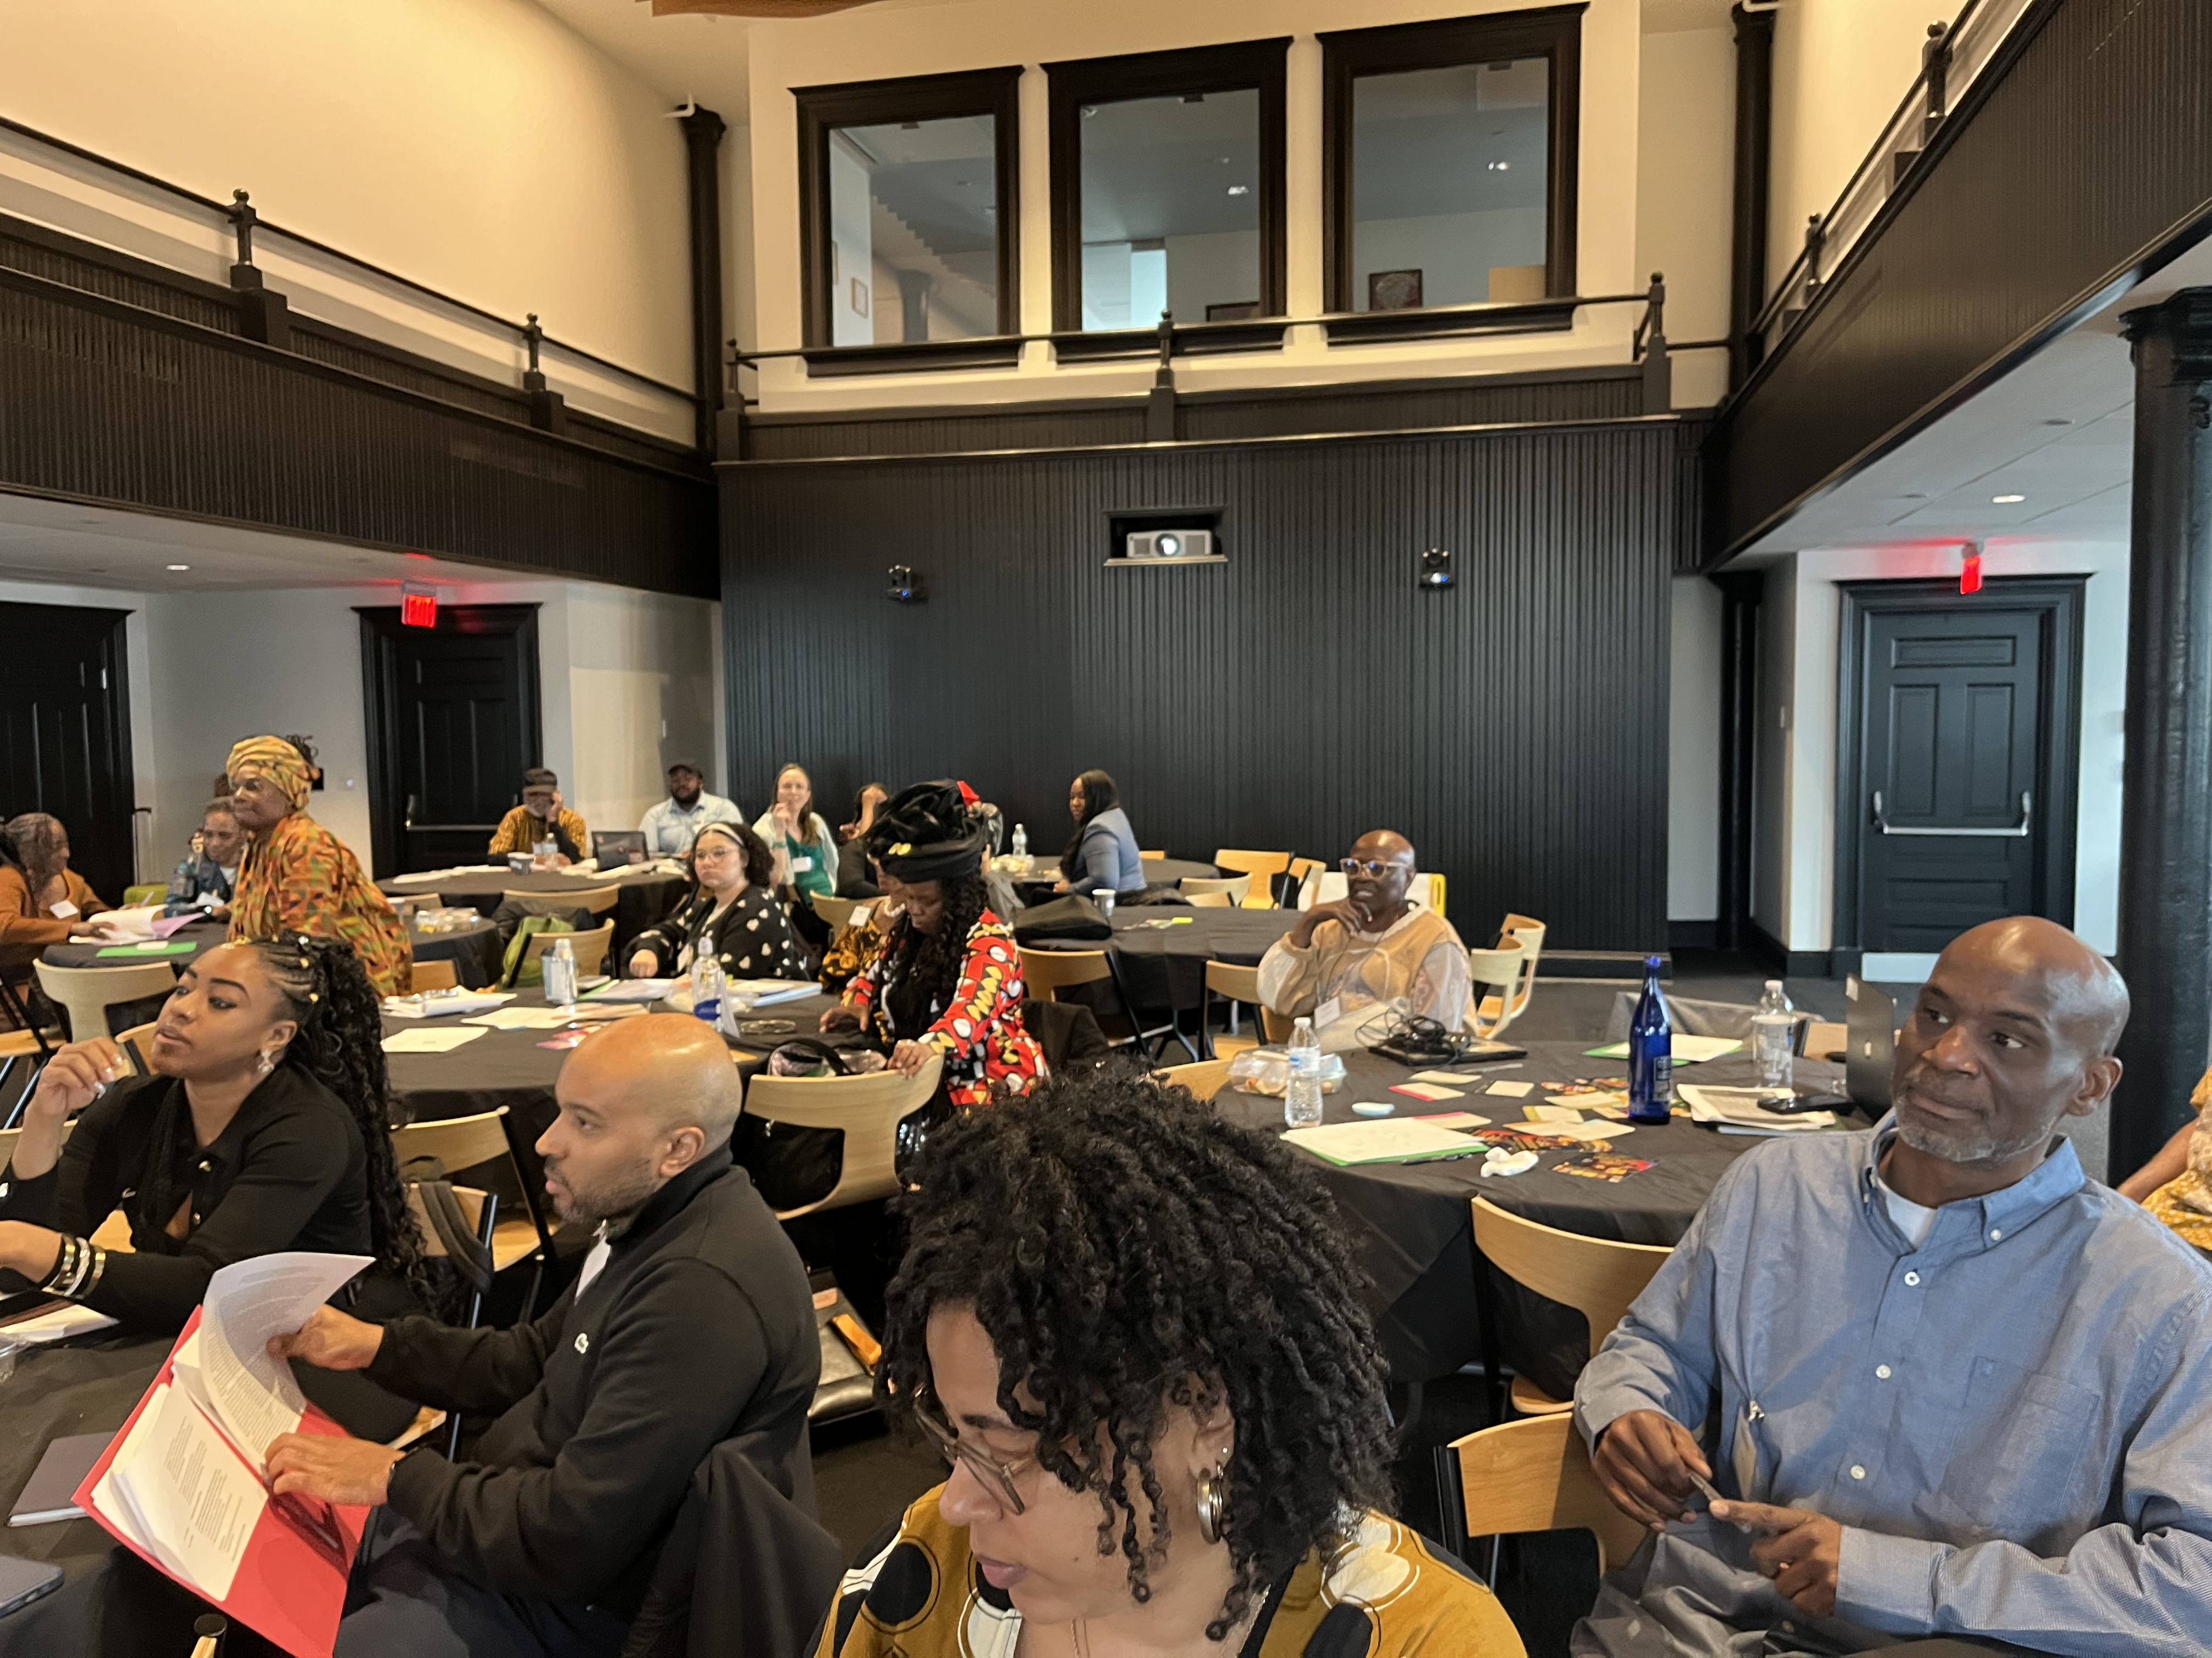
Notes:
I had a chance to go to a national reparations leaders meeting in Washington DC recently where about 50 or so people from all over the country gathered to strategize about making reparations an integral part of our nation’s culture and everyday life.
This kind of endeavor makes me think about all the contributions so many people made over the years for freedom, for equality, for justice. I think about every tear, every bit of energy used (physical, mental, spiritual, and emotional), every once of sweat excreted, every drop of blood shed, every resource utilized. I think about how all of those things add to the debt for black people as none of it should have been necessary and I think about how not an iota of any of it was wasted.

Slide 5
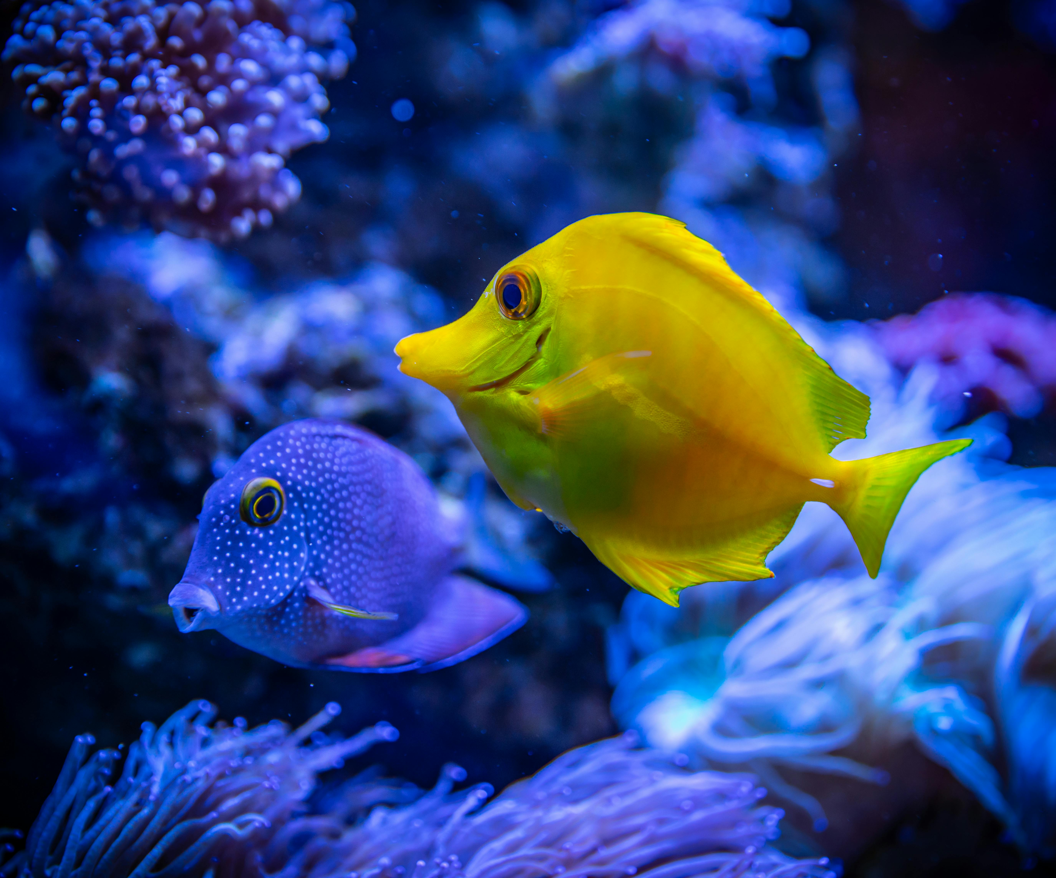
What The H___ Is Water?
Notes:
So much in life is normalized even when it probably should not be
Our minds adapt, we do what we must to survive, and may not sense crazy even when it’s for everyone to see
This applies in racial justice
Today, I want to think about the concept that “Nothing is Wasted” with that saturation in mind

Slide 6

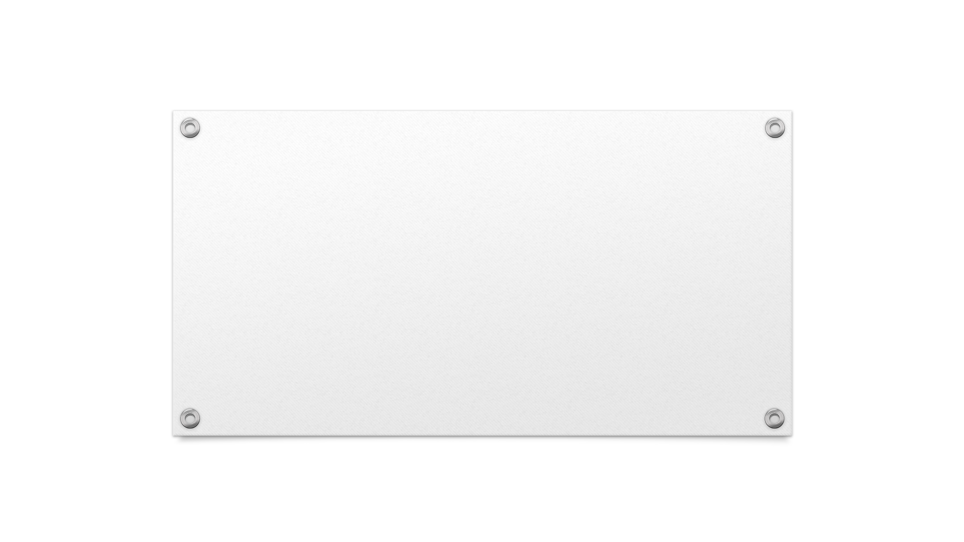

Nothing Wasted
And we know that in all things God works for the good of those who love him, who^{[i]} have been called according to his purpose.
Romans 8:28
Notes:
We know the term woke has been used to describe a sensitivity to others and interestingly and ironically even, it is used as a criticism
Apparently, there are those that believe being asleep is the way to go
But my teaching is not geared towards people that refuse to be awake, but for us that are awake but still cannot see. I believe no one is exempt from this condition in some area in their lives. Some areas, we are open to learning and growth while other areas we feel we have it all figured out
It is difficult to press toward the mark for the prize when you think you have already passed the finish line

Slide 7
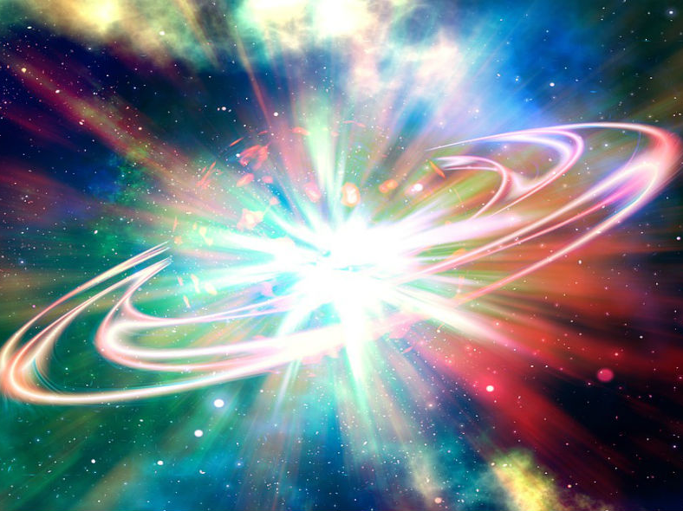
Notes:
I am going to get a little existential for a moment.
Did you know that according to the most modern science we have available today from the most brilliant minds, that we all are 13.8 billion years old.
Yeah, I know your first thought is all the birthdays you missed that you could have gotten presents for all this time.
Whether the latest science or biblical instruction, everything comes from the same source
God is Everything, Everything is God. God created EVERYTHING and scientifically speaking we are all made out of the same stuff.
How can anything be wasted? There are disposable parts of God is there?

Slide 8
Time
Time is never wasted
Notes:
If you’re like me, you may feel guilty when you do things that seem like a waste of time. After all, there are so many “significant” things to do in life, who are we to waste the precious little time we have.
And time does indeed fly by. There’s probably a reason Paul described life like a vapor that vanishes away. When I think about being 50, I especially wonder where the time went when I play basketball. I watch some of these young guys and think to myself, “I used to be able to do that”. Now, I am proud just to be on the court and be called Old School by the young guys. It did not seem that long ago when I was playing with those old school guys thinking how easy it is to run around them.
The reality is that despite what we do with our precious time, it all matters. Nothing is truly wasted. If you are resting, your body probably needs it, if you are zoning out, your mind probably needs a break, if you are waiting somewhere, your life probably needs to slow down anyway.

Slide 9
Joseph
Seemed like a waste at the time
Notes:
You may be thinking, but Jeff, surely everything is not meaningful and useful TO US. And I’d say, you are right, not to us… but I would still contend nothing is wasted from a God perspective.
If you were to ask Joseph when his brothers sold him into slavery, at that moment, he’d say it was a waste of time and energy.
If you were to ask Joseph when he was imprisoned for years after being falsely accused, at that time, he’d say it was a waste of time and energy.
But after all was said and done, Joseph came to the same conclusion that we read in Romans 8: 28. God did not say that all things are good, it says God works all things for good.
In, Genesis 50:20, when Joseph reveals himself to his brothers, he says, “You meant evil against me, but God meant it for good”
Of course, as the story goes, Joseph’s experience allowed God’s people to survive a 7-year drought due to Joseph becoming a top leader in Egypt, guiding the Pharoah

Slide 10
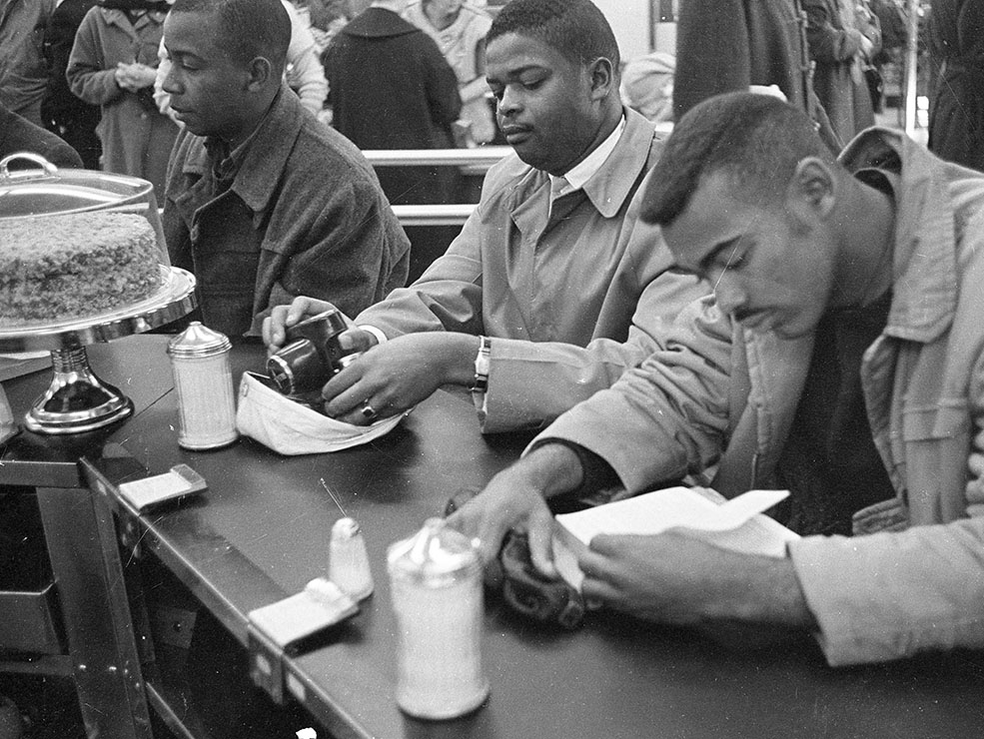
Notes:
Brutalized, Arrested, Put in Prison, and Repeat (wash, rinse, repeat)
Seemed like a waste at the time (frustration birthed the Black Power Movement)
King, “Where Do We Go From Here?”
Every once of sweat, every tear, every drop of blood, every blow, every insult, every heartbreak, every moment of stress, should not have been needed
King was feeling despair and frankly sounded frustrated and hopeless even. However, he knew it all mattered even though he realized the struggle would go far beyond his lifetime.

Slide 11
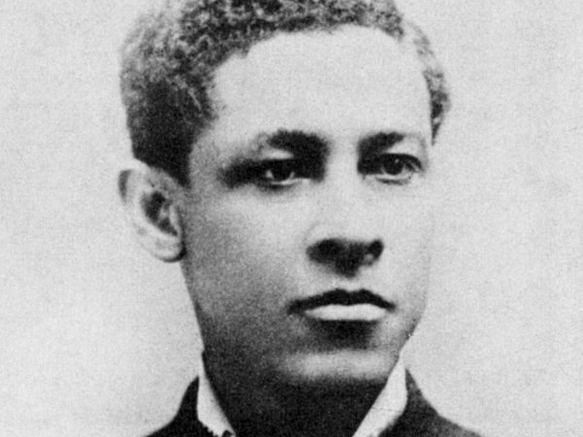
These Shoes Were Made for Walking
Notes:
American History (Black History)
Matzeliger obtained a patent for his invention of an automated shoe-lasting machine in 1883
NIKE can thank Jan Ernst Matzeliger
Probably felt like a waste to come up with such a meaningful invention only to see it be used by others and you not benefit from your labor and expertise

Slide 12
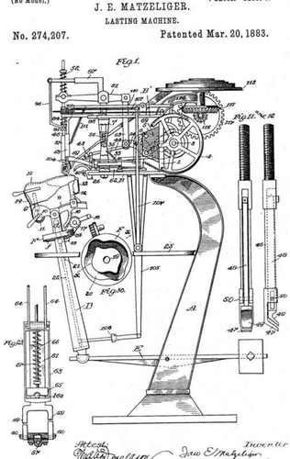
Notes:
So many things can feel like they have been lost, wasted, forgotten, considered insignificant, but to God, it is ALL MEANINGFUL

Slide 13



What Do You Feel Was Wasted?
Notes:
You might feel like certain parts of your life were wasted
Whether it feels like missed opportunities, time spent at a unfulfilling job, or delayed or unrealized dreams
Whether we see it or not, God uses it. For us, it can be painful, unjust, unfair, and just plain suck. But know that nothing is wasted.

Slide 14
Change in Perspective
Appreciation for the “little things”
Engaging in each moment when traveling
Yard waste as future life
Notes:
How holding this mind set might help deal with those painful, unjust, unfair, sucky parts of life.
Taking a breath (let’s try that together)
Taking a walk, or experience nature in some way
View everything around you having purpose even if we tend to not value it (insects, yard waste, etc)
Appreciating the “in-between” time (such as with traveling somewhere)

Slide 15
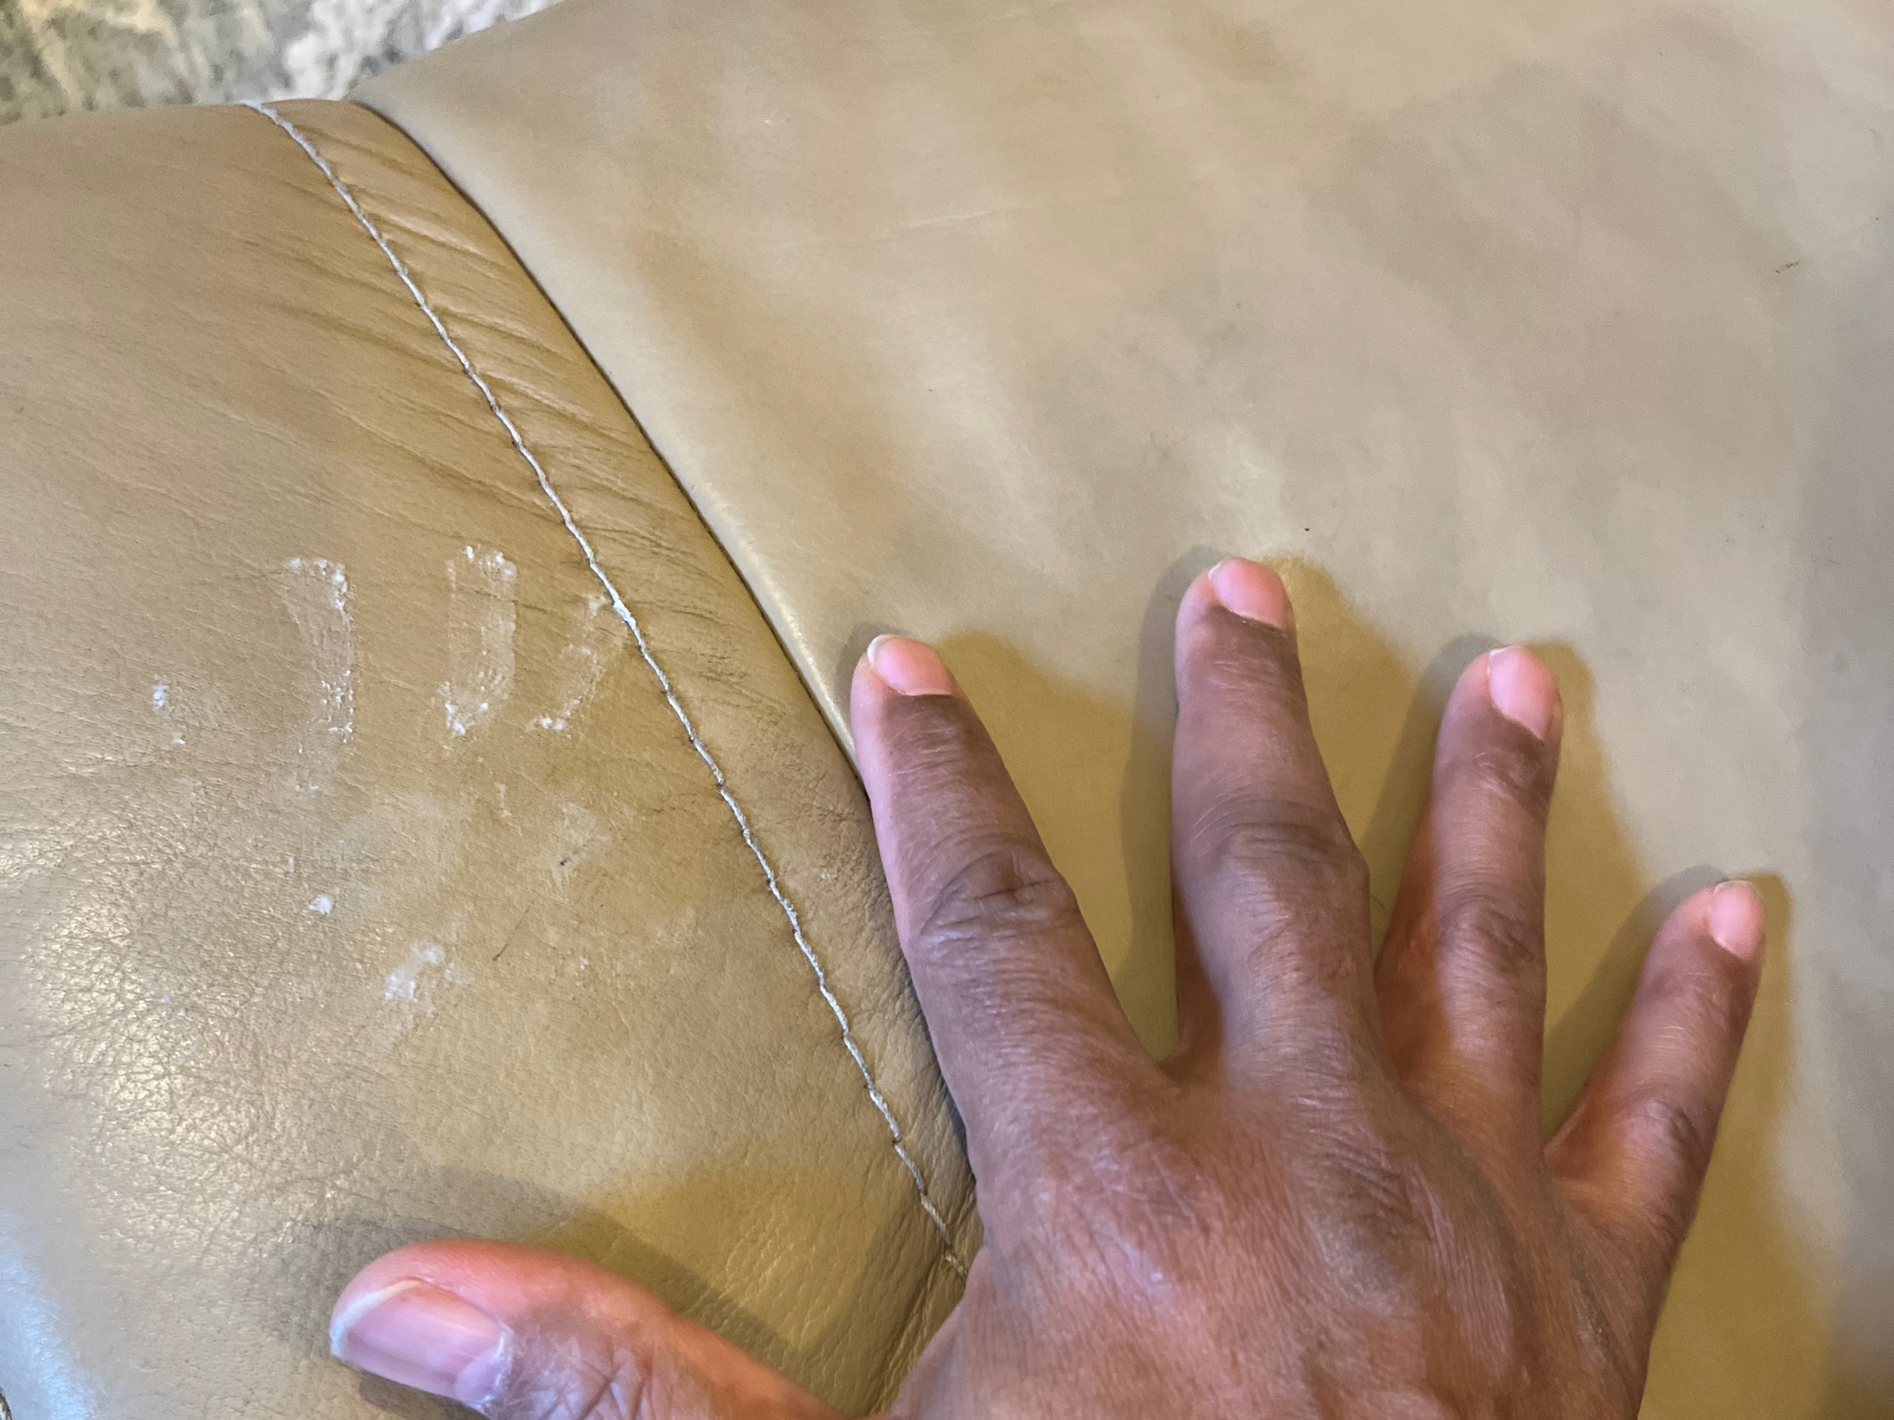
Notes:
I know this can all feel very elusive.
Found some evidence that NOBODY exists... First clue I have obtained in 29 years of parenting.

Slide 16
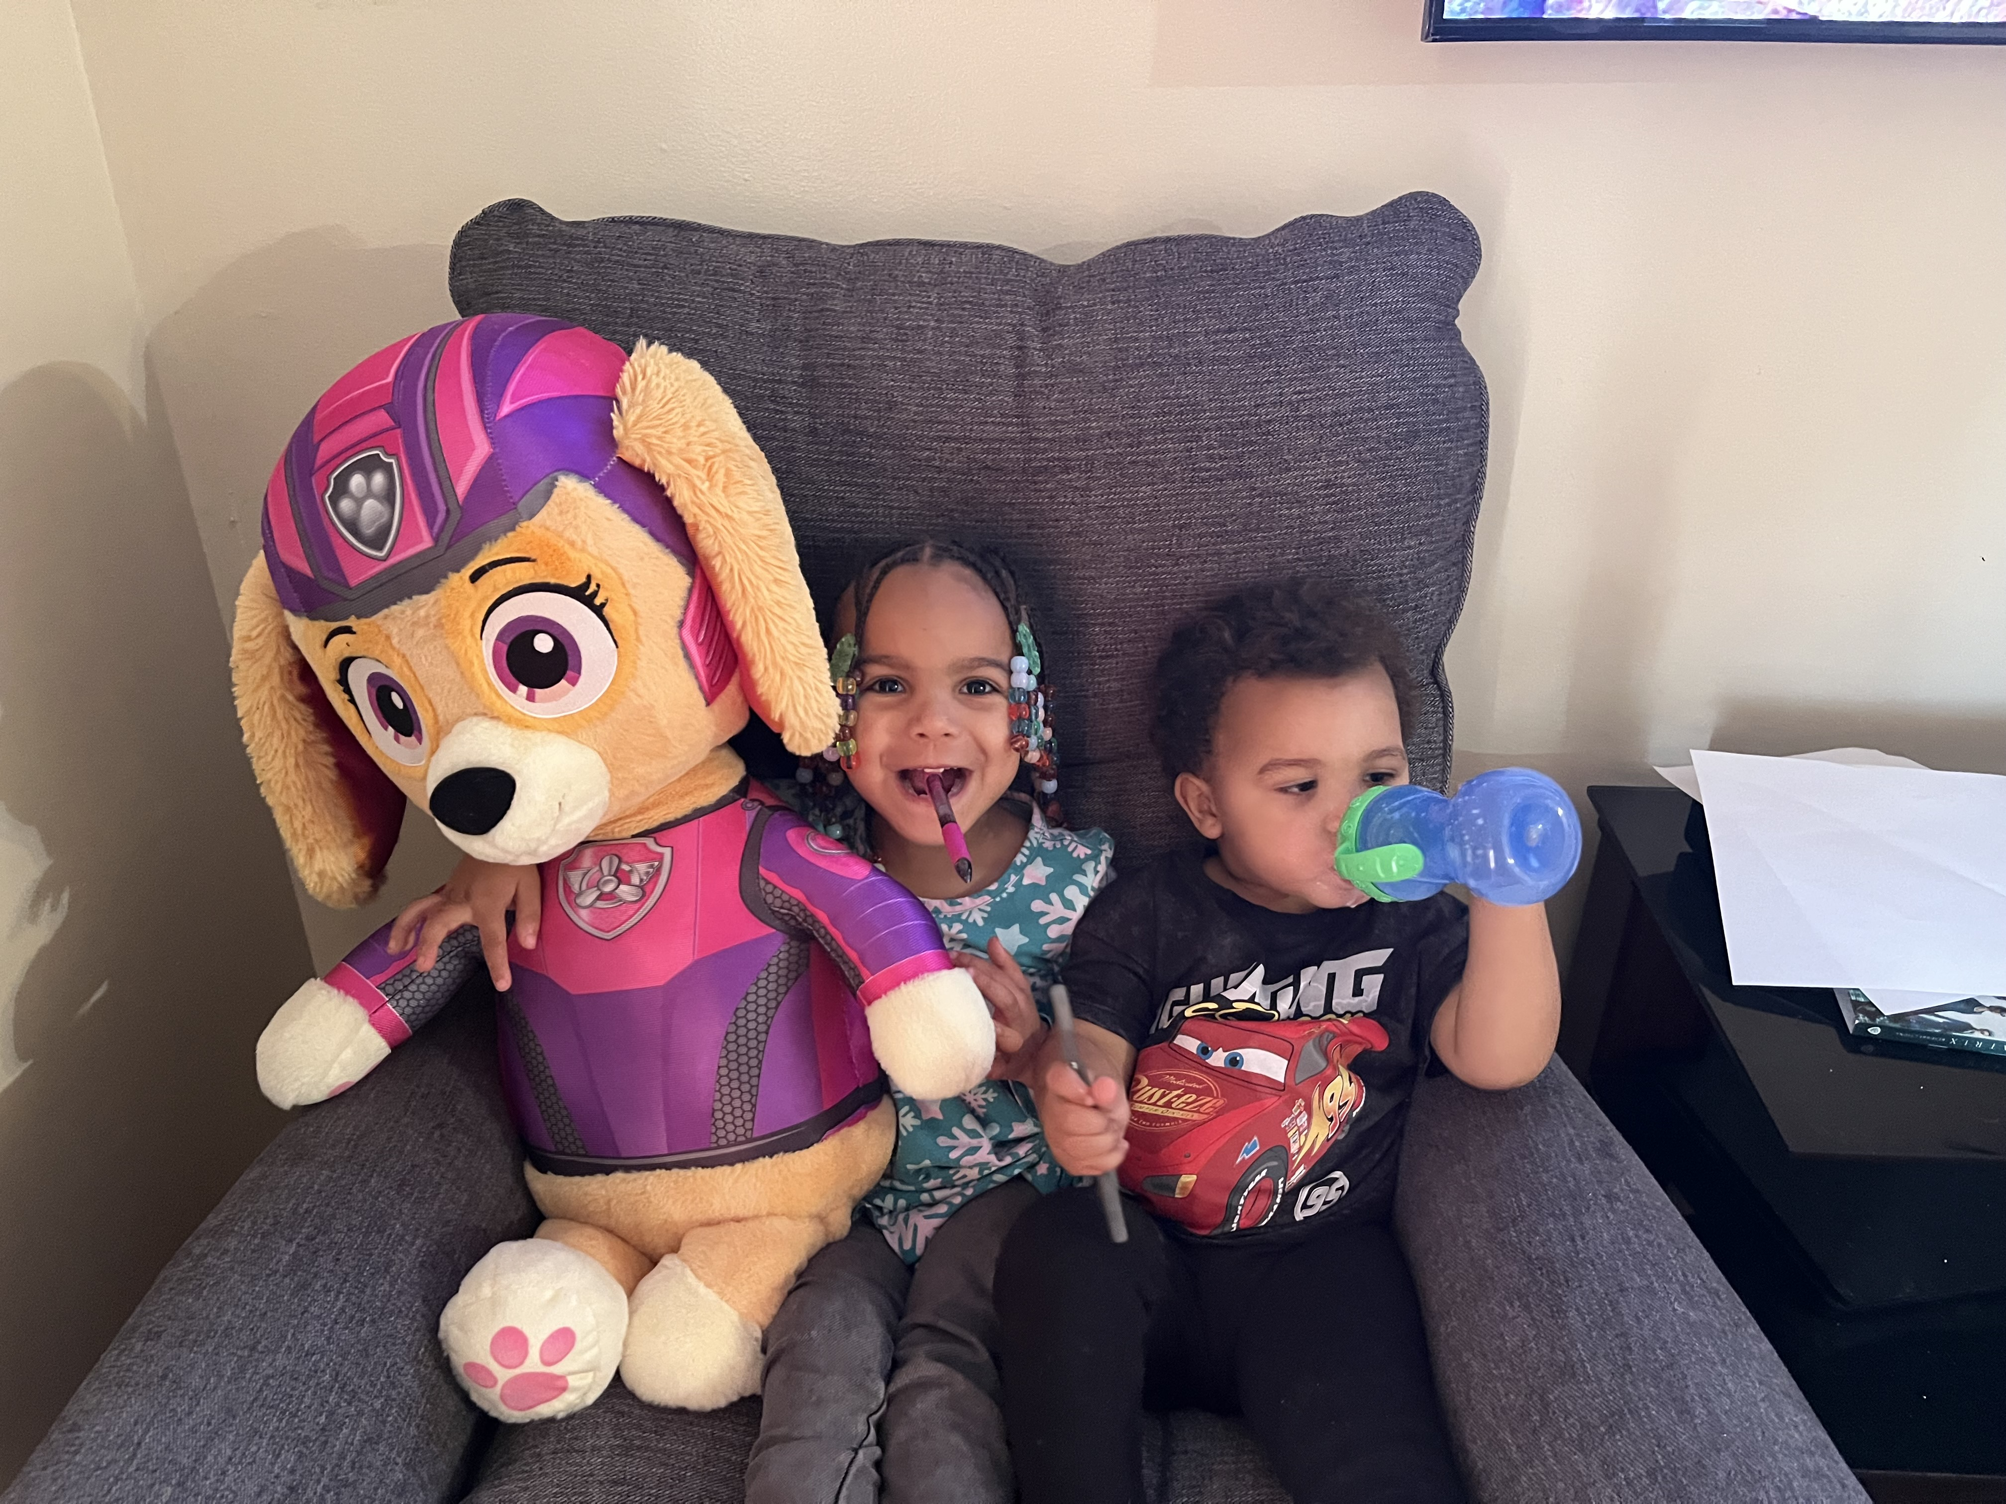
Notes:
Narrowed it down to two suspects
As elusive as NOBODY has been, finding comfort in the fact that God does not waste anything does not have to be as elusive

Slide 17
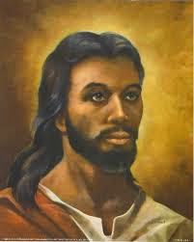
Notes:
You know what else probably seemed like a waste?
Three years of ministering to disciples and thousands of people only to find yourself persecuted, tortured, and put up on a cross.
In the moment, no one but Jesus knew the significance of this action and what would result from it thousands of years later.
I can’t imagine how painful, unjust, unfair, and just plain sucky that whole experience must have been.
But now, we get to live in the reality that God used it for good. Just as God does with everything.

