Slide 1


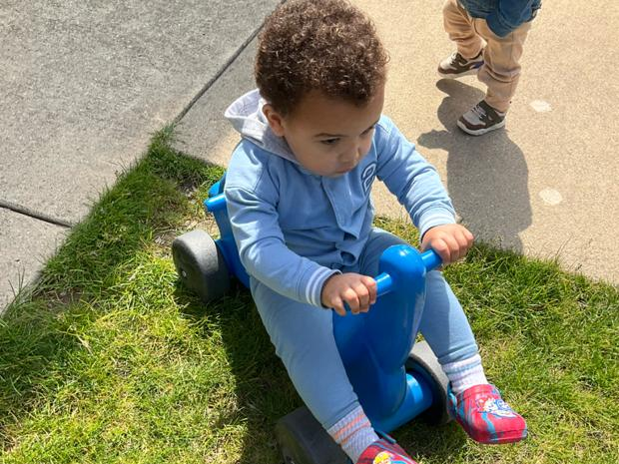

Notes:
Goanna be in Chambana.
New Daycare/School for Amari and Amaya

Slide 2
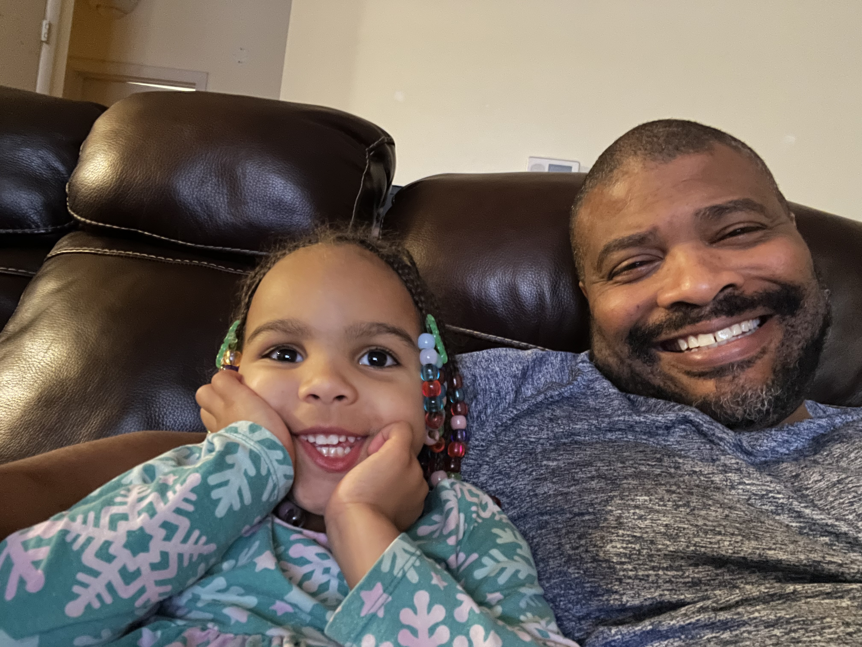
Notes:
Not too many better things than sitting with Amaya while she enjoys Paw Patrol

Slide 3
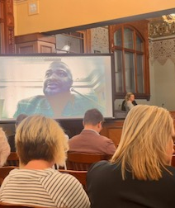
Notes:
Another trip to Springfield to convince the state to provide more resources to help free clinics serve those most in need
Been a part of IAFCC for over 15 years, on the board for about 12 years. Currently, serving as the vice chair after being the chair for 7-8 years or so.

Slide 4
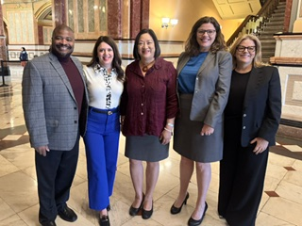
Notes:
Springfield Hearing – IAFCC Health and Hunan Services Appropriations Committee
Shout out to Representative Mah (center of picture) who has been IAFCC champion for years now

Slide 5
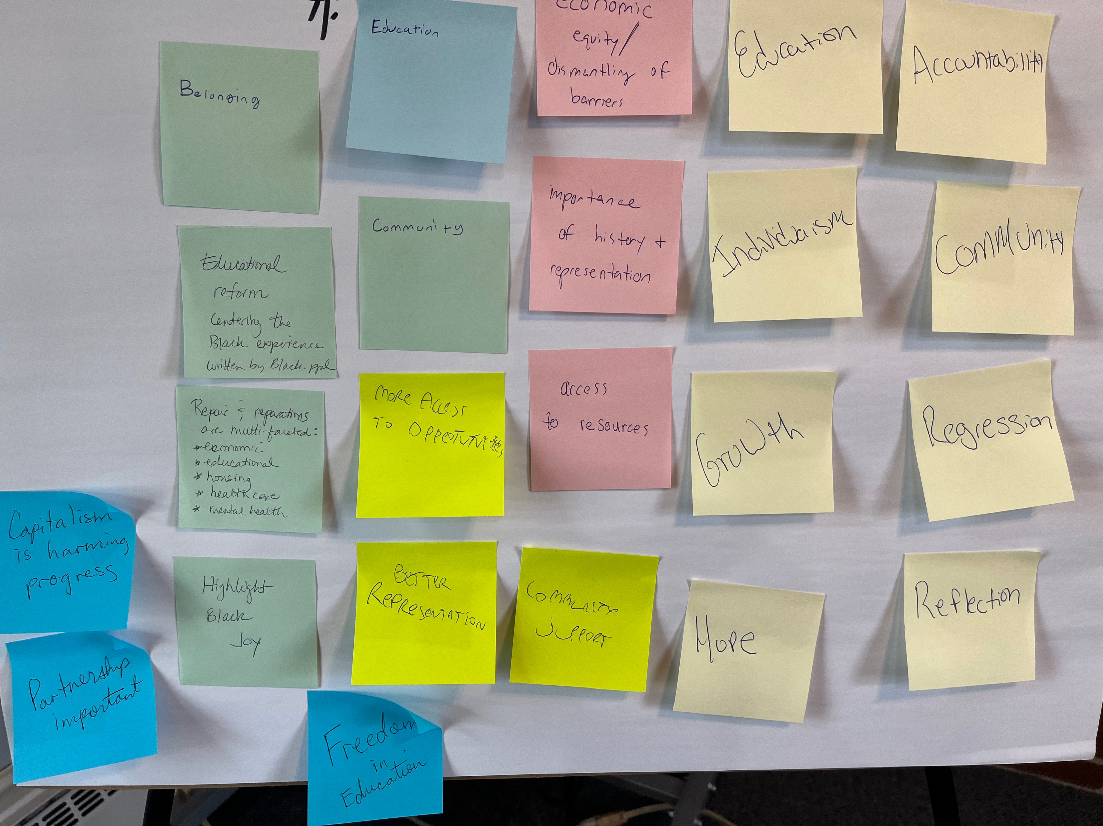
Notes:
Circle of Repair Group that met at First Mennoonite
Confirms that racial pain is universal
Just having a 90-minute discussion was therapeutic, revelatory, heart wrenching, and hopeful

Slide 6

Notes:
Reparations Evaluation Community of Practice (RECOP) – funded by RWJF
Planning and preparing strategy concerning how to evaluate reparations efforts, programs, policies, legislation, etc.
Is also centered on grounding, emotional health, rest, and being in community
Charleston, SC

Slide 7

Notes:
Quite the location to meet about reparations - as Charleston, SC was the delivery site for 40—50% of enslaved people from Africa
To say I had mixed emotions would be an understatement

Slide 8
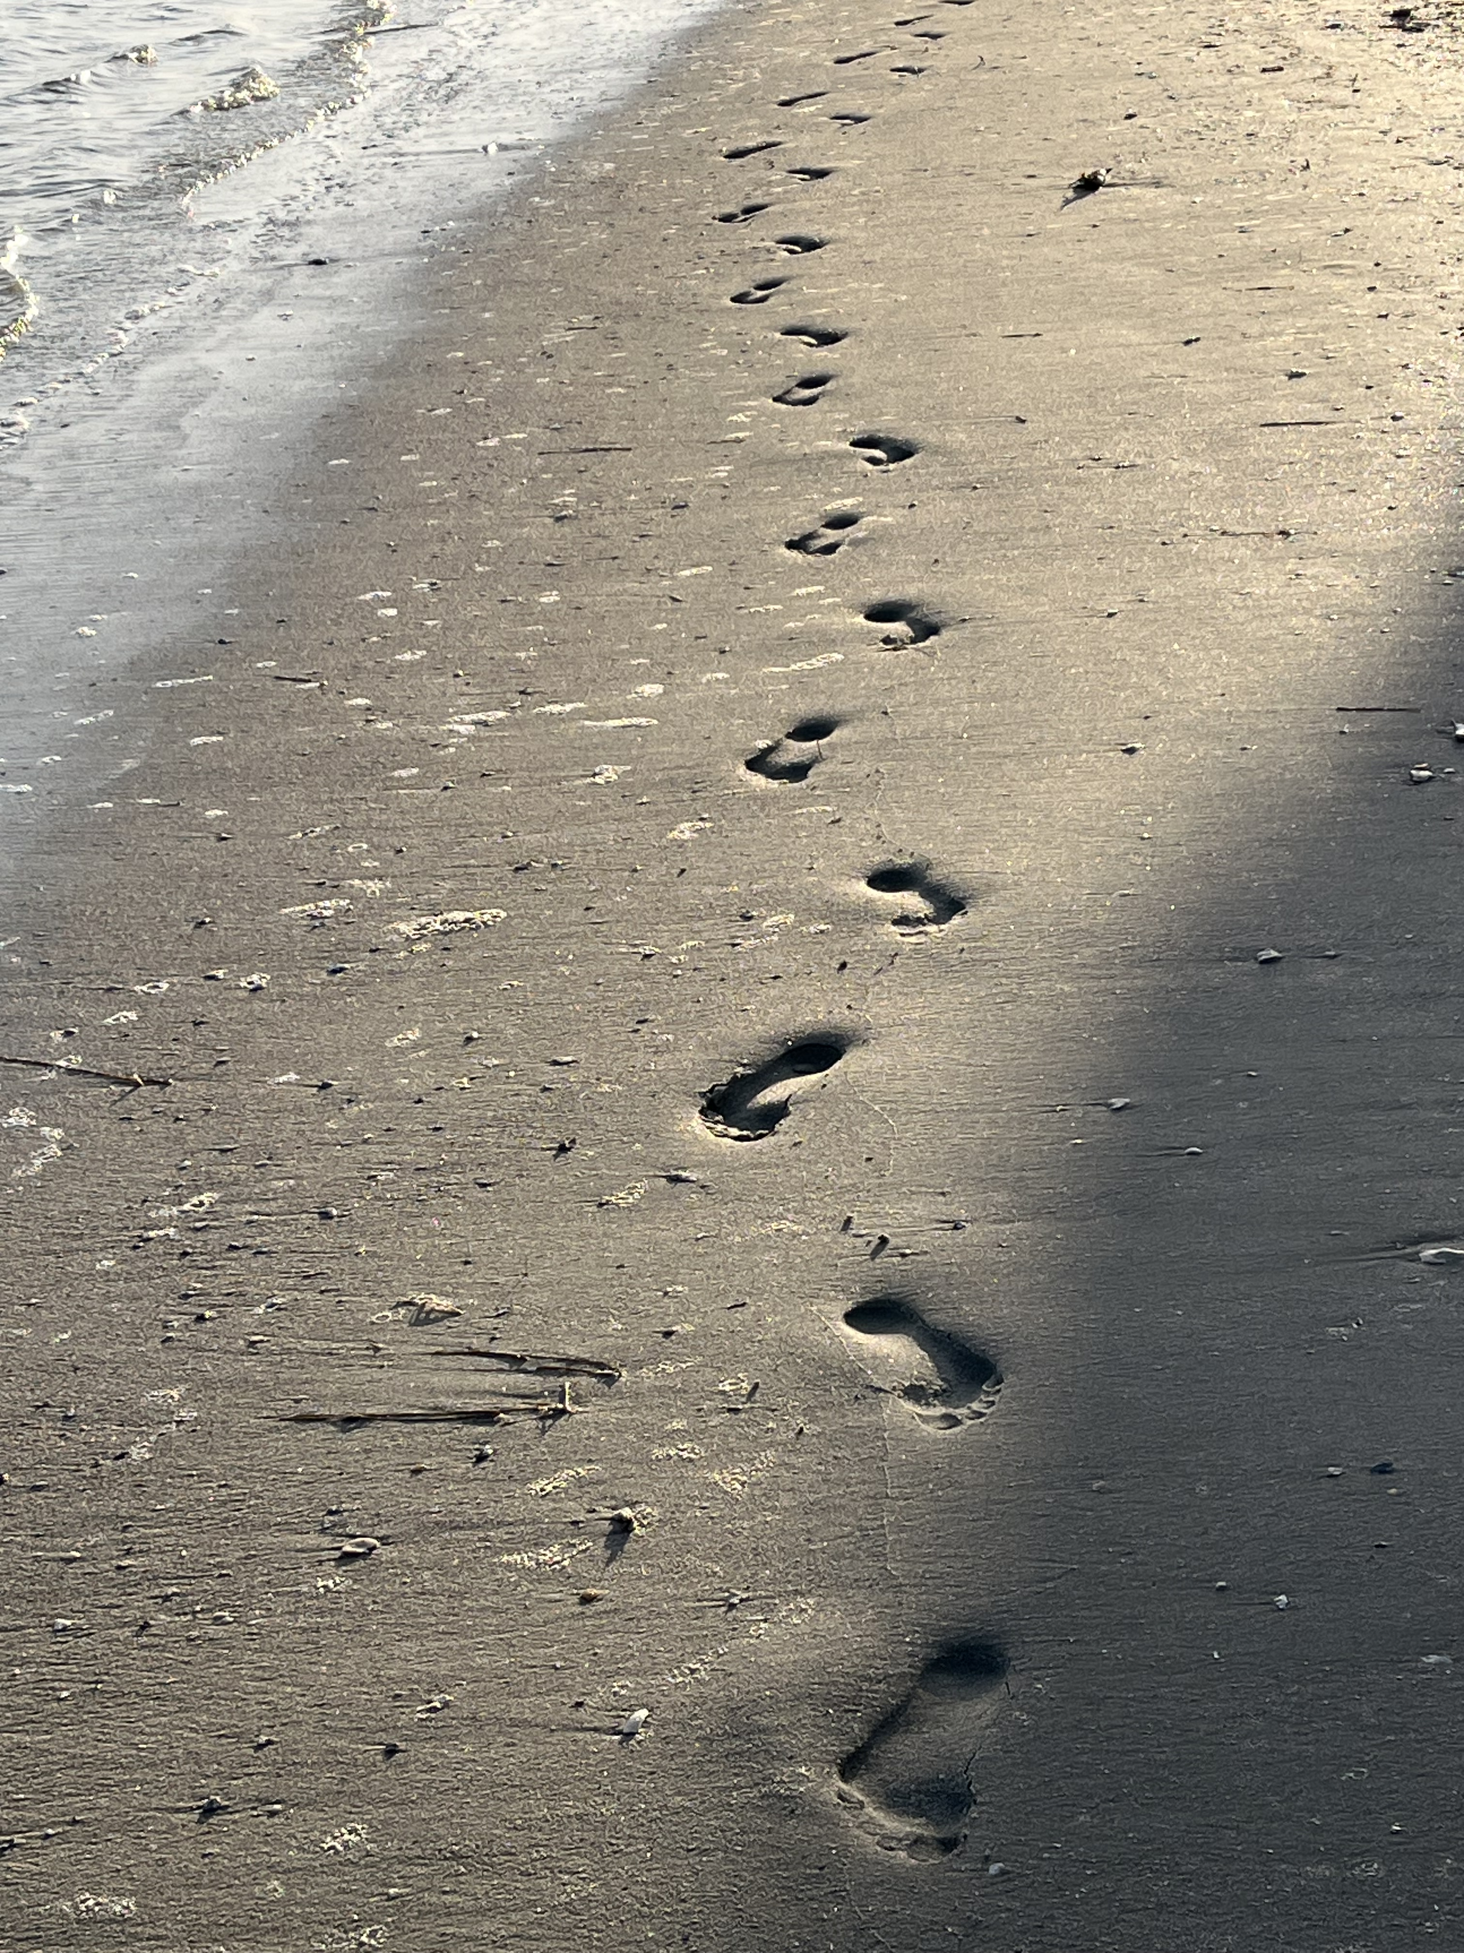
Notes:
It led me to teach about our journeys in life. How to help keep perspective. How to live with the internal and external conflicts and how to be hopeful throughout.
The Long Walk pertains to us as individuals, as a community, and as a people.

Slide 9



The Long Walk
Expect the Expected
Notes:
¹² Dear friends, do not be surprised at the fiery ordeal that has come on you to test you, as though something strange were happening to you.
¹³ But rejoice inasmuch as you participate in the sufferings of Christ, so that you may be overjoyed when his glory is revealed.
¹⁴ If you are insulted because of the name of Christ, you are blessed, for the Spirit of glory and of God rests on you.

Slide 10
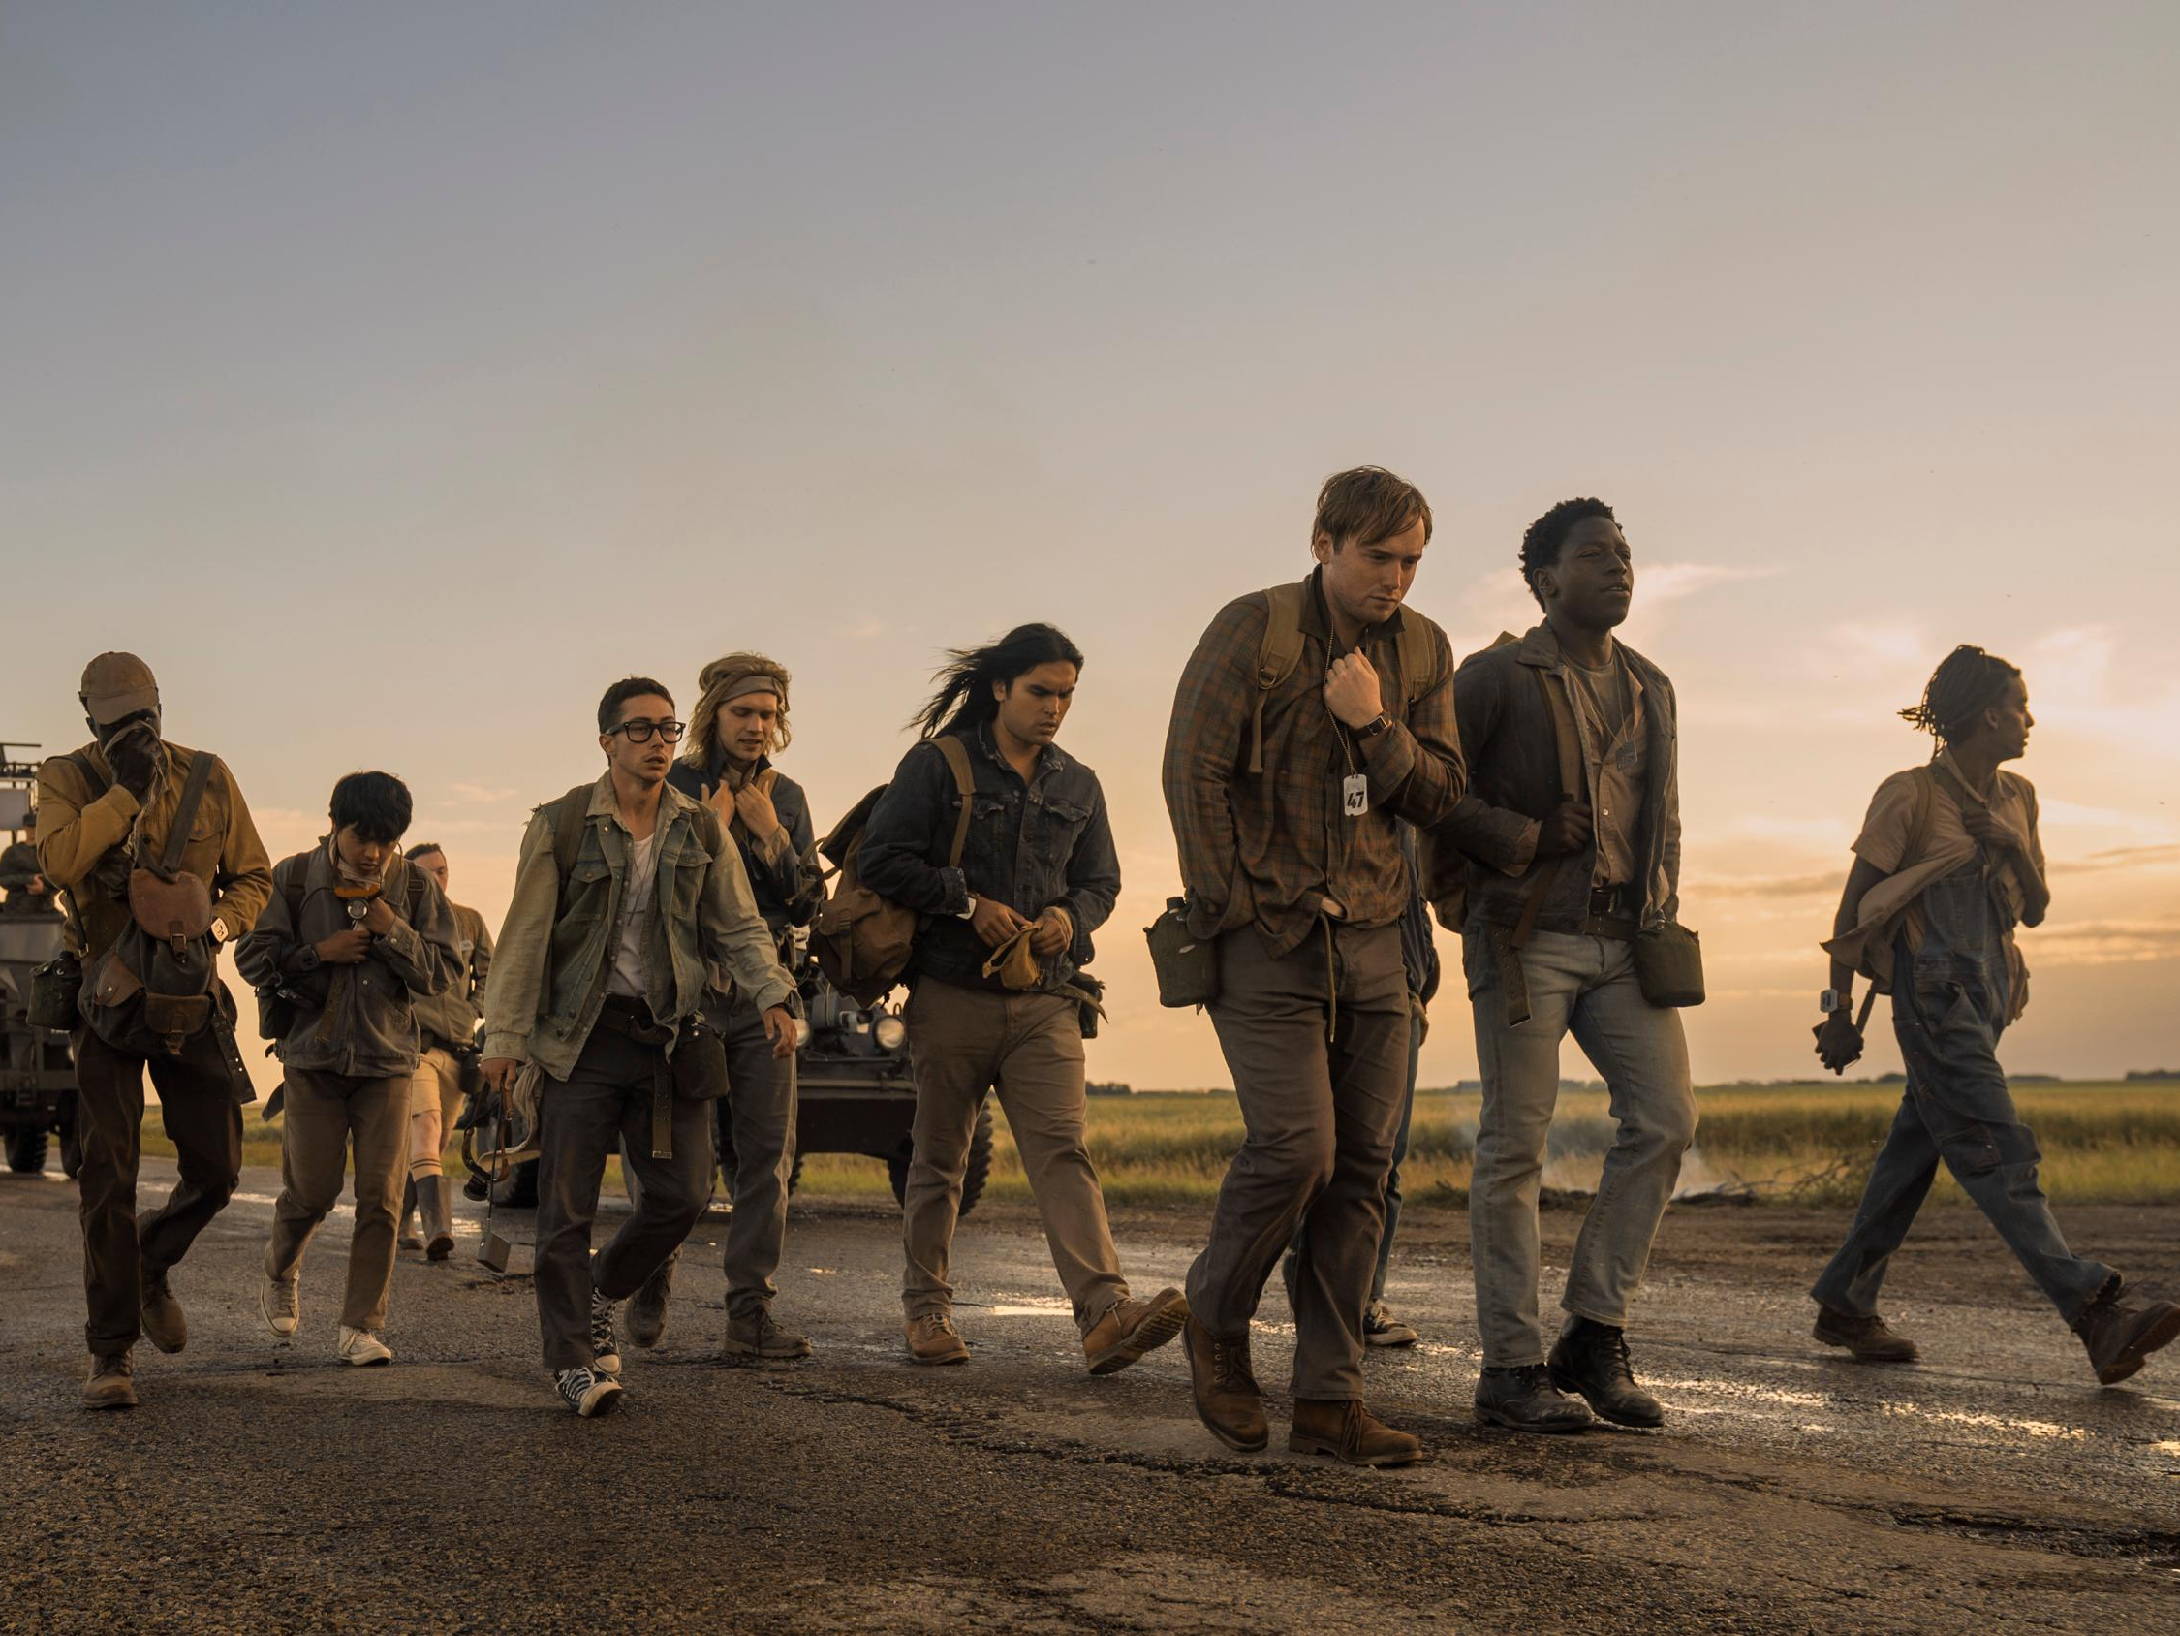
Notes:
Background on the movie
50 young men (100 in the book) live in a dystopian world where authoritarianism exists.
Unlike the pleasant stroll I had in SC, these young men are in a competition. Simple rules. You walk, you live. You don’t walk, …
Additionally, only one person can win the competition.
The prize is getting one wish granted no matter what it is
Very Hunger Games ish

Slide 11

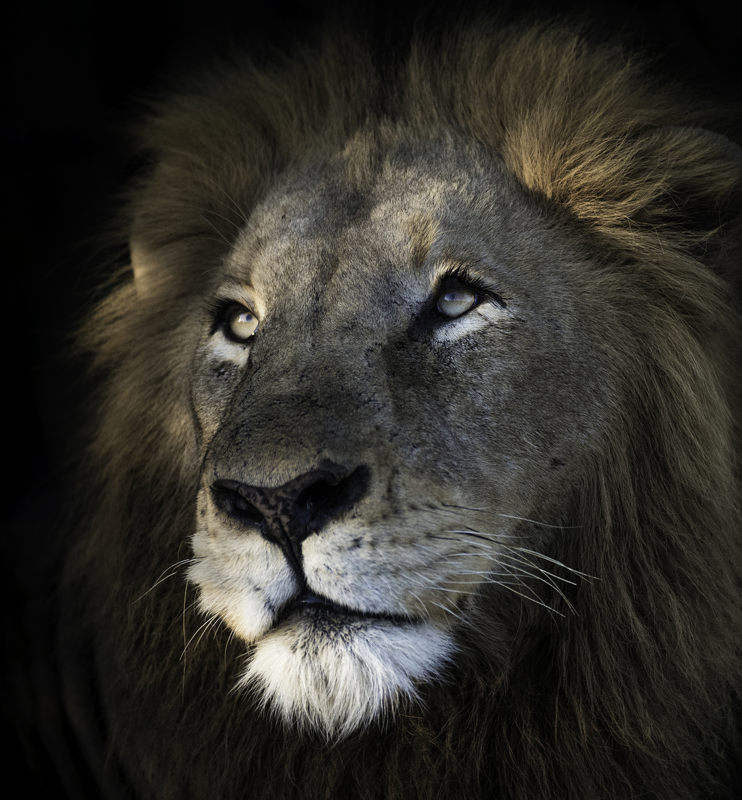
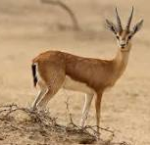
I Peter 5: 6-11
Cast your anxiety on God. WHY? Because God cares
Practice discipline and stay alert. WHY? Because your adversary is like a lion looking for someone to devour
Notes:
Humble yourselves therefore under the mighty hand of God, so that he may exalt you in due time. Cast all your anxiety on him, because he cares for you. Discipline yourselves, keep alert. Like a roaring lion your adversary the devil prowls around, looking for someone to devour. Resist him, steadfast in your faith, for you know that your brothers and sisters in all the world are undergoing the same kinds of suffering. And after you have suffered for a little while, the God of all grace, who has called you to his eternal glory in Christ, will himself restore, support, strengthen, and establish you. To him be the power forever and ever. Amen.

Slide 12
Life is a Long Walk
The idea is not to constantly worry, but be aware of your surroundings and recognize the situation
Worry is warranted if you are not operating in reality
Suffering is still part of the package, and you are not alone in your suffering
Not all suffering is the same
Rejoice as restoration comes after the suffering
Notes:
Red pill vs. Blue pill (Matrix)
You do not have to worry if you do the first part

Slide 13
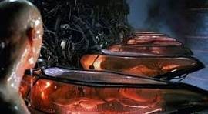
Notes:
CHOICE?
Live in a dream world with ZERO freedom
OR
Live in a reality where suffering is the norm?

Slide 14
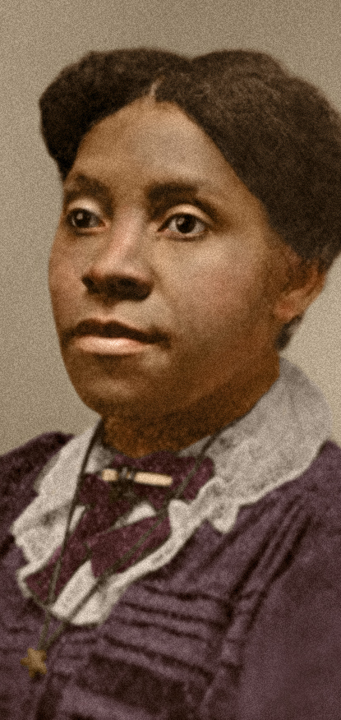
Callie House
Former enslaved person
Started an organization fighting for reparations for other former enslaved people at age 36 (200-300K members)
Filed a reparations lawsuit for $68 million ($2.2 billion in 2026) (from a cotton tax from 1862-1868)
Sentenced to a year in jail for mail fraud (all white, all male jury)
Notes:
She took the red pill
Started in slavery
Callie House (1861–1928) was a leader of the National Ex-Slave Mutual Relief, Bounty and Pension Association, one of the first organizations to campaign for reparations for slavery in the United States
The courts dismissed the lawsuit stating governmental immunity
The supposed reasoning for the sentencing was fraud based on the belief that she knew reparations would never happen so collecting funds for the movement was just a scam
The people in the movement she started was the base for the Marcus Garvey movement that had 2-6 million

Slide 15
How we get through
Not alone
Choosing the light
Knowing it is not easy
Nothing to lose but everything to gain
Relying on one another
Notes:
“You’ve been walking for 5 days, I’ve been walking for my whole ___ life”
Choosing the light in the darkness
Do you think this ___ is easy?
Nothing to lose but everything to gain
“ Do you know what I could have used Ray?… a brother”

Slide 16
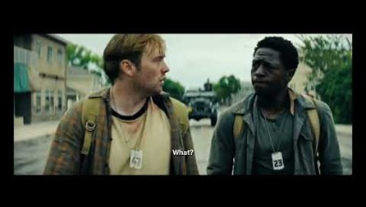
Perspective
Notes:
When we try to help others, we help ourselves
It is not about comparing suffering, it is about realizing we are in this together. When we realize that, we focus on the bigger picture,… together. And we naturally address disparities in suffering as we are only as strong as our most needful link.
Our clinic is not here to only help those that need healthcare, it is also to help those that need to be a part of helping others get healthcare. We are wired and designed to be ONE BODY. It is why we use the word “neighbor” in our mission statement.
We will all suffer if we allow any to suffer. Think about the narrative about voting in America. They can focus on Democrats generally, but the focus is on Black areas being disenfranchised… trying to convince the mainstream that it is just about “those people” suffering

Slide 17
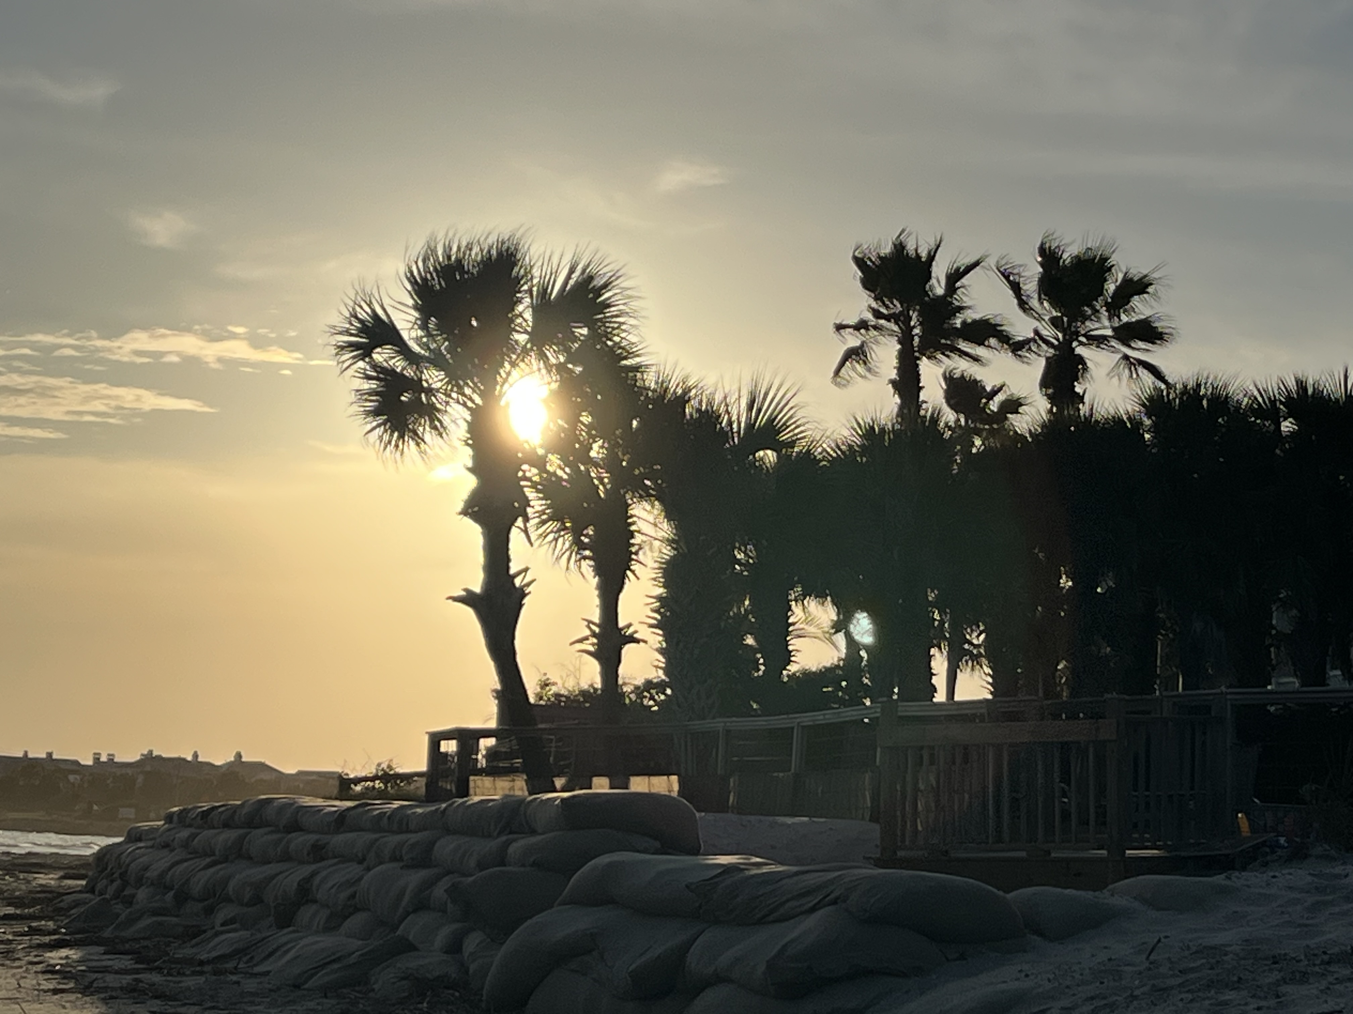
Notes:
When the sun sets on our lives, what will our walk look like?
If you tuned in last month when I taught about Nothing Wasted, you would know that the reflection is not for the purpose of regret, disappointment, or lacking anything.
The reflection is to appreciate the time we have, celebrate the lives we are living, and anticipate (with excitement) the eternity ahead.
The Long Walk is full of suffering but more so full of hope if we can learn to embrace both

Slide 18
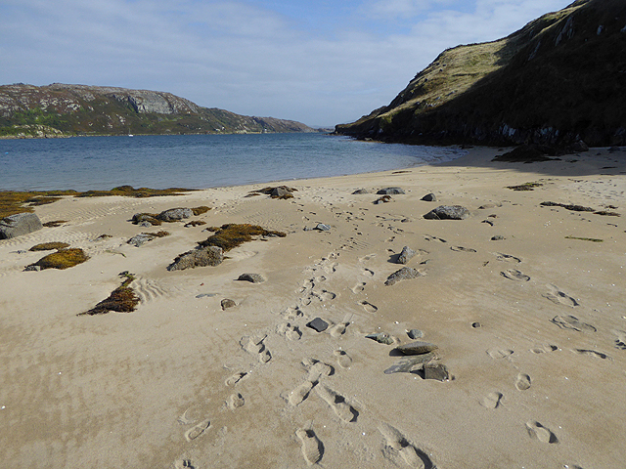
Notes:
Footprints in the Sand Poem
It can often feel like we are on the Long Walk alone. If can often feel like most of everyone around us is doing fine while we may not feel like getting out of bed in the morning.
If we are working on kingdom building, then it is not just Jesus carrying you over the sand, it is a group of people carrying you
After all, we can all use a brother or sister

