Slide 1


A Journey for Justice
NCF’s Role in Doing God’s Work
Notes:
How I came to NCF

Slide 2
10,000 BC – Movie Quote
“A good leader does not need to be the strongest. A leader is the one who brings strength to others”

Slide 3
NCF Resume
MMJ, CCDA, CCHF, CMJN, CCCHC, MLK, IAFCC, CURC
Softball, Announcements, Sunday School
Worship, Teaching, Administration
Leadership Team
Reparations
Notes:
My alphabet soup

Slide 4
Early NCF Ministries
Christian Mercy and Justice Network
Christian Community Development Association
Christian Community Health Fellowship
MLK Advocacy for Justice Committee

Slide 5

The Story Behind CCCHC
Notes:
CCDA 2002

Slide 6

Notes:
Struggles but NCF grounded us through giving, volunteerism, and leadership

Slide 7
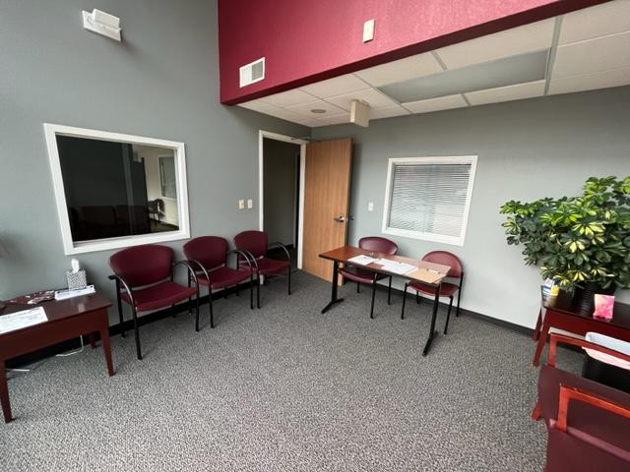
Notes:
New Home and Growth

Slide 8
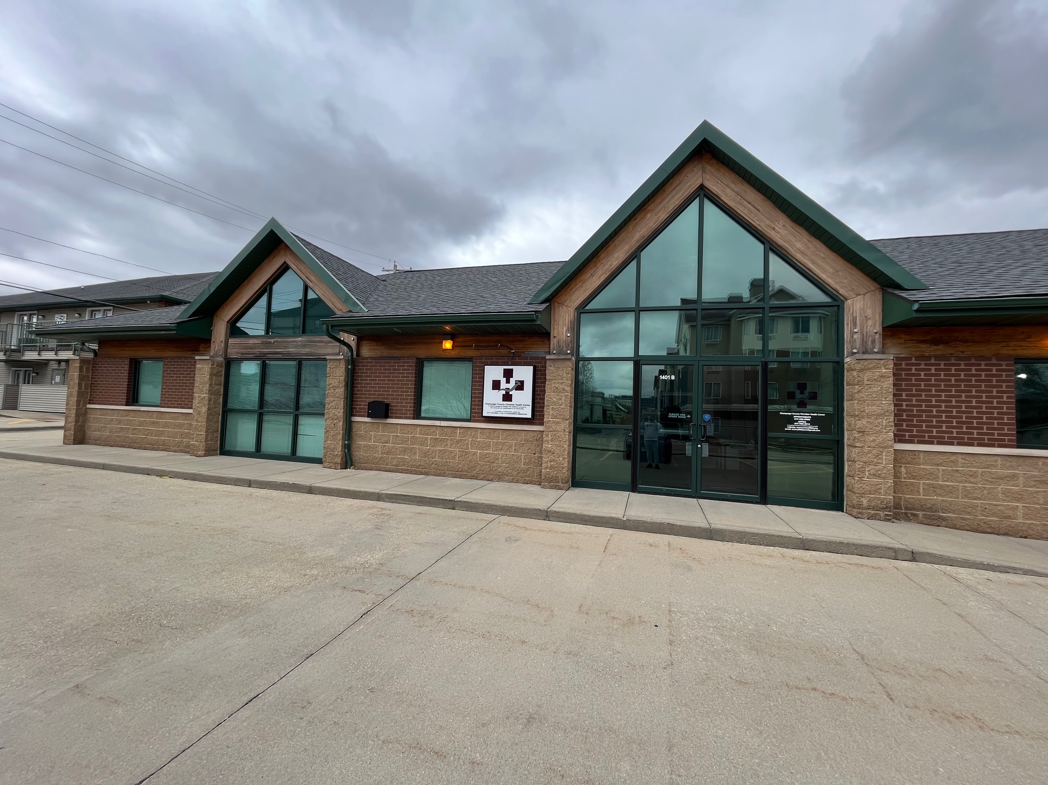
Notes:
Great success

Slide 9

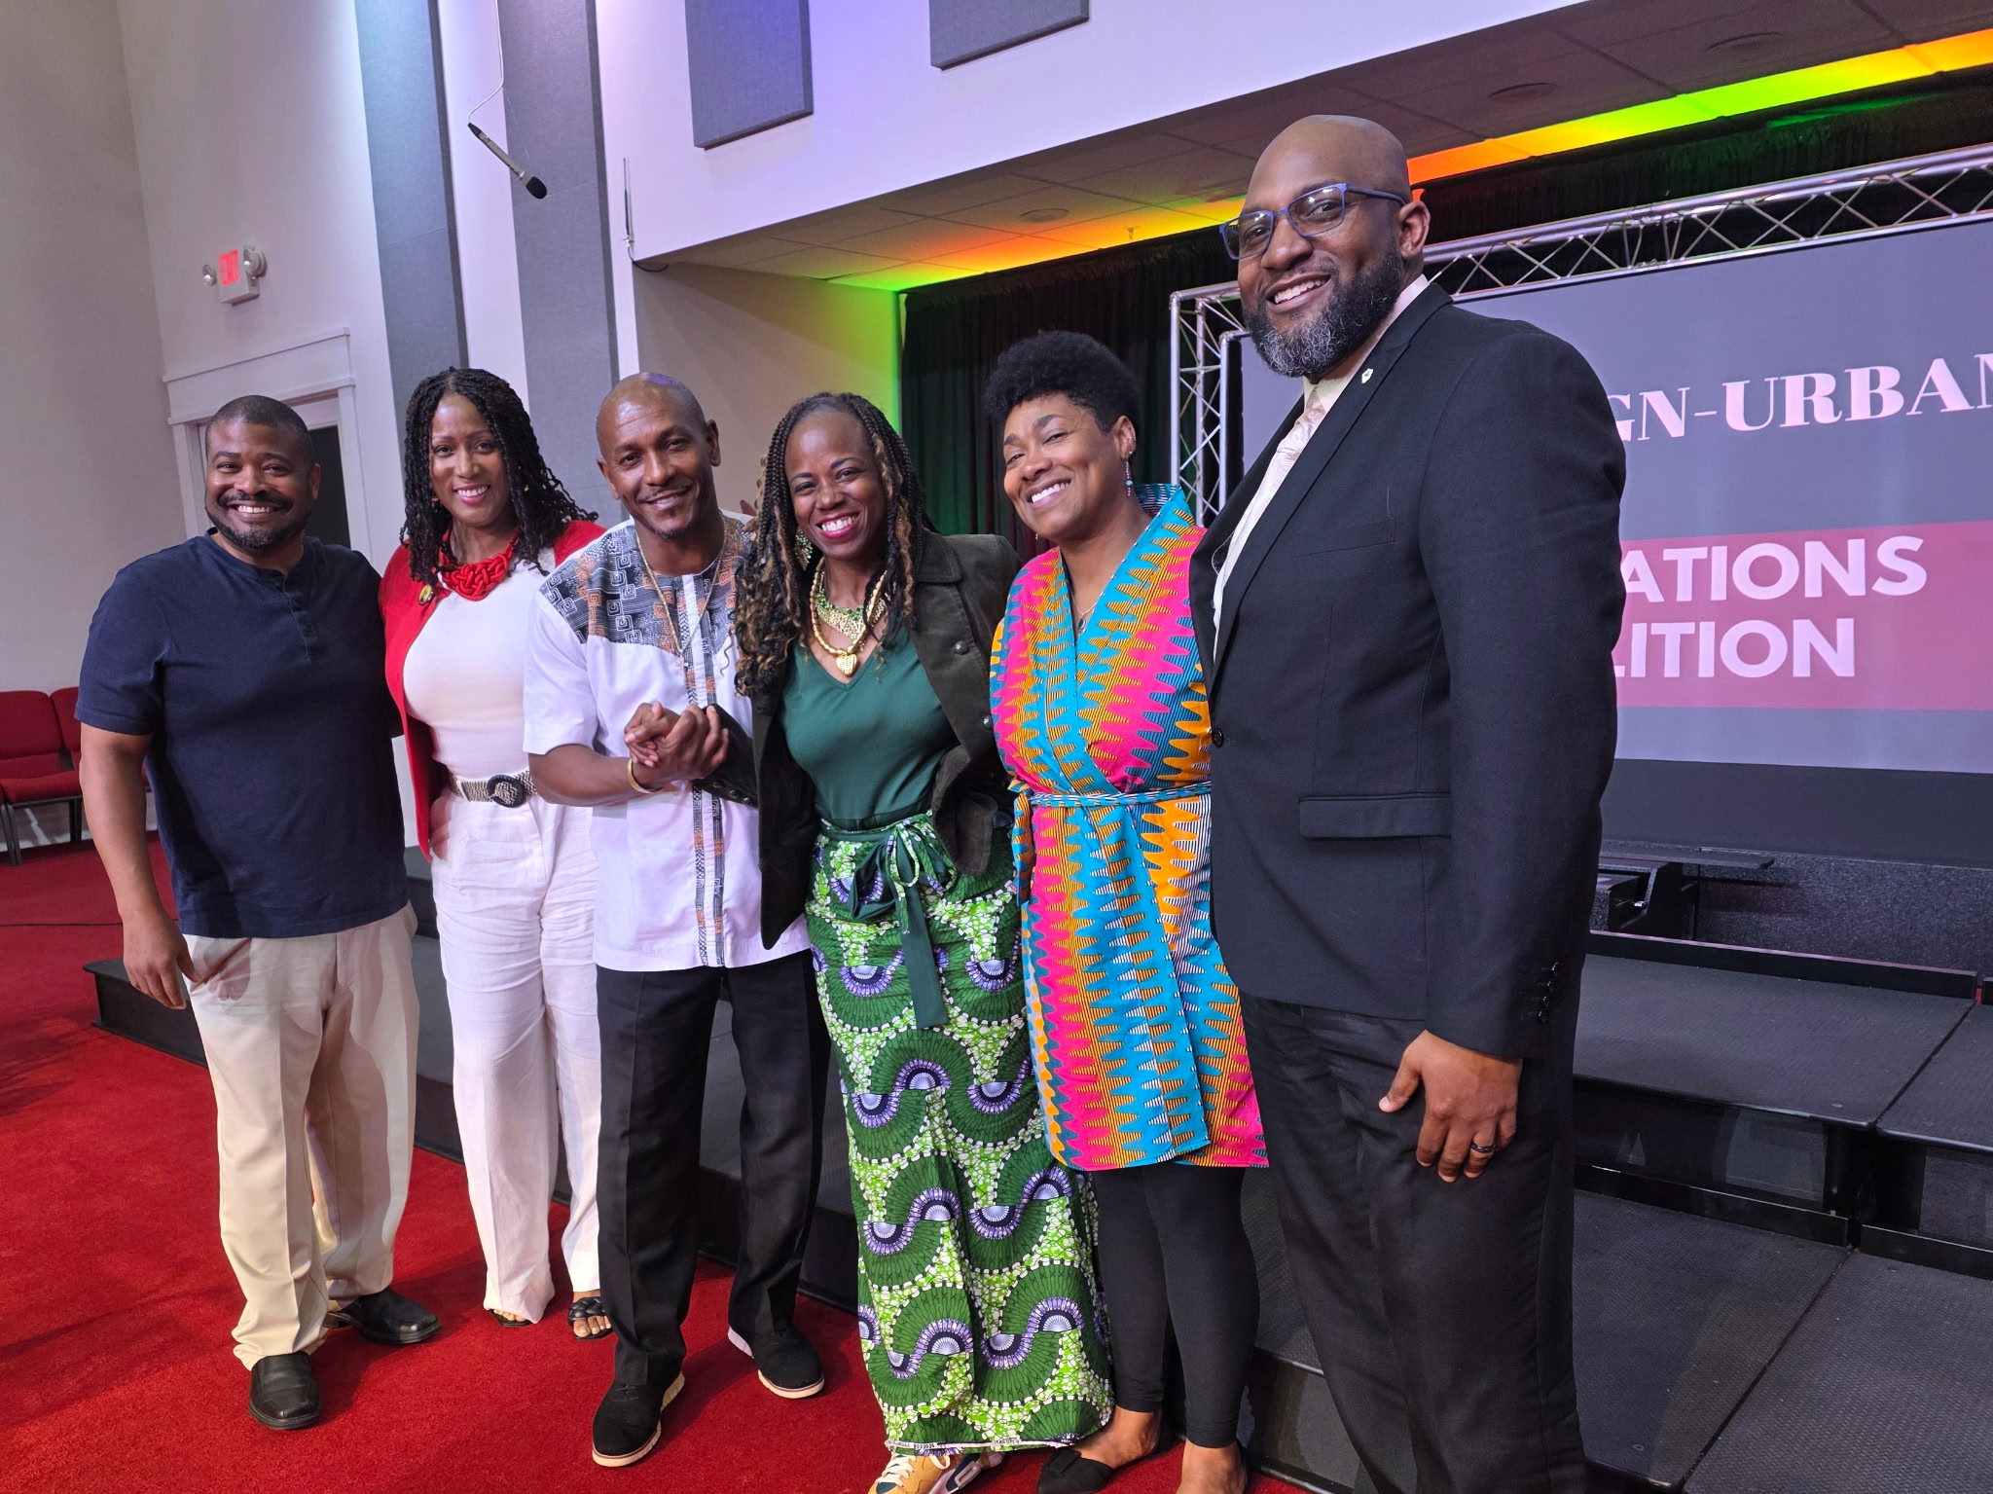
Reparations Timeline
CURC Milestones
Started May 2023 with 5-6 people
Reparations Event including Robin Rue Simmons Nov 2023
Tabling at Juneteenth Event June 2024
Reparations Town Hall June 2025
City of Urbana support for a reparations commission by Mayor Williams
Champaign County Board Vote for approval (15-6)
Notes:
Many presentations, articles, radio appearances, and even a time or two on TV

Slide 10
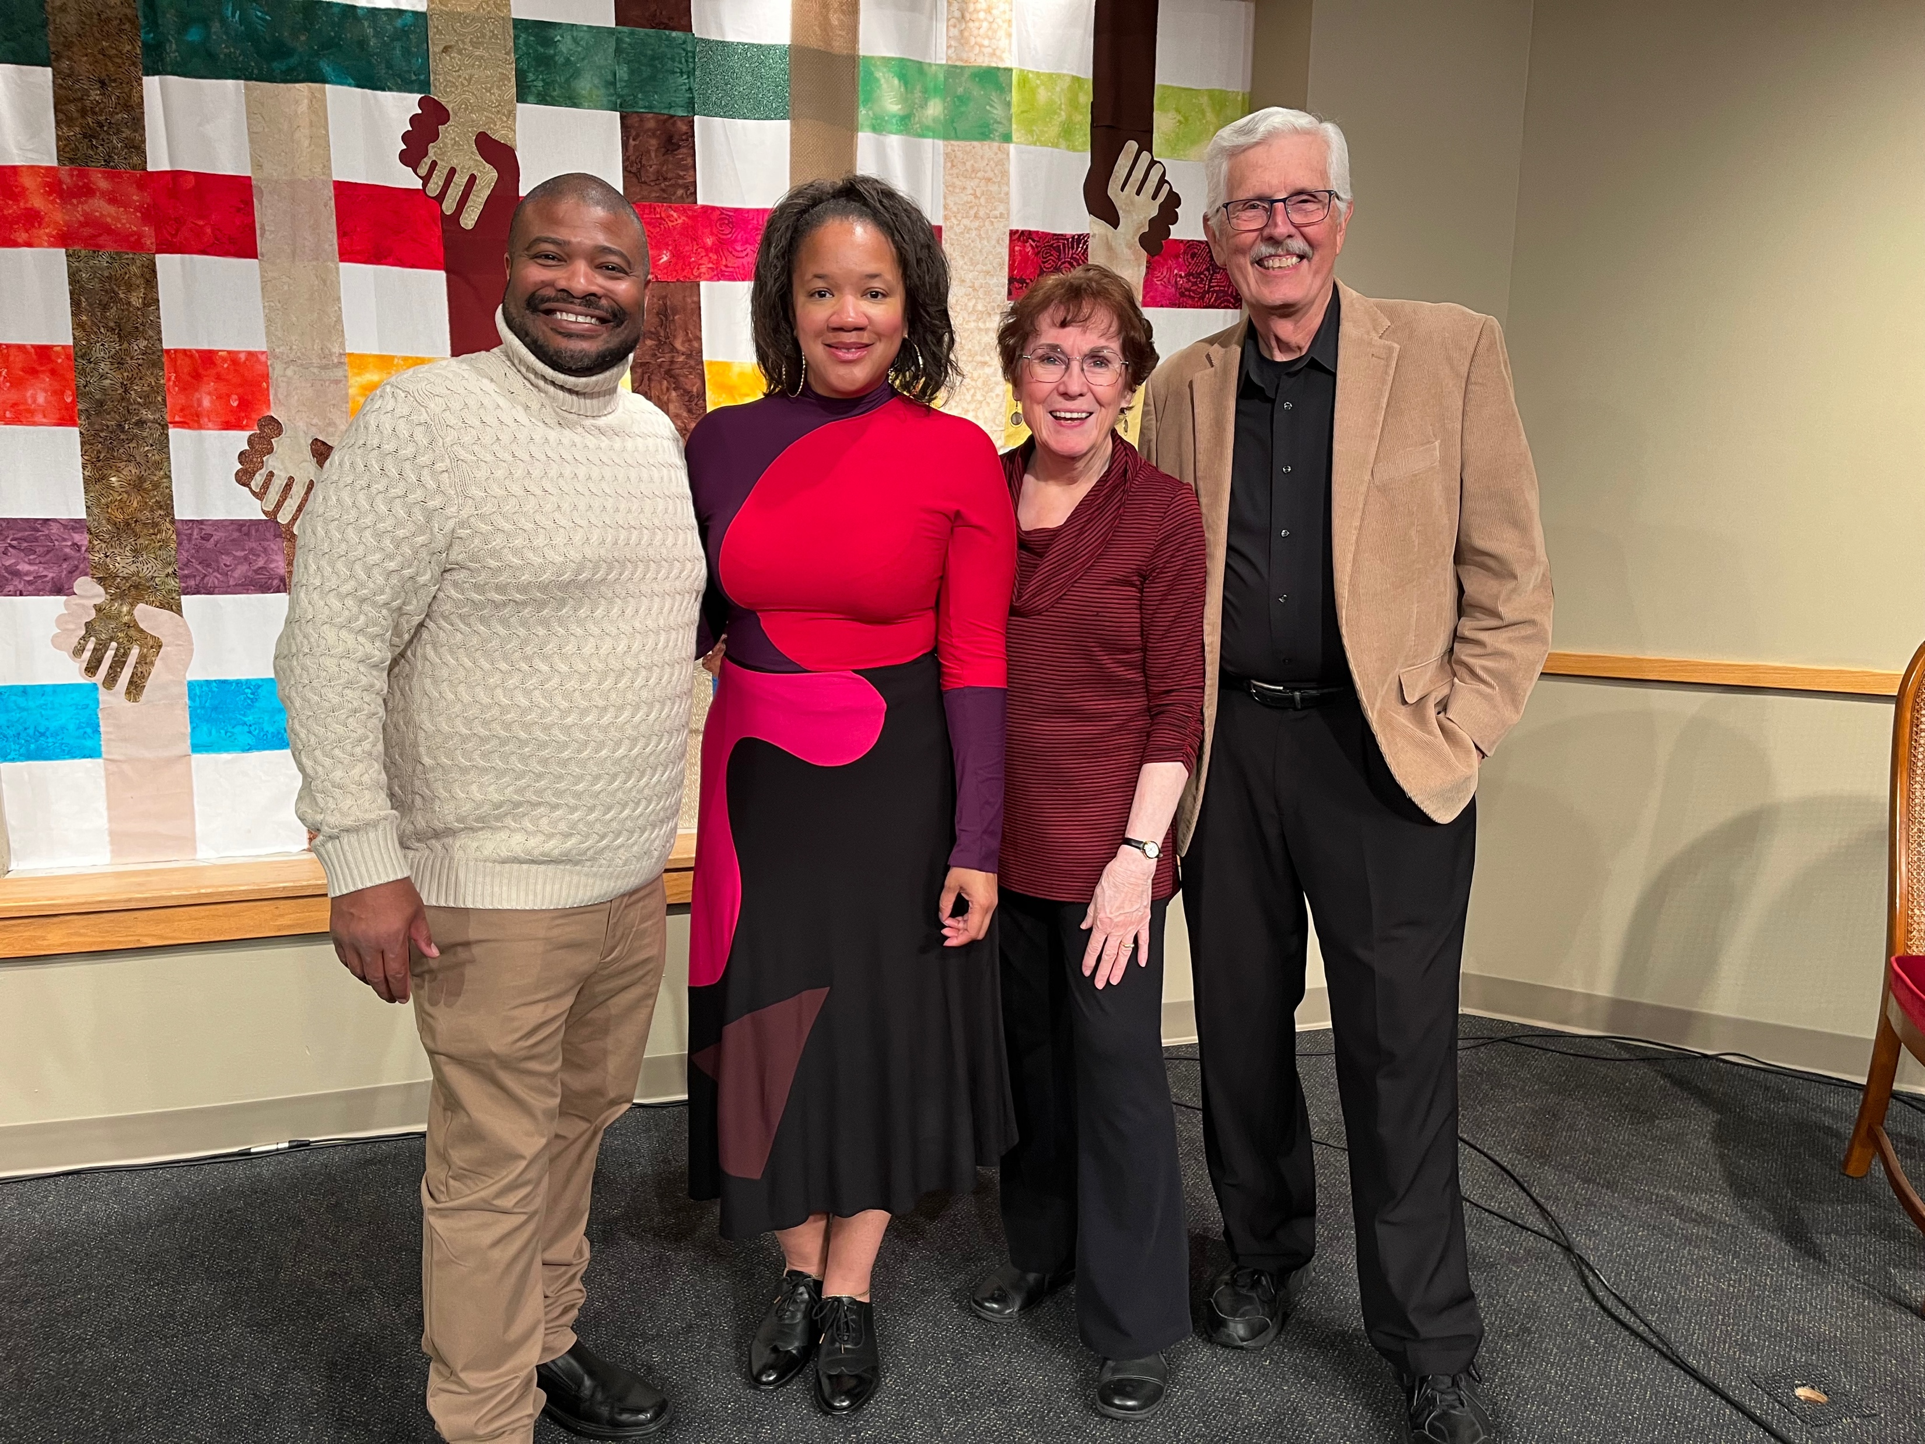
Notes:
Champaign Urbana Reparations Coalition

Slide 11
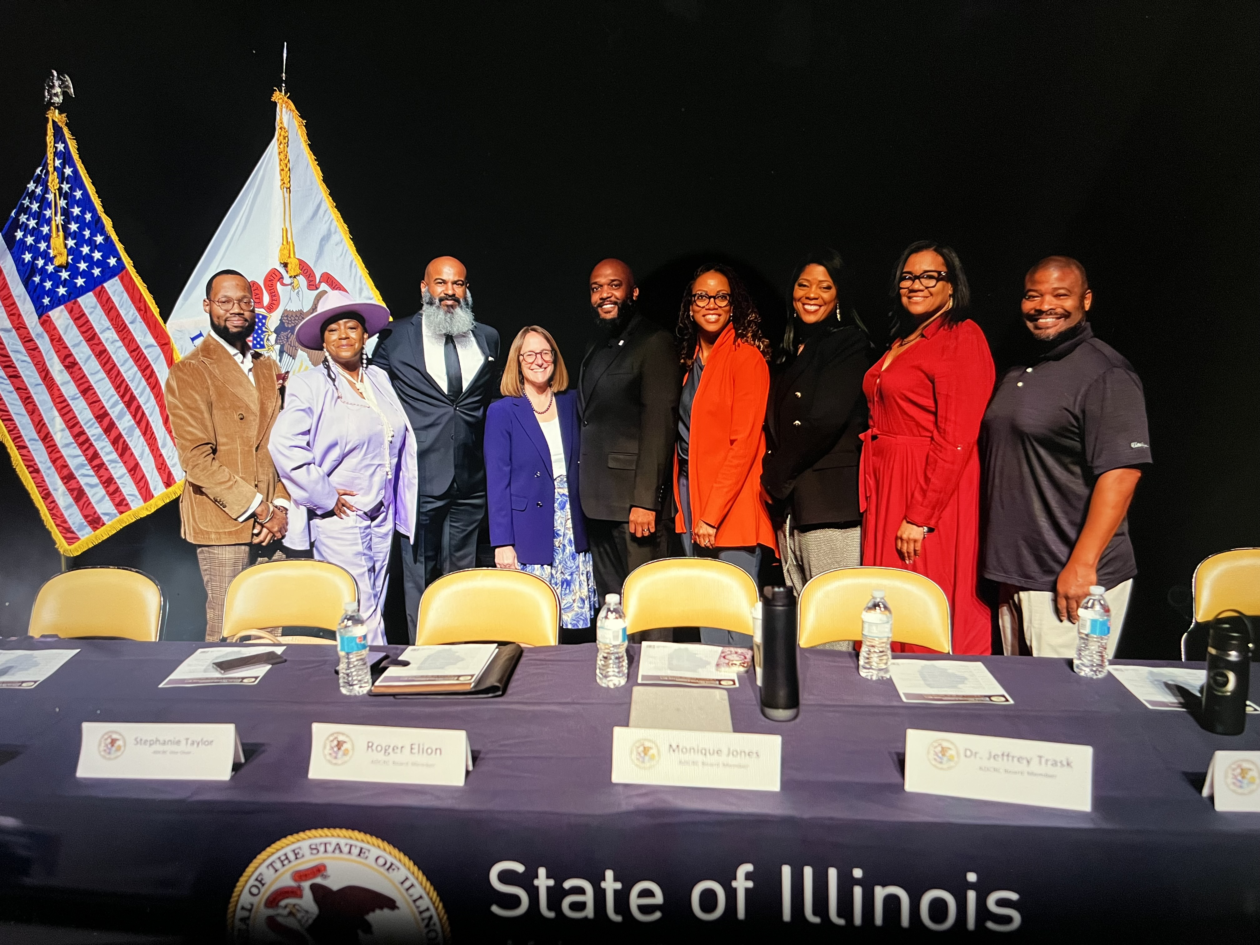
Notes:
African Descent Citizens Reparations Commission (ADCRC)

Slide 12
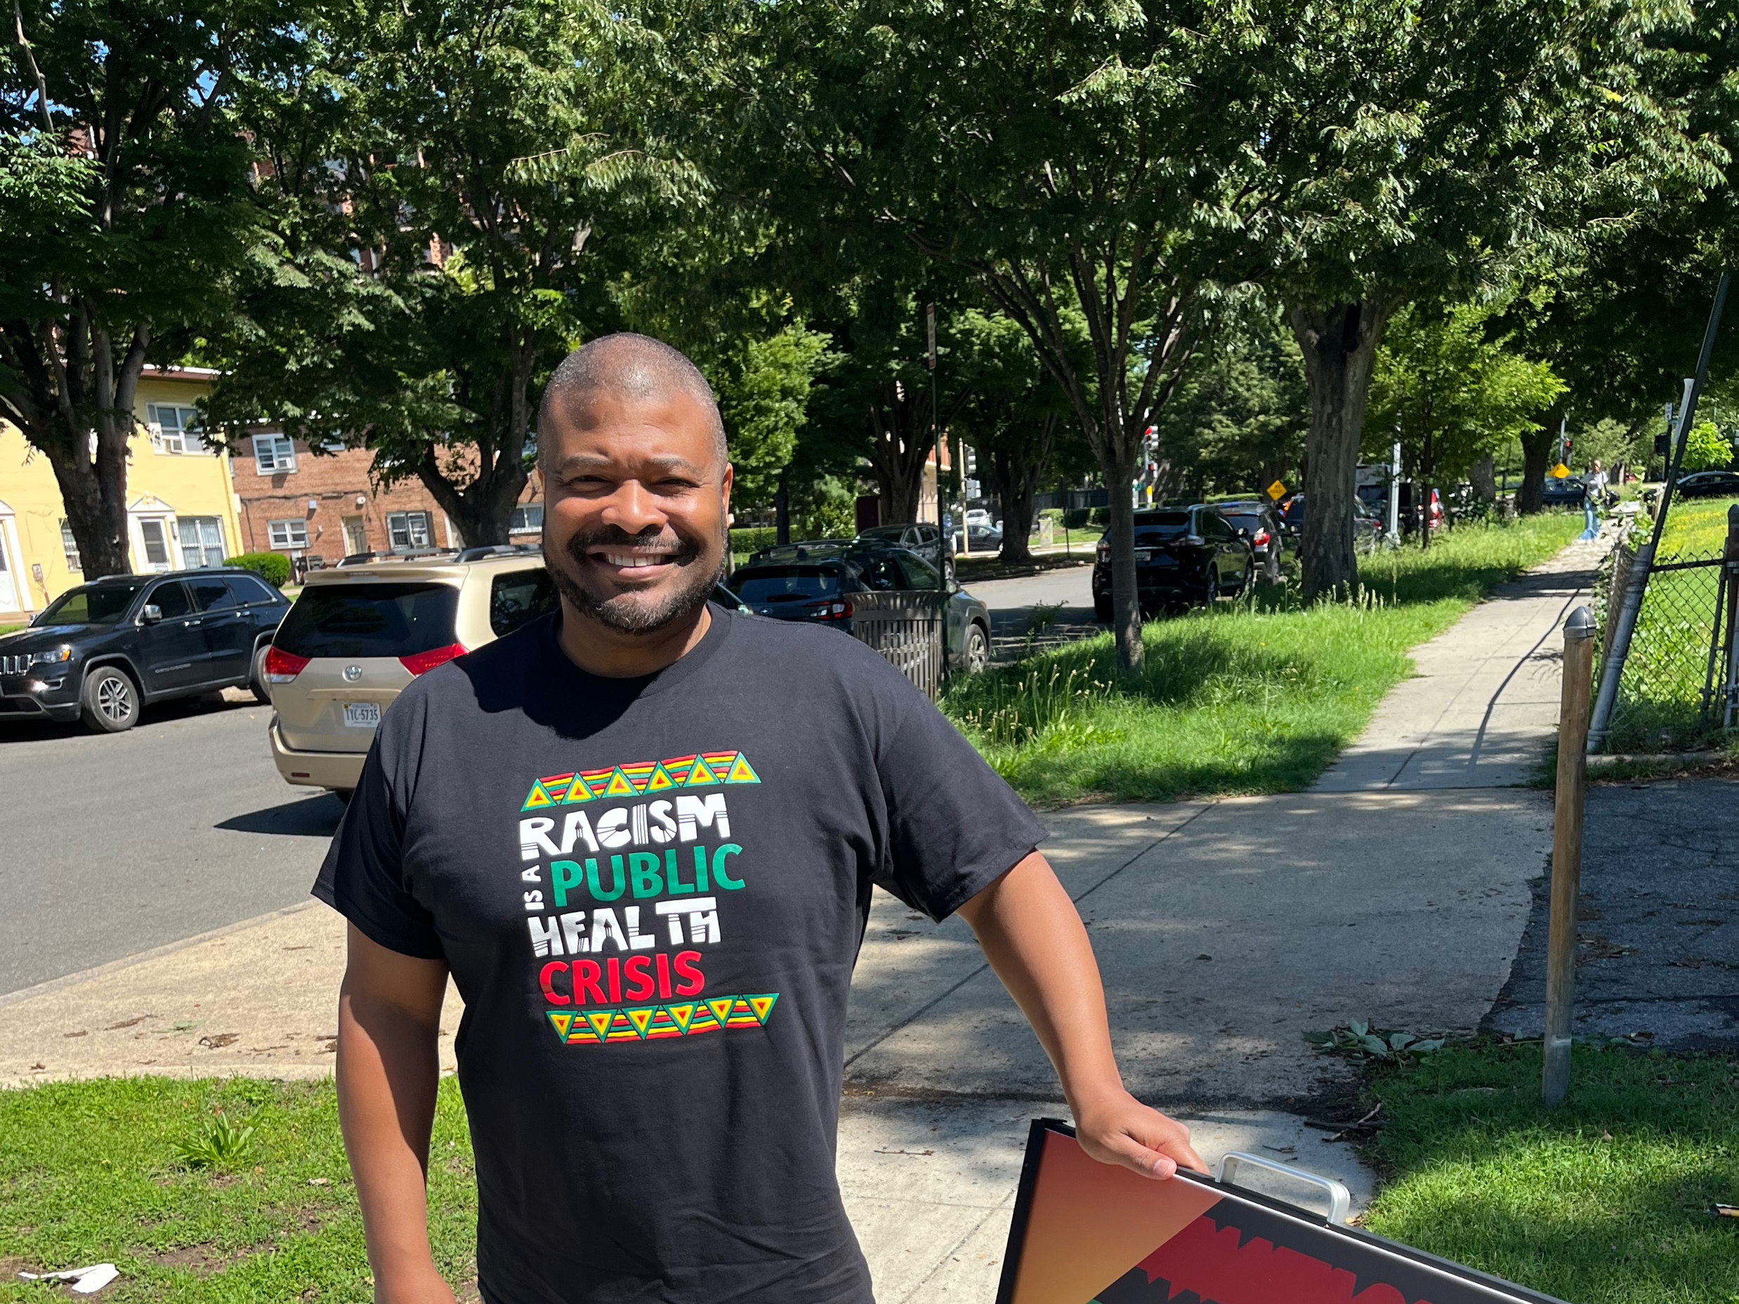
Notes:
National Reparations Leaders Rally & Gatherings

Slide 13
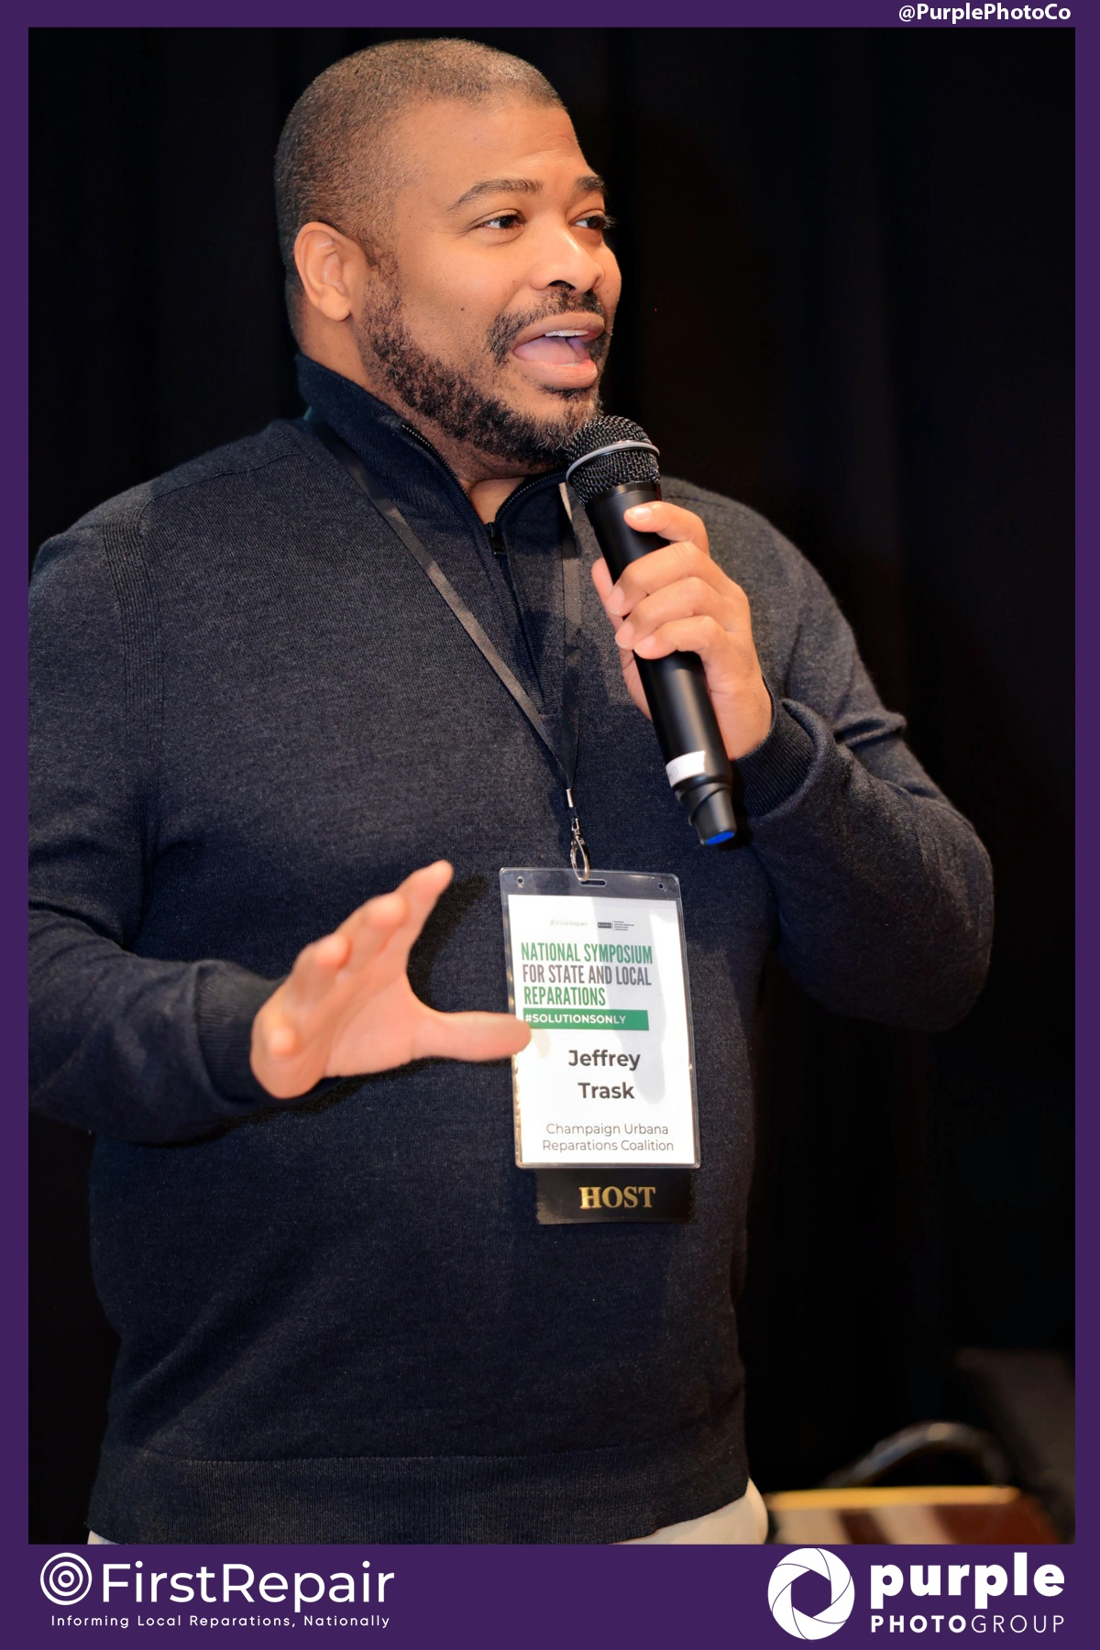
Notes:
First Repair Midwest Regional Leader

Slide 14
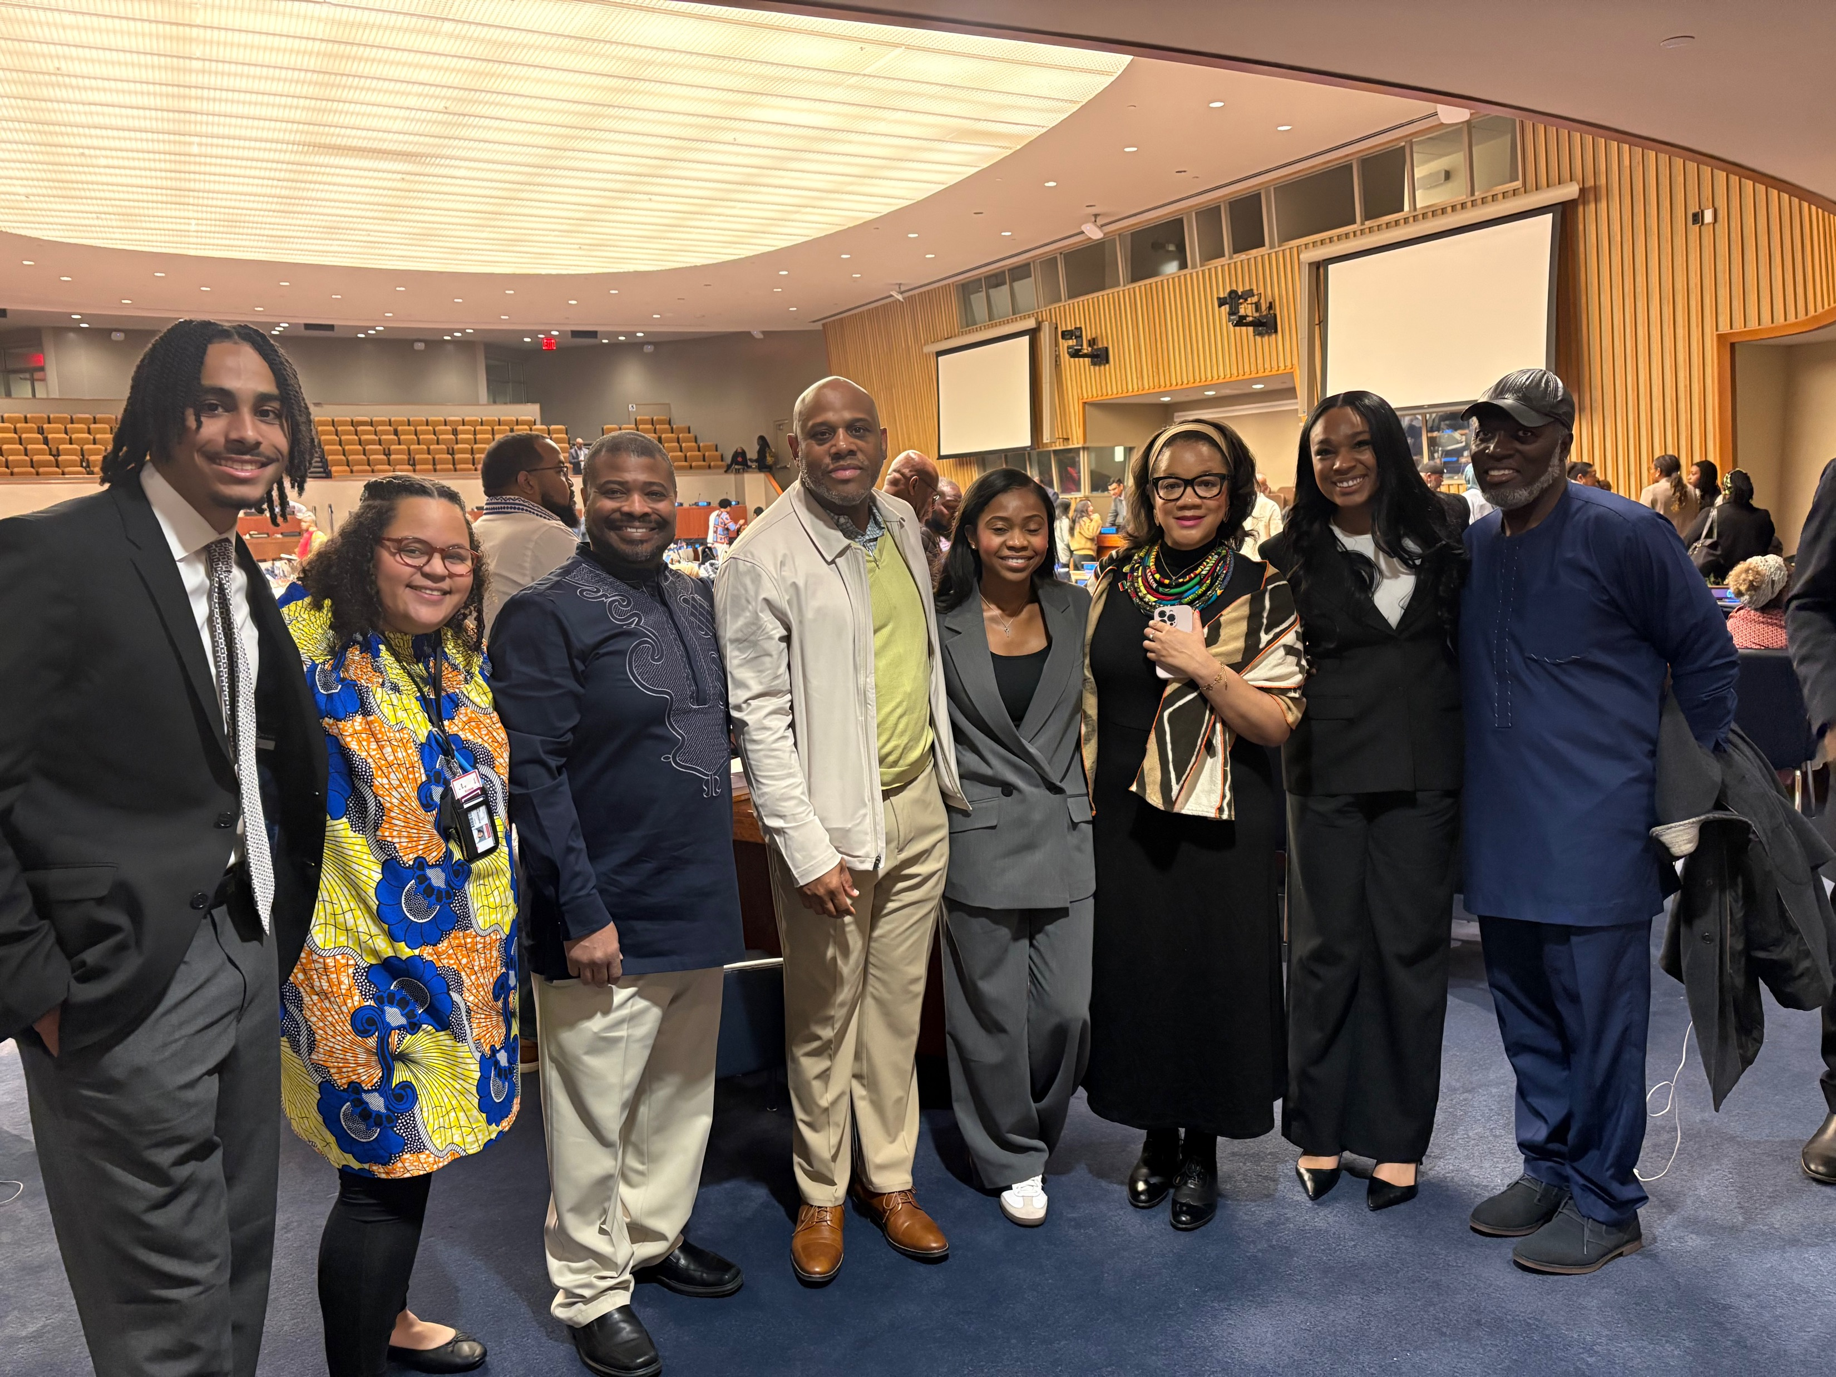
Notes:
United Nations April 2025

Slide 15
Notes:
Justin Pearson (Tennessee legislator)

Slide 16
Future
Clinic Expansion
Reparations Commission
CCDA Legacy

Slide 17
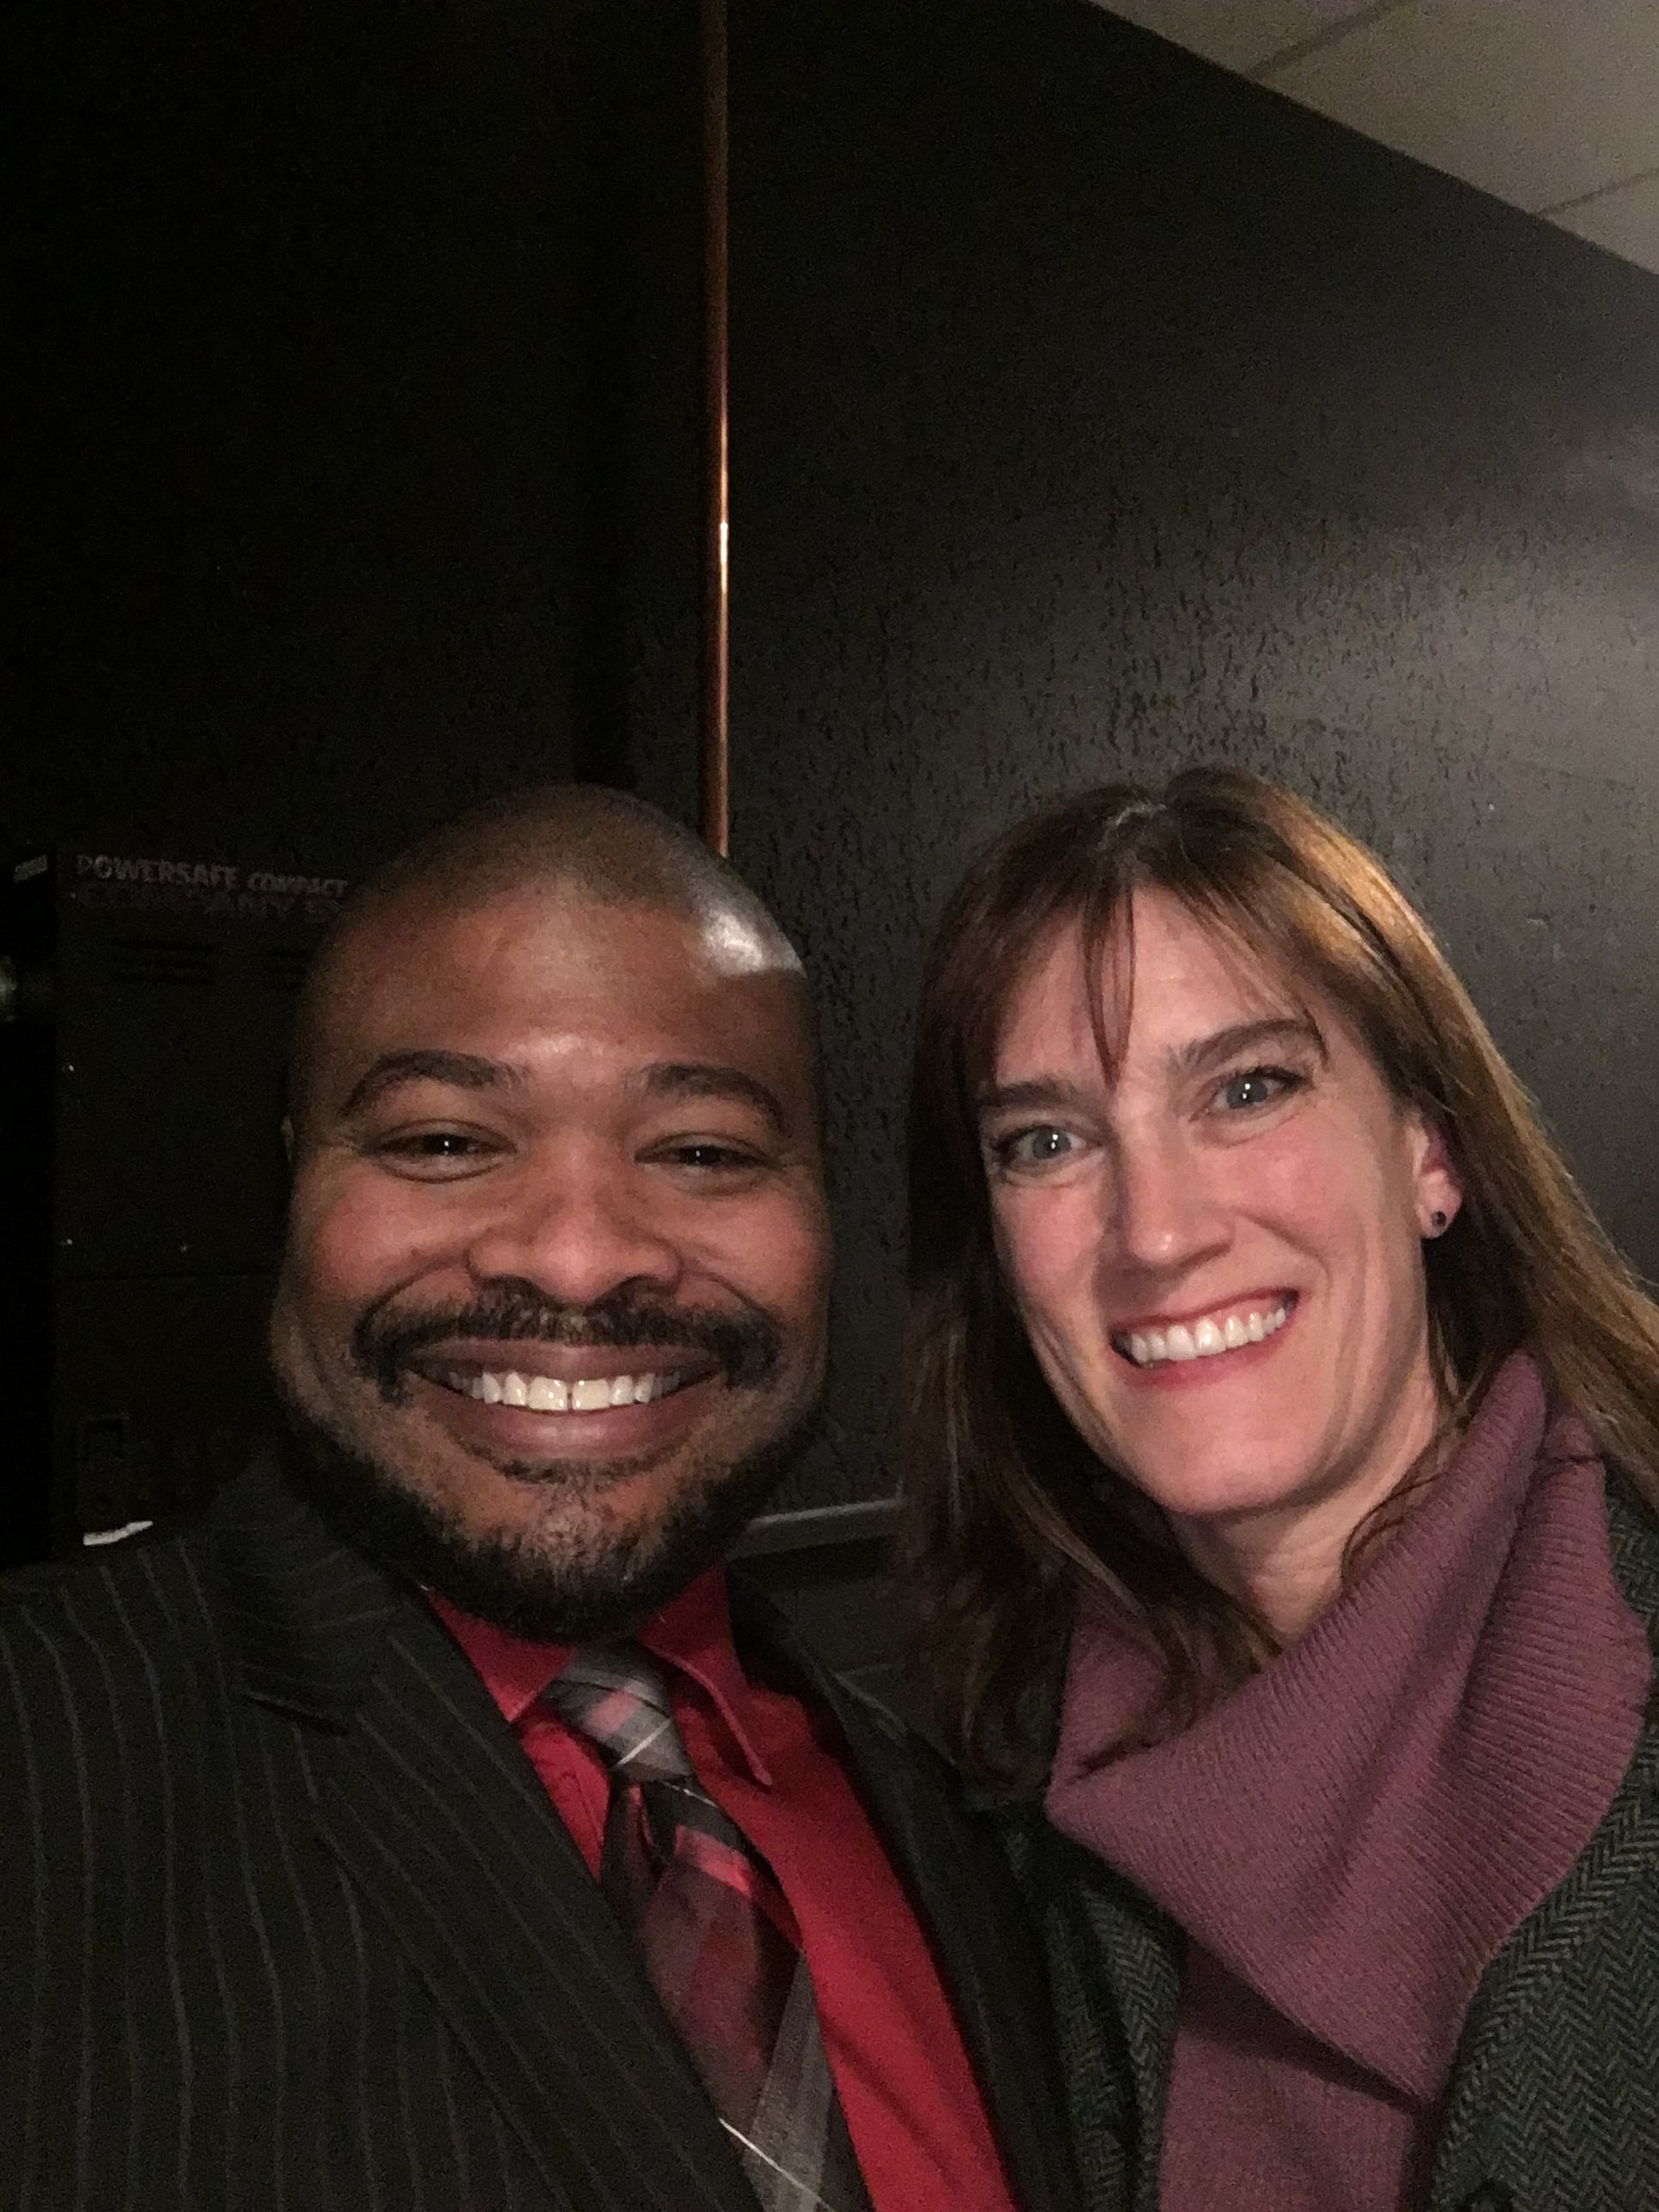
Notes:
Future at NCF

Slide 18
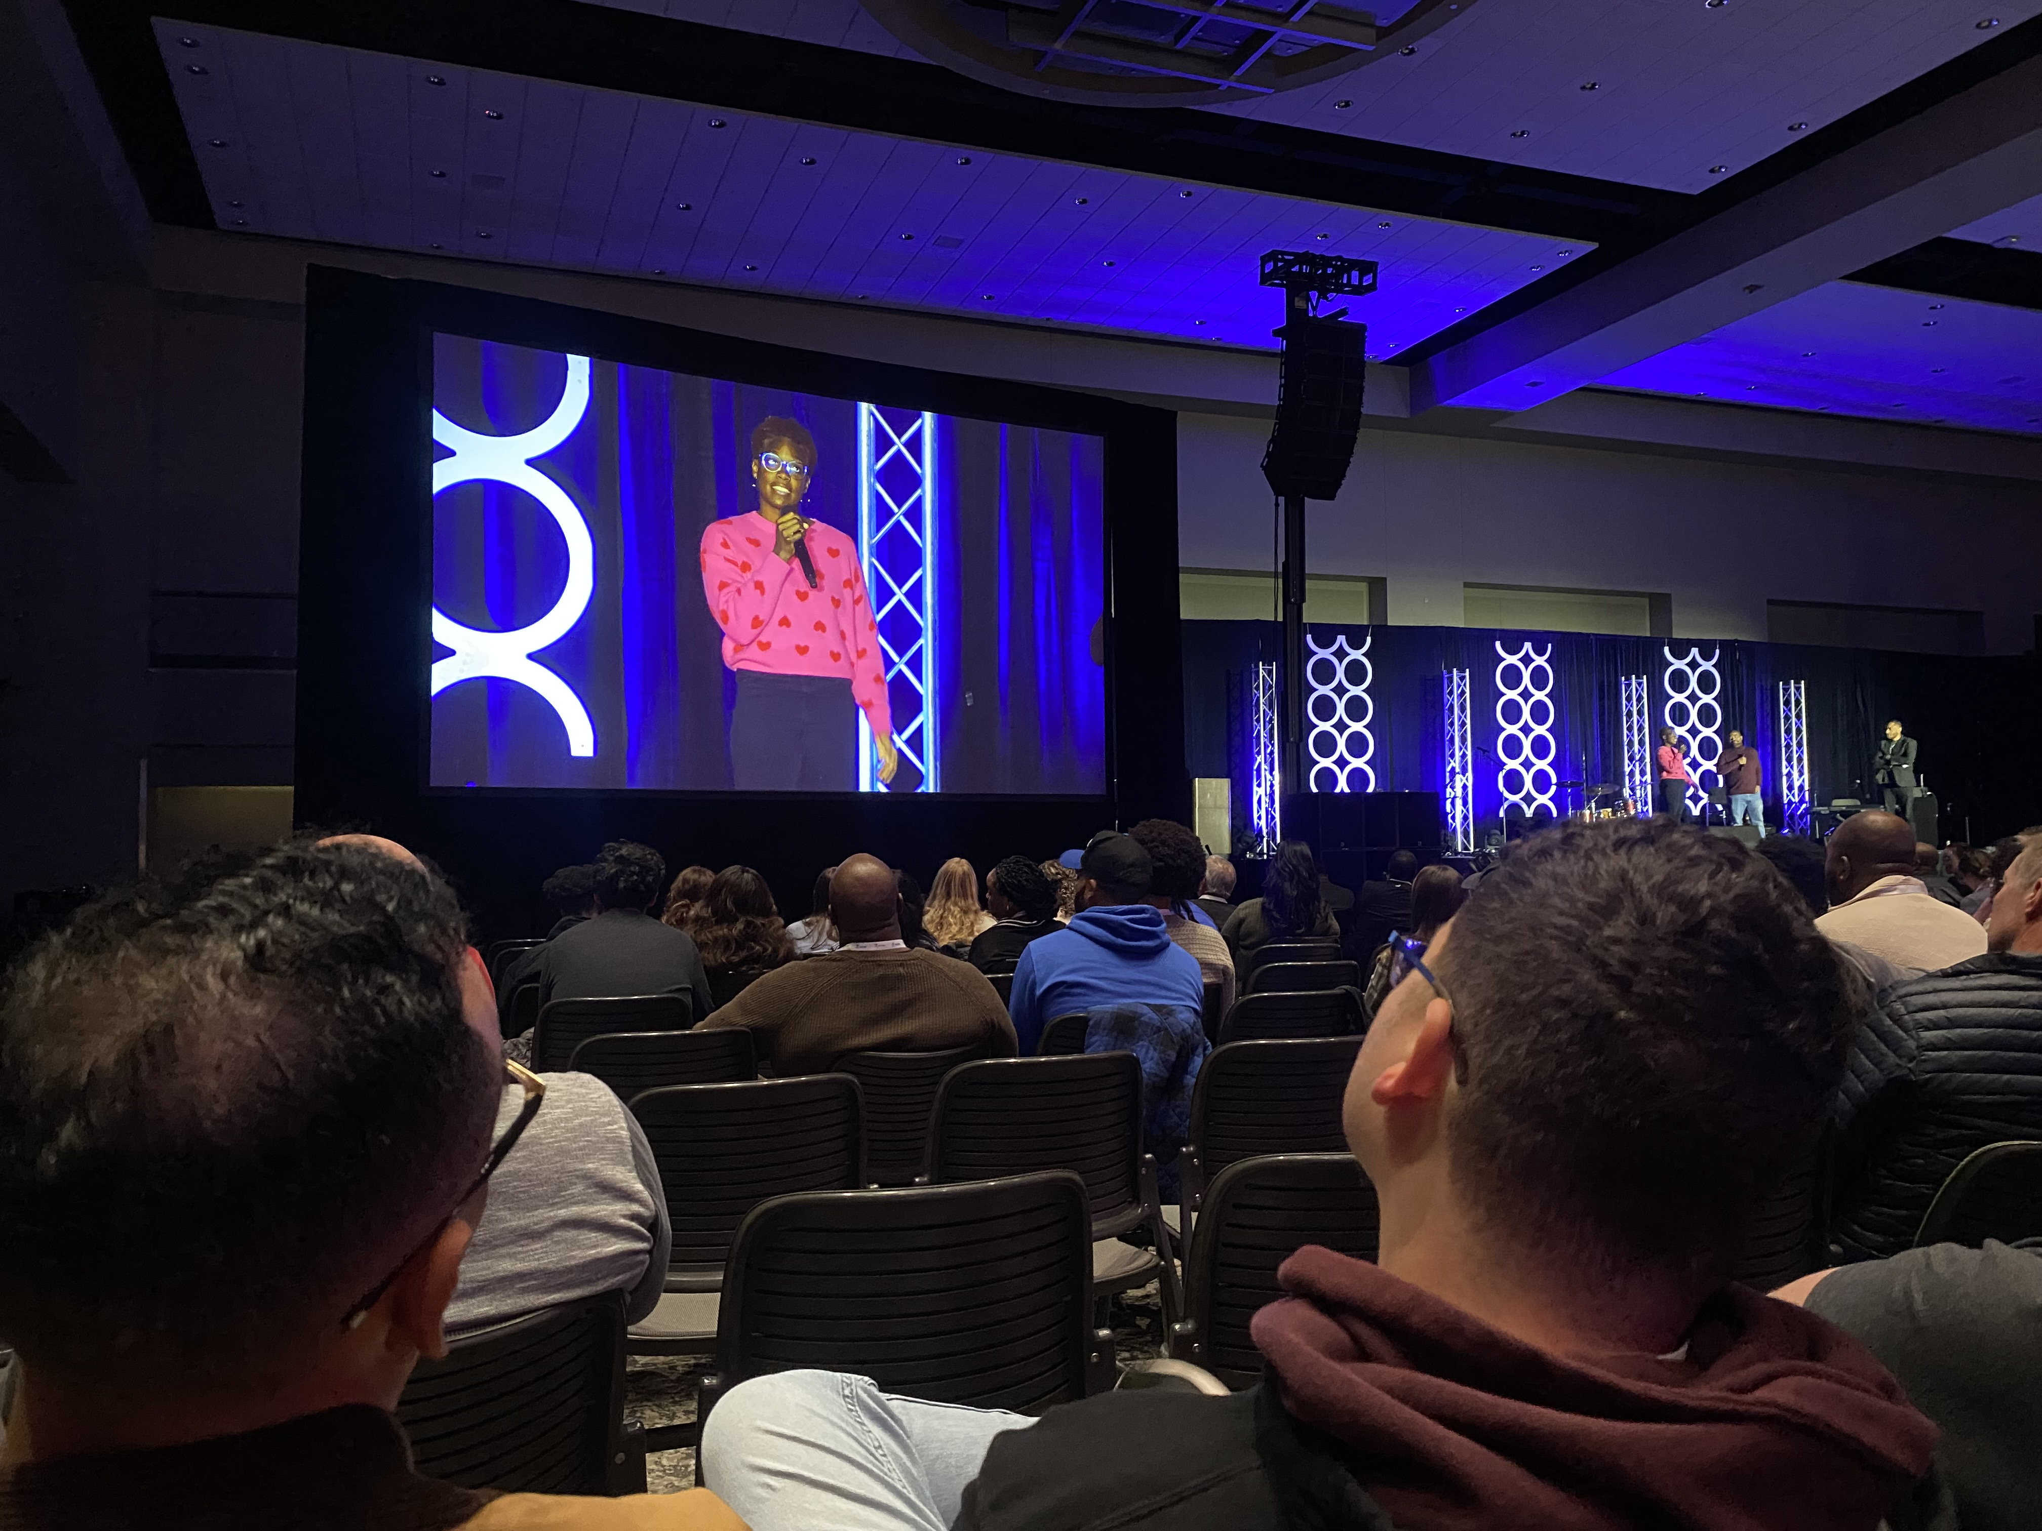
Notes:
CCDA Cohort Member – First time second generation – Ken Griffey, Sr. playing baseball with his son Ken Griffey, Jr

Slide 19
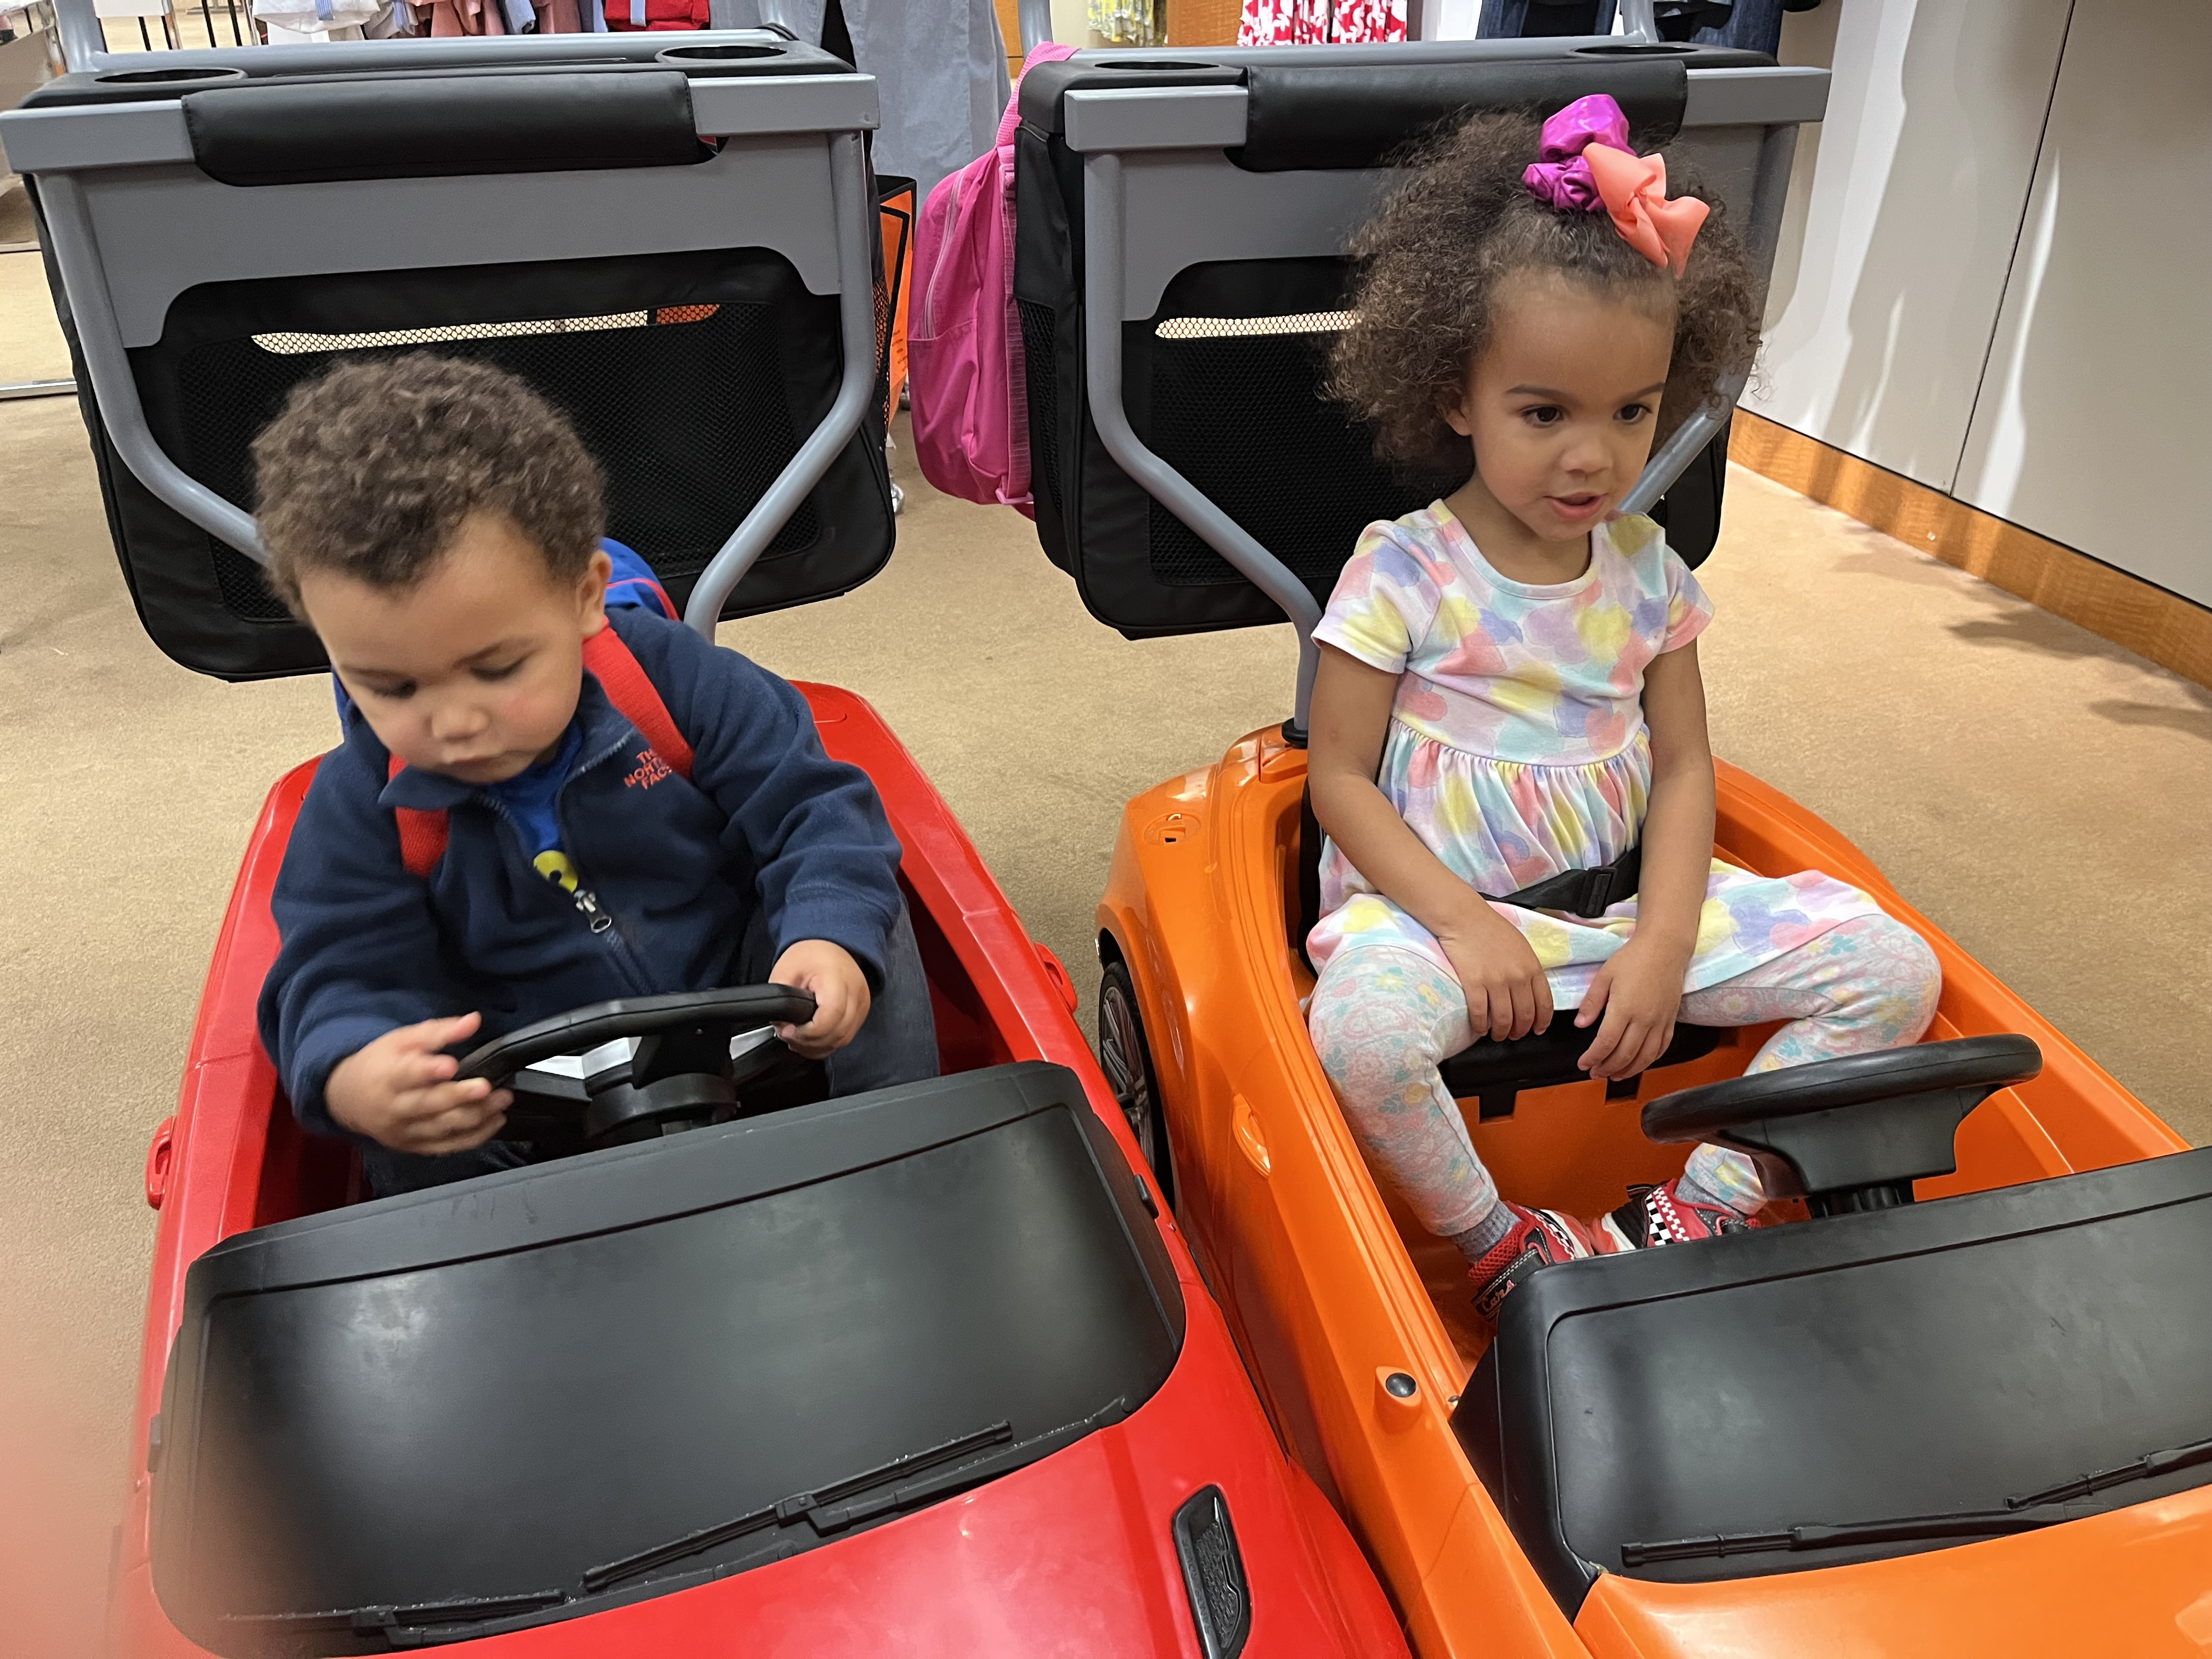
Notes:
Hope to have set the stage for my grandchildren to take the wheel one day

Slide 20
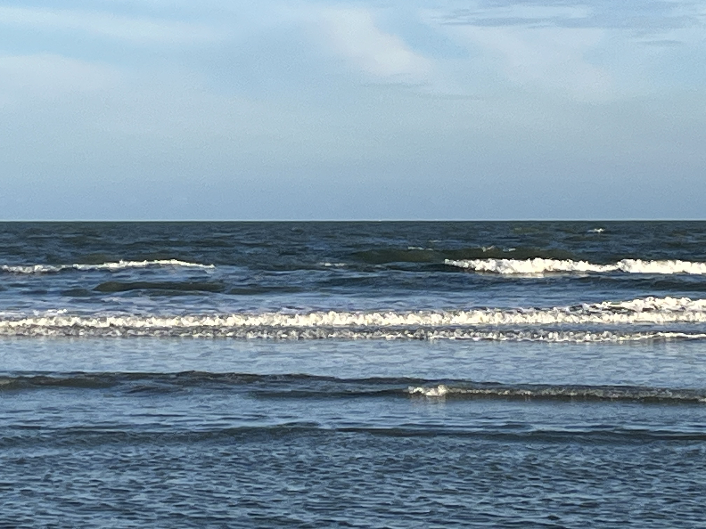
Gratitude
Amazing journey so far
Amazing support through it all
Amazing achievements accomplished together
Amazing people helping make it all happen
Amazing family that got me through

