Slide 1

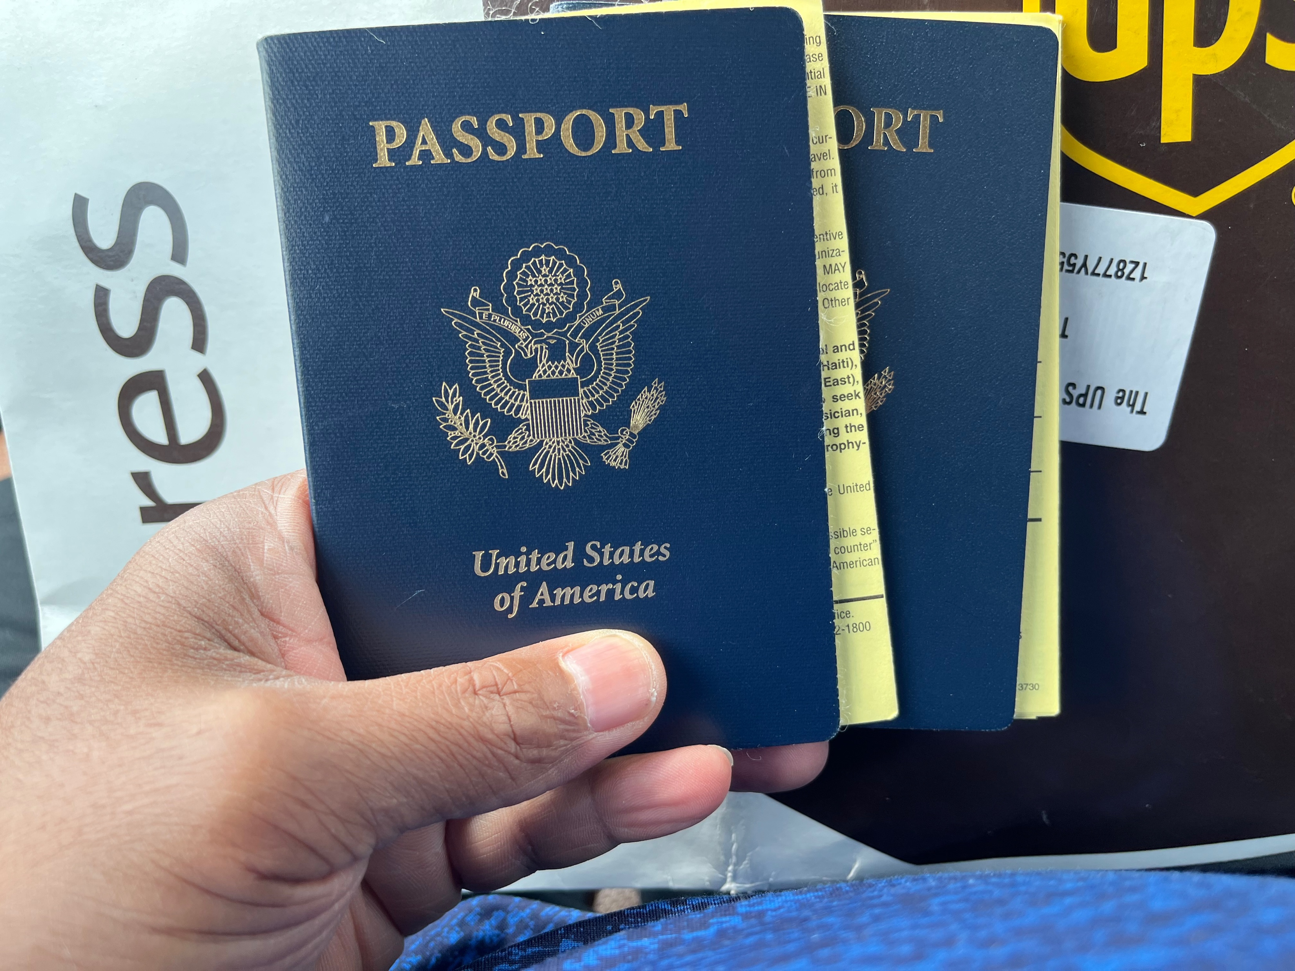
Notes:
This is me not going to Ghana
The Ghanian embassy hijacked our passports and did not return them until a month after we were supposed to go on our trip.
The worst part is that people told me after the fact that you could get your visa done on site when you arrive in the country.
The good news is that my brother had already arranged a Ghana/Senegal trip for any interested family members so I was able to change course and get signed up for that trip. It’s not till Jan 2028, but had to sign up for it in June.

Slide 2
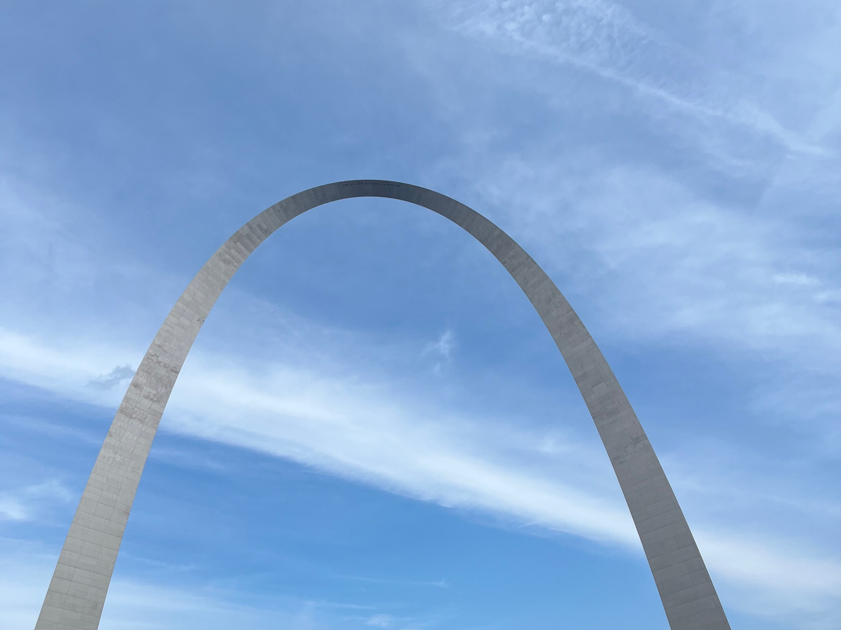
Notes:
In a 1853 sermon titled, “Of Justice and the Conscience”, an abolitionist named Theodore Parker said, “I do not pretend to understand the moral universe, the arc is a long one… But from what I see, I am sure it bends towards justice.”
As many of you know, the Rev. Dr. Martin Luther King Jr. popularized this statement, saying, “The arc of the moral universe is long, but bends towards justice.”
The first emphasized how our conscious should be leading to a world of justice while King emphasized we have to be actively engaged in bending that arc.
It would have been nice if the arc bent towards justice as sharply as the St. Louis Arch bends.

Slide 3
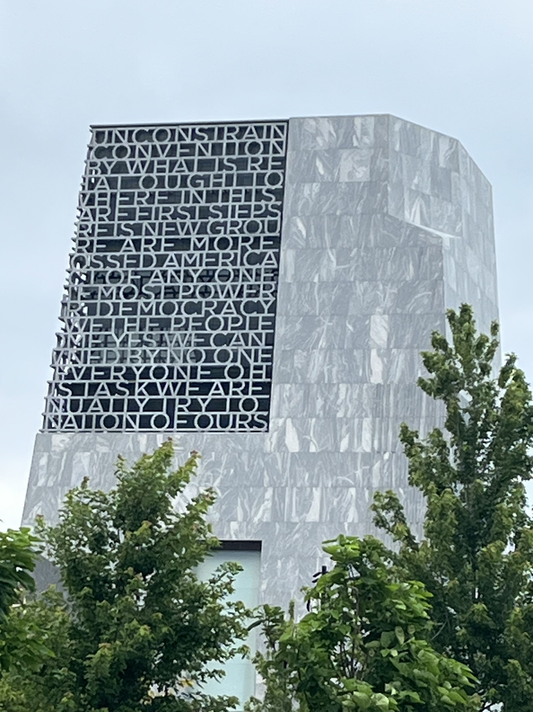
Notes:
The Obama Presidential Center
A symbol that some progress bending that arc has been made since Theodore Parker and Dr. King’s days.
Even this celebration of what the US can be was criticized

Slide 4
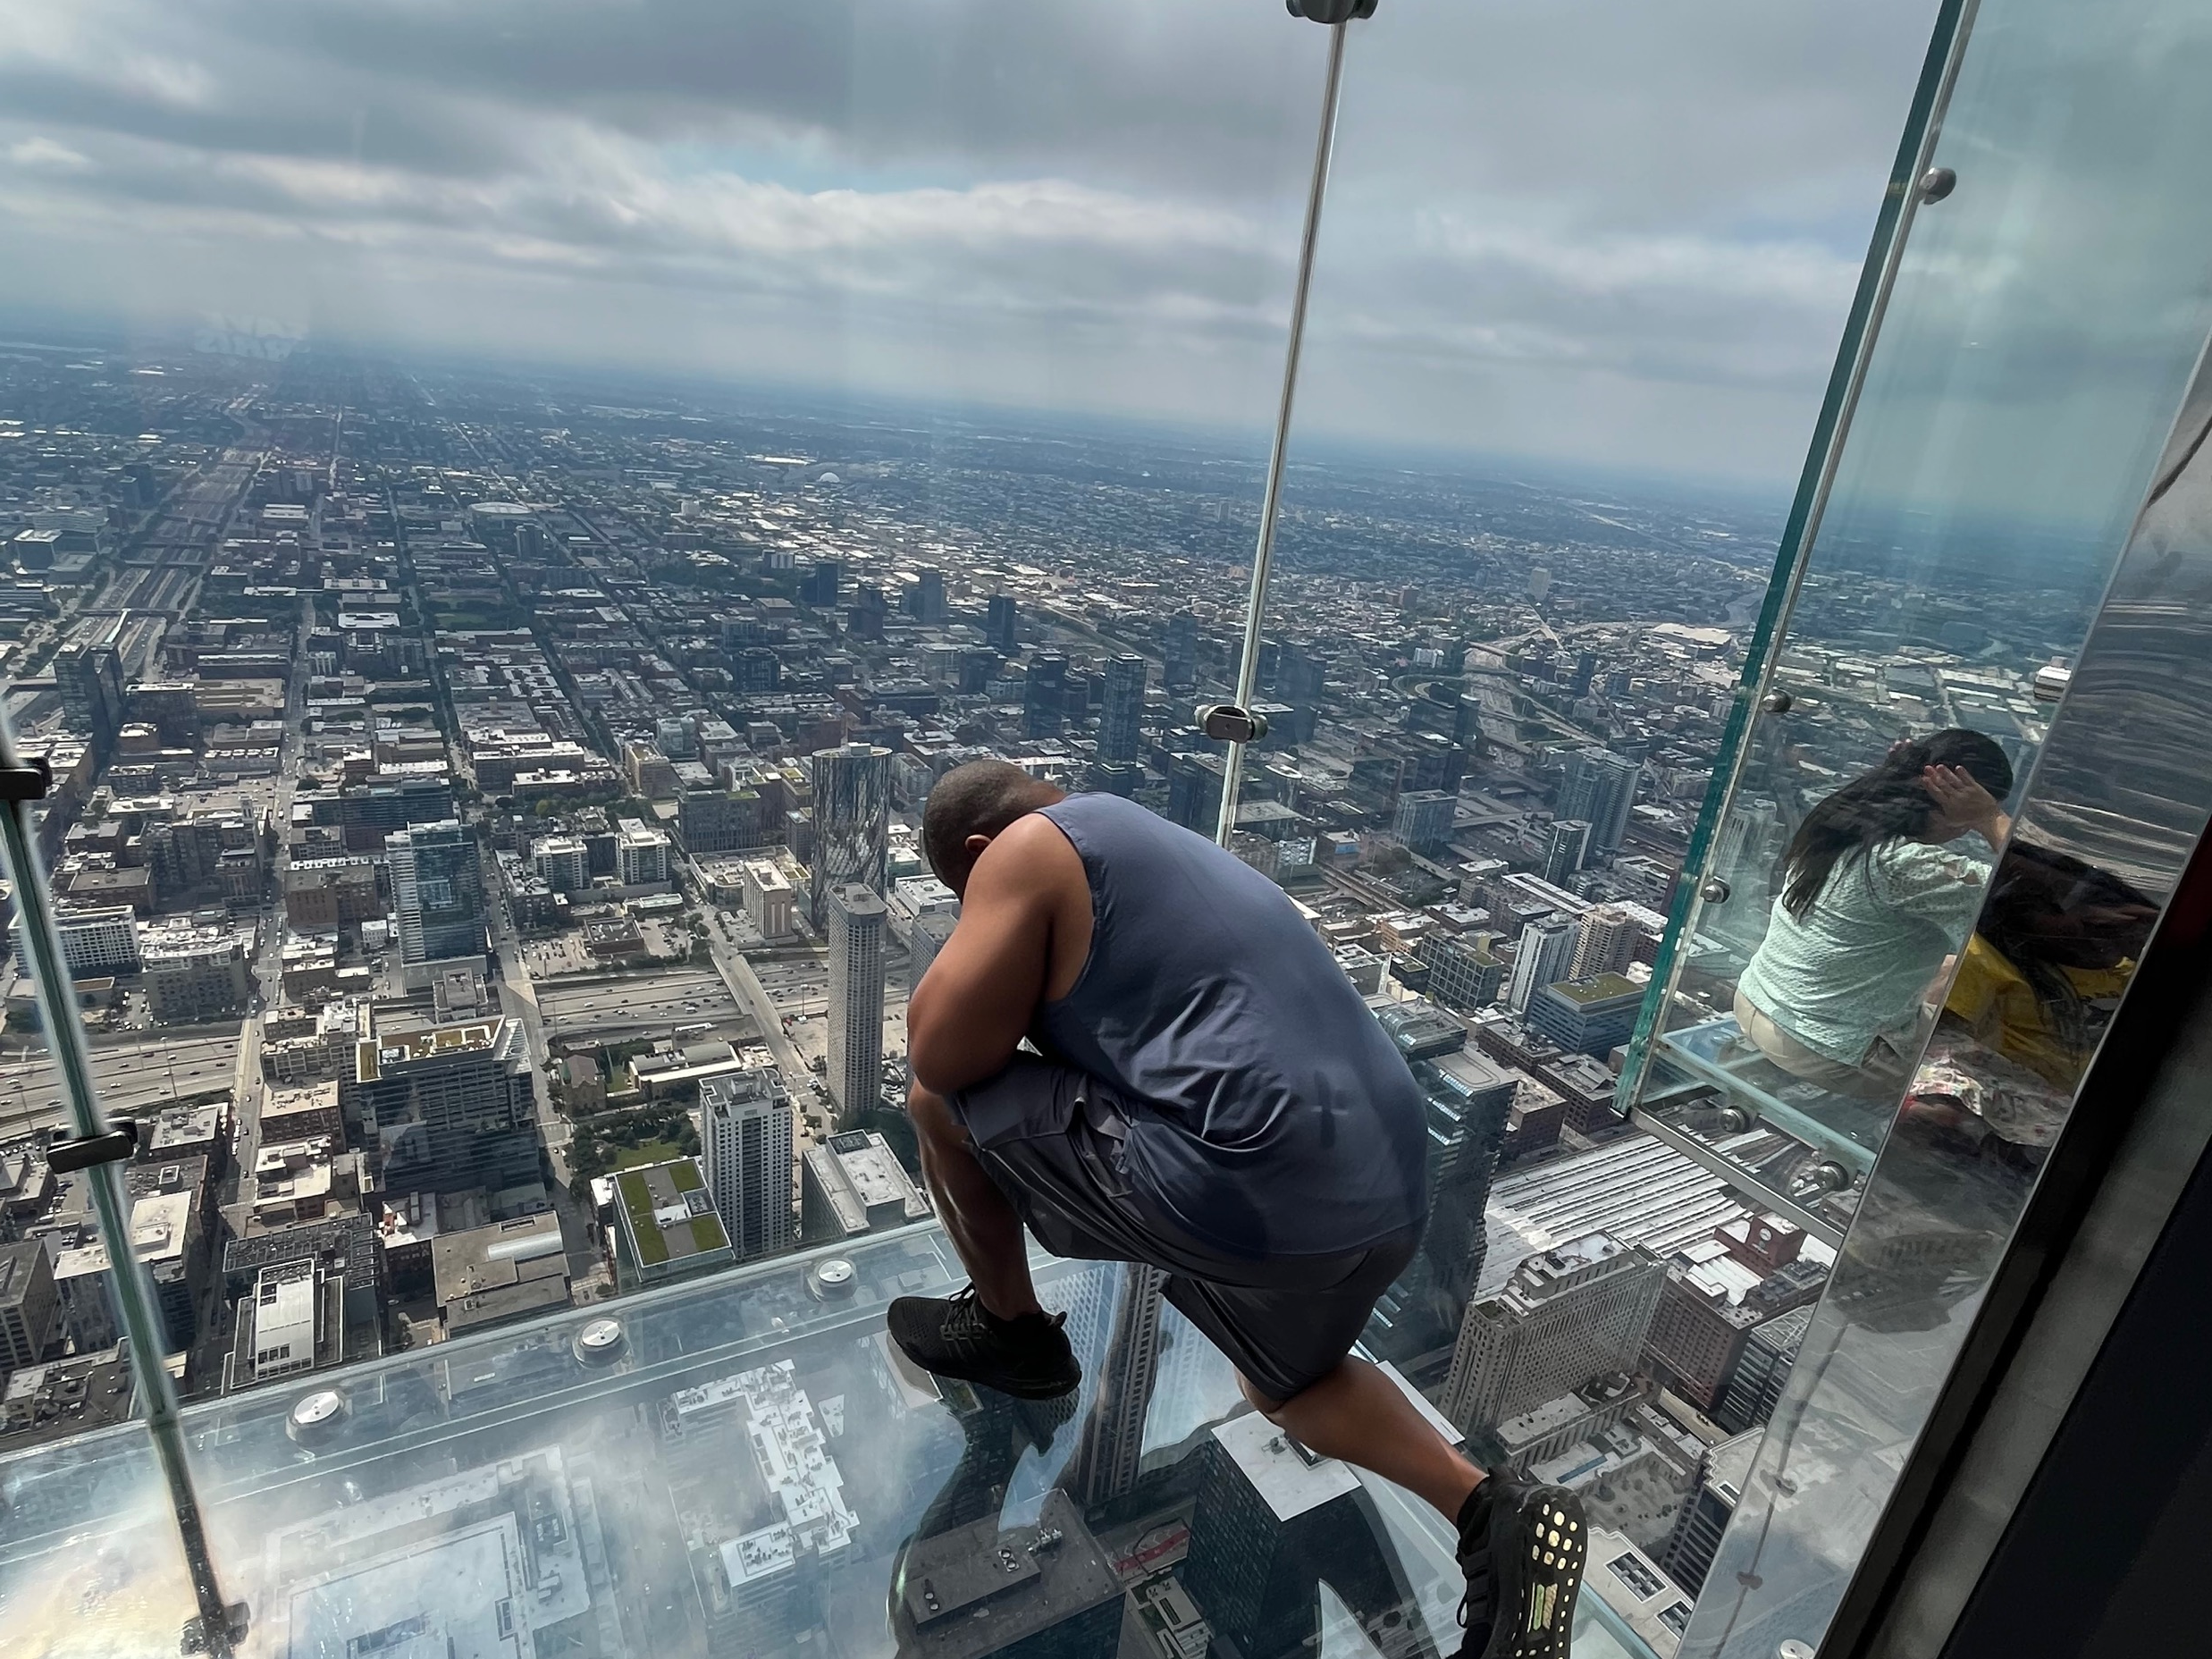
Notes:
1353 feet in the air (103 stories)
That’s 3.2 Eiffel Towers, 4.6 Statues of Liberty, and nearly 4 football fields tall
I often marvel about how many people live on this planet. This view certainly illustrates how many people there are.
However, I find it interesting how you typically have such a smaller group of people working towards various causes and even smaller working towards justice.

Slide 5
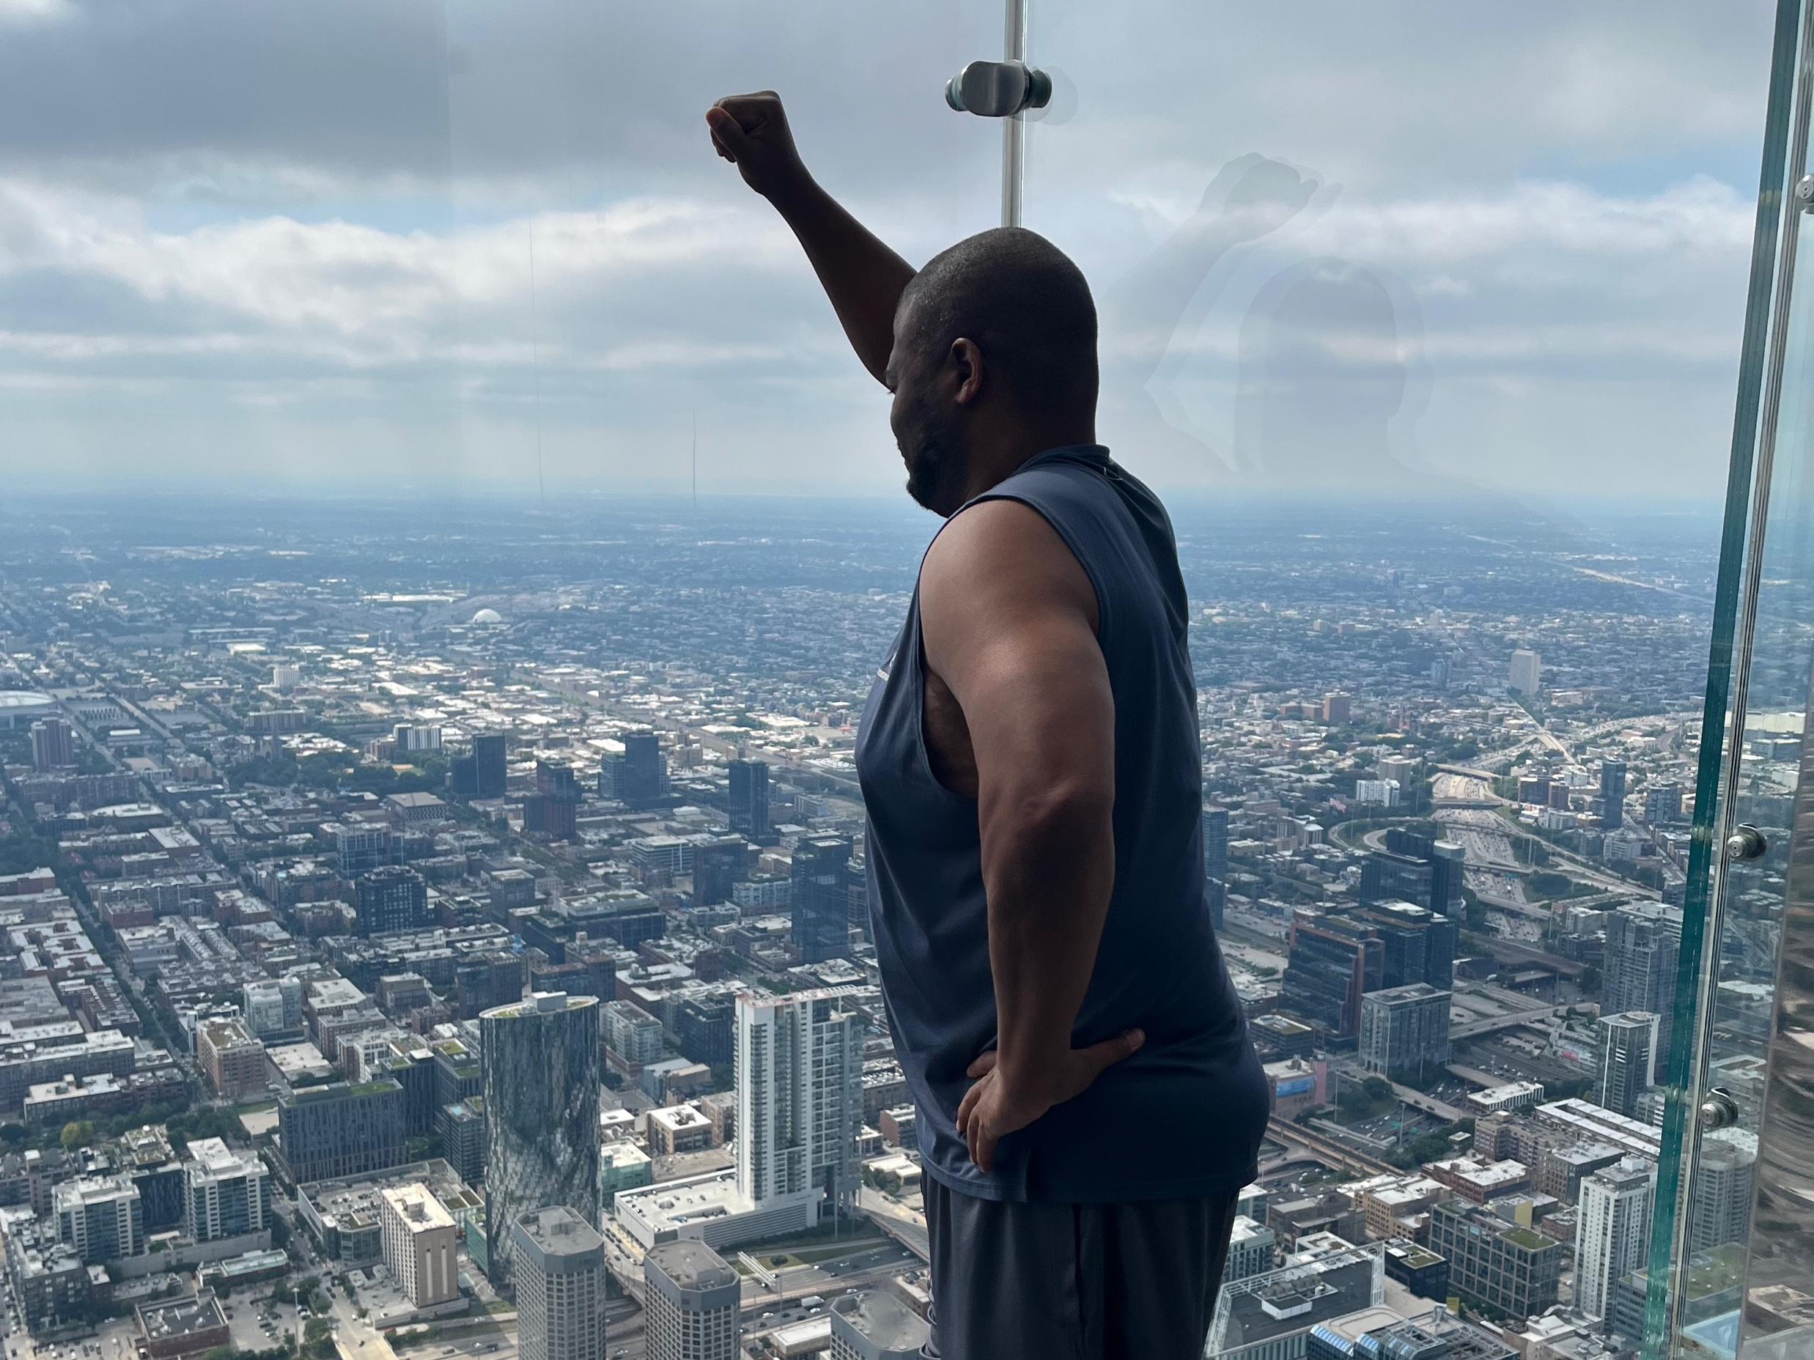
Notes:
I often wonder, even locally, what would happen if even half the population was truly engaged in efforts towards justice. Whatever was demanded would happen. As much as I am encouraged and excited about the 20-30 people that come to our meetings and the 400+ on our email list keeping up with the coalition, there is no reason why would couldn’t have hundreds at our meetings and thousands tracking everything online.
Even with the state reparations commission, there are a limited number of people that come to public hearings.

Slide 6
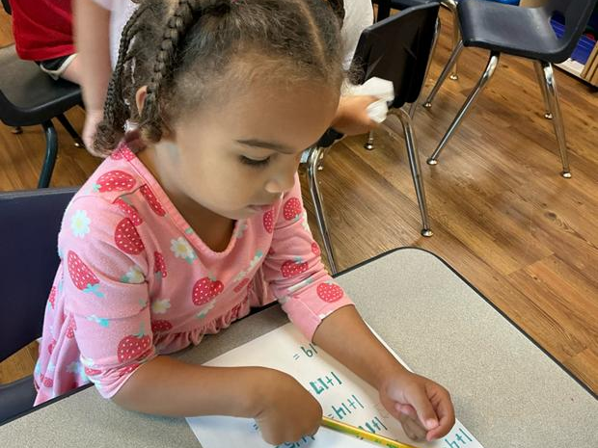
Notes:
While I was vacationing and contemplating, the grandchildren were hard at work.
Preparing themselves to have a successful life

Slide 7
Notes:
Starting math at 2
Reminds me of something Professor Sunidata Cha Chu has been sharing with Champaign City Council members about justice. He gives them the analogy of a child snatching a toy away from another child. He explains how we respond to that. We have the child that snatches the toy give it back, have them apologize and have both kids shake hands. Even as young children, the concept of justice can be taught.

Slide 8



Just(ice) Because
Justice as a Lifestyle
Notes:
Micah 6:8 “God has shown you, O mortal, what is good. And what does the Lord require of you? To act justly and to love mercy and to walk humbly with your God.”

Slide 9


Just(ice) Because
No need for a special occasion to convey feelings or sentiments
Underlying understanding that those feelings or sentiments are ongoing, consistent, & meaningful

Slide 10
Why Not Just(ice) Because?
Not treated fairly
Growing callous
Selfish ambition
Conditional justice
Notes:
Genesis 45: 1-15
There are more reasons but I will just focus on a few… ones that Joseph, in particular, was able to overcome.
Conditional Justice – giving money to a houseless person. People say they don’t help because it will just go to cigarettes or alcohol. While I am not advocating for any addictions, putting this condition on giving is kinda weird. I mean, do you expect the houseless person to be responsible and save your dollar gift for a down payment for a house? Should we somehow be able to regulate some peoples’ addictions and not others, or why assume it is an addiction at all. Lots of people drink and smoke… why is it a particular problem for a houseless person to do so?
Reparations – black people will waste the money… or it will go right back into the “system”. Sooooo.. We do not acknowledge harms and try provide compensation for those harms because of how the money will be spent? While it would be nice that every reparations dollar was used for “good” (who is even determining that definition), it is not the point. The point is justice.

Slide 11
Just(ice) Because
Genesis 45: 1-15
  Joseph recognized his brothers’ actions as God’s plan (as if they did not have a choice event)
  He is genuinely grateful and happy to be reunited with his family (he probably felt they would not accept him)
  His first thought is to make sure everyone is ok and assure them that they will be ok
  Gives God the credit for position he was in (despite him going through so much to get there)
Notes:
I cannot imagine the myriad of thoughts going through Joseph’s brothers’ minds. I would imagine they were a combination of extremely fearful (Joseph had absolute power), grateful (they won the billion dollar lotto – imagine the odds of Joseph going from a sold slave to lord of Egypt), guilt-filled (despite Joseph’s grace and mercy, any decent minded person would have felt like a heel), maybe even jealous (they hated on Joseph back in the day for having dreams… and now he’s in charge of Egypt!?!?!?).
I would imagine the dad had to be like President Obama’s parents. How proud would a parent be and how shocking would it be to see your child achieve something impossible (like becoming the first black president in history or in Jacob’s case, his lost son popping up as lord of the most powerful nation in the world)

Slide 12
What Was It With Joseph?
Made the best of his situation – even at its worse
Treated people well – even those that hurt him
Had a drive to keep putting himself out there
Found the joy in victories and shared his success
Held on to his faith in God

Slide 13
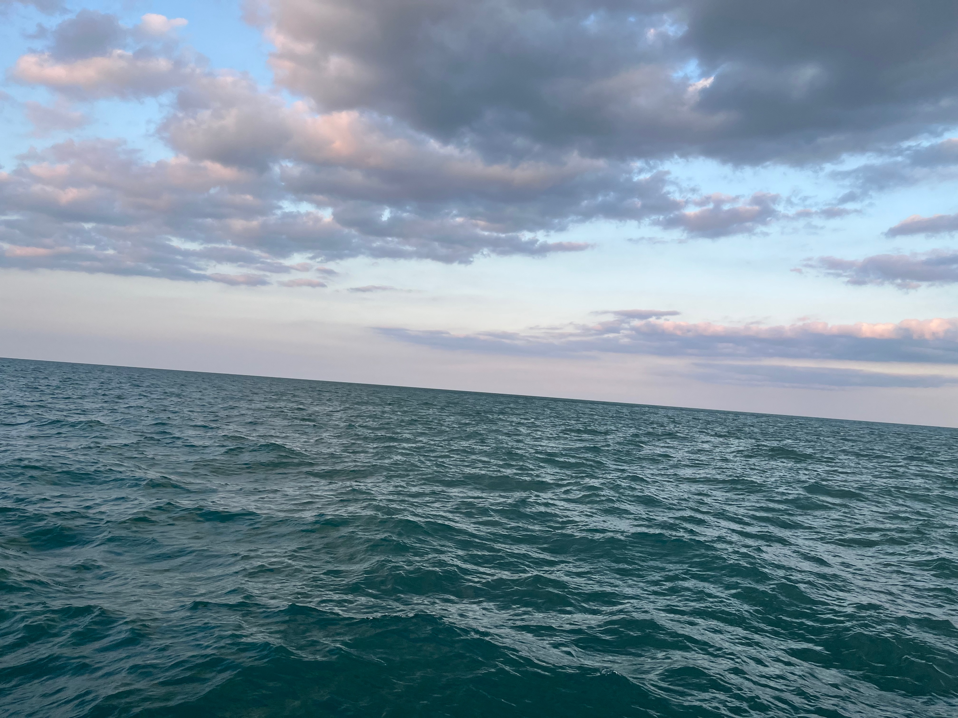
Notes:
The road may be rocky or the water may be choppy
Tisa and I were invited on a small private yacht ride on Lake Michigan by N’Nanba (i.e. Robin Rue Simmons) and I was surprised about how jarring the lakes waves were – thus my off centered picture
Pursuing justice feels that way. There is relatively small group of people trying to maintain their balance and footing throughout all the rocking back and forth. Trying to enjoy the experience while everything you do has to be done despite steady uneasy rocking along with sometimes sudden jarring movements (eating, walking, using the bathroom, etc.). And you cannot forget about the chilling temperatures.
There are beautiful parts as well of course, like the serenity of being in nature, or the cool perspective of seeing a big city from a distance, and comradery of those on the ride with you.

Slide 14
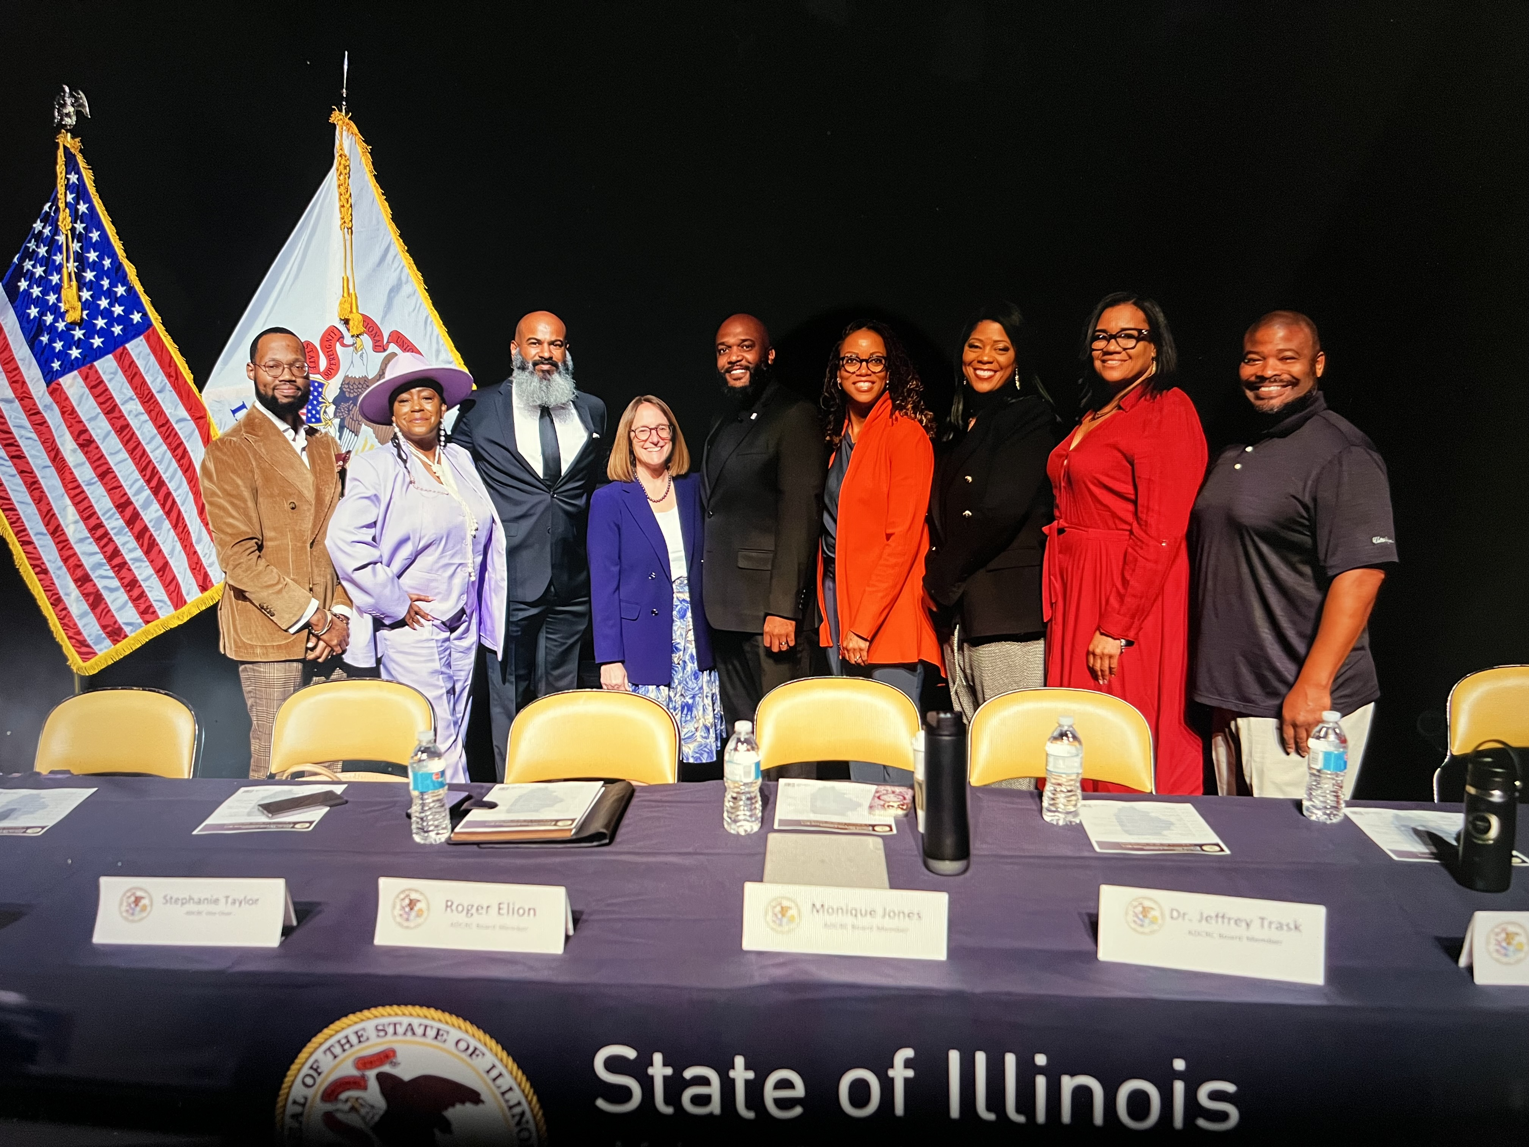
Notes:
Rocky waters convincing city officials of the need for a reparations commission

Slide 15
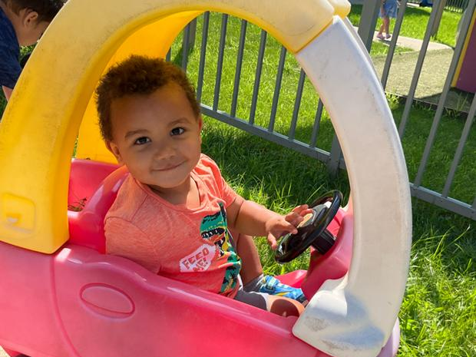

Slide 16
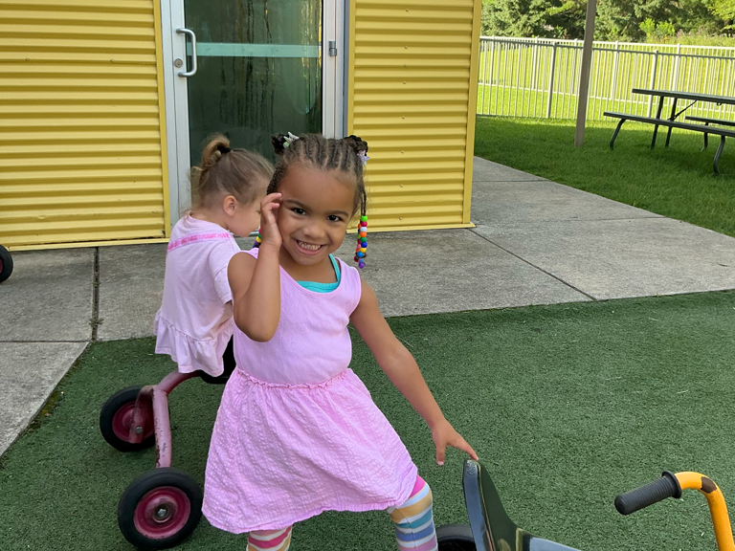
Notes:
Meanwhile, there are people benefitting from your labor.

Slide 17
