Slide 1

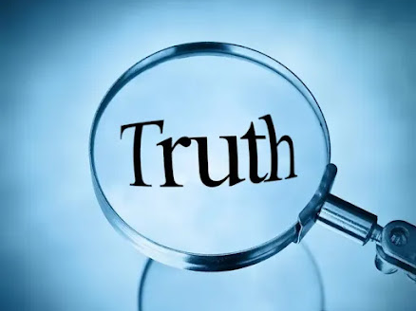

Slide 2
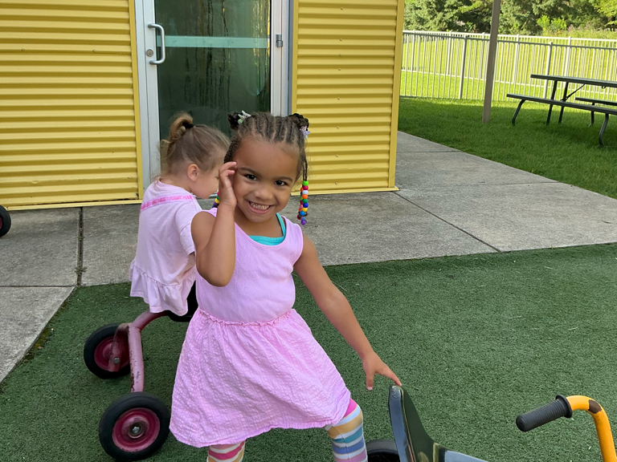
Notes:
Amaya posing with her tricycle
Getting more and more grown everyday.

Slide 3
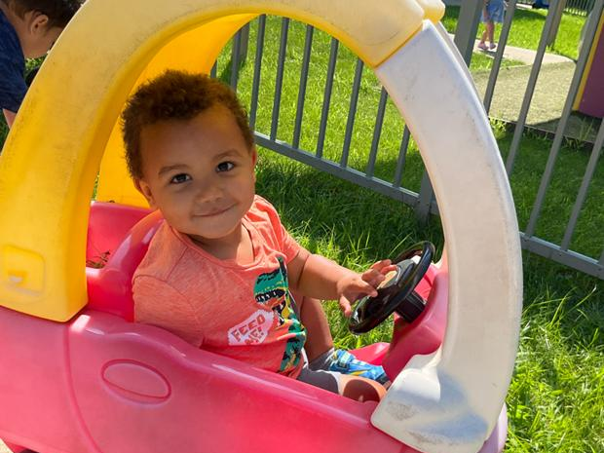
Notes:
Amari styling in his car
Full of energy
Love kids ability to move on

Slide 4
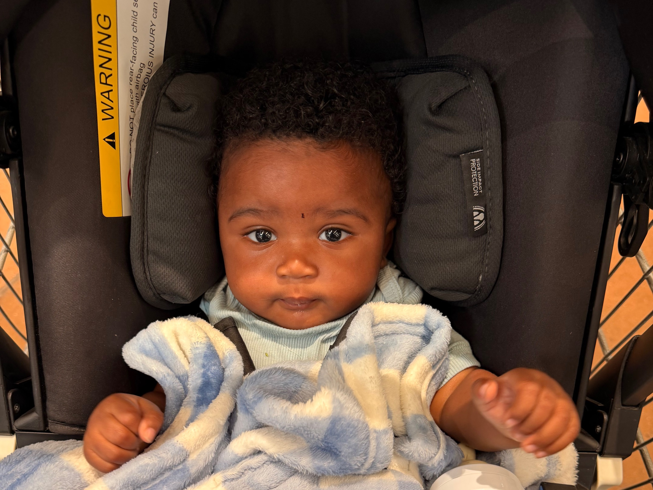
Notes:
Malachi Trask
Born May 19, 2026
Amaya and Amari have a cousin

Slide 5
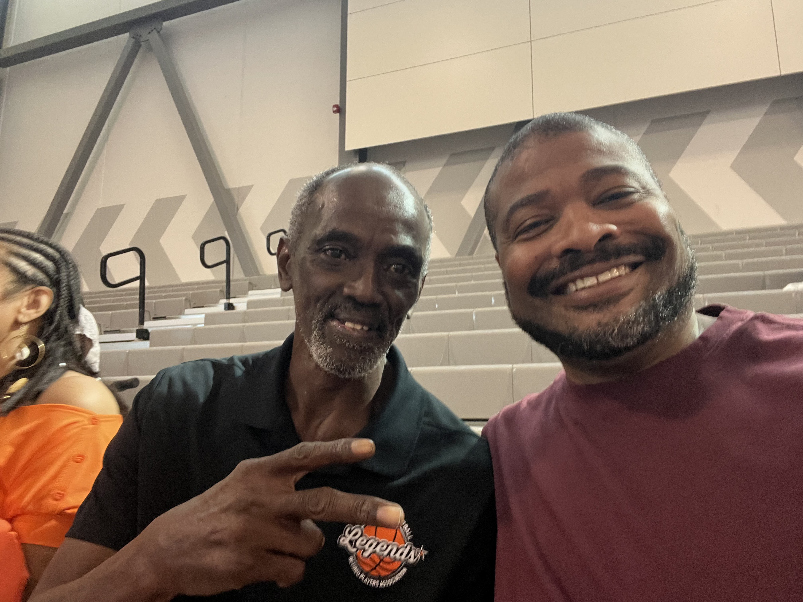
Notes:
Voting event in Chicago
Picture with Craig Hodges from the Michael Jordan NBA Champion Chicago Bulls (3 point specialist)

Slide 6
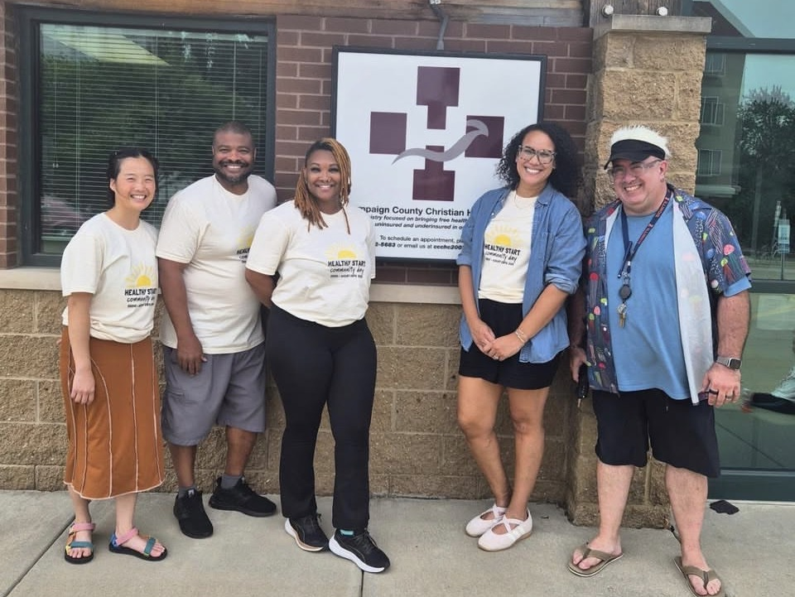
Notes:
August 29 Healthy Start Community Day

Slide 7
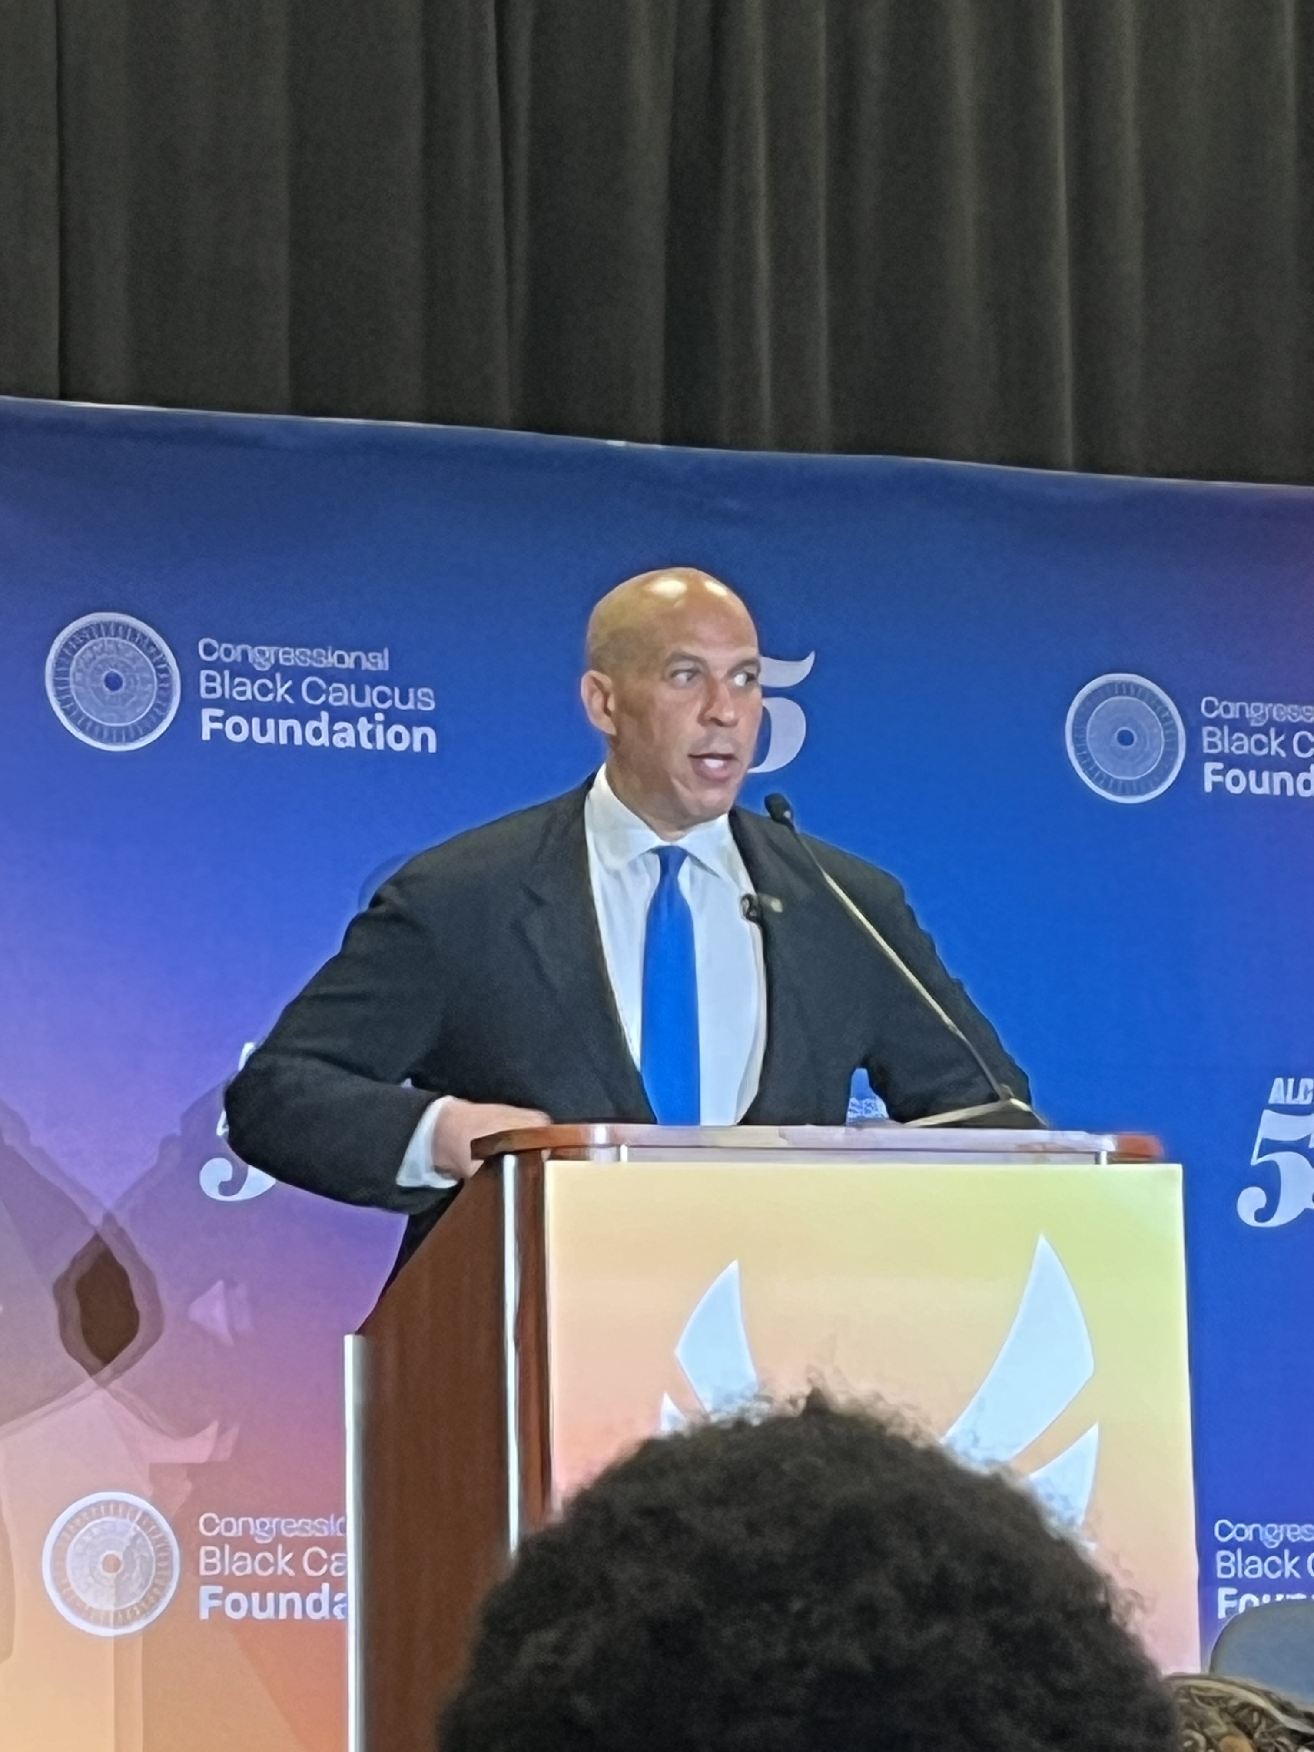
Notes:
Senator Cory Booker at a powerful session on Black Men’s Mental Health

Slide 8
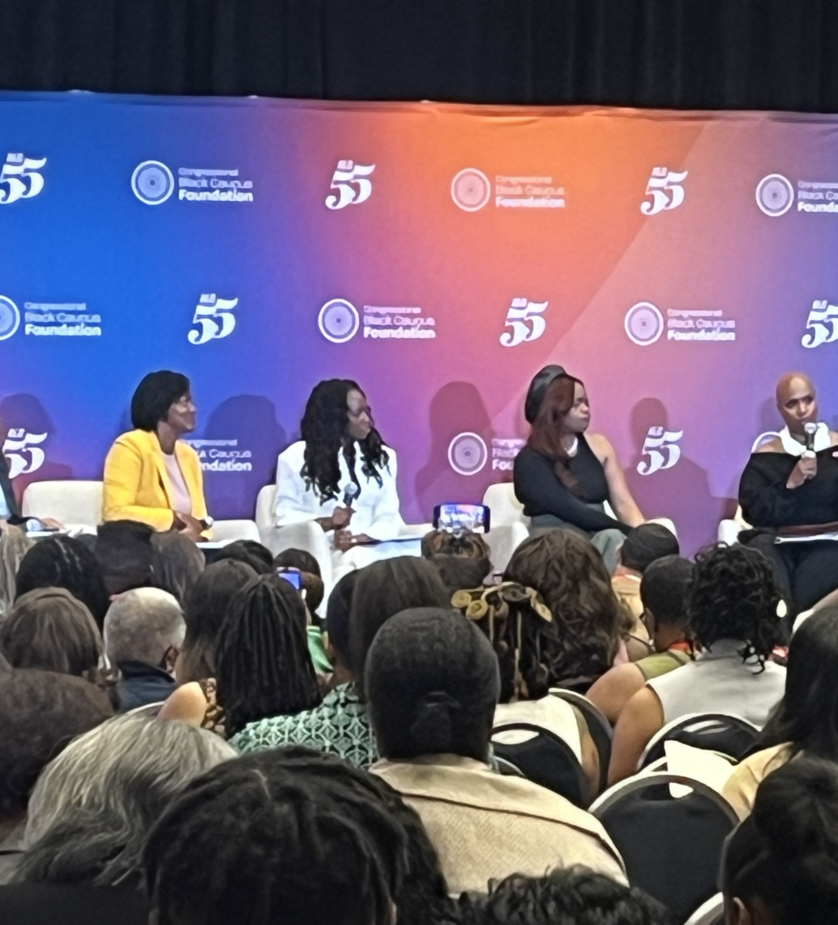
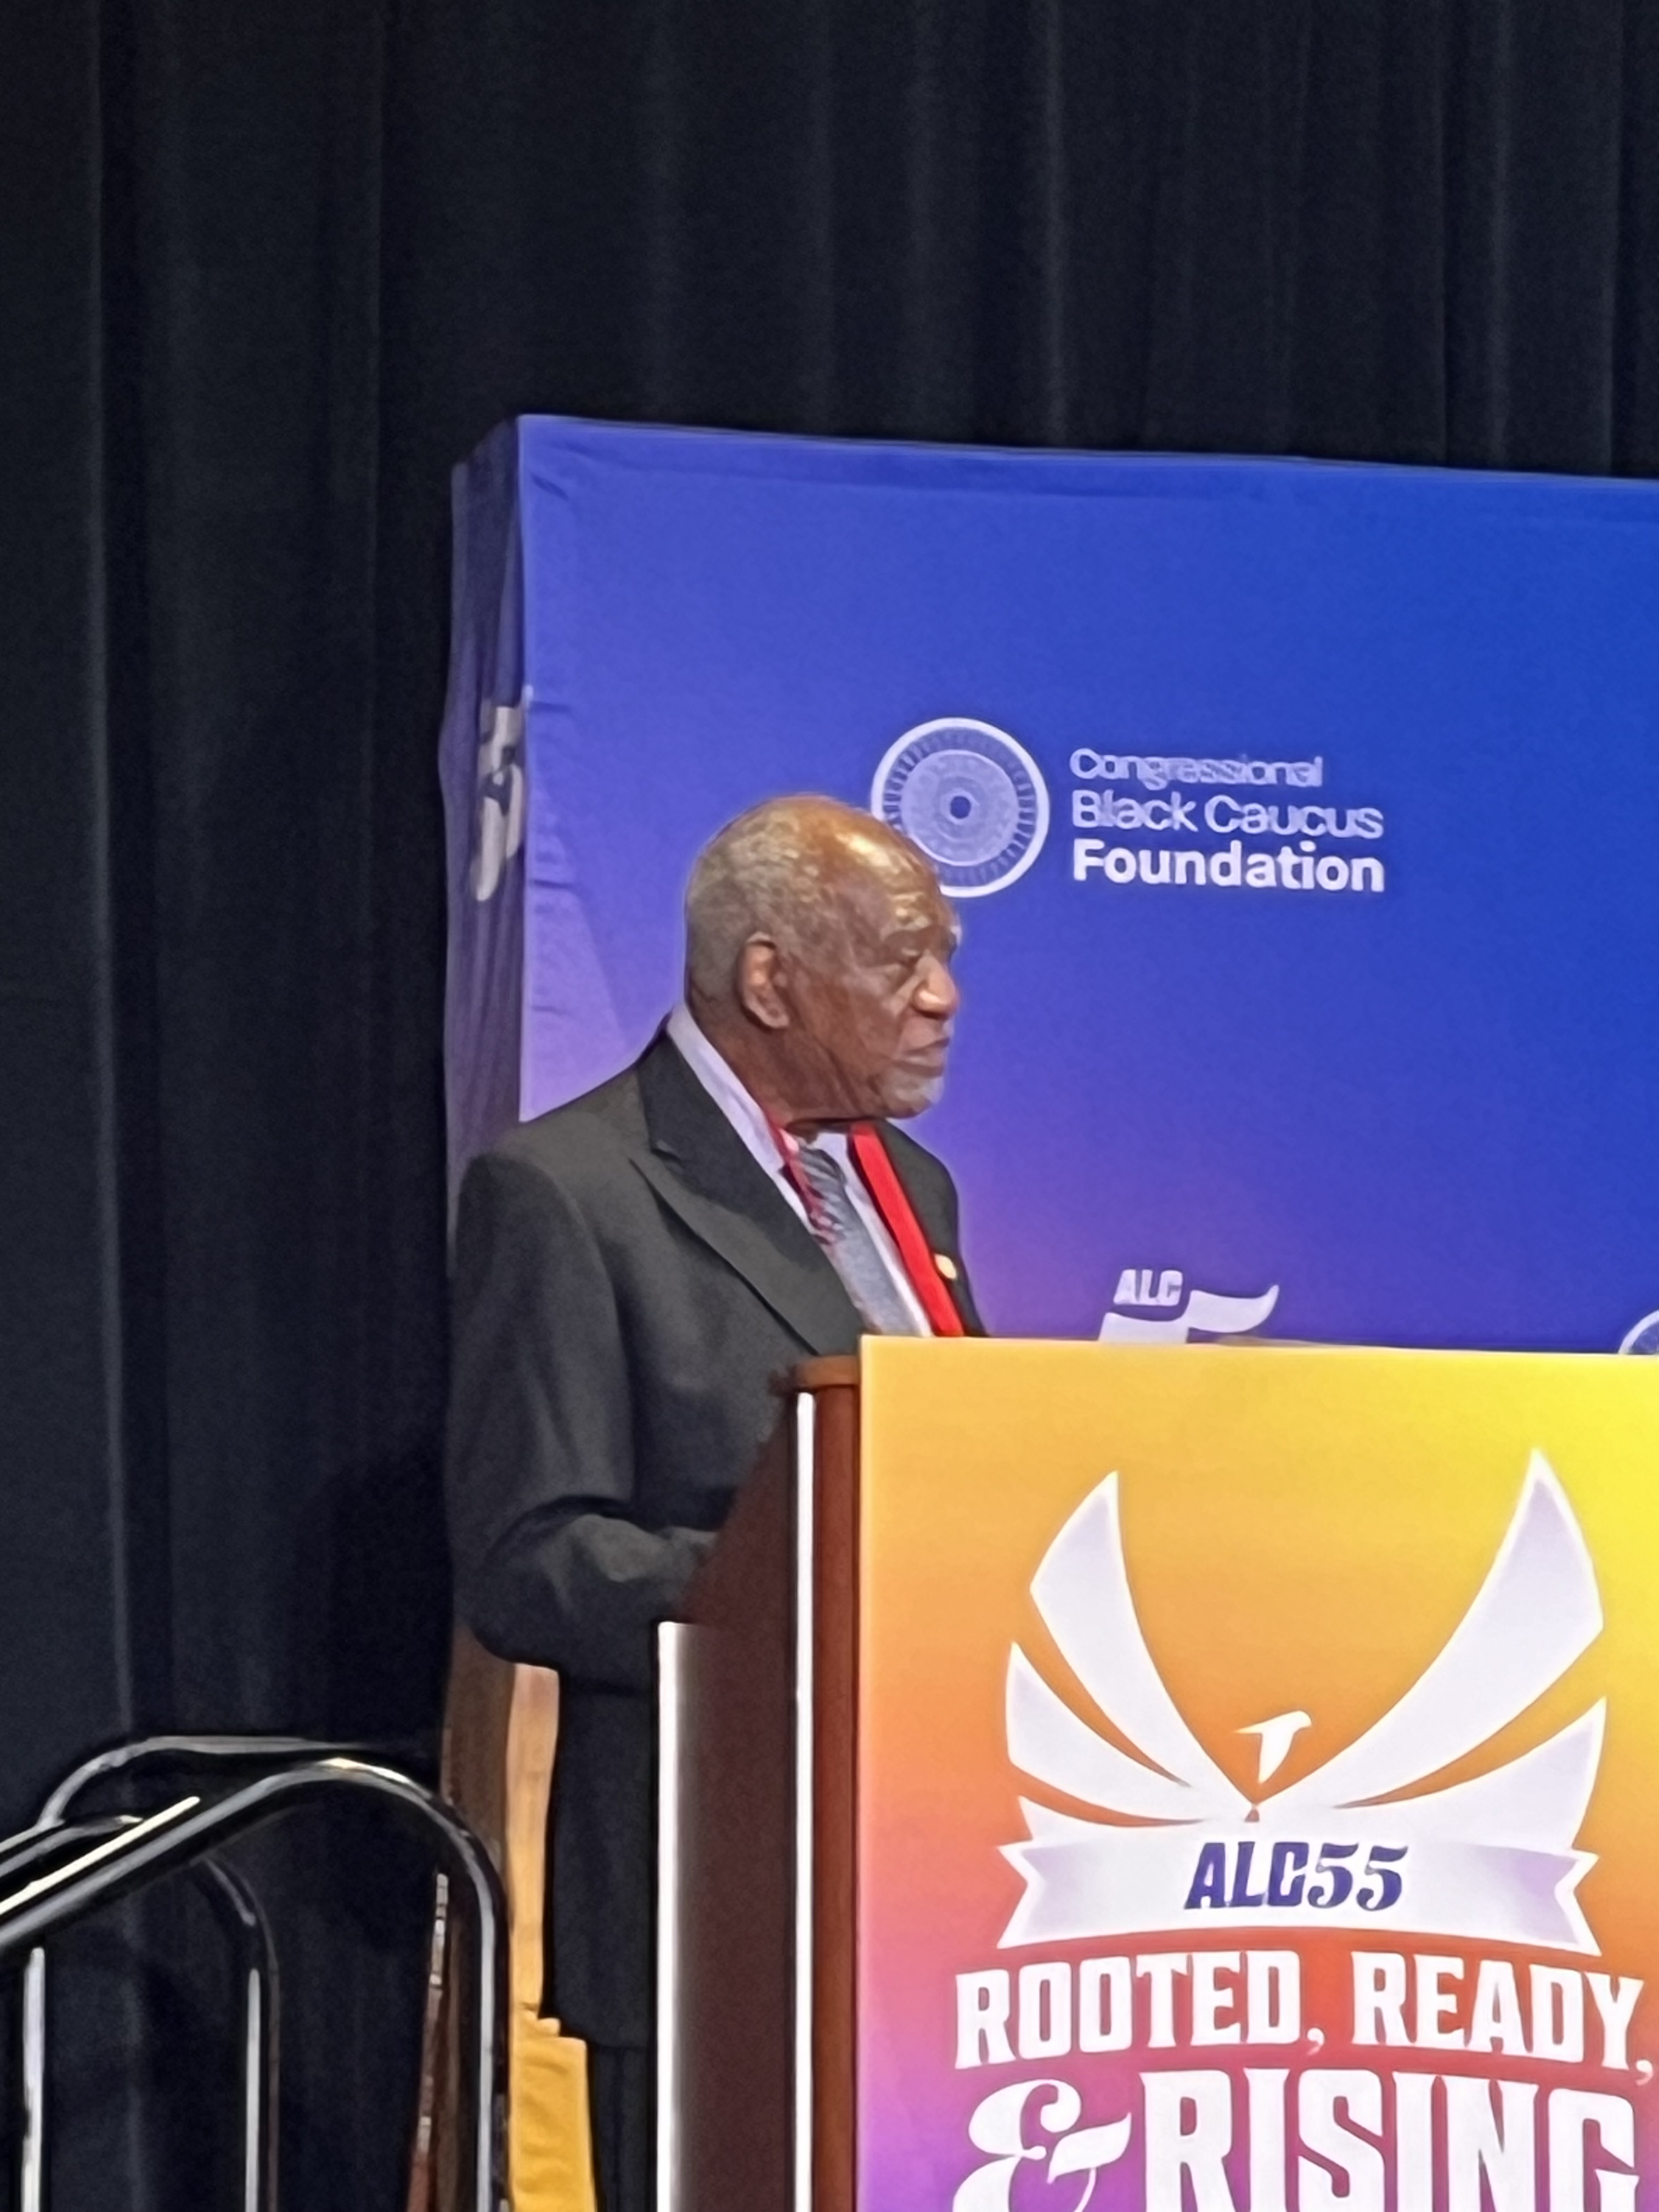
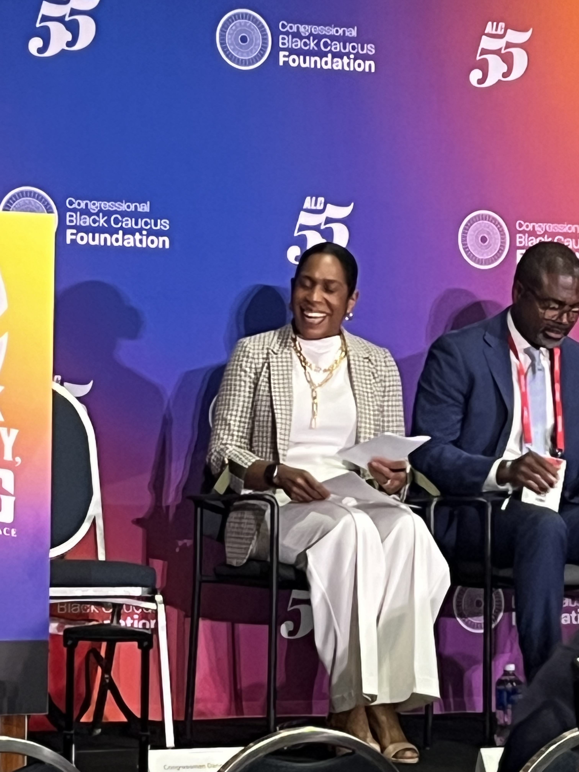
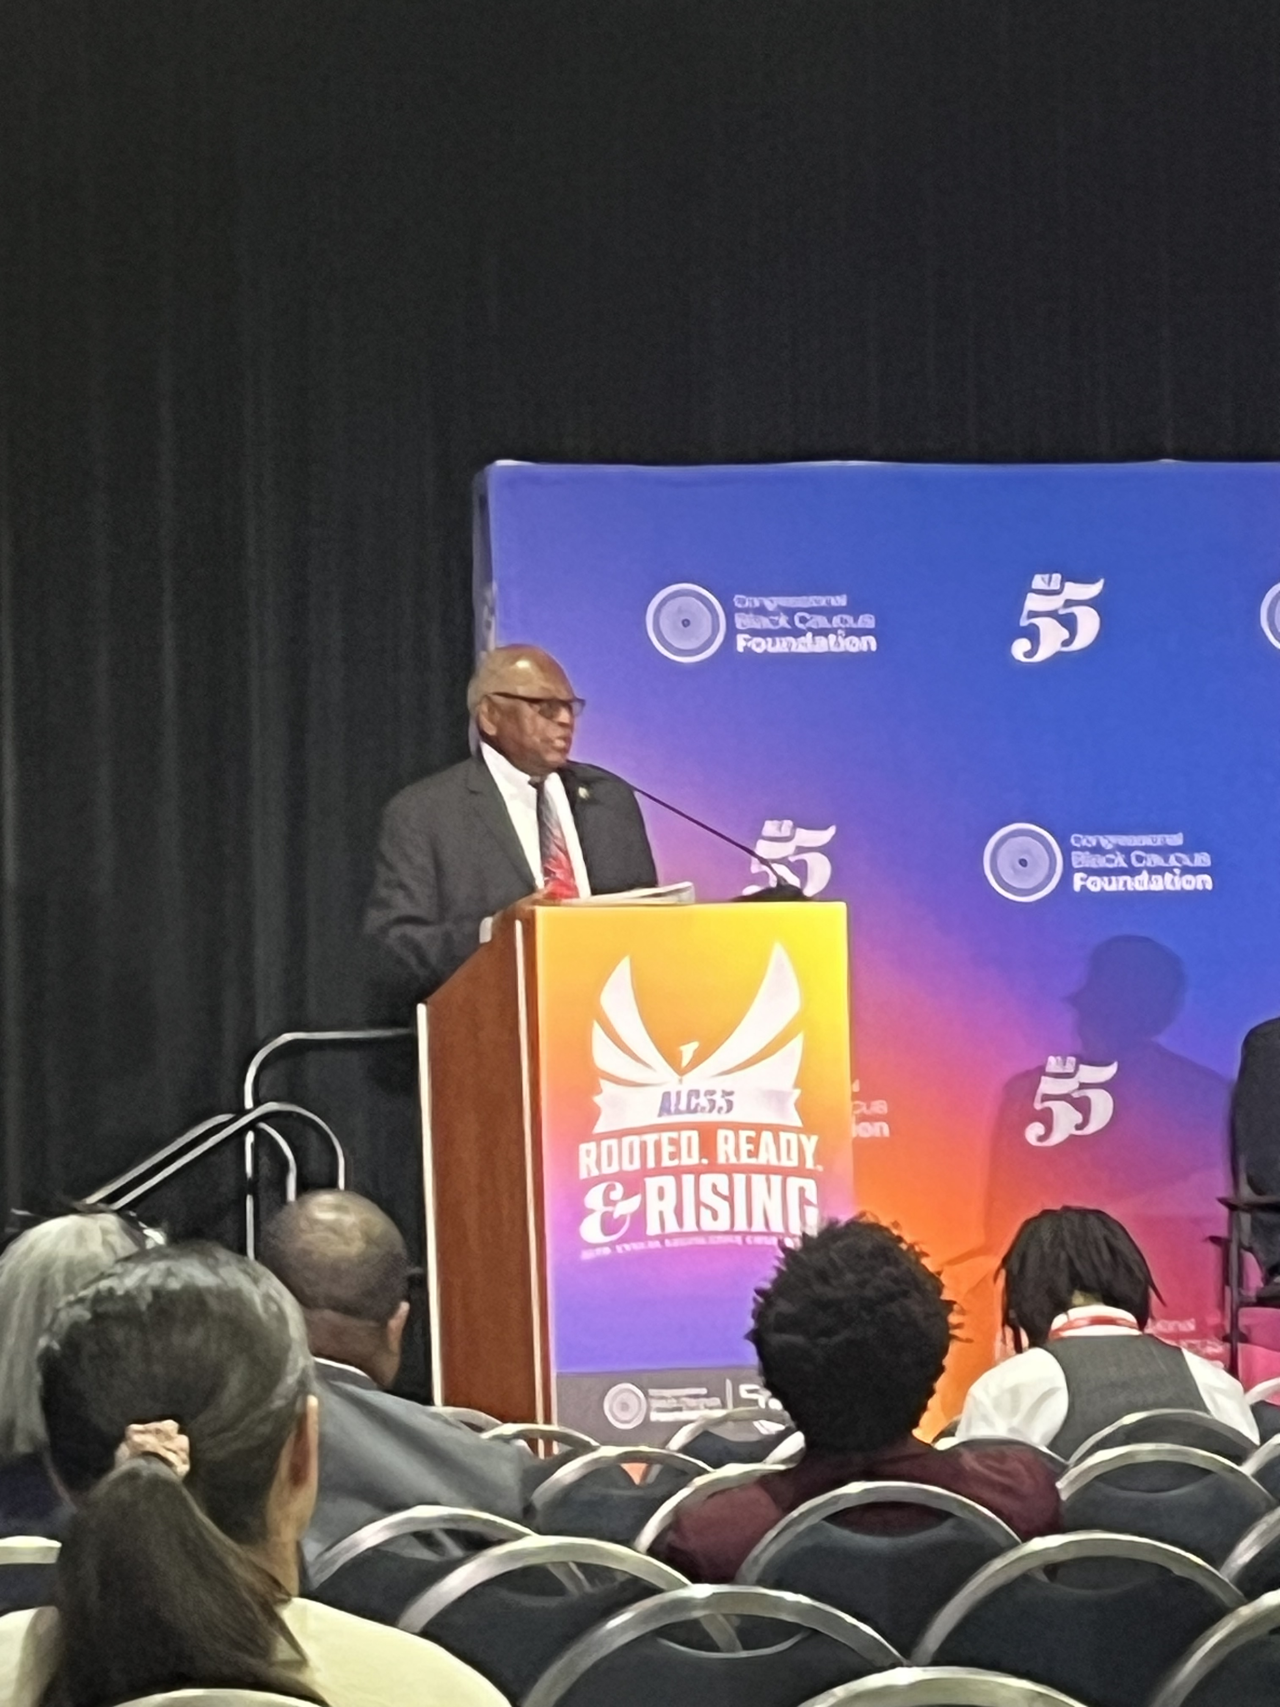
Notes:
Illinois Congressmen Danny Davis
Illinois Lt Governor Juliana Stratton (future Senator?)
Massachusetts Congresswomen Ayanna Pressley
Democratic Nominee for Florida Senate Angie Nixon
South Carolina Congressmen James Clyburn

Slide 9



Lift Your Anchor
Rejecting Lies, Embracing Truth
Notes:
John 8:32 Then you will know the truth, and the truth will set you free.”
“If you hold to my teaching, you are really my disciples. Then you will know the truth, and the truth will set you free.”

Slide 10
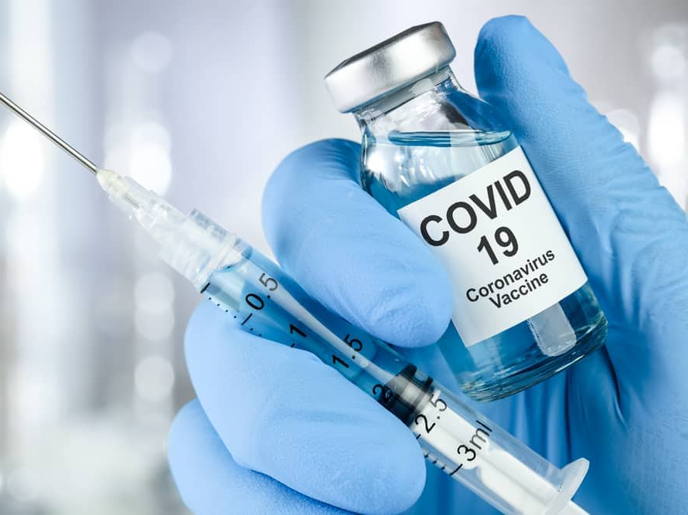
Notes:
Sometimes getting the truth is difficult
Study on COVID vaccine with African Americans –
Revelations
Reason for trust of sources not terribly solid
Strong confidence in choice based on shaky sources of information

Slide 11
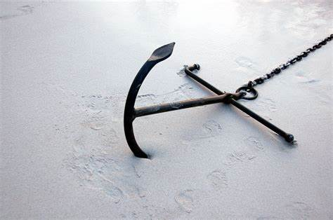
Lift Your Anchor
Default Thinking
Cognitive Dissonance
Confirmation Bias
Notes:
Peoples’ minds are like concrete, thoroughly mixed up and permanently set

Slide 12
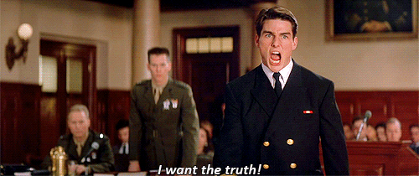
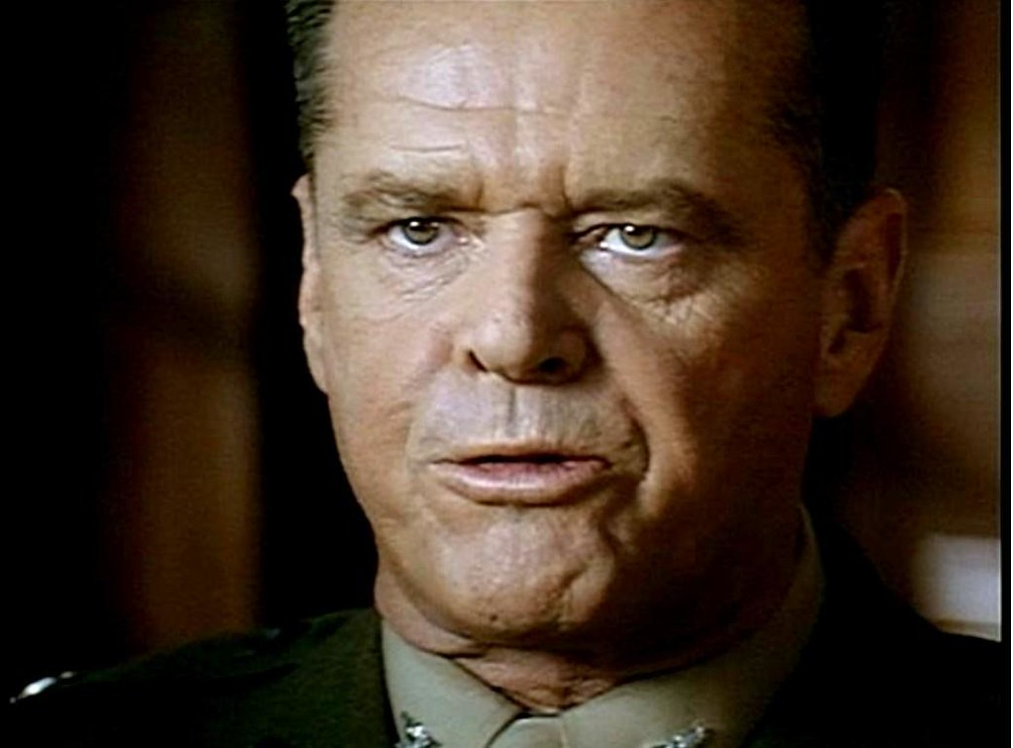
YOU CAN’T HANDLE THE TRUTH!!!!!!!!!!
Notes:
Why don’t we follow the truth?
We can’t HANDLE the truth

Slide 13

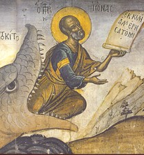
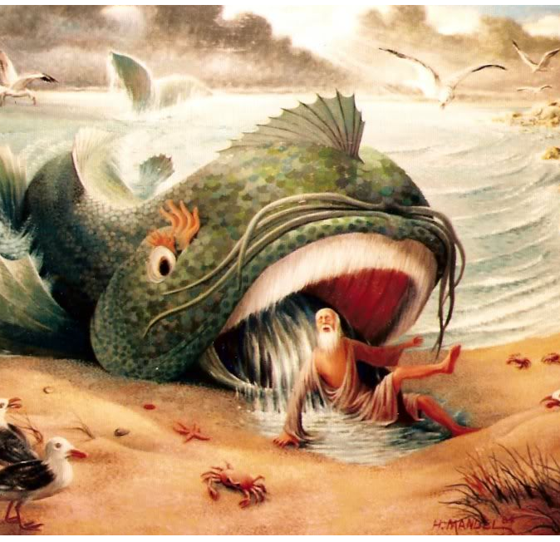
Jonah
Jonah’s problem was that he and Nineveh knew the truth – that God was merciful
Led to the city repenting
Led to Jonah’s frustration with God’s mercy
Notes:
Tarshish was on the edge of the known world in the opposite direction of Nineveh

Slide 14
Can’t Handle the Truth
Jonah had his reasons
  Assyrians were not a pleasant people: 1) Warlike and militarily powerful, 2) Brutal towards conquered people, 3) the “rod” for Israel (how much sympathy does one have for one’s instrument of destruction, 4) Ruthless and merciless, 5) Deceptive and intimidating, 6) Proud and self-exalting
Notes:
Have you ever watched a movie that begins with some kind of injustice and you spend the whole movie anticipating the evildoers will get their just desserts? I mean the ”bad guys” do horrible, unspeakable things to innocent people and whatever punishment they get would never be enough.
What if near the end of the movie the ”bad guys” say they sorry and all the pain they caused is simply forgiven? Would that sit right with you?

Slide 15
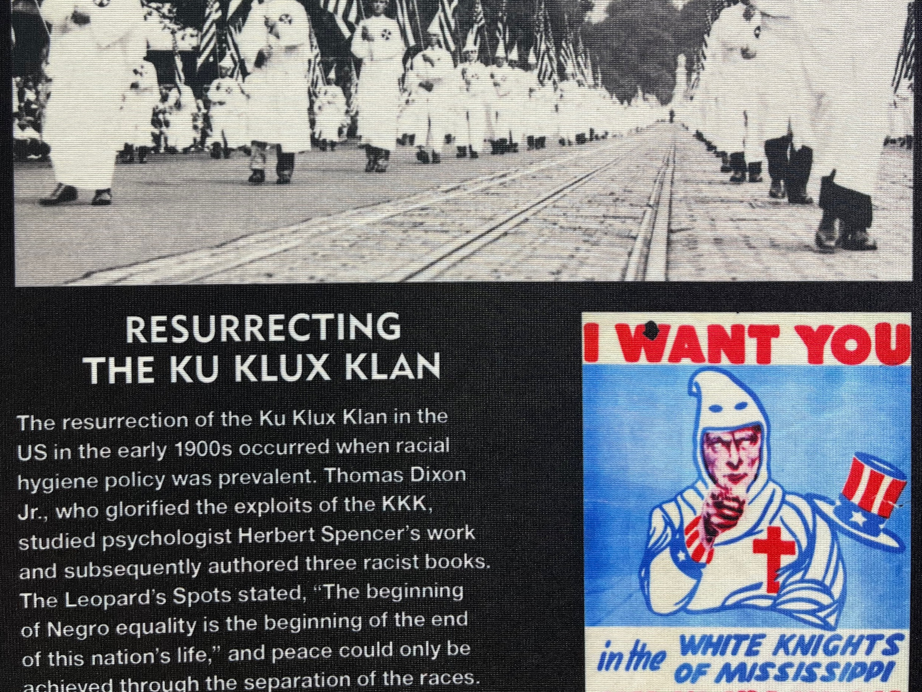
Notes:
This was an at an exhibit at the Congressional Black Caucus
For me, I think about the KKK bombing black churches, lynching black people, burning black communities, boasting that all if it was justified and the law never seeking justice because they were the same people causing the terror
If I lived in the midst of the KKK’s most active periods, and God told me to go to their rallies and tell them to repent and I knew God would allow them to repent and spare them, I’d try to fly to the moon to avoid that assignment

Slide 16

The Anchor of Mistrust
Does God really know best?
God does not really know the score/the deal.
God’s mercy does not apply to EVERYONE, right?
God would want me to see justice in my lifetime, right?
God would not let such a bold perpetrator off the hook, right?
Notes:
If God knew the details, the depth of my pain, the absurdity of those that caused my pain not paying a price for it, or boldness of the perpetrator, he would not let it go unpunished if they repented, right?
We have been hurt, disappointed, led astray, tricked, fooled, scammed, taken advantage so much, we learn not to trust
We must lift our anchor of mistrust when it comes to God

Slide 17
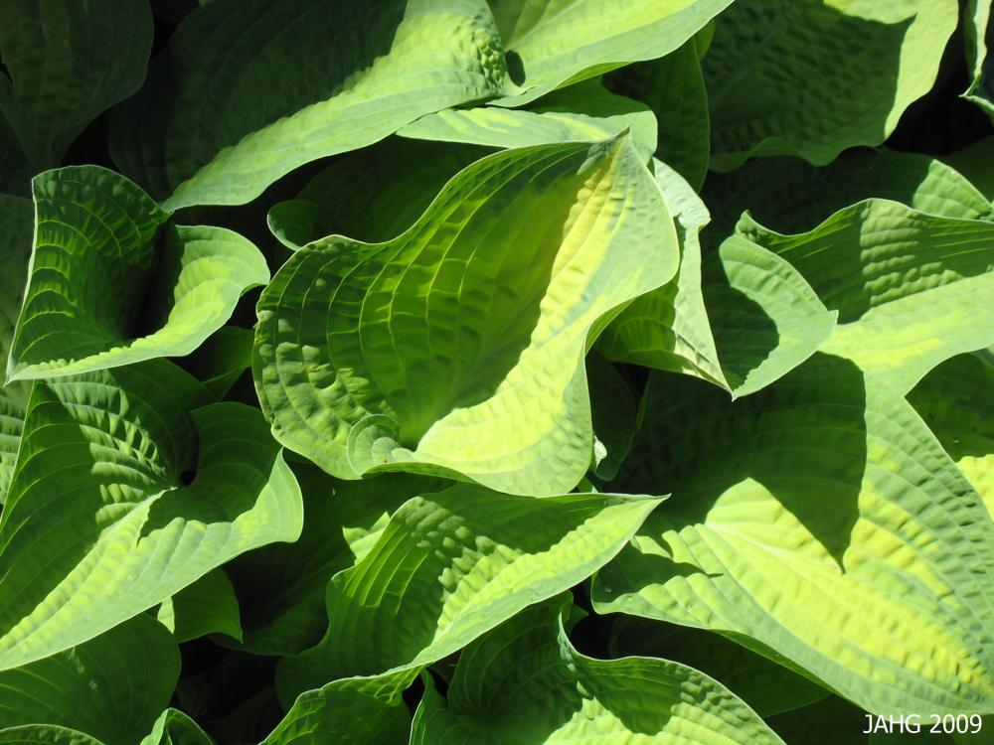
Notes:
God tries to give Jonah and object lesson but Jonah isn’t trying to hear it
Again, I can’t totally blame and judge Jonah given his situation
Can care for a plant but not 120,000 repentant souls
We can only hold on to God’s promise that we will not be given anything we cannot handle

Slide 18
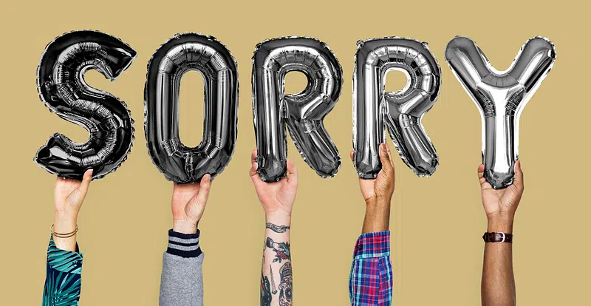
Notes:
Note that God does not condone the Assyrian’s actions or indicate they do not have to atone for their actions
But because they were repentant, God spared them

Slide 19
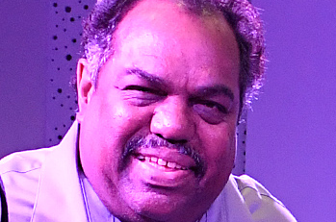
Notes:
The Beauty in trusting God
The story of Darryl Davis

Slide 20
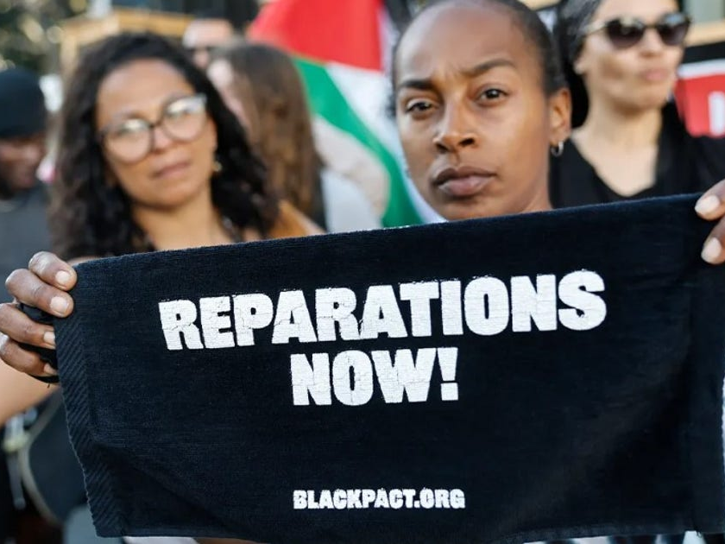
Notes:
It is why a critical element in the reparations movement is an apology and acknowledgement of the the pain inflicted
God, and people, can be merciful when their pain is acknowledged

Slide 21
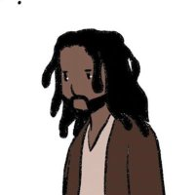
Notes:
Jesus would have had plenty of reasons to mistrust his Father when given the plan for human kind’s salvation
Even Jesus had a “are you sure God?” moment
Thankfully for us, Jesus did not have an anchor of mistrust or if he did, he lifted it up to move forward
I only gave one main example today, but there are many anchors that can keep us from moving forward – fear, hate, hopelessness, rage, etc. Let us pray to discover the truth of God’s way and learn to better handle that truth

