Slide 1


Notes:
Part II of a possible infinite number of teachings given our current environment where

Slide 2
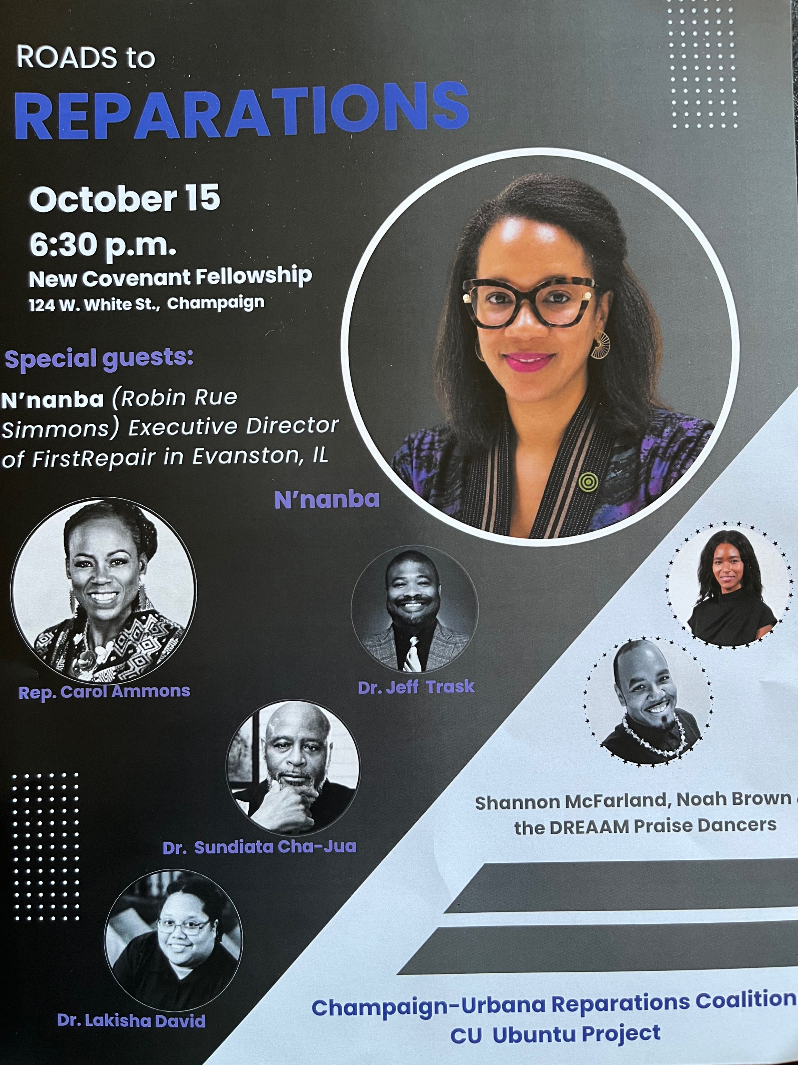
Notes:
Major event planned for Thursday
Including a special announcement you don’t want to miss

Slide 3
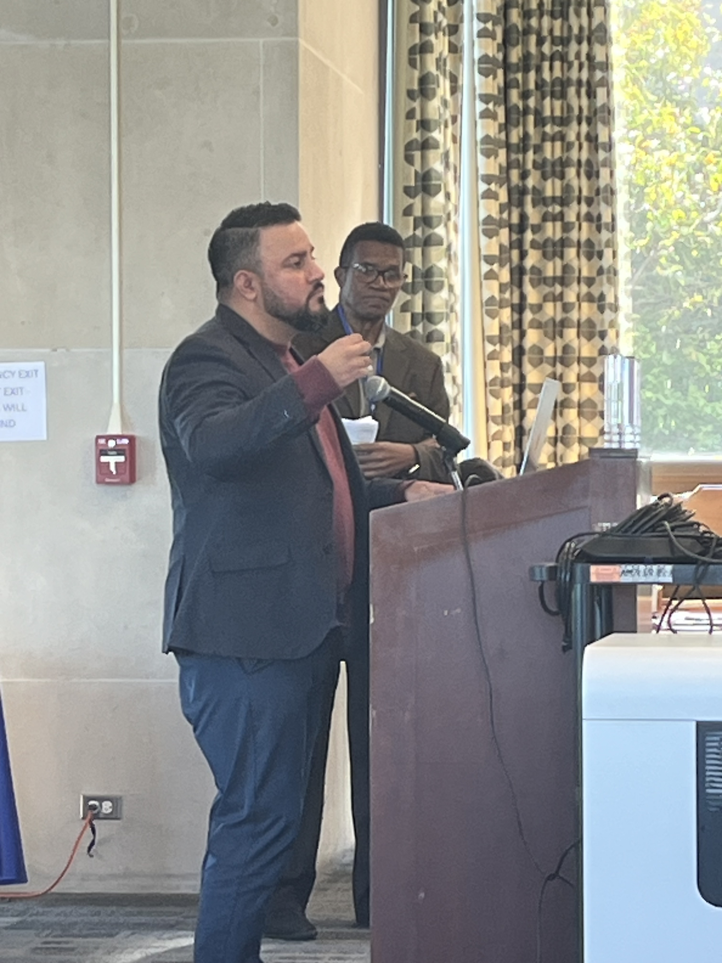
Notes:
Illinois Association of Free and Charitable Clinics (IAFCC) conference

Slide 4
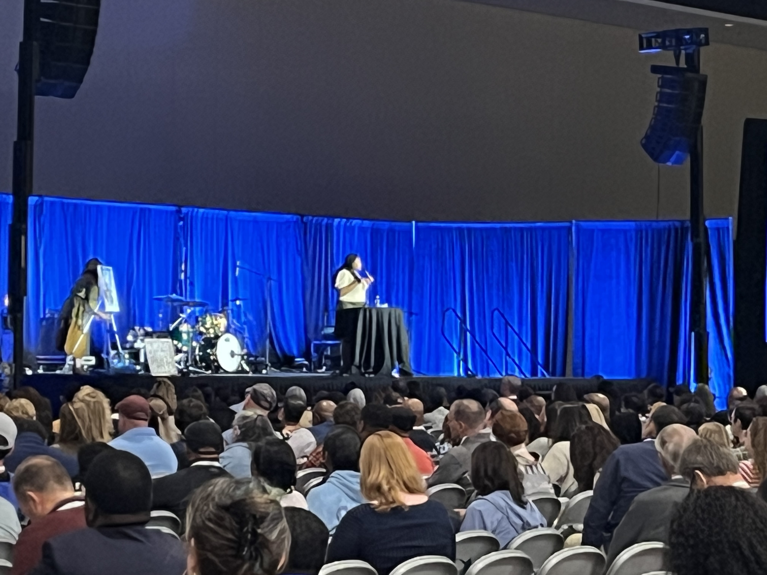
Notes:
2026 CCDA Conference
Reparations Networking Session

Slide 5
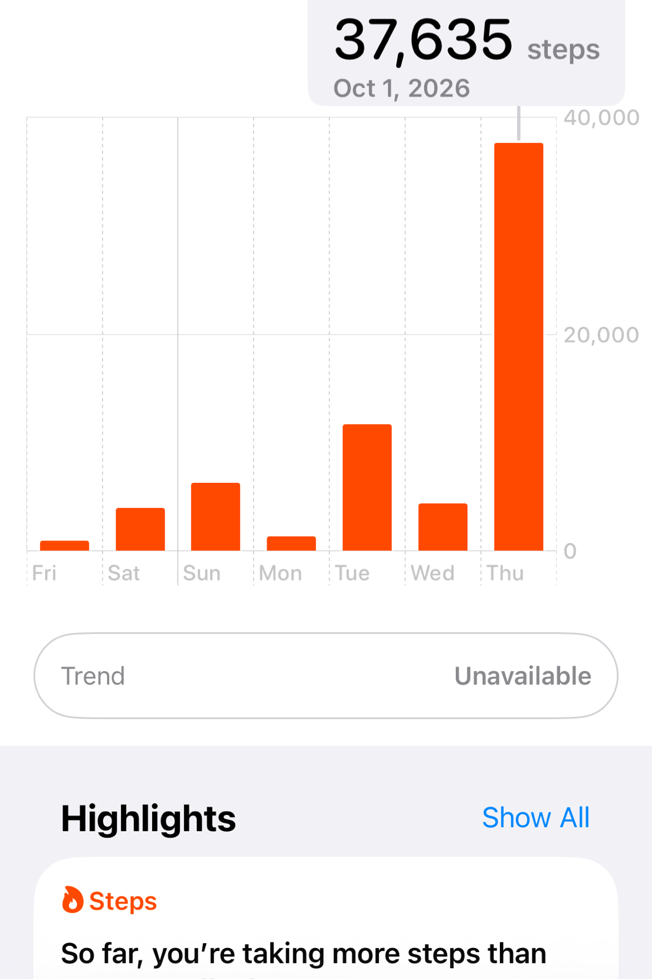
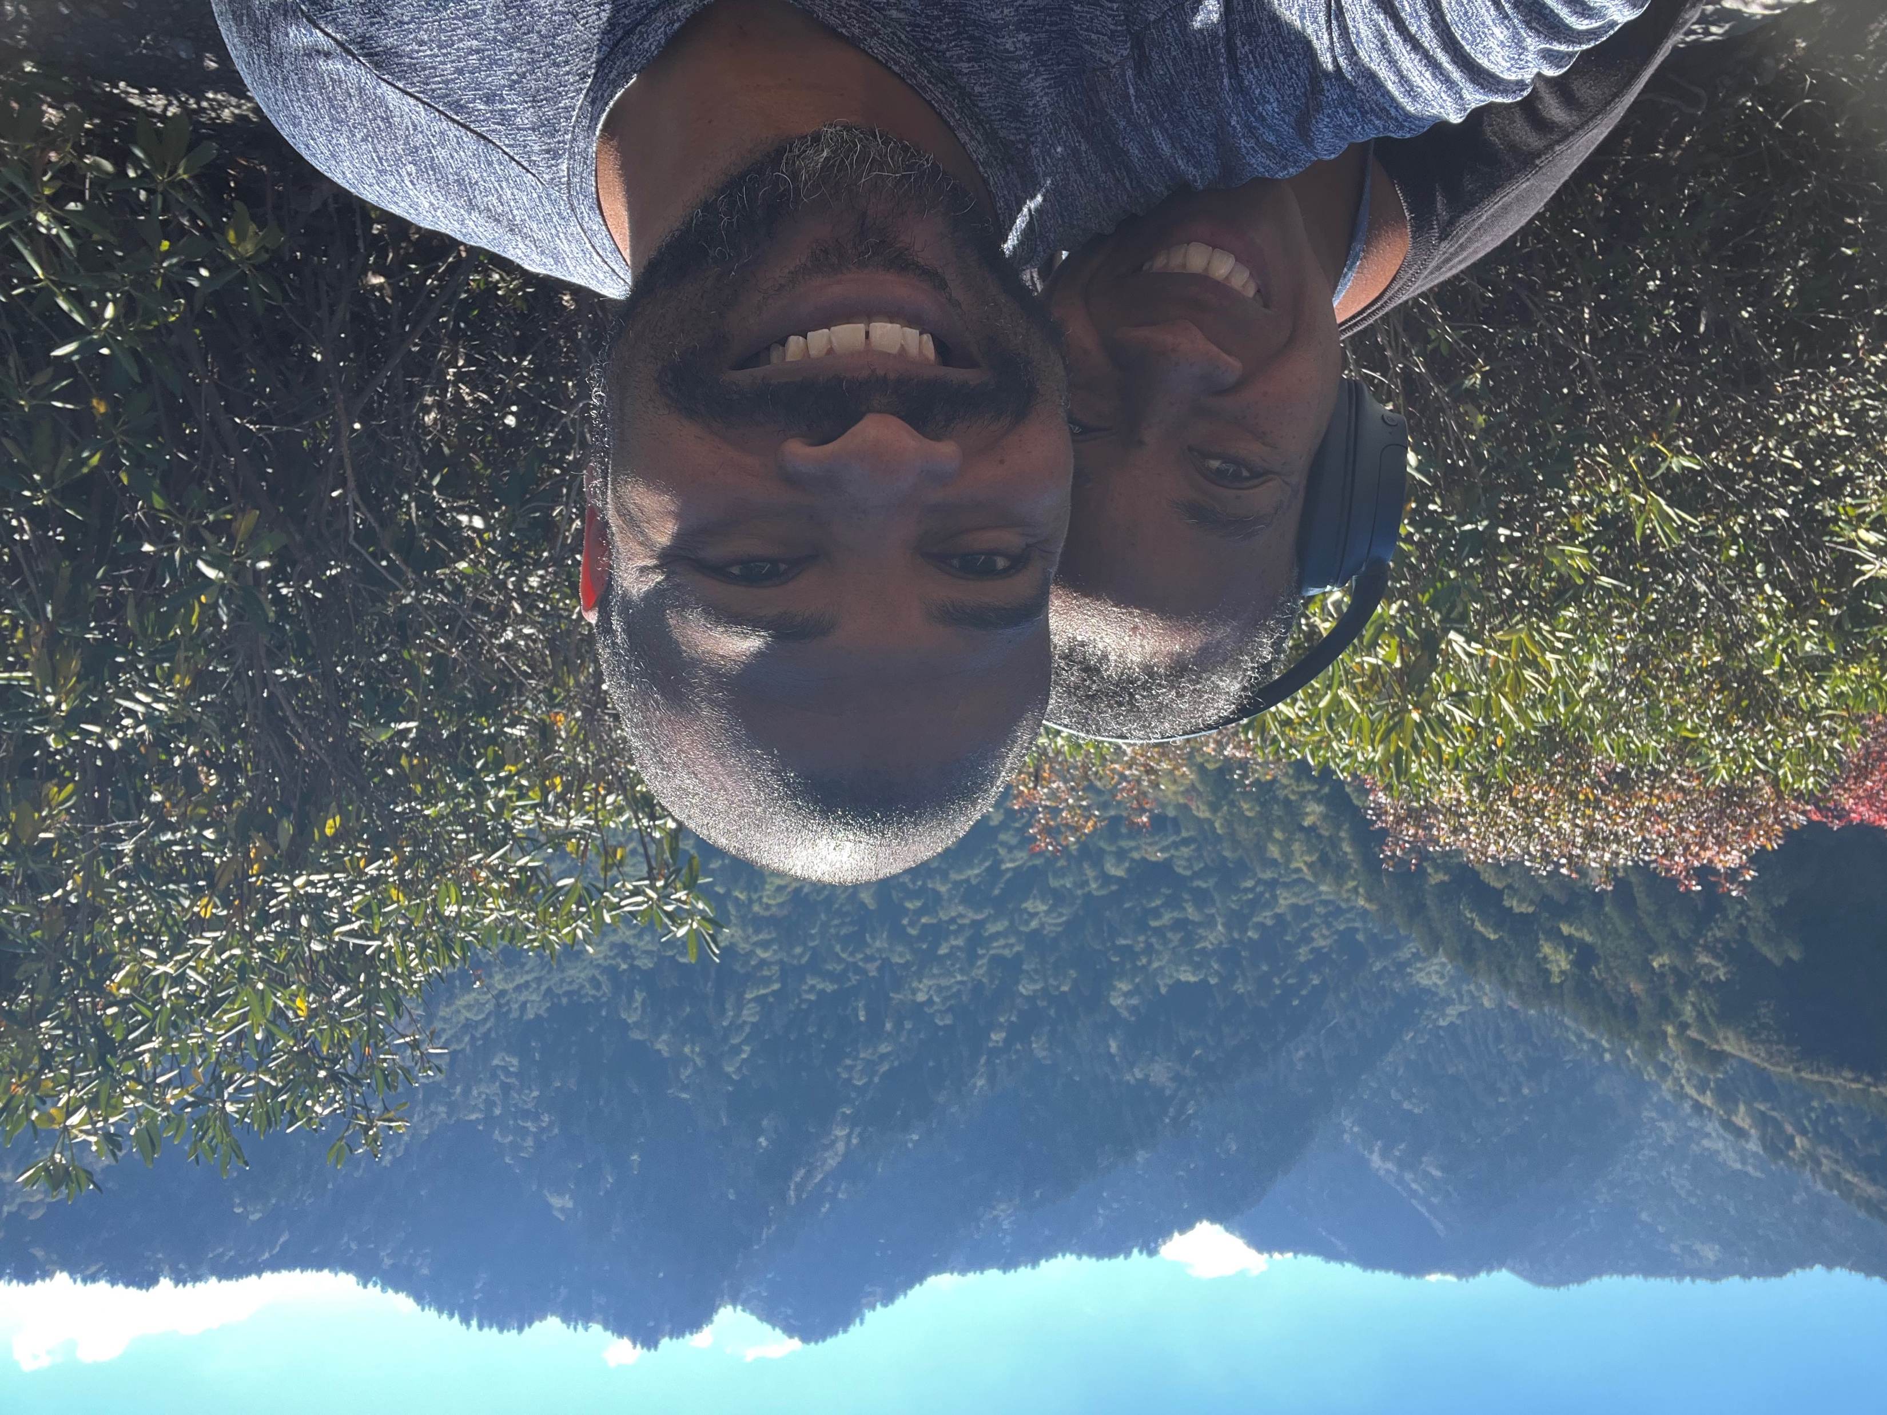
Notes:
Smokey Mountains
92 flights

Slide 6
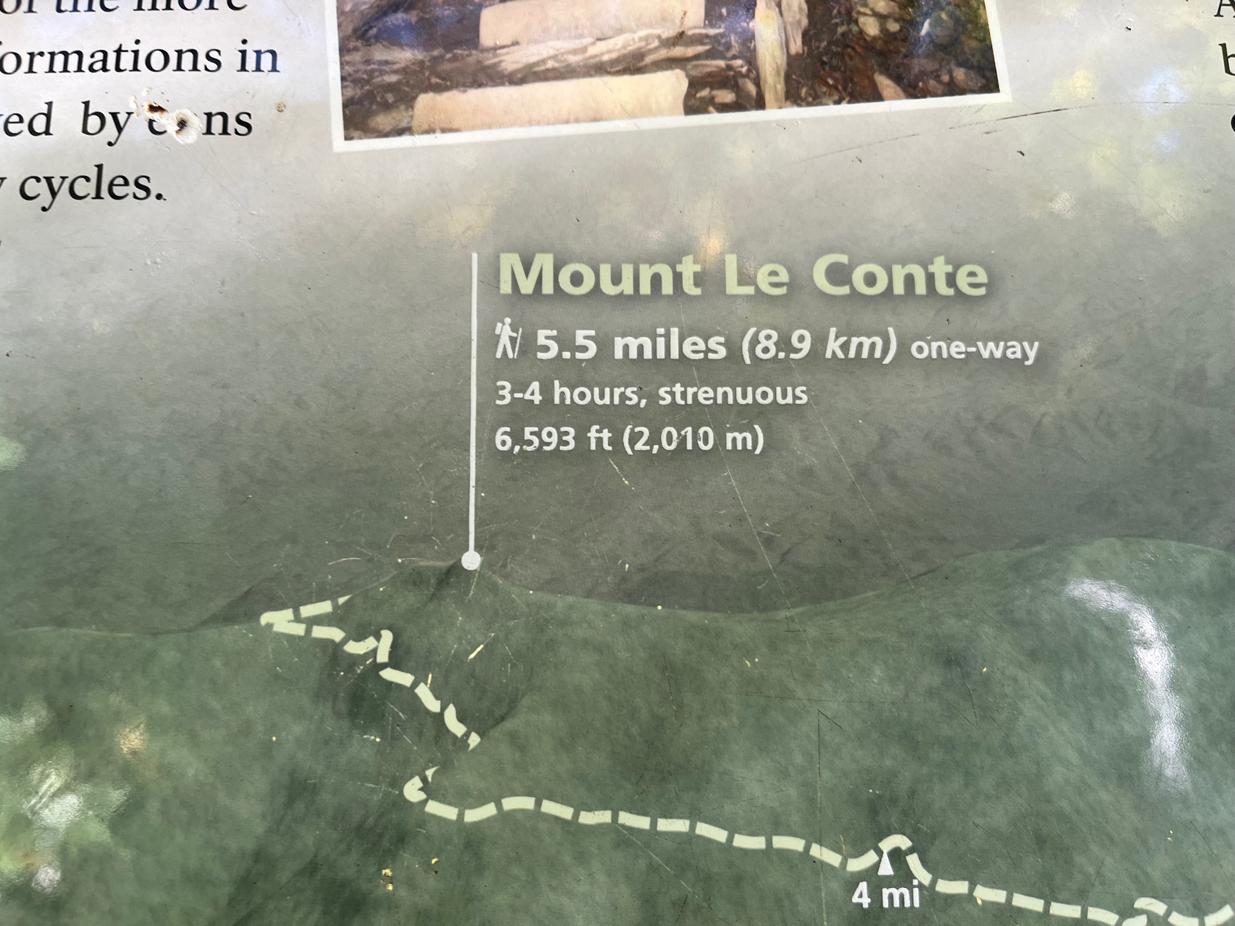
Notes:
Sometimes getting the truth is difficult
Study on COVID vaccine with African Americans –
Revelations
Reason for trust of sources not terribly solid
Strong confidence in choice based on shaky sources of information

Slide 7
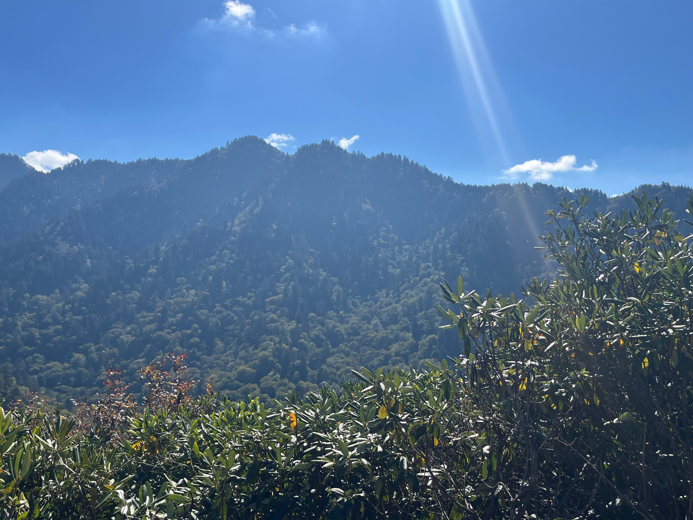

Slide 8



Lift the Anchor of Hopelessness
Rejecting Lies, Embracing Truth
Notes:
John 8:32 Then you will know the truth, and the truth will set you free.”
“If you hold to my teaching, you are really my disciples. Then you will know the truth, and the truth will set you free.”

Slide 9
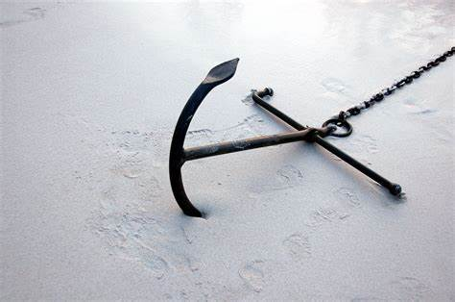
Lift Your Anchor
Default Thinking
Cognitive Dissonance
Confirmation Bias
Notes:
Peoples’ minds are like concrete, thoroughly mixed up and permanently set
Challenge use to break up the concrete today

Slide 10
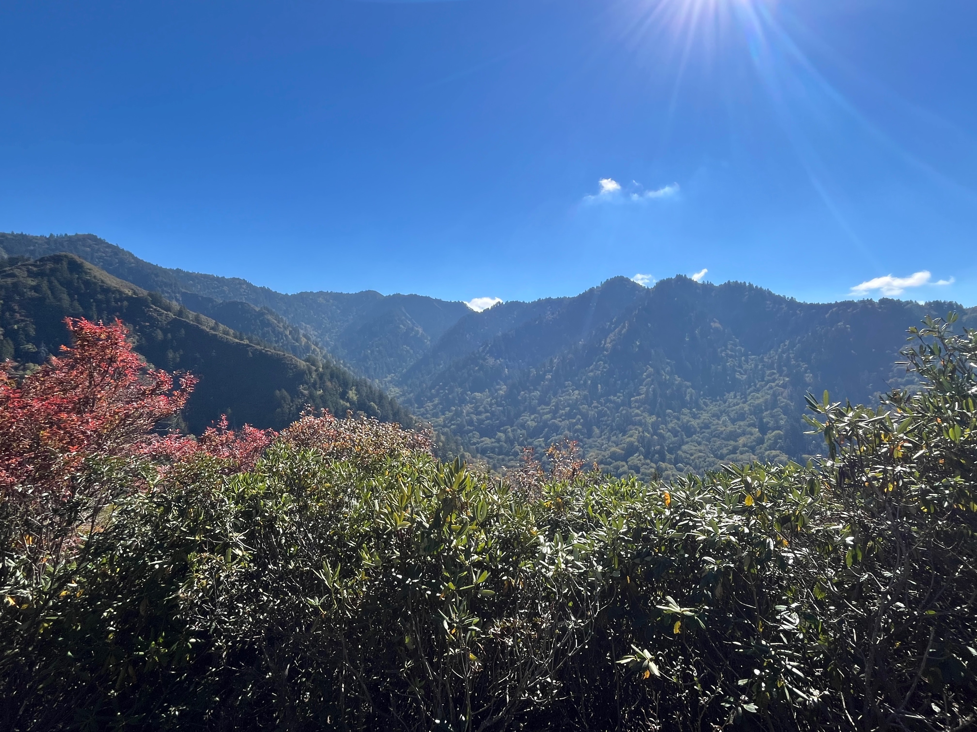
Exodus 32: 1-14
Moses was up on the mountain going over the gameplan with God
The Children of God got restless and made a calf at the tail end of Moses’ 40 days/nights
Major consequences to their actions
Notes:
Tarshish was on the edge of the known world in the opposite direction of Nineveh

Slide 11
BUT WHY???
After 400 years of bondage and now free why so quick to abandon God?
  Mix of other surrounding cultures (Egyptian, Canaanite, other middle east deities)
  Stemmed from fear of starving out in the wilderness
  A pedestal for the invisible God
Notes:
They were not quite abandoning God, just foolishly trying to address their needs and concerns in the moment
They tried to create some back up for God just in case God was not totally up to the task at hand
Still tried to honor God with their own methods

Slide 12
The Anchor of Hopelessness
Does God care for me?
Shouldn’t I do what I see working for others?
Doesn’t God need my help?
Does God realize I’m on a schedule?
Notes:
Perhaps some of the people must have questioned God’s ongoing willingness to care for them. Maybe they started thinking they were not worthy of God’s care. NOTE: The mana never stopped while Moses was away.
Despite evidence of the contrary, there was something in the back of their minds saying, God will let us starve to death. How did they lose hope without any indication that God was doing anything different?
Today: We feel like we are in the wilderness in life and feel like God abandoned us (for any number of reasons). But the evidence shows the contrary. The anchor of negative self-worth is quite heavy and there are many things in life that contributes to that weight. However, God gave us a hope in Jesus and the Holy Spirit – not just to save us from whatever calamity we feel we are in… but to give us strength in the midst of calamity. God’s word indicates that we will indeed experience hardship and should even learn to celebrate in our suffering. So what is telling us God is abandoning us? It is the anchor of fear, low self-worth, and lack of hope. If so, let’s work on lifting those anchors and help each other to do so.
No matter what you are going or been through, what you ever done or didn’t do, or how much you think you fall short, God truly loves you and has your best interests at heart

Slide 13
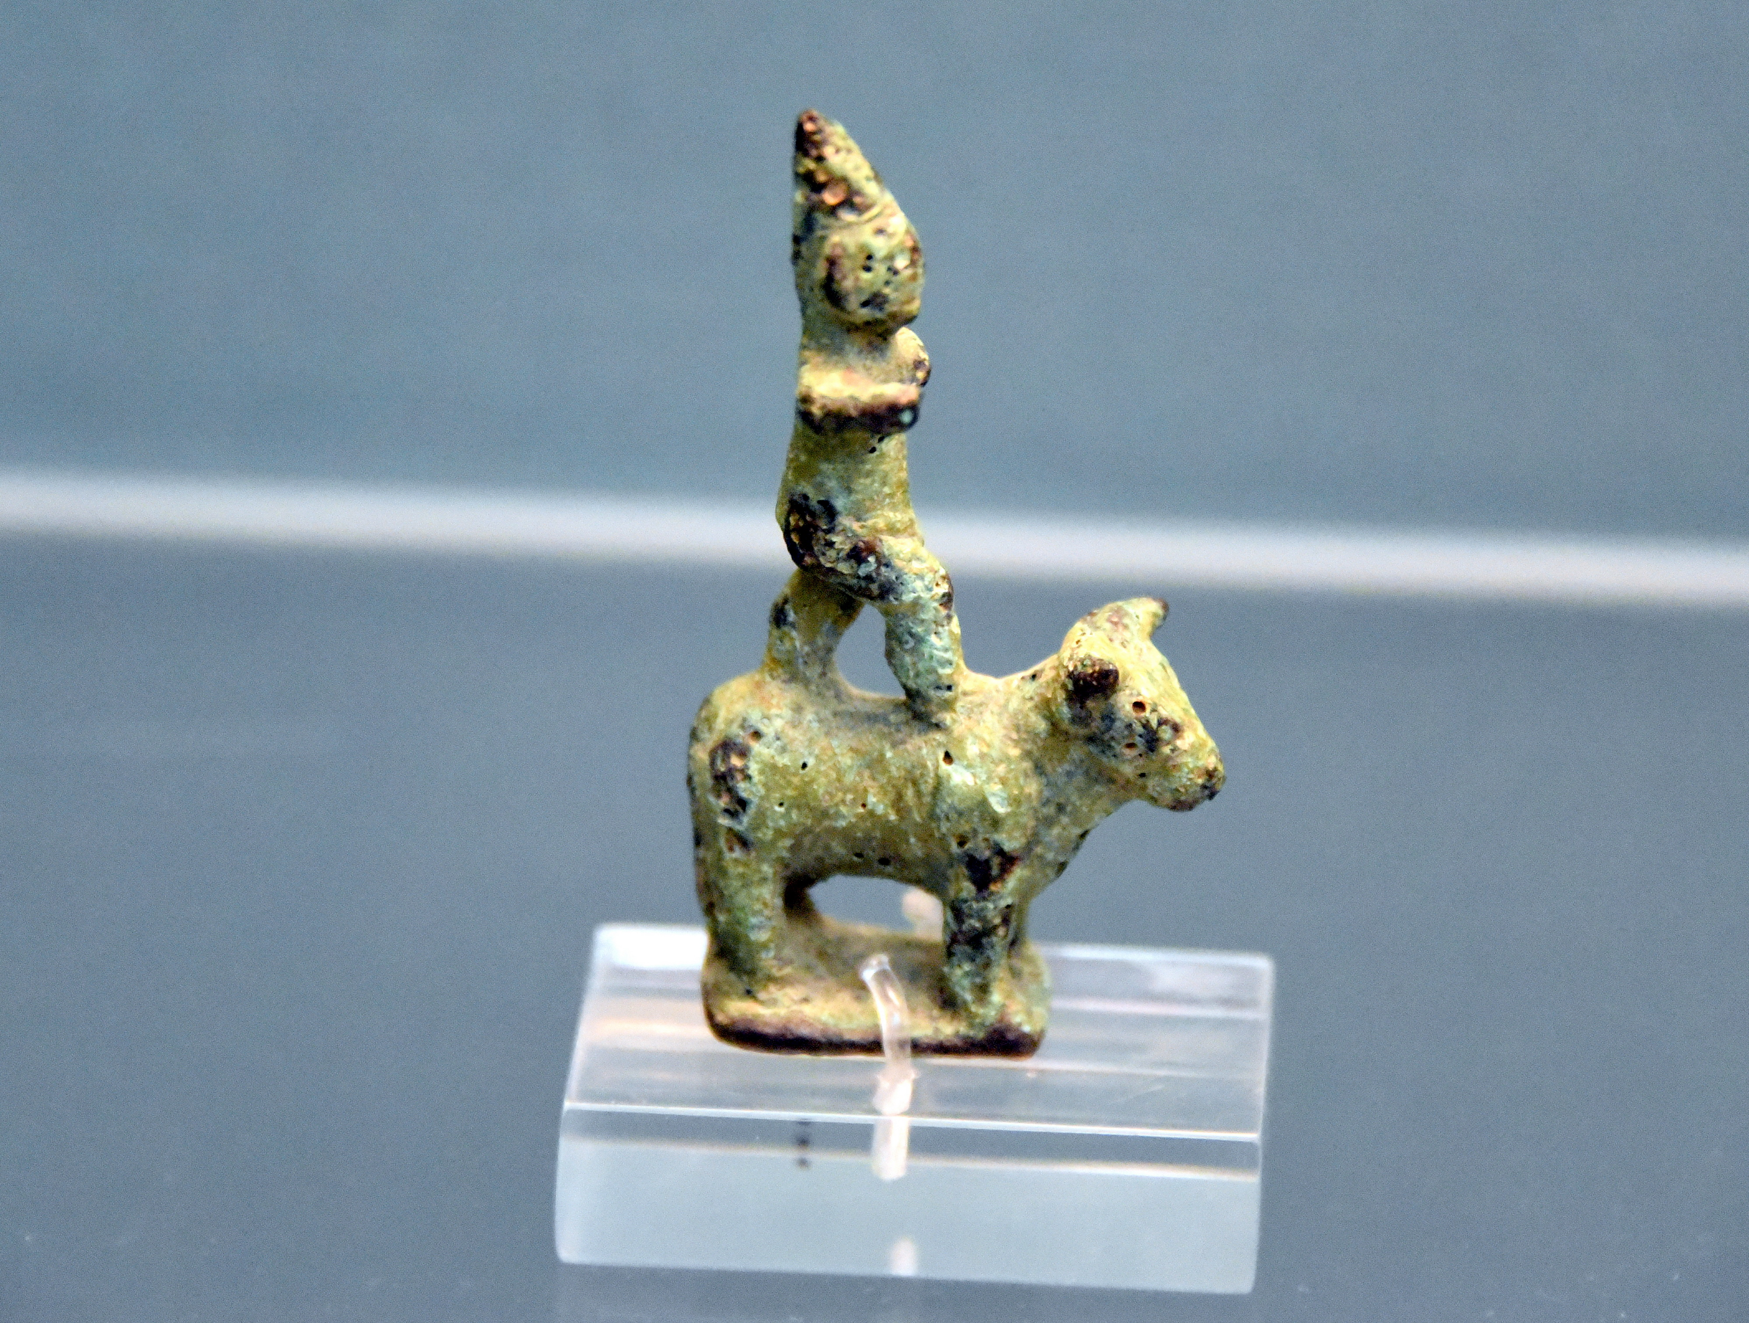
Notes:
Others might have been comforted by going with what they knew. 400 years of exposure to foreign gods provided a lot of background and experience learning about other deities. Seems like it works for others so why not us?
The blueprint for worshipping other gods included making a bull or calf as a pedestal for their god.
So the people were not necessarily to outright abandon God, they just wanted to give God a little nudge or guidance
And btw, we see this practice of mixing Christian and pagan in our holidays. Halloween or All Hallows’ Eve is the new year for pagan traditions. The church attempted to counter this celebration by placing All Saints Day and All Souls Day in early November. I think we all know who won the popularity contest for that. Same thing for Christmas and Easter. I mean I got nothing against easter eggs or Easter bunnies that someone as mammals, produce those eggs, but can someone explain to me what that has to do with the resurrection?

Slide 14
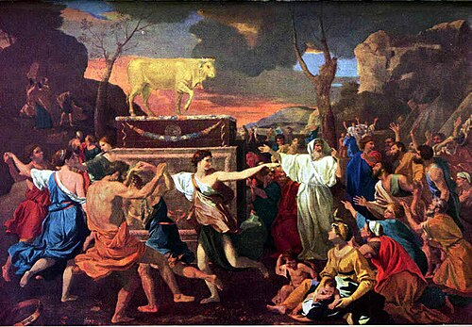
Notes:
Today: Peoples’ reliance and comfort that comes from money. In this world, if you have enough money, you don’t need God. I marvel of how much capitalism has been linked with Christianity – have people read the scriptures?
Zacchaeus’ story is the opposite of relying on money. The rich man was going to have a very difficult time getting to heaven
The love of money is the root of all evil – led to slavery and the oppression of a group of people for 400 years (both the Israelites and Black people)
It is like people made this golden calf to worship money and expect God to stand on top of the calf as part of it.
What are the ways in which we try to go with what we think works? What are those things we think work because it seems to work for others around us?

Slide 15

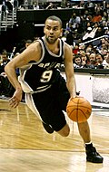
Notes:
Some of the people thought they had to be Lionel Messi to God’s Luis Suarez or Tony Parker to God’s Tim Duncan. Most prolific assist duo’s in soccer and basketball history. Even though they witnessed the seven plagues, the parting of the Red Sea, and getting magical mana in the past 3 months, some did not believe God was up to the task.
Today: I get it. We see wondrously horrible things today. The outright assault on so many groups of people with impunity plus some rubbing it in. I cannot but think about all the ways black people are being affected by this current administration. Anti DEI everything but still wanting to give treasonous rioters reparations. How do we do our parts that God calls us to do without getting in God’s way?
Ever try to assist God only to discover that you only got in the way? I can assure you that the God that created the trillions of galaxies with billions of stars and planets in each can handle your problems. God may give us a task, but we should always be prayerful and try not to do God’s job.

Slide 16

Notes:
One of the most interesting actions related to this self inflicted action was the brevity of patience by the people. The people had been in the wilderness for about 3 months when Moses went up to Mt Sinai to speak with God. And before 40 days/nights passed, they had rebelled, melted all their gold, formed a golden calf, and planned a party. I mean where did they even get the casting for a golden calf in that time? Did they snatch that from the Egyptians as part of their reparations?
If we consider the primary motivation was worry about starving, you would understand it better if the mana stopped coming. However, it was not a matter of what they needed but what they wanted.
Today: We put God on a schedule … our schedule often times. Patience is not easy… especially if we feel something is pressing. It is an ongoing struggle to not move ahead of God’s schedule regarding reparations work… especially when you believe it is already 400 years behind schedule. While I believe there is a legitimate urgency in reparations, how we handle the details day in and day out matters and makes a difference. At NCF, we spent 3 years educating ourselves about reparations in various formats on a consistent basis. If I expected every congregation to drop everything and start a reparations program immediately and got frustrated if they didn’t, I would have gotten burned out a long time ago.
As difficult as it is, we have to work within God’s schedule and not our own.

Slide 17
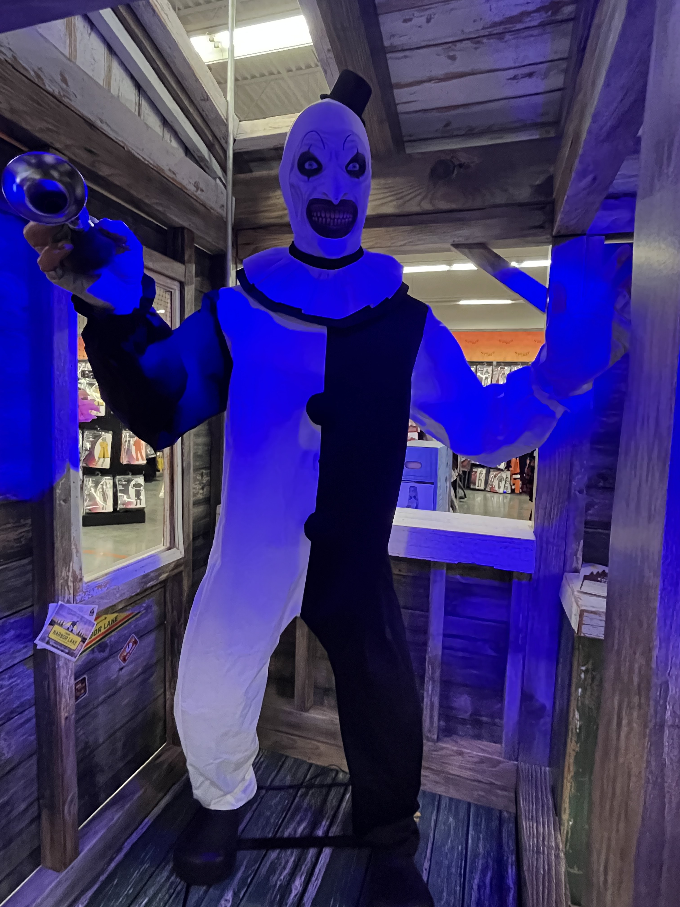
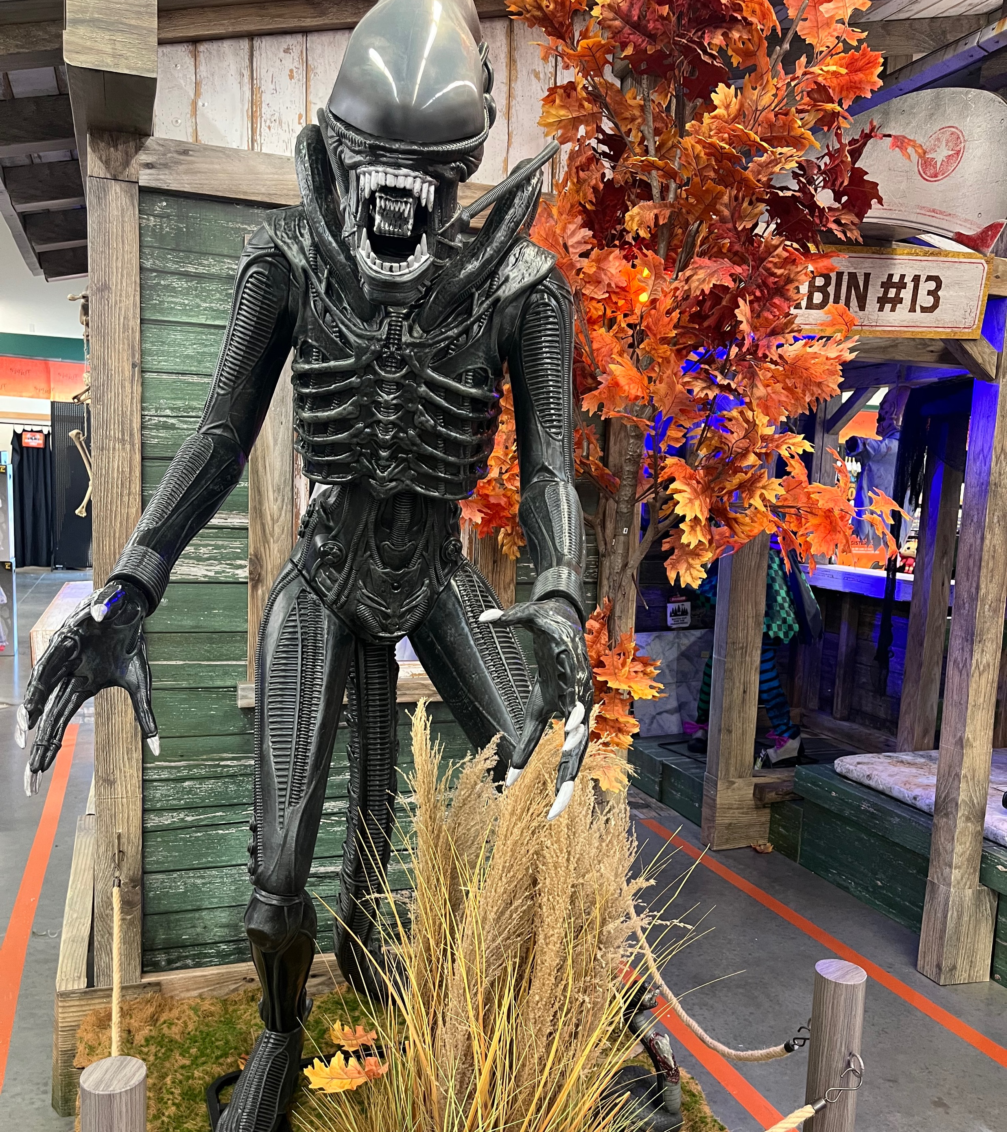
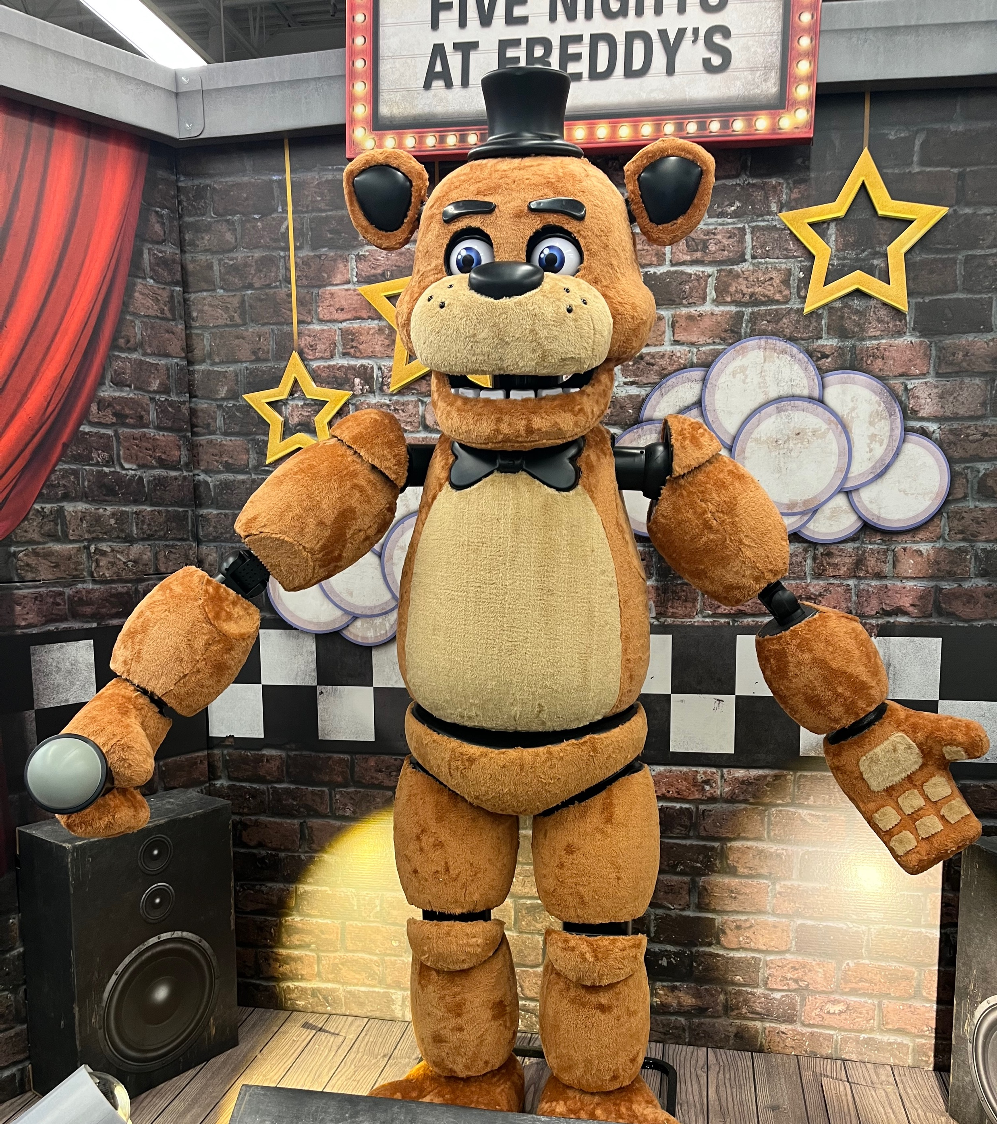
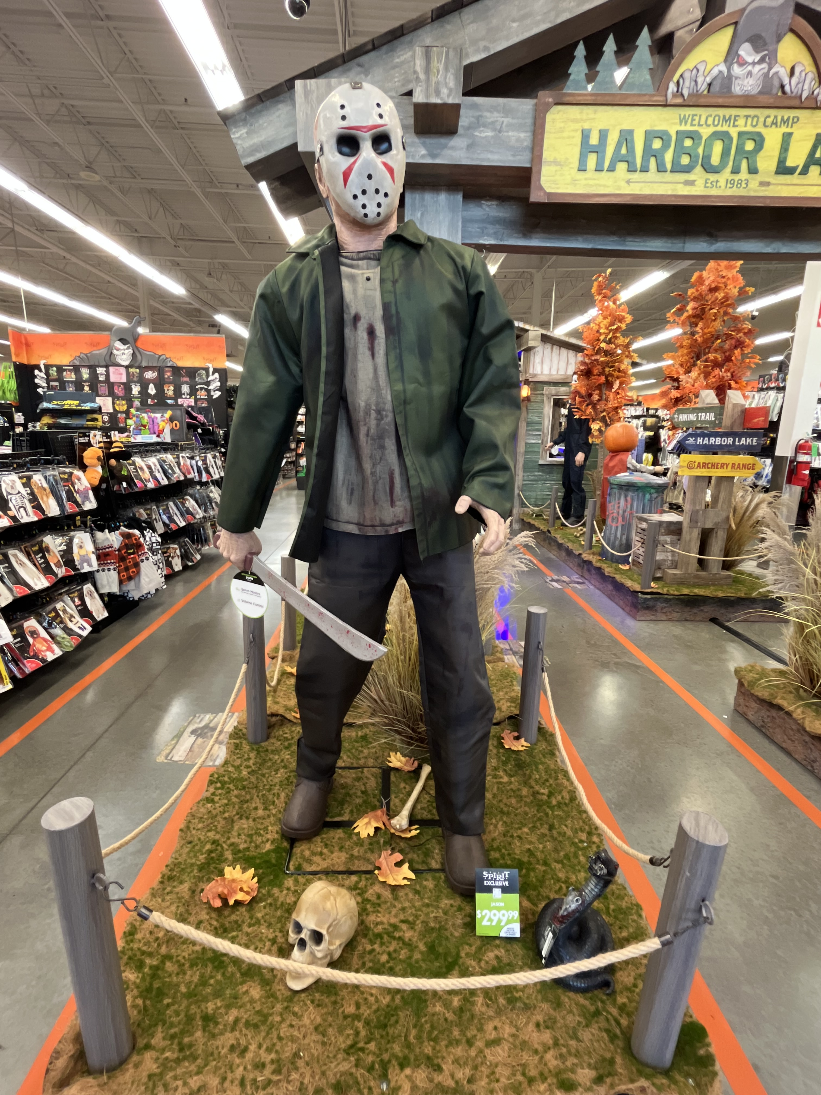
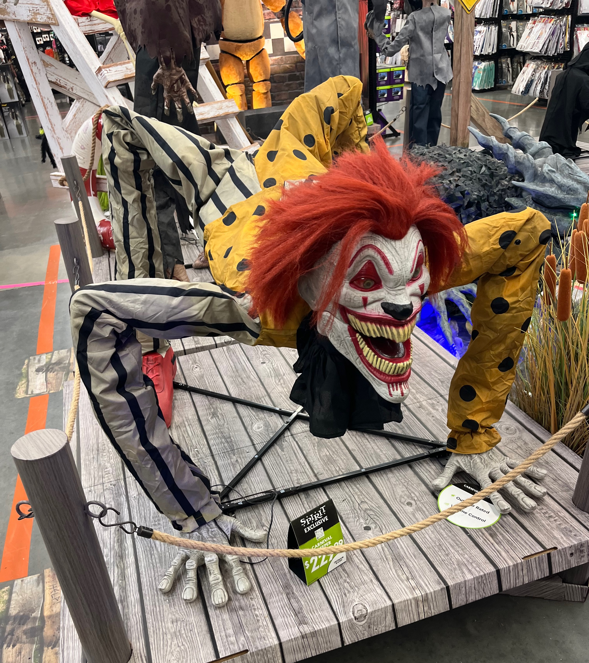
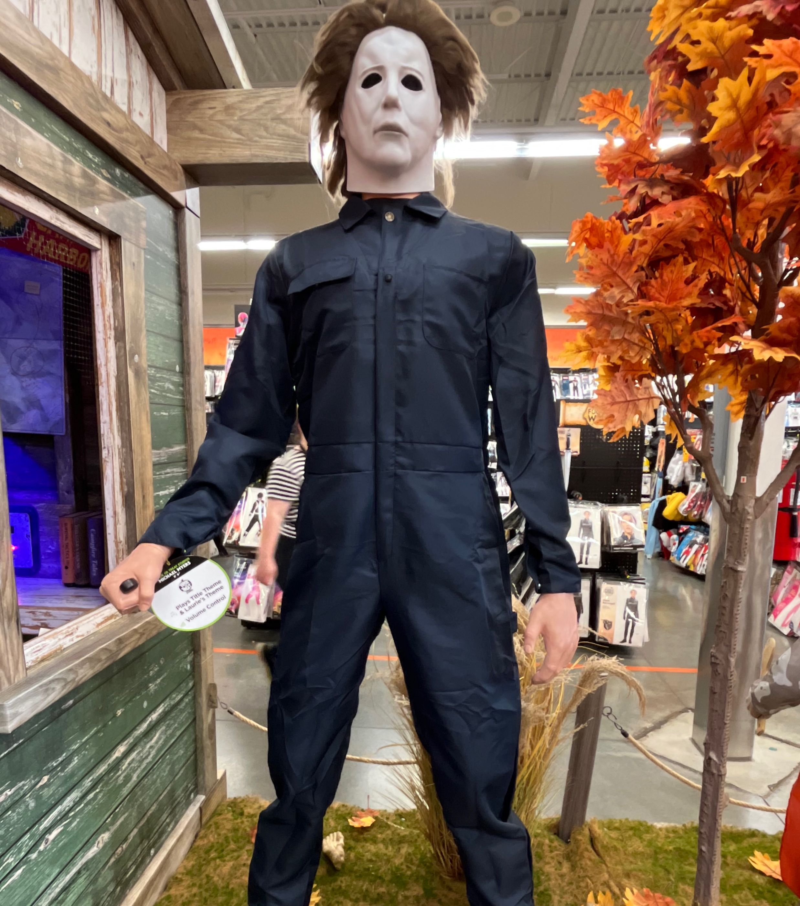
Notes:
We have the Art Clown, Alien, Freddy, Jason, IT, and Michael Myers among others as the featured pieces to put in your yard for All Hallow’s Eve
The anchor of fear runs deep in our society.
I realize trusting God is not easy. Fear seems to be a prized commodity in our society
Ongoing fear often translates into hopelessness which leads to attempting to assist or direct God into what we want to happen within a timeframe that is comfortable to us.

Slide 18
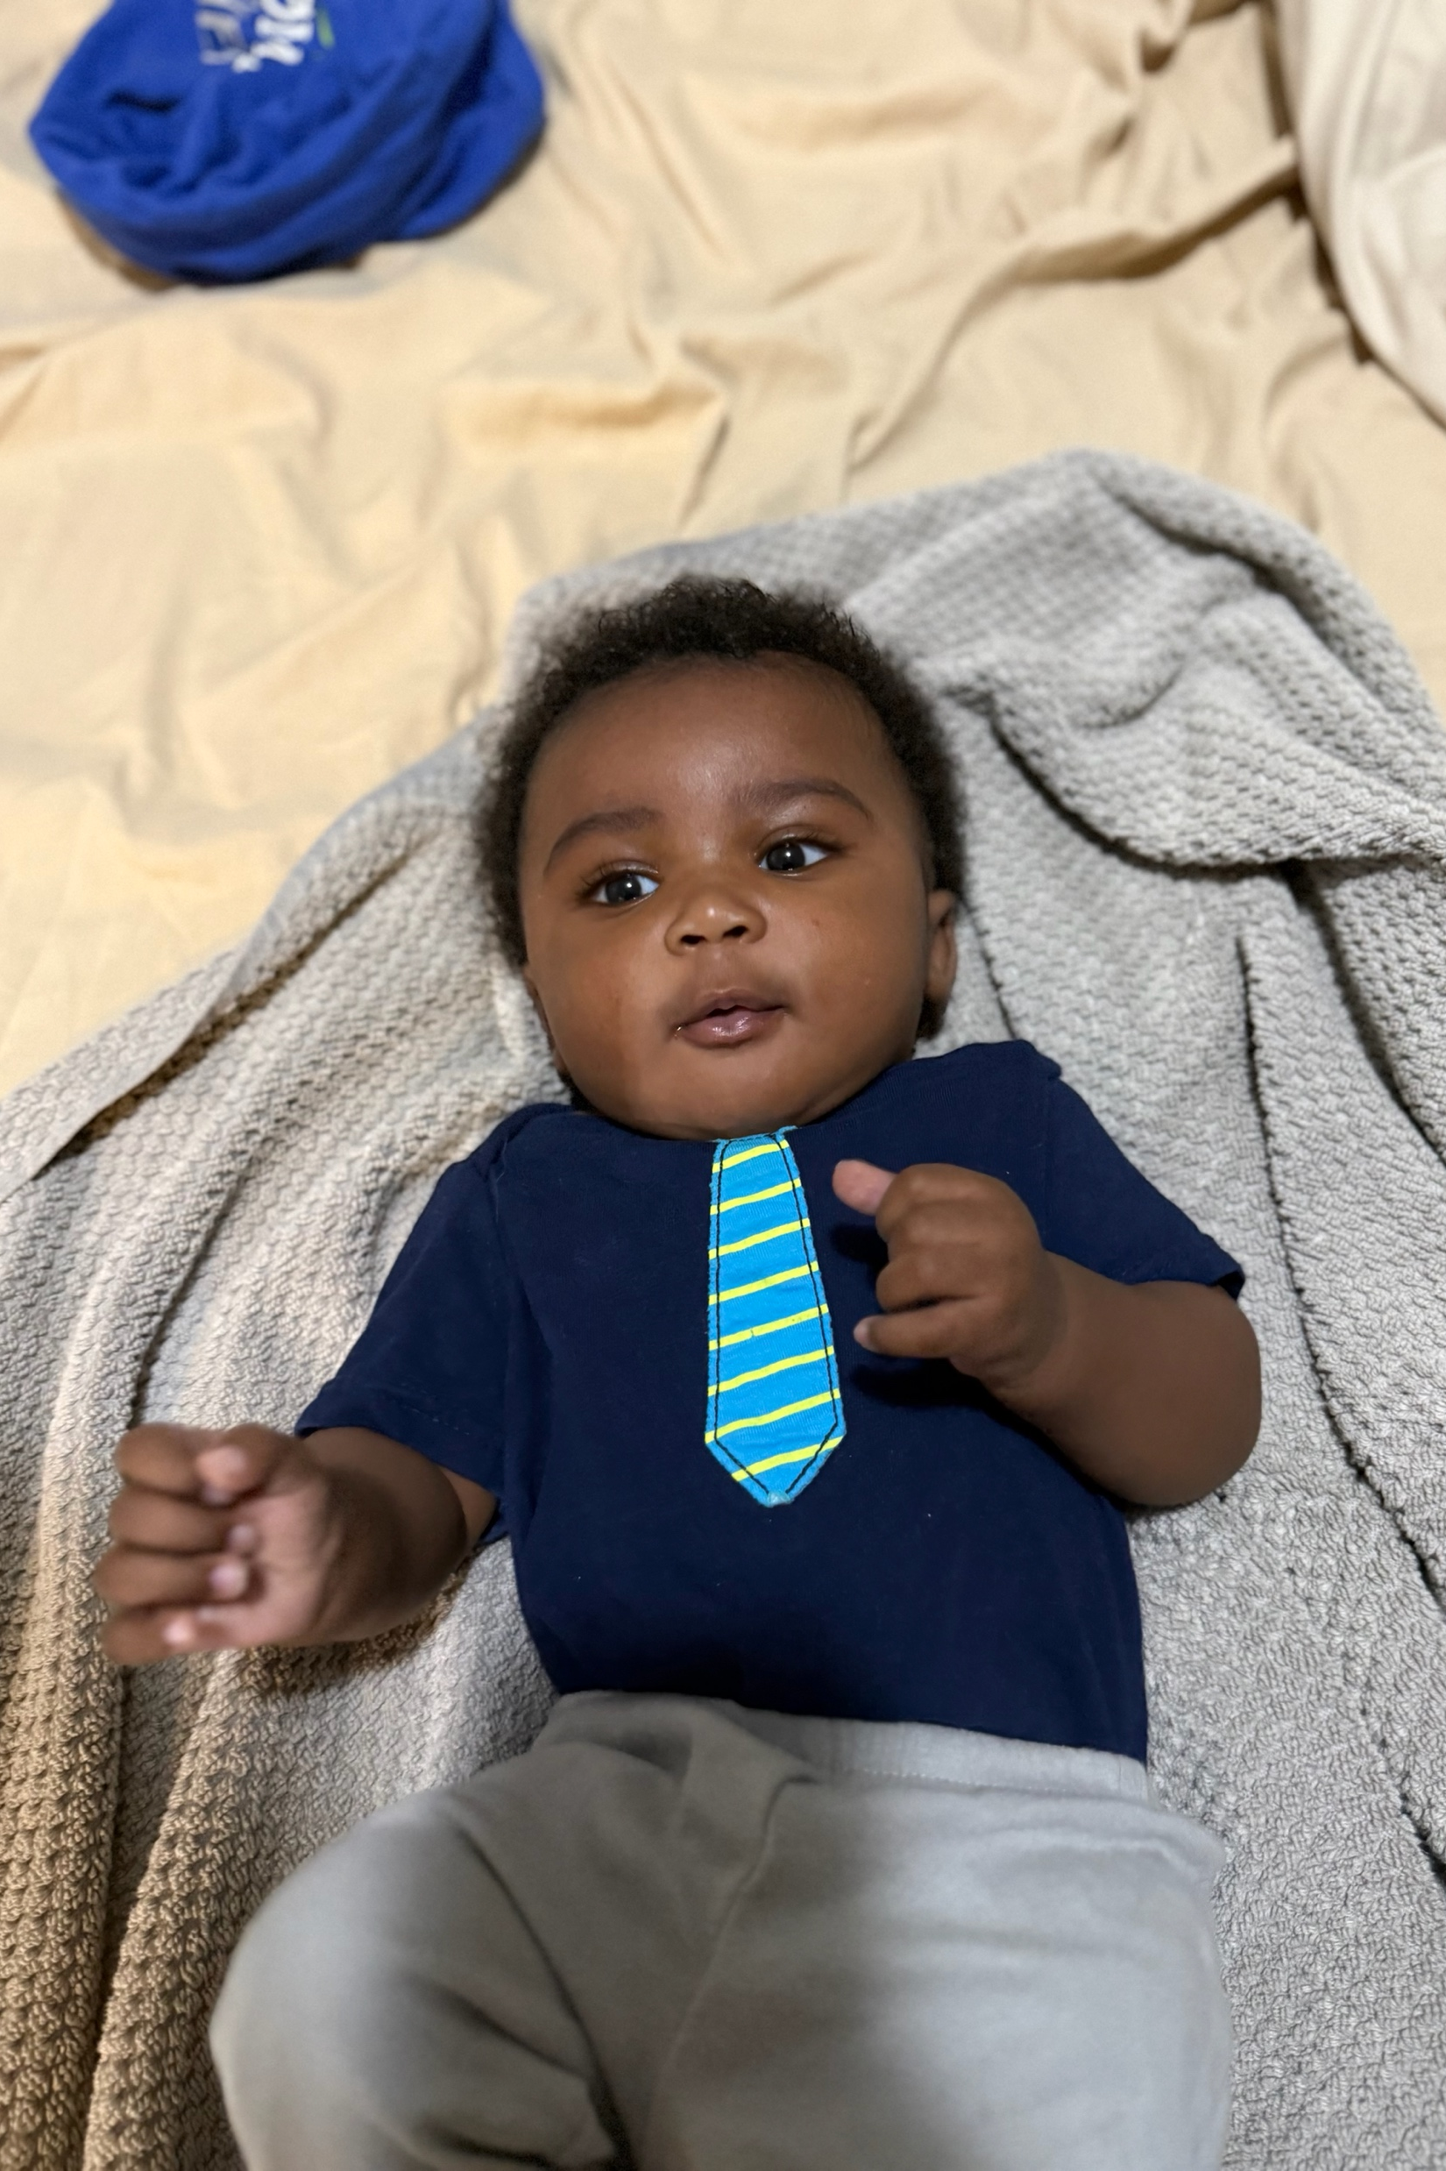
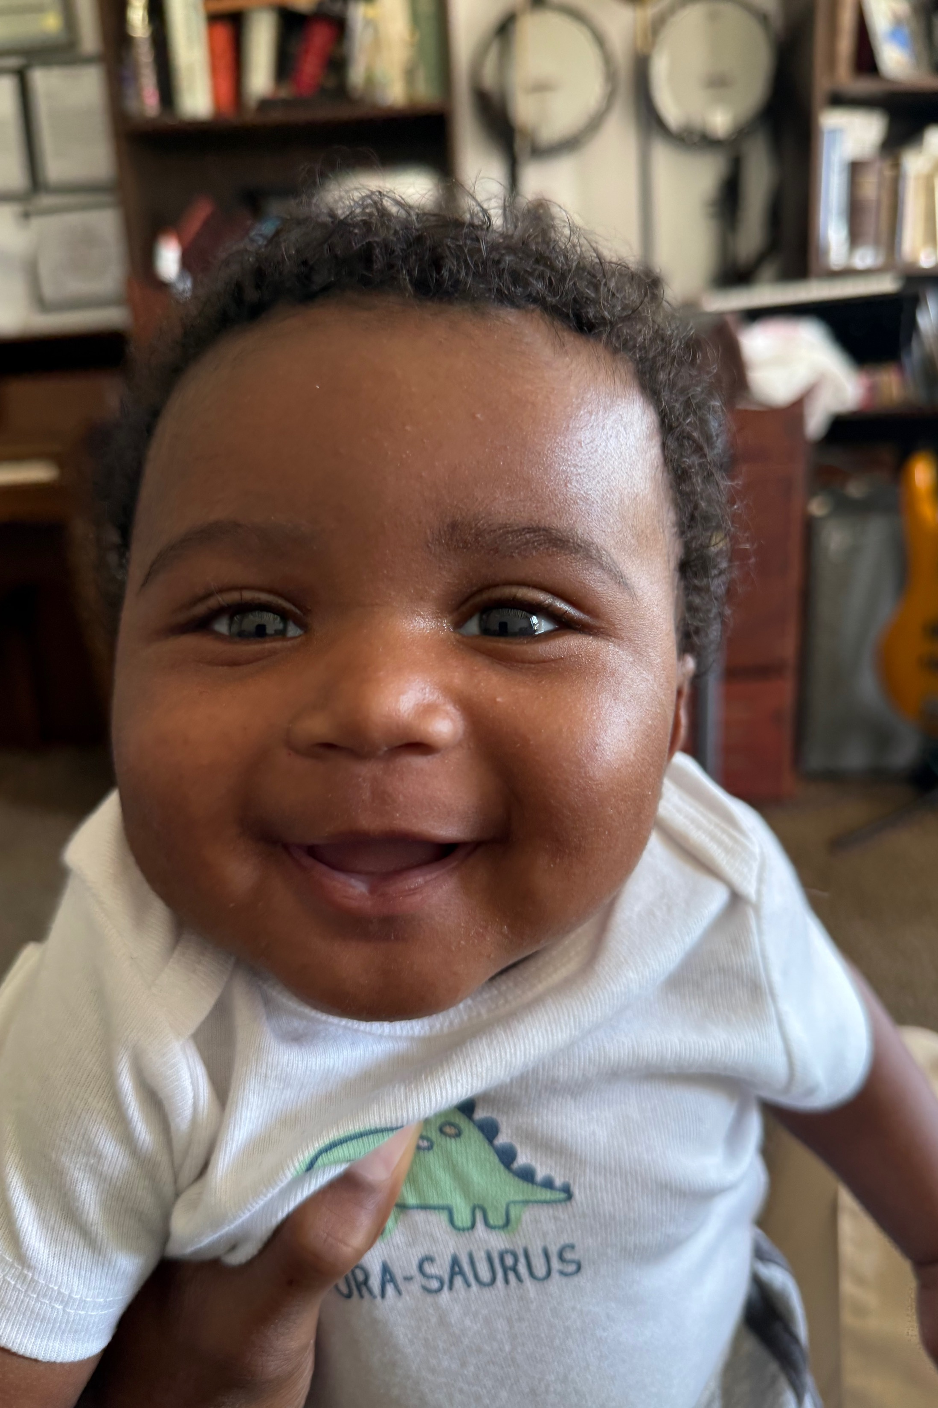
Notes:
However, the opposite of fear is hope.
Hope can be found in many places, especially when it comes to our future. Hope leads to us following God’s plan and timeline which I would argue, leads to much better outcomes

Slide 19
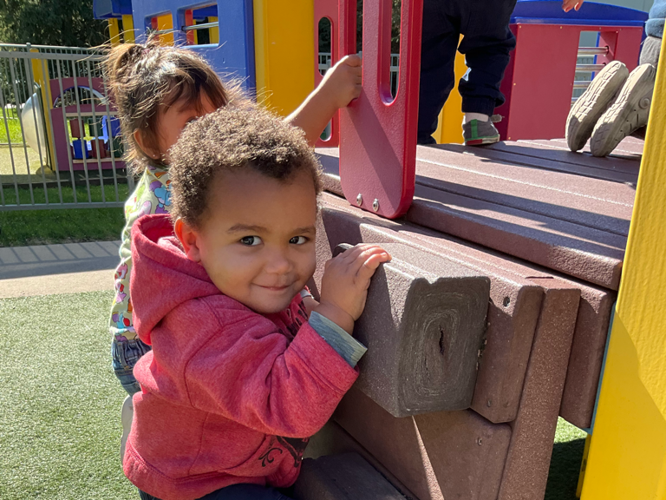
Notes:
Not to say that we do not have our role to play. A role that can often be uncomfortable at best and extremely sacrificial to a point where it feels like we are barely hanging on

Slide 20
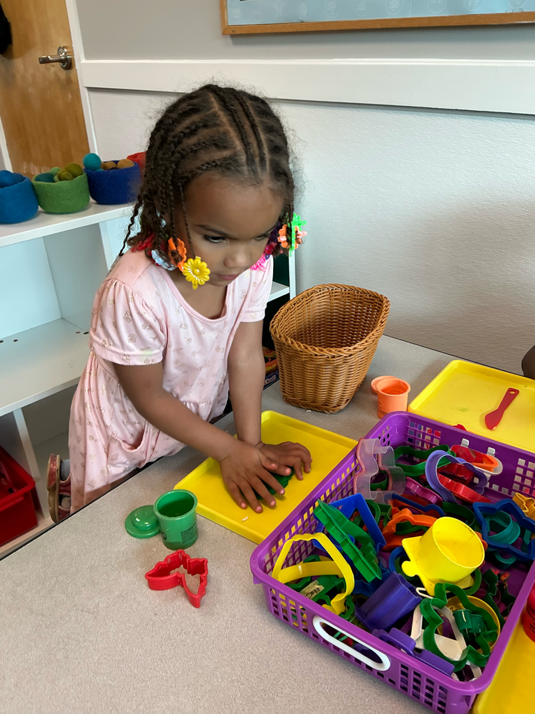
Notes:
However, God will show us the way, shaping and molding us so we can fulfill our calling in building God’s kingdom on earth as it is in heaven

Slide 21
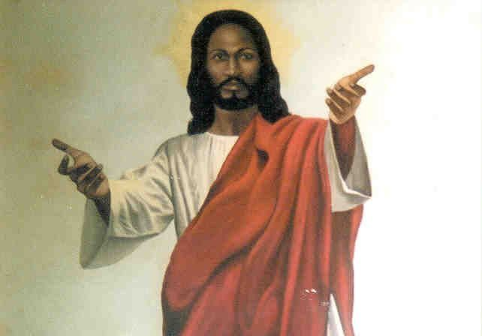

Notes:
When you are feeling fearful, panicked, and hopeless, know that Jesus is there with open arms to comfort you in your despair
I am not saying the pain will go away and all our problems will be solved, … you can just look at the news for 10 minutes to realize that.
But I am saying we have a God that can lift our anchors of hopelessness and allow us to explore a life of freedom, joy, hope, and love.

